Slide 1
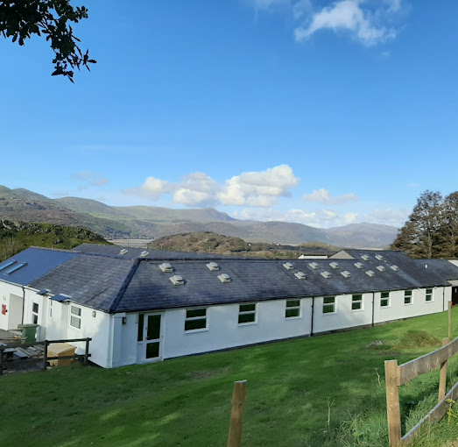
Arthog 2023 March 29th-31st
Welcome and information event.
Bwlchgwyn, Arthog LL39 1BX

Slide 2
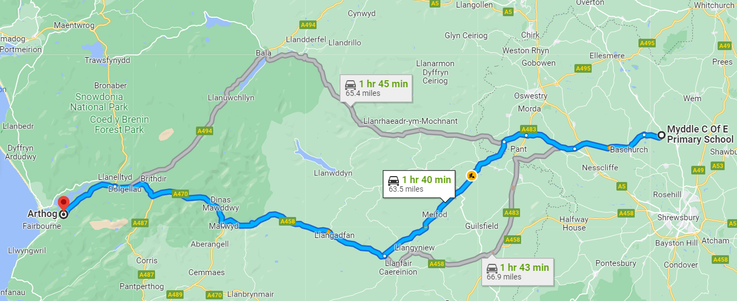
The Journey

Slide 3
Trip timings – the essentials
WBS School → Arthog
Arthog → WBS School
Please arrive at a normal time for school on Wednesday 29th March.
Depart school at 9.30am
Arrival time at Arthog 11:30am
Lunch on arrival
Return from Arthog to arrive at school for 3pm on 31st March
Pupils to be picked up / have set arrangements for collection.

Slide 4
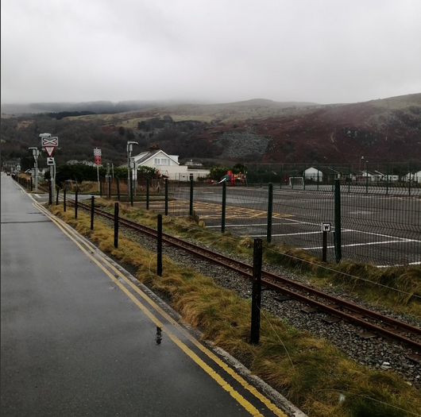
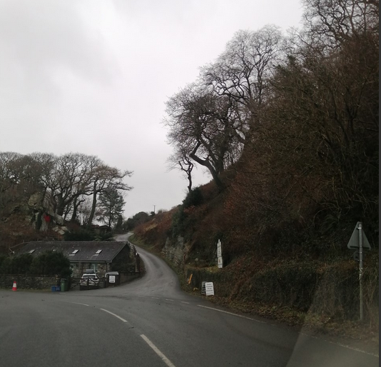
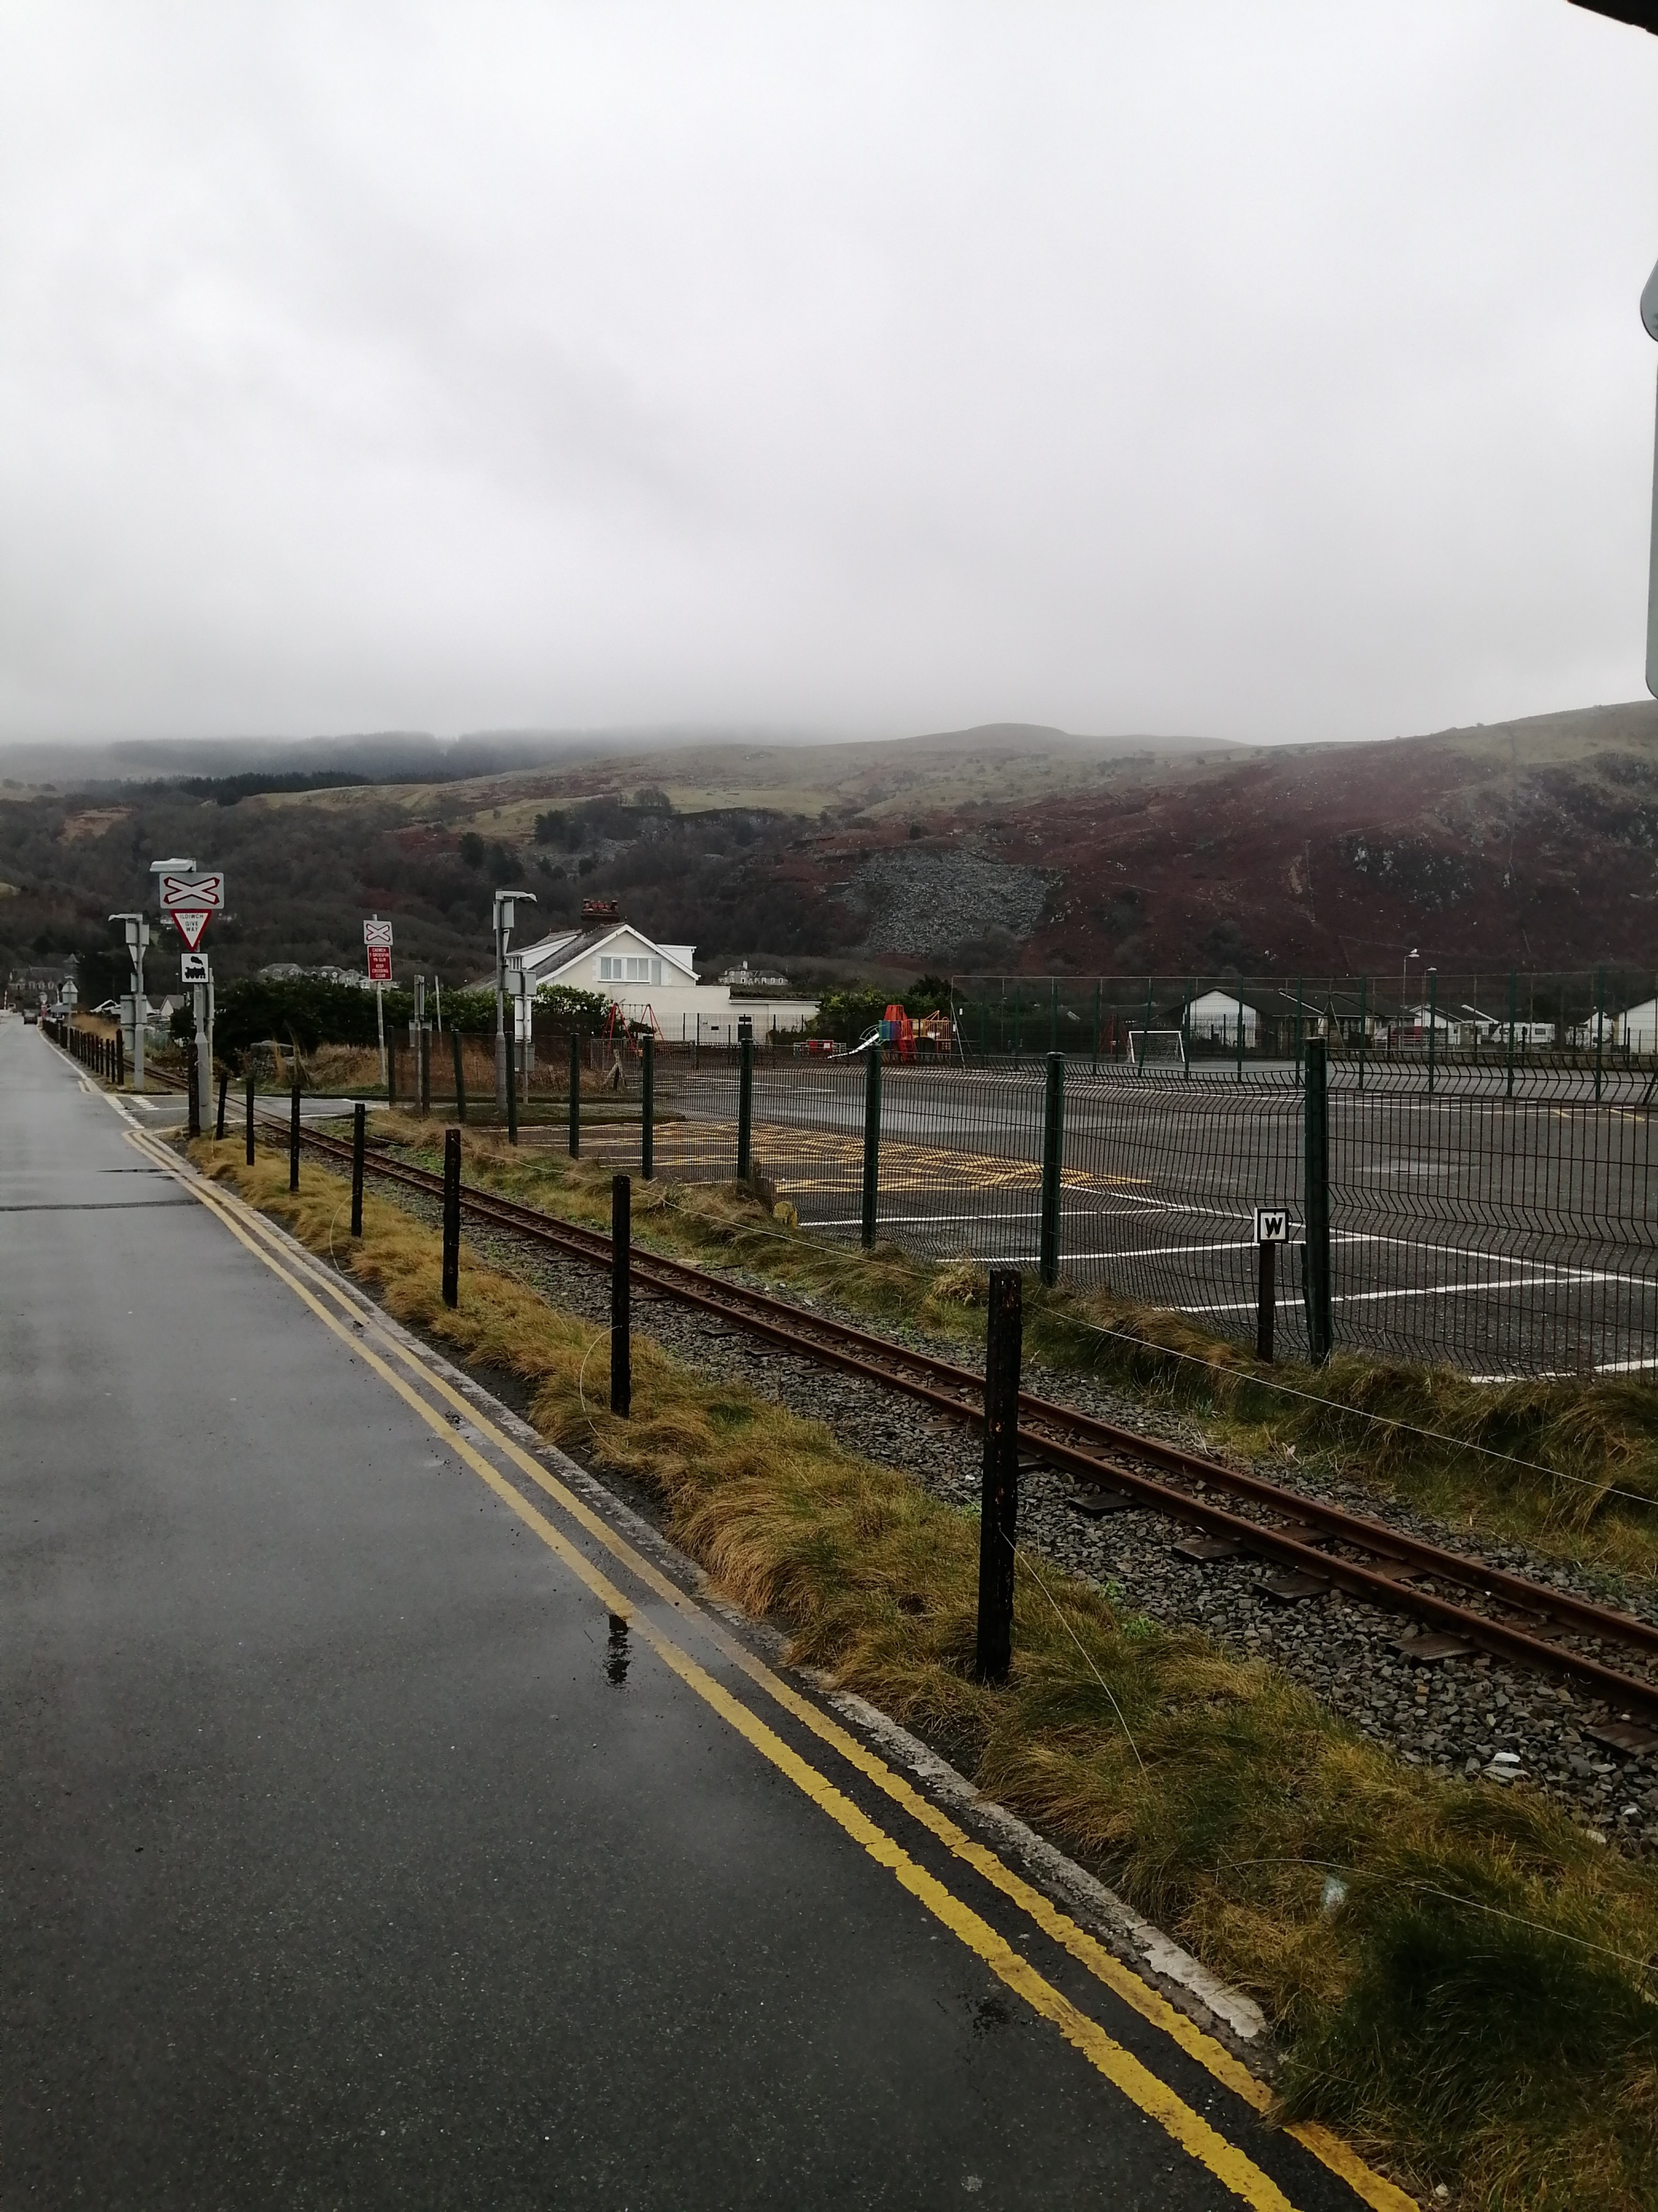

Slide 5
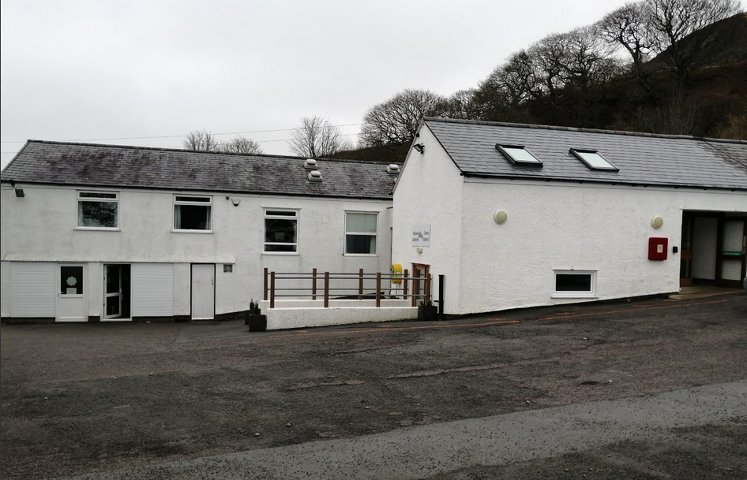

Slide 6
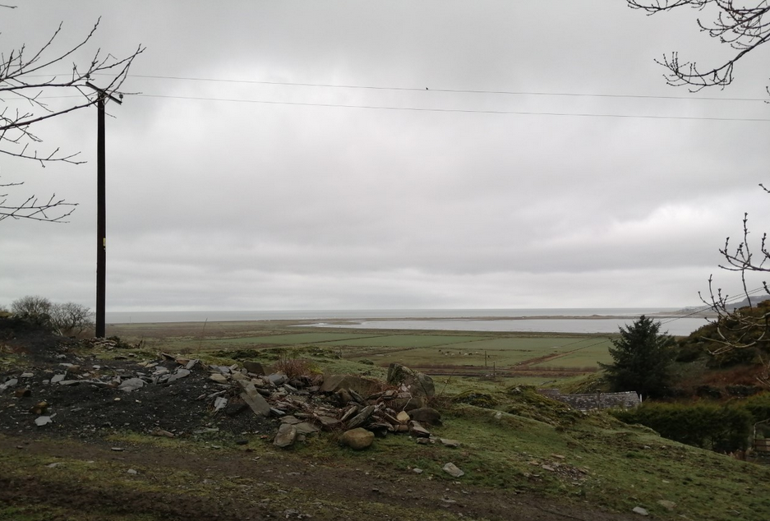

Slide 7
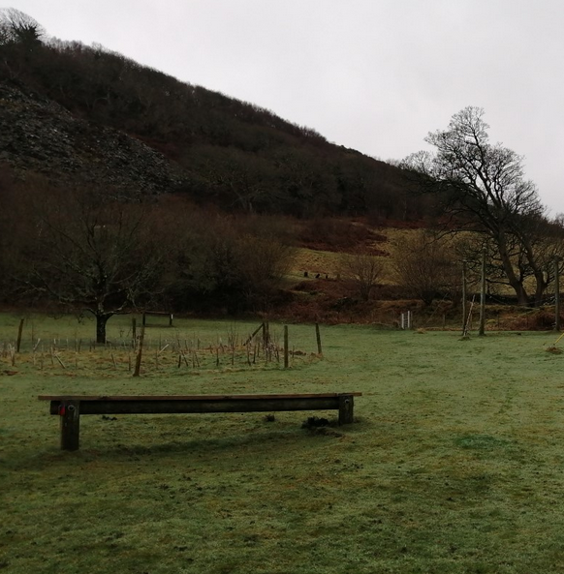
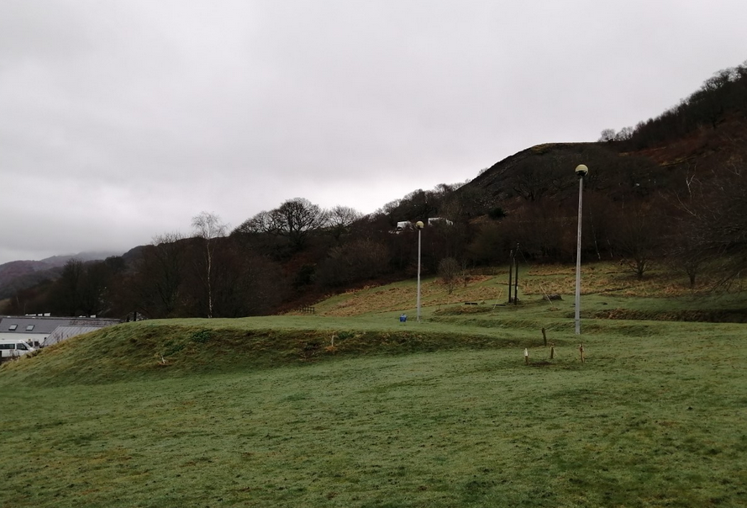

Slide 8
Activities
Team building
Night walk
Beach walk
Gorge walking / scrambling
Rock climbing
Orienteering
Nightline

Slide 9
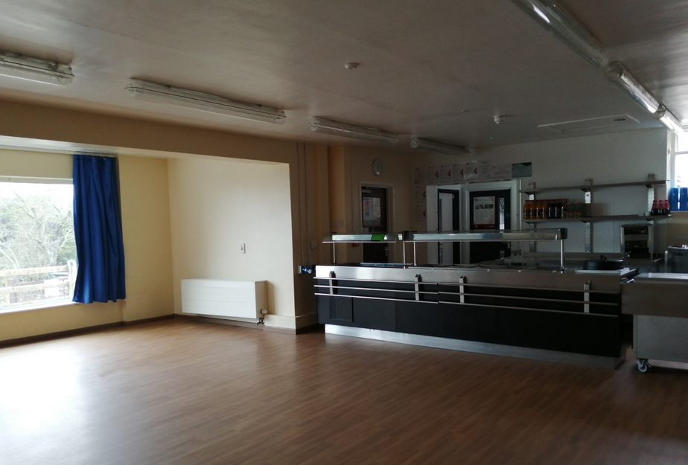

Slide 10
Food arrangements
Wednesday – Please bring a packed lunch
Wednesday evening → Friday lunch - all meals provided
Please make sure you let us know of any specific allergens / dietary requirements on the consent form.
Jobs

Slide 11
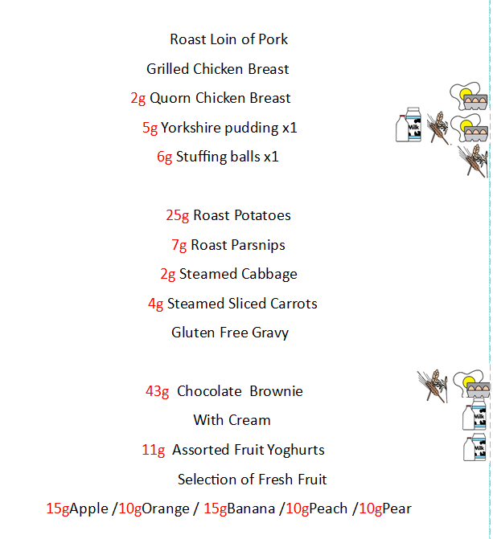
Wednesday
evening meal

Slide 12
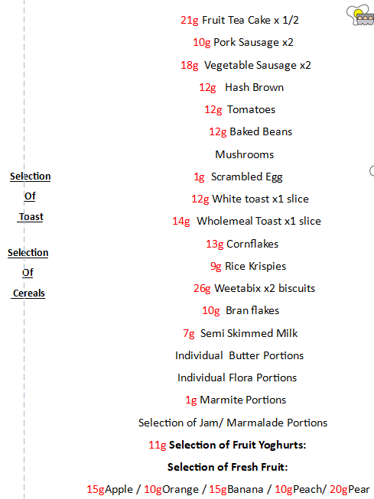
Thursday
breakfast

Slide 13
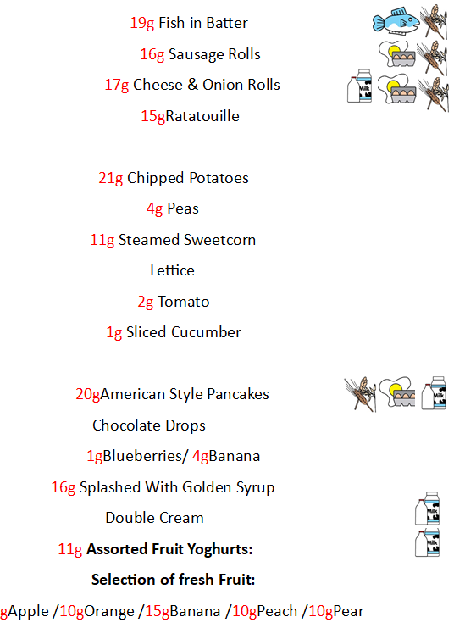
Thursday
evening meal

Slide 14
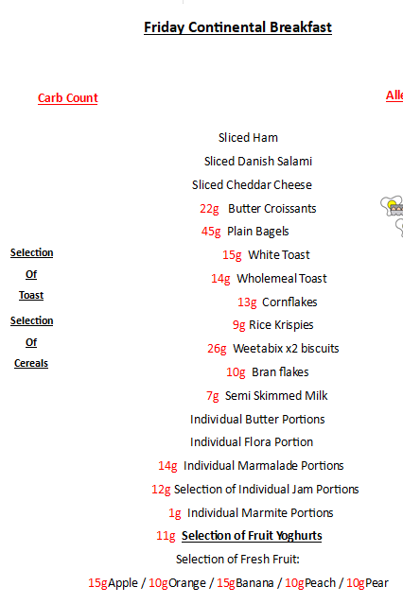
Friday
breakfast

Slide 15
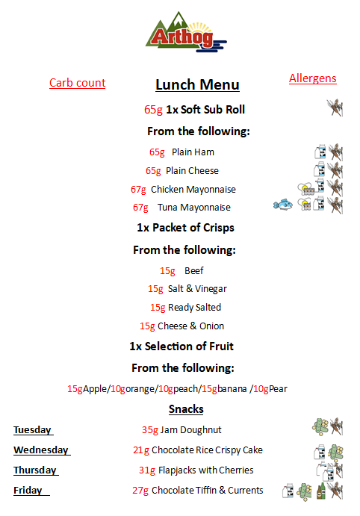
Lunch
menu

Slide 16
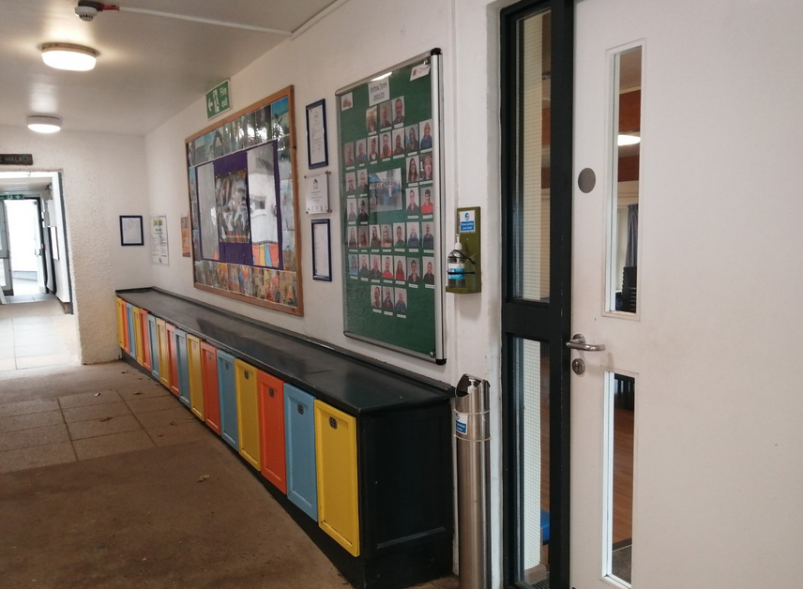
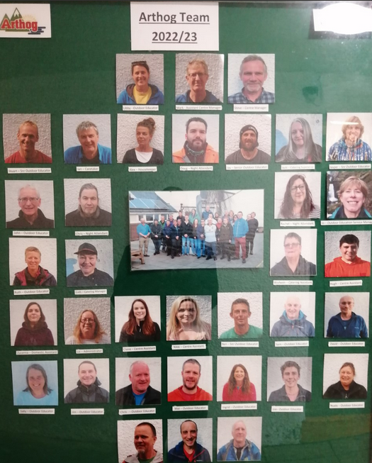

Slide 17
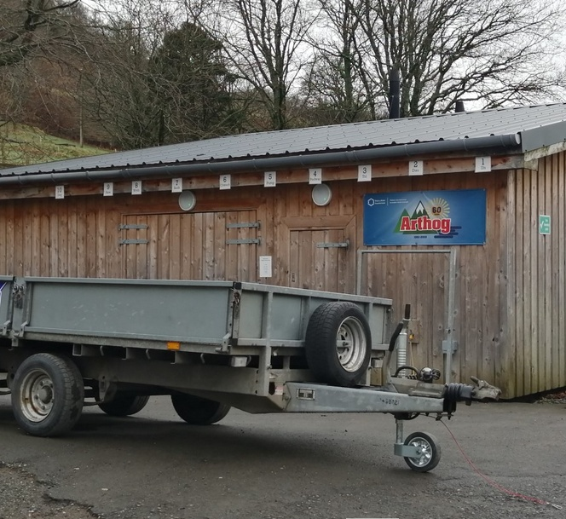
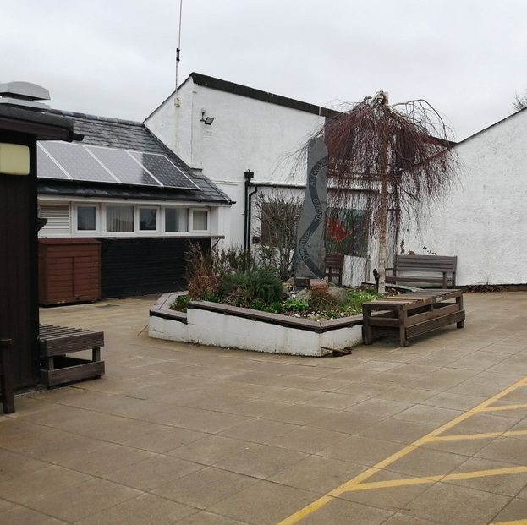

Slide 18
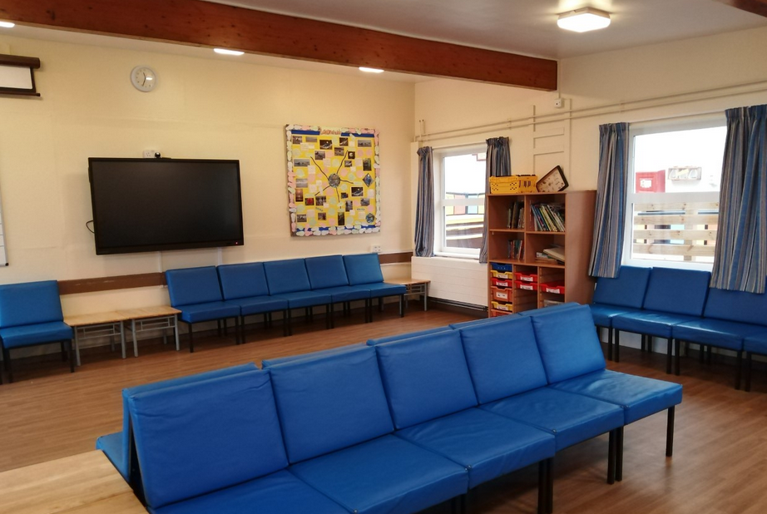
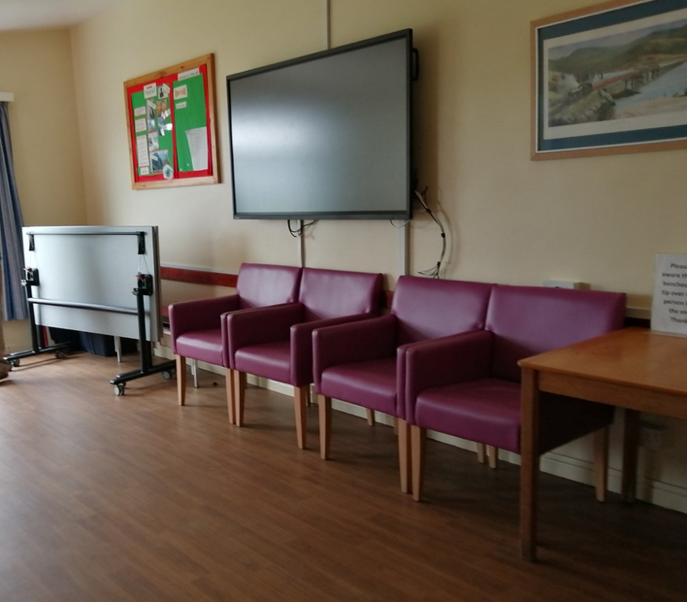

Slide 19
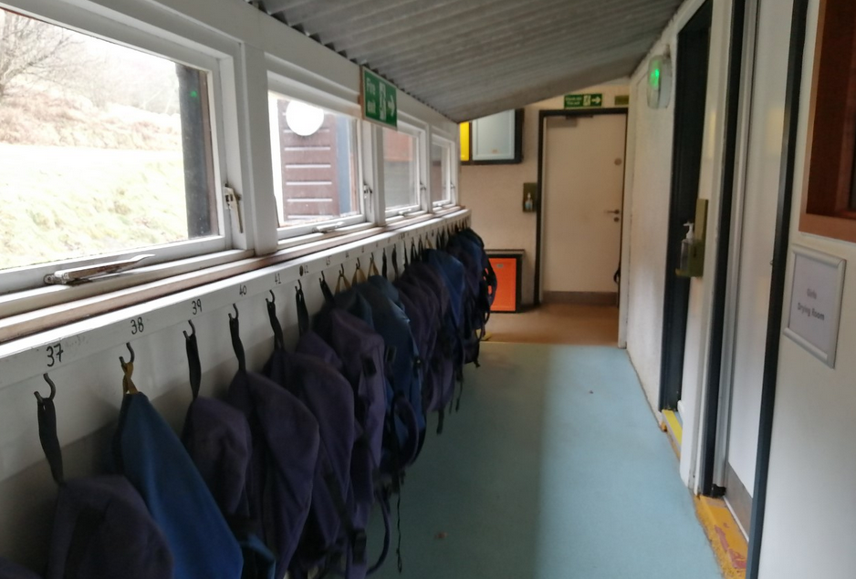

Slide 20
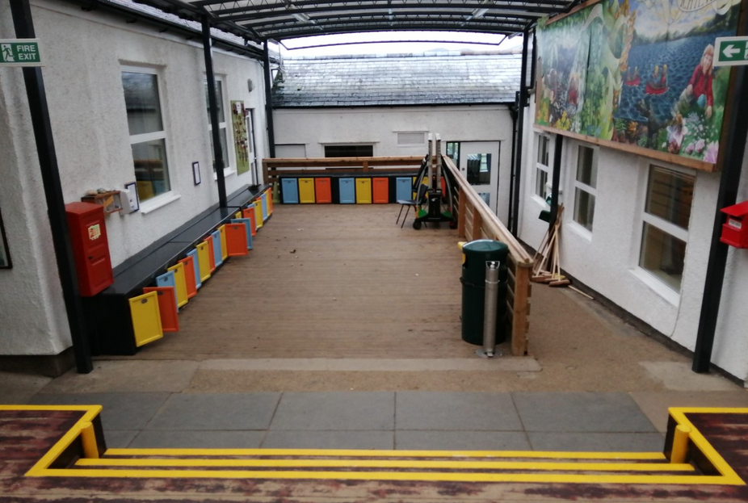

Slide 21
Dormitories and overnight
Boys dormitories – Rooms of 2, 3 and 4
Girls dormitories – Rooms of 9 and 4

Slide 22
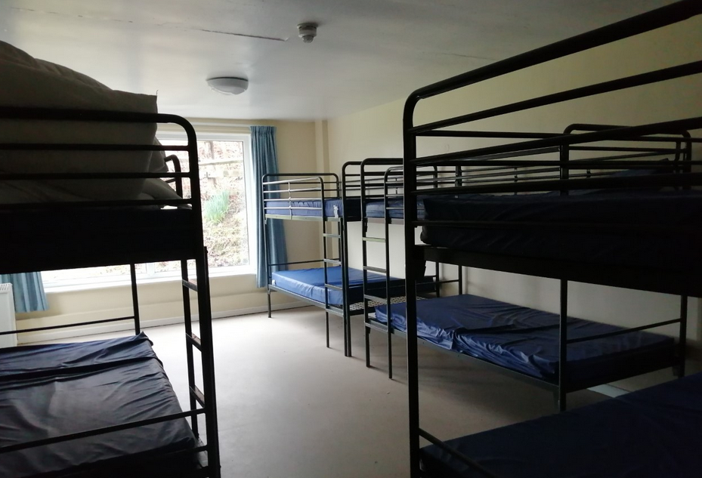
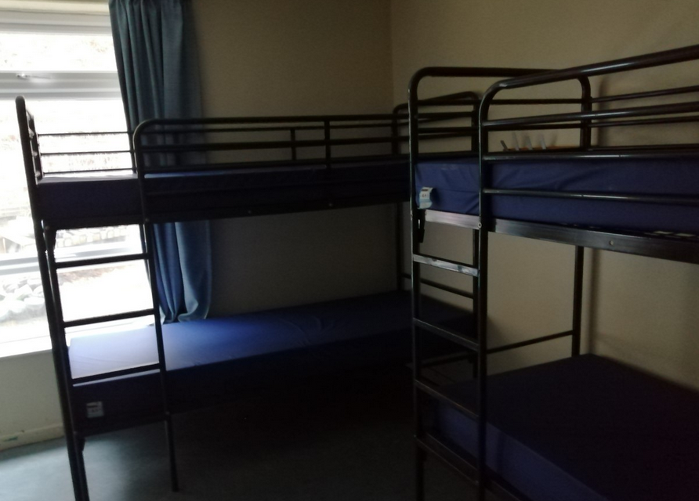

Slide 23
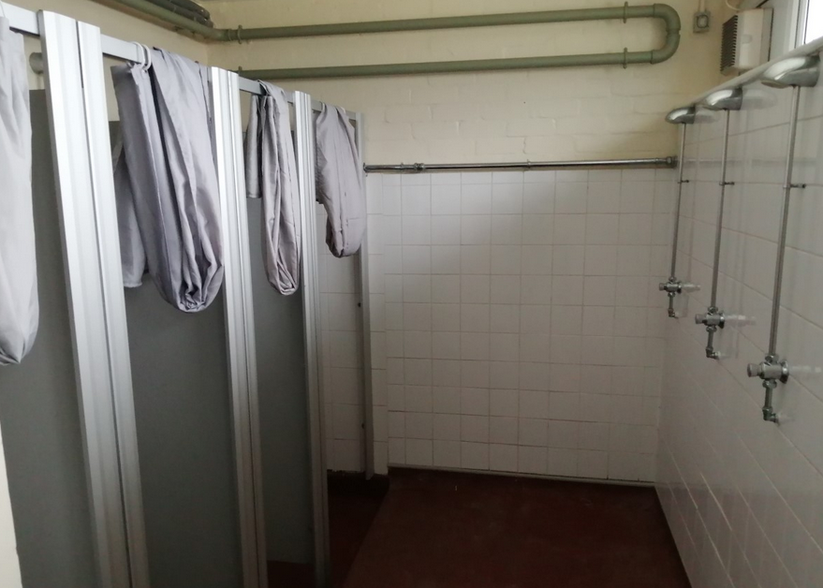

Slide 24
Kit list and all-weather essentials
Sheet for bedding
Duvet cover (not the duvet!)
Pillowcase (not the pillow!)
Pyjamas
2 towels / shower soap / shampoo
Toothbrush / toothpaste
Small thermos
3-4 old t-shirts
2-3 jumper / fleece
3-4 set underwear
2-3 joggers / trousers
3-4 pairs socks (3 x thick!)
Woolly / warm hat
Gloves
Pairs of boots / trainers
Coat and over-trousers
Wellies (if wish)
Swimwear
Drinks bottle
2 plastic carrier bags
Torch (if wish)

Slide 25
Useful hints and tips
1) Involve pupils in packing so they know what they are taking with them
2) Write names on items
3) Do not bring mobile phones, cameras, music players, computer games, jewellery and fashion clothes
4) Practice making your bed!
5) Casual warm clothes are the most useful – there is a drying room.
6) No need to bring any money.
7) No aerosol or deodorant sprays, roll on is great!

Slide 26
The key to a successful trip.
Behaviour
Positive attitudes bring positive outcomes
Everyone wants a safe, fun and incredible time.
Make sure to be kind and supportive to everyone
Listen to instructions and follow expectations

Slide 27
Q & A. – Any questions?

