Slide 1
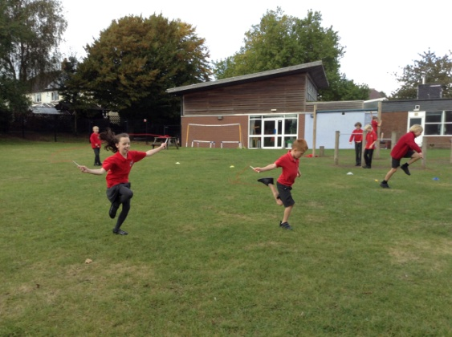
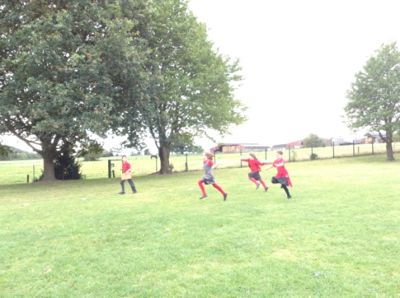
Myddle CE Primary School Sports 2021-2022
Sports Leaders in Action

Slide 2
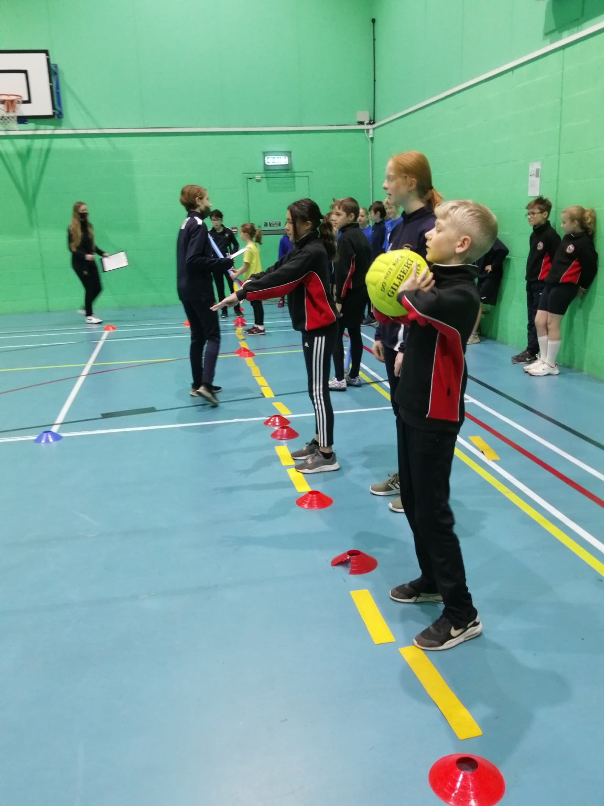
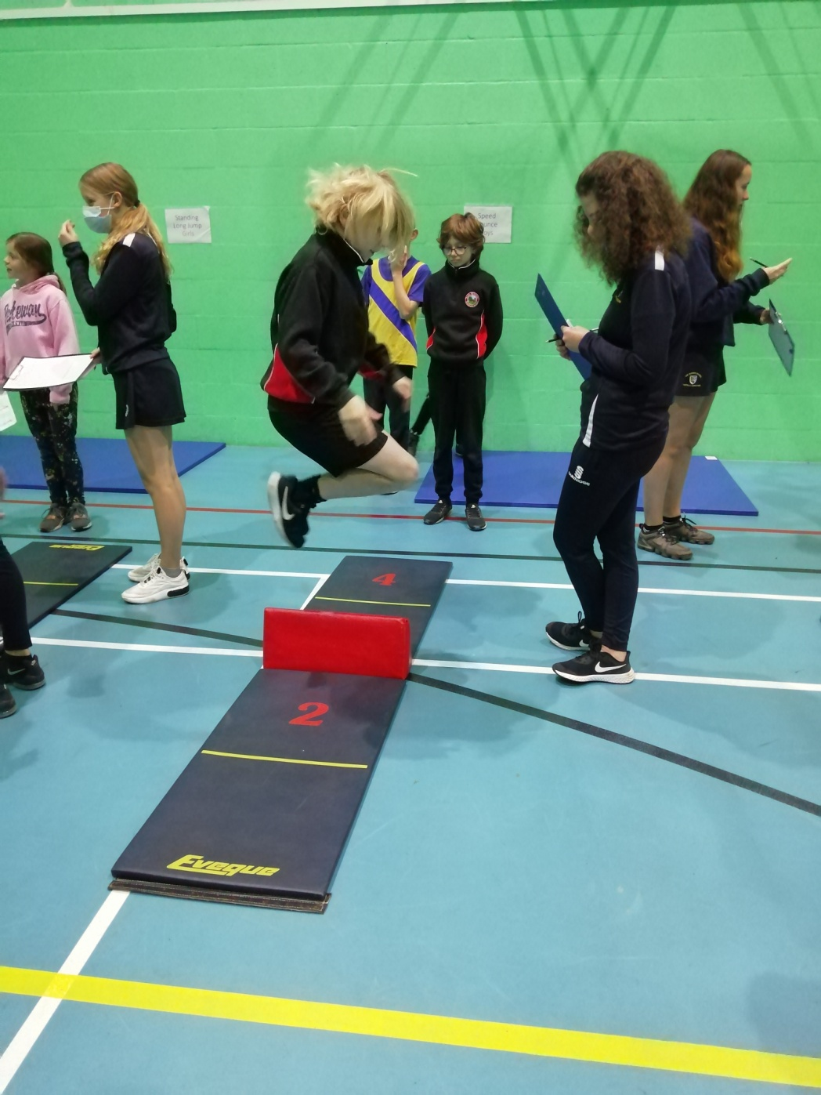
Myddle CE Primary School Sports 2021-2022
Indoor Athletics

Slide 3
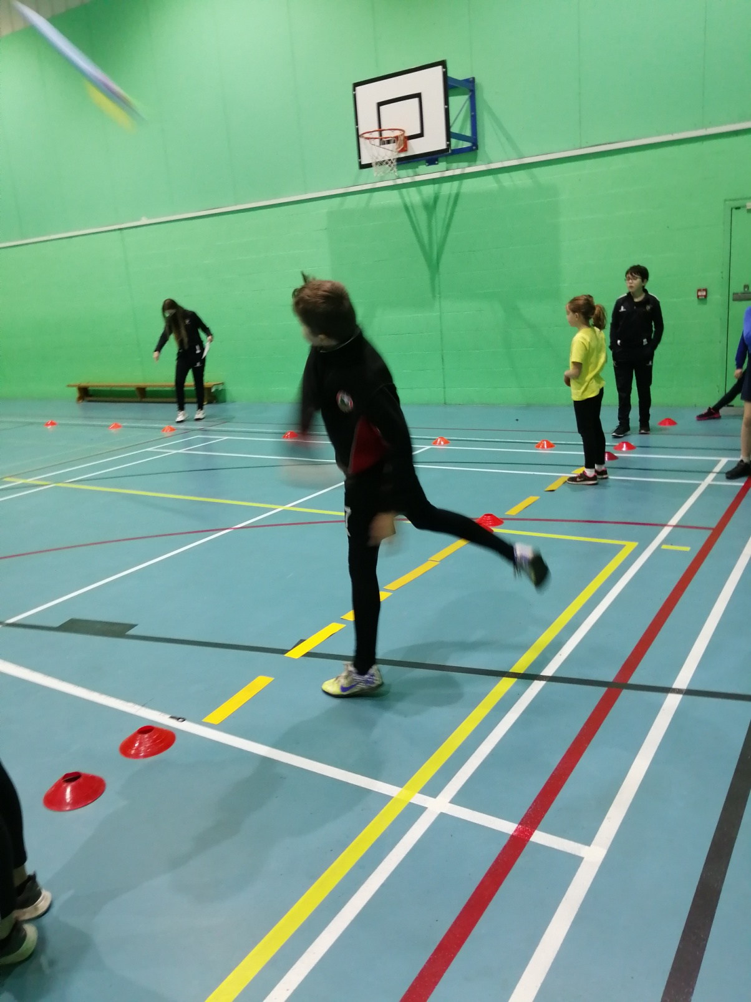
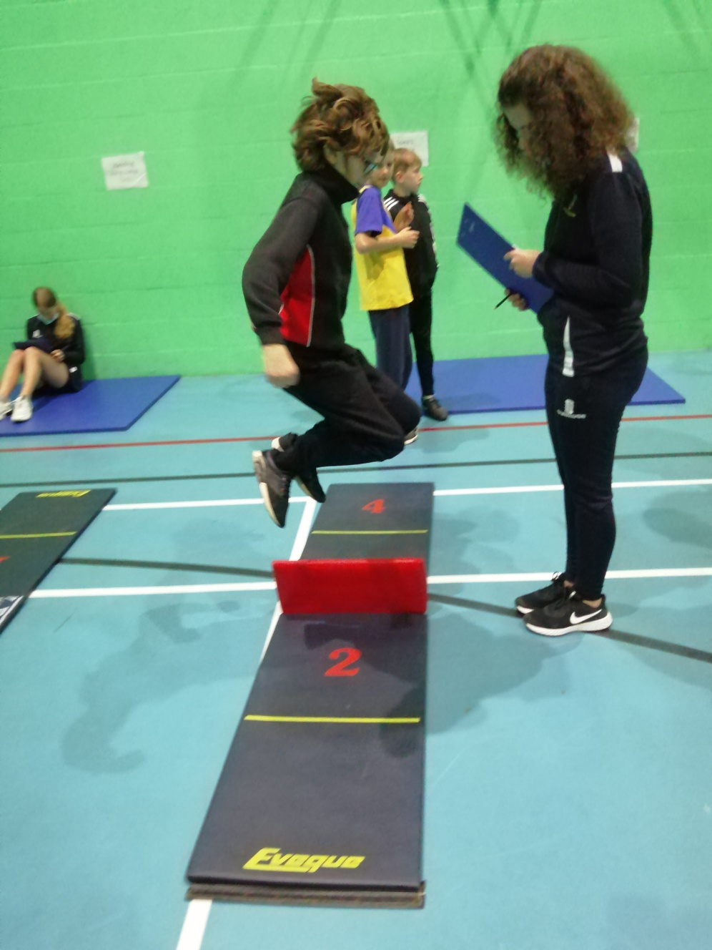
Myddle CE Primary School Sports 2021-2022
Indoor Athletics

Slide 4
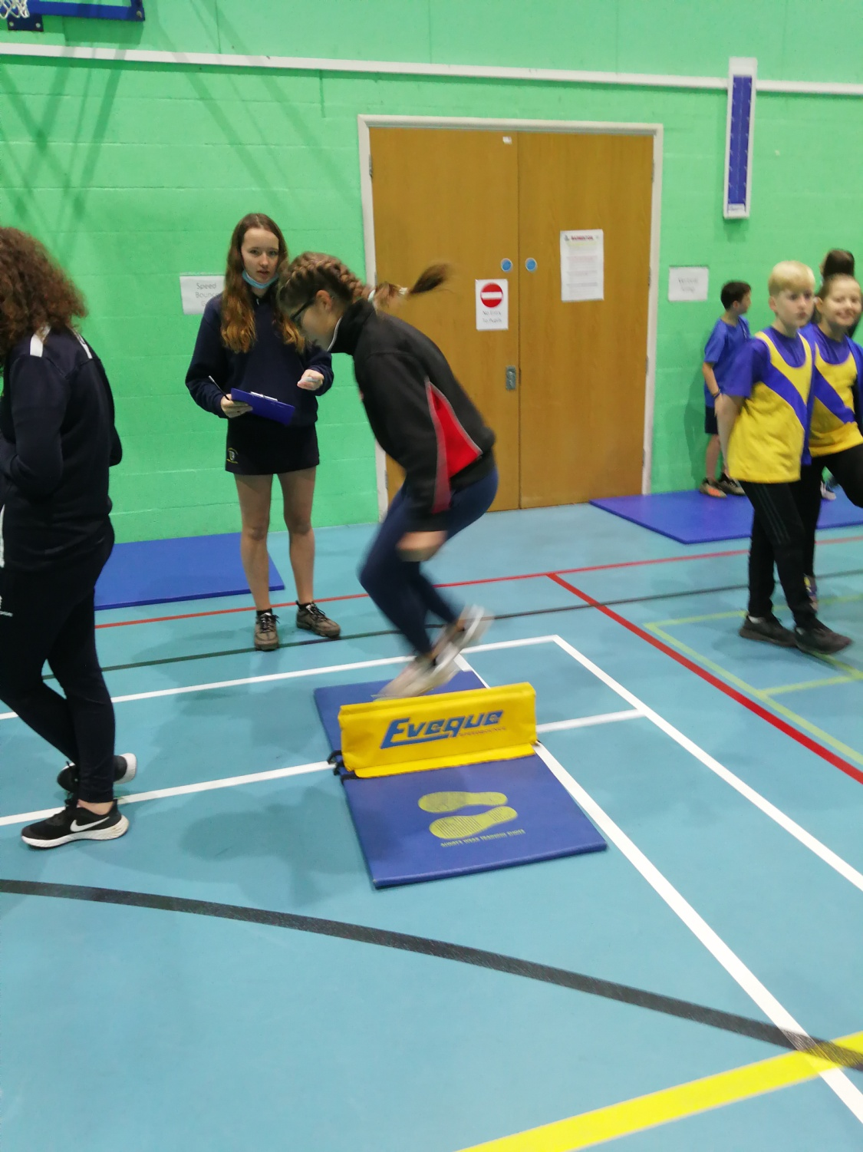
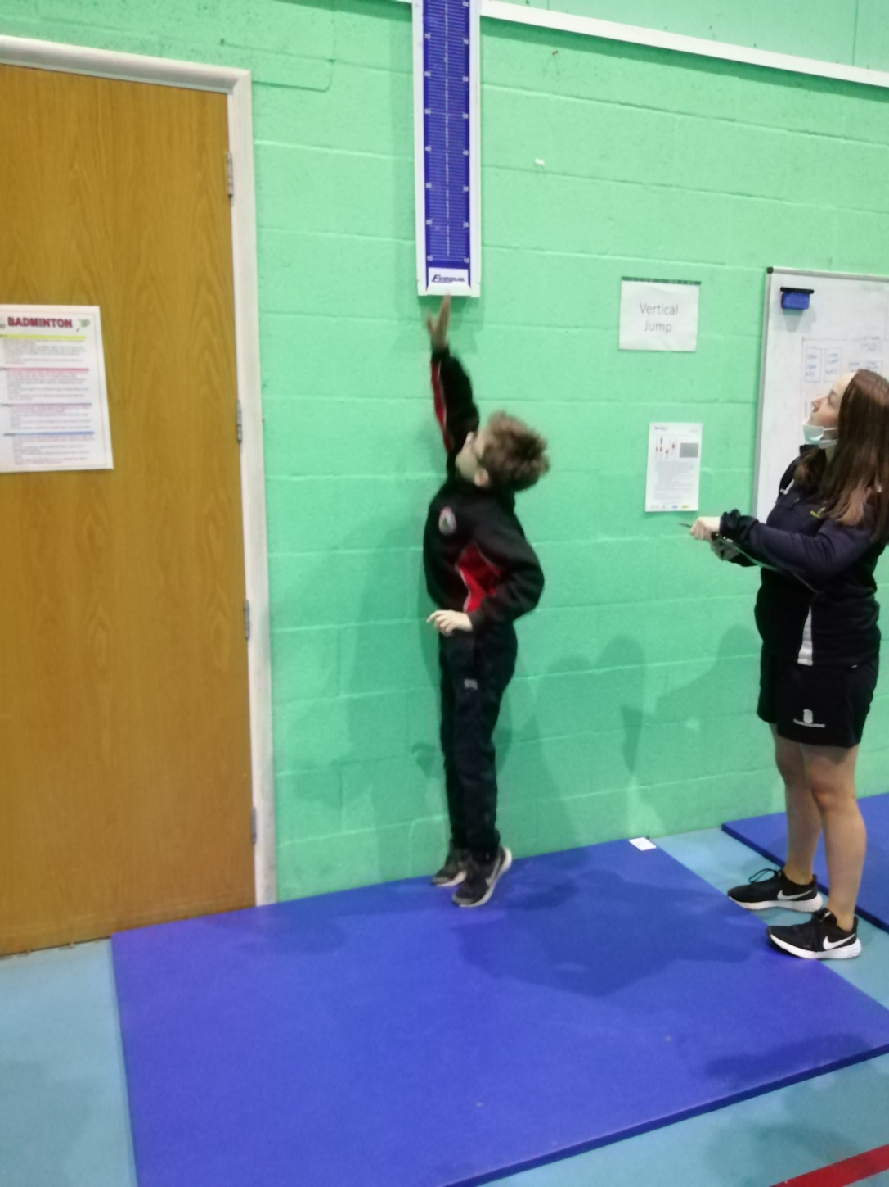
Myddle CE Primary School Sports 2021-2022
Indoor Athletics

Slide 5
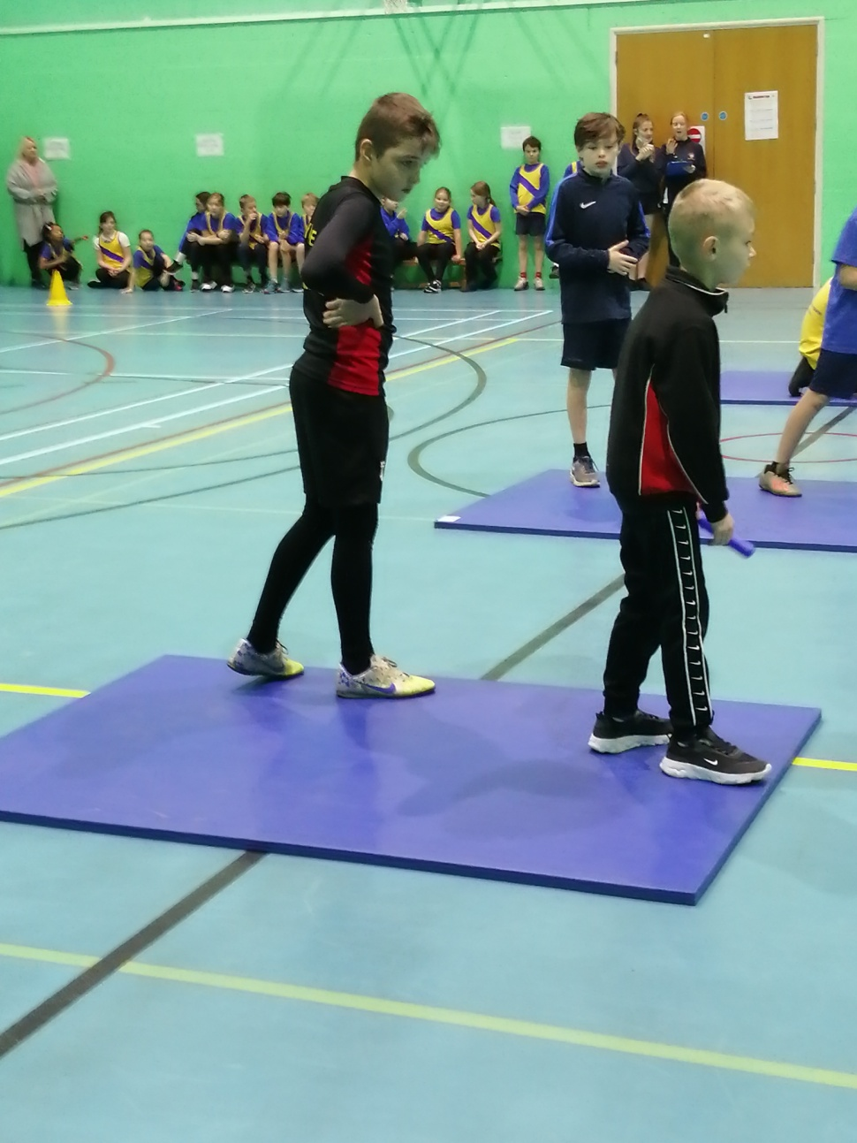
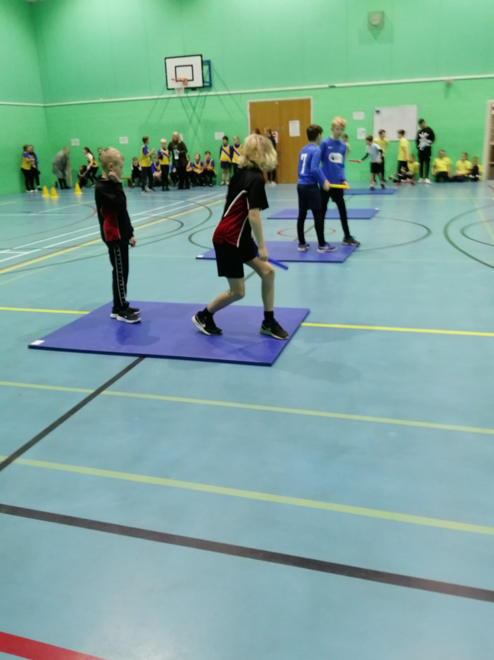
Myddle CE Primary School Sports 2021-2022
Indoor Athletics

Slide 6
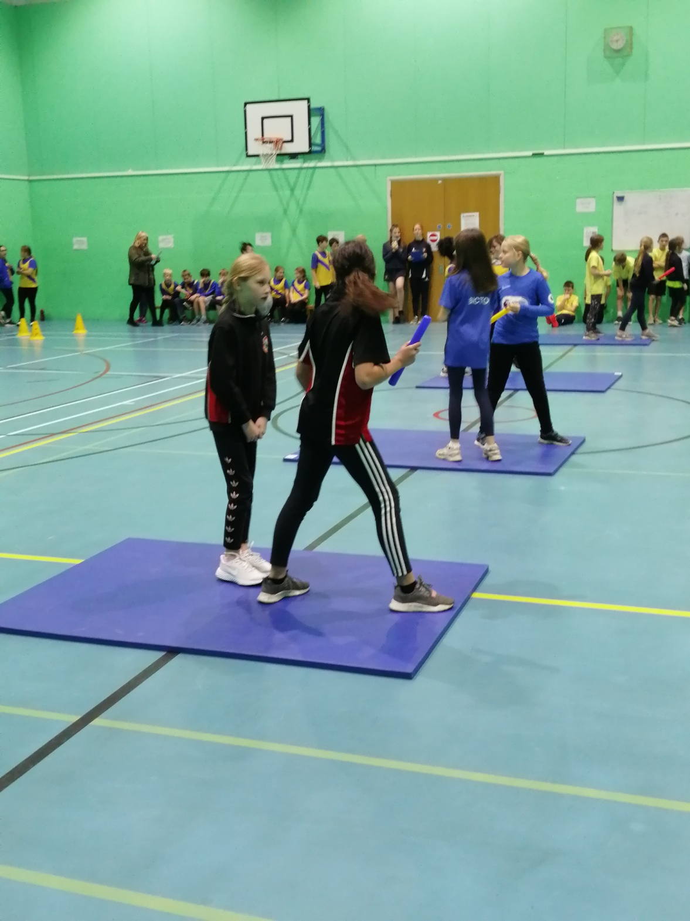
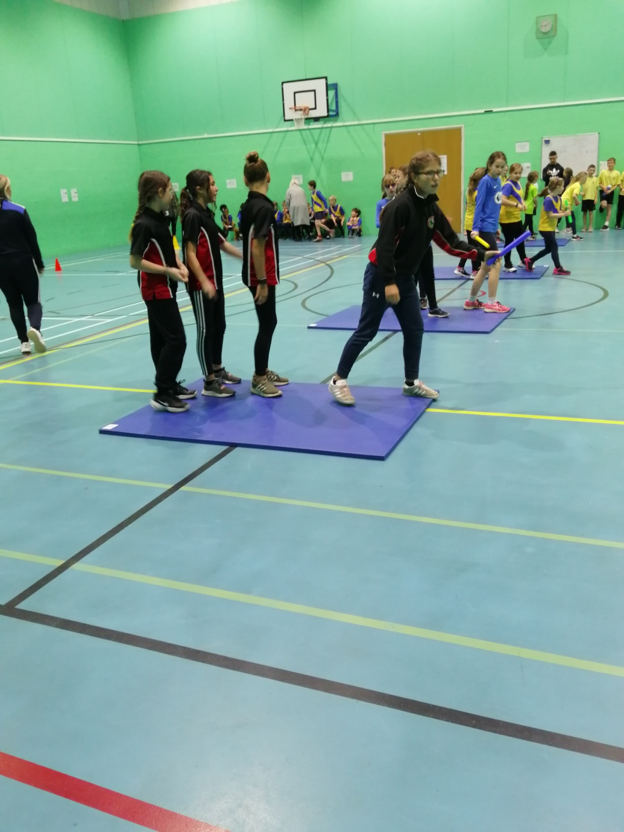
Myddle CE Primary School Sports 2021-2022
Indoor Athletics

Slide 7
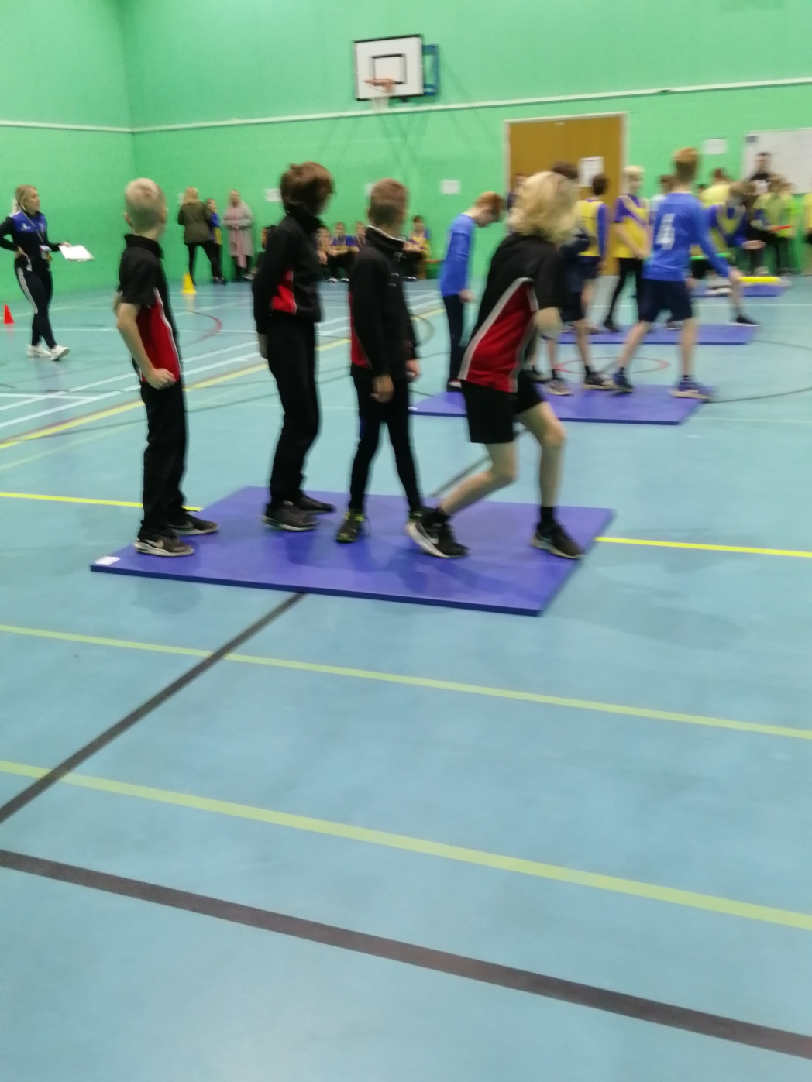
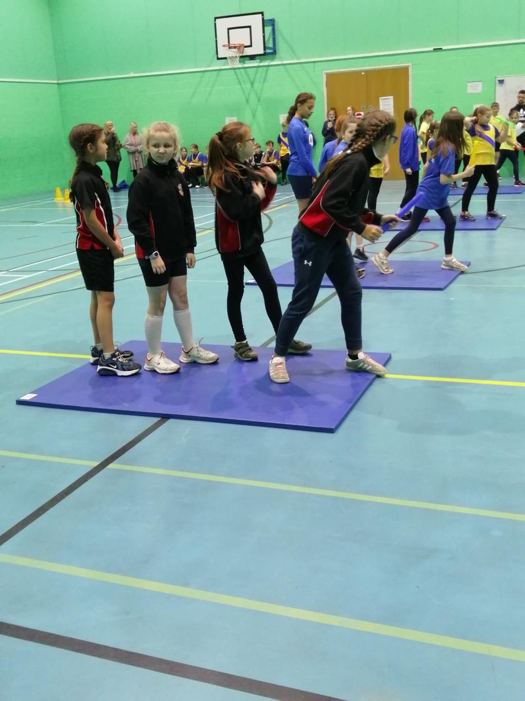
Myddle CE Primary School Sports 2021-2022
Indoor Athletics

Slide 8
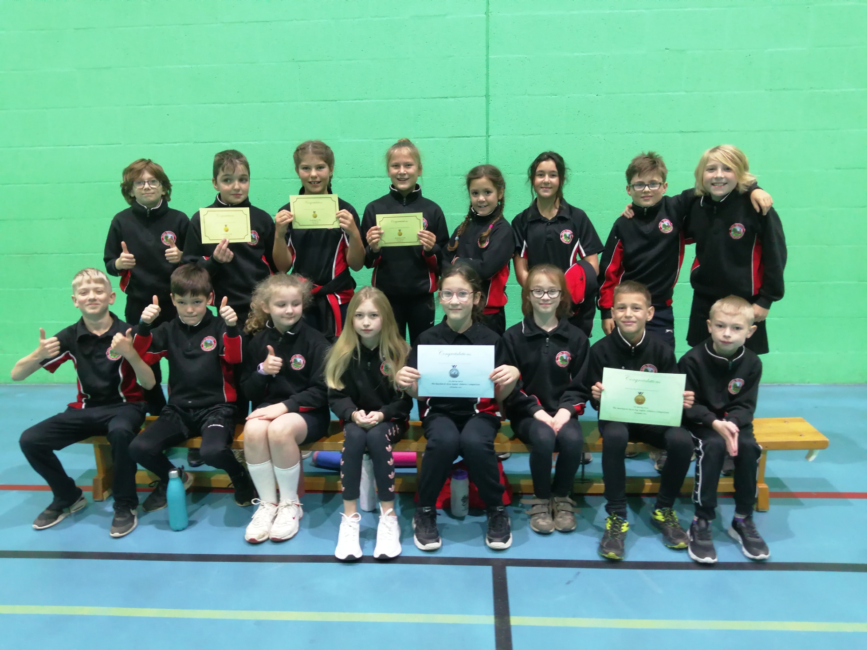
Myddle CE Primary School Sports 2021-2022
Indoor Athletics

Slide 9
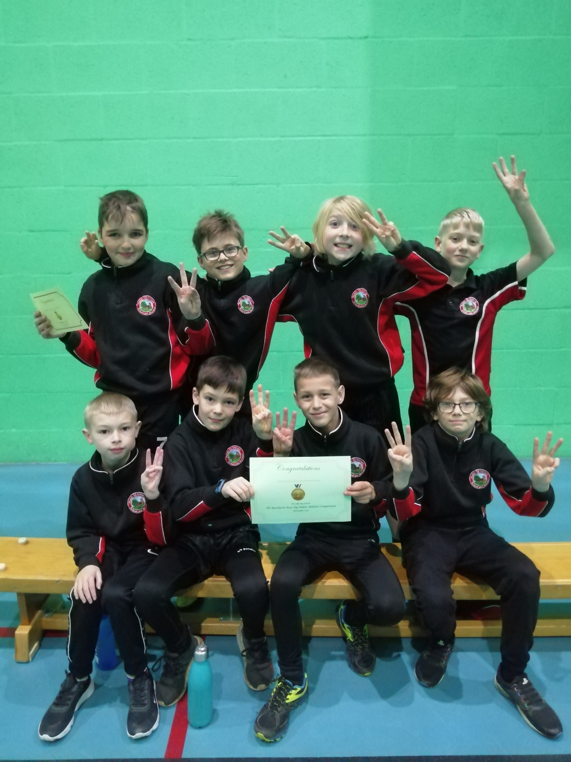
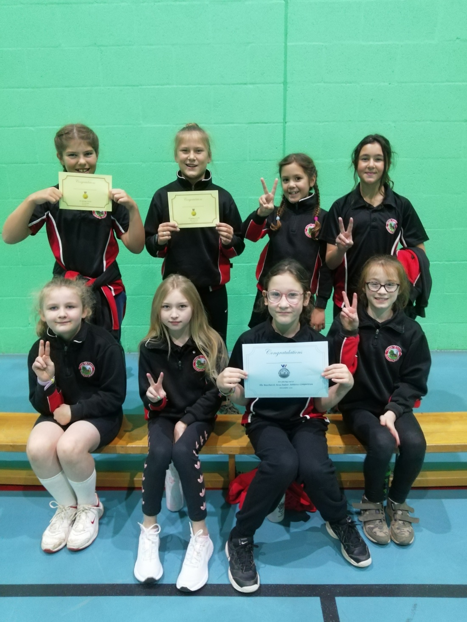
Myddle CE Primary School Sports 2021-2022
Indoor Athletics

Slide 10
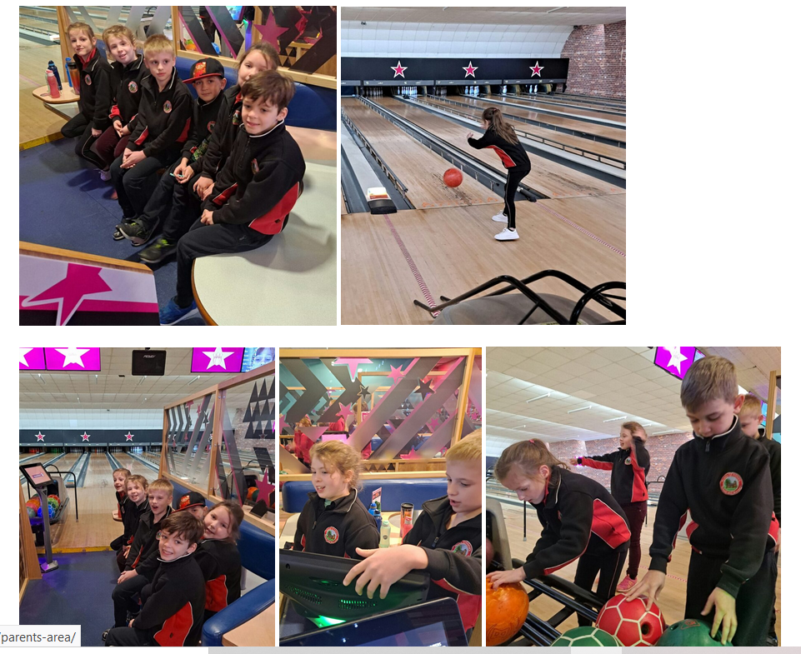
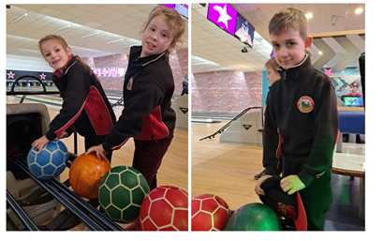
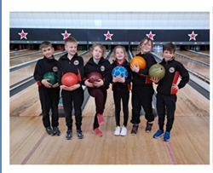
Myddle CE Primary School Sports 2021-2022
Panathlon

Slide 11
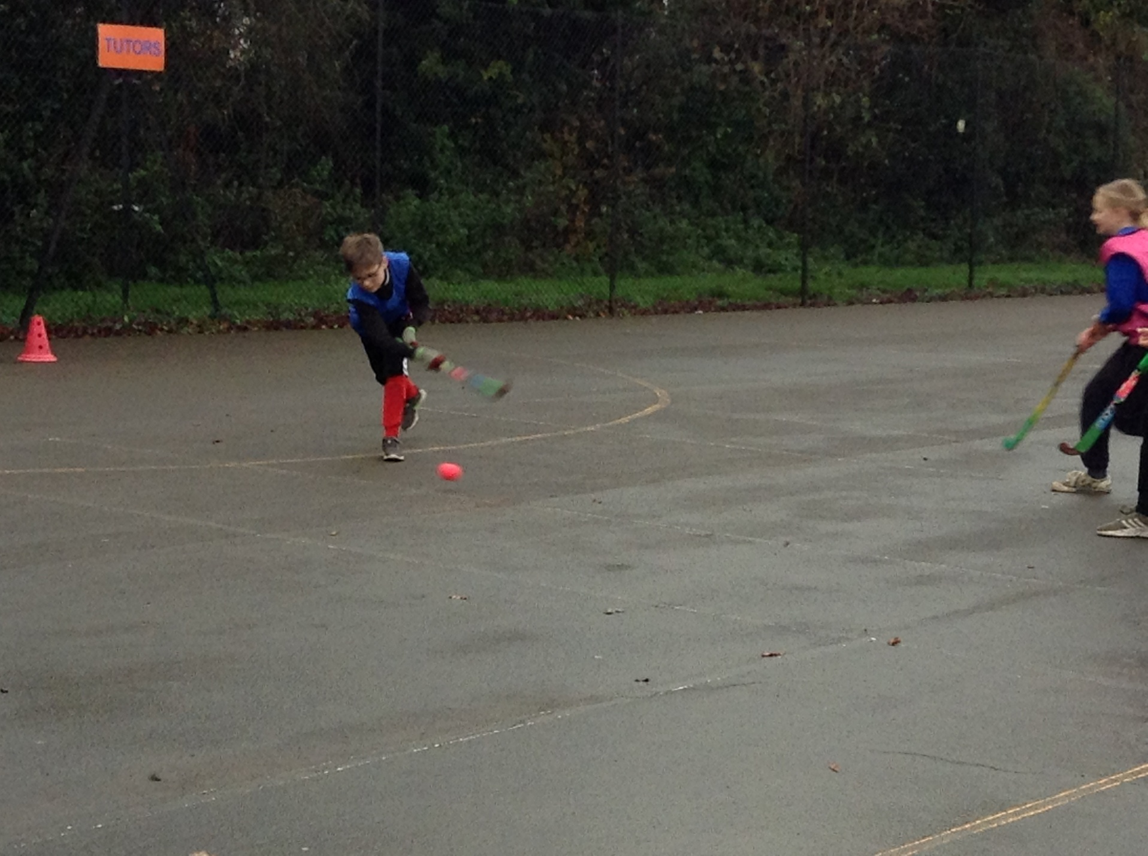
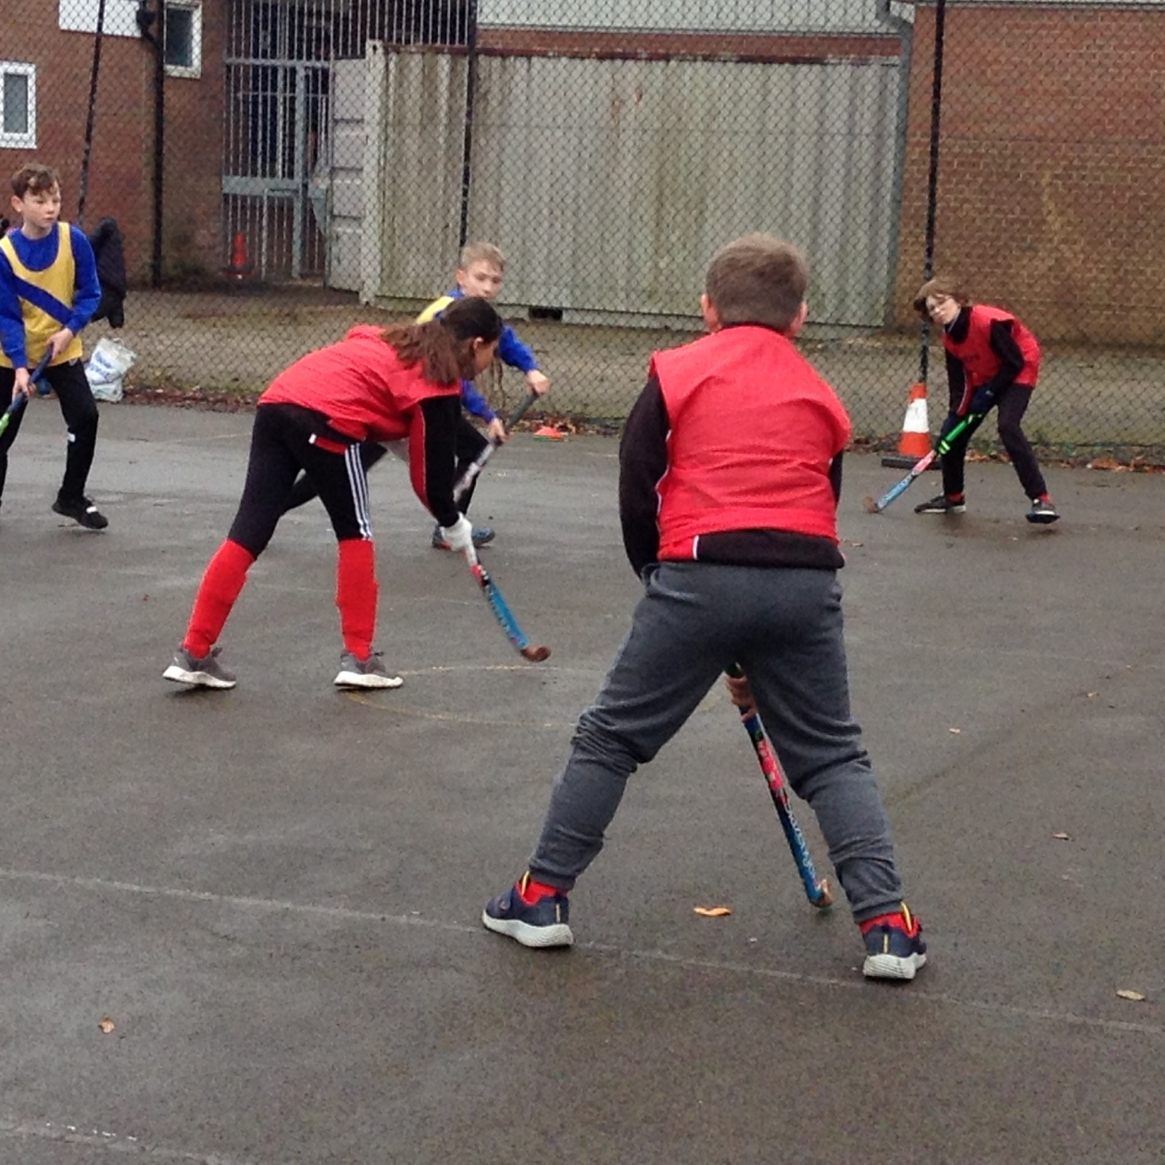
Myddle CE Primary School Sports 2021-2022
Hockey

Slide 12
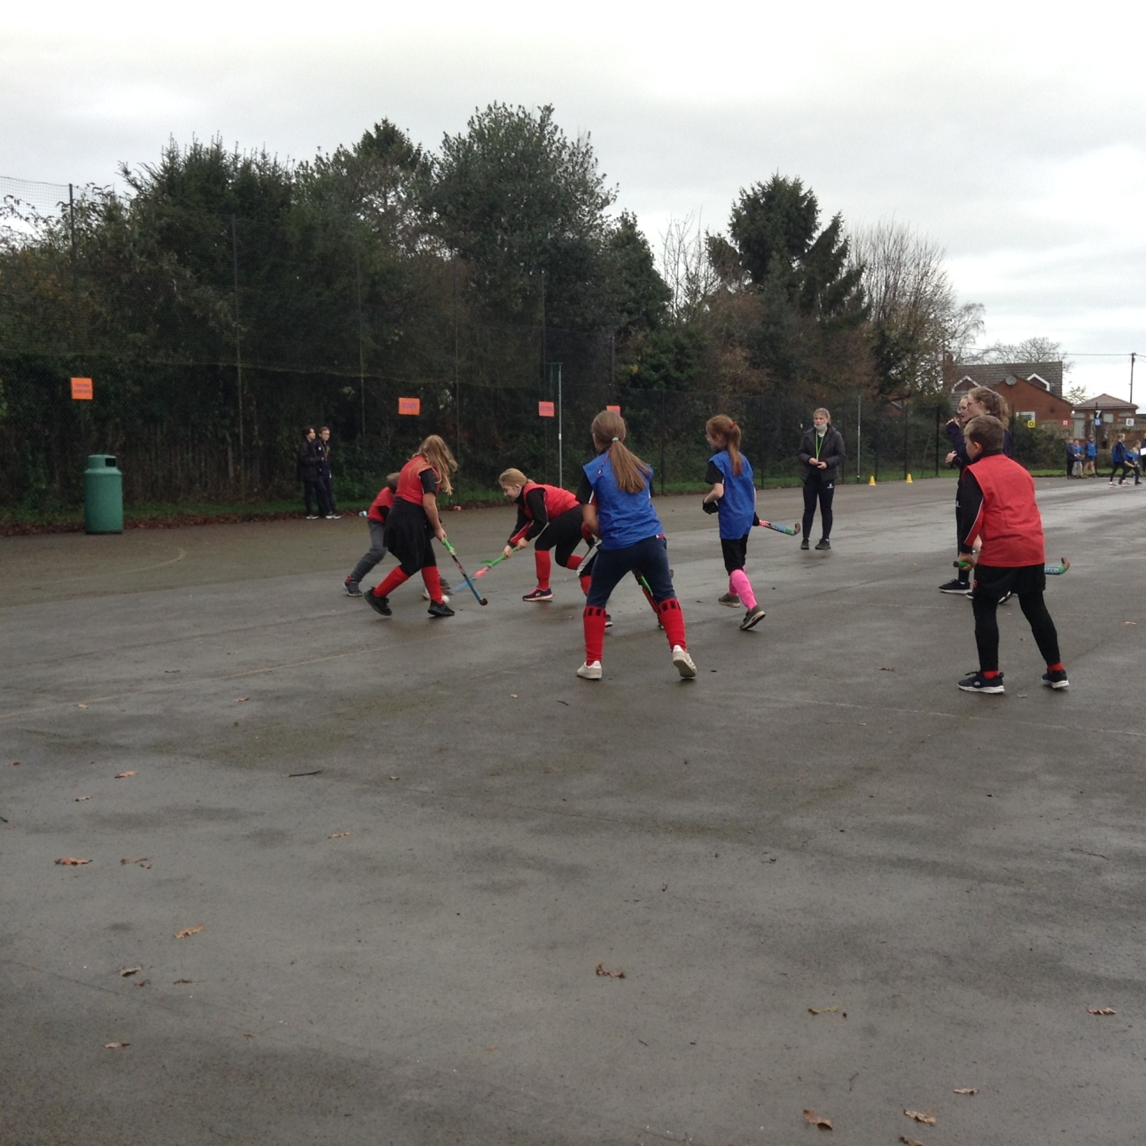
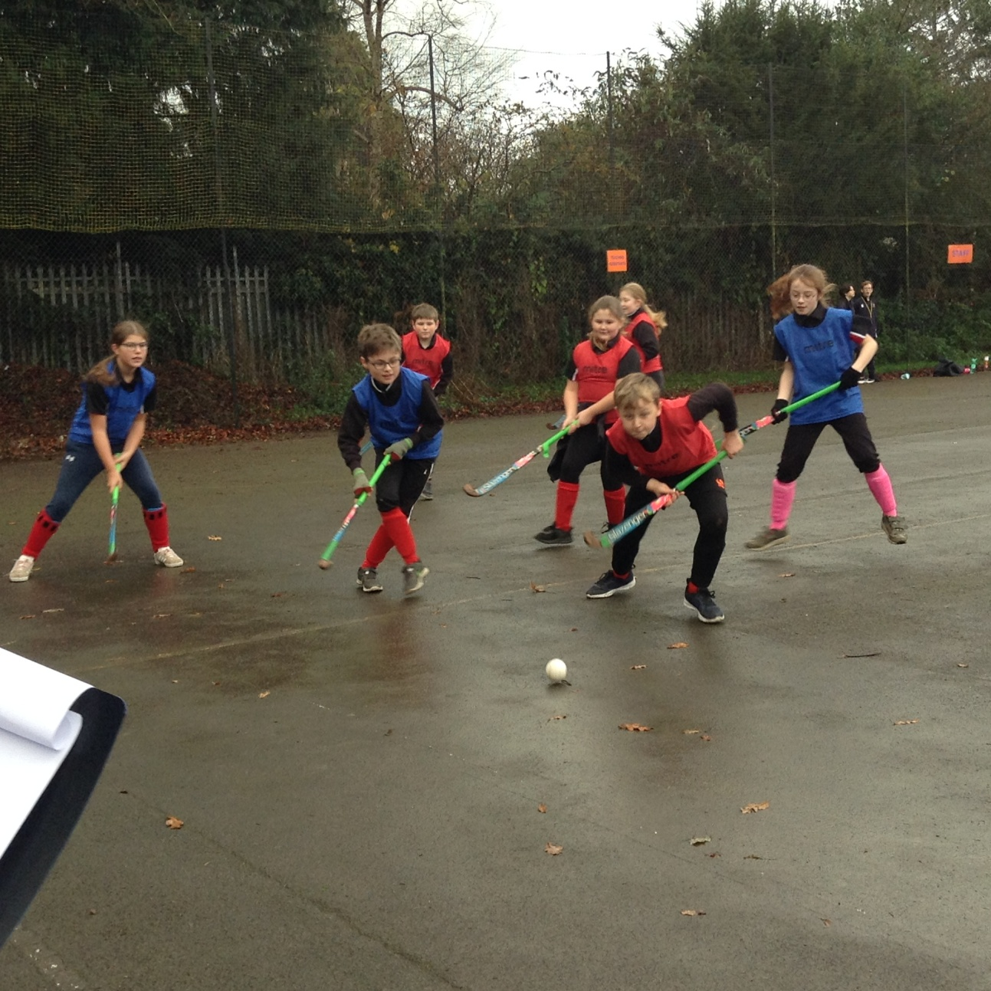
Myddle CE Primary School Sports 2021-2022
Hockey

Slide 13
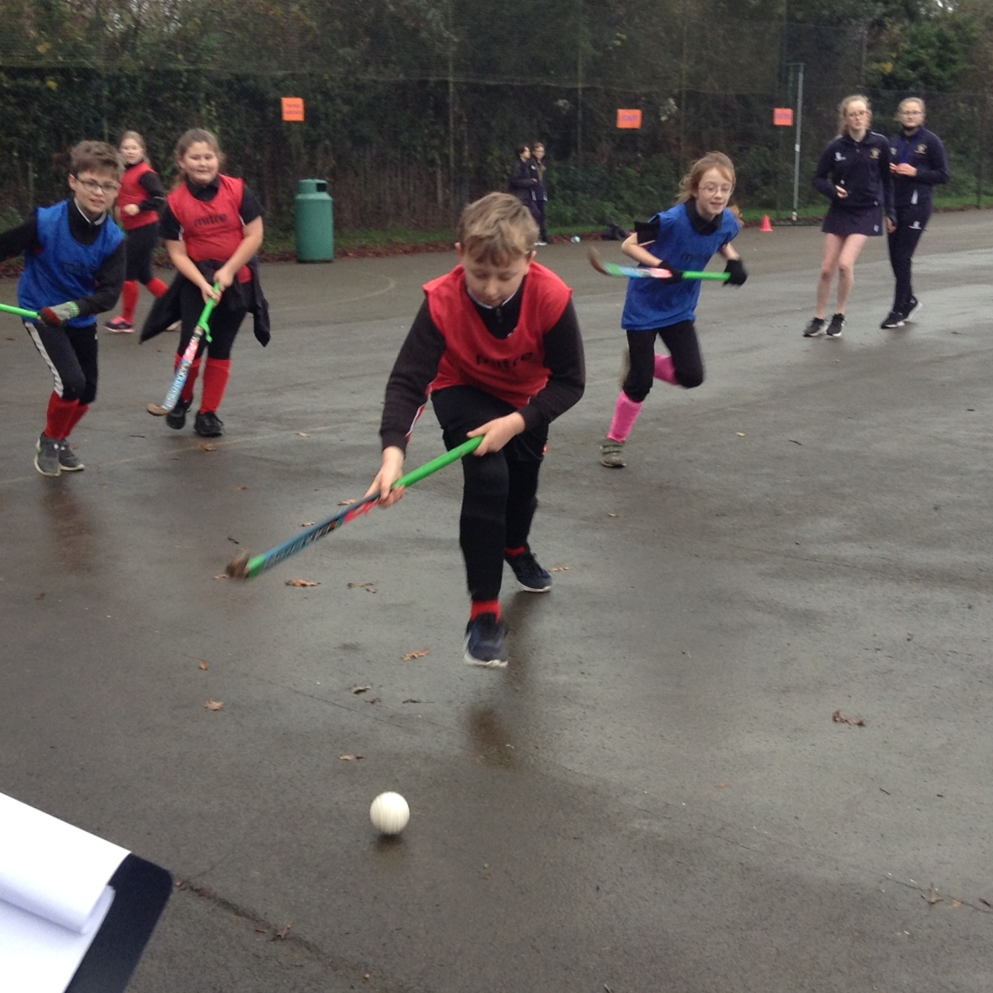
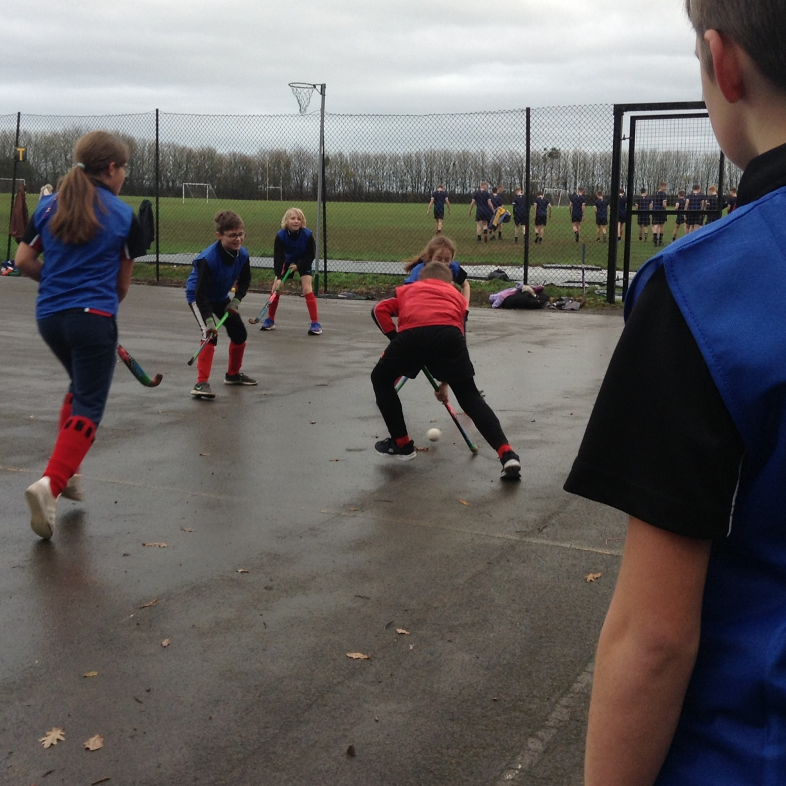
Myddle CE Primary School Sports 2021-2022
Hockey

Slide 14
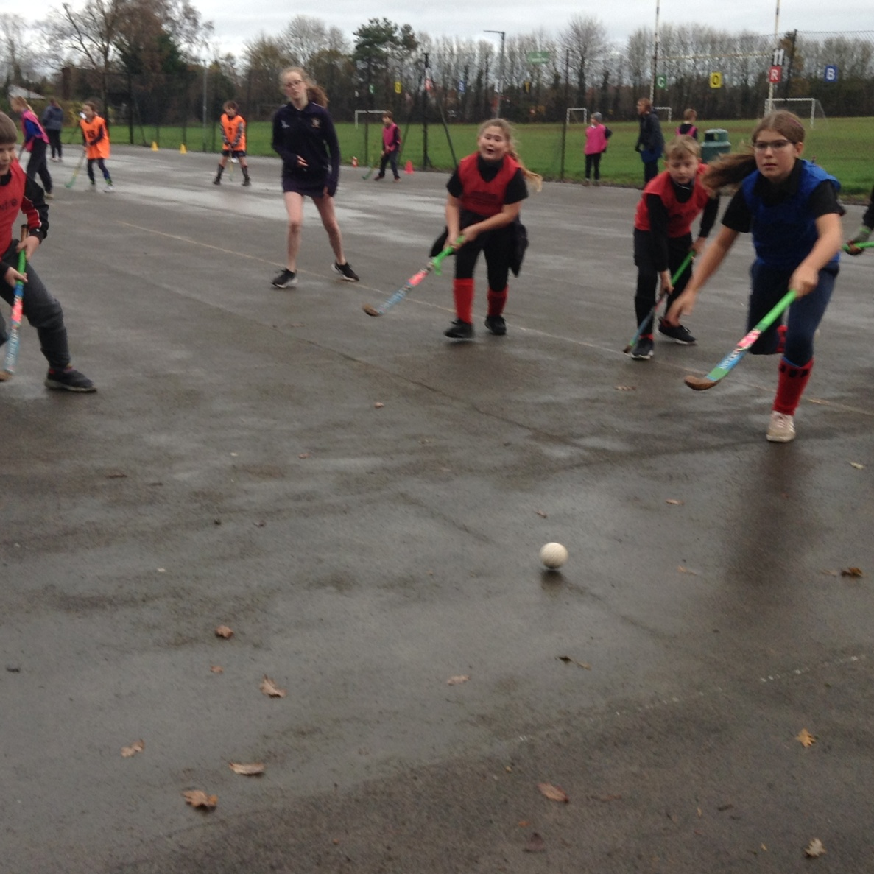
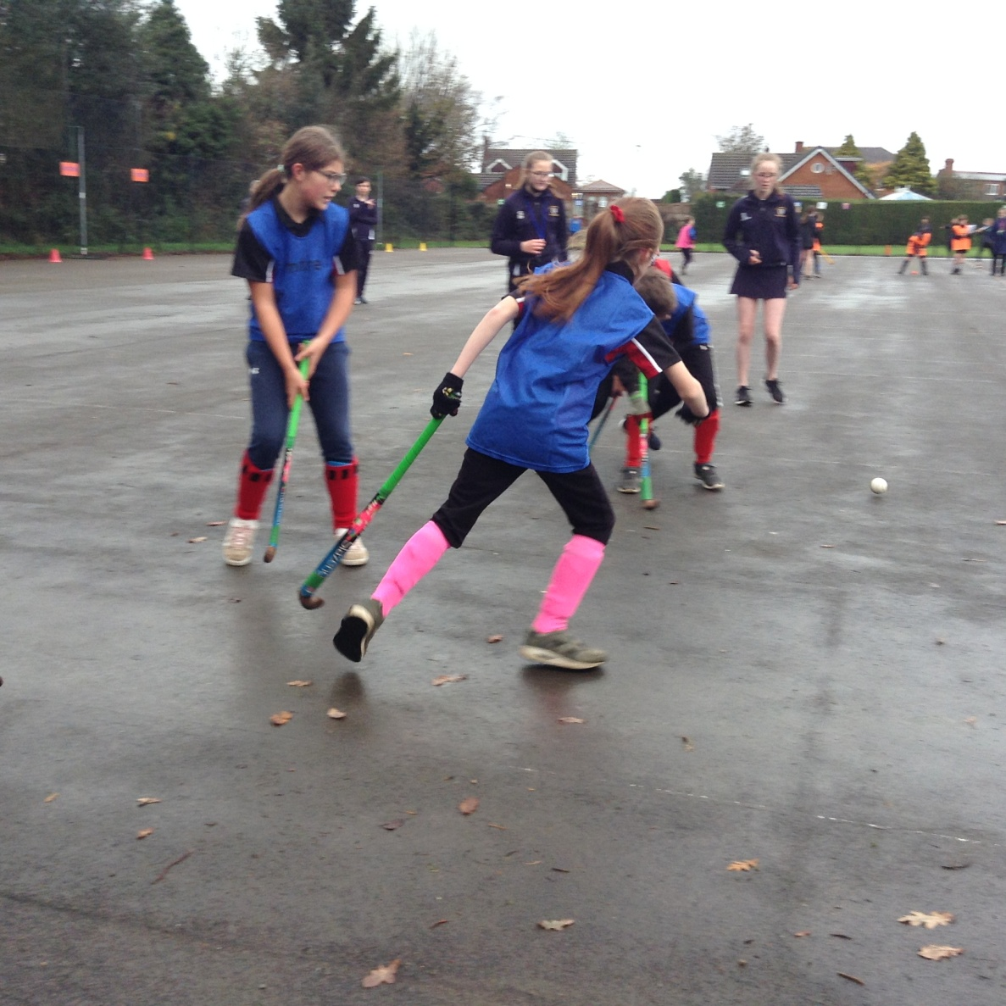
Myddle CE Primary School Sports 2021-2022
Hockey

Slide 15
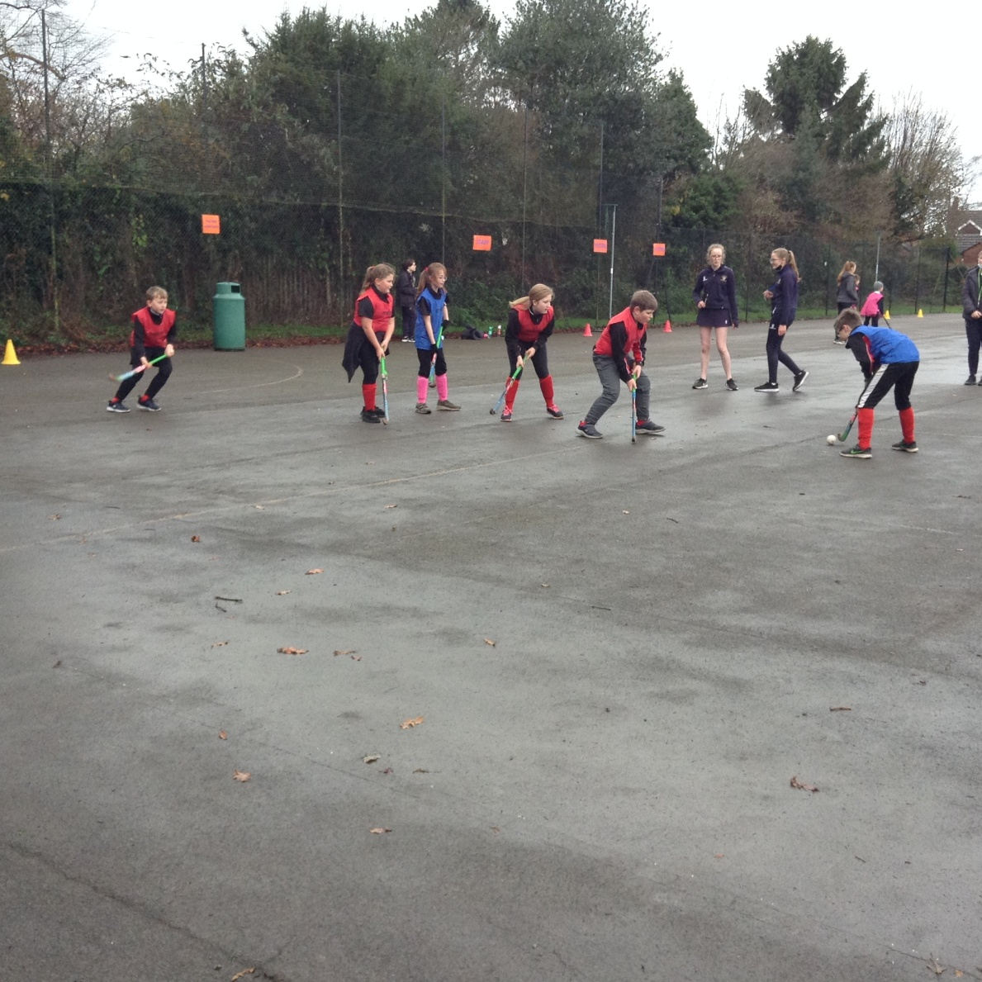
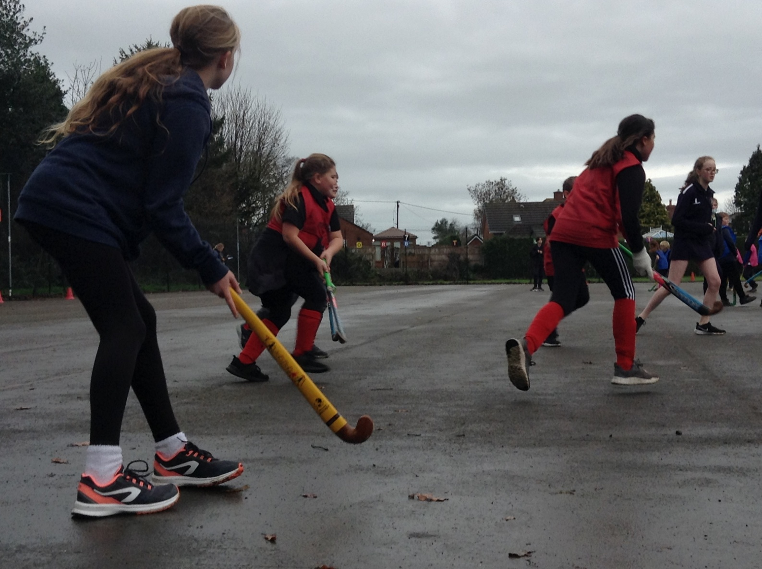
Myddle CE Primary School Sports 2021-2022
Hockey

Slide 16
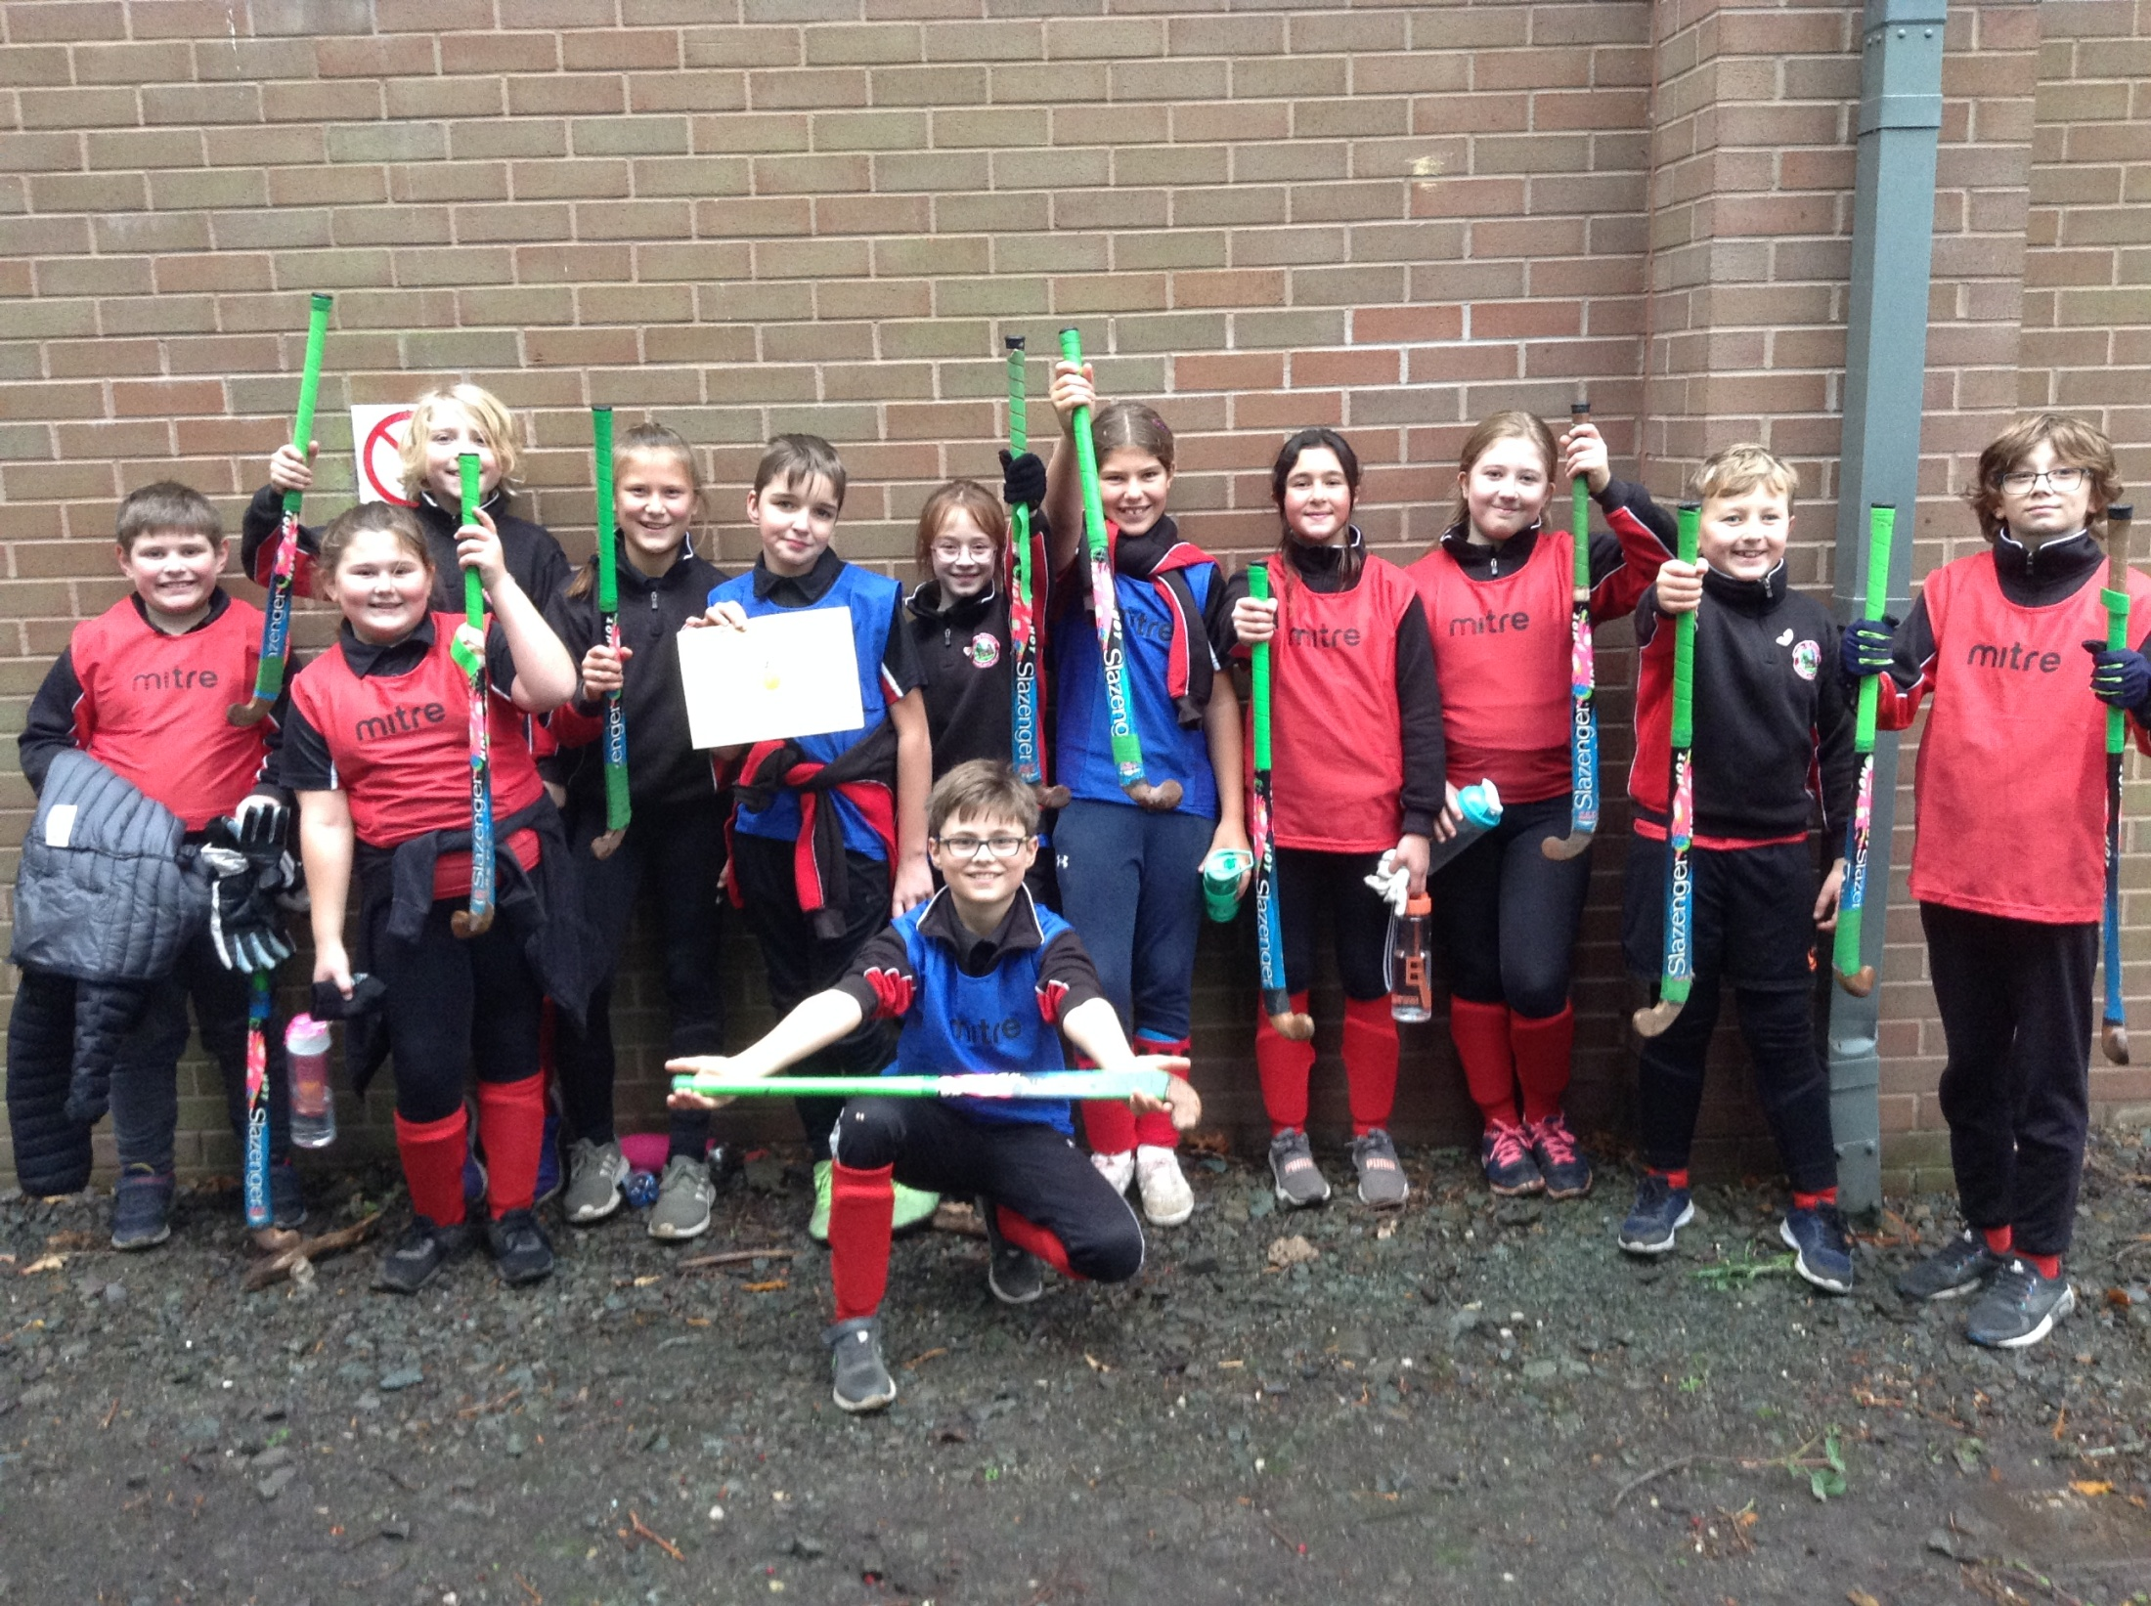
Myddle CE Primary School Sports 2021-2022
Hockey

Slide 17
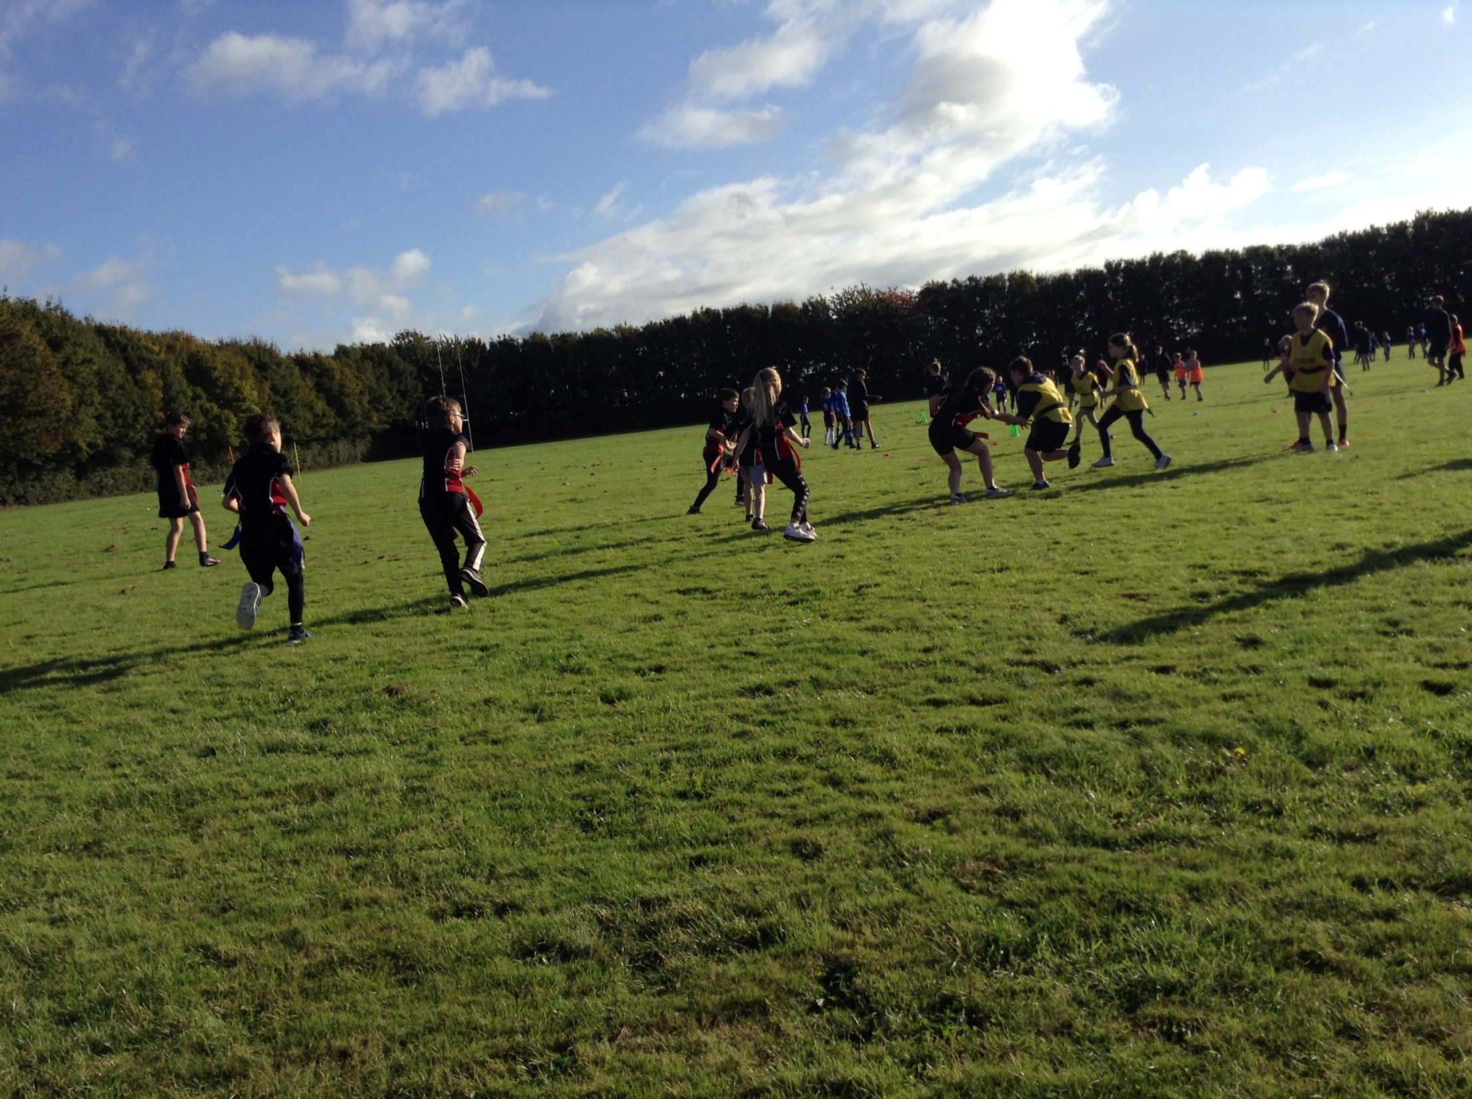
Myddle CE Primary School Sports 2021-2022
KS2 Tag Rugby

Slide 18
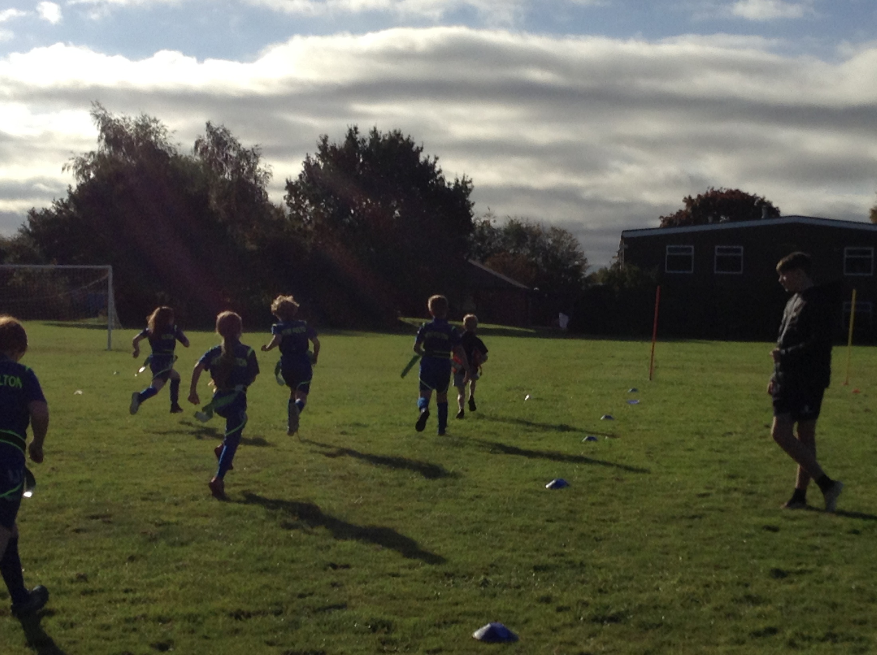
Myddle CE Primary School Sports 2021-2022
KS2 Tag Rugby

Slide 19
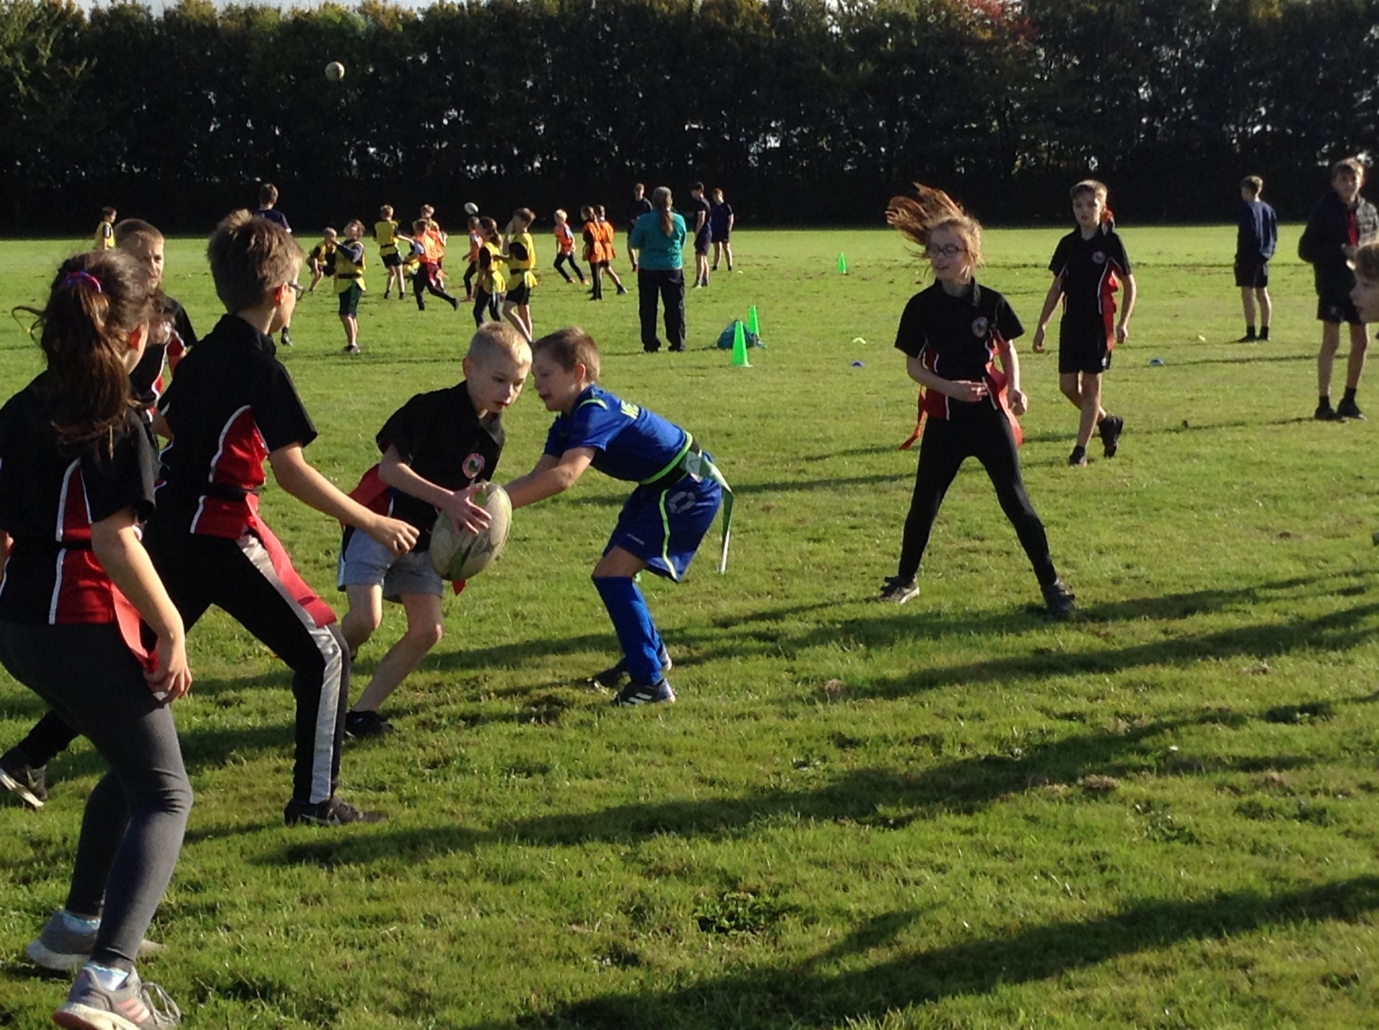
Myddle CE Primary School Sports 2021-2022
KS2 Tag Rugby

Slide 20
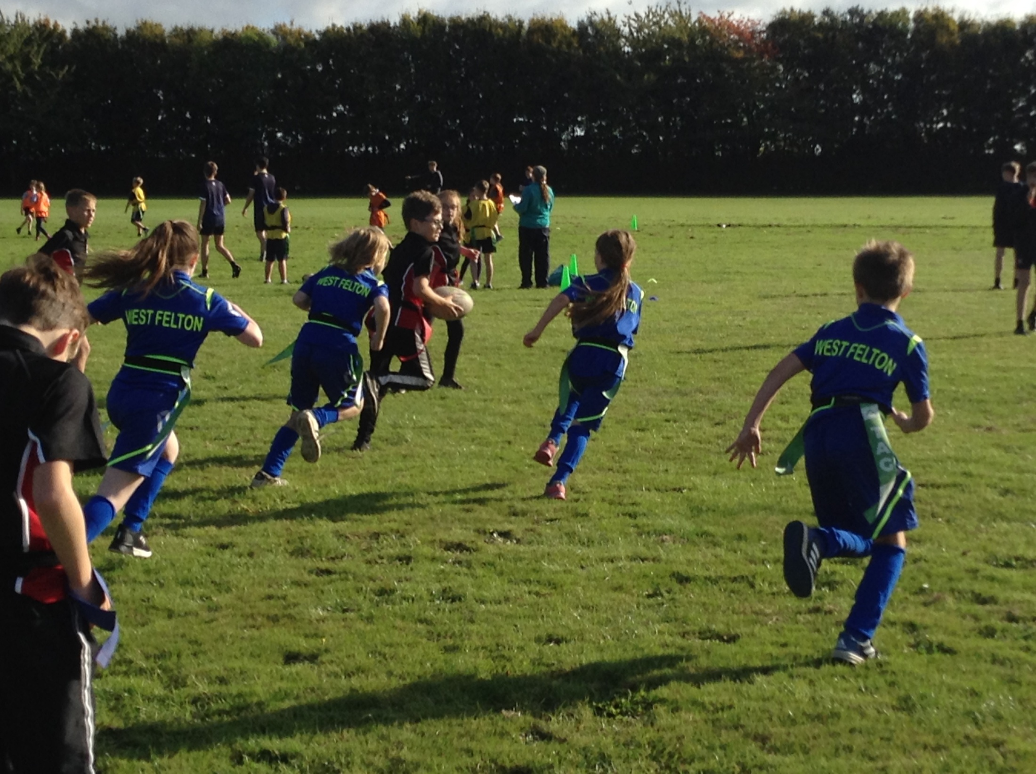
Myddle CE Primary School Sports 2021-2022
KS2 Tag Rugby

Slide 21
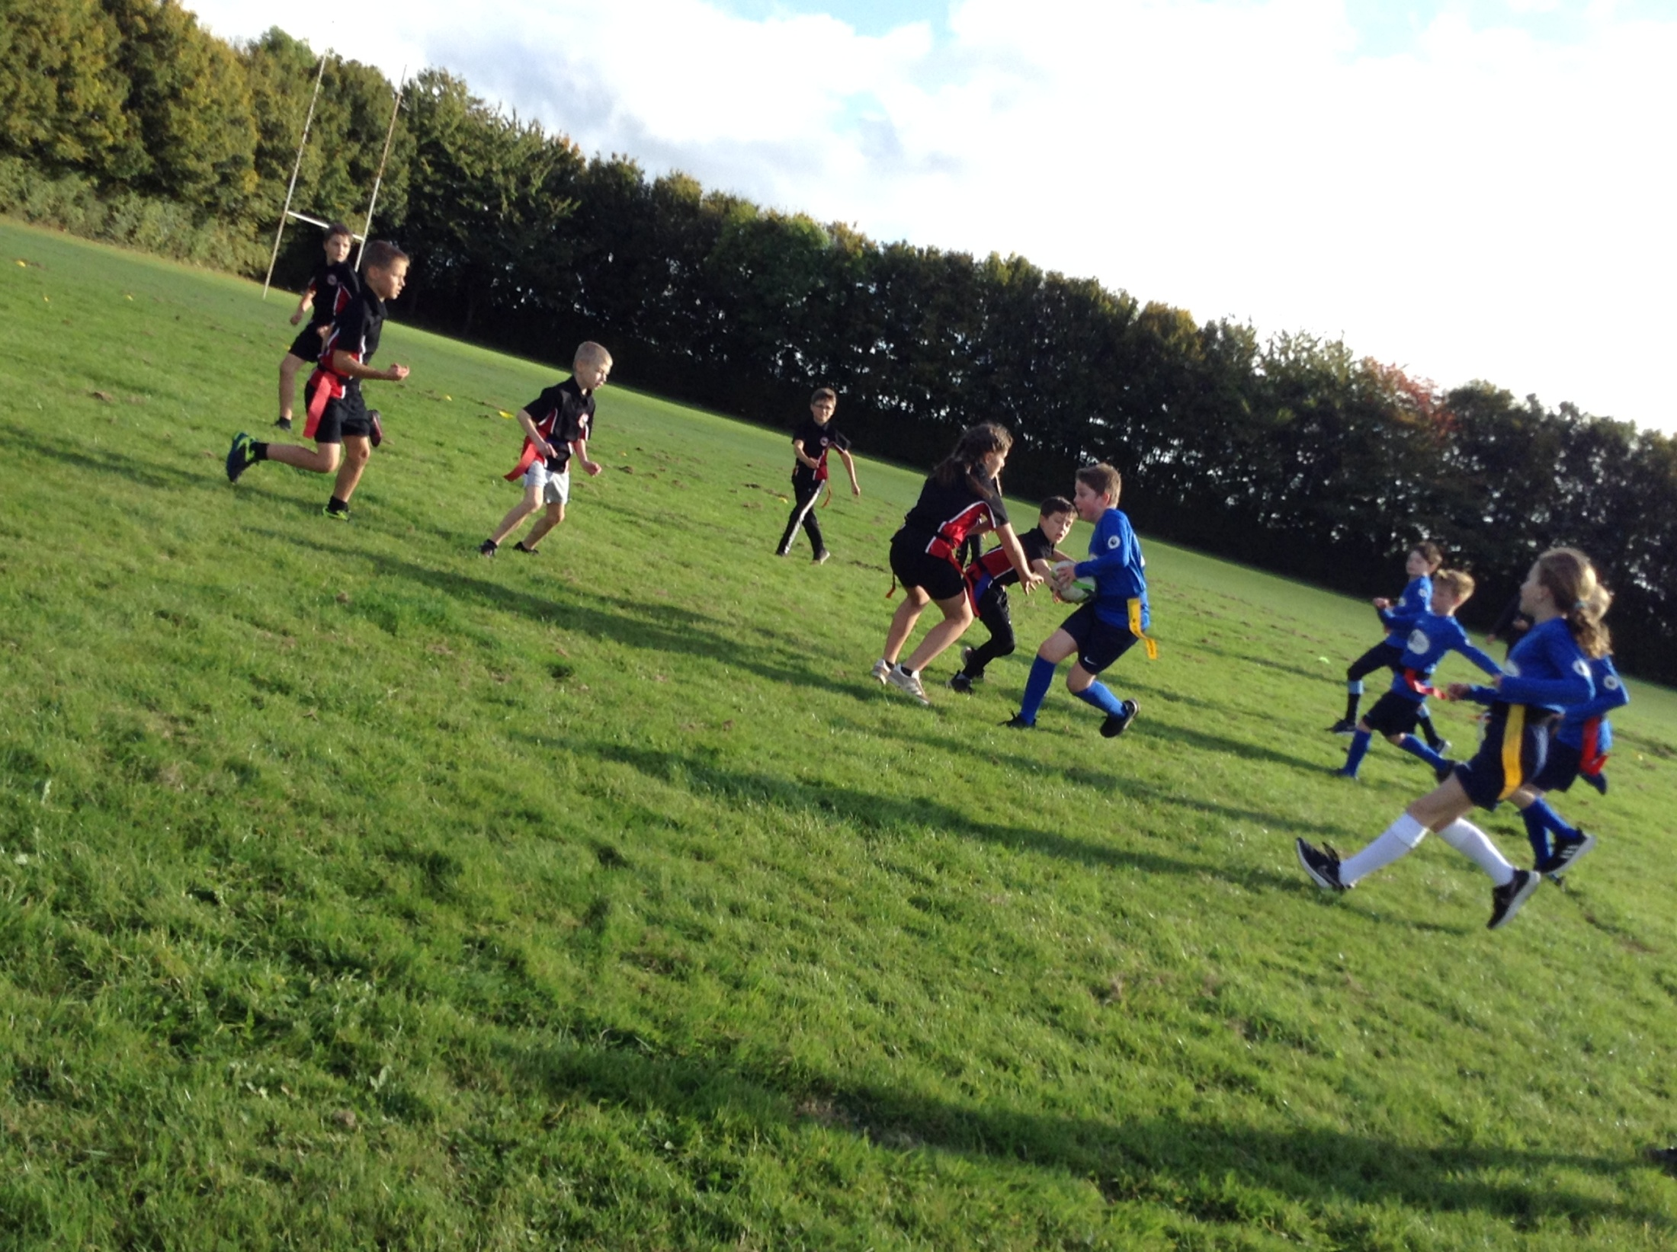
Myddle CE Primary School Sports 2021-2022
KS2 Tag Rugby

Slide 22
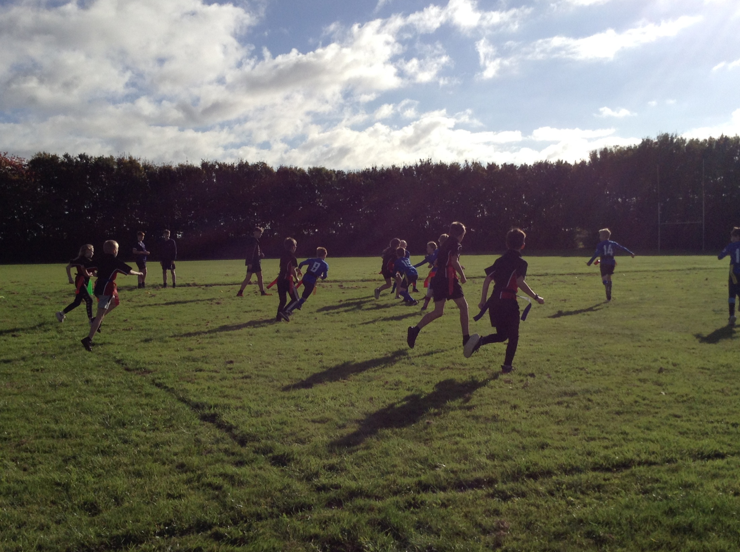
Myddle CE Primary School Sports 2021-2022
KS2 Tag Rugby
KS2 Tag Rugby

Slide 23
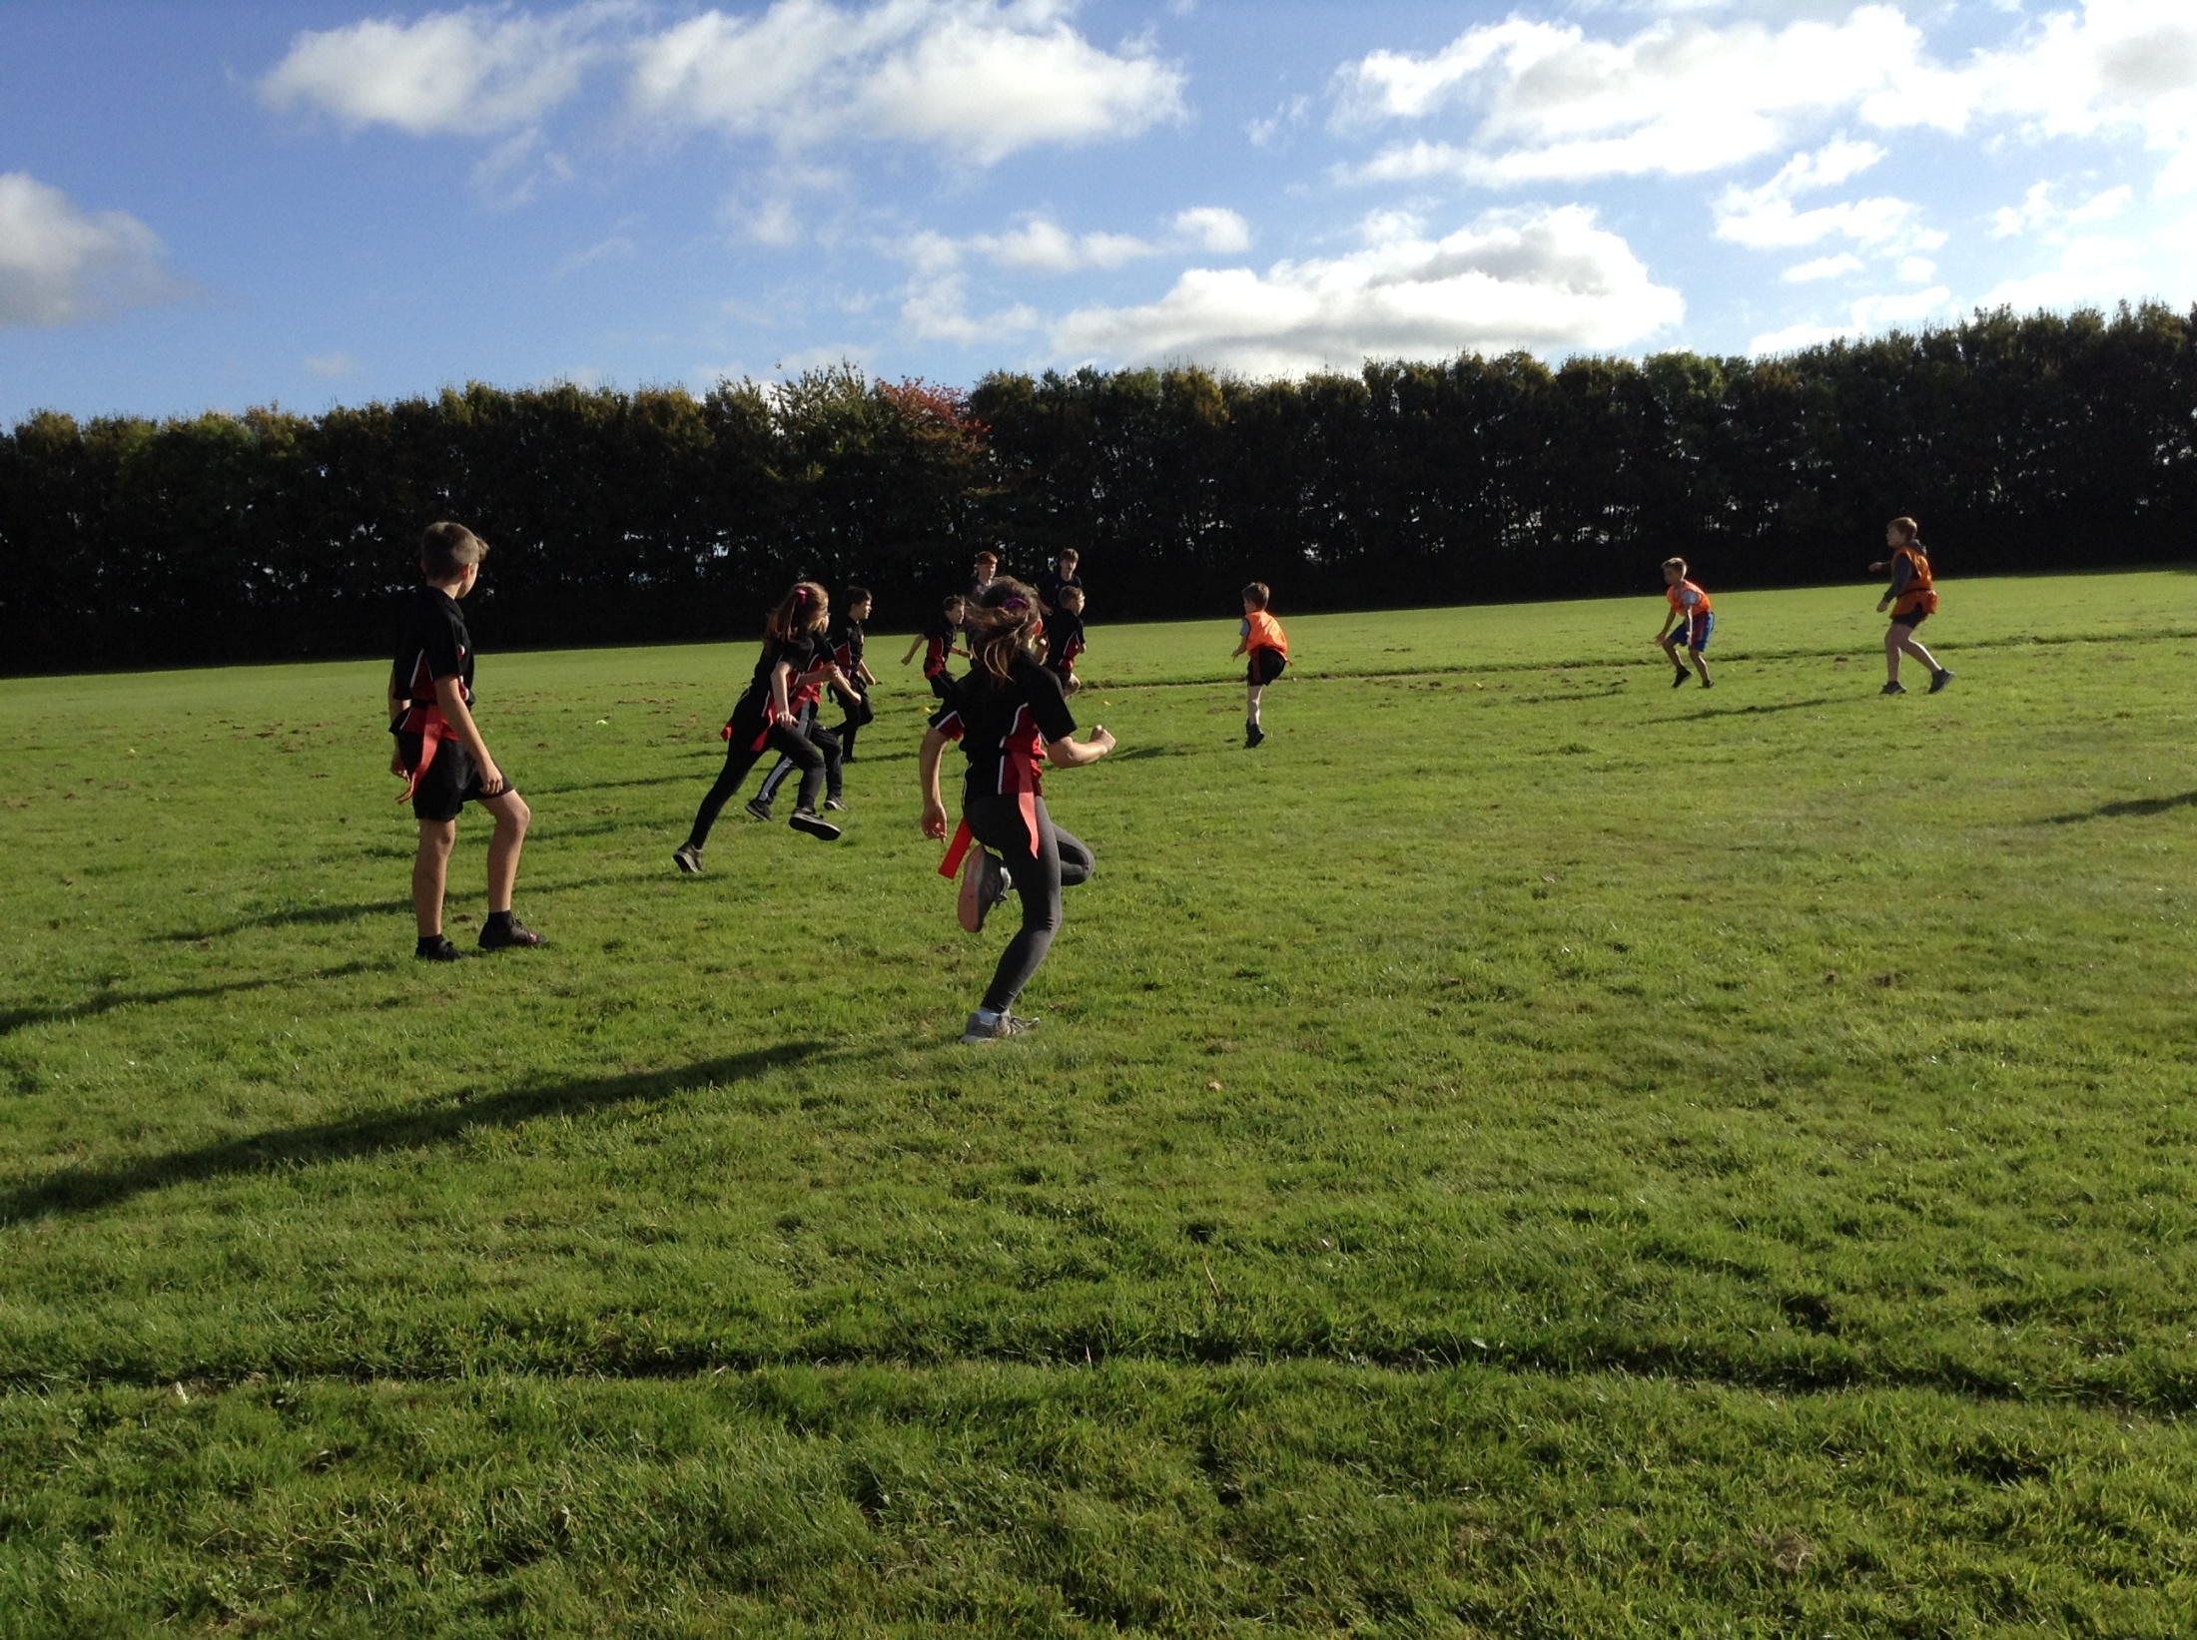
Myddle CE Primary School Sports 2021-2022
KS2 Tag Rugby

Slide 24
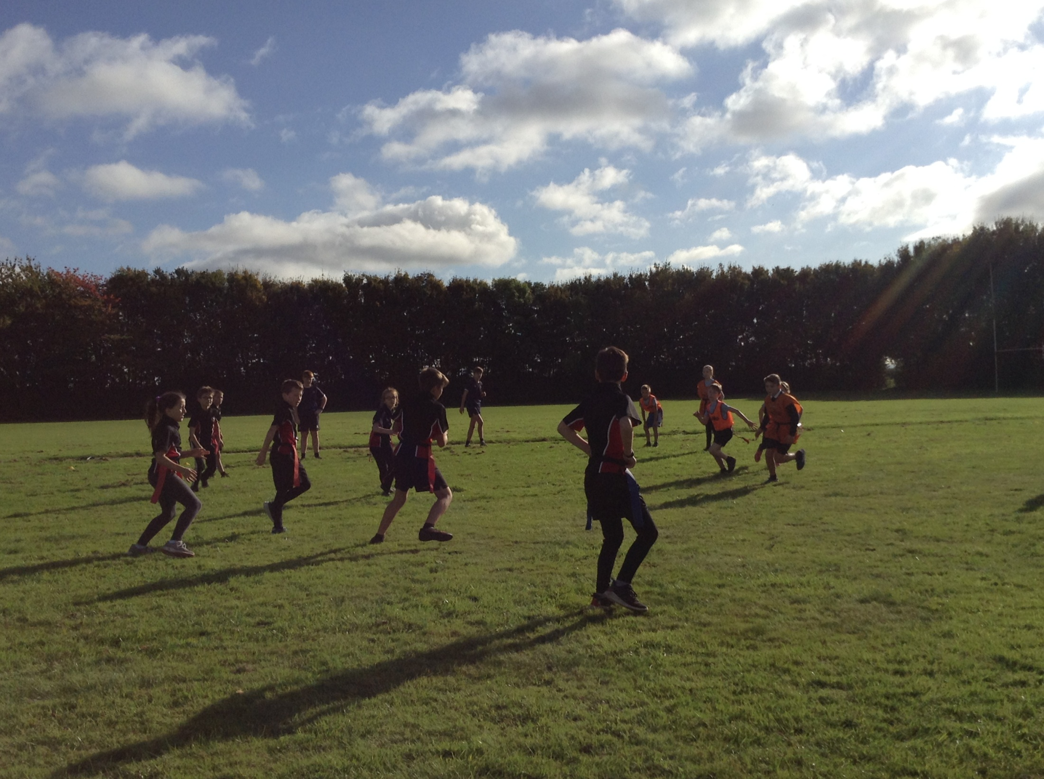
Myddle CE Primary School Sports 2021-2022
KS2 Tag Rugby

Slide 25
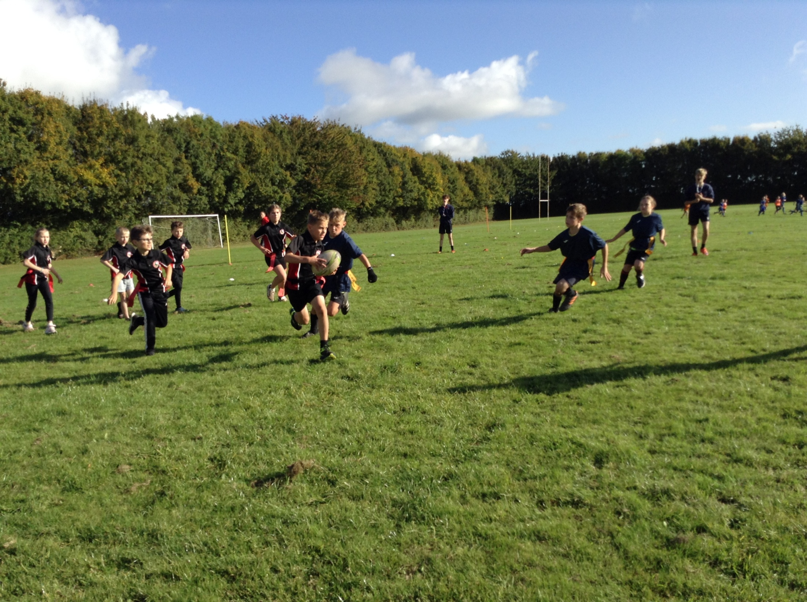
Myddle CE Primary School Sports 2021-2022
KS2 Tag Rugby

Slide 26
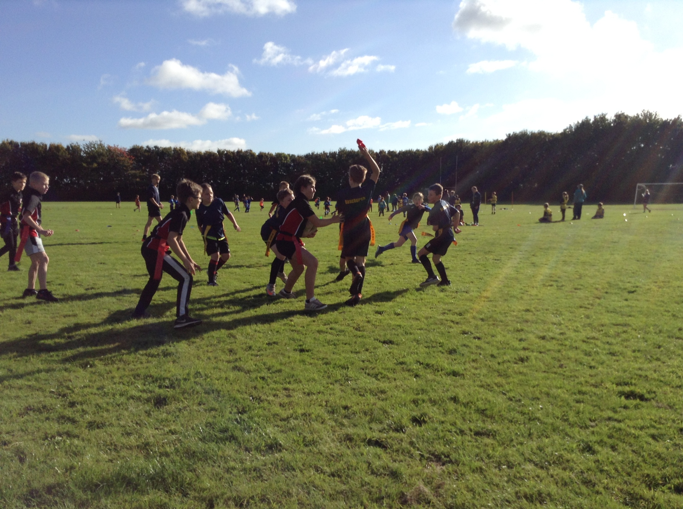
Myddle CE Primary School Sports 2021-2022
KS2 Tag Rugby

Slide 27
House Champion - Hockey
1st – Wrekin 68 points
2nd – Pimhill 67 points
3rd – Grinshill 63 points
3rd – Haughmond 63 points

Slide 28
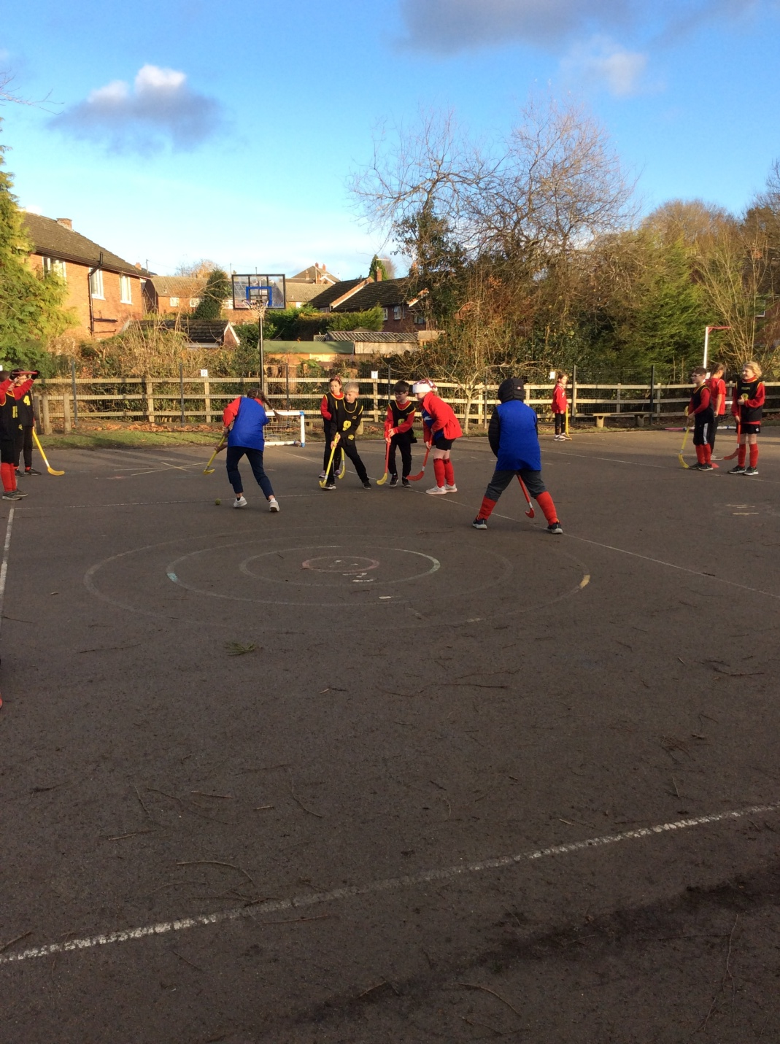
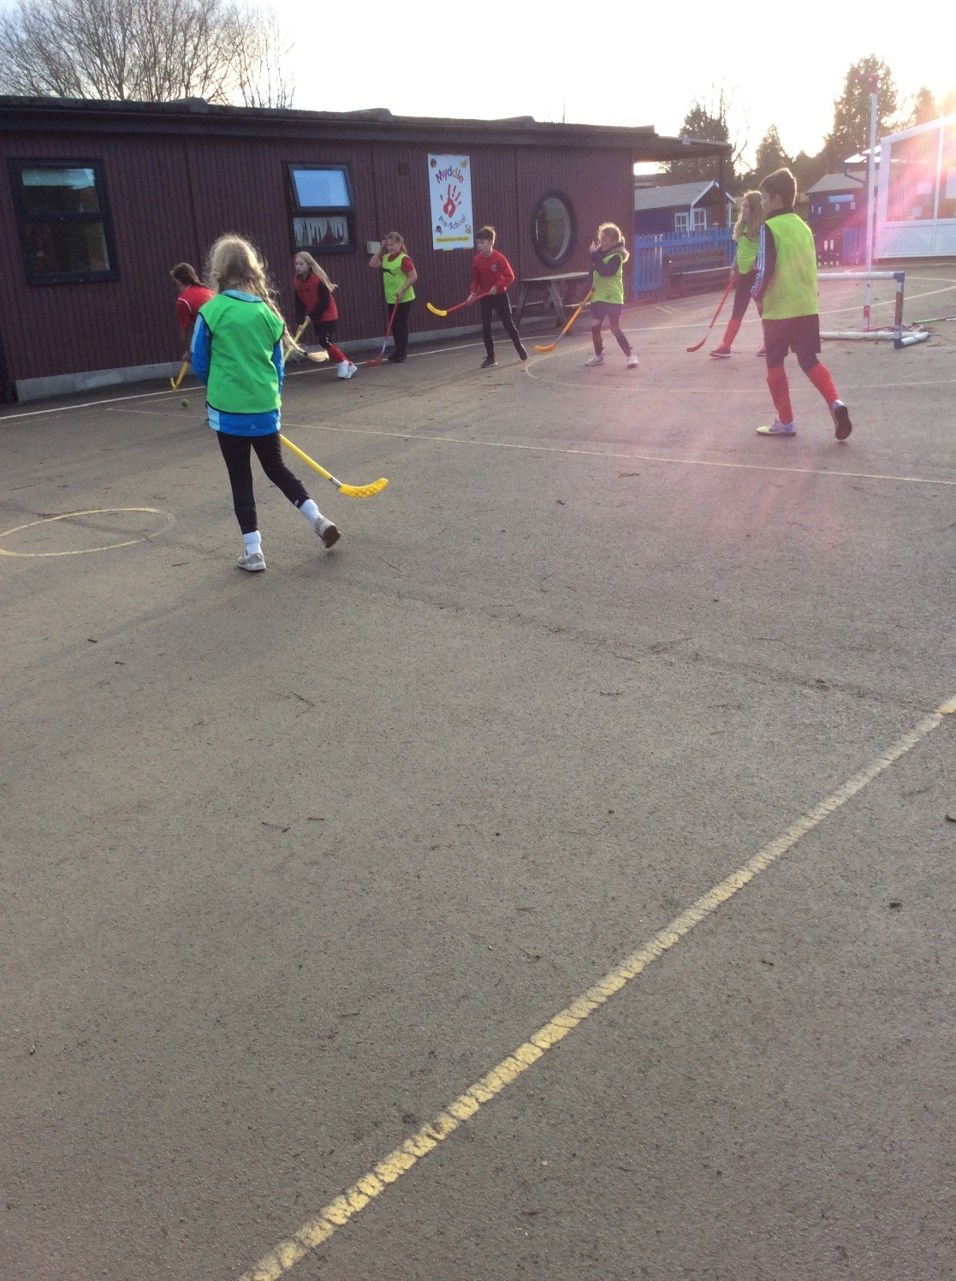
House Champion
1st – Wrekin

Slide 29
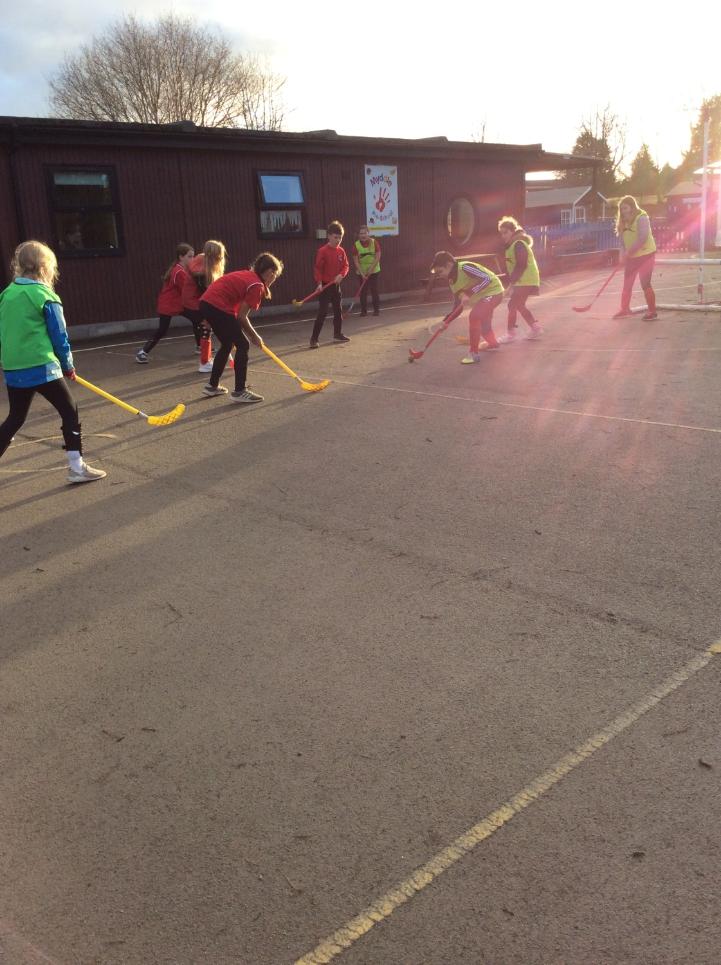
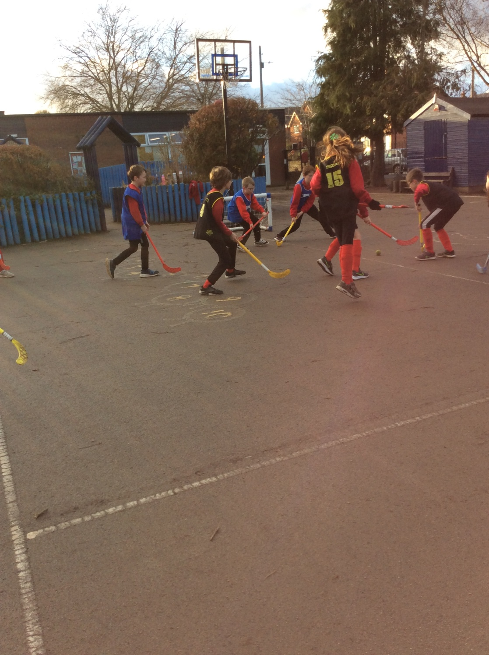
House Champion
1st – Wrekin

Slide 30
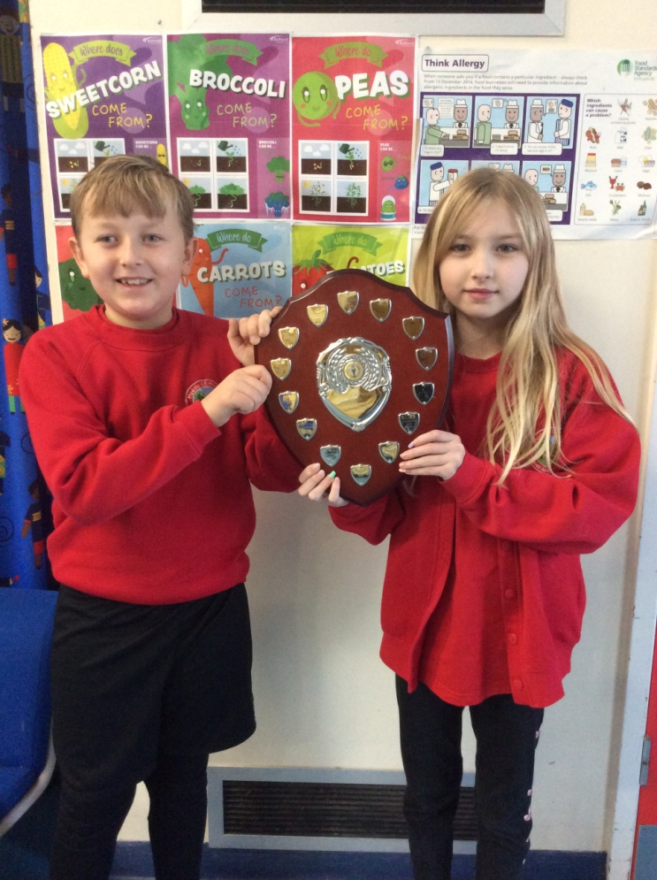
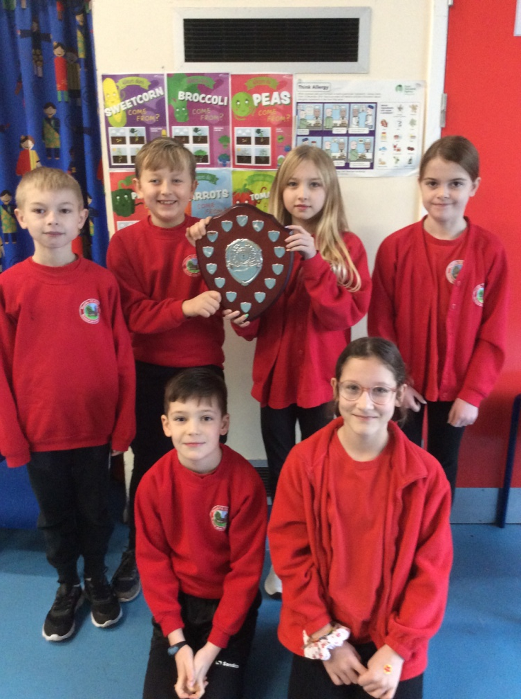
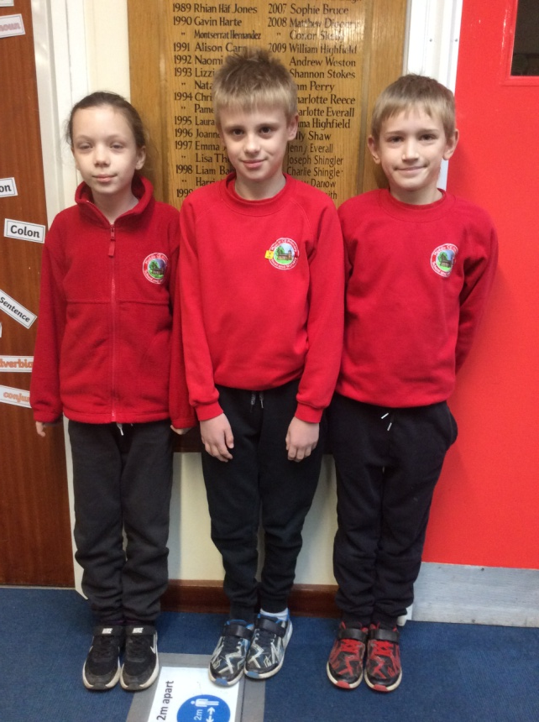
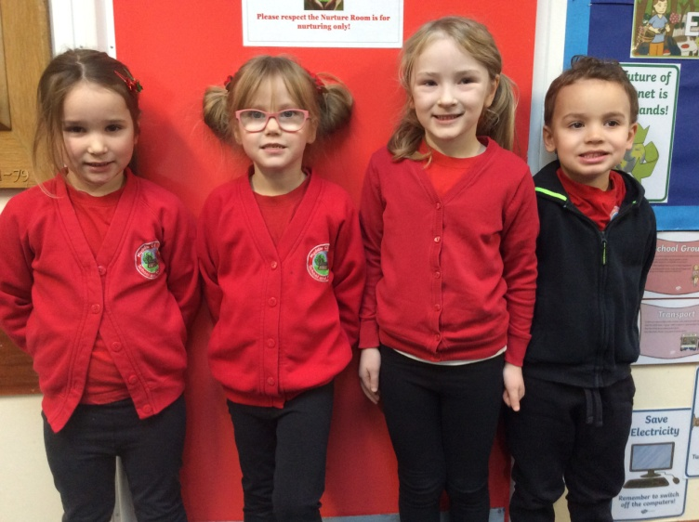
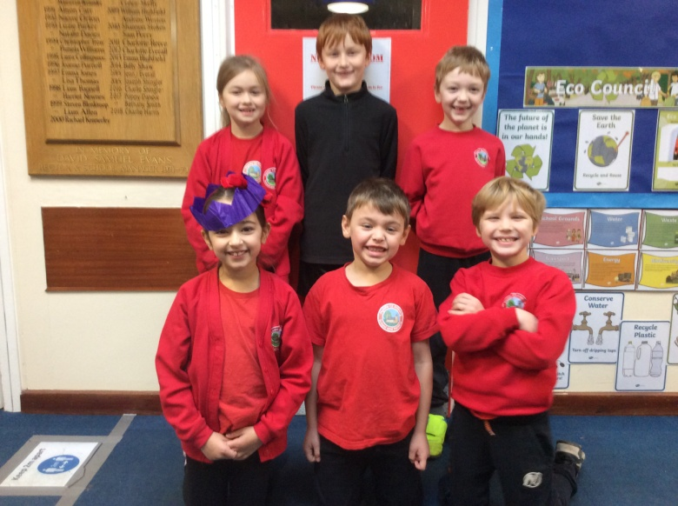
House Champion - Hockey
Wrekin

Slide 31
Myddle CE Primary School Sports Teams 2021-2022

