Slide 1
What I’m learning in Maths today
Maths – Y6 (Measurement) Date: 2.3.21
L.Obj: *I can convert units of metric measurement, understanding x and ÷ by 10, 100 and 1,000 when converting g and kg, ml and l, cm and m.
*I can calculate % of measurements.

Slide 2
1) 52% of 360 =
2) 3/5 x 4 =
3) 7/10 ÷ 5 =
4) 1/8 + 5/16 =
5) 132 x 19 =
6) 20 – 6.5 =
23 ÷ 100 =
720 ÷ 8 = 9) 3 ½ x 8 =

Slide 3
1) 52% of 360 = 187.2
2) 3/5 x 4 = 12/5 or 2 whole and 2/5
3) 7/10 ÷ 5 = 7/50
4) 1/8 + 5/16 = 7/16
5) 132 x 19 = 2,508
6) 20 – 6.5 = 13.5
23 ÷ 100 = 0.23
720 ÷ 8 = 90 9) 3 ½ x 8 = 28

Slide 4
Introduction
Match the item to the most appropriate unit of measurement.
Weight of a sack of potatoes |  | L
Volume of water in a glass |  | mm
Length of a park |  | cm
Length of a finger |  | m
Weight of an apple |  | ml
Volume of water in a bucket |  | g
Length of an ant’s leg |  | kg
© Classroom Secrets Limited 2019

Slide 5
Introduction
Match the item to the most appropriate unit of measurement.
Weight of a sack of potatoes |  | kg
Volume of water in a glass |  | ml
Length of a park |  | m
Length of a finger |  | cm
Weight of an apple |  | g
Volume of water in a bucket |  | L
Length of an ant’s leg |  | mm
© Classroom Secrets Limited 2019

Slide 6
Varied Fluency 1
True or false?
20% of 3,500ml is larger than 0.8L.
© Classroom Secrets Limited 2019

Slide 7
Varied Fluency 1
True or false?
False, 20% of 3,500ml is 700ml.
700ml is smaller than 800ml.
20% of 3,500ml is larger than 0.8L.
© Classroom Secrets Limited 2019

Slide 8
Varied Fluency 2
Put these measurements in order from smallest to largest.
155cm
2.6m
0.6m
1,050mm
155mm
165cm
© Classroom Secrets Limited 2019

Slide 9
Varied Fluency 2
Put these measurements in order from smallest to largest.
155mm; 0.6m; 1,050mm; 155cm; 165cm; 2.6m
155cm
2.6m
0.6m
1,050mm
155mm
165cm
© Classroom Secrets Limited 2019

Slide 10
Varied Fluency 3
Complete the missing operation and measurement to convert between g and kg.
285g |  | = |  | kg
© Classroom Secrets Limited 2019

Slide 11
Varied Fluency 3
Complete the missing operation and measurement to convert between g and kg.
285g | ÷ 1,000 | = | 0.285 | kg
© Classroom Secrets Limited 2019

Slide 12
Varied Fluency 4
Find and correct the errors in these conversions:
a. | 1,565g | = | 1.565kg
b. | 2.35L | = | 235ml
c. | 15cm | = | 150mm
d. | 1,500mm | = | 1.05m
© Classroom Secrets Limited 2019

Slide 13
Varied Fluency 4
Find and correct the errors in these conversions:
a. | 1,565g | = | 1.565kg
b. | 2.35L | = | 2,350ml
c. | 15cm | = | 150mm
d. | 1,500mm | = | 1.5m
© Classroom Secrets Limited 2019

Slide 14
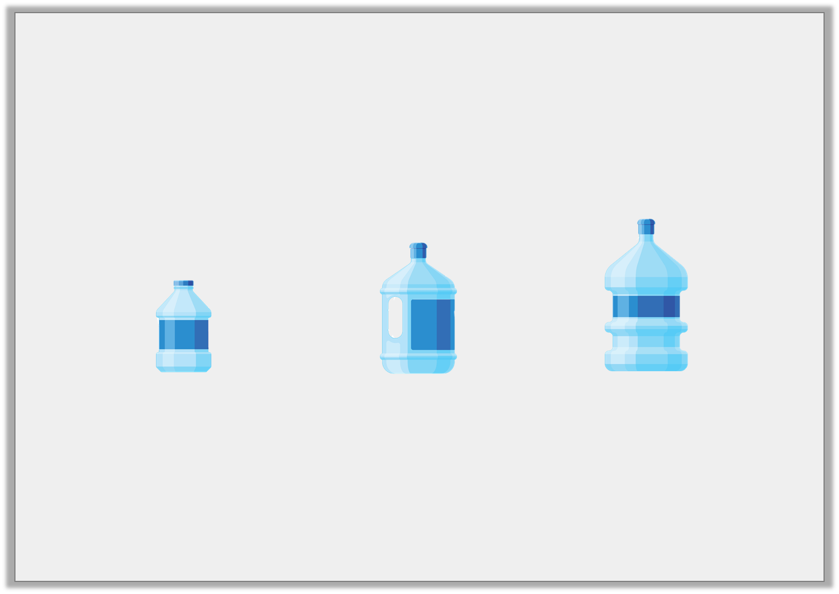
Problem Solving 1
A garden pond has a maximum water allowance of 24.865L
Josie uses 6 bottles in total and fills her pond to capacity. How many of each size did she use?
Small 2.485L |  | Medium 4,625ml |  | Large 6,020ml
© Classroom Secrets Limited 2019

Slide 15
Problem Solving 1
A garden pond has a maximum water allowance of 24.865L
Josie uses 6 bottles in total and fills her pond to capacity. How many of each size did she use?
2x Small; 3x Medium; 1x Large
Small 2.485L |  | Medium 4,625ml |  | Large 6,020ml
© Classroom Secrets Limited 2019

