Slide 1
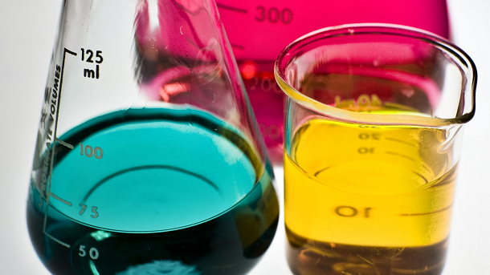
What I’m learning in Science today
Date: Wednesday 3rd March 2021 (Formulations)
L.Obj: *I can explain the meaning of a ‘formulation’.
*I can investigate, using squash, to show how different formulations provide different results.
https://classroom.thenational.academy/lessons/what-is-a-formulation-74r32t?step=2&activity=video

