Slide 1
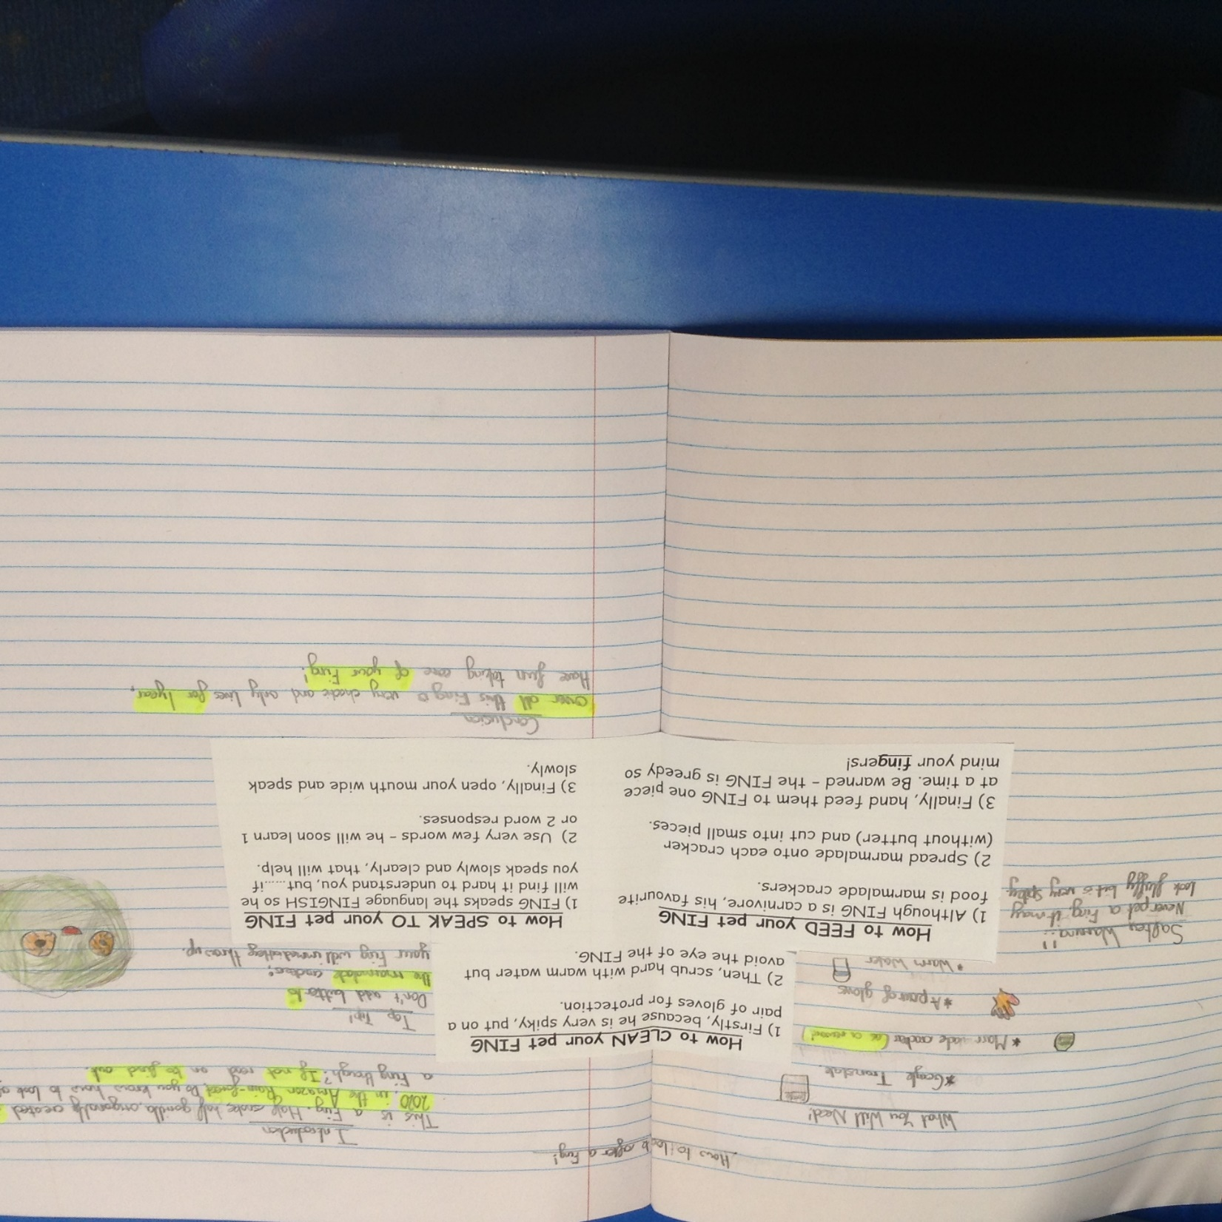
The children in class have been completing the instruction text based on ‘How to care for a Fing’.

Slide 2
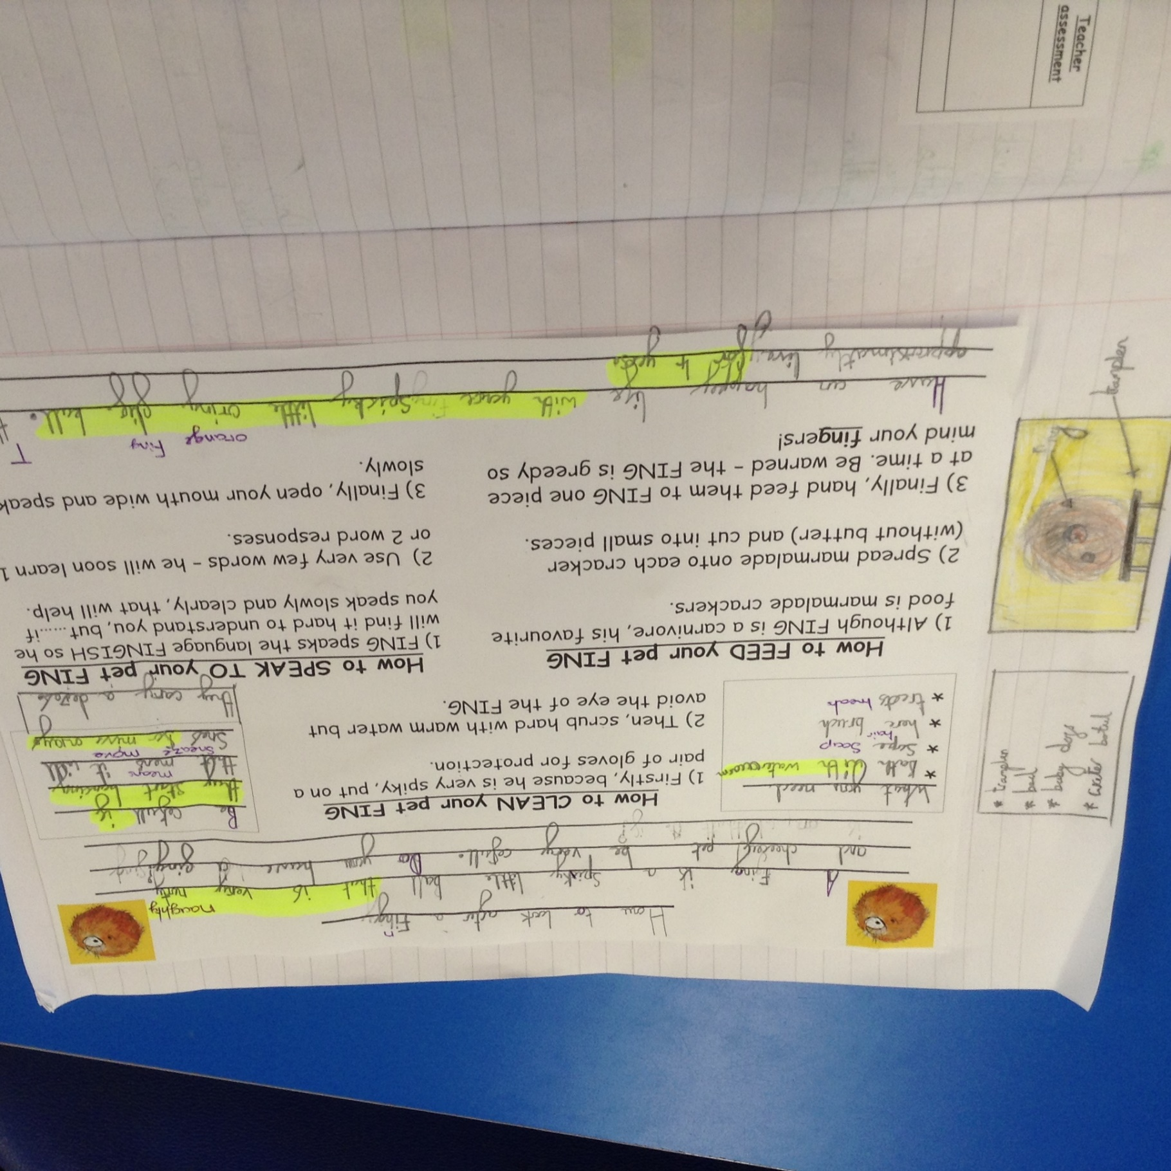
The children in class have been completing the instruction text based on ‘How to care for a Fing’.

Slide 3
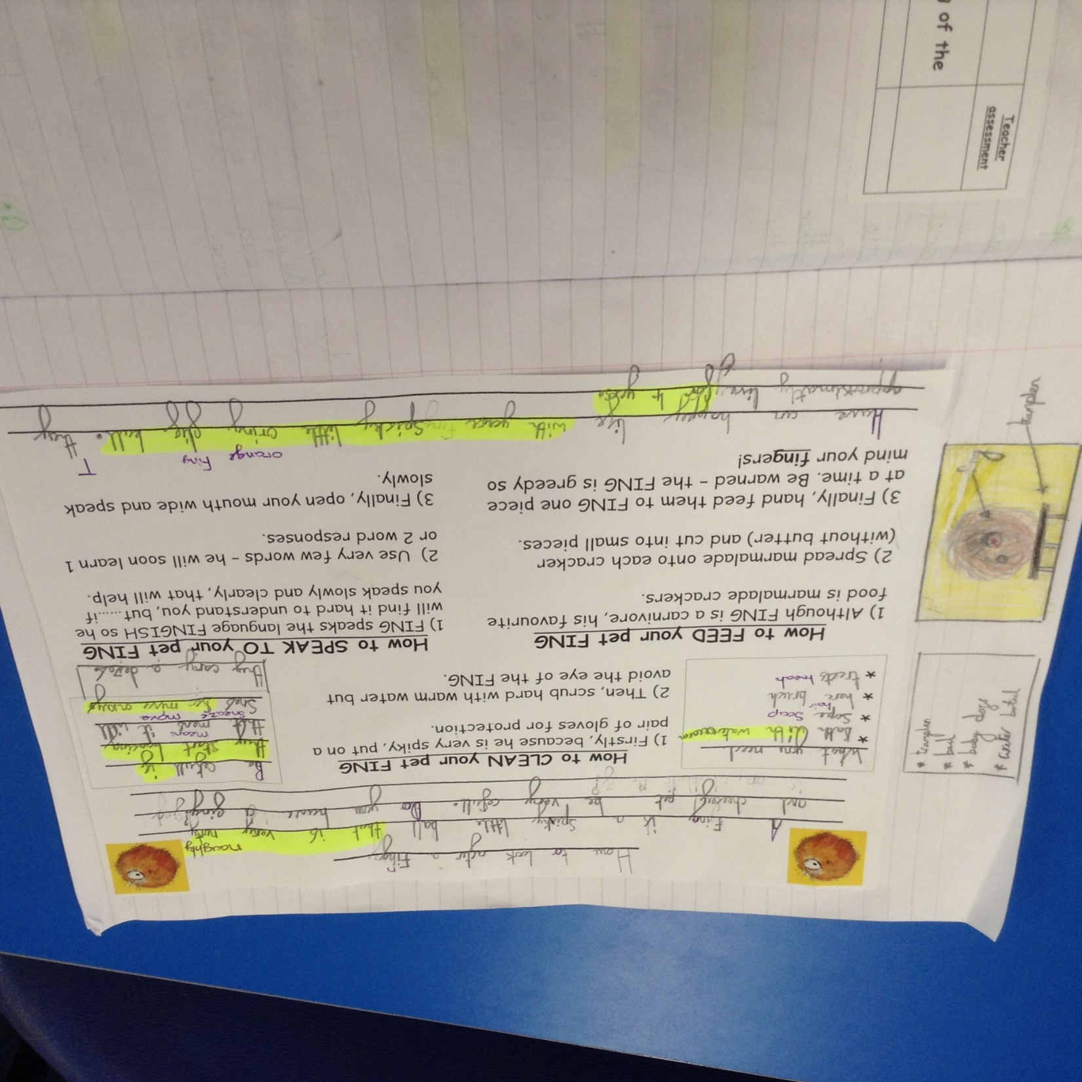
The children in class have been completing the instruction text based on ‘How to care for a Fing’.

Slide 4
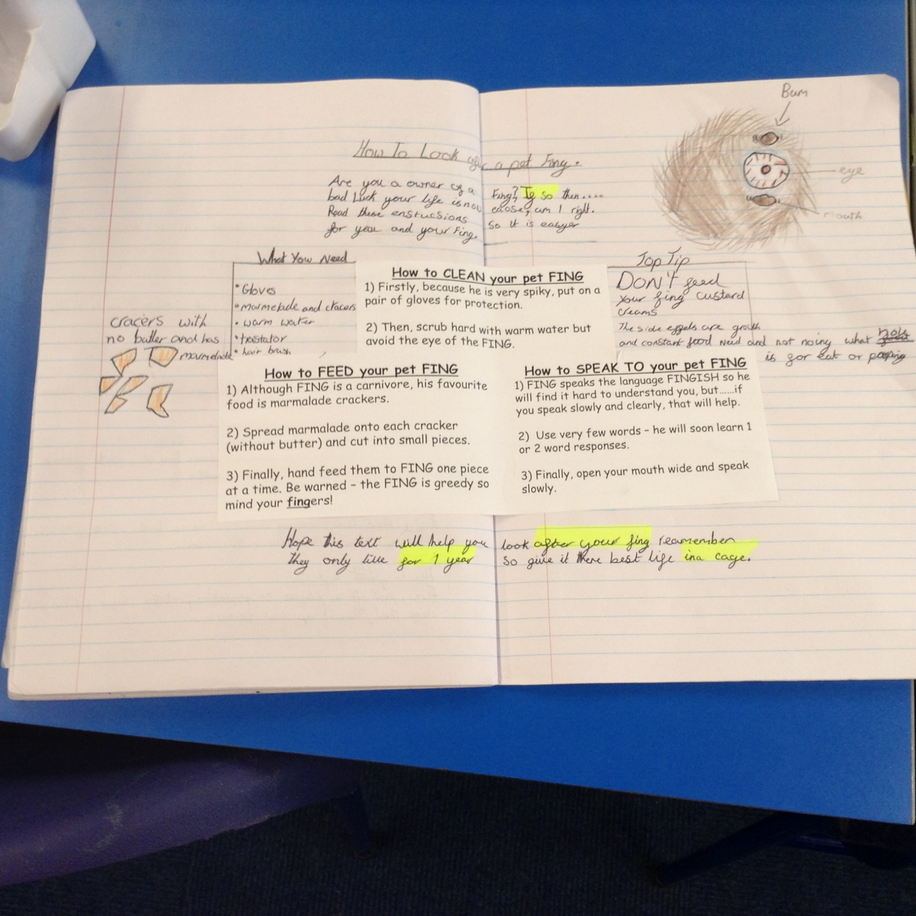
The children in class have been completing the instruction text based on ‘How to care for a Fing’.

Slide 5
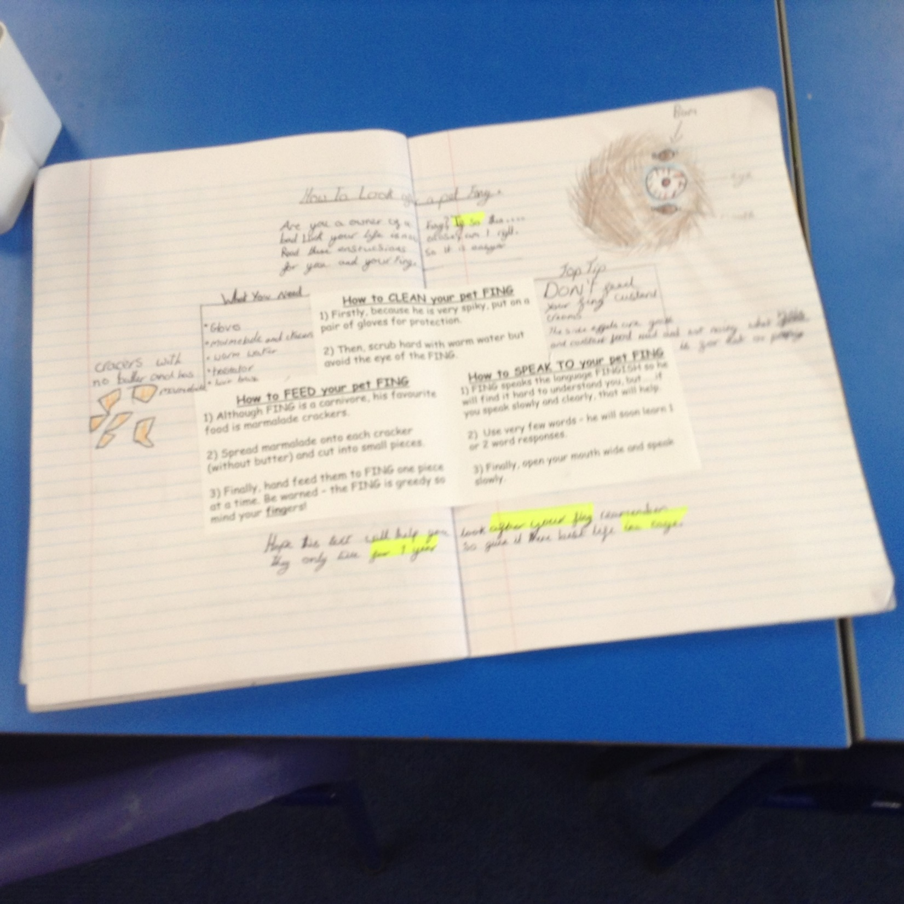
The children in class have been completing the instruction text based on ‘How to care for a Fing’.

Slide 6
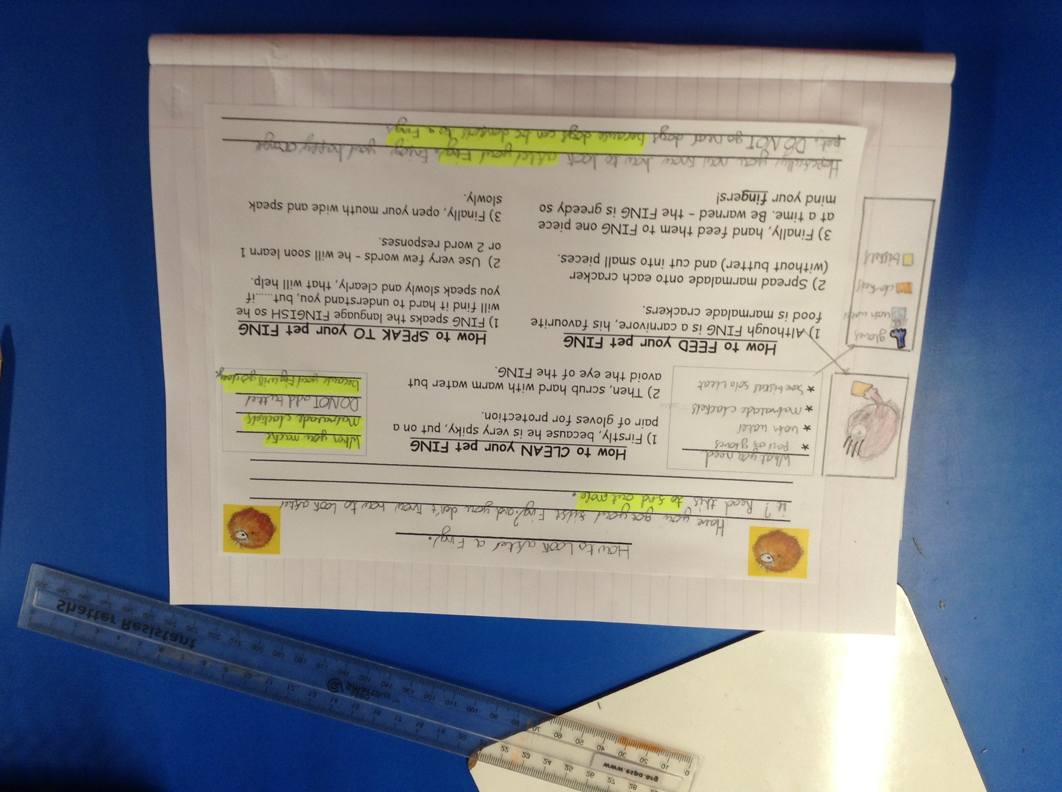
The children in class have been completing the instruction text based on ‘How to care for a Fing’.

Slide 7
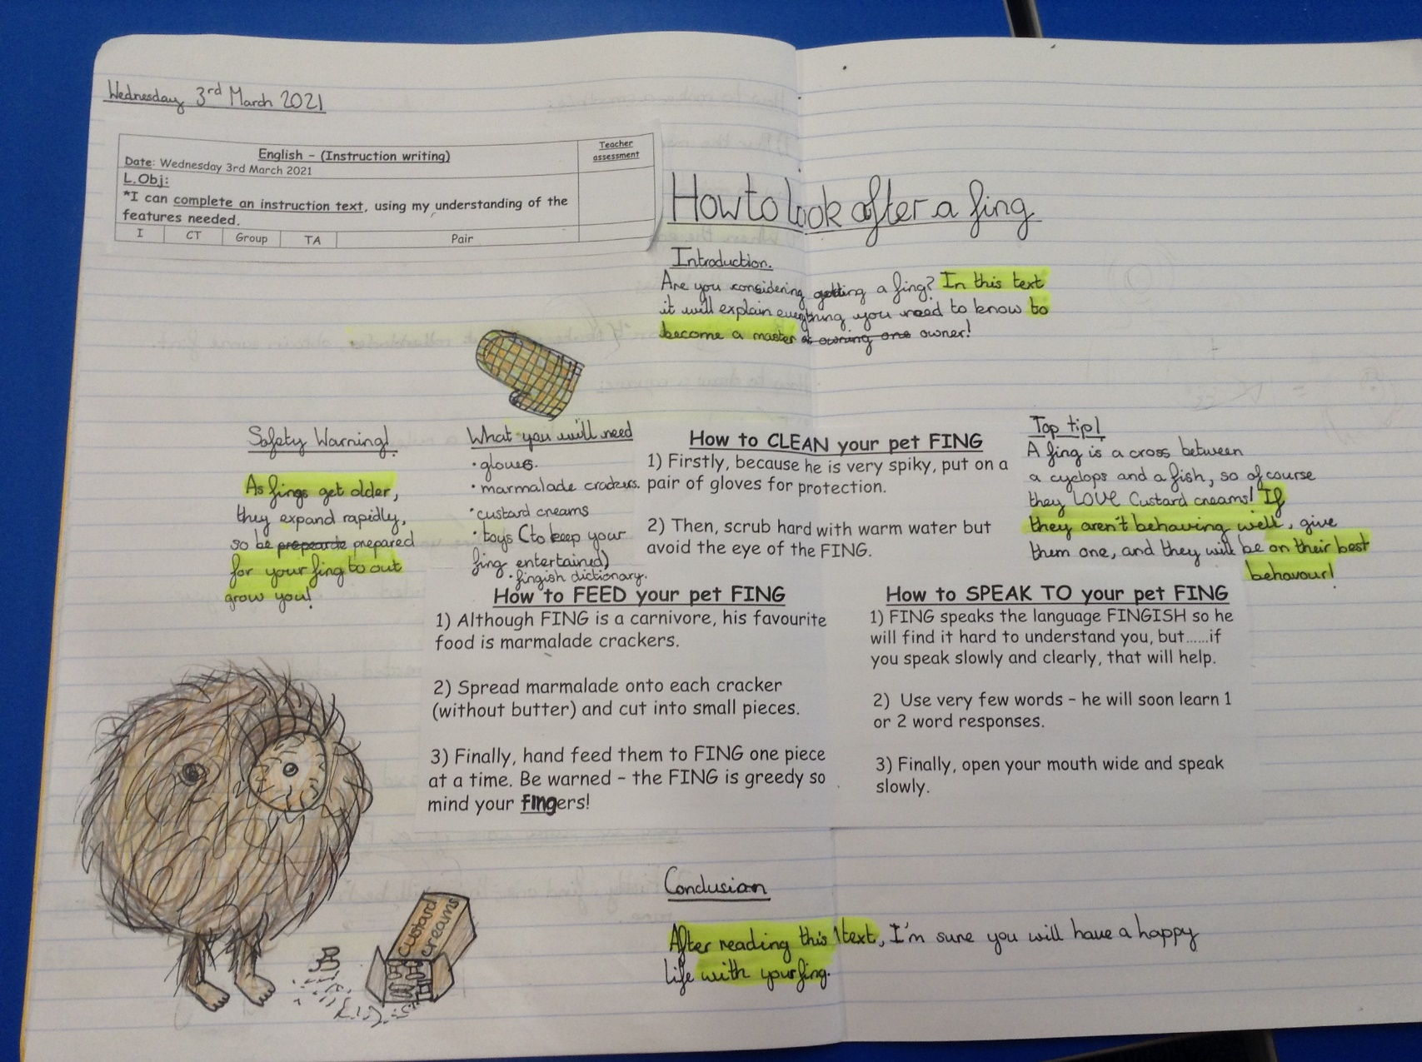
The children in class have been completing the instruction text based on ‘How to care for a Fing’.

Slide 8
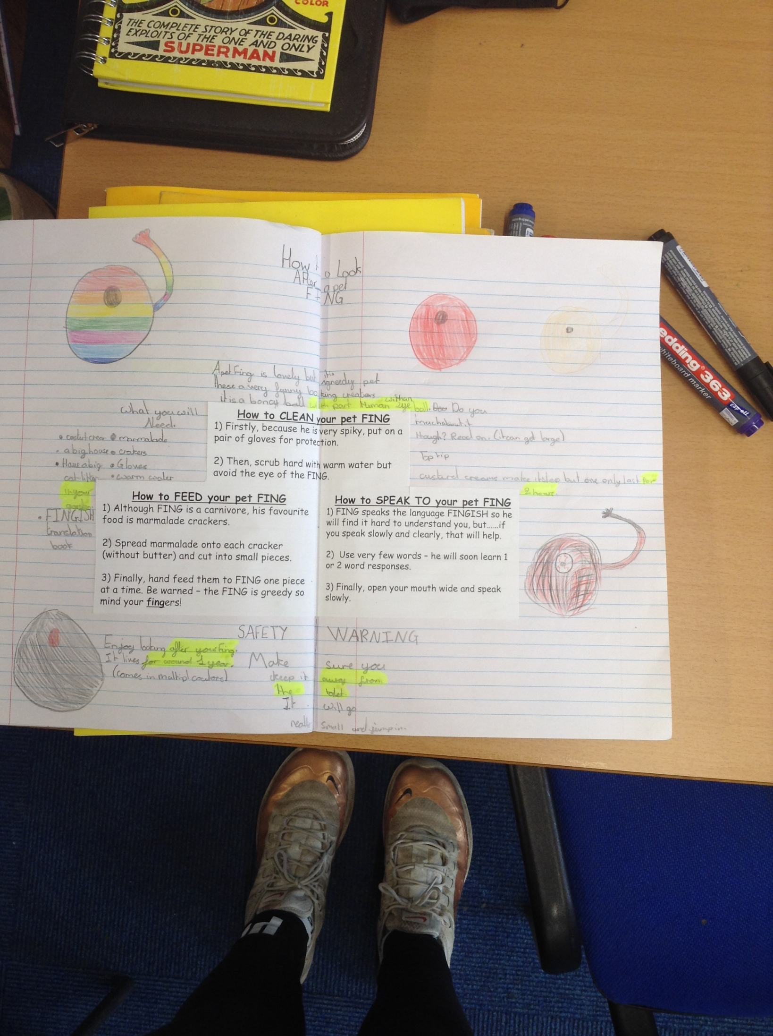
The children in class have been completing the instruction text based on ‘How to care for a Fing’.

Slide 9
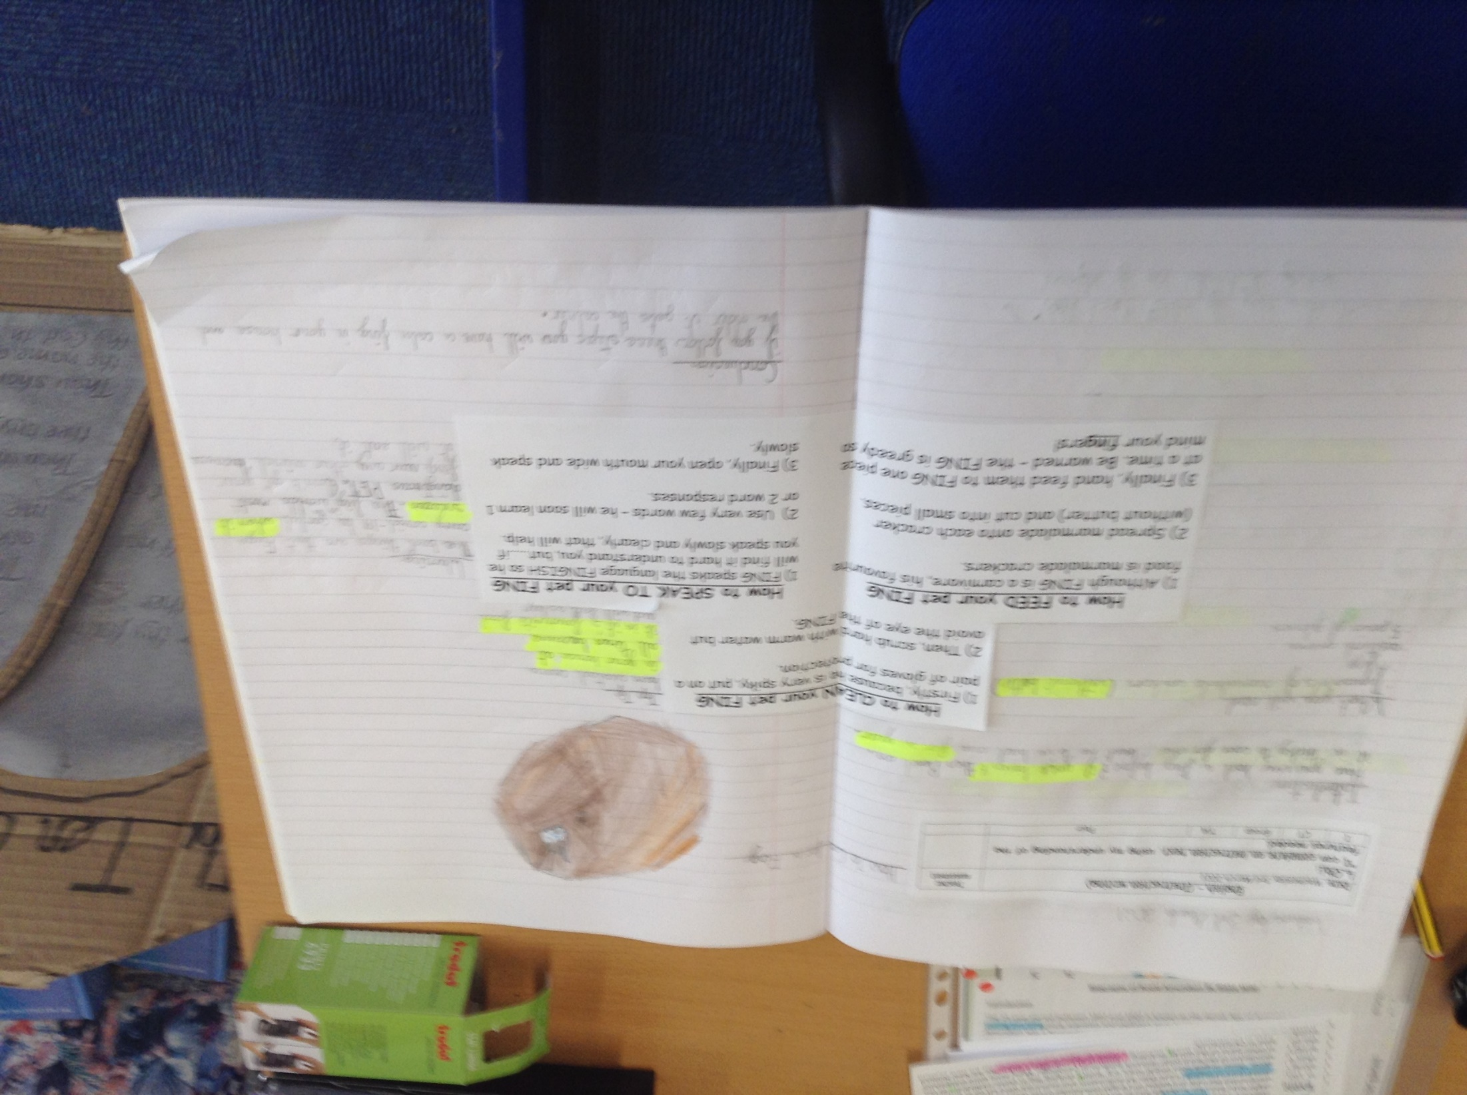
The children in class have been completing the instruction text based on ‘How to care for a Fing’.

Slide 10
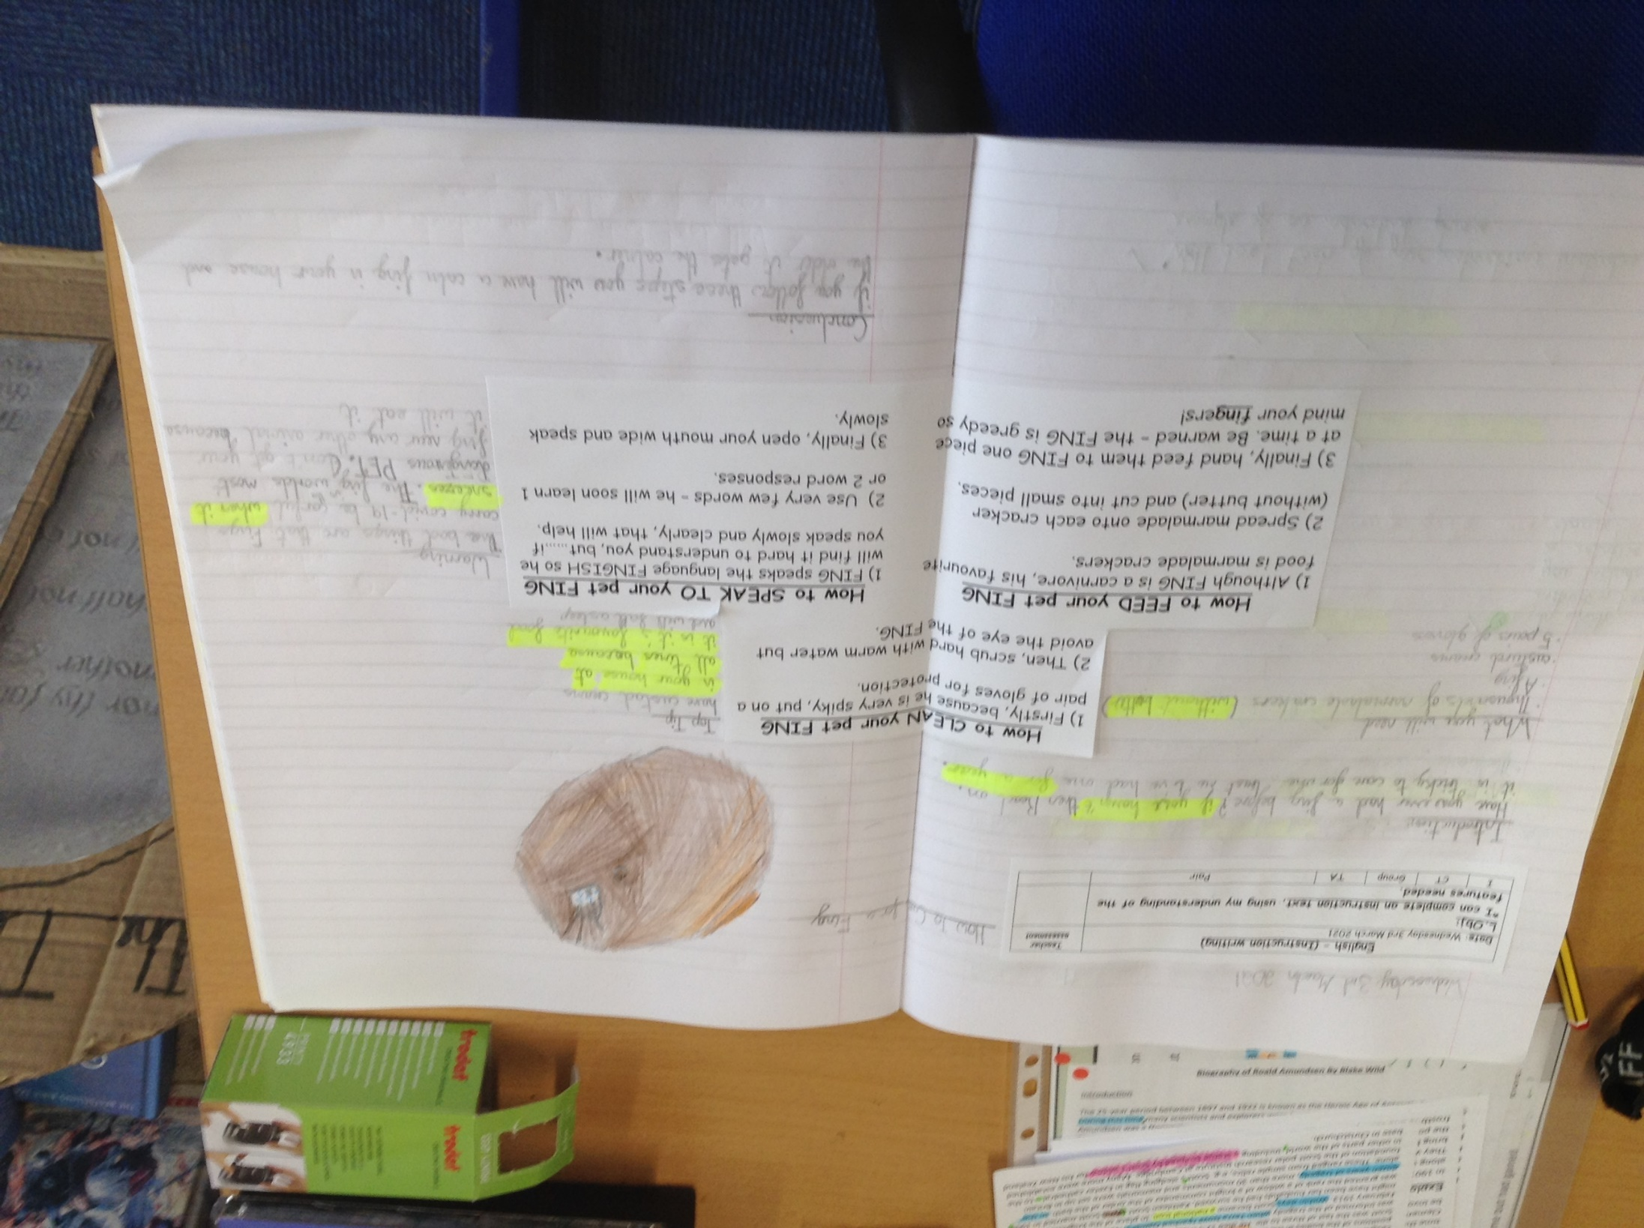
The children in class have been completing the instruction text based on ‘How to care for a Fing’.

Slide 11
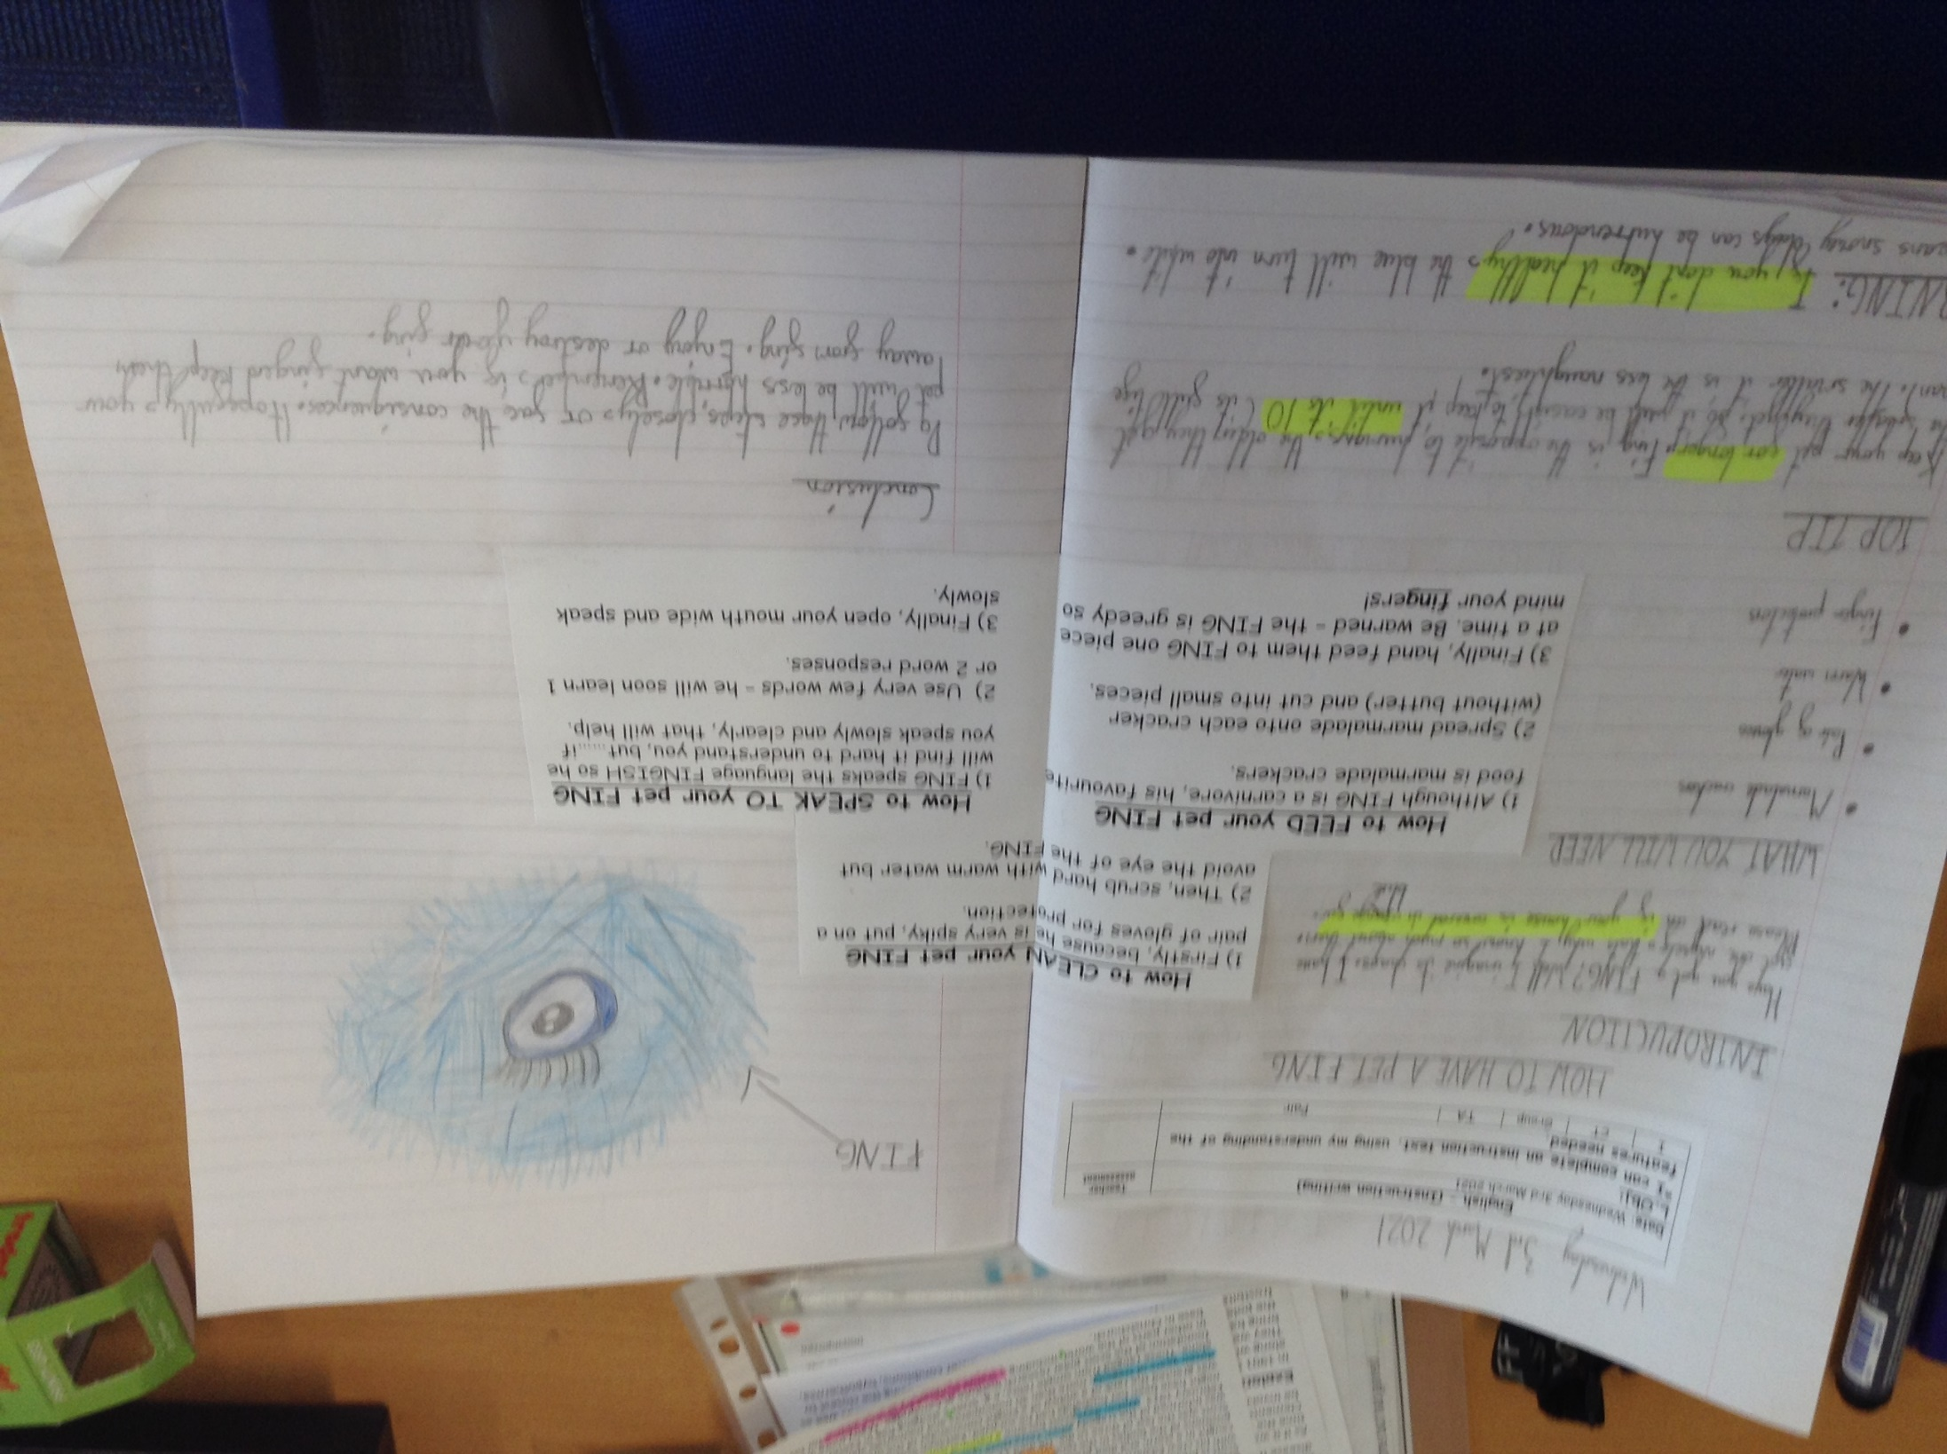
The children in class have been completing the instruction text based on ‘How to care for a Fing’.

Slide 12
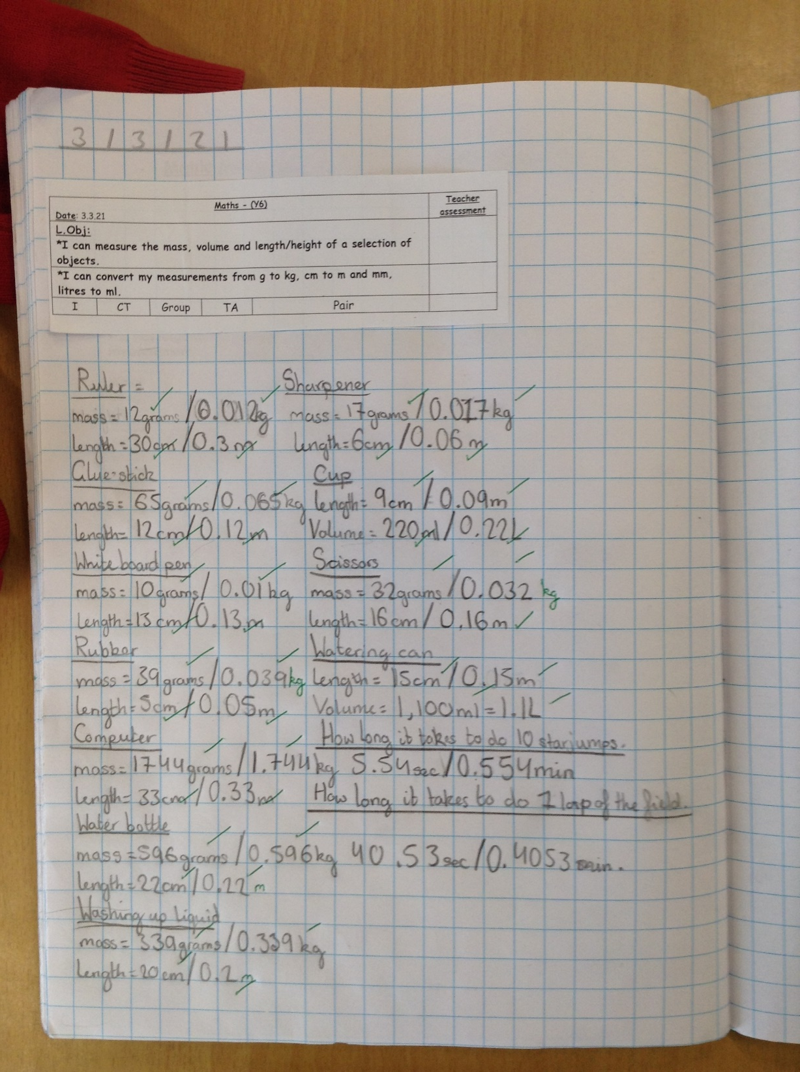
The Y6s have been practical in their maths today, measuring different objects / events using different pieces of measuring equipment.

Slide 13
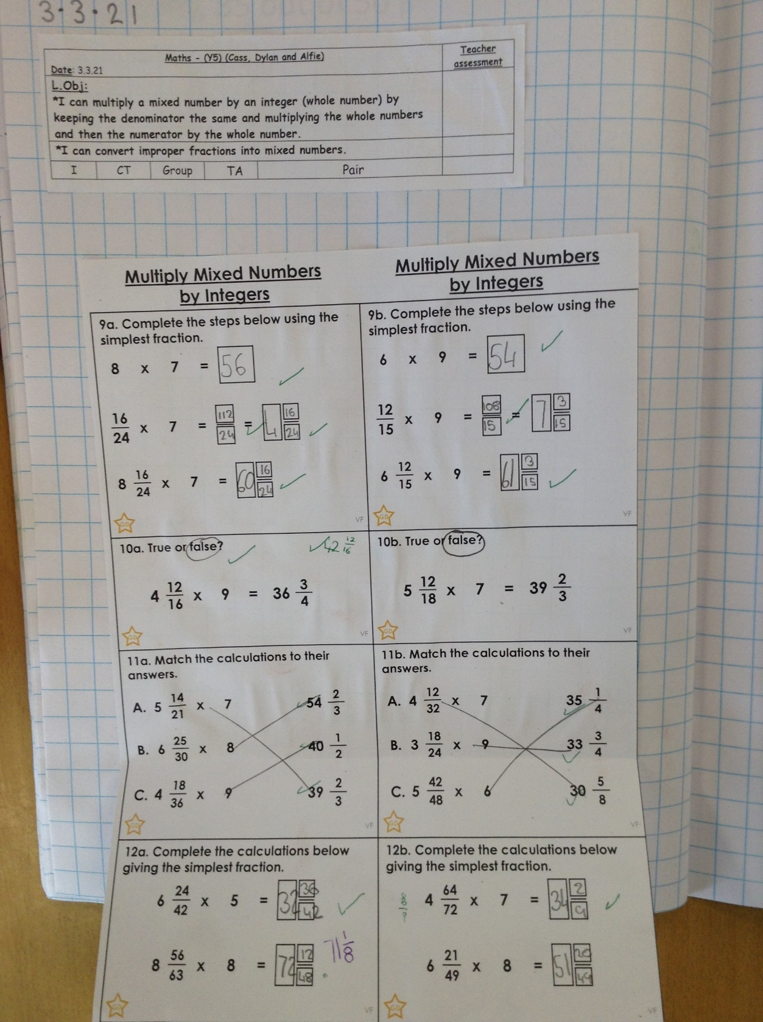
Cass has been multiplying mixed numbers by whole numbers.

Slide 14
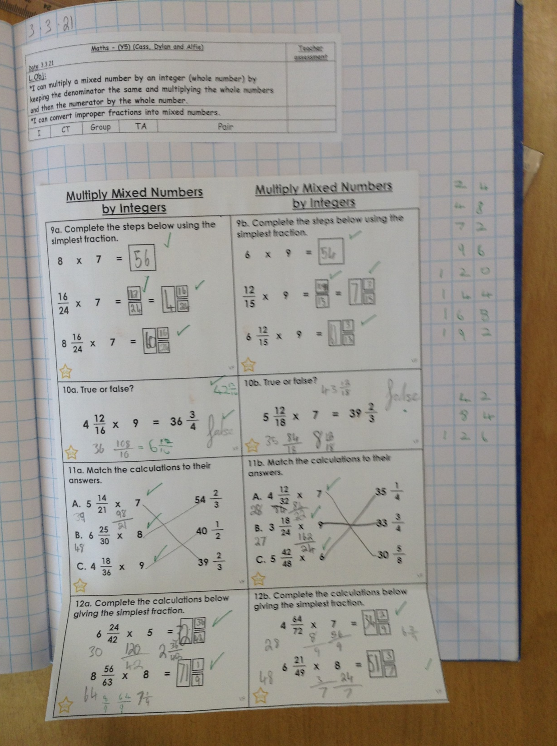
Alfie has been multiplying mixed numbers by whole numbers.

Slide 15
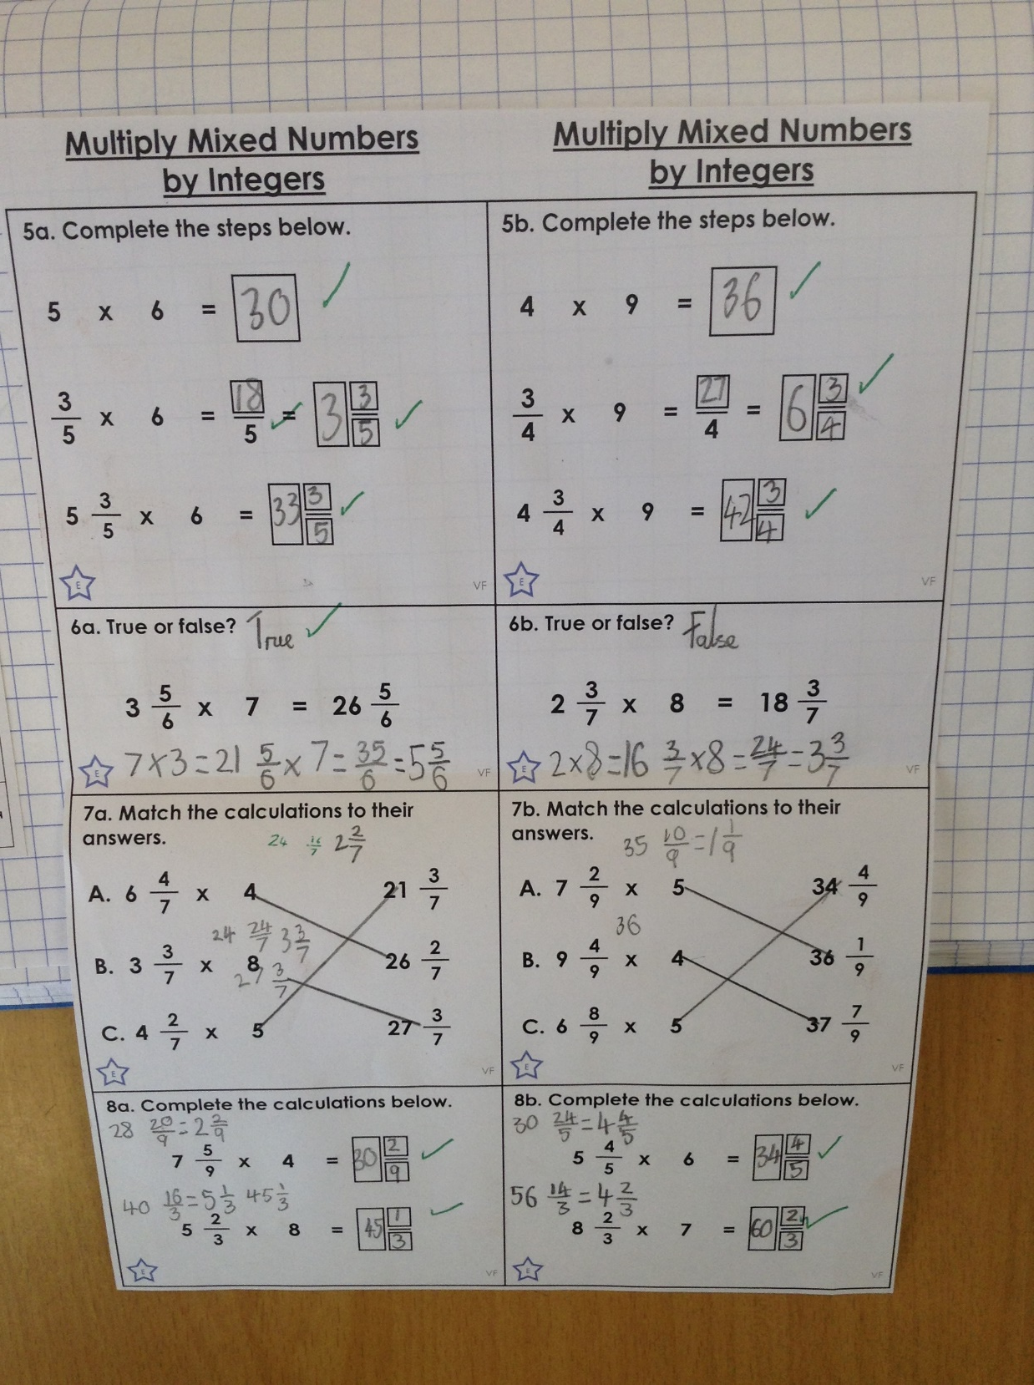
Ariana has been multiplying mixed numbers by whole numbers.
Esme’s comprehension from today.

Slide 16
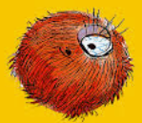
How to look after a pet Fing
Cameron
Have you had trouble looking after you're furry Fing? Fear
no more, follow these instructions and in no time you will know all of the secrets to looking after you're furry friend.
You will need
Marmalade crackers
Gloves
Warm water
Knife
How to CLEAN your pet FING
1) Firstly, because he is very spiky, put on a pair of gloves for protection.
2) Then, scrub hard with warm water but avoid the eye of the FING.
Warning
A Fing is known to eat humans so act responsibly around this creature.
How to FEED your pet FING
1) Although FING is a carnivore, his favourite food is marmalade crackers.
2) Spread marmalade onto each cracker (without butter) and cut into small pieces.
3) Finally, hand feed them to FING one piece at a time. Be warned – the FING is greedy so mind your fingers!
How to SPEAK TO your pet FING
1) FING speaks the language FINGISH so he will find it hard to understand you, but……if you speak slowly and clearly, that will help.
2) Use very few words – he will soon learn 1 or 2 word responses.
3) Finally, open your mouth wide and speak slowly.
Now you have learnt how to look after your Fing try giving it a name, teach it
tricks or give it a haircut. © Cameron 2021

Slide 17
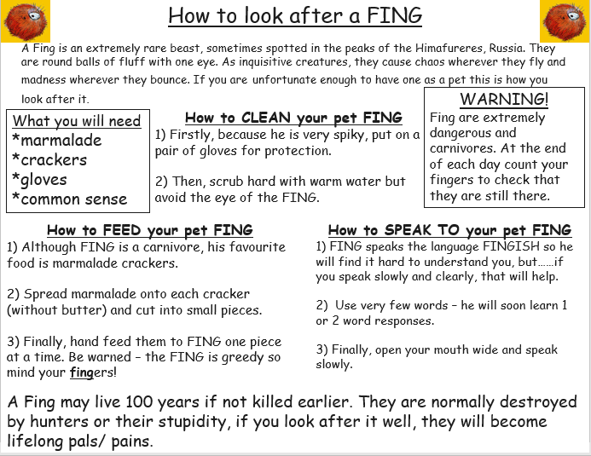
Amy

Slide 18
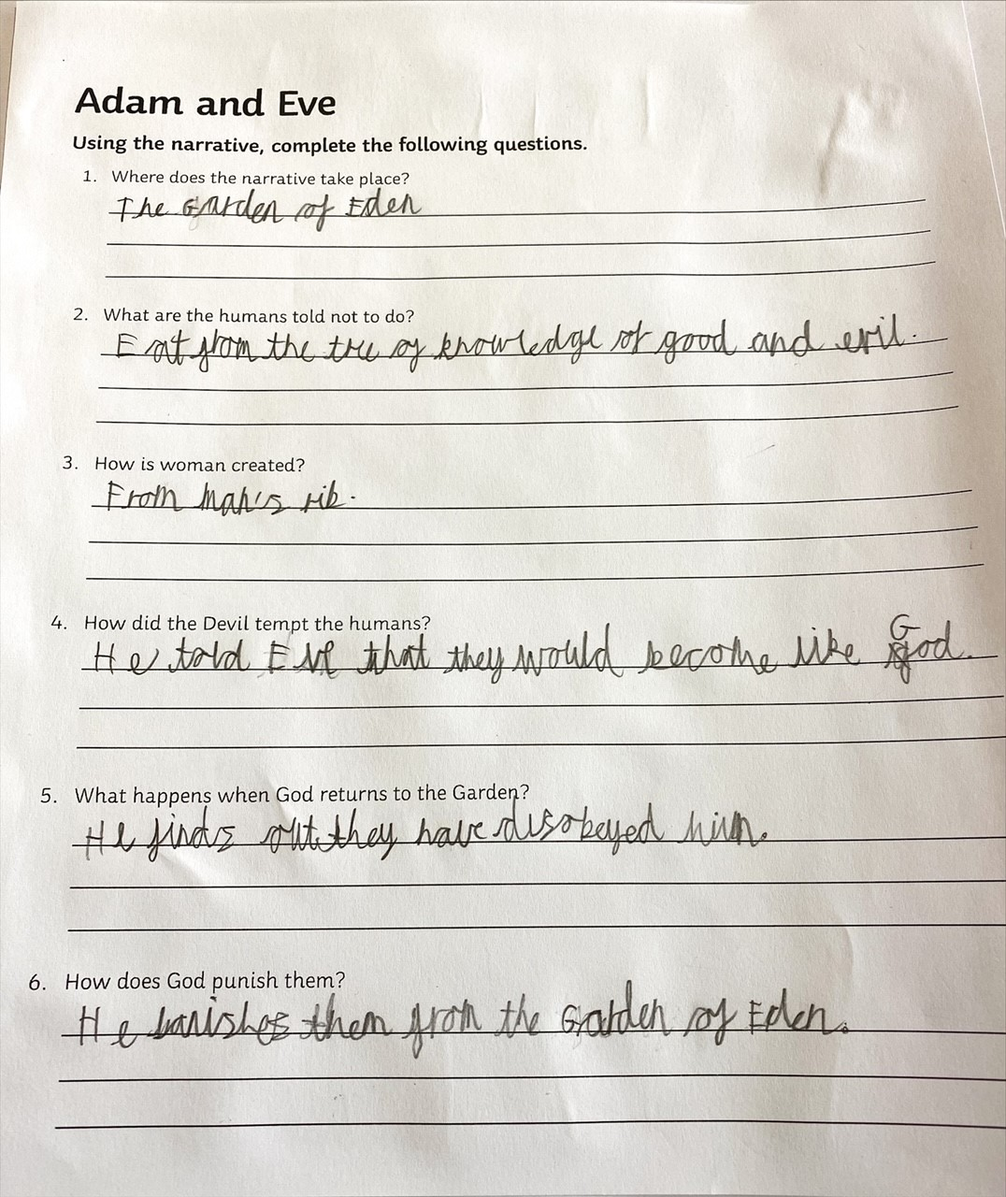
Sam has been thinking about how the creation of Adam and Eve had a big impact on the need for the arrival of Jesus on Earth.

Slide 19
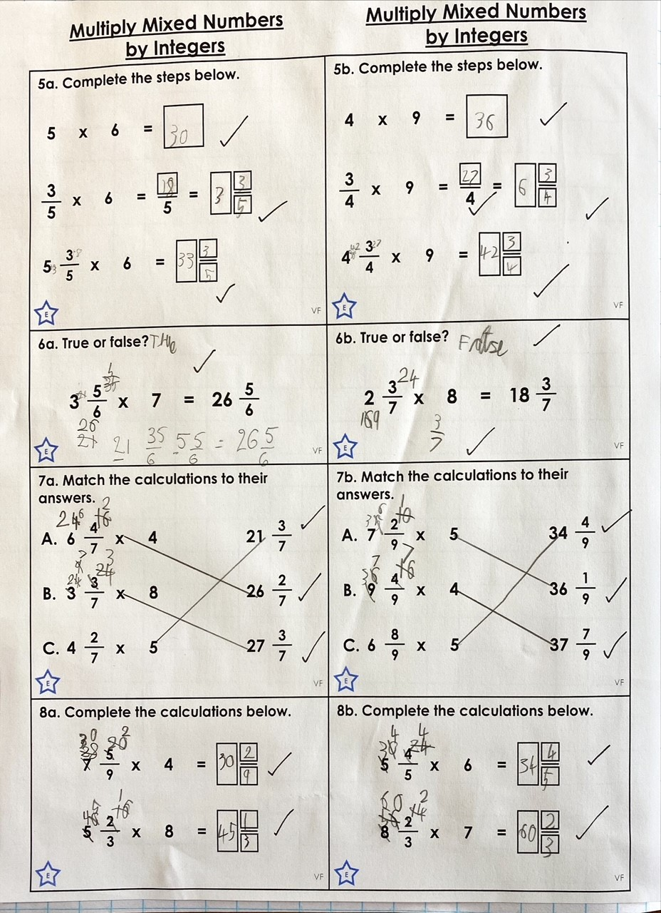
Sam has been multiplying mixed numbers by whole numbers (integers) today.

Slide 20
Sam

Slide 21
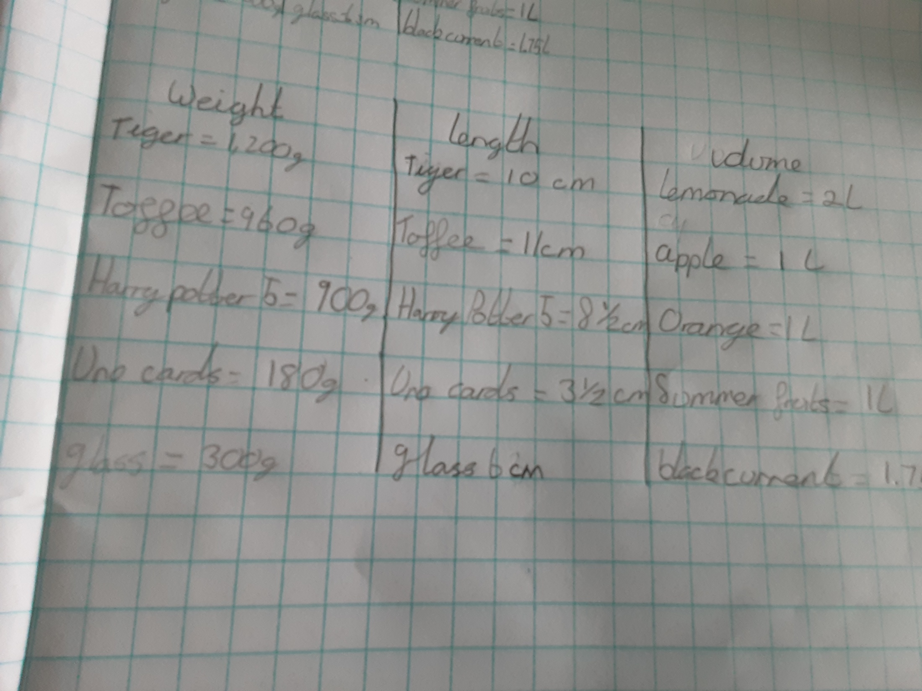
Katie has been practical in her measuring today.

Slide 22
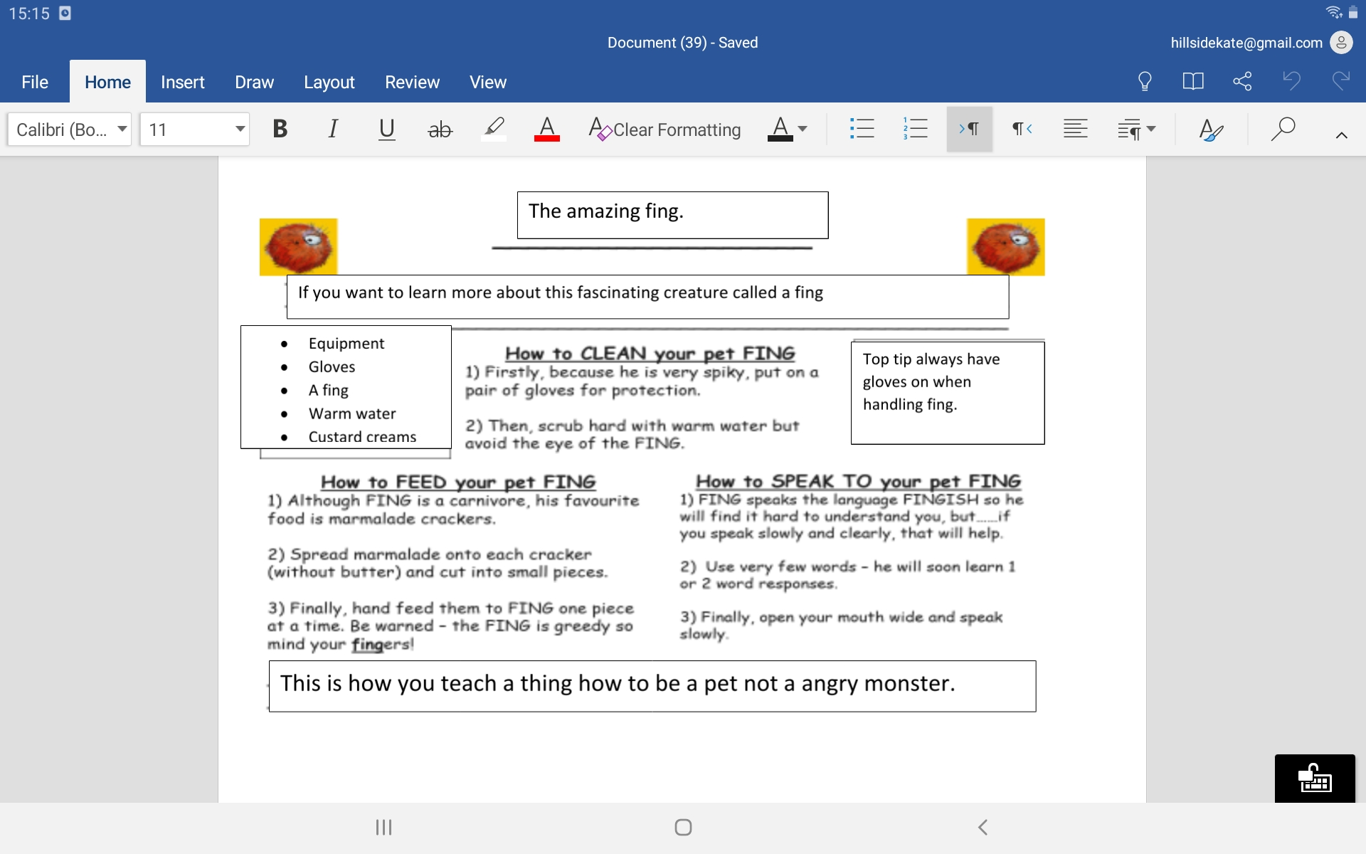
Katie has completed her instruction text today.

Slide 23
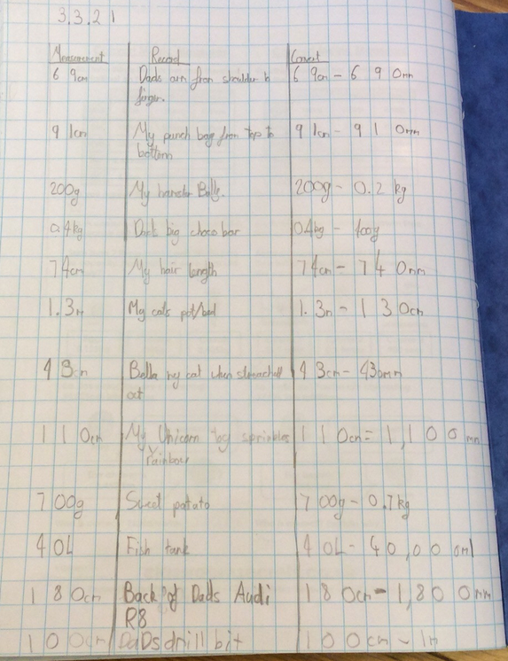
Holly H has organised her maths measurements really well when recording today.

Slide 24
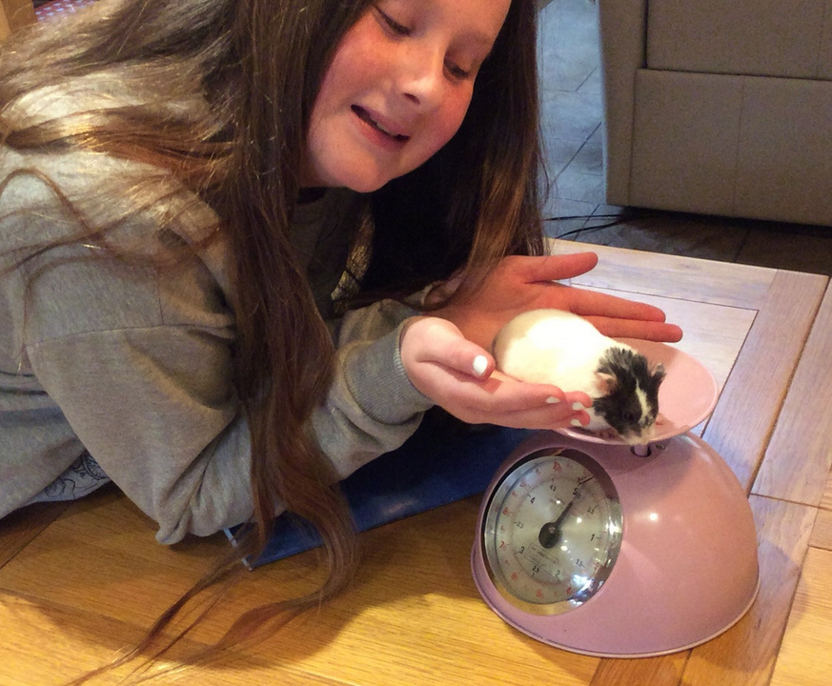
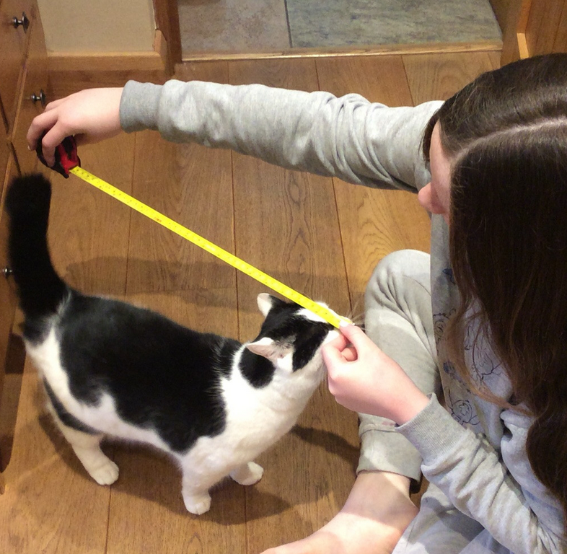
Holly was very inventive and creative when choosing what she could measure in maths today.

Slide 25
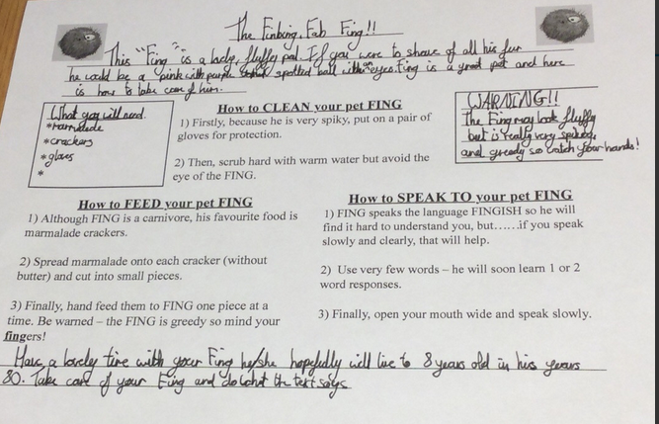
Holly H

Slide 26
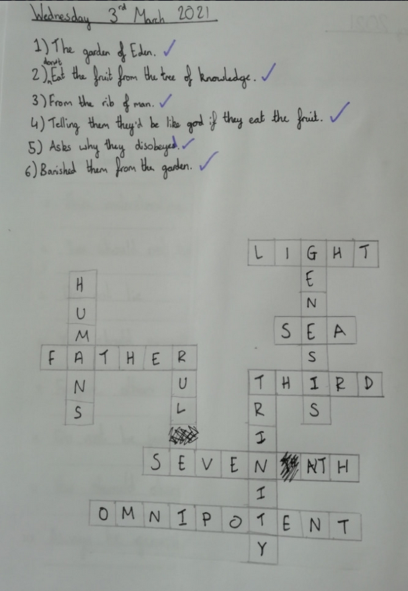
Amy has recalled her understanding of the creation story before thinking about salvation (death of Jesus)

Slide 27
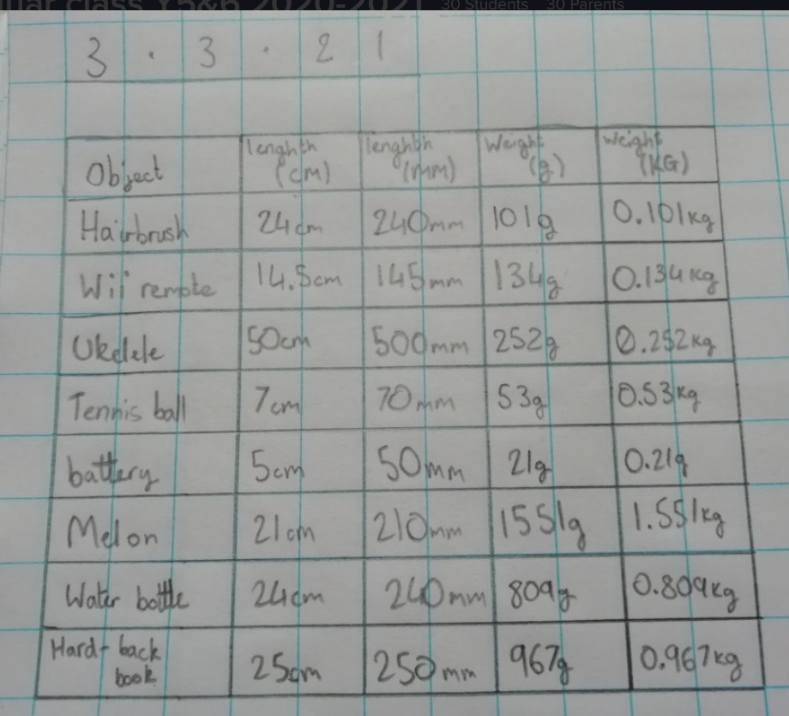
Amy has used a great layout for her maths recording today.

Slide 28
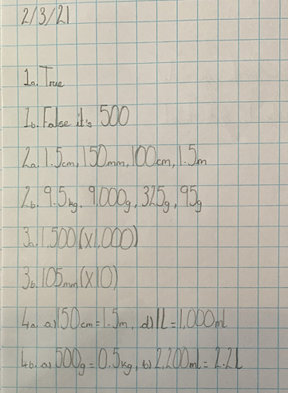
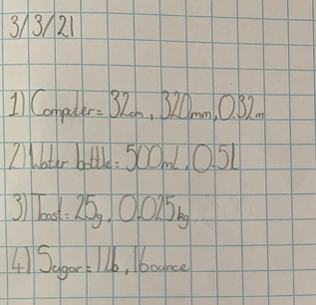
Sophie in Y6 has been measuring well and recording her findings neatly.

Slide 29
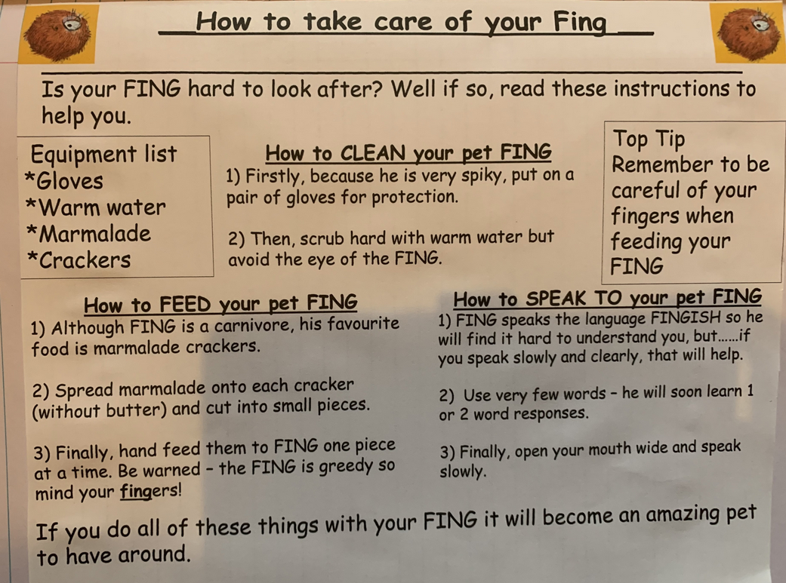
Sophie
Collins

Slide 30
Sophie in Y6 has produced a wonderful poster to promote the danger of global warming.

Slide 31
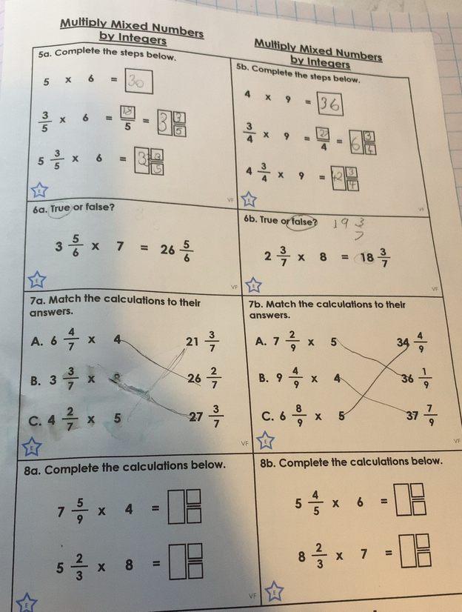
Alex has been multiplying mixed numbers by whole numbers (integers) very well.

Slide 32
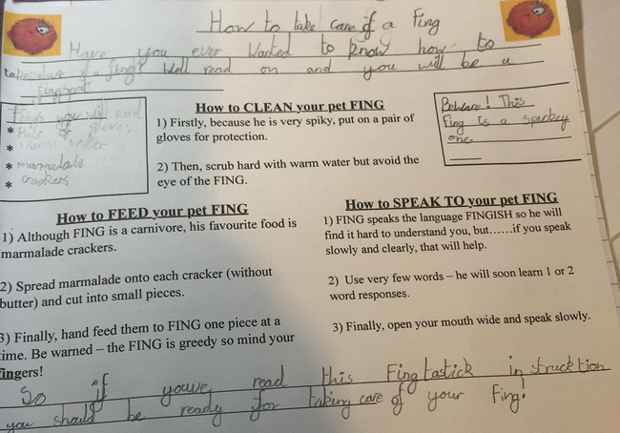
Alex

Slide 33
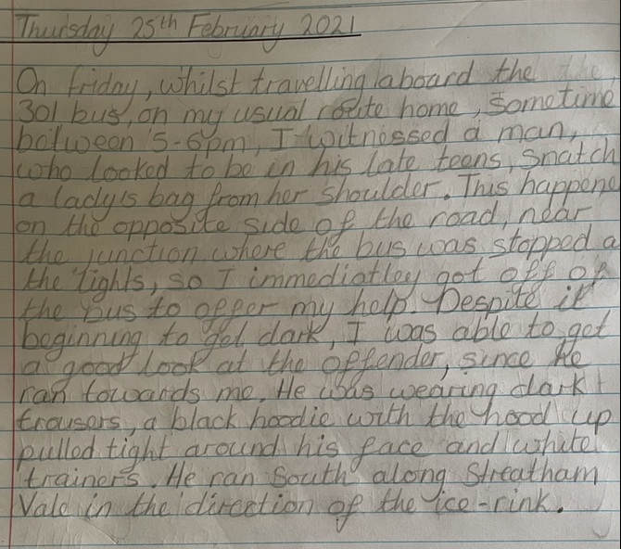
Nelly has sent in some of the work she has produced at home.

Slide 34
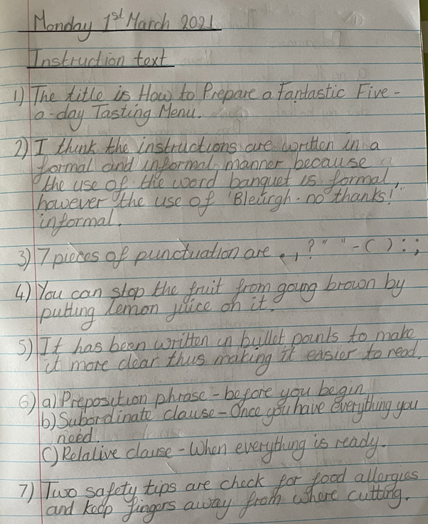
Nelly has read her instruction text very well to answer the questions accurately.

Slide 35
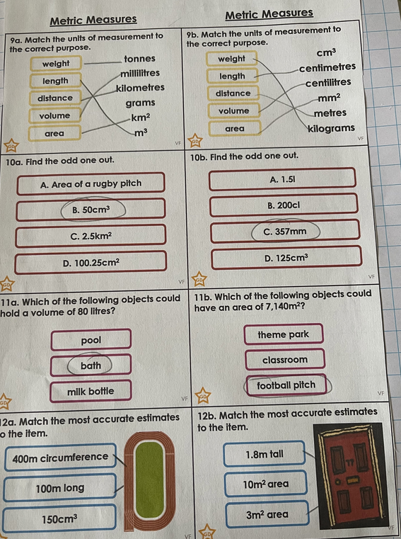
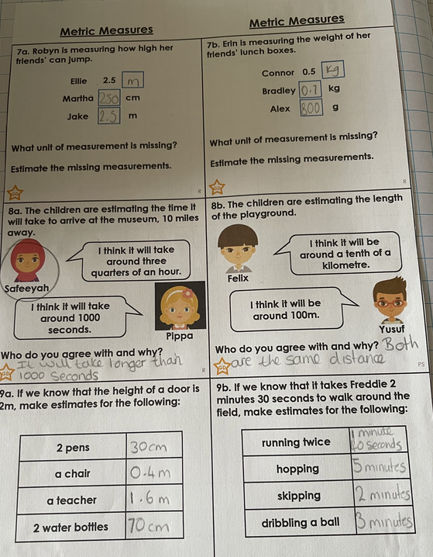
Nelly has been identifying units of measurement in her maths.

Slide 36
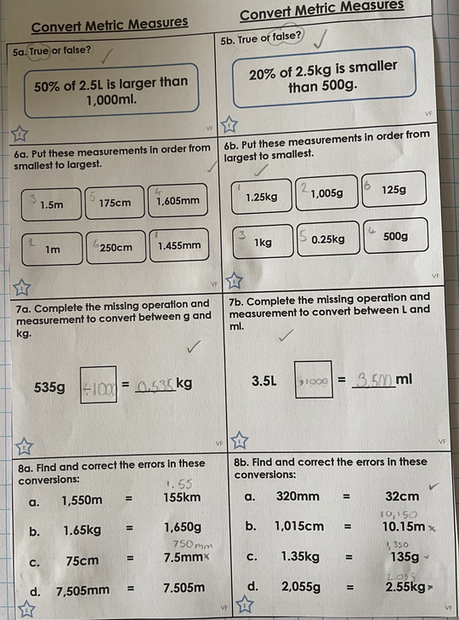
Nelly has continued to work on her measurements in maths.

Slide 37
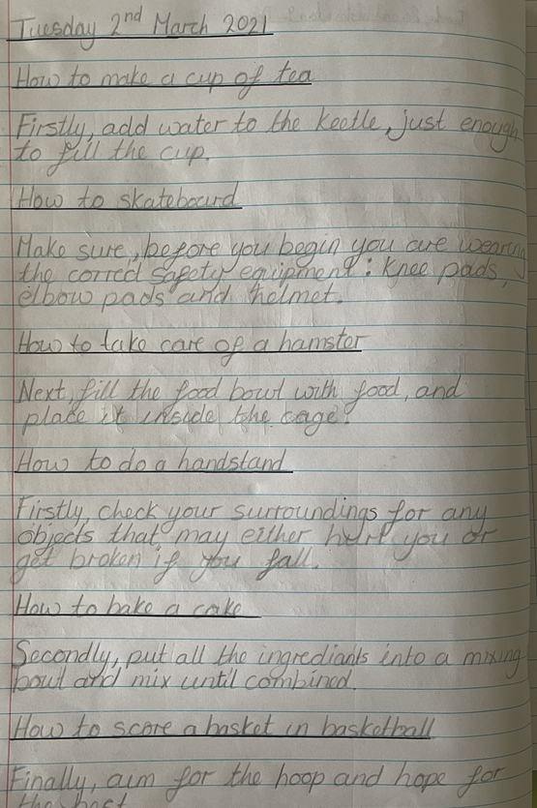
Nelly has created many instructions containing a variety of adverbial phrases.

Slide 38
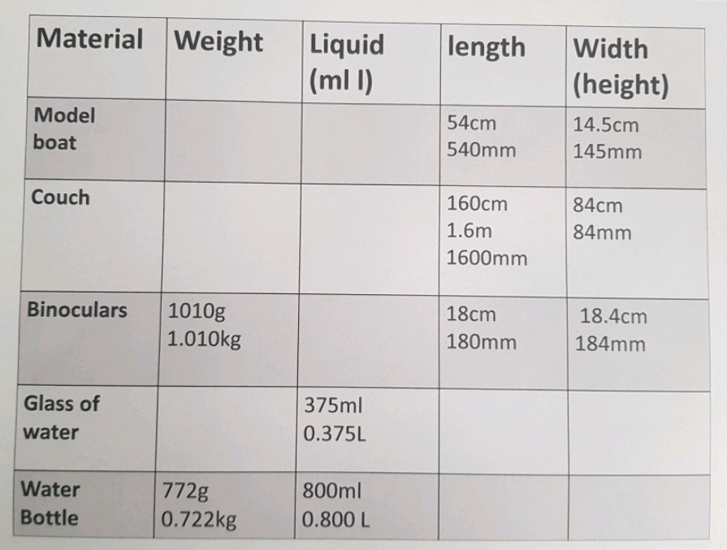
Cameron

Slide 39
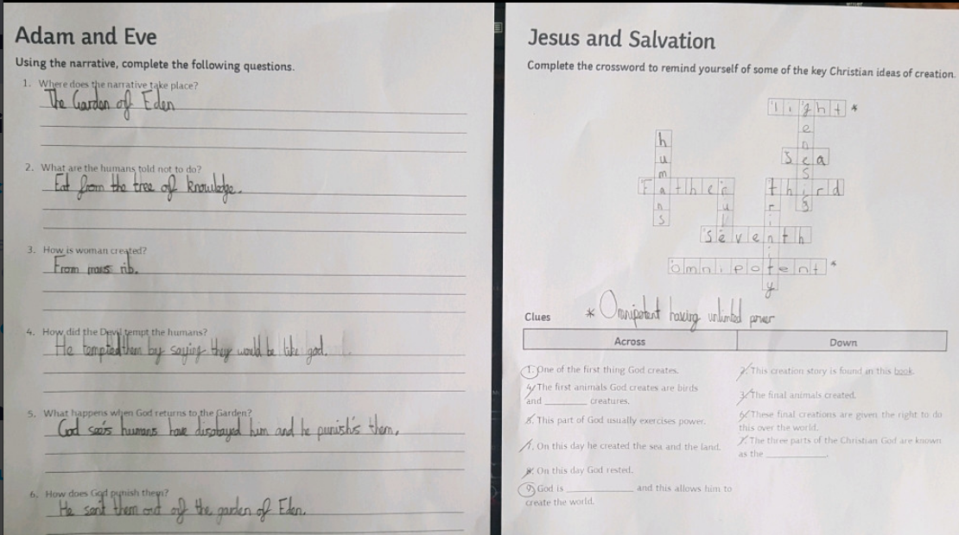
Cameron has recalled his understanding of the creation story before thinking about salvation (death of Jesus)

