Slide 1
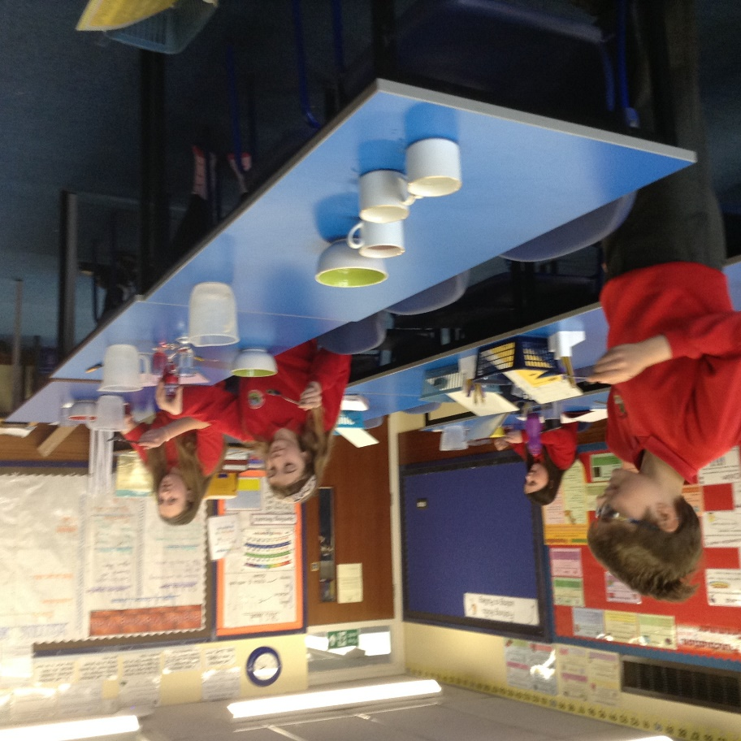
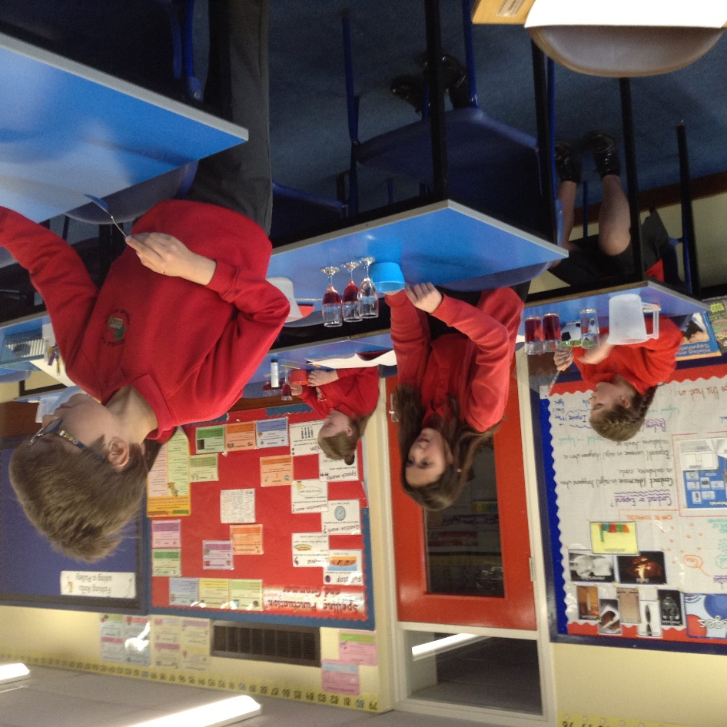
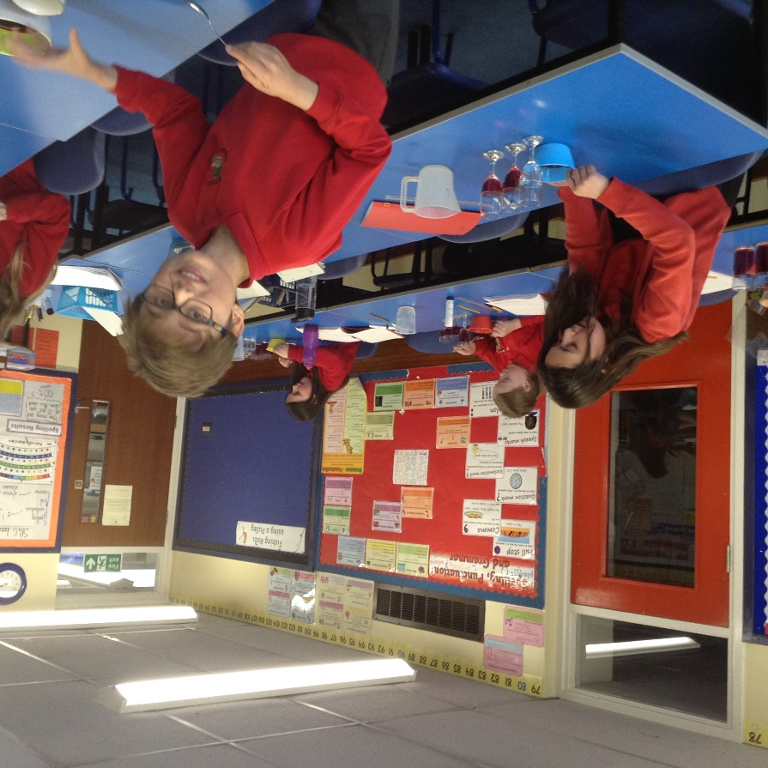
We have been investigating formulations of substances today in Science.

Slide 2
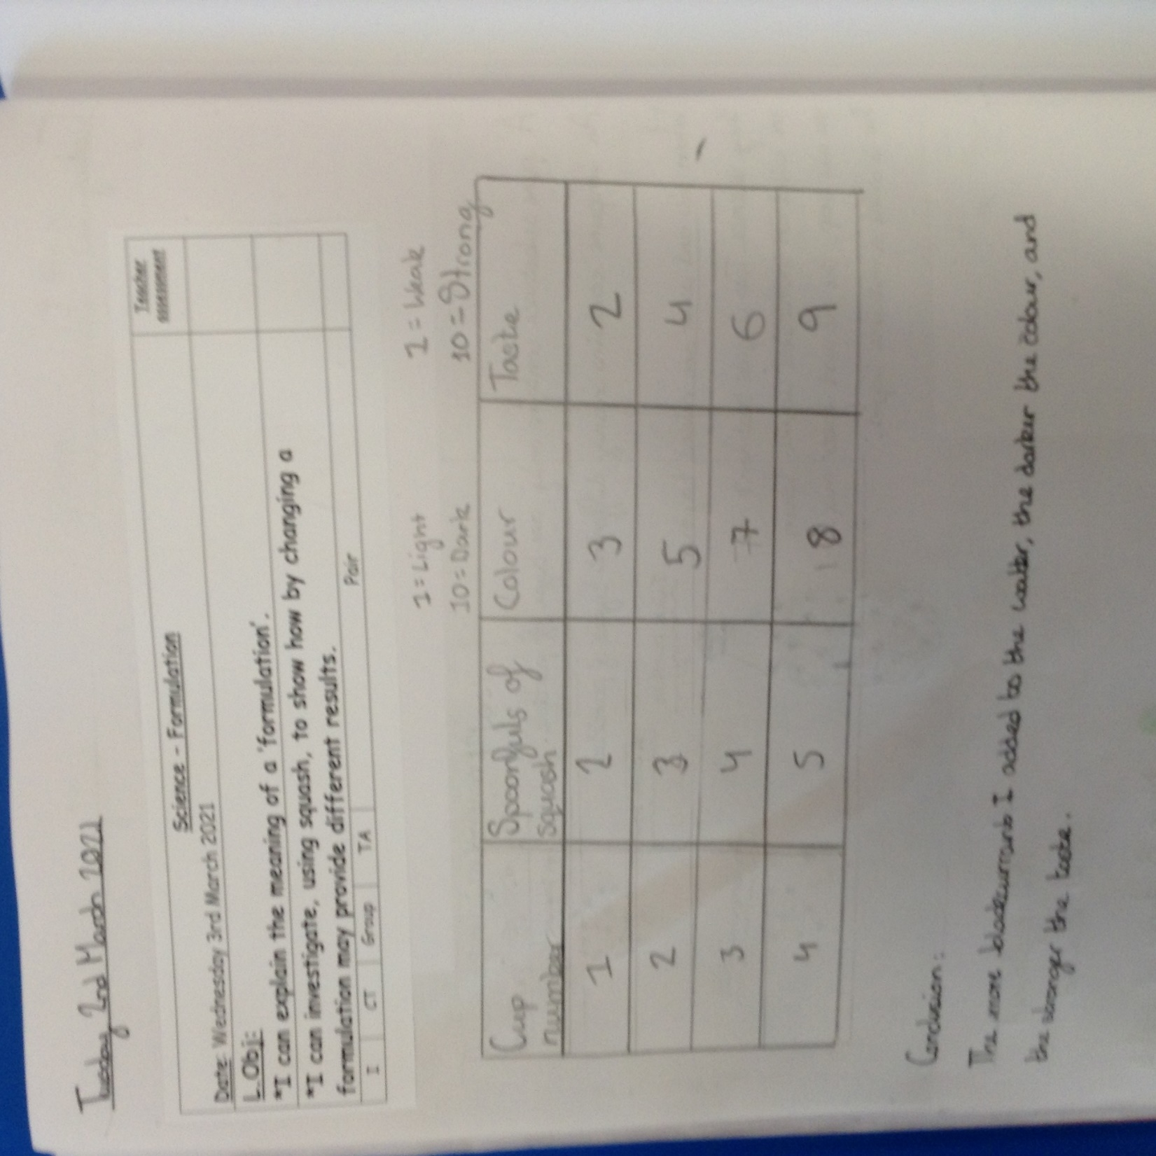
We concluded that the more blackcurrant that was added, the stronger the taste was and the darker the colour was.

Slide 3
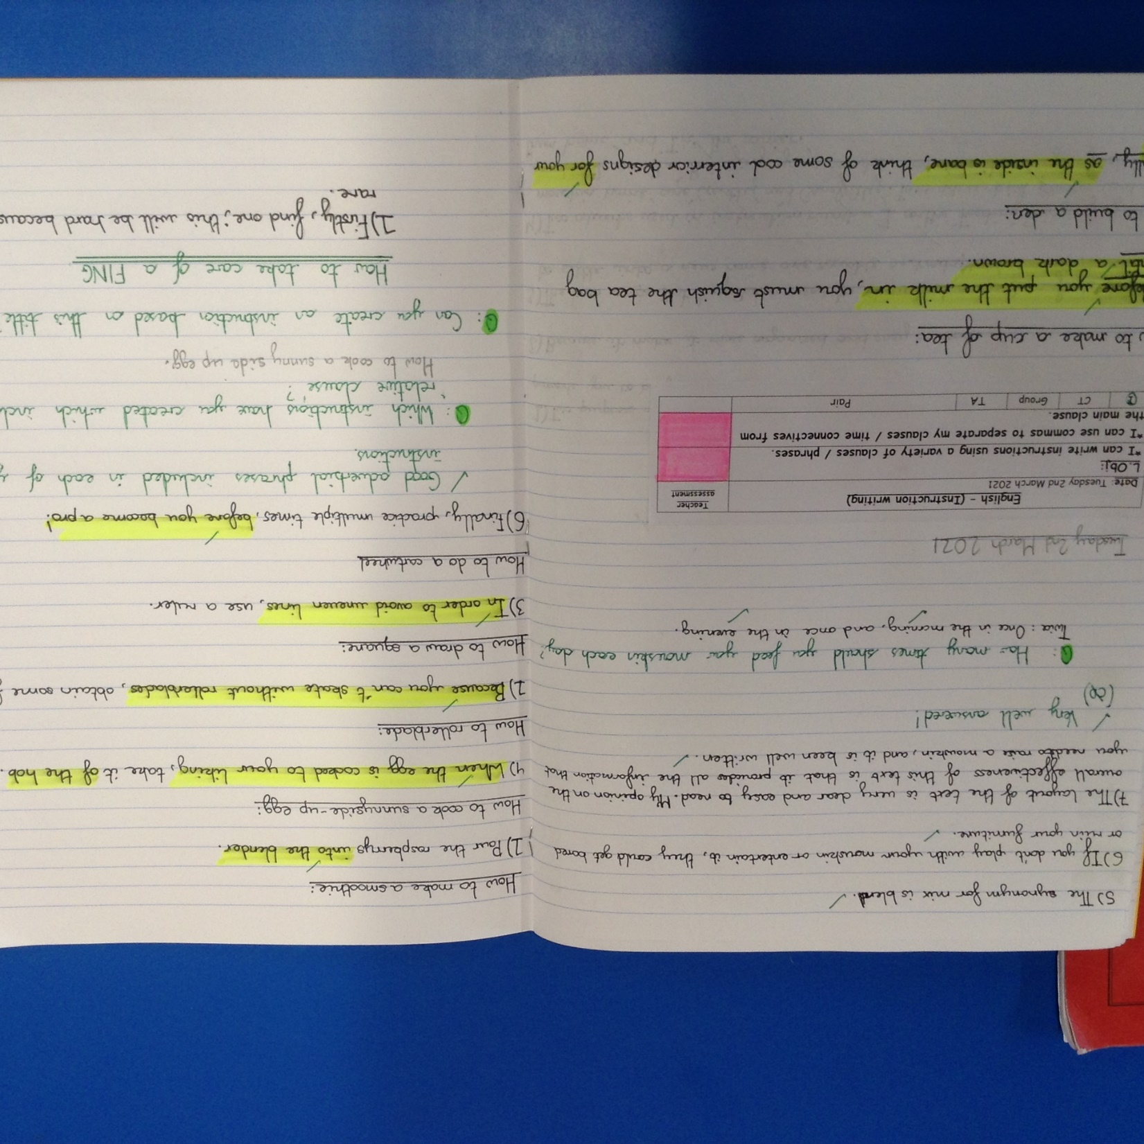
Heidi has used a variety of clauses / phrases as part of her instructions for each title.

Slide 4
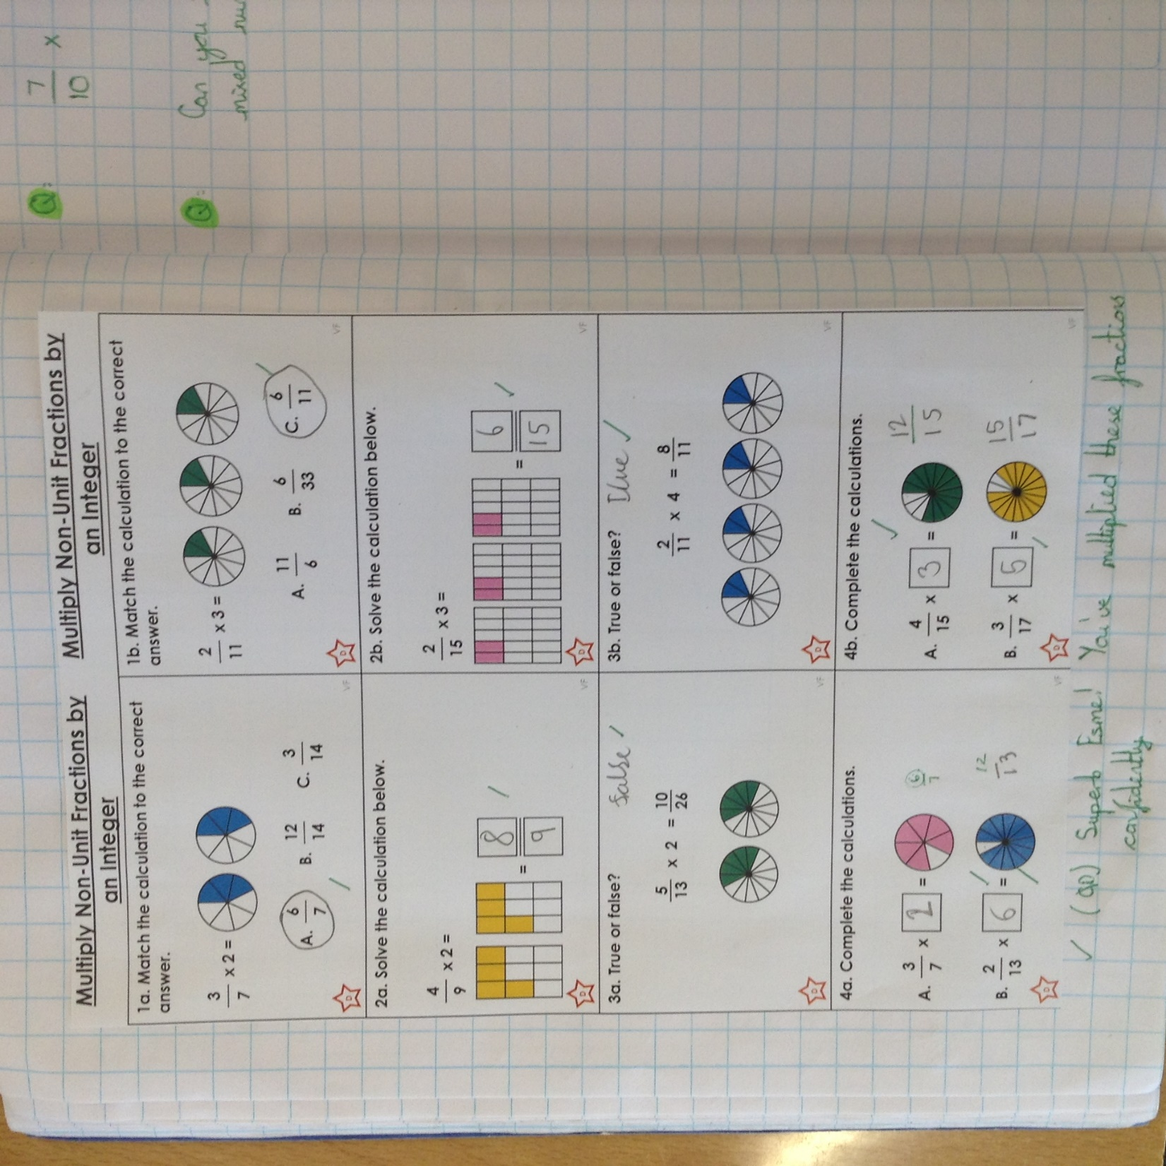
Esme has multiplied these fractions really well by whole numbers.

Slide 5
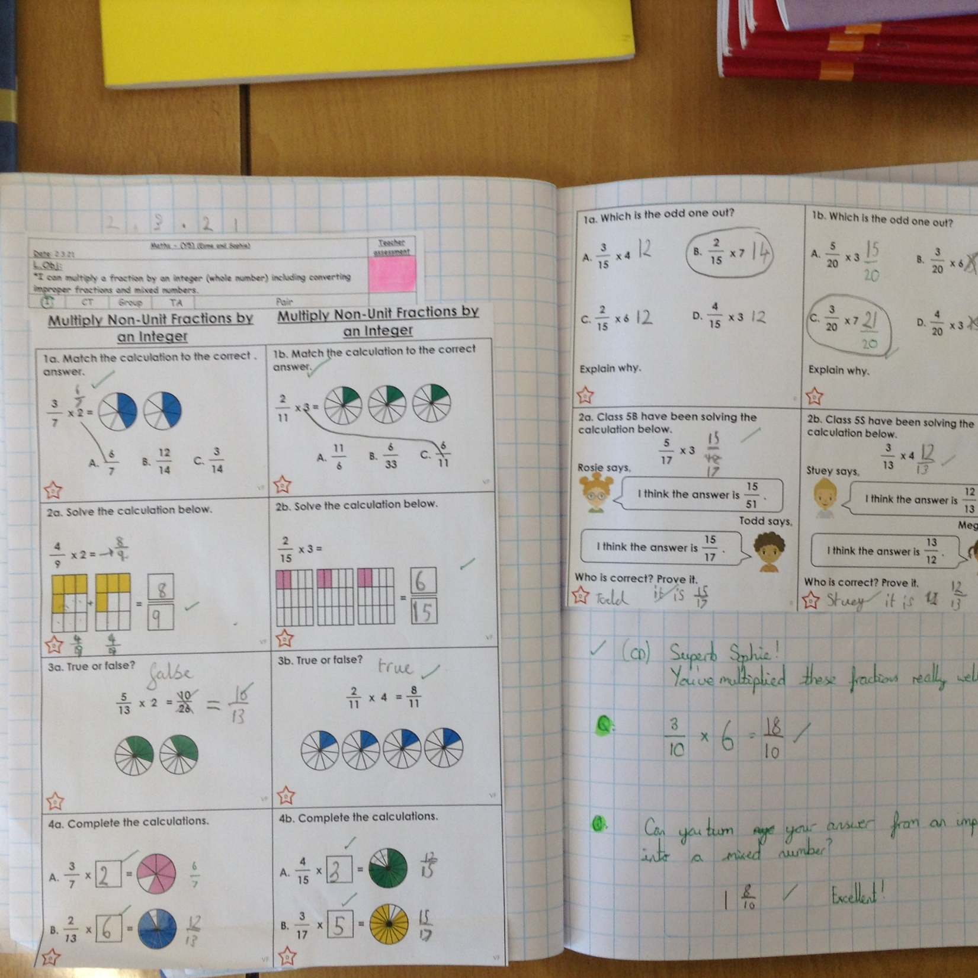
Sophie in Y5 has multiplied her fractions superbly by whole numbers.

Slide 6
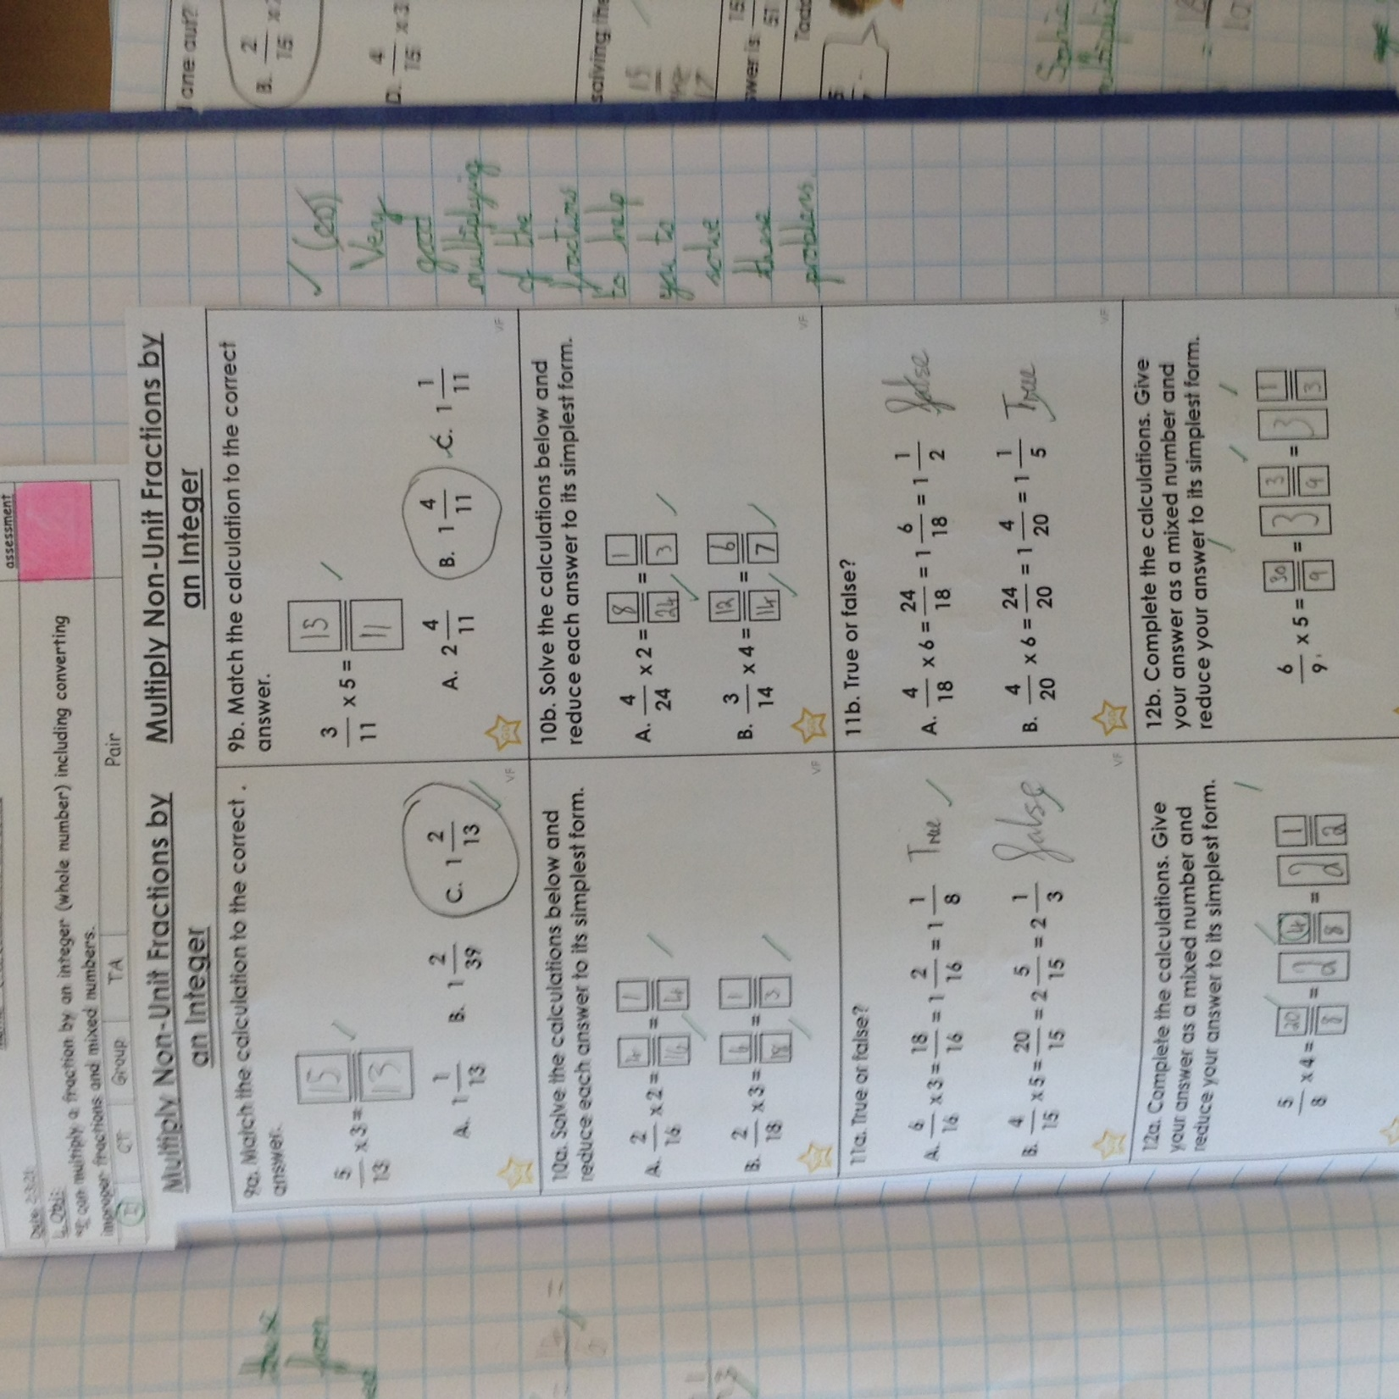
Cass has multiplied his fractions very well and showed good understanding of mixed numbers and improper fractions.

Slide 7
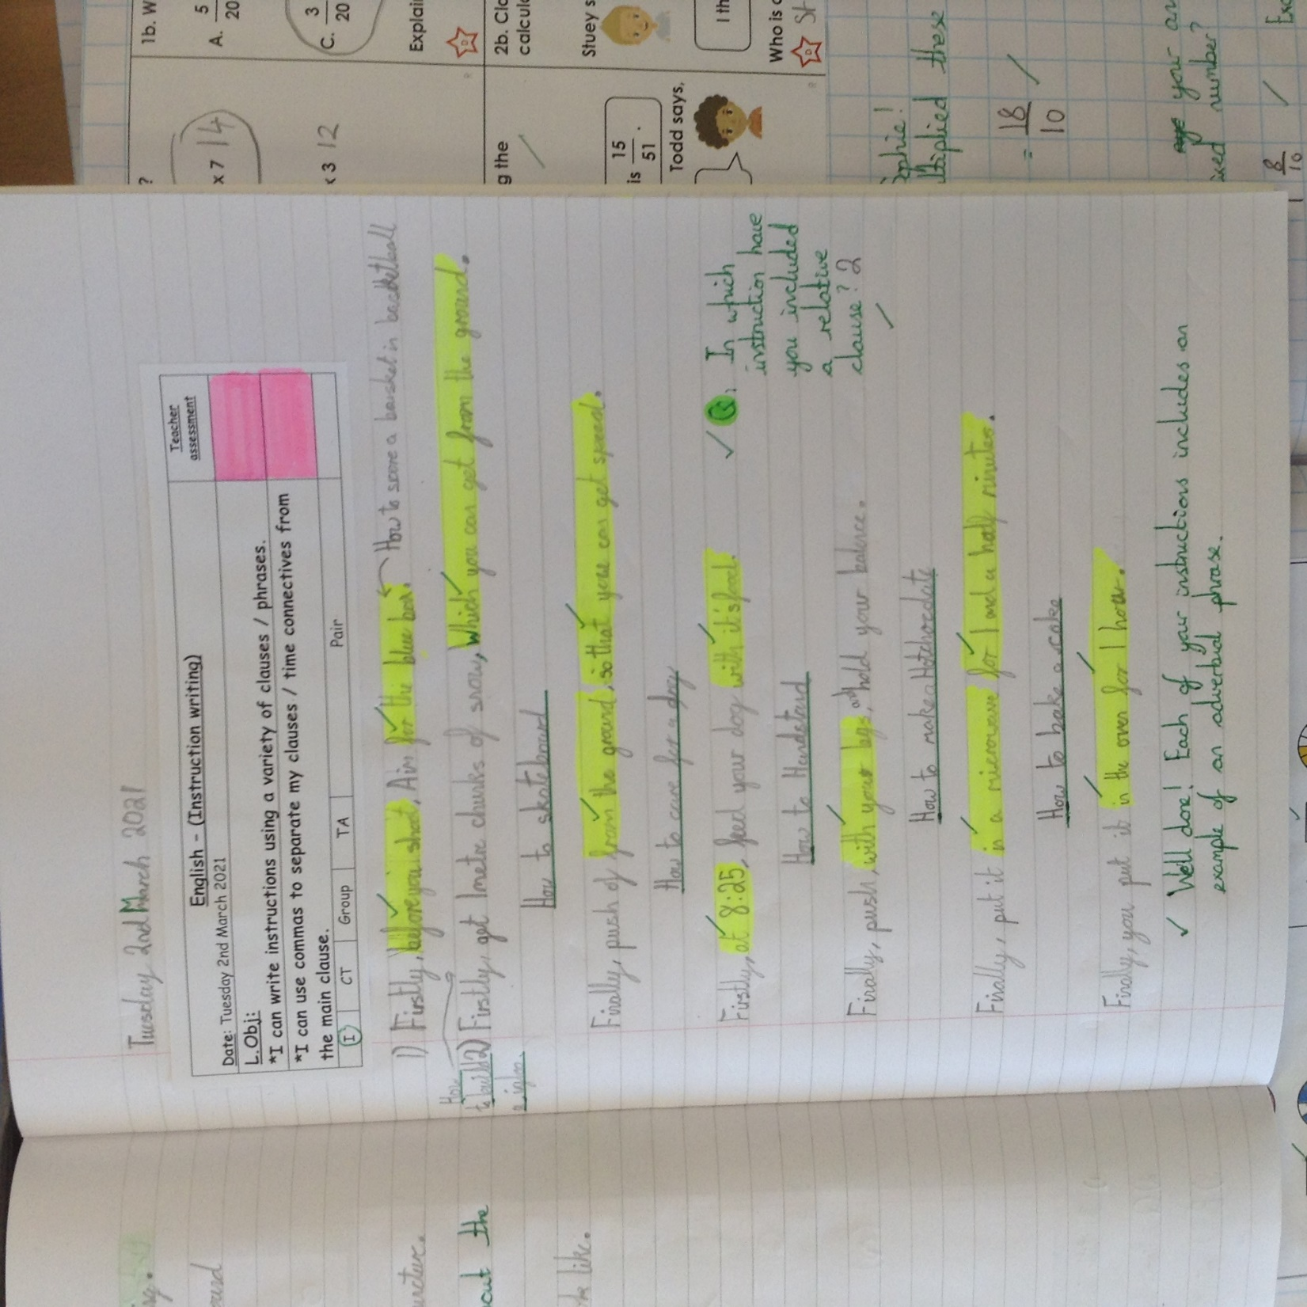
Cass has used different clauses / phrases as part of his instructions for each title.

Slide 8
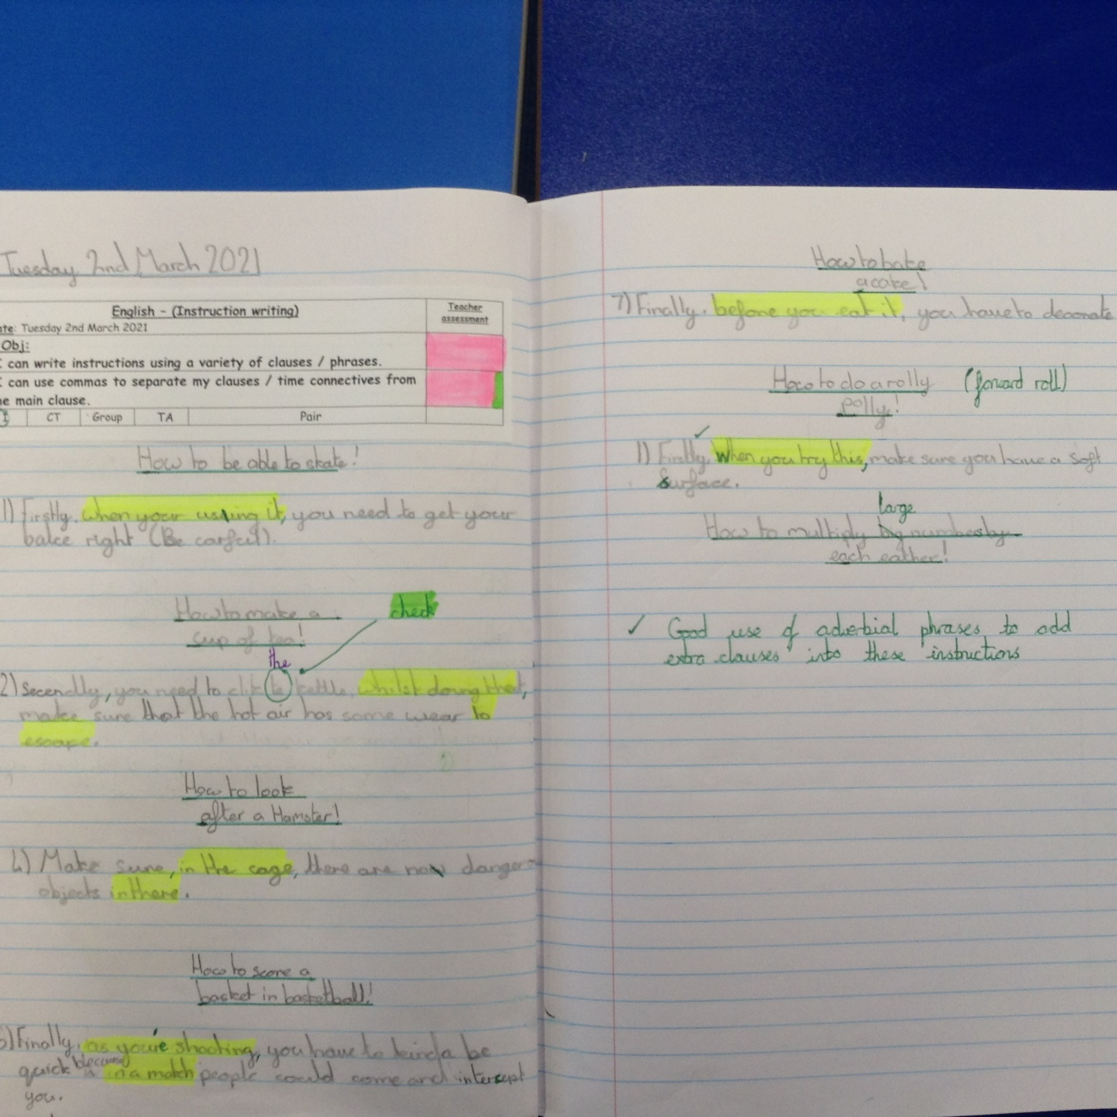
Isla has used a variety of clauses / phrases in each of her instructions under each title.

Slide 9
Cameron has created his instructions using different clauses.
How to take care of a Hamster
After a week, clean out the hamster’s cage
How to build an igloo
Cut the ice into large cubes, which shouldn’t be able to break easily.
How to bake a cake
Next, after pouring in the flour, stir until the mixture is light and creamy
How to do handstand
After putting on the correct head gear, proceed to placing the top of your head on the floor supported by your hands if needed.
How to make a cup of tea
Place the tea bag (which shouldn’t have any rips) into a cup.
How to skateboard
Make sure you wear the correct protection gear, because I’m not liable if you hurt yourself.
How to score a hoop in basketball
While bouncing the ball run inside the semi-circle, which should be on the opposite side of your hoop.

Slide 10
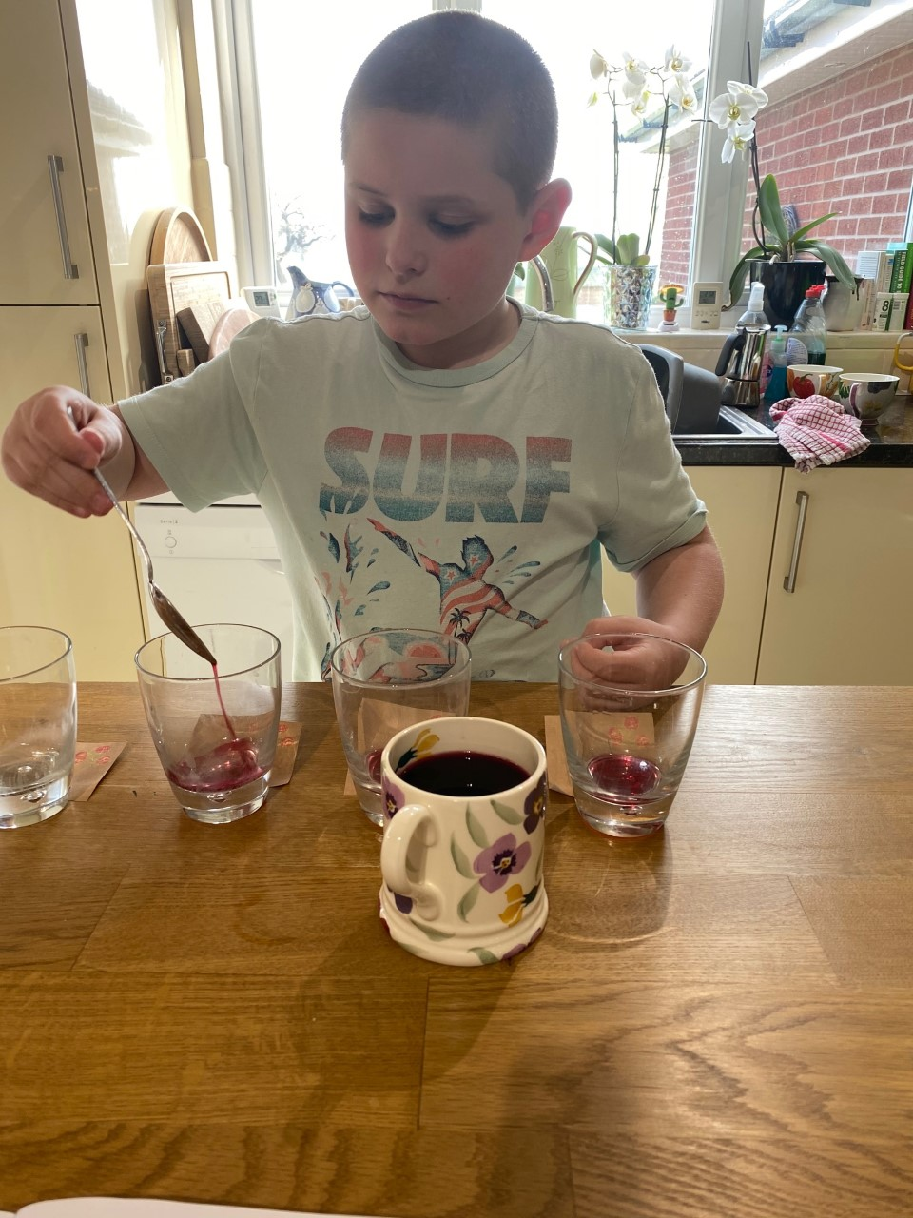
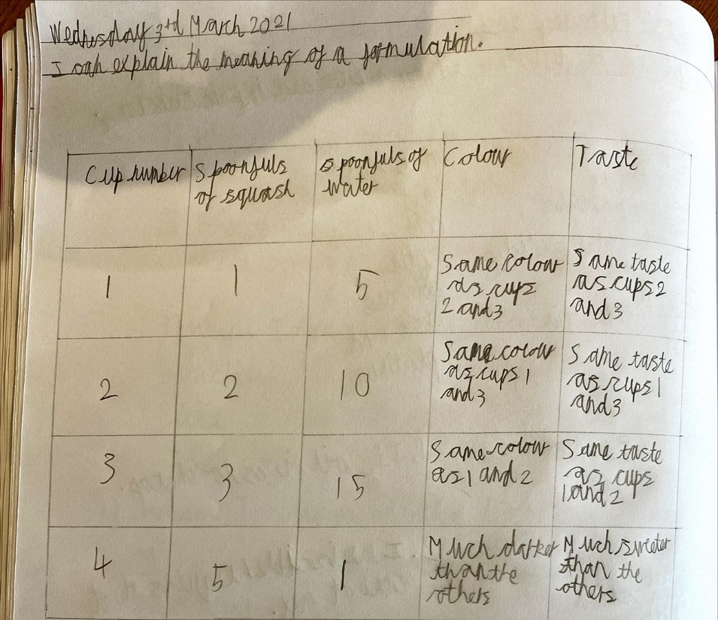
Sam has been learning about formulation in Science today.

Slide 11
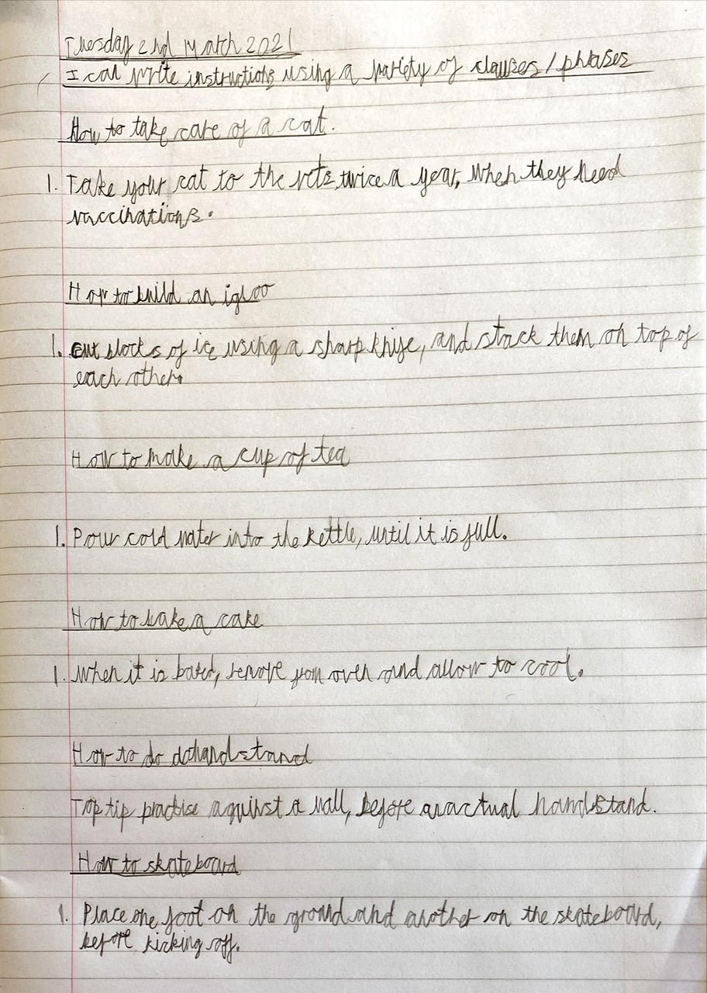
Sam has been creating instructions underneath each title including different clauses / phrases.

Slide 12
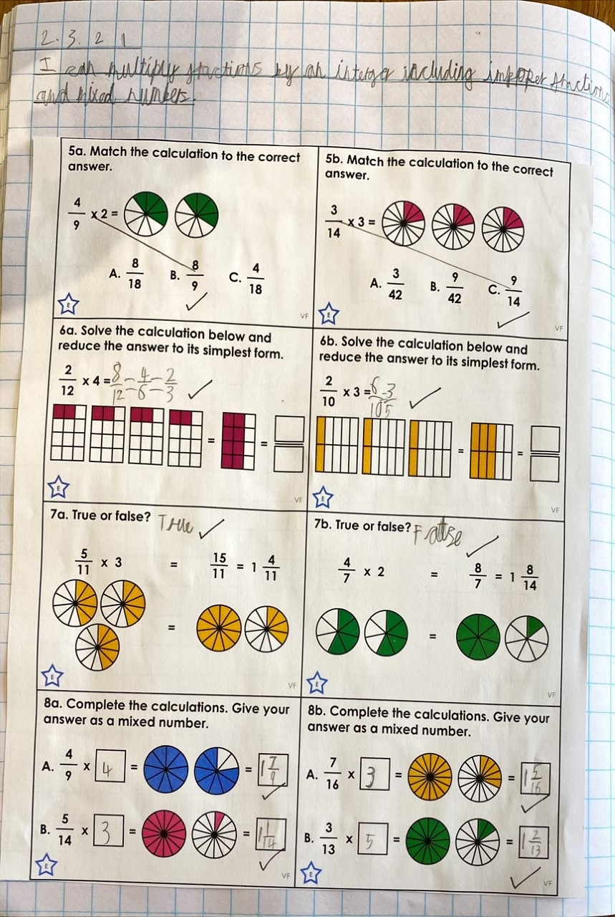
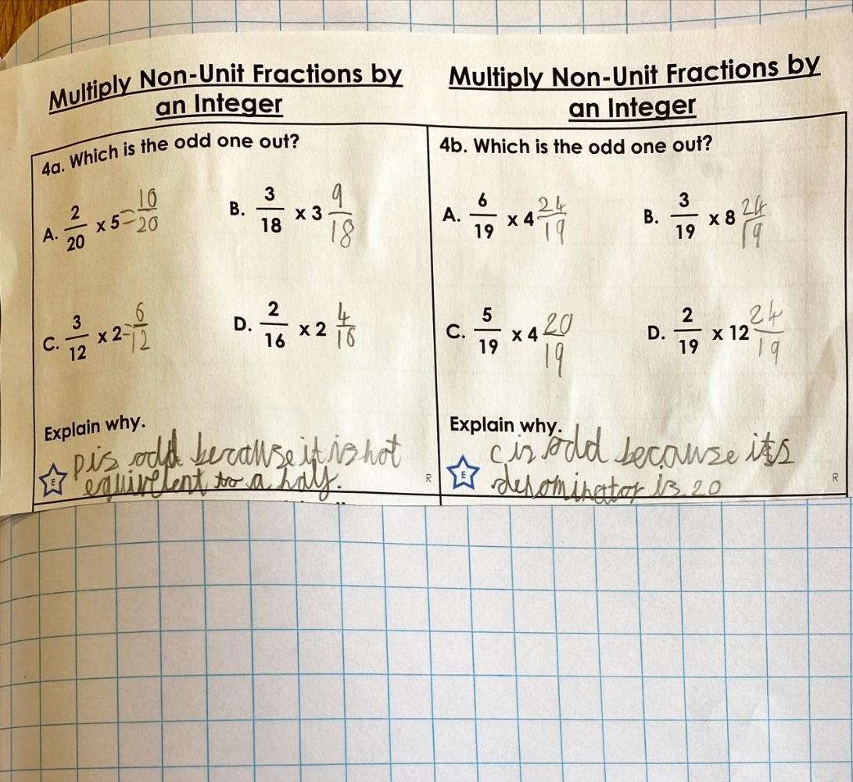
Sam has worked very independently to multiply his fractions here in maths today.

Slide 13
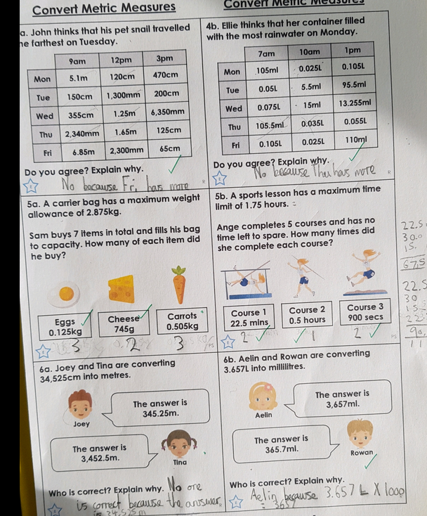
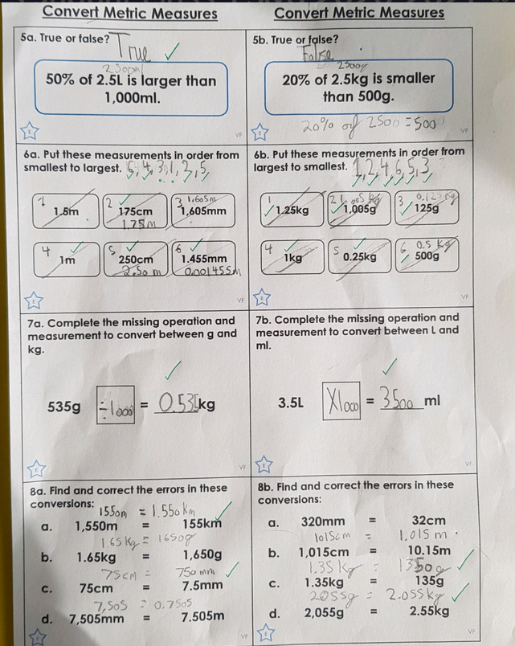
Cameron has been converting measurements to solve the problems.

Slide 14
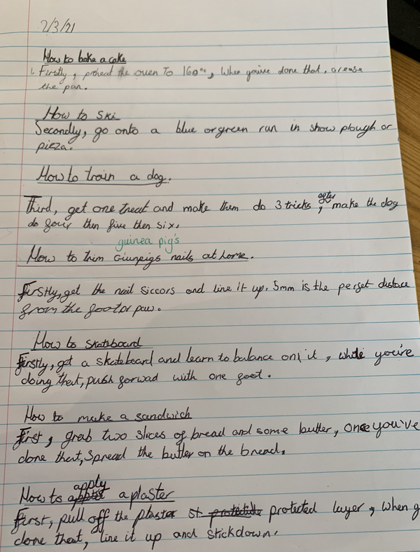
Can you find the prepositions, relative pronouns and subordinate conjunctions that Zoe has included in her instructions today?

Slide 15
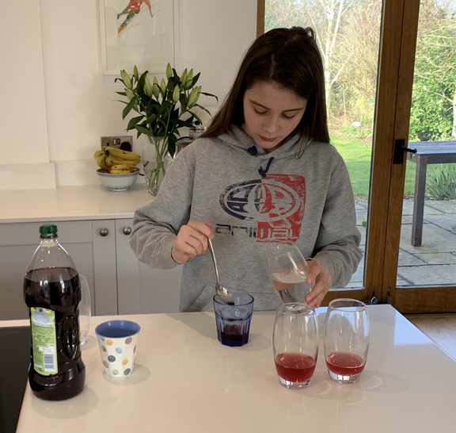
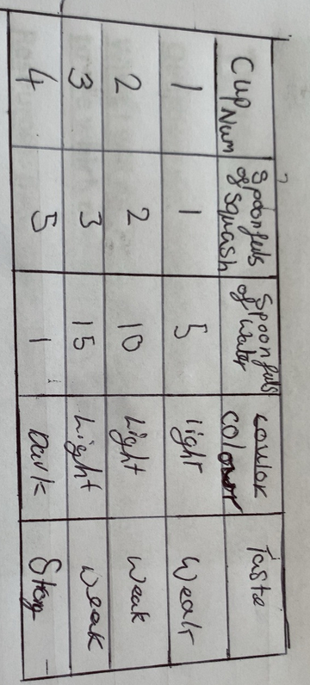
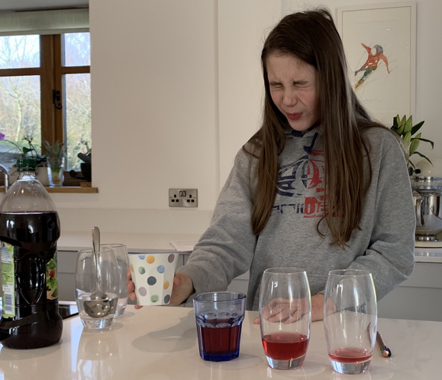
Zoe has been investigating ‘formulations’ today in Science.
Here’s what she thought about the strongest amount of cordial.

Slide 16
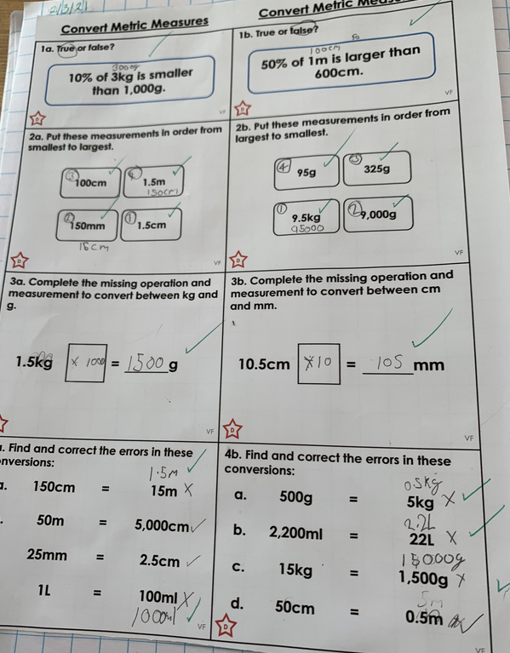
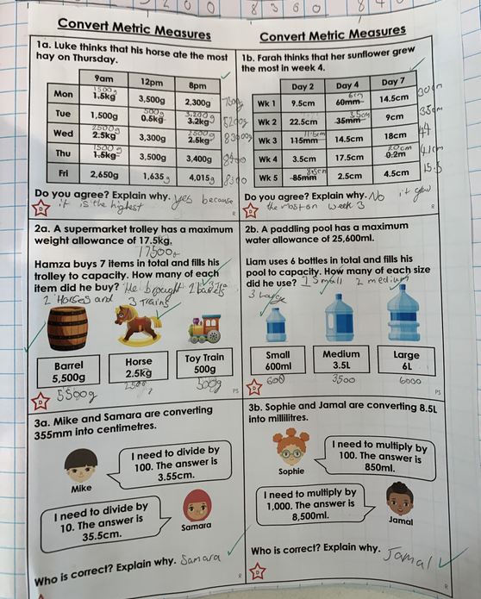
Zoe has been thinking about the conversions of different units of measurement to help her with her maths.

Slide 17
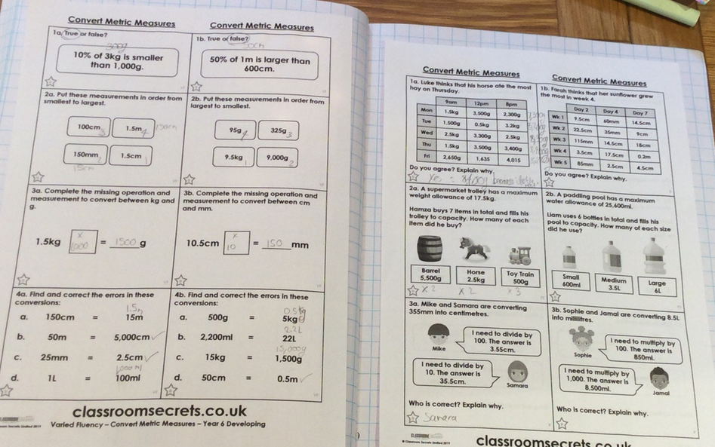
Holly H has been converting units of measurement to help to solve the problems.

Slide 18
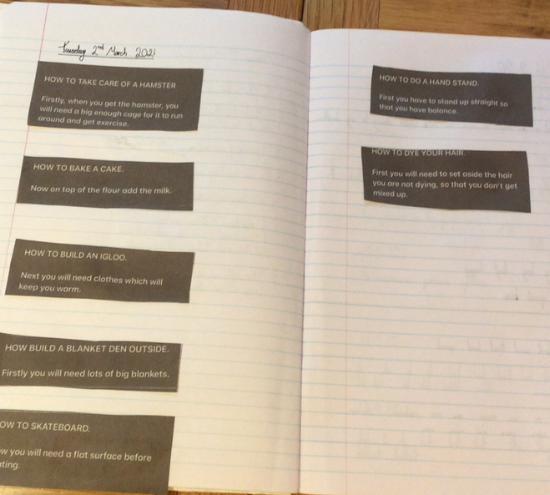
Holly H has been creating an instruction for each title using different types of clauses / phrases. Can you spot them?

Slide 19
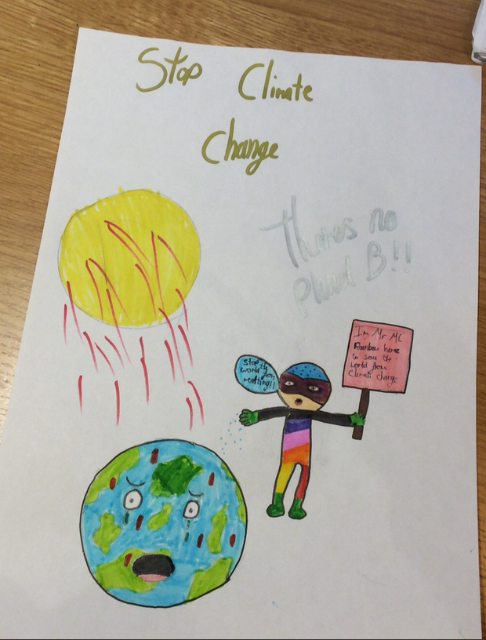
Holly H idea for her climate change hero –
Mr McRainbow

Slide 20
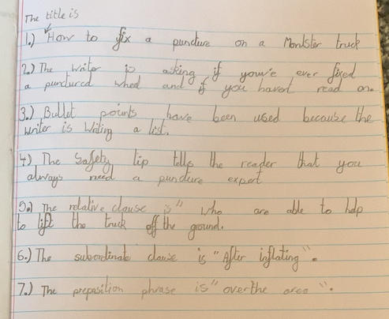
Alex read his instruction text well to answer the questions.

Slide 21
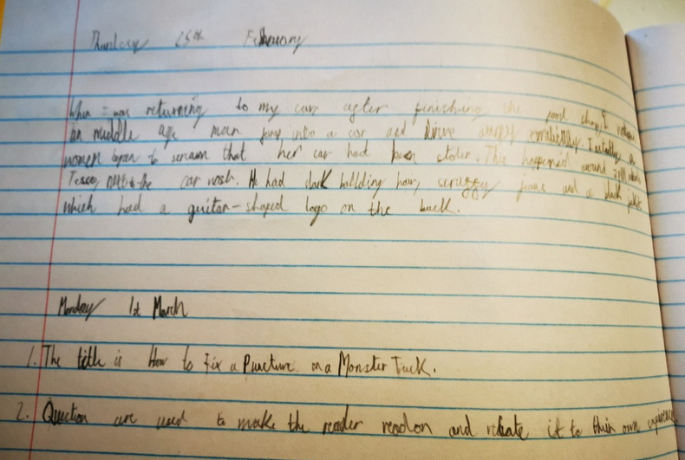
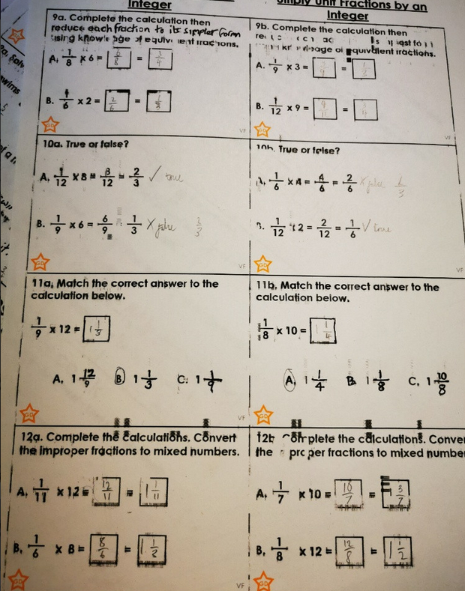
Blake has been catching up on his English and his maths after recovering from a spell of illness.

Slide 22
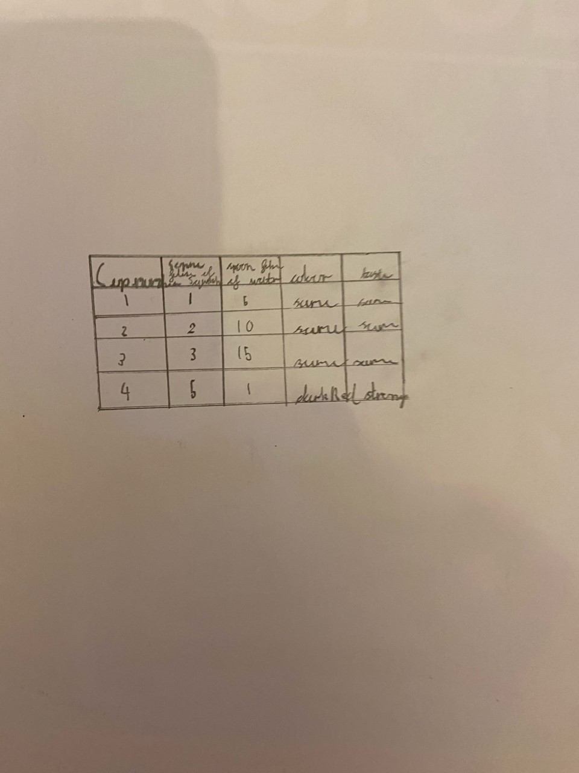
Dylan has produced his table of results from his Science investigating.
He also found ‘The more cordial added, the stronger and darker the liquid’ was.

Slide 23
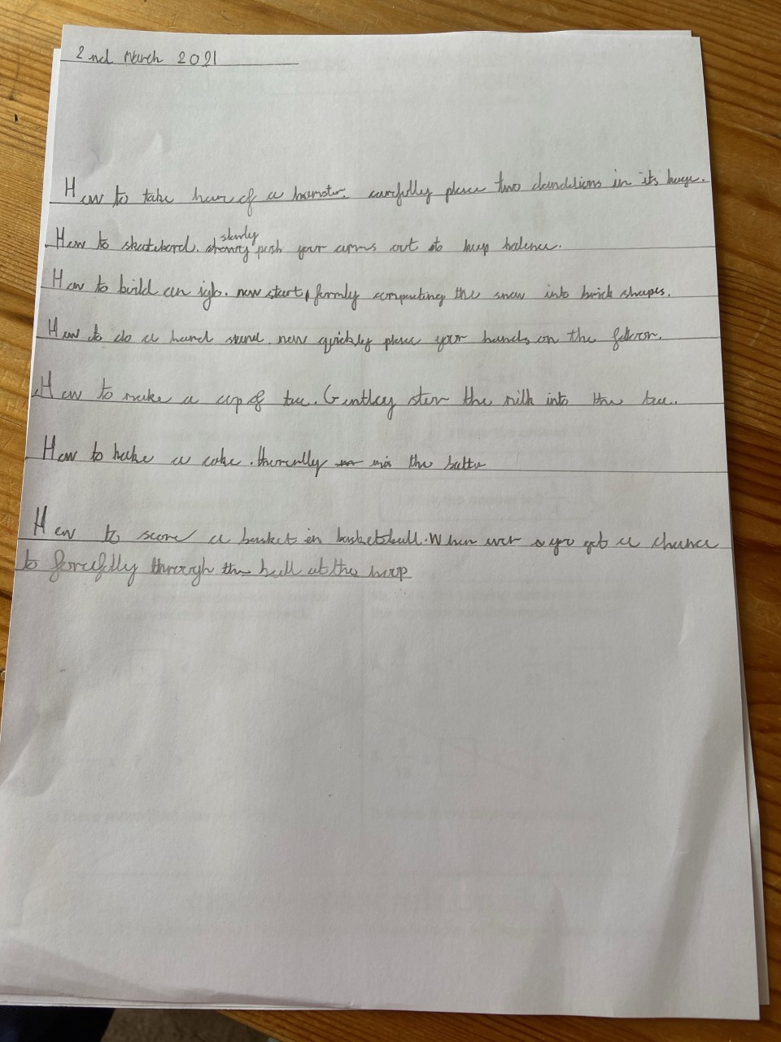
Dylan used different clauses and phrases as part of some instructions in his writing today.

Slide 24
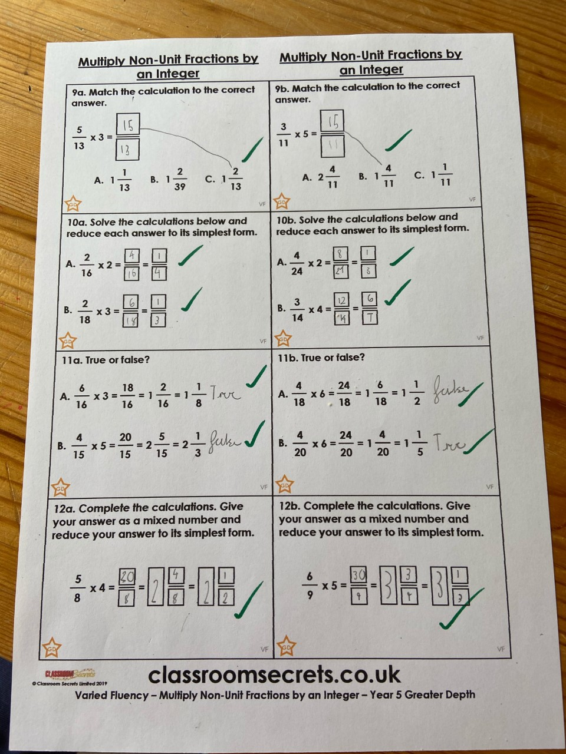
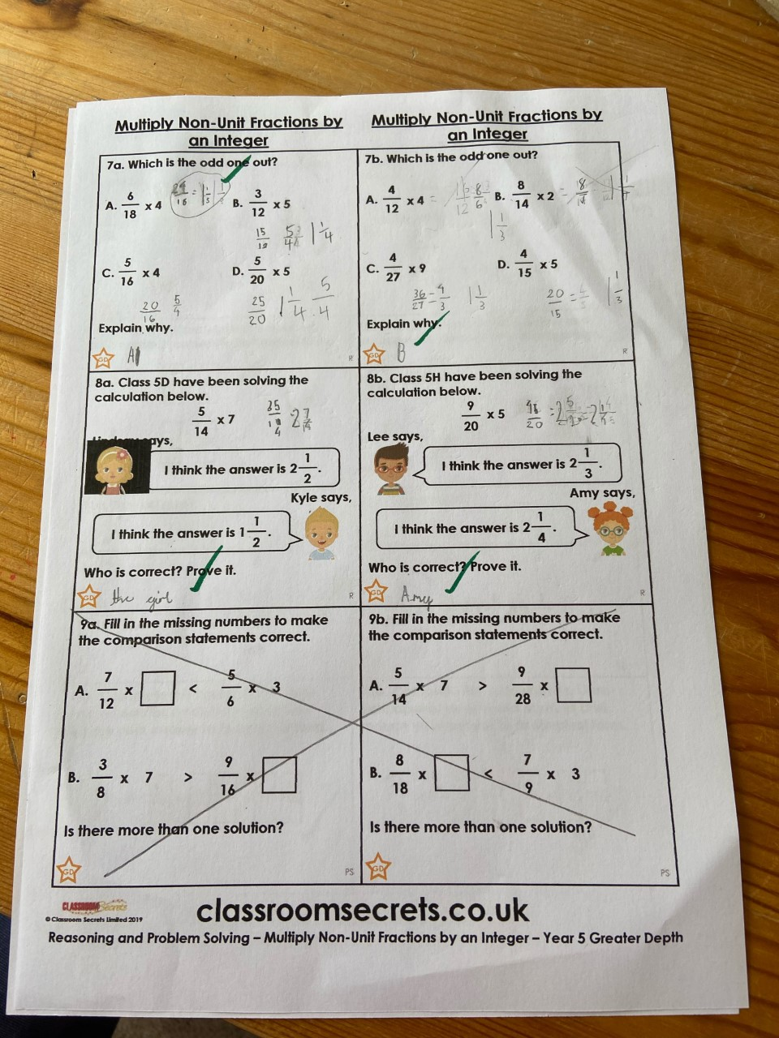
Dylan multiplied his fractions well today and converted from improper fractions into mixed numbers.

