Slide 1
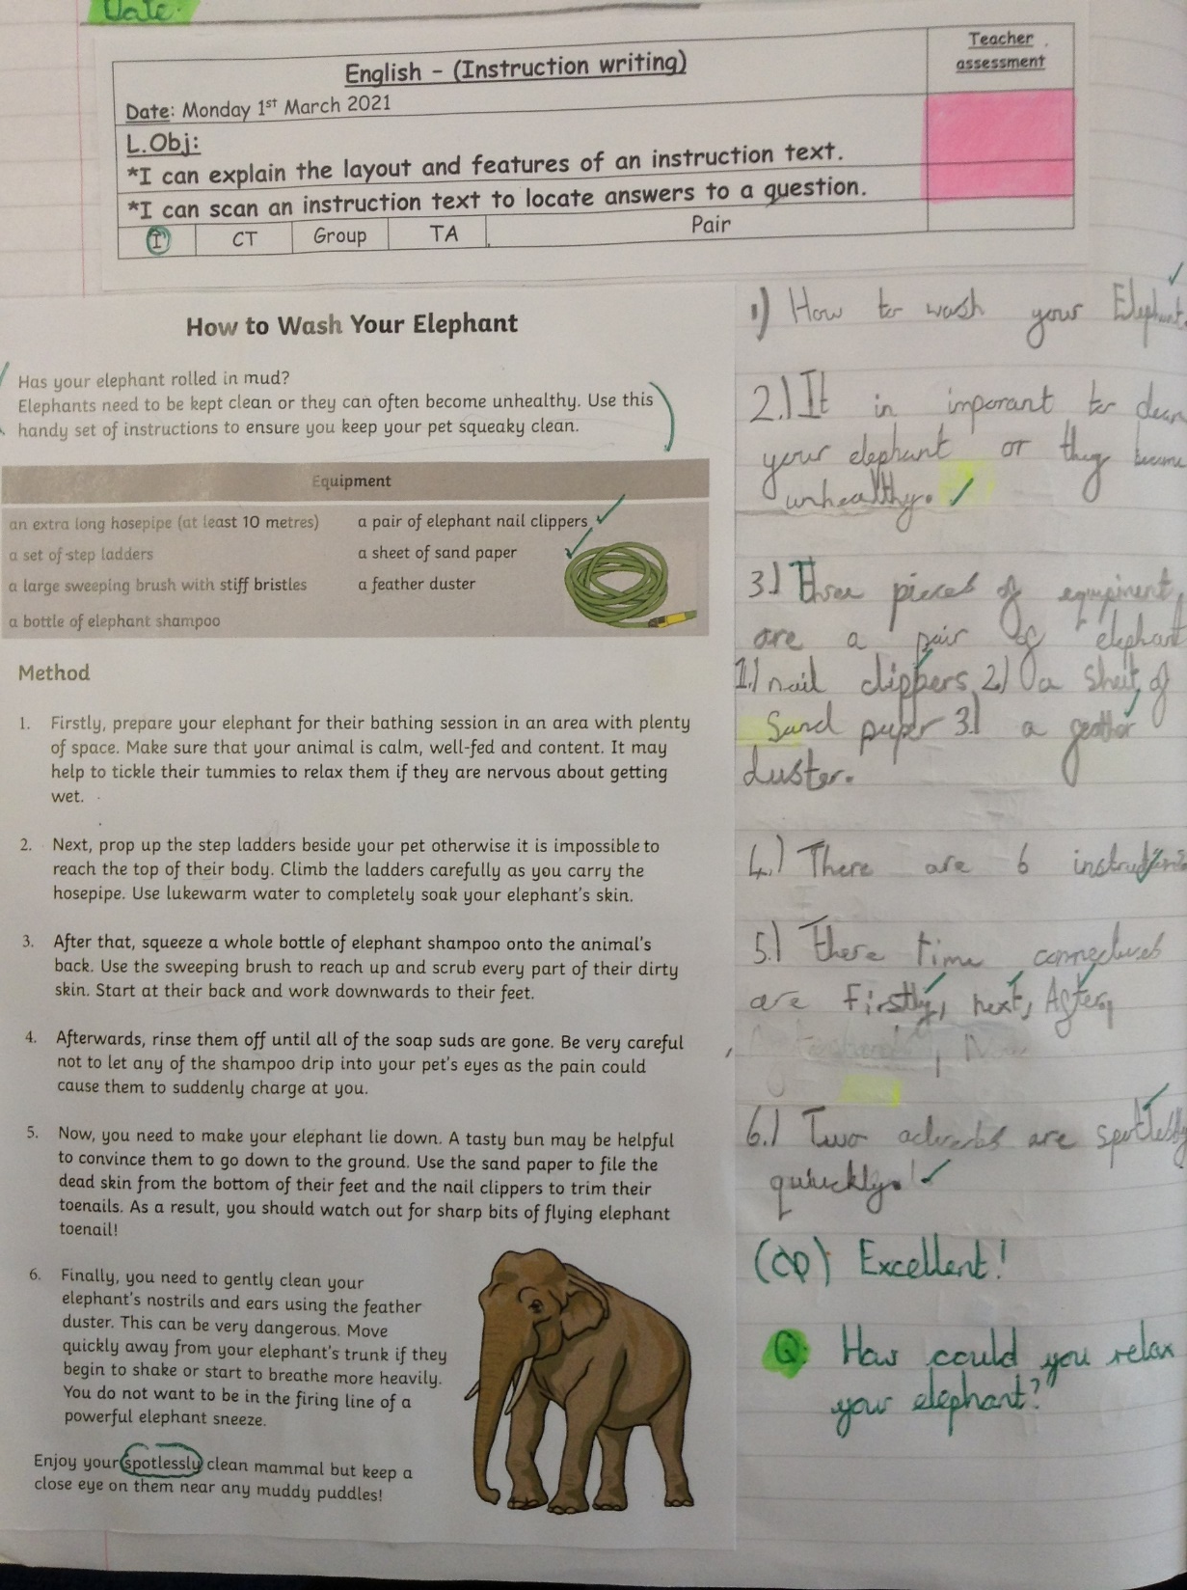
Sophie in Y5 has read the instruction text really carefully to answer the questions correctly.

Slide 2
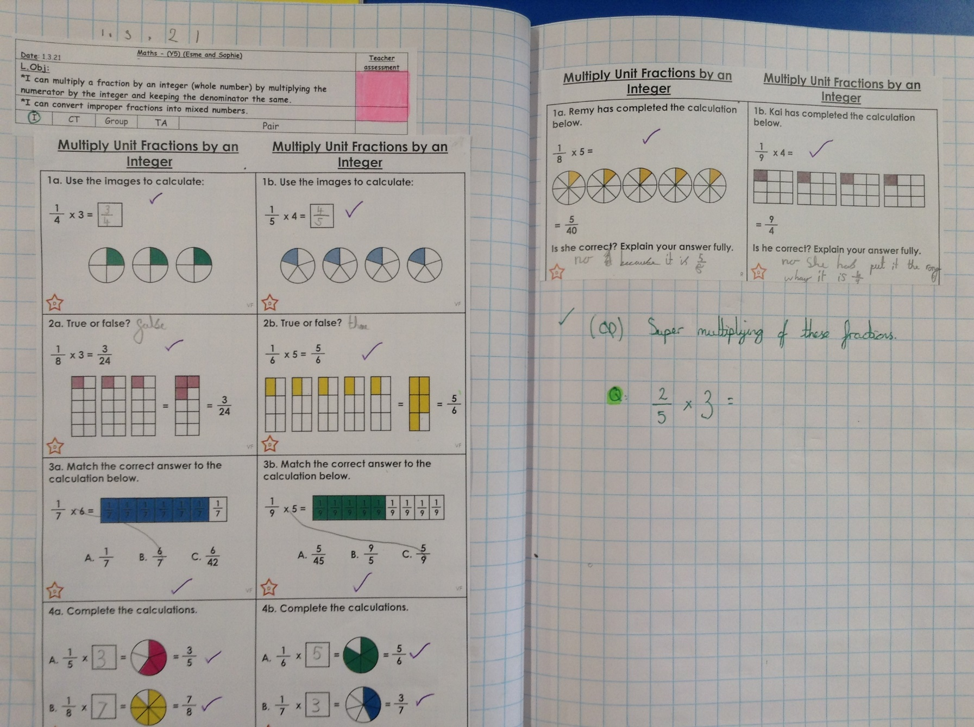
Sophie in Y5s has thought superbly to help her to multiply these fractions by a whole number.

Slide 3
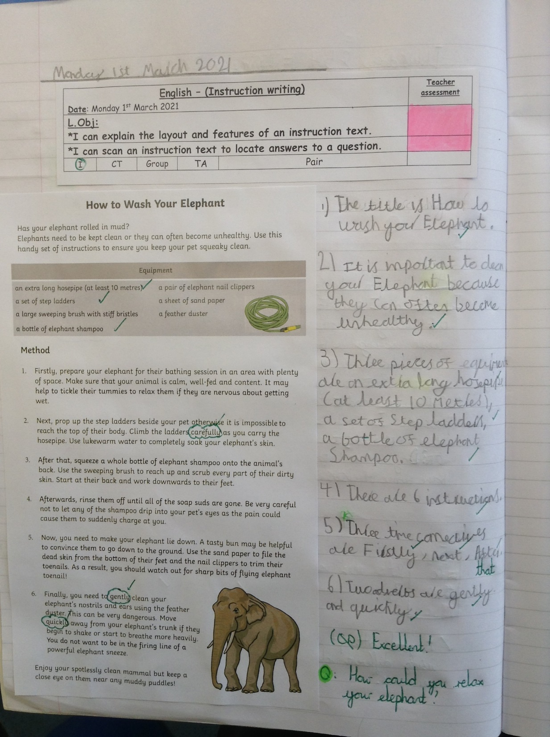
Esme ahs read her instruction text really carefully to answer the questions correctly.

Slide 4
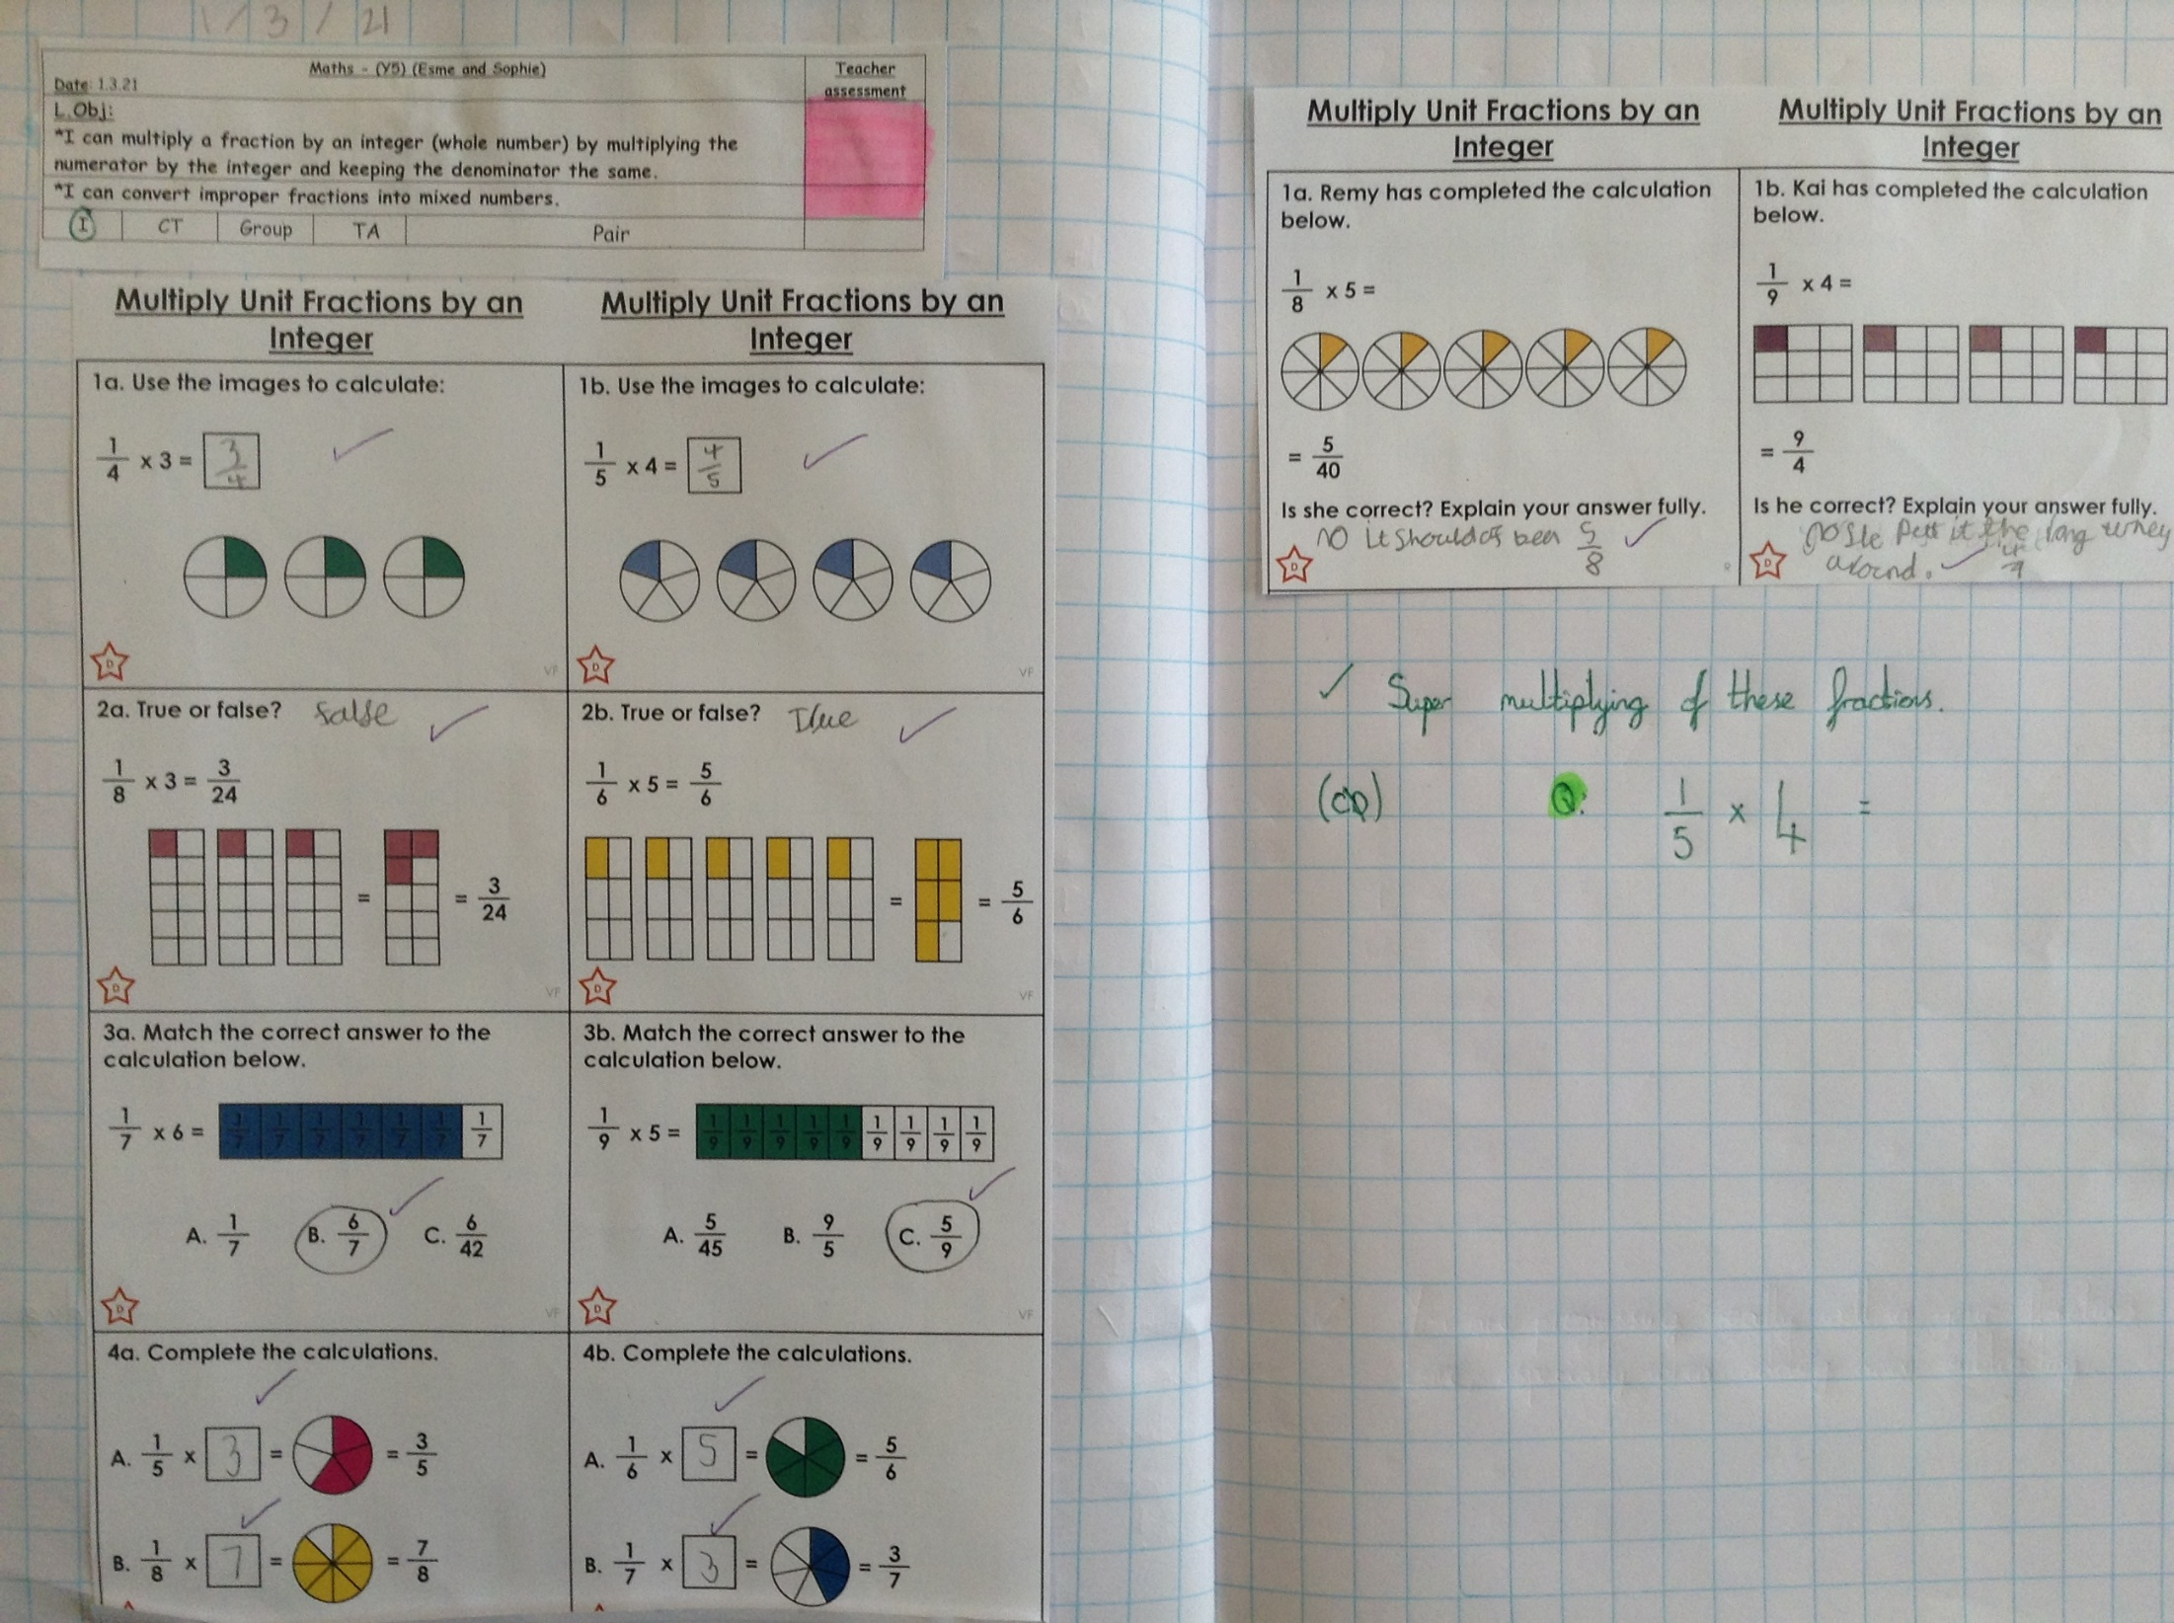
Esme has thought very carefully to multiply her fractions by a whole number.

Slide 5
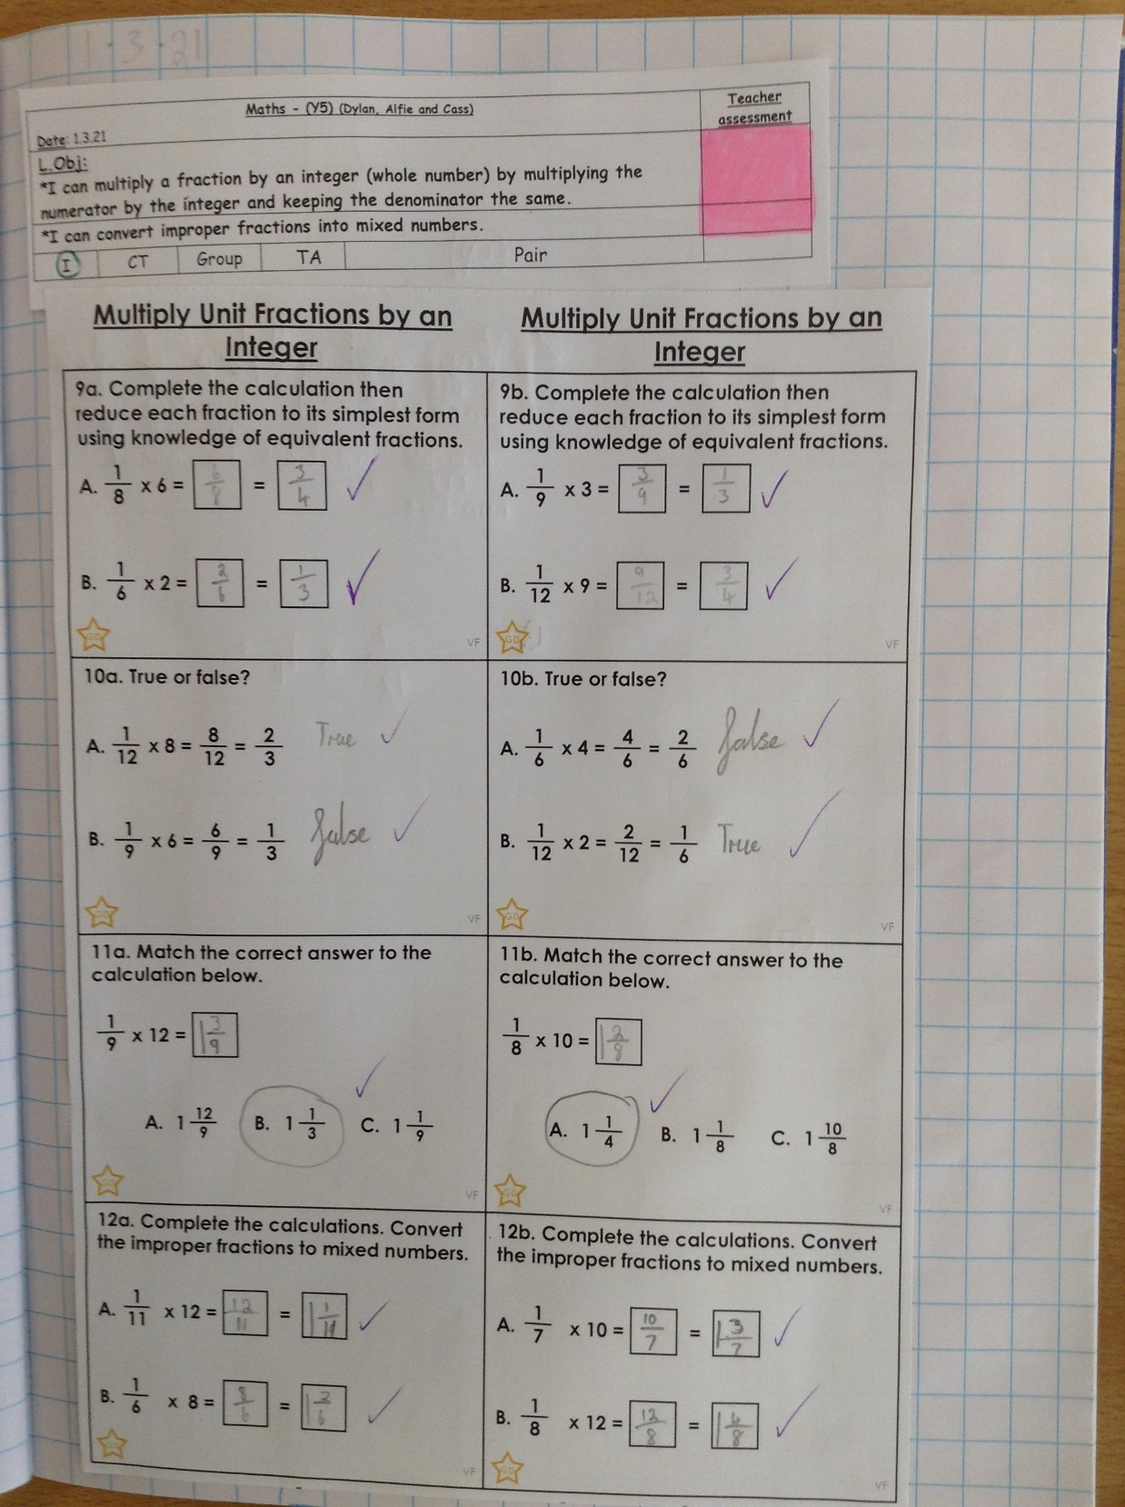
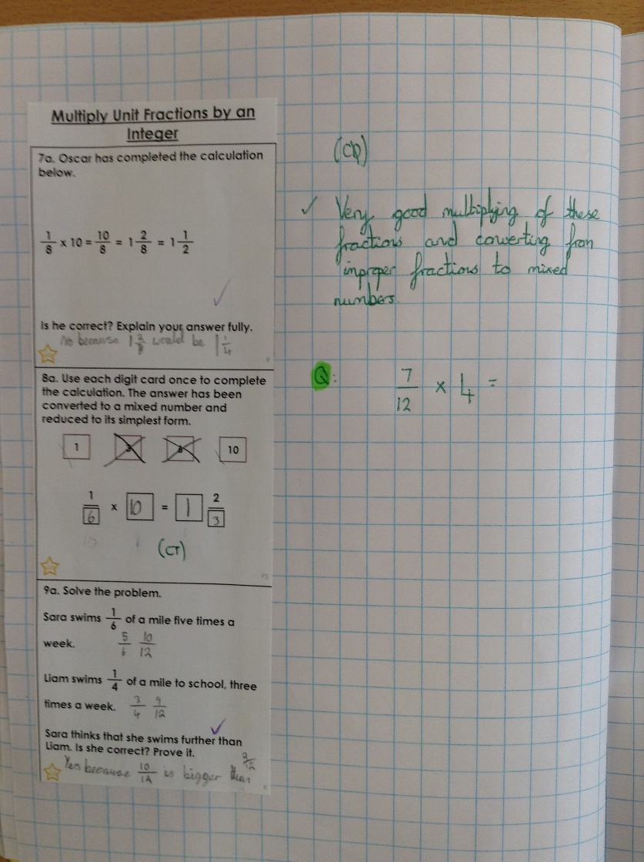
Cass has multiplied these fractions by a whole number superbly.

Slide 6
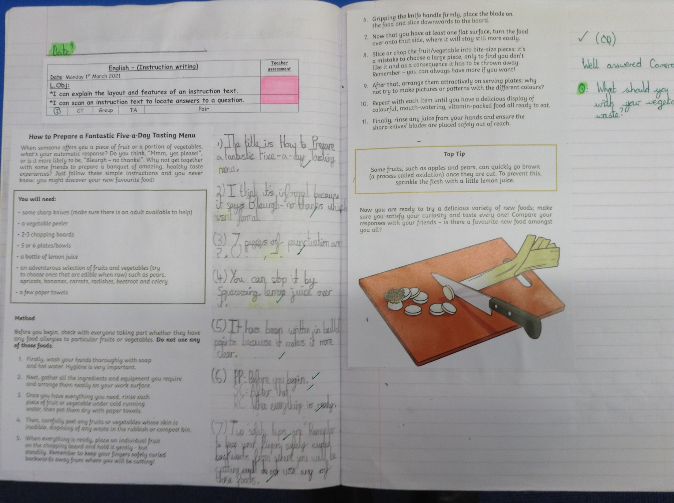
Cameron has read the instruction text carefully.

Slide 7
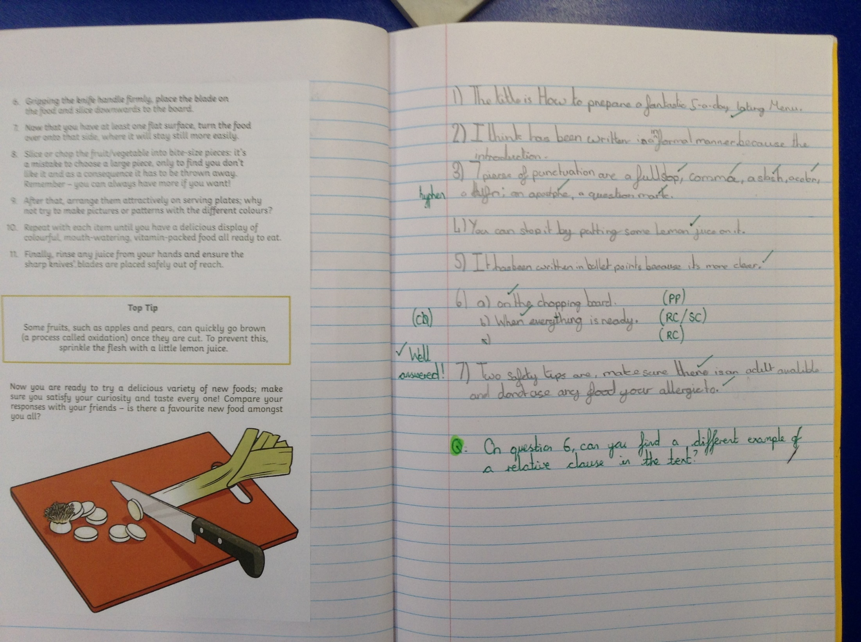
Isla has read the instruction text carefully to answer the questions correctly.

Slide 8
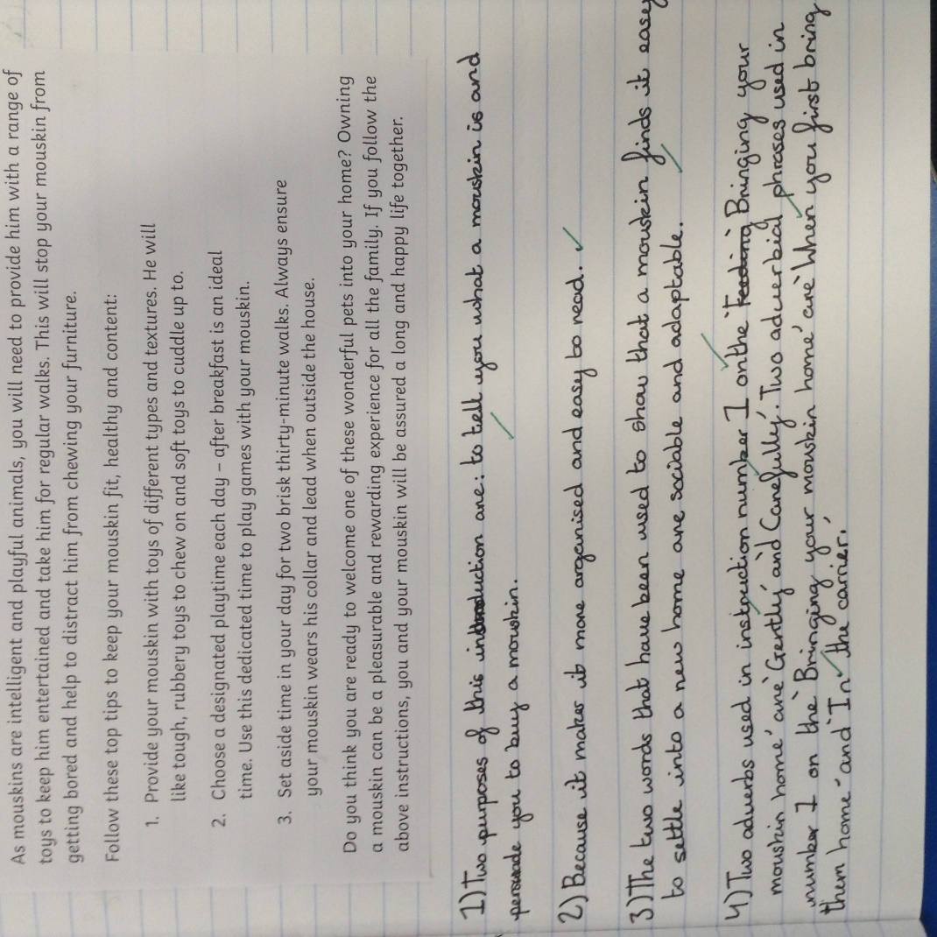
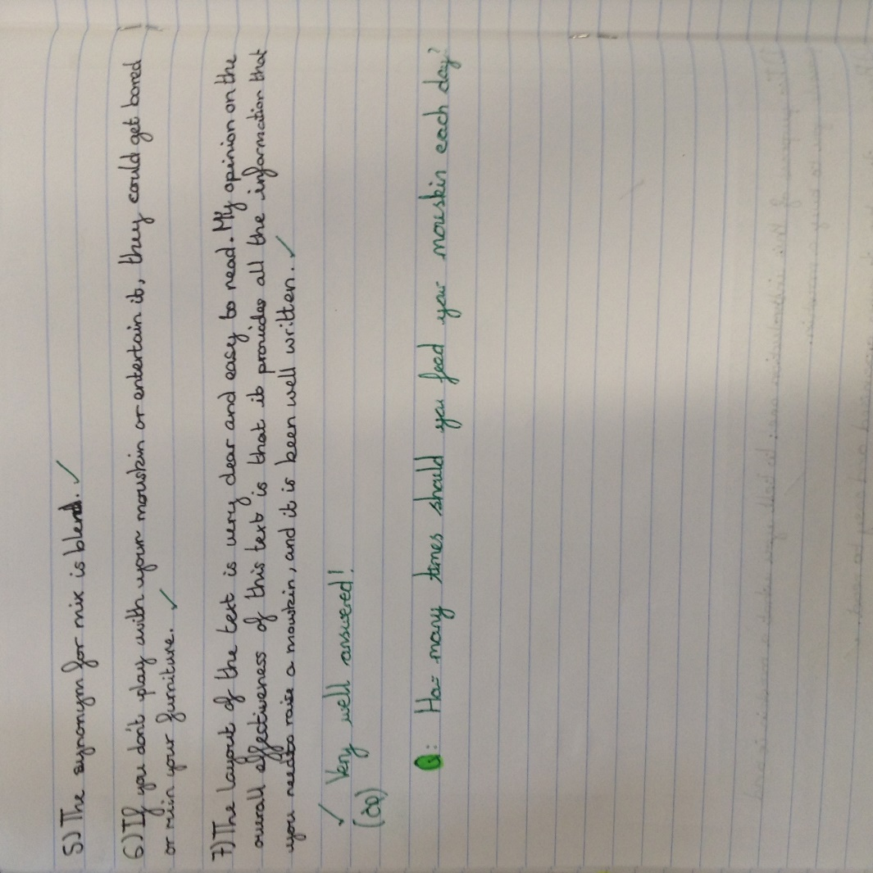
Heidi has read her instruction text carefully to locate the answers to the questions.

Slide 9
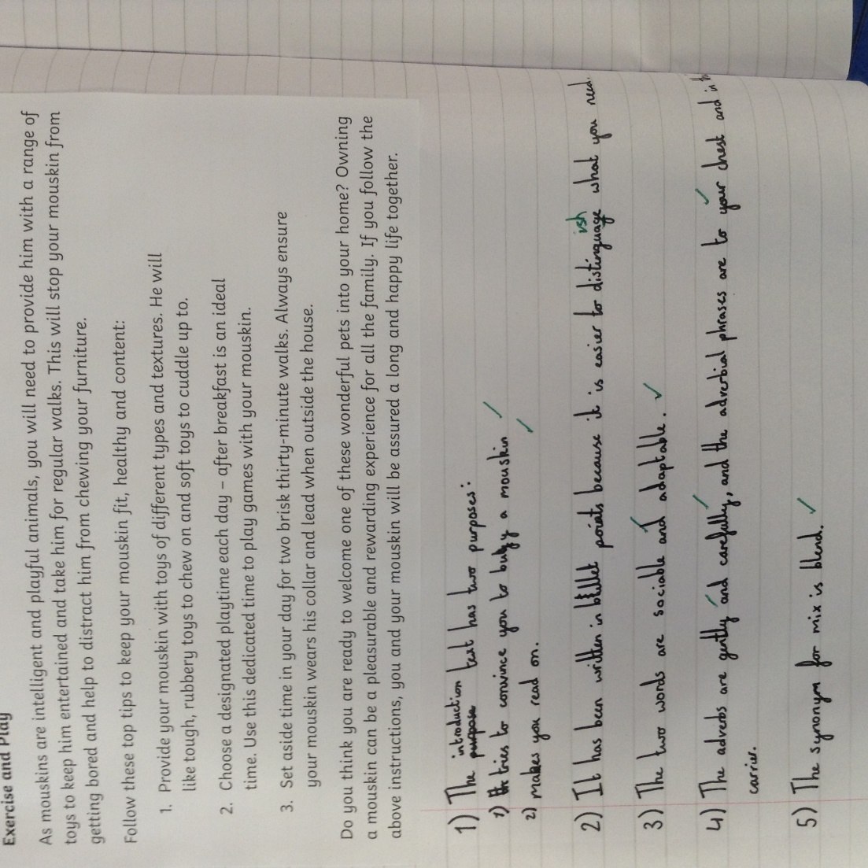
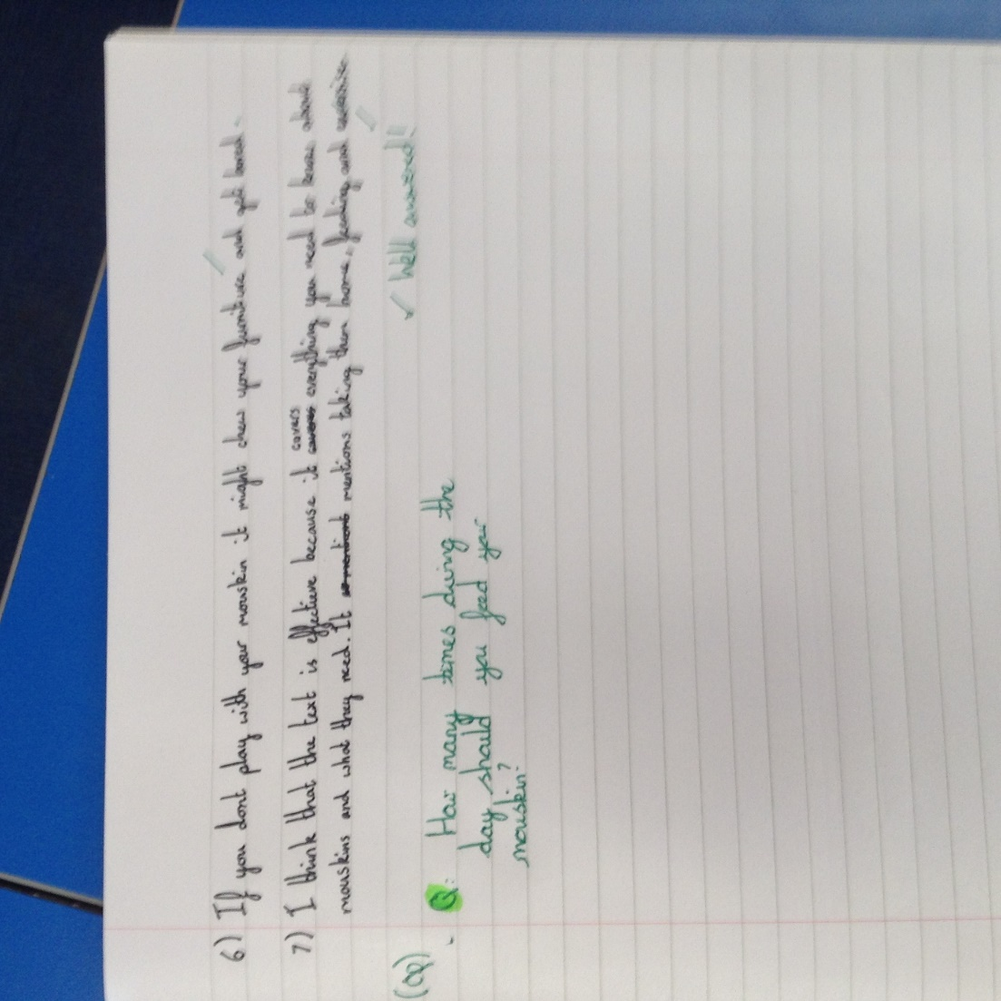
Amy has read her instruction text carefully to locate the answers to the questions.

Slide 10
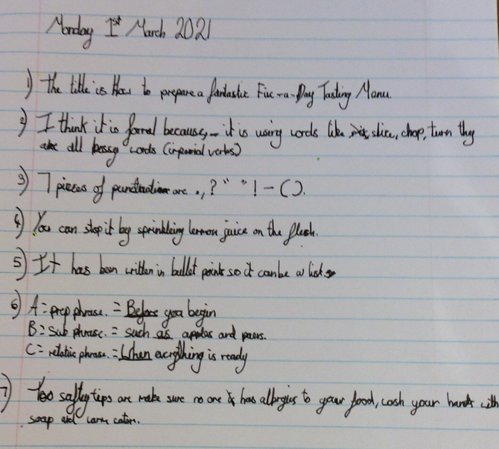
Holly has been reading her instruction text to answer the questions.

Slide 11
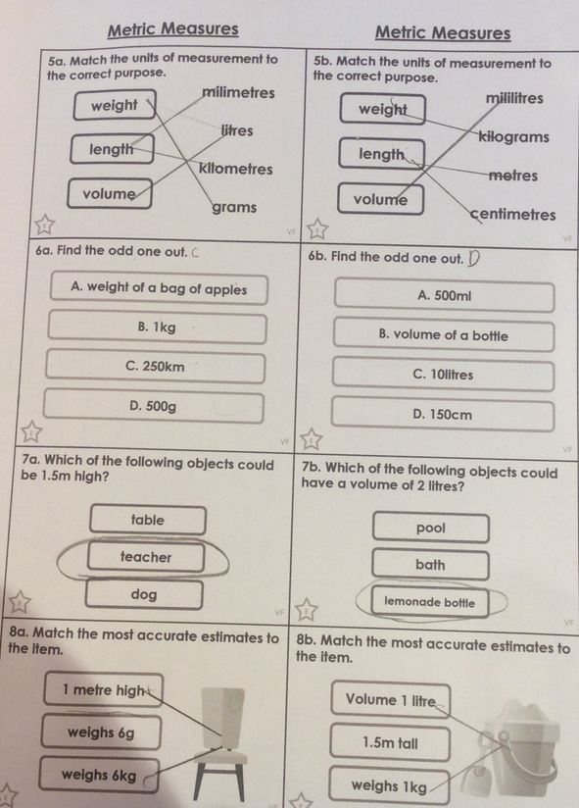
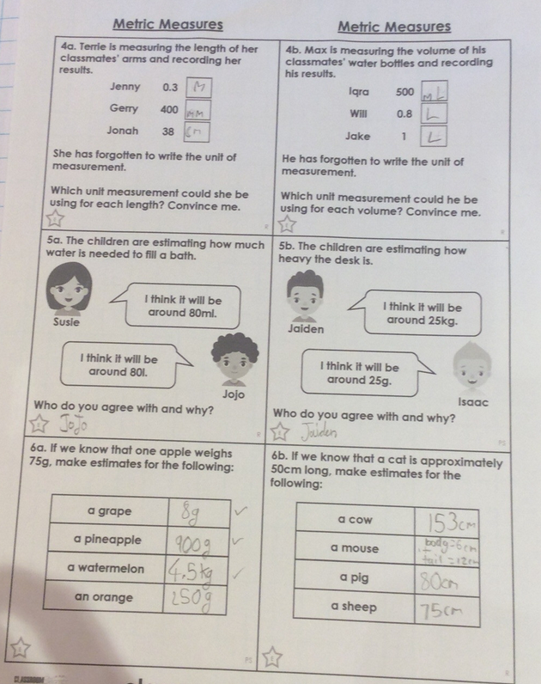
Holly H has been thinking about the different units of measurement.

Slide 12
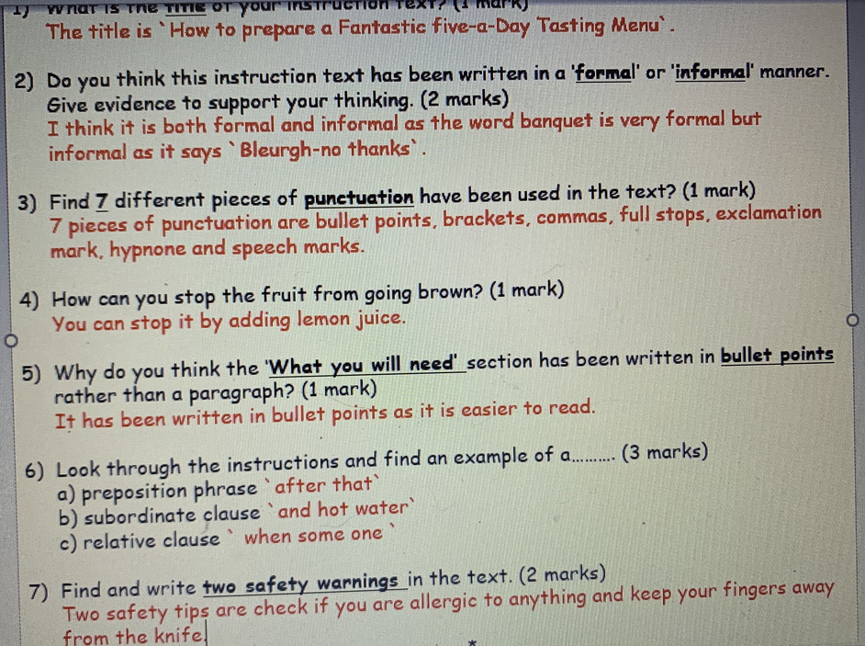
Zoe has read the instruction text to answer the questions.

Slide 13
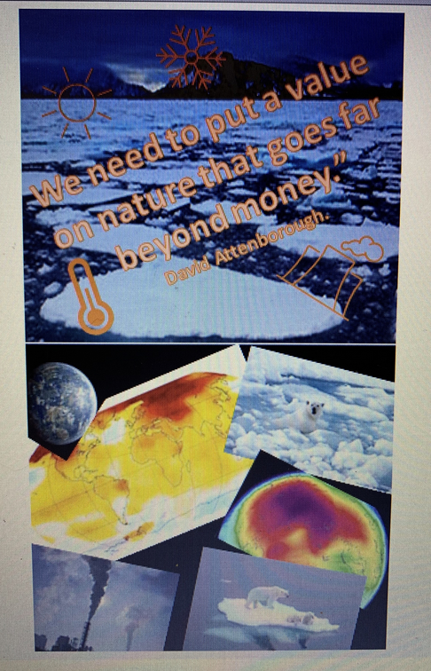
Zoe has produced a poster to persuade others to think about the affects of climate change.

Slide 14
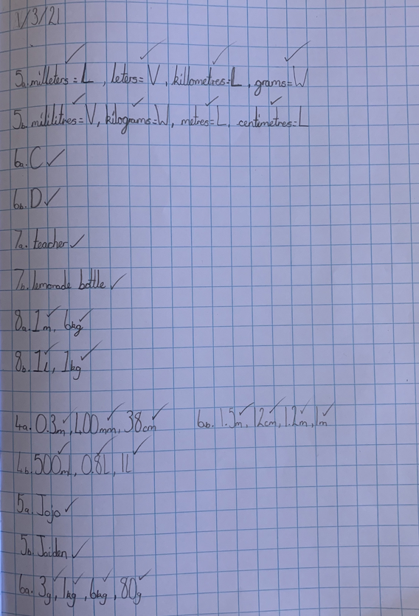
Sophie in Y6 has been thinking carefully about different units or measurement.

Slide 15
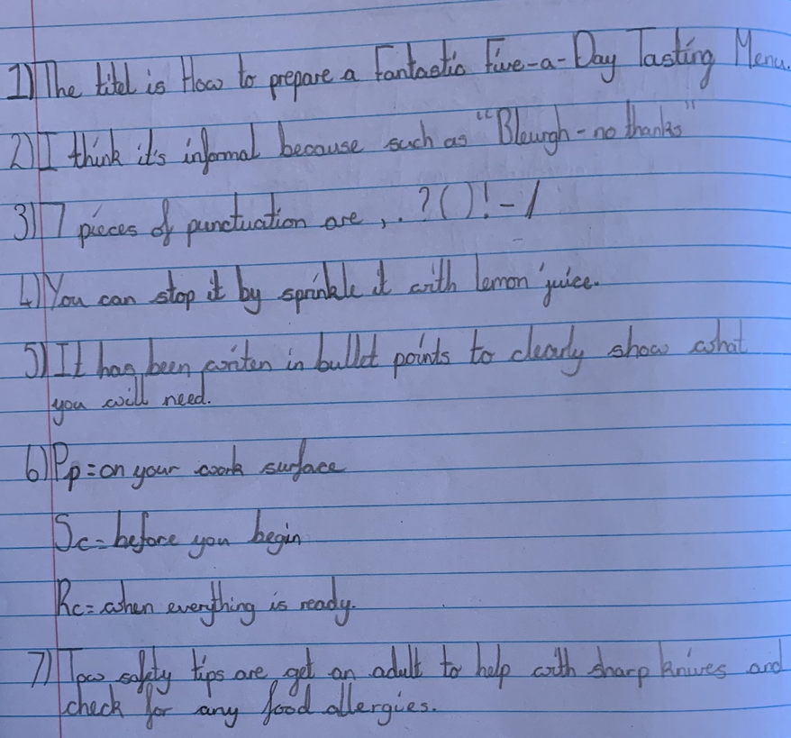
Sophie in Y6 has read her instruction text carefully to answer the questions really well.

Slide 16
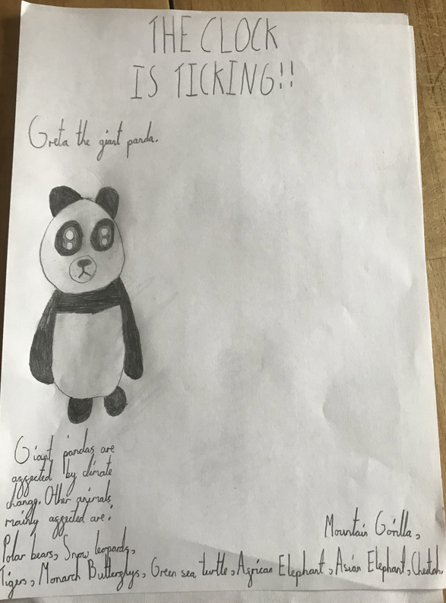
Ariana has made an excellent start on her climate change poster to warn others of the affects it is having on the polar parts of our world.

Slide 17
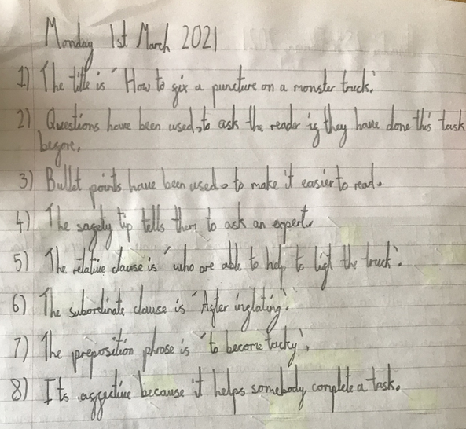
Ariana has read her instruction text carefully to answer these questions well.

Slide 18
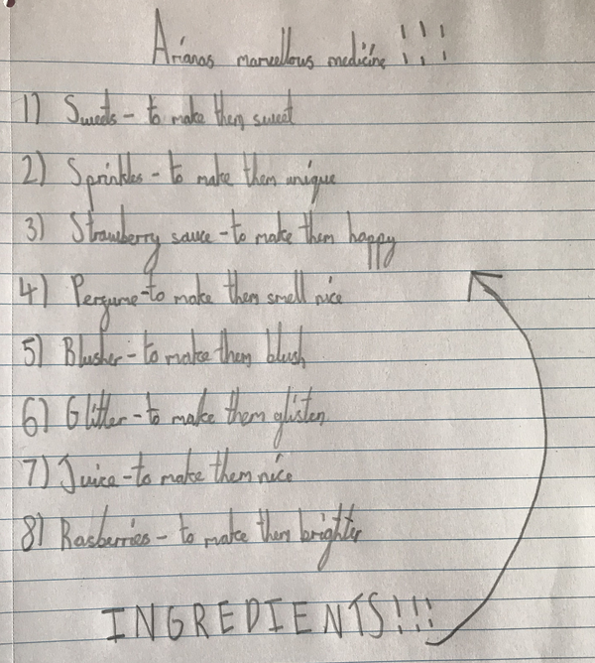
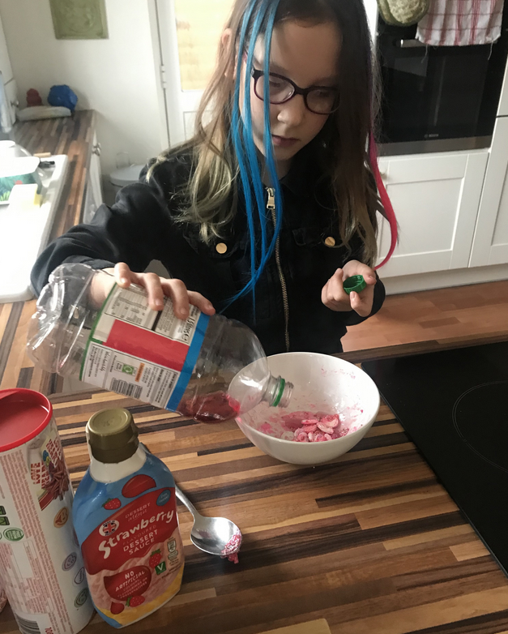
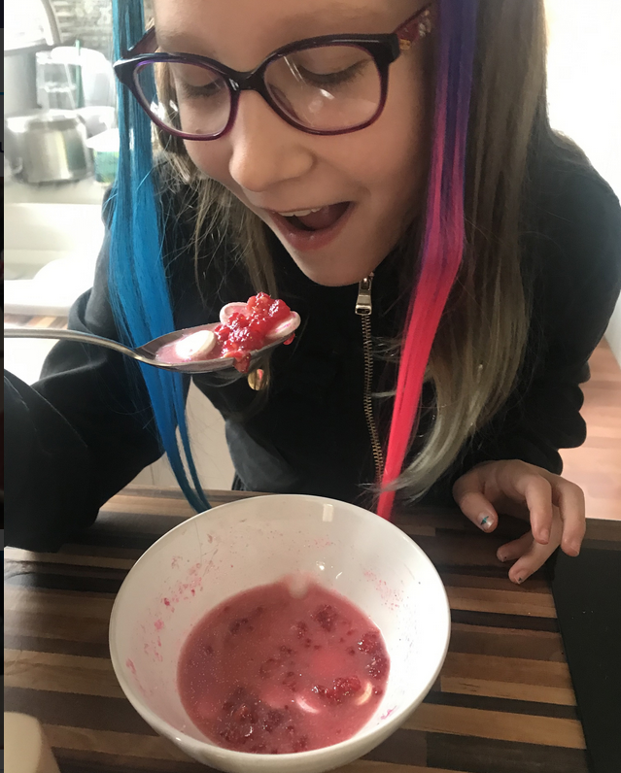
Ariana’s marvellous medicine

Slide 19
Sam has recommended this book to others as a really good read!

Slide 20
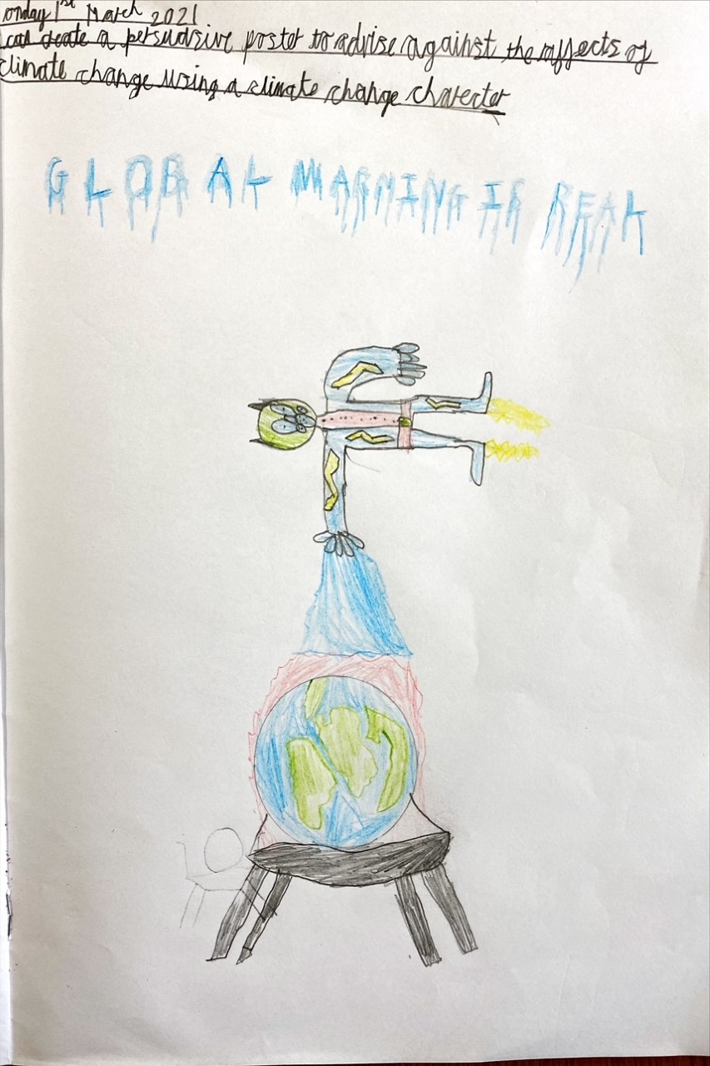
Sam has designed his climate change poster using his own character.

Slide 21
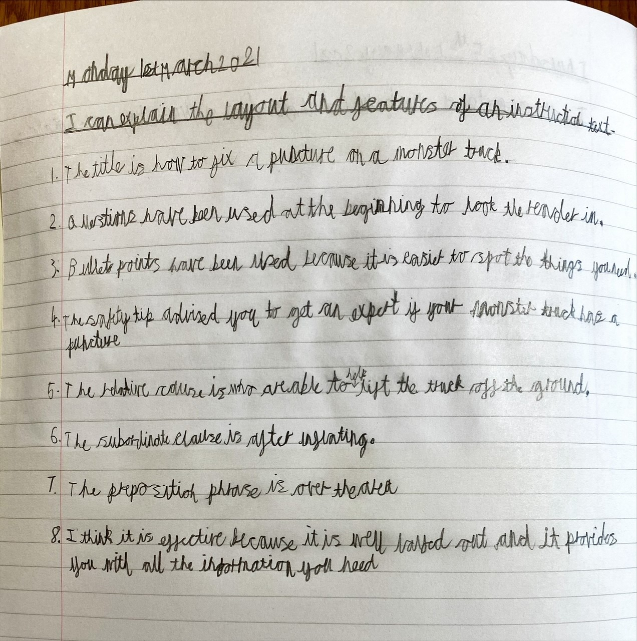
Sam has read the instruction text carefully to answer questions about it.

Slide 22
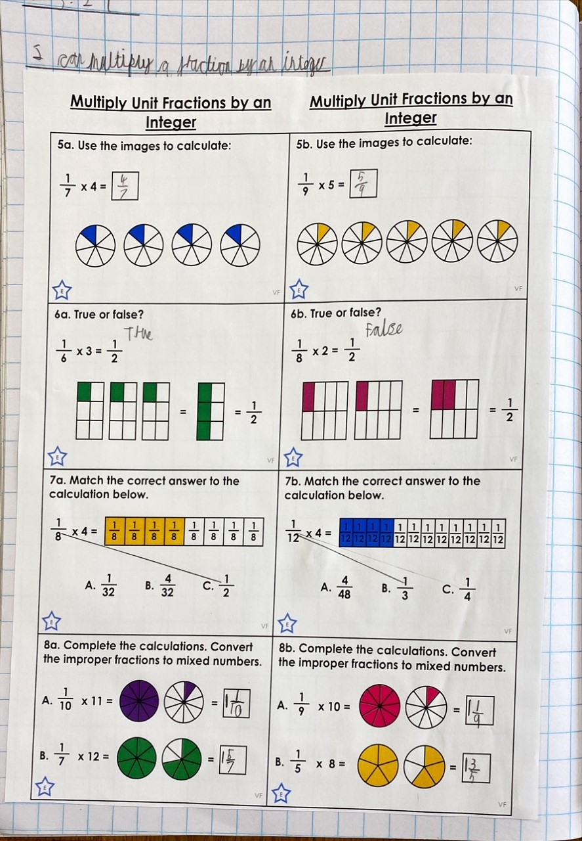
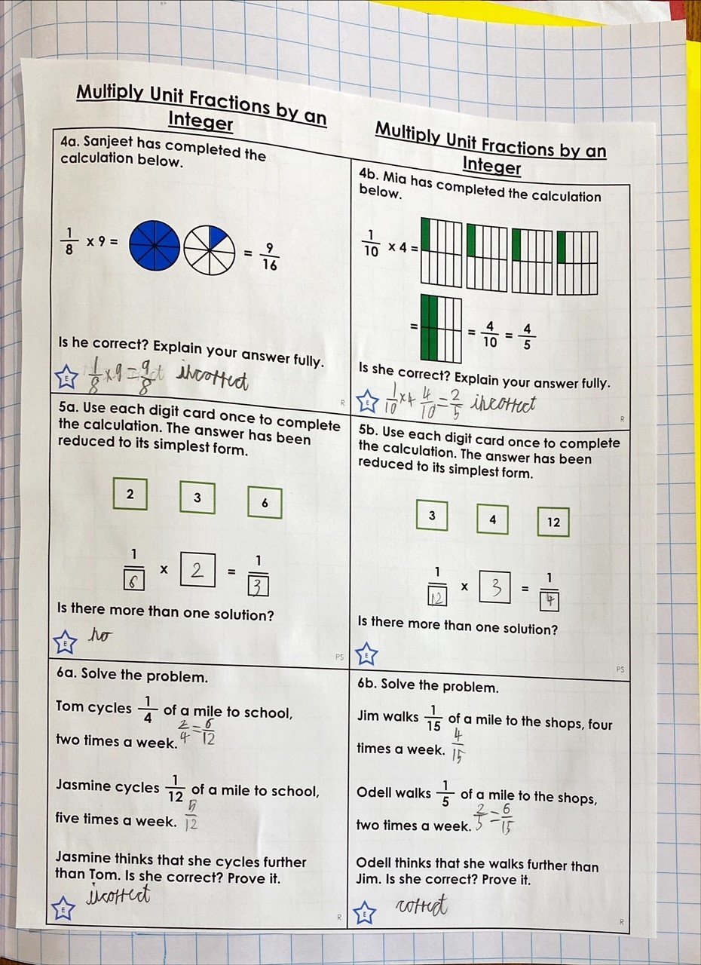
Sam has challenged himself well in maths today.

