Slide 1
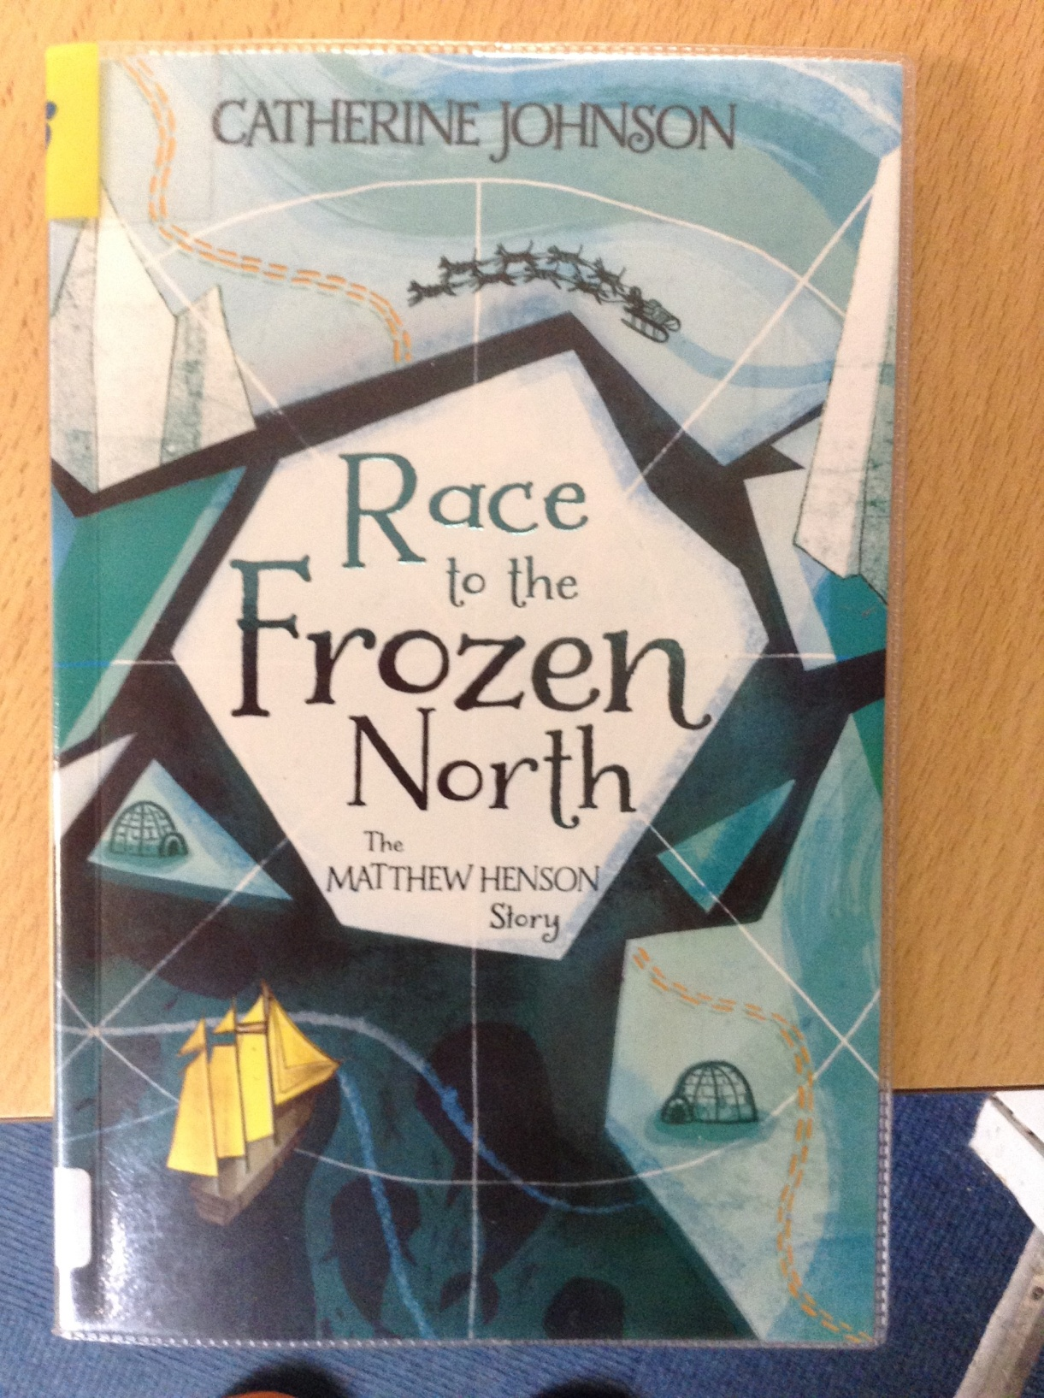
GUIDED READING
Y6
Chapter 6
Pages 49-57

Slide 2
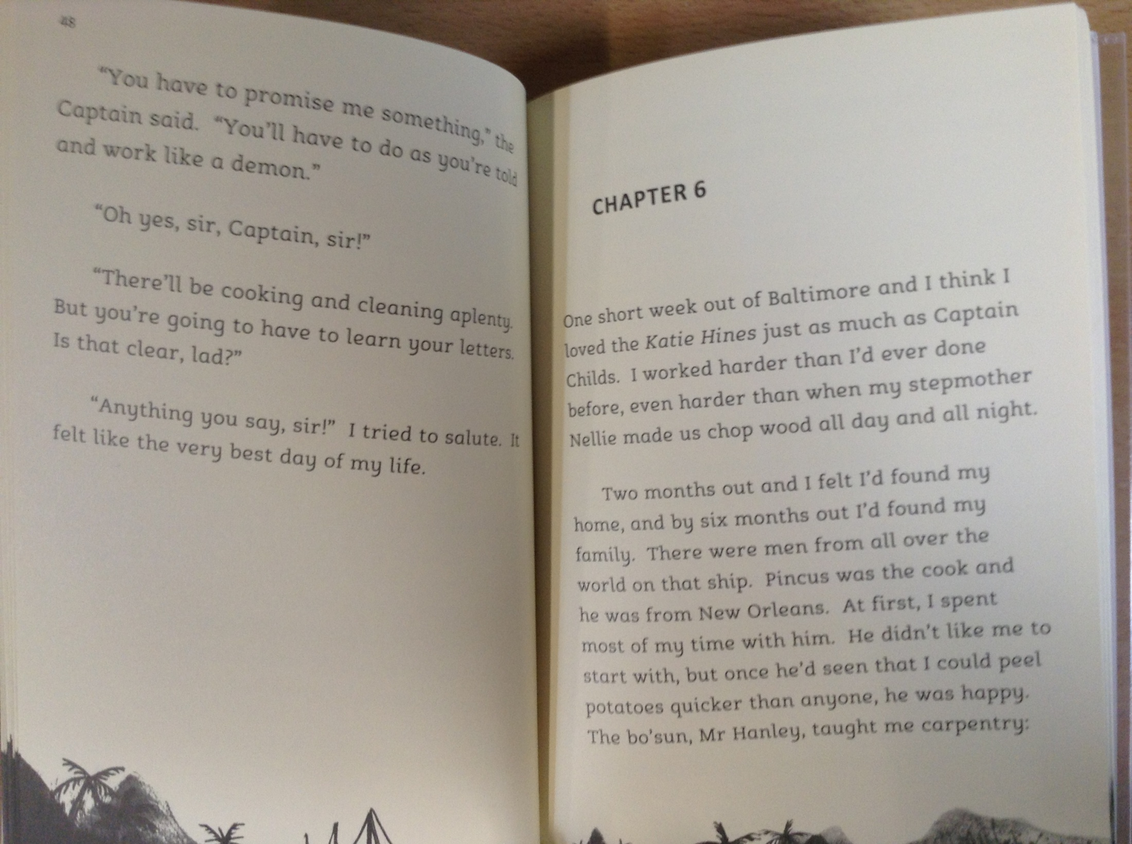

Slide 3
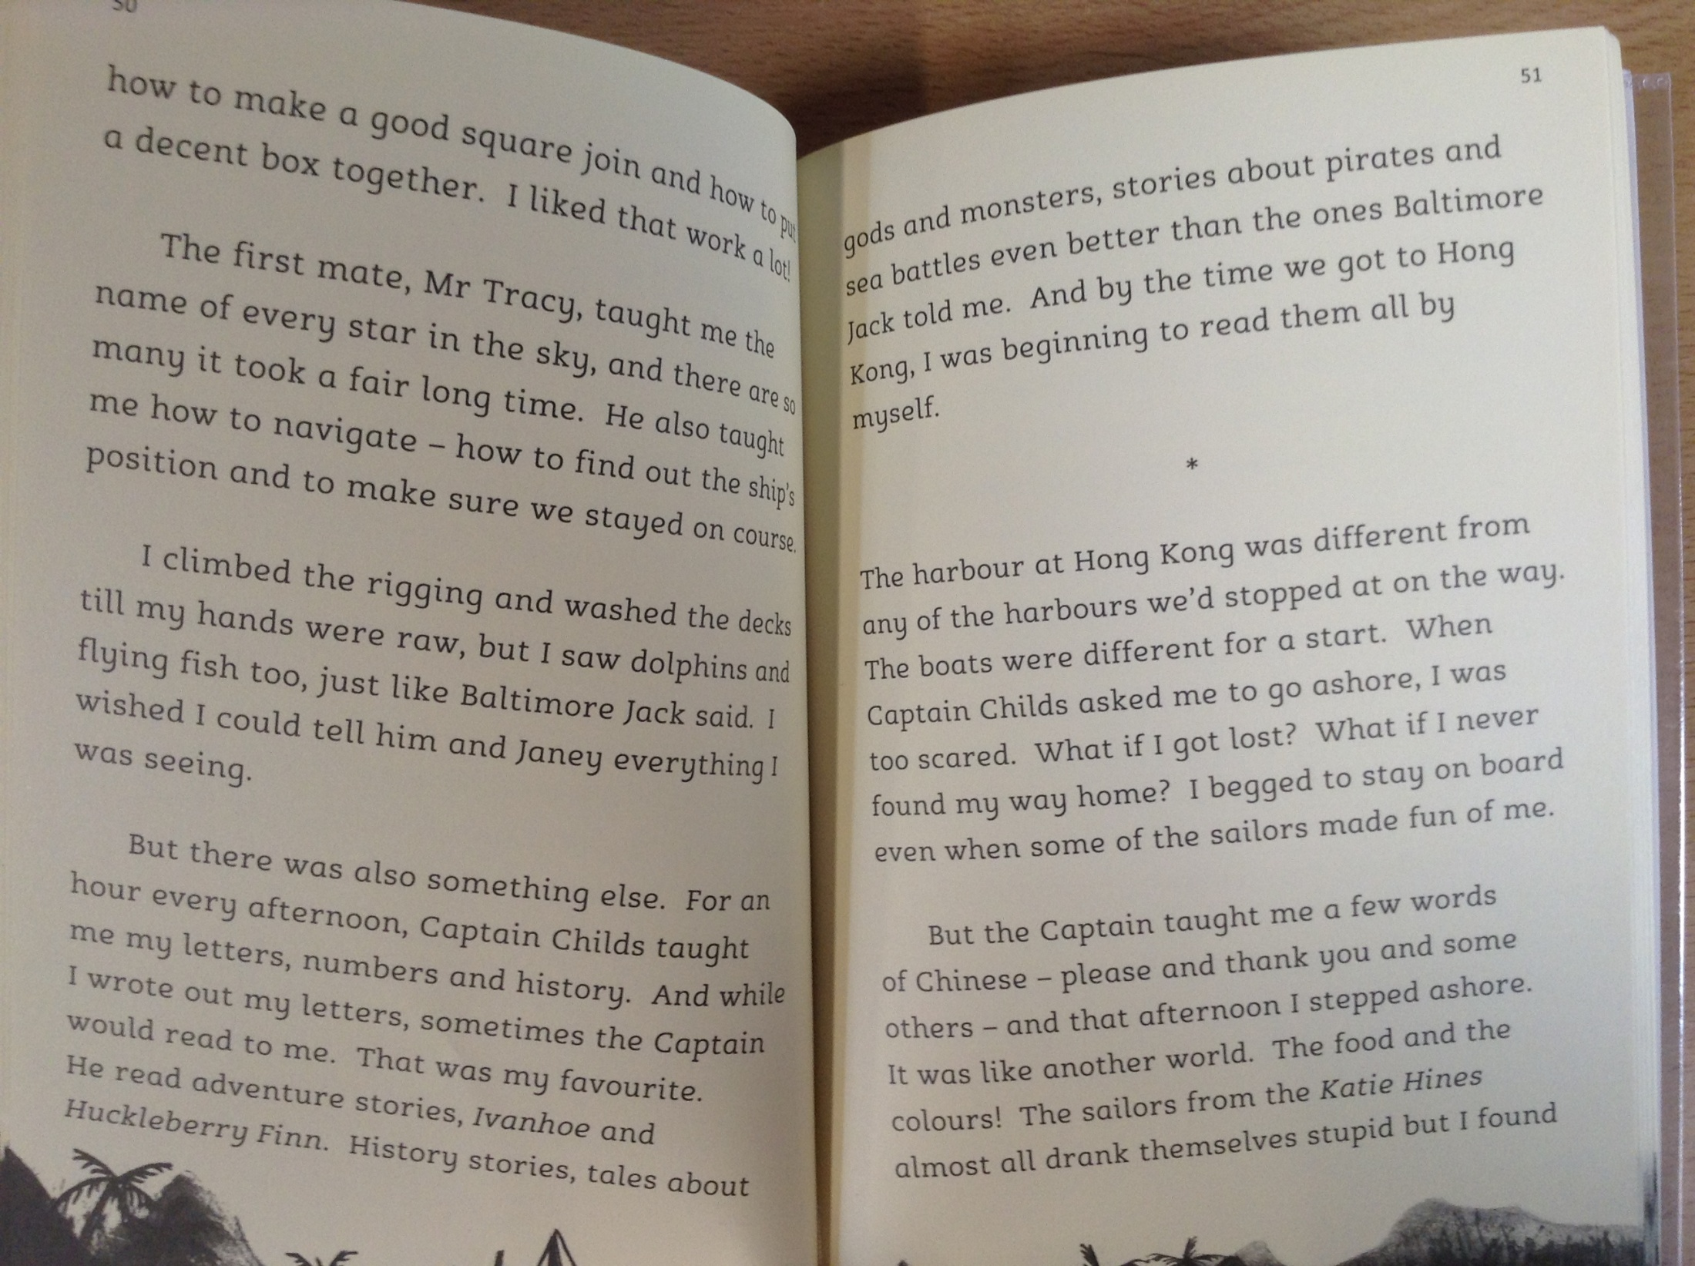

Slide 4
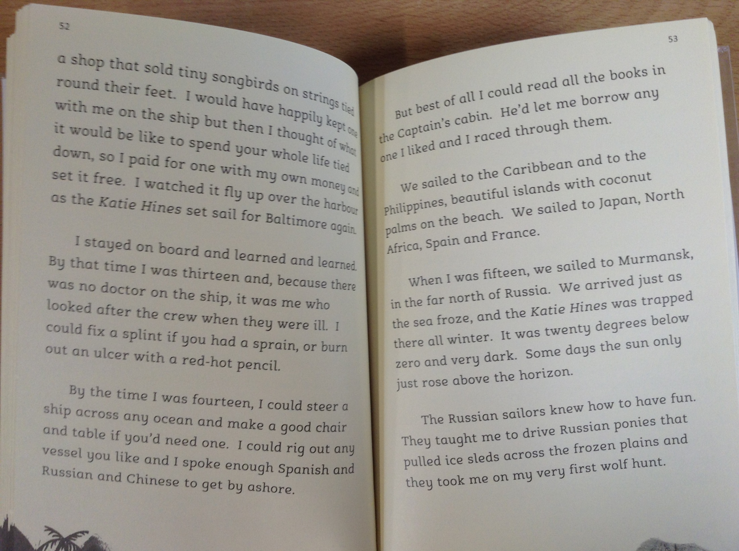

Slide 5
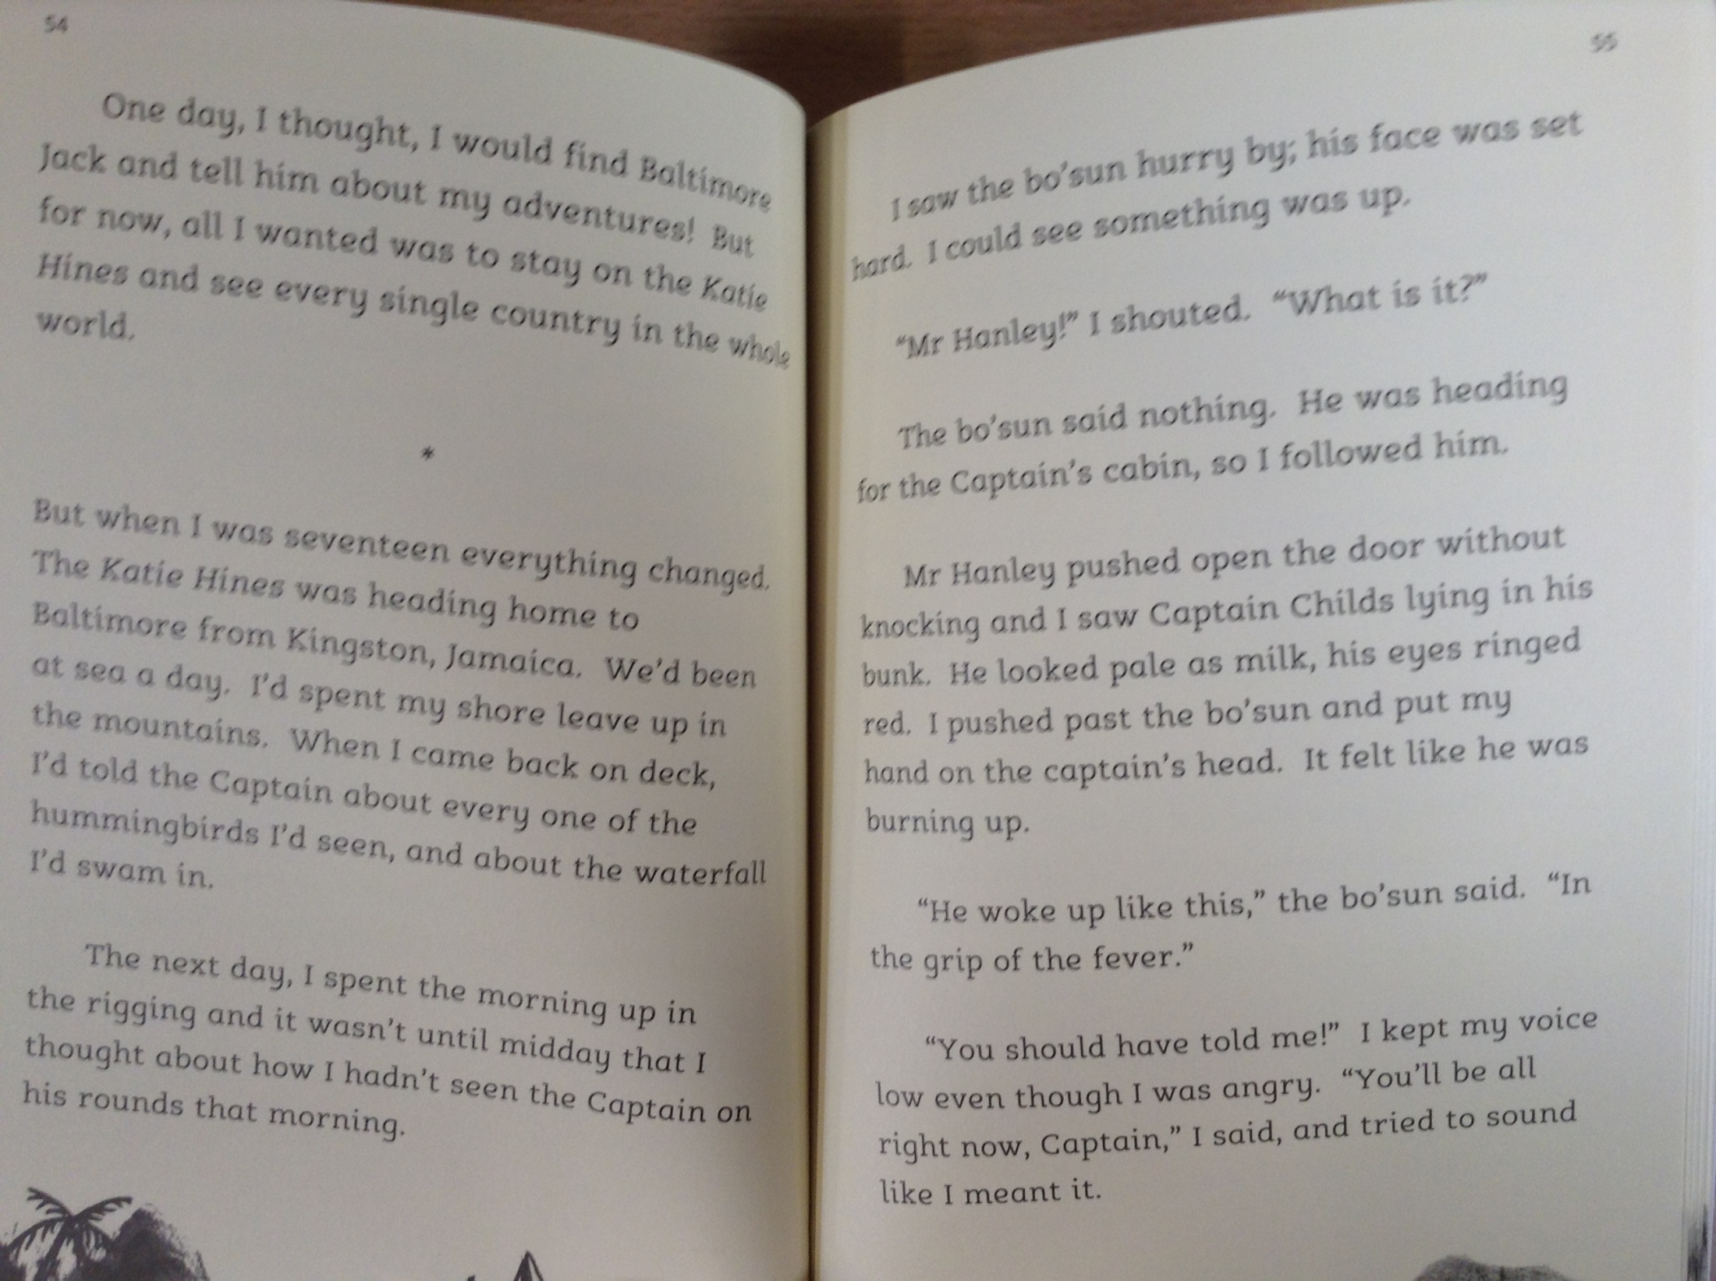

Slide 6
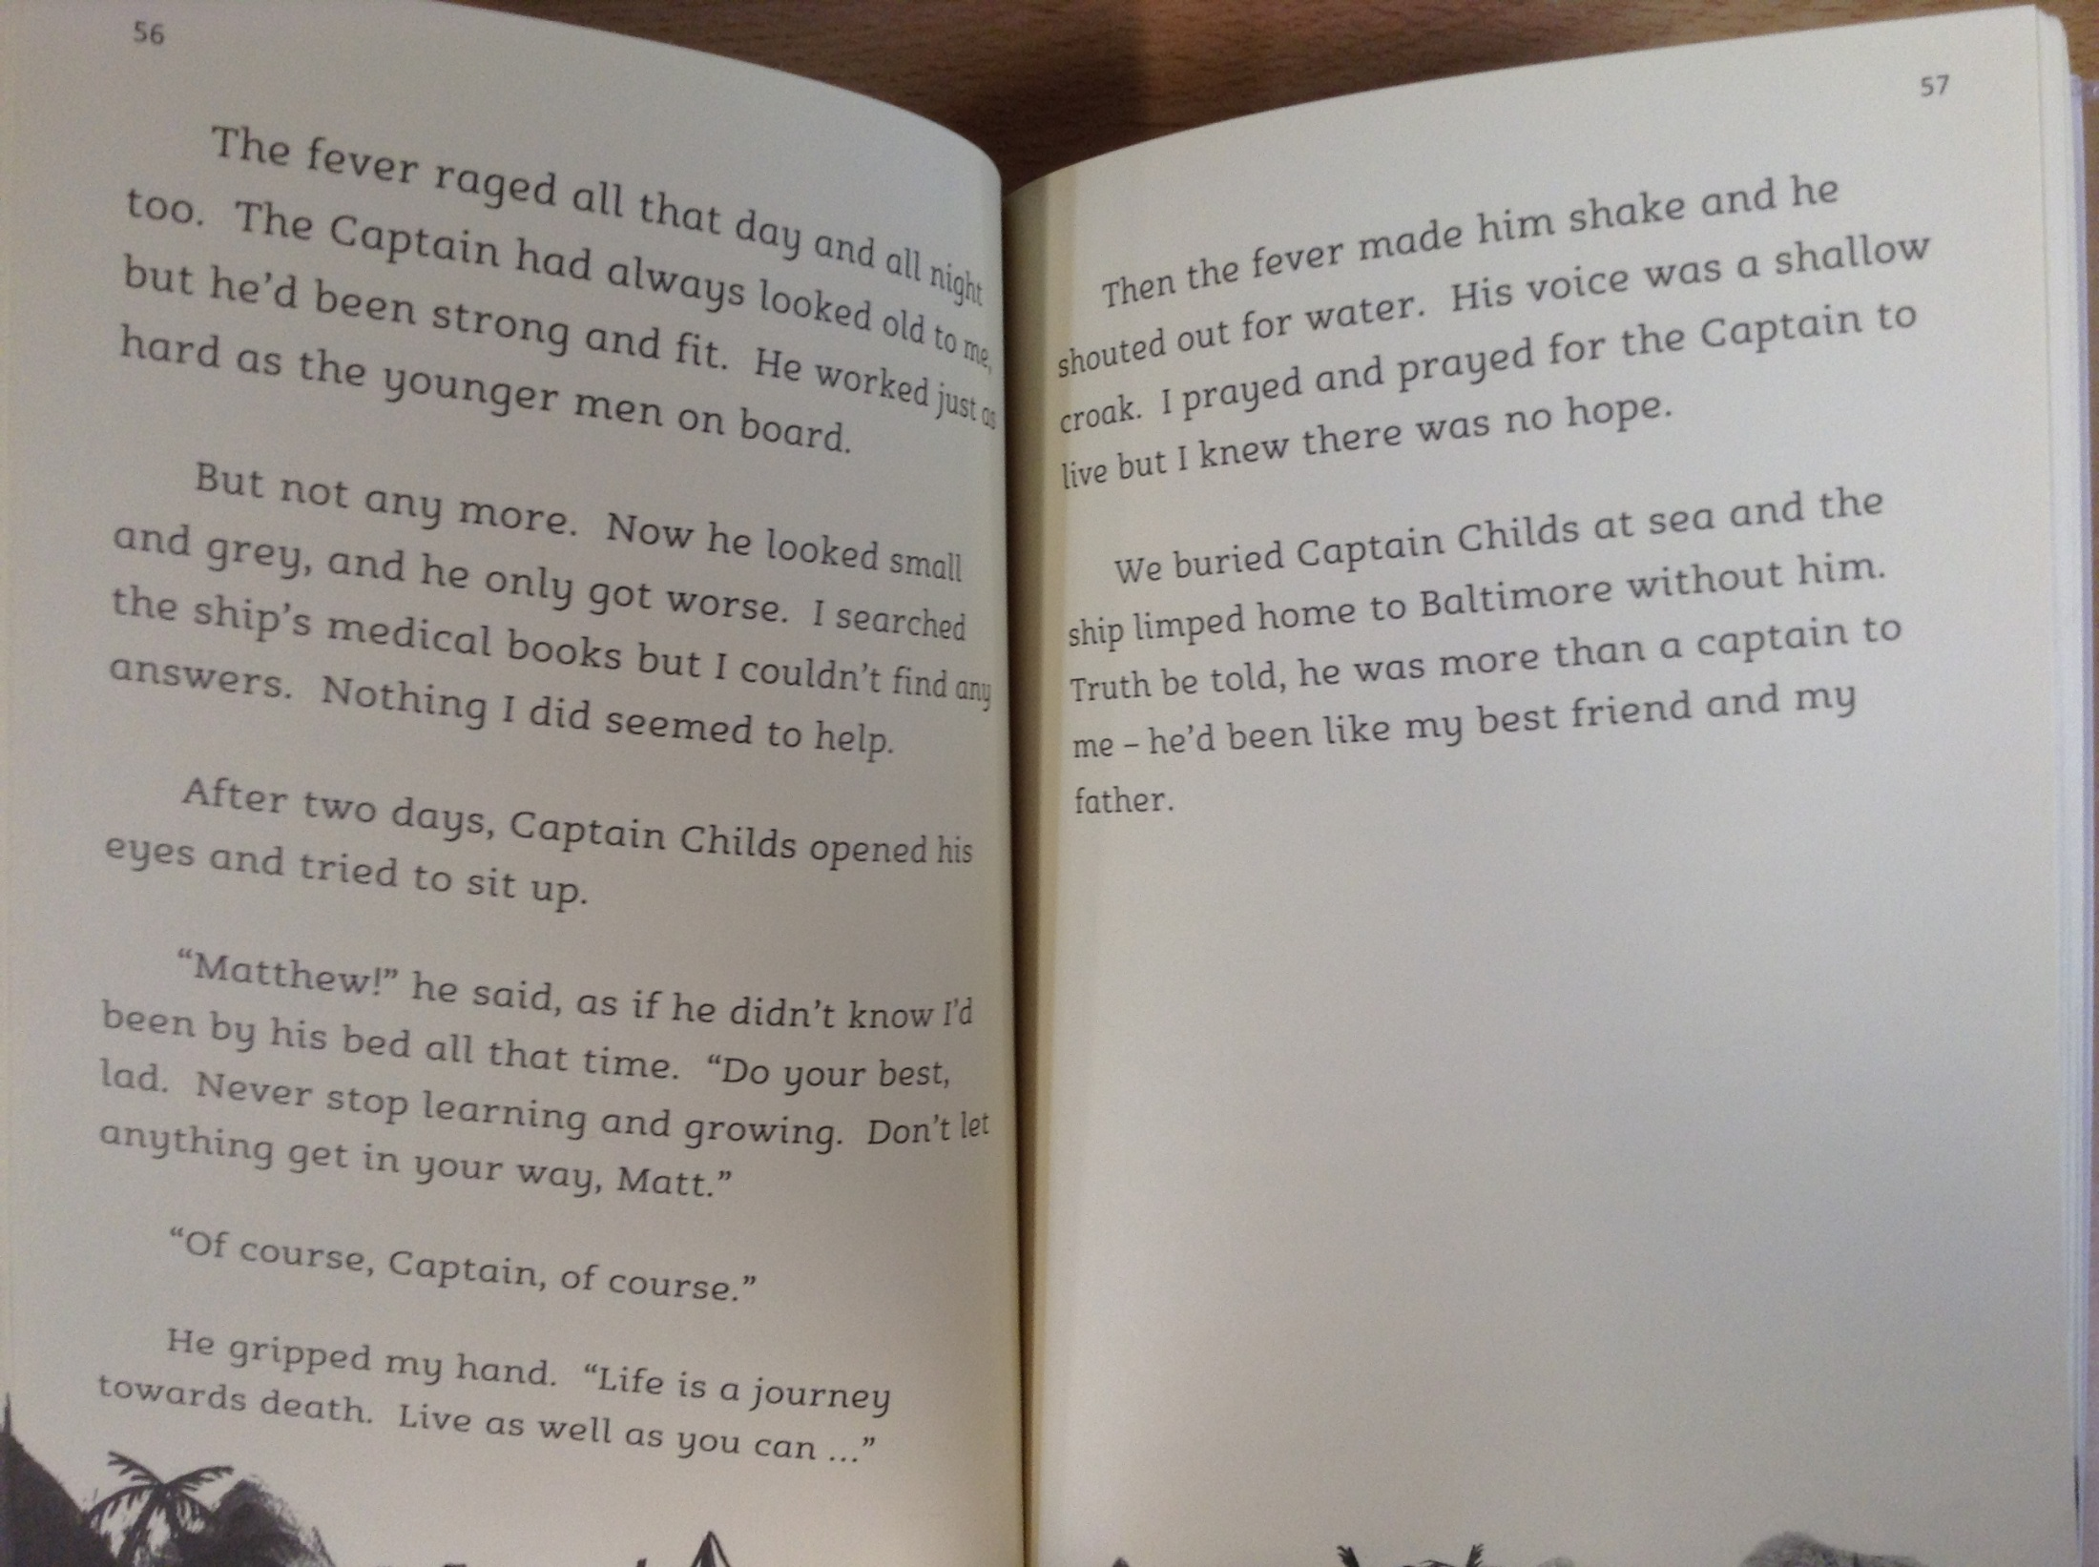

Slide 7
*Please note – the word ‘coloured’ has been used to describe characters in the story. This word is offensive and shouldn’t be used in modern society.
Match the ship’s crew with their jobs on board.
Mr Tracy a) in charge of making food
Mr Hanley b) in charge of the crew
Pincus c) the deck boss
25) How else did Captain Childs support Matthew during the journey?
26) Name two new skills that Matthew had learned whilst on his travels.
27) What caused Captain Childs’ life to end?

