Slide 1
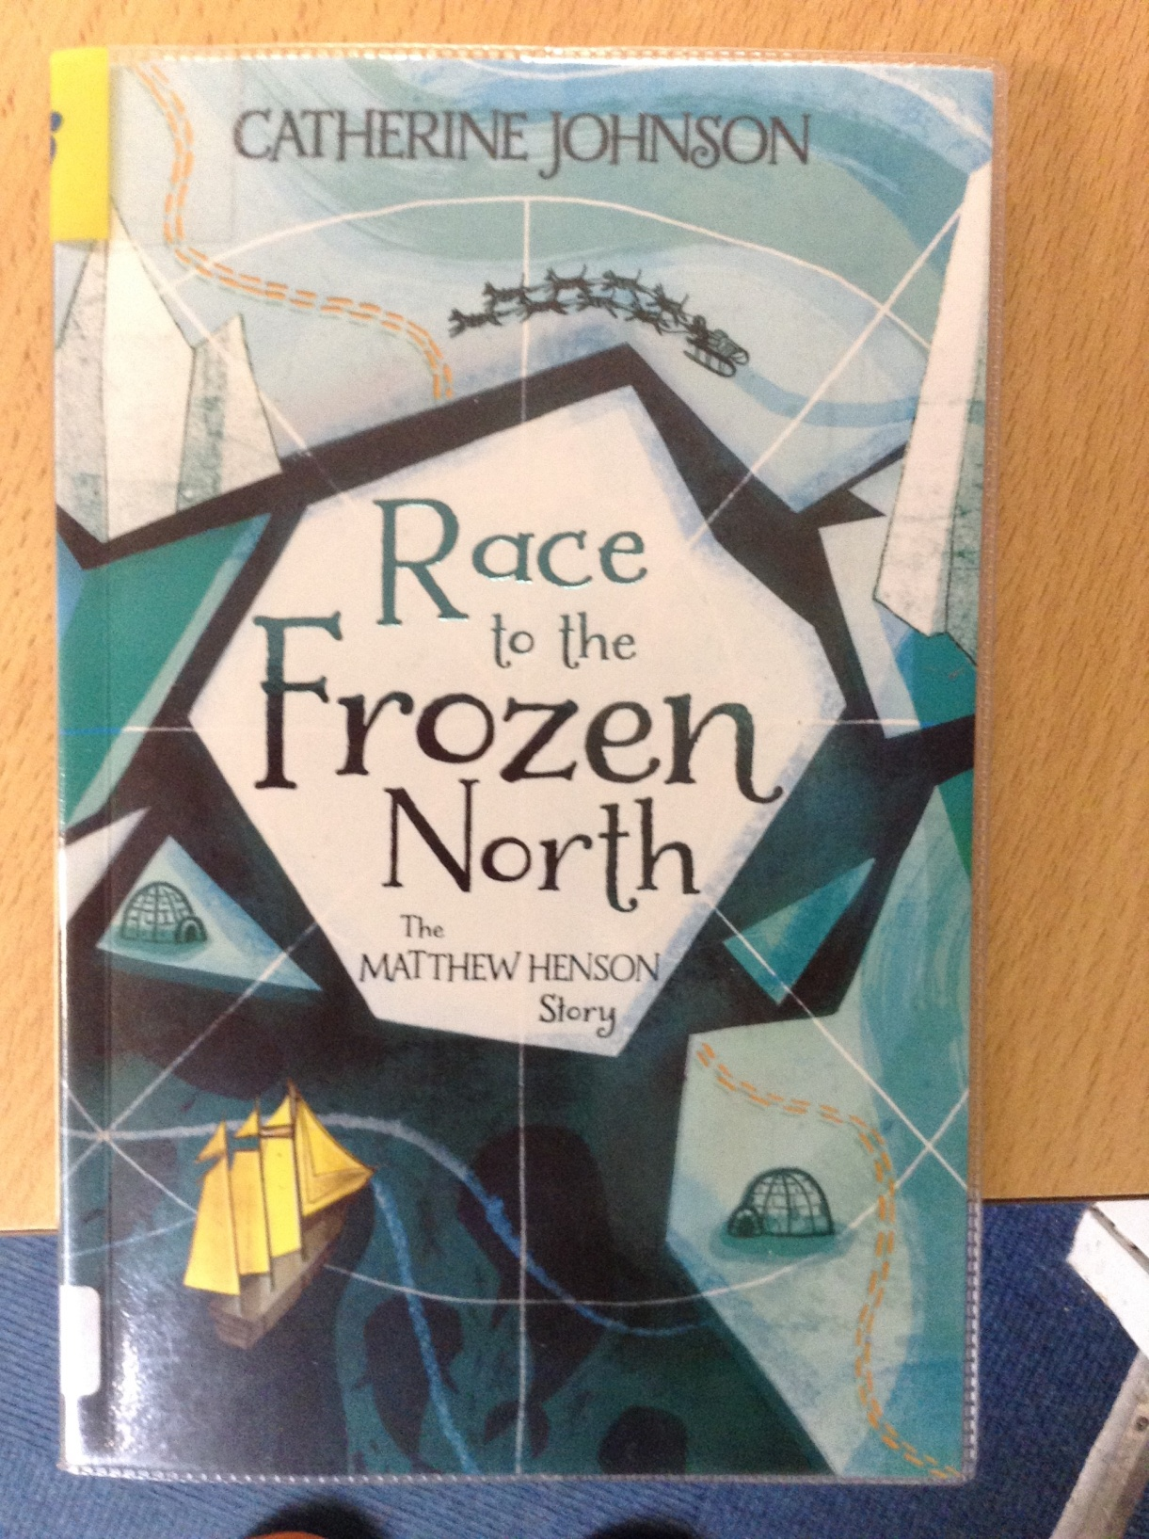
GUIDED READING
Y6
Chapter 5
Pages 42-48

Slide 2
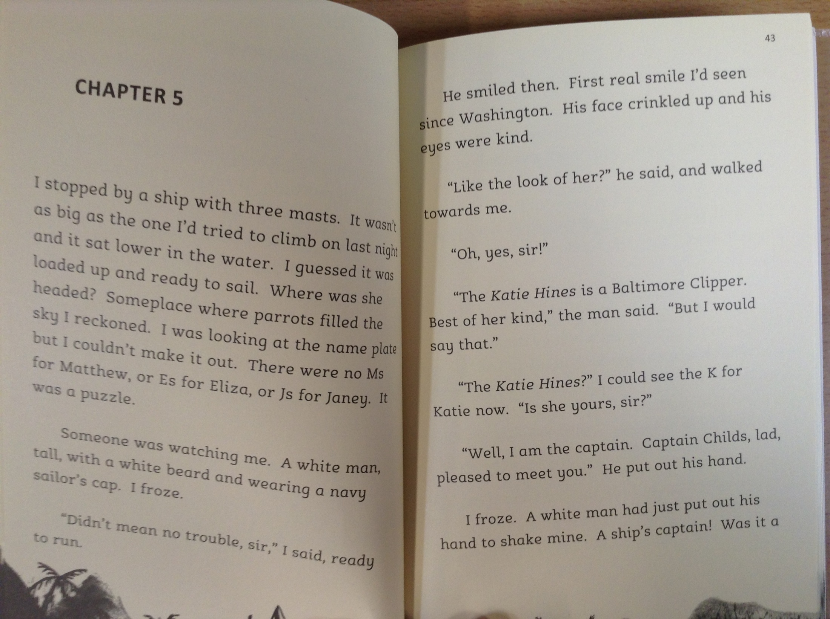
35

Slide 3
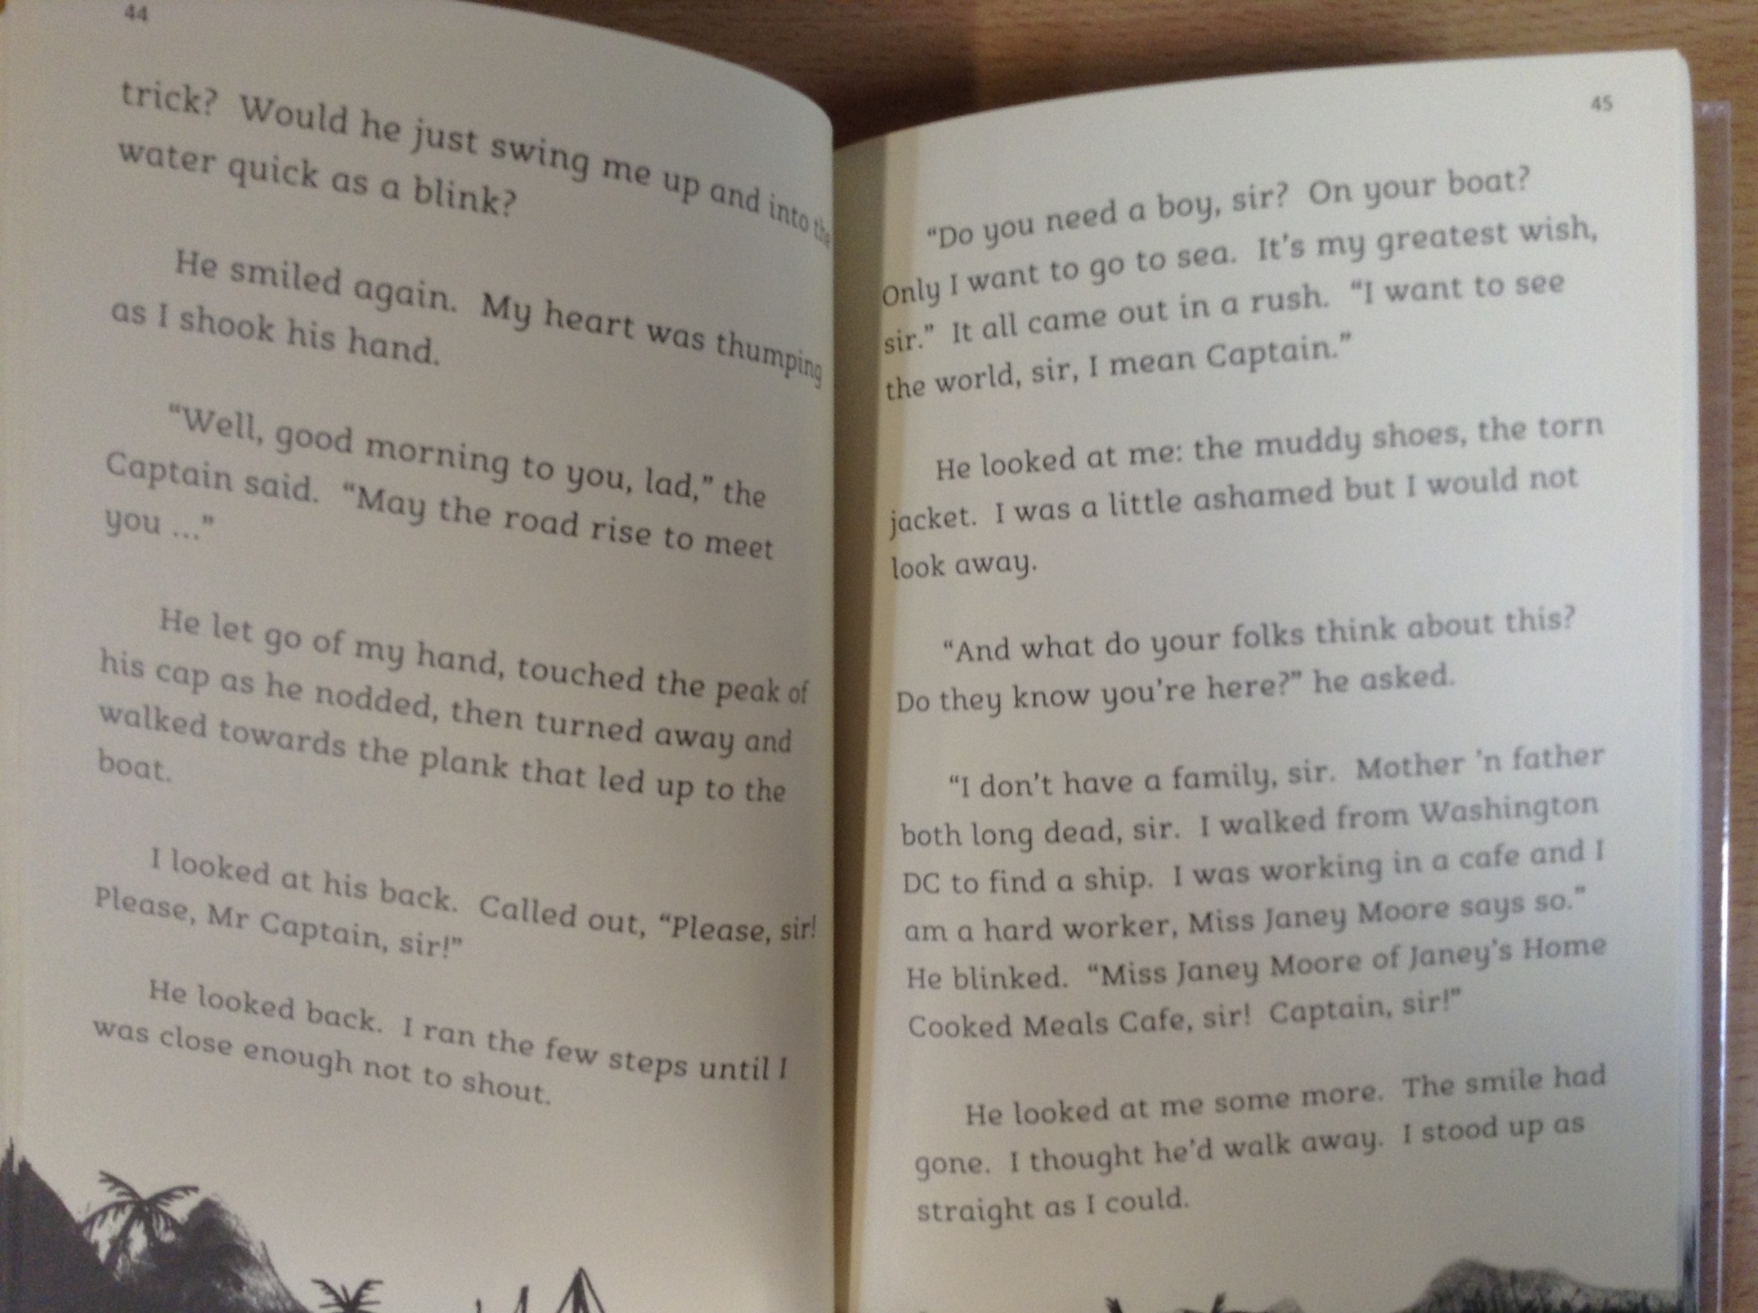

Slide 4
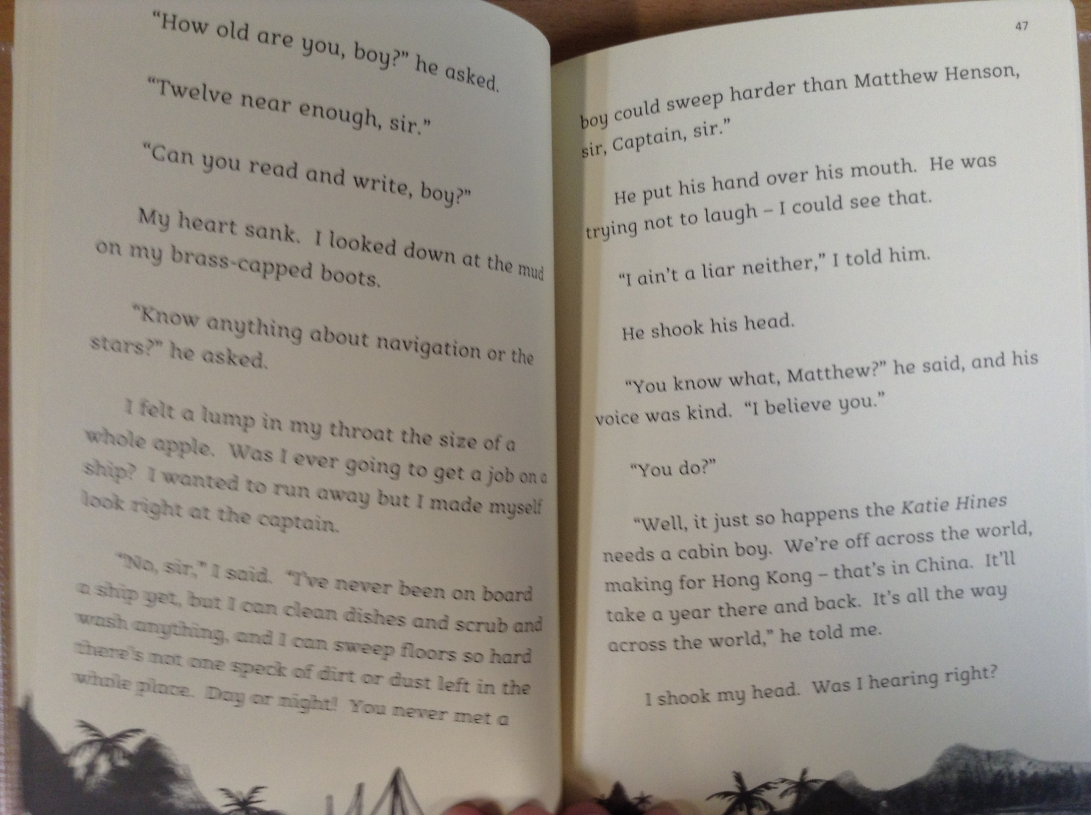

Slide 5
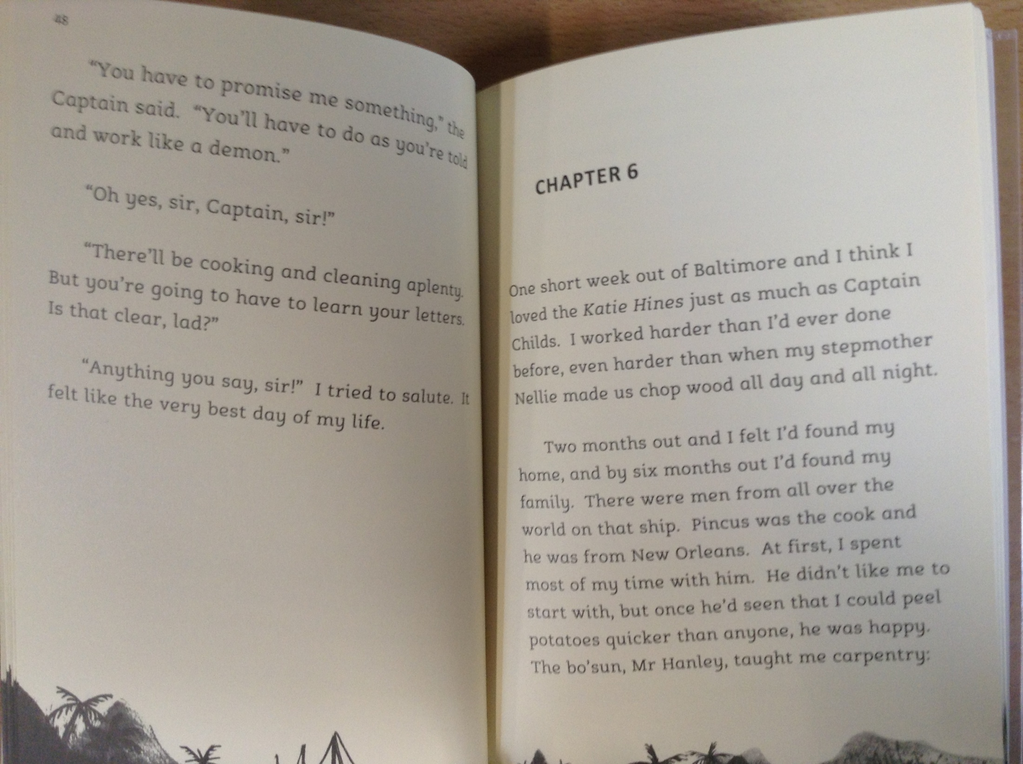

Slide 6
The story has been narrated by Matthew Henson.
*Please note – the word ‘coloured’ has been used to describe characters in the story. This word is offensive and shouldn’t be used in modern society.
Read pages 42 and 43. Since Matthew had arrived at Washington, which two new letters of the alphabet had he learned and how?
What was the name of the captain on the ‘Katie Hinds’ boat and what type of ship was it?
Which location in the world was the ‘Katie Hinds’ heading for and how long would they be travelling for?

