Slide 1
GUIDED READING
Y5
Chapter 8
Pages 34-42

Slide 2
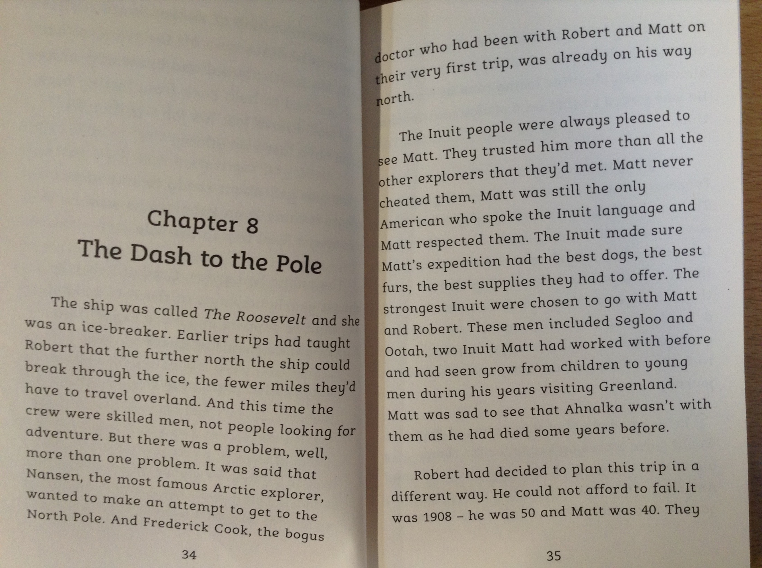

Slide 3
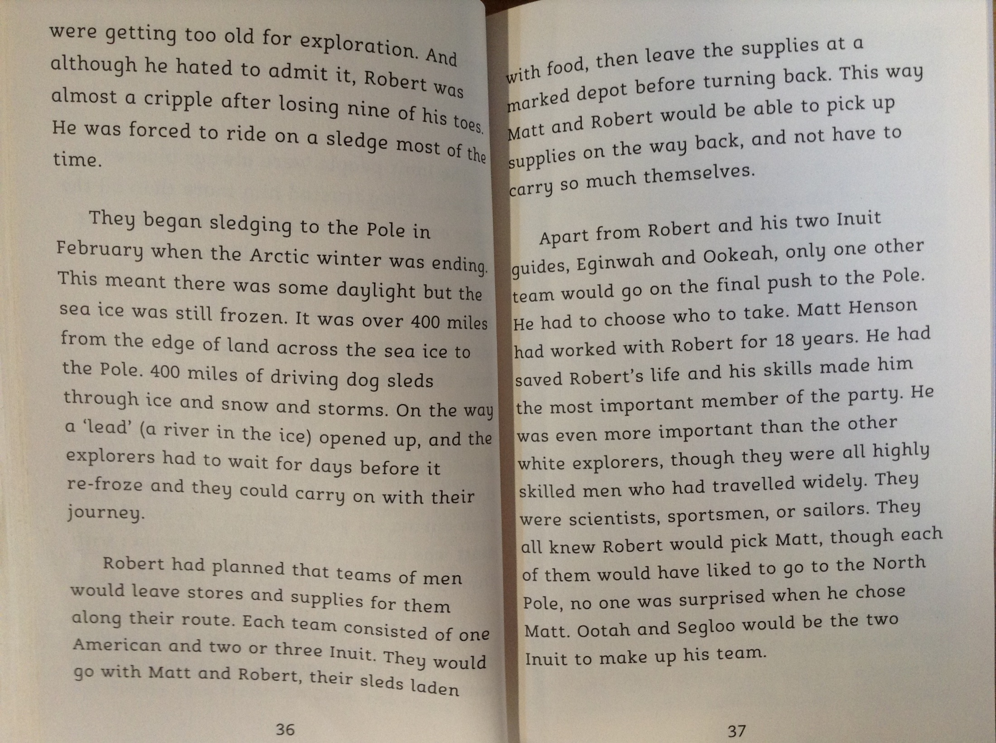

Slide 4
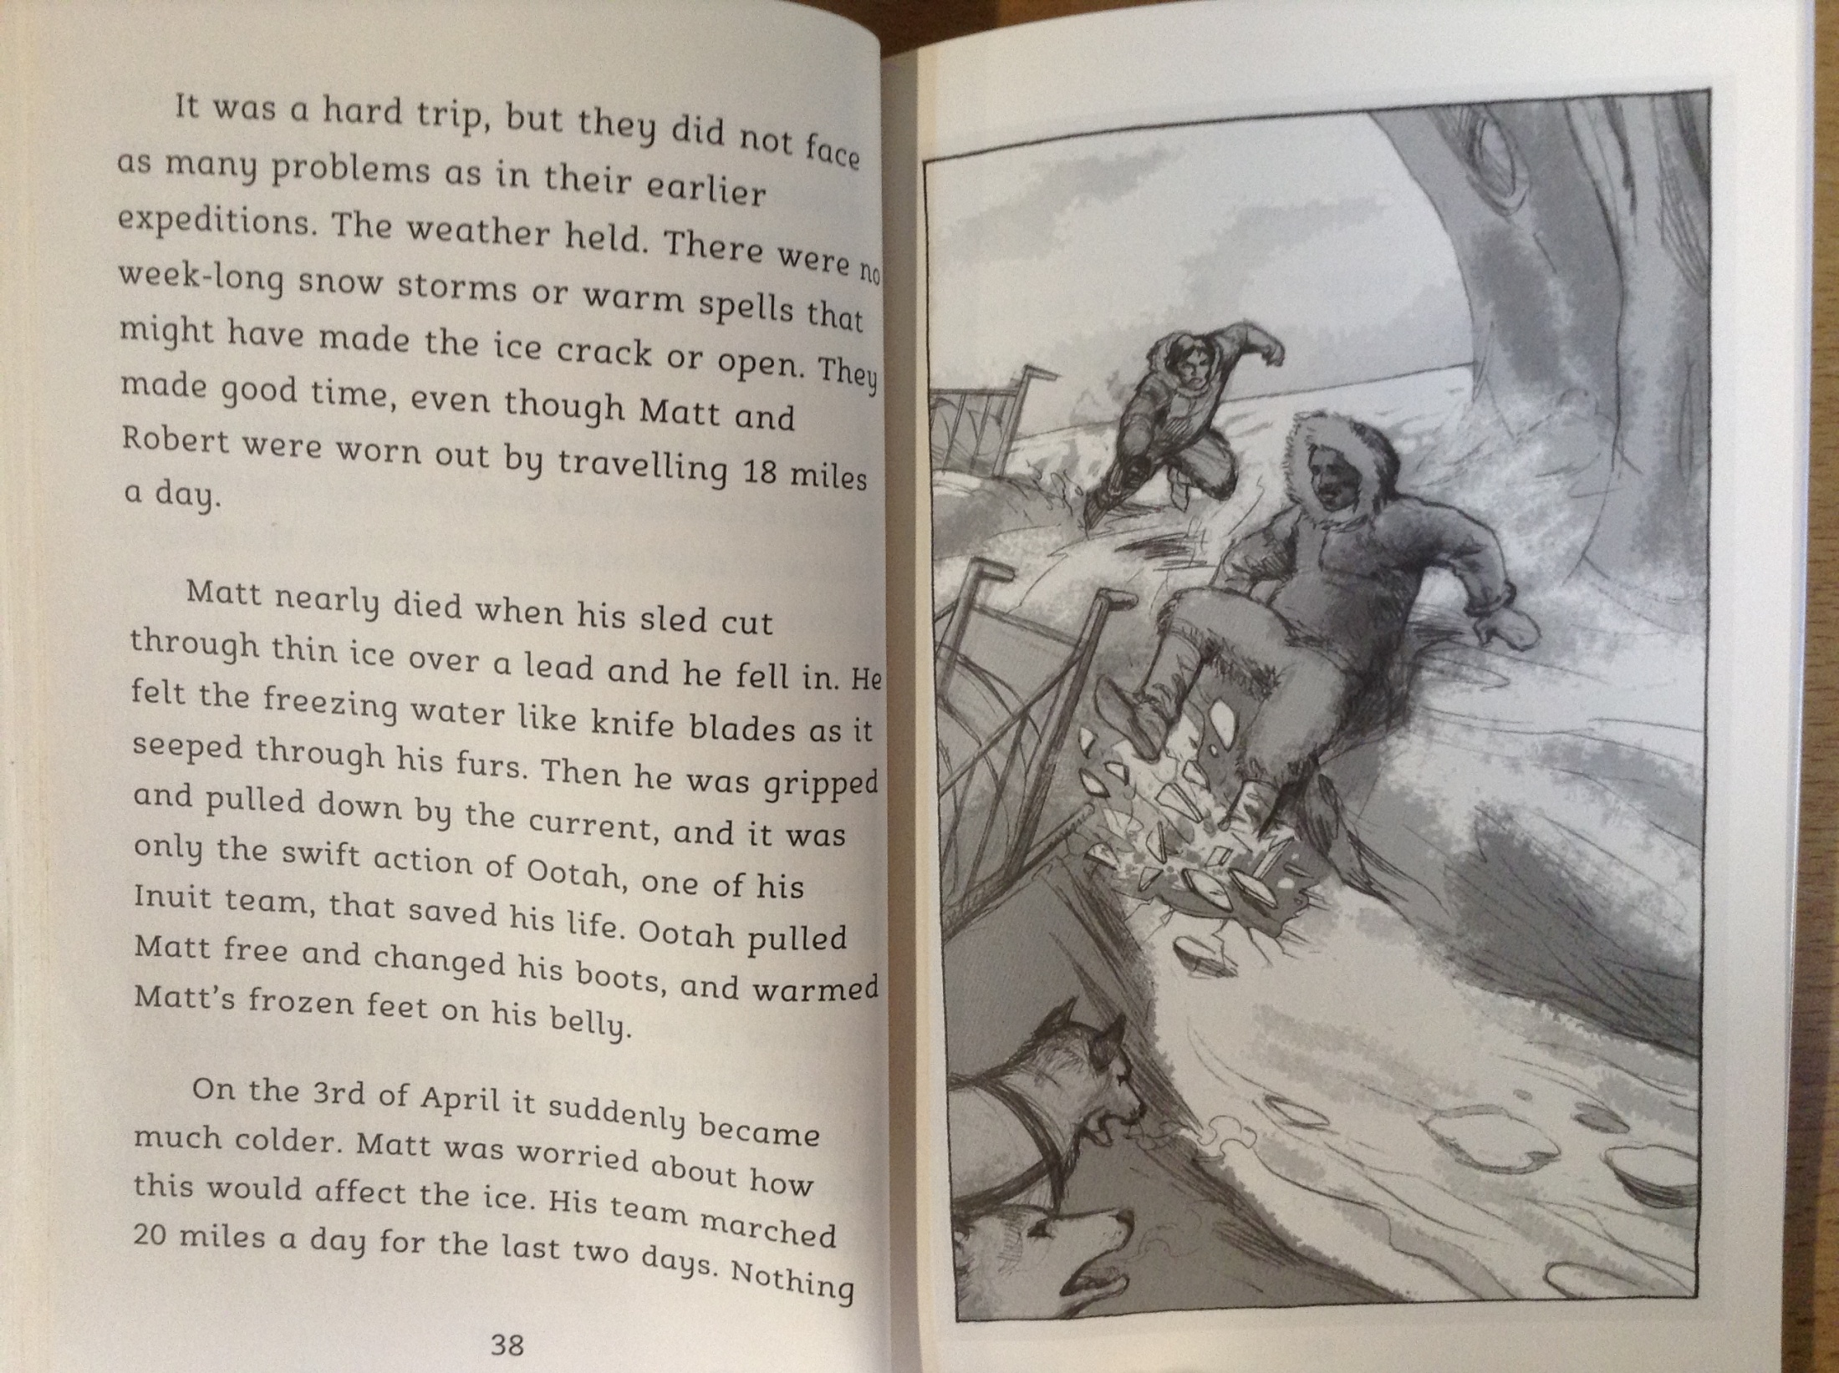

Slide 5
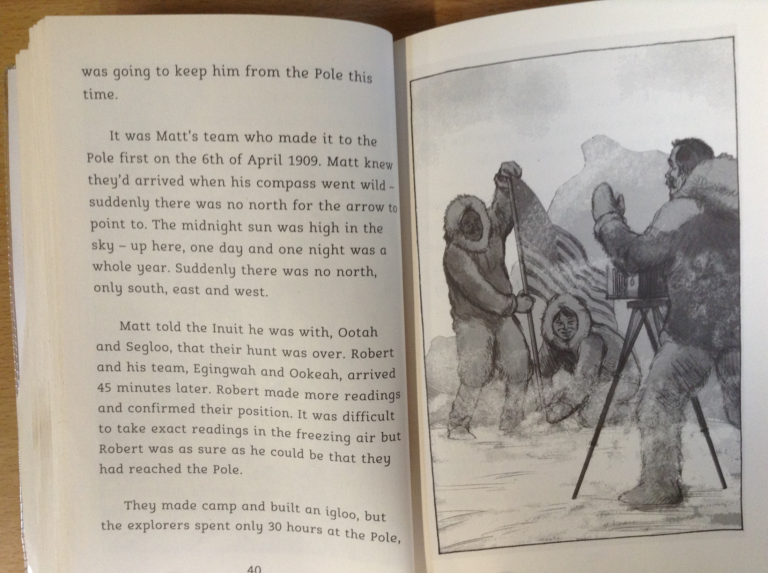

Slide 6
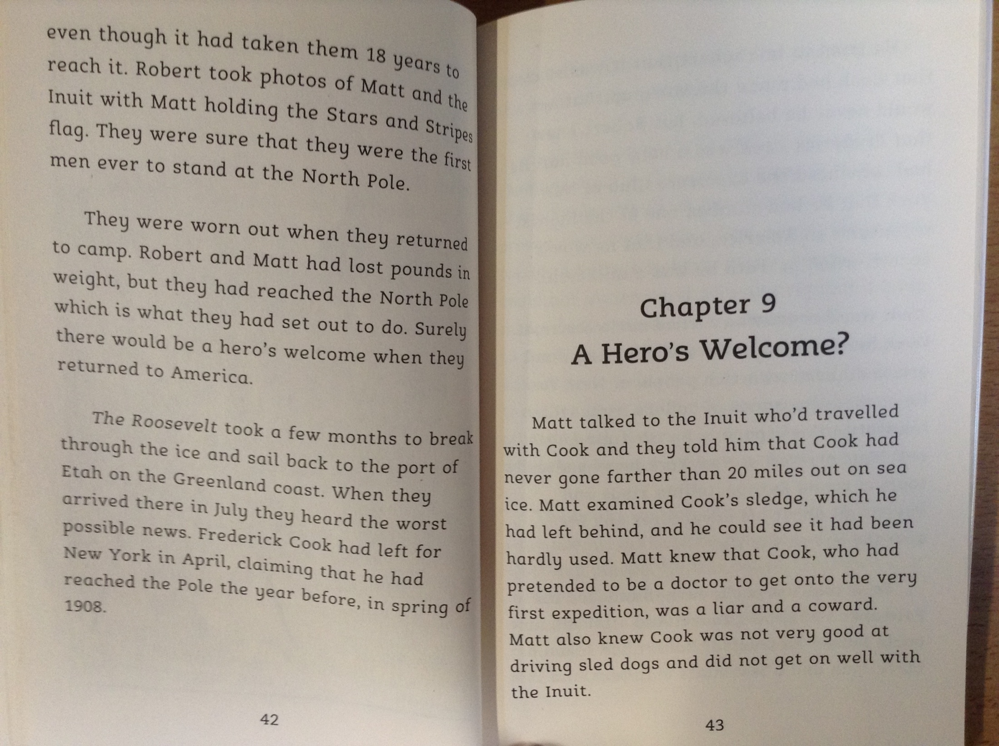

Slide 7
26) What was the name of the ship on the final expedition that Peary and Matthew took together to the North Pole?
27) How old was Matthew on this final attempt to reach the pole?
28) Read page 38. How was Matthew feeling during this time? Find evidence in the text to support your answer.
29) Read page 40. When did Matthew and his team finally reach the North Pole?
30) Read page 42. Despite a great success, what had caused Matthew to be disappointed when he reached the coast of Greenland on the way back home?

