Slide 1
GUIDED READING
Y5
Chapter 7
Pages 27-33

Slide 2
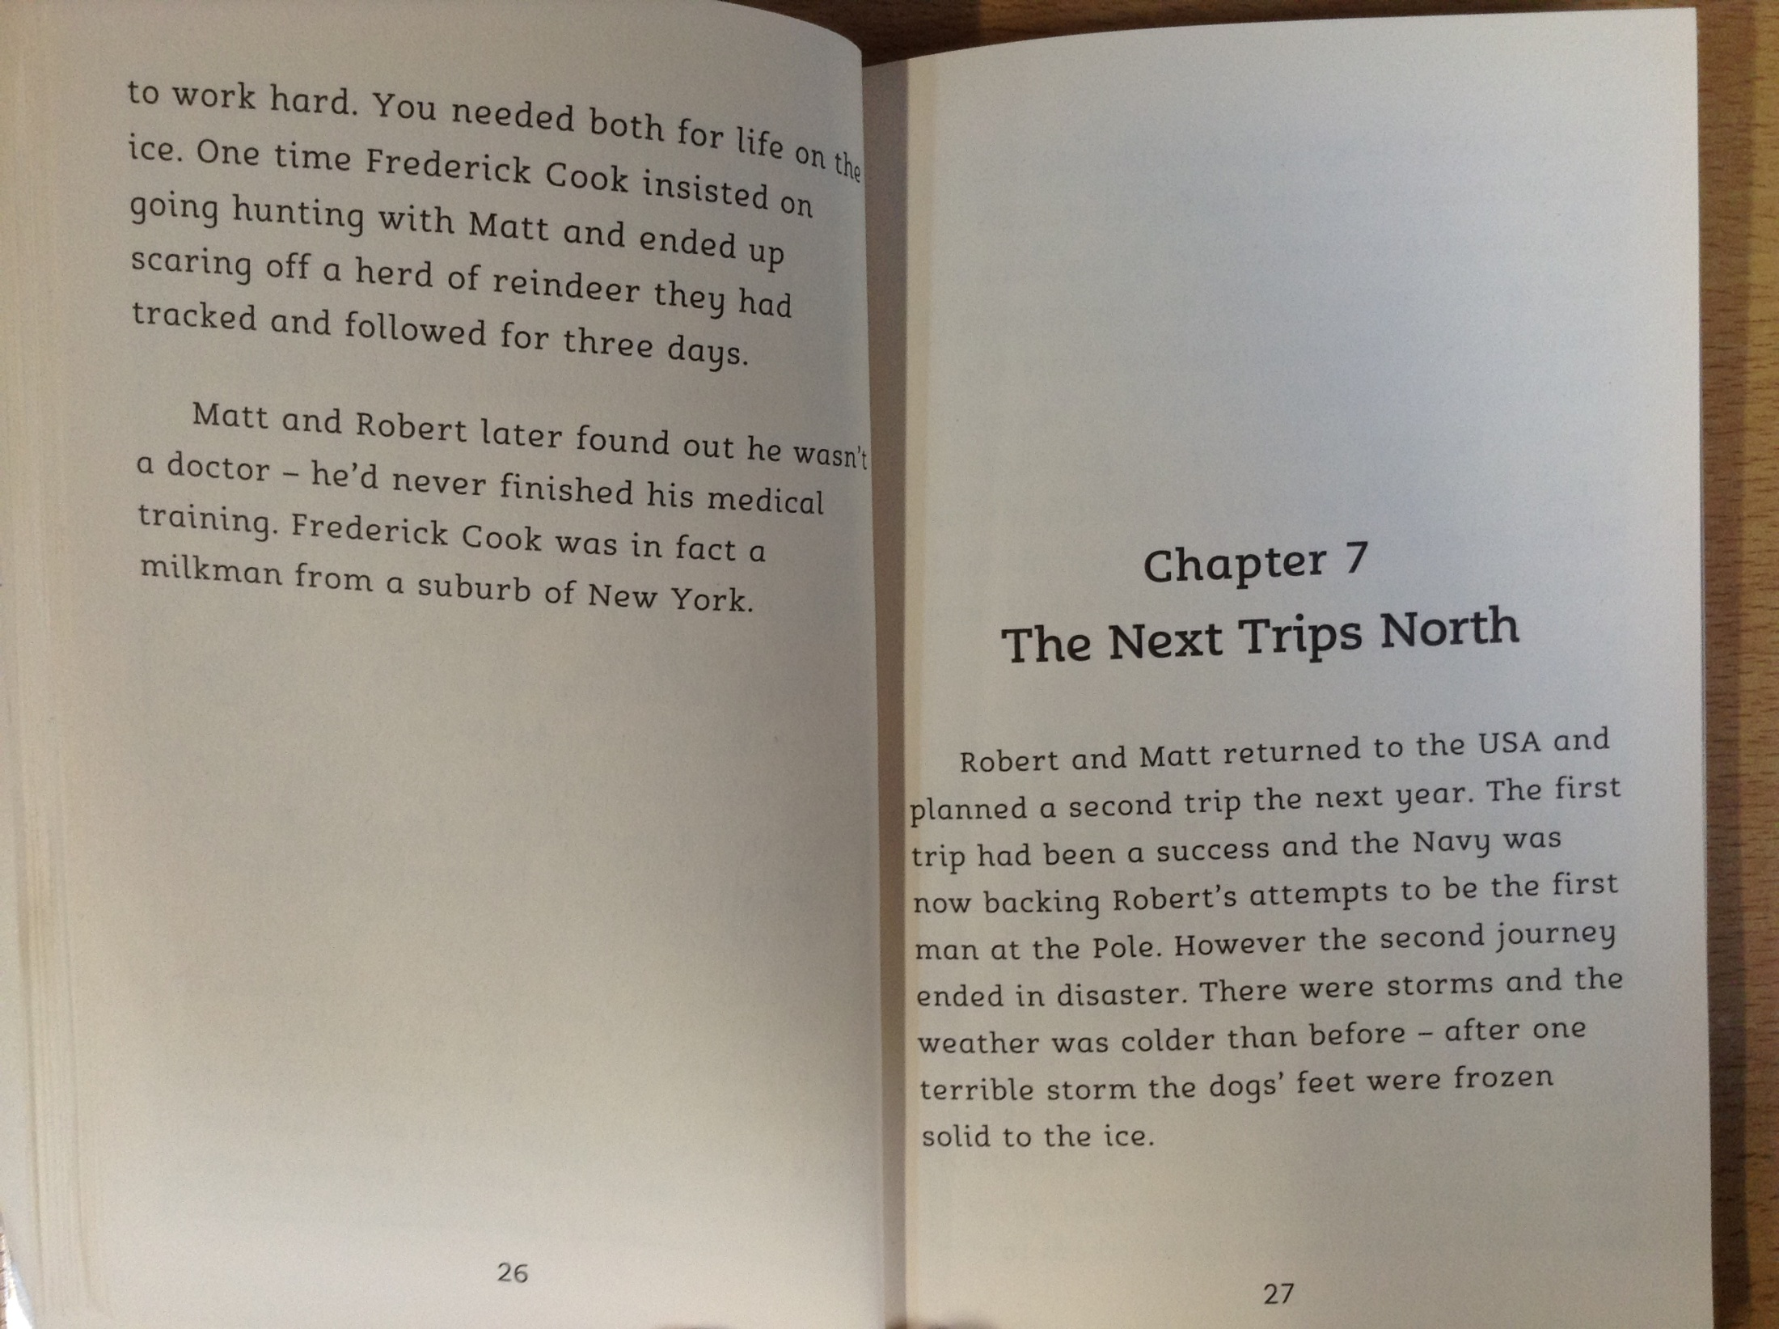

Slide 3
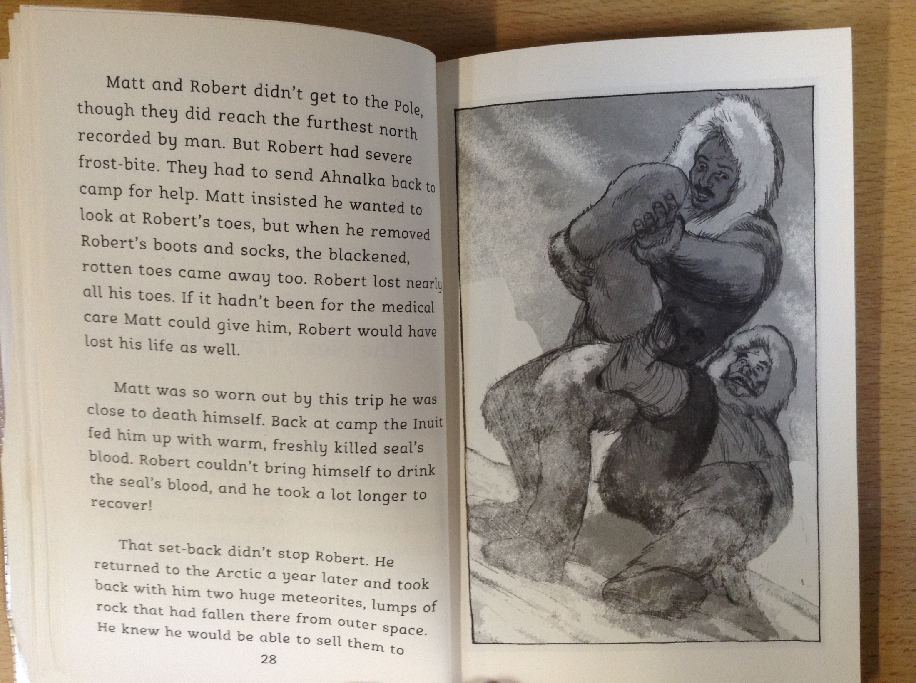

Slide 4
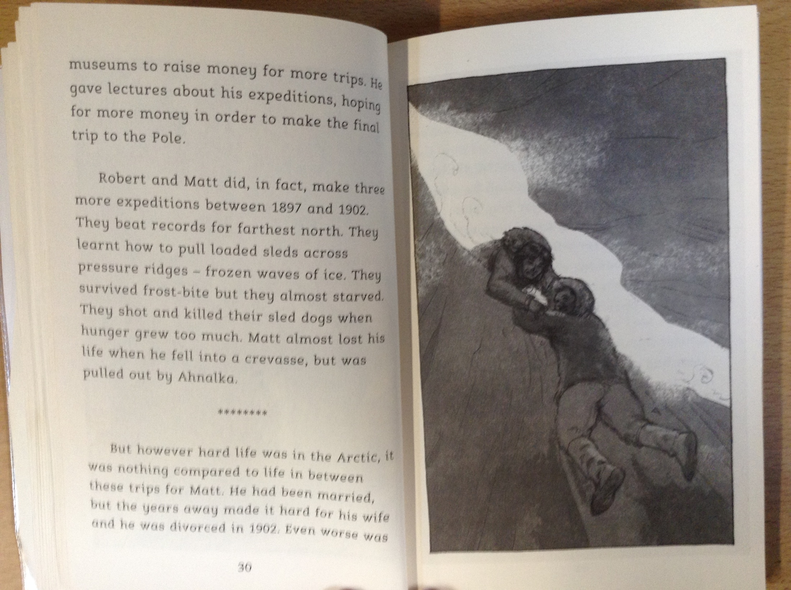

Slide 5
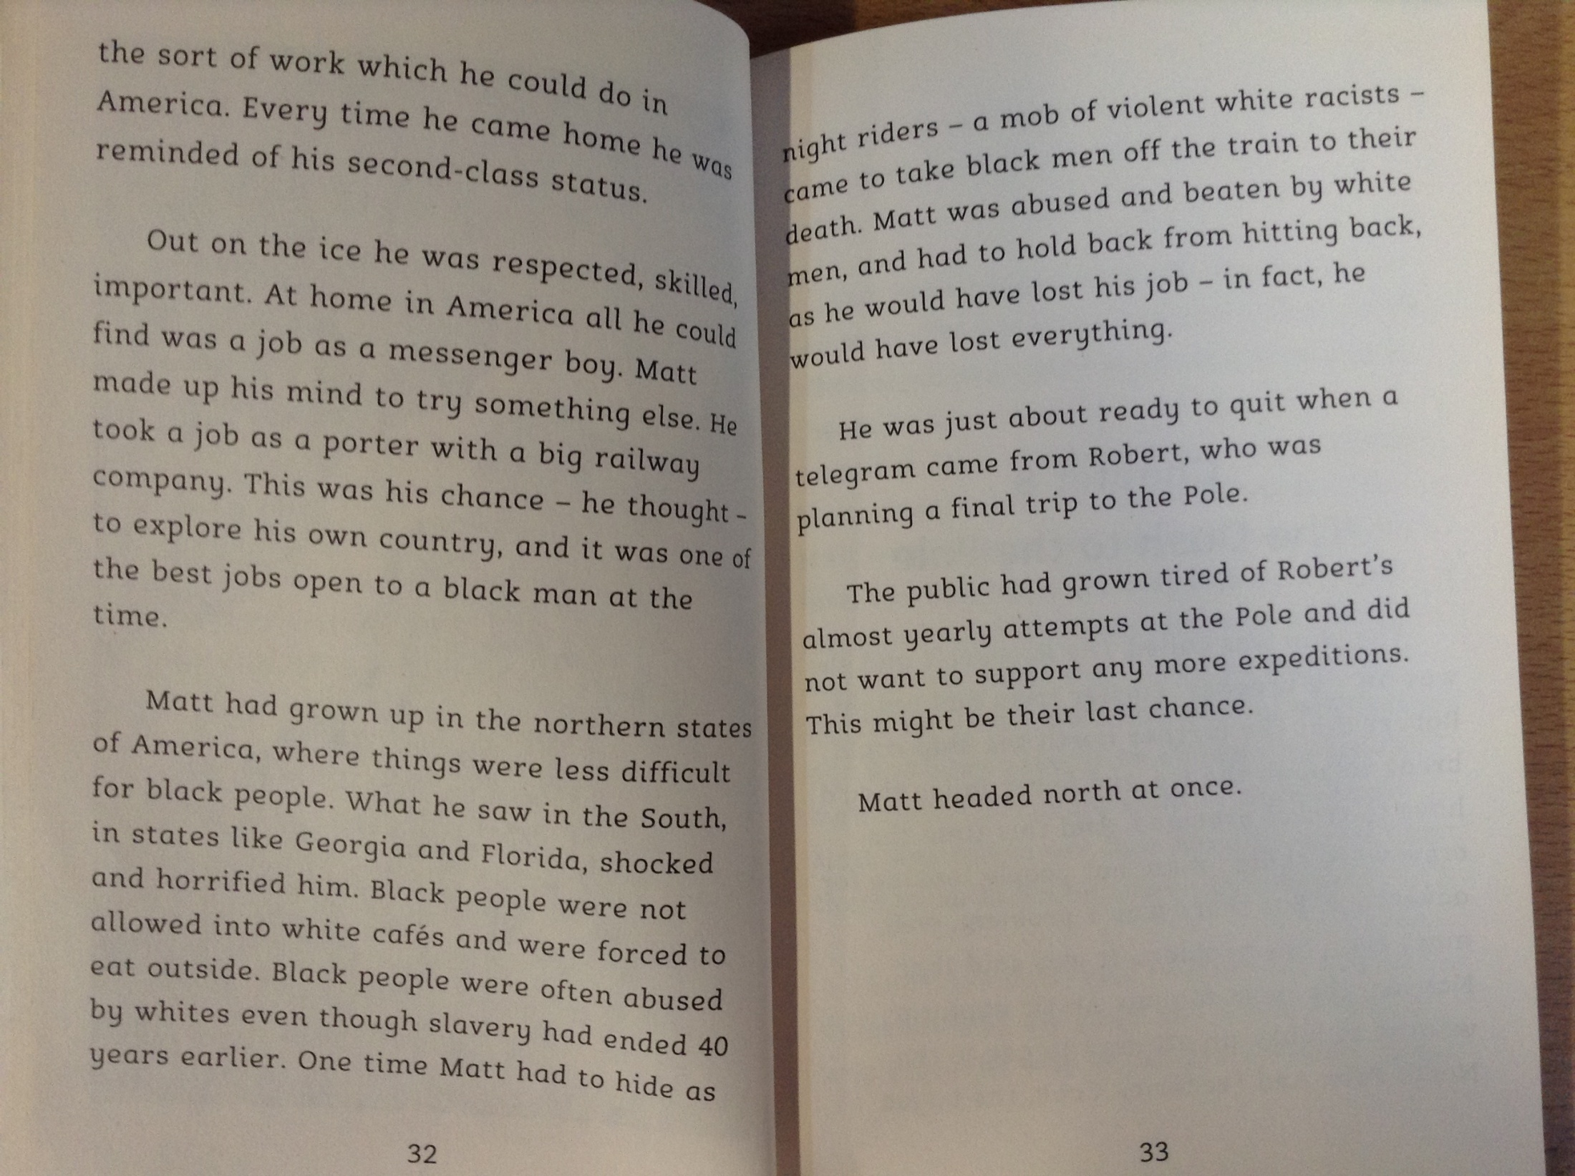

Slide 6
22) What had caused Matthew and Robert Peary’s second attempt to reach the North Pole to fail?
23) Read page 28. Which part of Robert’s body had become very badly damaged during their time away?
24) Read page 30. How had Matthew narrowly escaped death on one of his future attempts to reach the North Pole?
25) Why was life so different for Matthew when he was on board a ship compared to when he was back on land in the USA?

