Slide 1
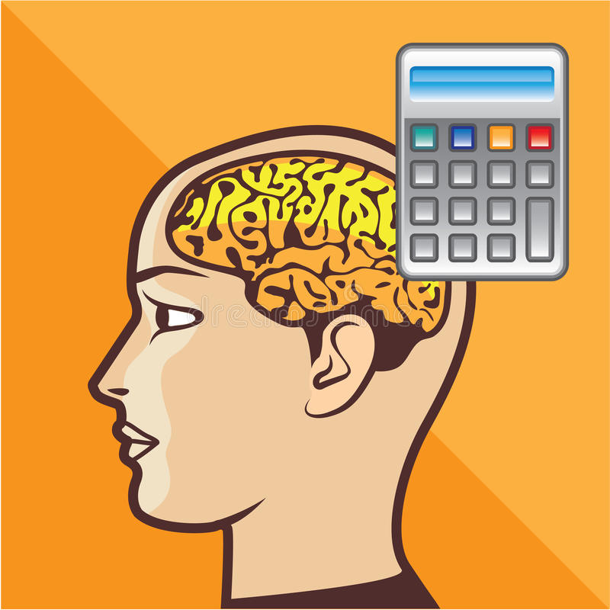
What I’m learning in Maths today
Maths – Y6 (Revising calculations) Date: 8.2.21
L.Obj: *I can confidently use the 4 operations to solve calculations both mentally and using written methods.
*I can confidently use fractions decimals and percentages.

Slide 2
Fractions of amounts
% of amounts
1/5 of 450
50% of 110
¼ of 800
50% of 1

Slide 3
On Monday, Tuesday and Wednesday this week, you are going to be showing how much of a calculation master you are!
https://myminimaths.co.uk/year-6-arithmetic-practice-paper-week-10/
Question 1-20

Slide 4
You can check your answers here.
https://myminimaths.co.uk/year-6-arithmetic-practice-paper-week-10-answers/

