Slide 1
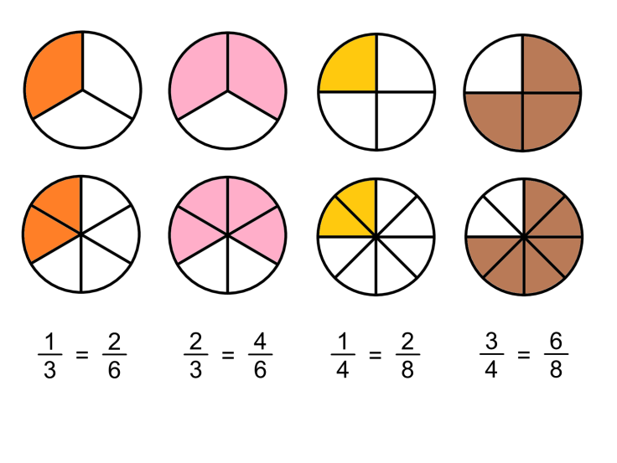
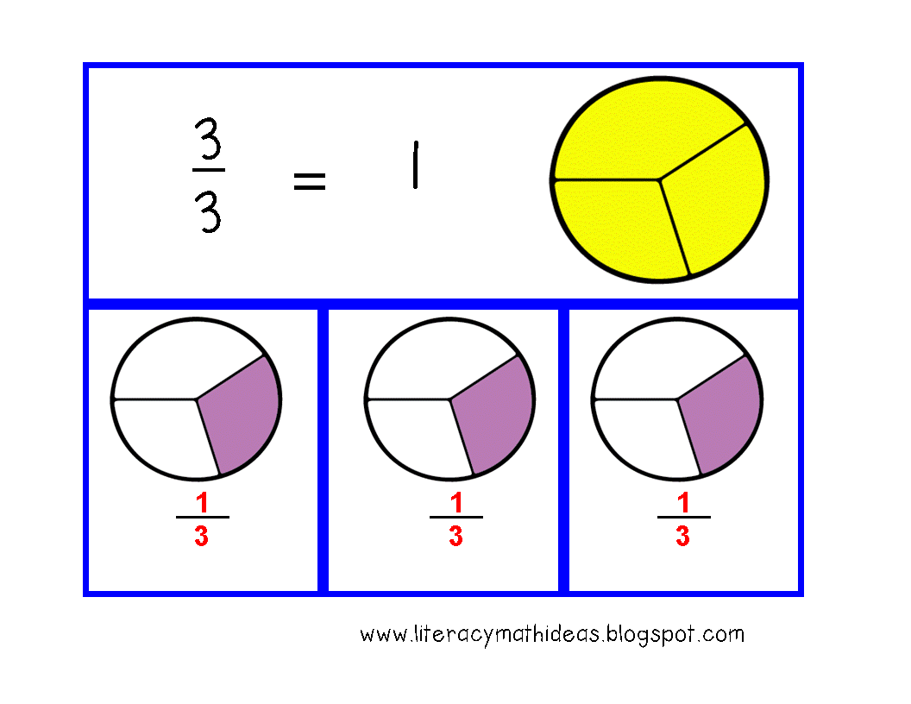
What I’m learning in Maths today
Maths – Y5 (Adding and converting mixed numbers) Date: 10.2.21
L.Obj: *I can add fractions with different denominators by finding common denominators.
*I can convert improper fractions into mixed numbers for my answers.

Slide 2
Year 5
520 + 100 = Double ___
520 + 100 = Double 310
72 x 10 = 800 - ____
72 x 10 = 800 - 80
___ x 4 = 20 + 8
7 x 4 = 20 + 8
27 ÷ 3 = ___²
27 ÷ 3 = 3²
568 – 100 = 470 - ___
568 – 100 = 470 - 2
1,254 x 5 = _____
1,254 x 5 = 6,270
Extra challenge!
9² = 100 - ____
3.6 x 4 = ½ of ____
Extra challenge!
9² = 100 - 19
3.6 x 4 = ½ of 28.8

Slide 3
Year 5
Some examples are….
1/18 + 3/18 + 13/18
2/18 + 5/18 + 10/18
3/18 + 11/18 + 3/18
As long as the numerator added up to 17 and the denominator was 18, they are correct.
Adding fractions with the same denominator
Sam has added 3 fractions together to get an answer of 17/18
What could his fractions have been?
Find as many different possibilities as you can.

Slide 4
Year 5
No because
3/5 = 12/20
1/10 = 2/20
3/20 = 3/20
So the answer is 17/20
Adding fractions with different denominators
Zoe is attempting to answer:
3/5 + 1/10 + 3/20
Do you agree with Zoe? Why?
The answer is 7/20

Slide 5
Introduction
Find the equivalent fractions:
Introduction
Find the equivalent fractions:
2 | = | 8
7
2 | = | 8
7
 |  | 28
5 | = | 20
8
5 | = | 20
8
 |  | 32
4 | =
6 |  | 3
4 | = | 2
6 |  | 3
© Classroom Secrets Limited 2018
© Classroom Secrets Limited 2019

Slide 6
Varied Fluency 2
Complete the bar model.
1
2
3
8
9
3
18
Varied Fluency 2
Complete the bar model.
1 | 13
 | 18
2
3
8
9
3
18

Slide 7
Varied Fluency 3
Solve the following calculations.
A. | 15 | + | 7 | + | 3 | =
 | 16 |  | 8 |  | 4
Varied Fluency 3
Solve the following calculations.
A. | 15 | + | 7 | + | 3 | = | 2 | 9
 | 16 |  | 8 |  | 4 |  |  | 16
© Classroom Secrets Limited 2018

