Slide 1
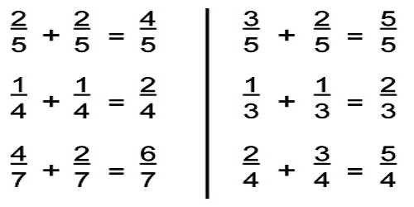
What I’m learning in Maths today
Maths – Y5 (adding fractions) Date: 4.2.21
L.Obj: *I can add fractions with the same denominator.
*I can add fractions with different denominators.

Slide 2
Balancing Equations – Fill in the missing number
5 x ___ = 19 + 6
Extra challenge!
1³ = Double ____
4.5 x 2 = 3 x ___
67 ÷ 10 = 7 - __
___ x 10 = 140 - 80
48 ÷ 6 = ½ of ___
8 x 9 = 100 - ___
210 ÷ 10 = 3 x ___
____ - 50 = 6²

Slide 3
Balancing Equations – Fill in the missing number
5 x 5 = 19 + 6
Extra challenge!
1³ = Double 0.5
4.5 x 2 = 3 x 3
67 ÷ 10 = 7 – 0.3
6 x 10 = 140 - 80
48 ÷ 6 = ½ of 16
8 x 9 = 100 - 28
210 ÷ 10 = 3 x 7
86 - 50 = 6²

Slide 4
Lucy and Sinead both have two identical pizzas each.
Lucy says,
Sinead says,
I have cut each pizza into 4 equal pieces and eaten 3.
I have cut each pizza into 8 equal pieces and eaten 5.
Who ate the most pizza?

Slide 5
Lucy and Sinead both have two identical pizzas each.
Lucy says,
Sinead says,
I have cut each pizza into 4 equal pieces and eaten 3.
I have cut each pizza into 8 equal pieces and eaten 5.
Lucy because ¾ is 6/8 which is greater than 5/8

Slide 6
Introduction
Identify the fractions represented by the bar models below.
Use >, < or = to compare them.
A)
B)
or
© Classroom Secrets Limited 2018

Slide 7
Introduction
Identify the fractions represented by the bar models below.
Use >, < or = to compare them.
A)
B)
or
7
4
13
8
13
8
7
4
<
>
© Classroom Secrets Limited 2018

Slide 8
Varied Fluency 1
True or false? The following calculation is correct.
4 | + | 3 | = | 7 | = | 1 | 1
5 |  | 5 |  | 5 |  |  | 5
© Classroom Secrets Limited 2018

Slide 9
Varied Fluency 1
True or false? The following calculation is correct.
False. The answer is
4 | + | 3 | = | 7 | = | 1 | 1
5 |  | 5 |  | 5 |  |  | 5
1 | 2
 | 5
© Classroom Secrets Limited 2018

Slide 10
Varied Fluency 2
Match the image to the correct answer.
+
A) | 1 | 1 | B) | 1 | 3 | C) | 8
 |  | 7 |  |  | 7 |  | 14
© Classroom Secrets Limited 2018

Slide 11
Varied Fluency 2
Match the image to the correct answer.
+
A) | 1 | 1 | B) | 1 | 3 | C) | 8
 |  | 7 |  |  | 7 |  | 14
© Classroom Secrets Limited 2018

Slide 12
Varied Fluency 3
Calculate the following:
8 | – | 3 | =
9 |  | 9
© Classroom Secrets Limited 2018

Slide 13
Varied Fluency 3
Calculate the following:
8 | – | 3 | = | 5
9 |  | 9 |  | 9
© Classroom Secrets Limited 2018

Slide 14
Varied Fluency 4
Giles drinks of his milk.
Jilly drinks of her milk.
How much milk have they drunk altogether?
Record your answer as a fraction.
9
11
8
11
© Classroom Secrets Limited 2018

Slide 15
Varied Fluency 4
Giles drinks of his milk.
Jilly drinks of her milk.
How much milk have they drunk altogether?
Record your answer as a fraction.
9
11
8
11
1 | 6
 | 11
© Classroom Secrets Limited 2018

Slide 16
Reasoning 1
Trisha is calculating the missing numerator in the following calculation:
Is she correct? Explain why.
 | + | 7 | = | 1 | 3
12 |  | 12 |  |  | 12
I think the missing numerator must be 10.
© Classroom Secrets Limited 2018

Slide 17
Reasoning 1
Trisha is calculating the missing numerator in the following calculation:
Is she correct? Explain why.
Trisha is incorrect because the numerators need to total 15, so the missing numerator must be 8.
 | + | 7 | = | 1 | 3
12 |  | 12 |  |  | 12
I think the missing numerator must be 10.
© Classroom Secrets Limited 2018

Slide 18
Problem Solving 1
Insert the following symbols to make the
equations correct: >, < or =
15 | – | 7
11 |  | 11
7 | + | 2
11 |  | 11
5 | + | 6
12 |  | 12
15 | – | 4
12 |  | 12
© Classroom Secrets Limited 2018

Slide 19
Problem Solving 1
Insert the following symbols to make the
equations correct: >, < or =
15 | – | 7
11 |  | 11
7 | + | 2
11 |  | 11
<
5 | + | 6
12 |  | 12
15 | – | 4
12 |  | 12
=
© Classroom Secrets Limited 2018

Slide 20
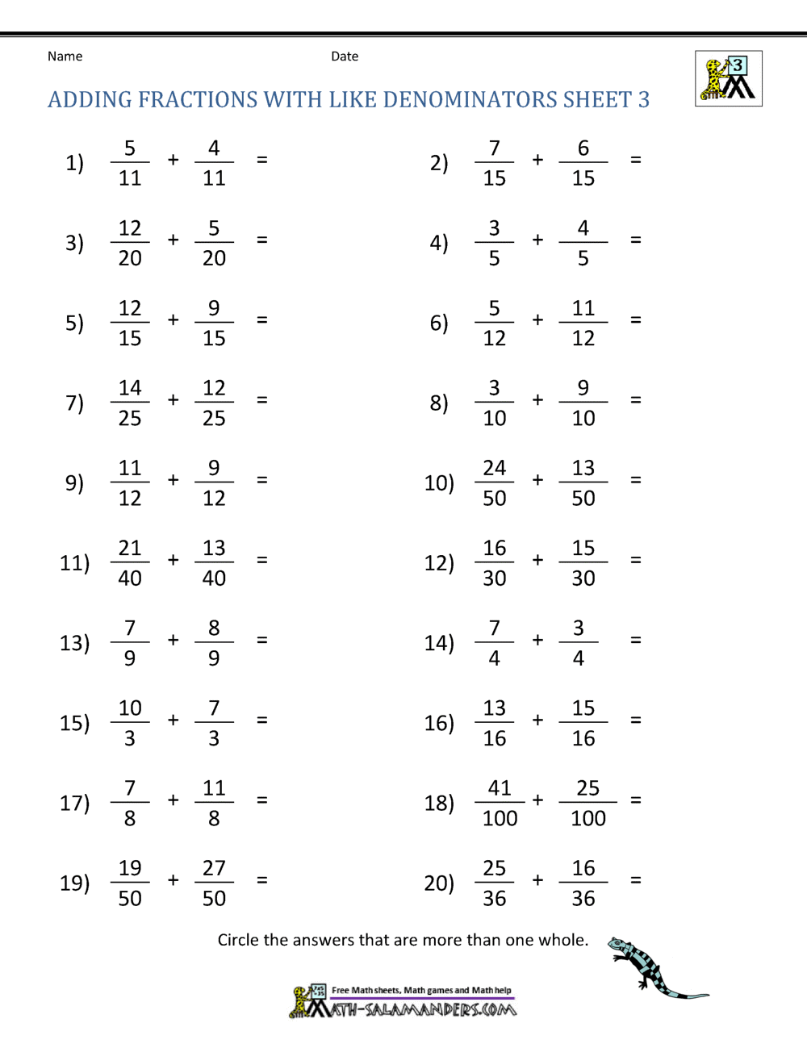
Ollie, Sophie and Esme –
Maths Activity 1

Slide 21
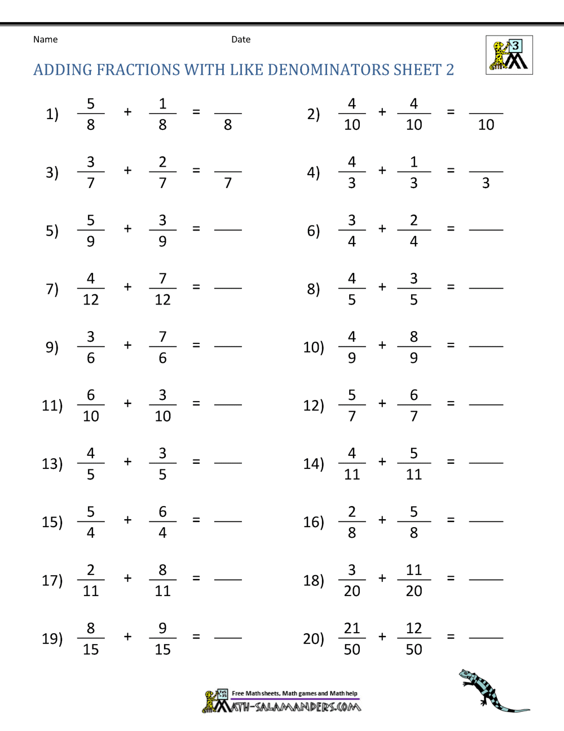
Alex, Sam, Ariana and Maisie –
Maths Activity 1

Slide 22
Lilly, Blake, Cass, Alfie and Dylan –
Maths Activity 1

Slide 23
Now can you try adding
fractions with different
denominators?

