Slide 1
Why is exercise important?

Slide 2
Warm up.
What exercise do you do?
What is exercise?
What does exercise do to our bodies?

Slide 3
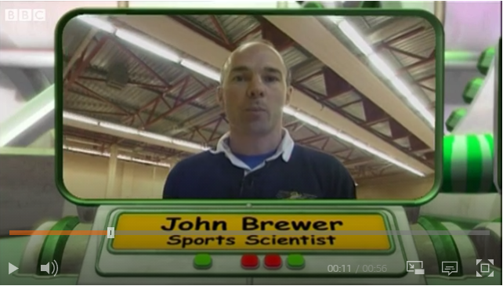
BBC Bitesize Click here

Slide 4
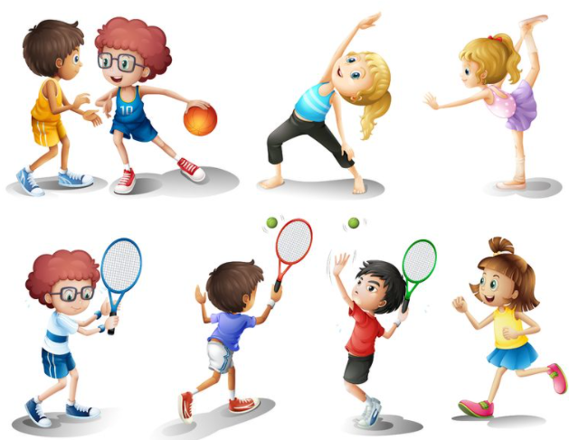
How does exercise help us?
.

Slide 5
How does exercise help us?
Exercise works your lungs so they use oxygen effectively.
Exercise keeps you healthy.
Exercise is good for your brain. It helps your brain to concentrate which helps you to learn better.
Exercise makes your bones and muscles stronger.
.
Exercise can make you
feel happier.

Slide 6
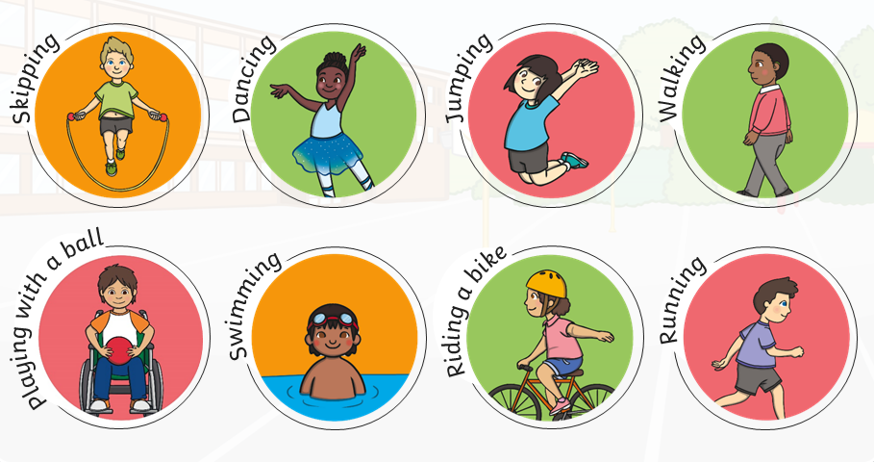
What exercise do you do?

Slide 7
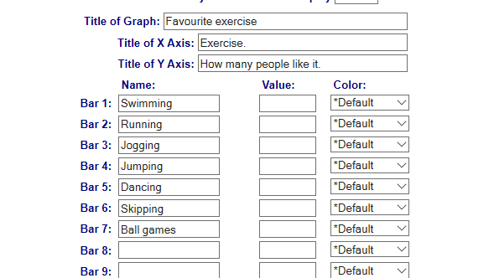
Chart.
Can you work out the favourite type of activity amongst your friends and family?
Bar chart

Slide 8
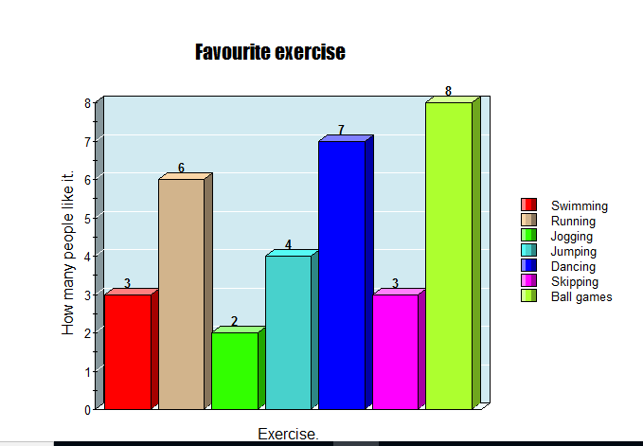

Slide 9
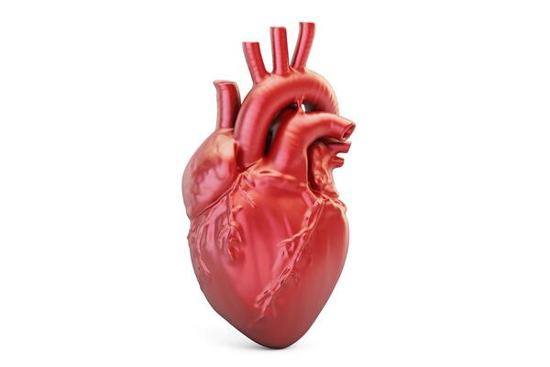
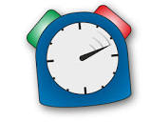
Your heart.
Put your hand on your heart, feel it beating. How many times does your heart beat in one minute?
Your heart is a muscle and when you exercise you help to keep it healthy.
The faster you move the harder your heart has to work to pump clean oxygenated blood around your body.
Now do 1 minute of exercise. How many heart beats can you feel now in one minute. You should feel more.

Slide 10
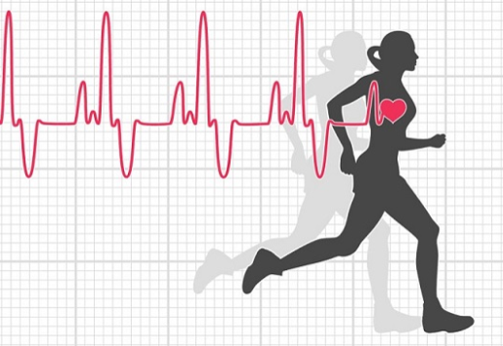
What did you find out happened to your heart rate after you exercised?
My heart rate because .

Slide 11
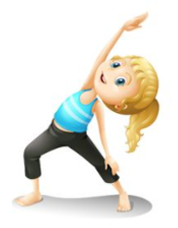
My heart rate increased because my muscles needed more oxygen as I exercised.

Slide 12
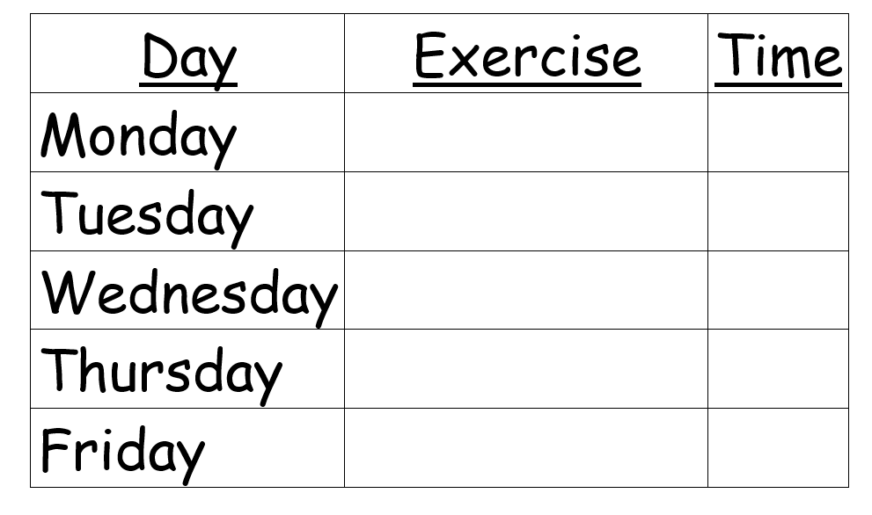
Homework

