Slide 1
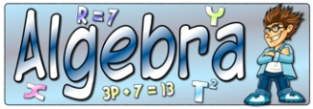
What I’m learning in Maths today
Maths – Y6 (Algebra) Date: 25.2.21
L.Obj: *I can use formulas and equations to solve mathematical problems.

Slide 2
1) 49% of 400 =
2) 2/3 x 4 =
3) 1/2 ÷ 6 =
4) 4/5 – 3/10 =
5) 119 x 32 =
6) 10 – 3.25 =
80 ÷ 1,000 =
6,300 ÷ 9 = 9) 3 ½ x 5 =

Slide 3
1) 49% of 400 = 196
2) 2/3 x 4 = 8/3 or 2 2/3
3) 1/2 ÷ 6 = 1/12
4) 4/5 – 3/10 = 5/10 or 1/2
5) 119 x 32 =
6) 10 – 3.25 = 6.75
80 ÷ 1,000 = 0.08
6,300 ÷ 9 = 700 9) 3 ½ x 5 = 17.5

Slide 4
Now you are going to practise
your algebra skills some more.
*Answer the questions 1-7 in your books. Copy out the table for question 7.
(I shall send you the answers at lunchtime so that you can check to see if you were correct.)

