Slide 1
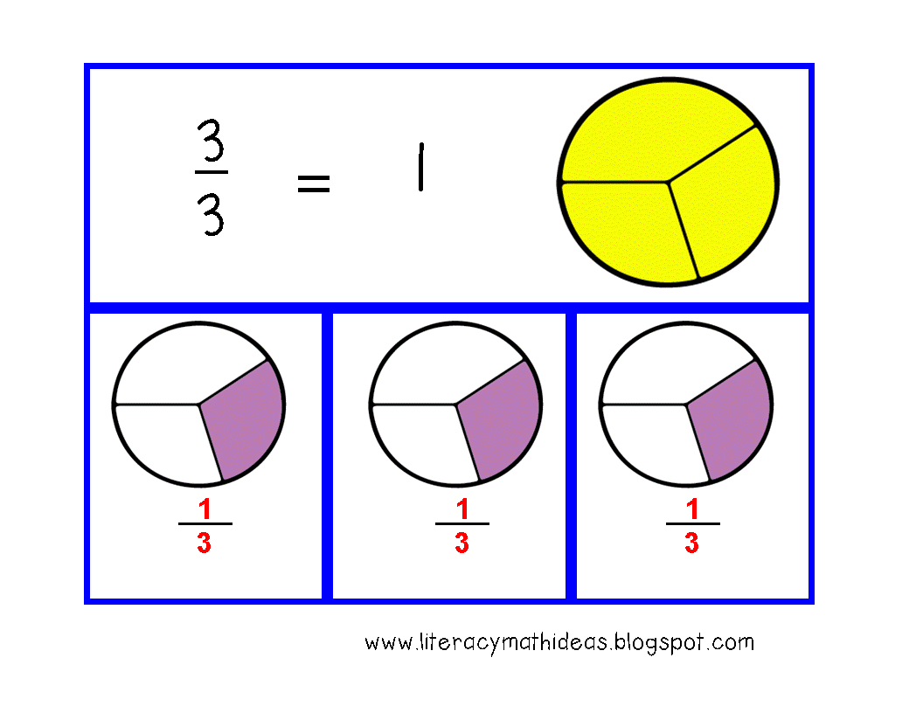
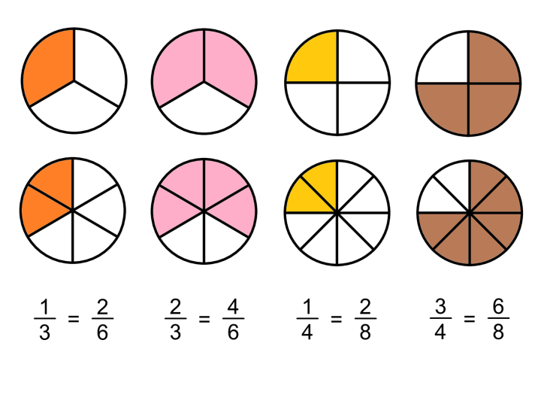
What I’m learning in Maths today
Maths – Y5 (+ and – fractions) Date: 25.2.21
L.Obj: *I can add and subtract fractions with and without the same denominator.
*I can add and subtract fractions including mixed numbers. (Cass, Blake, Alfie and Dylan)

Slide 2
What’s my missing number
I’m thinking of a number.
I add 8.
Then I multiply it by 10.
The answer is 160.
What is my number?
I’m thinking of a number.
I subtract 6.
Then I divide it by 3.
The answer is 3.
What is my number?
I’m thinking of a number.
I double it.
Then I subtract 20.
Next I divide it by 4.
My answer is 15.
What is my number?

Slide 3
What’s my missing number
I’m thinking of a number.
I add 8.
Then I multiply it by 10.
The answer is 160.
What is my number?
8
I’m thinking of a number.
I subtract 6.
Then I divide it by 3.
The answer is 3.
What is my number?
15
I’m thinking of a number.
I double it.
Then I subtract 20.
Next I divide it by 4.
My answer is 15.
What is my number?
40

Slide 4
Now you are going to practise
your adding and subtraction
fraction skills some more.
Click on the link on the school website for your maths activity for today. You should now be feeling very confident at + and – fractions.

