Slide 1


Slide 3
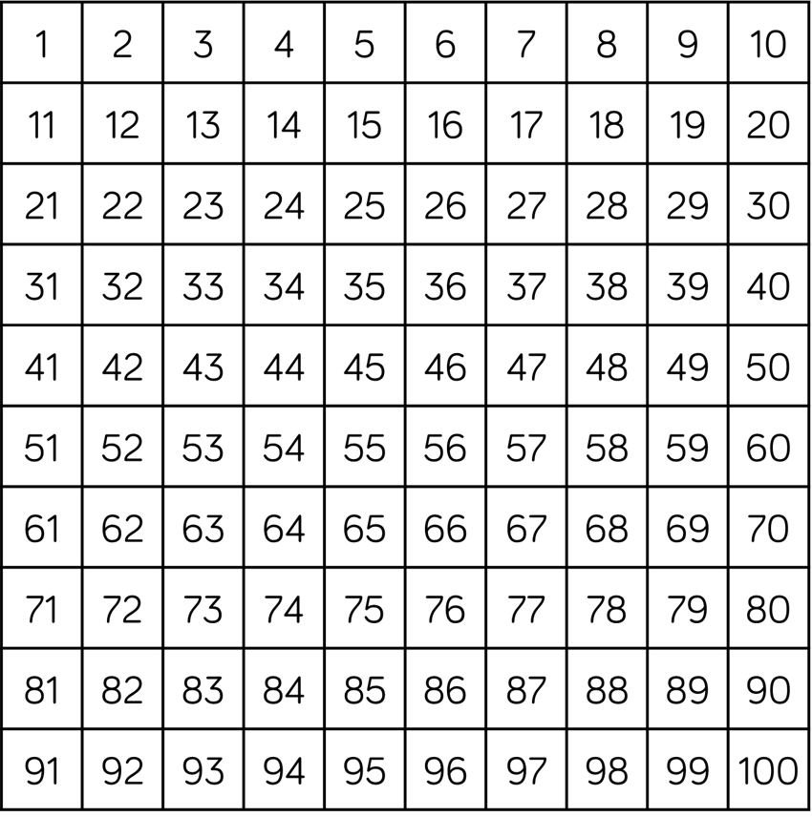

Can you find these numbers?
1) fourteen
2) 39
3) 20 $+ \text{2}$
4) 1 more than 49

Slide 4
Can you find these numbers?
1) fourteen
2) 39
3) 20 $+ \text{2}$
4) 1 more than 49

Slide 6
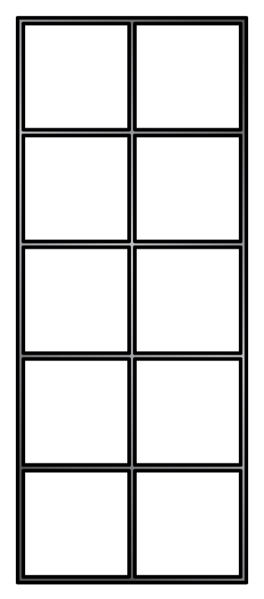
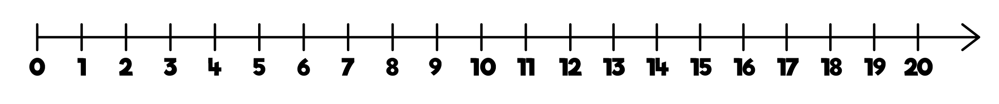
Ordering from
smallest to greatest
thirteen
16
8, 11, 13, 16

Slide 7
Ordering from
greatest to smallest
nineteen
17
19, 17, 14, 9

Slide 8
Comparing tens and ones
36
33
38
smallest to greatest
Notes:
How many ways can you describe a number?

Slide 9
Comparing tens and ones
36
43
28
smallest to greatest
Notes:
How many ways can you describe a number?

Slide 10
Have a go at question 1 on the worksheet

Slide 11

Ordering numbers
Have a think
28
18
48
8
smallest to greatest

Slide 12
Ordering numbers
Have a think
46
41
40
49
greatest to smallest

Slide 13
Ordering numbers
Have a think
6
31
50
Where would these numbers go?
48
19
25

Slide 14
Have a go at questions 2, 3 and 4 on the worksheet

