Slide 1


Slide 3


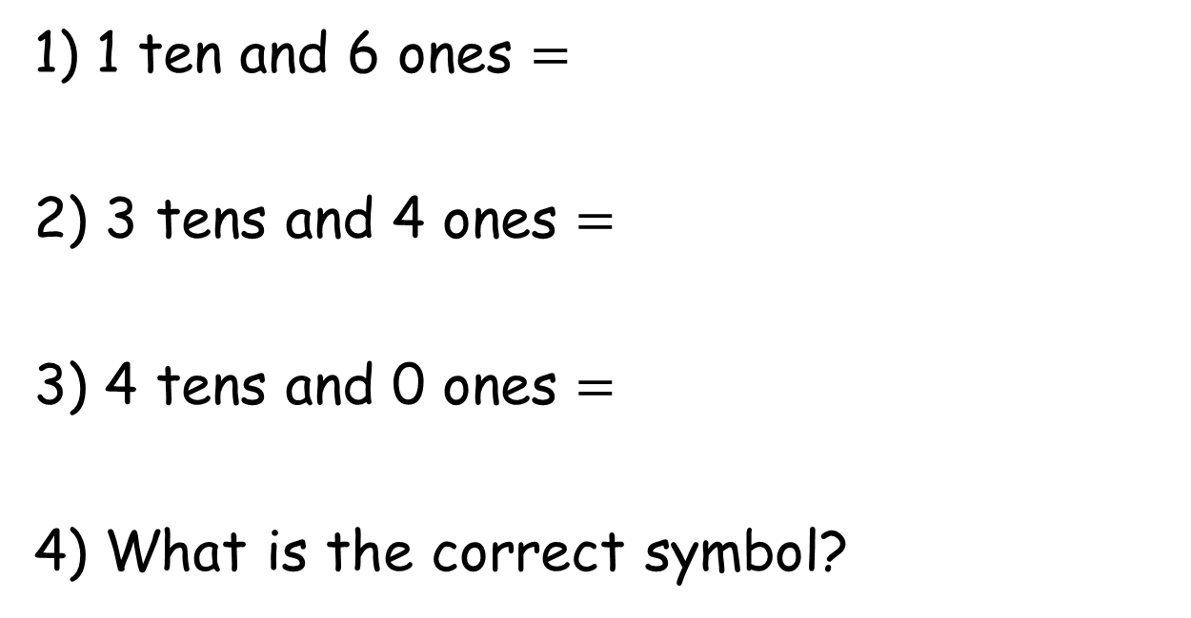
1) 1 ten and 6 ones =
2) 3 tens and 4 ones $=$
3) 4 tens and 0 ones $=$
4) What is the correct symbol?

Slide 4
1) 1 ten and 6 ones =
2) 3 tens and 4 ones $=$
3) 4 tens and 0 ones $=$
4) What is the correct symbol?
16
34
40
=

Slide 6
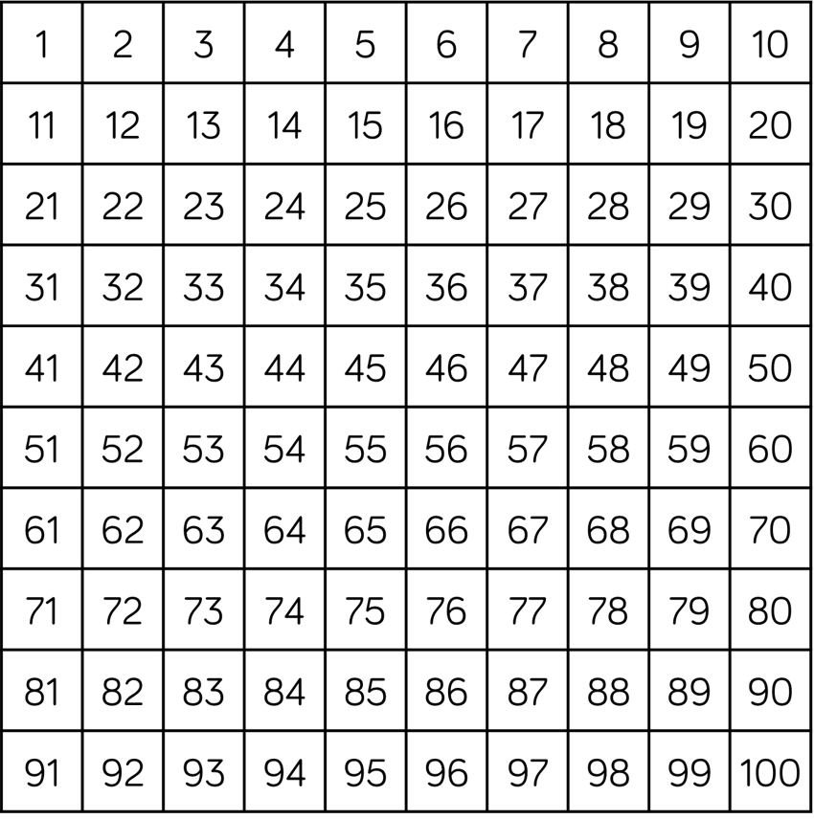
What can we use to compare numbers?
less than
less than
less than
greater than
greater than
greater than
equal to
33 is 35
13 is 11
29 is 19
14 is 41

Slide 7
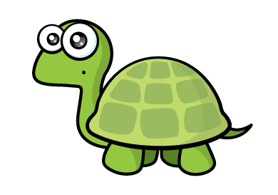

equal to
less than
equal to
less than
greater than
less than
greater than
greater than
These are not easy!
We can figure them out together!
twenty-two is ___________ 32
13 is __________ thirteen
3 tens and 4 ones is ___________4 tens and 3 ones
41 is ____________ 14

Slide 8
Have a go at questions 1 and 2 on the worksheet

Slide 9



Have a think
Comparing using symbols
=
=
>
=
>
>
<
<
twenty is 2 tens and 3 ones
50 is 40 $+$ 8
19 is 1 less than 18
twenty-nine is 30 $−$ 1

Slide 10
Have a go at question 3 on the worksheet

Slide 11
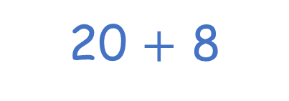
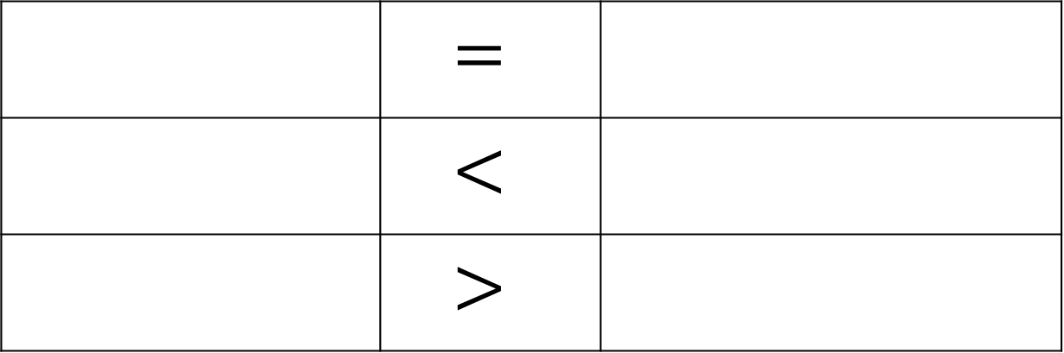
Have a think
 | $$=$$
 | $$<$$
 | $$>$$
16
20 $+$ 8
forty-three
27
4 tens
1 ten and 6 ones
1 less than 43
29
5 tens

Slide 12
Have a go at question 4 on the worksheet

