Slide 1
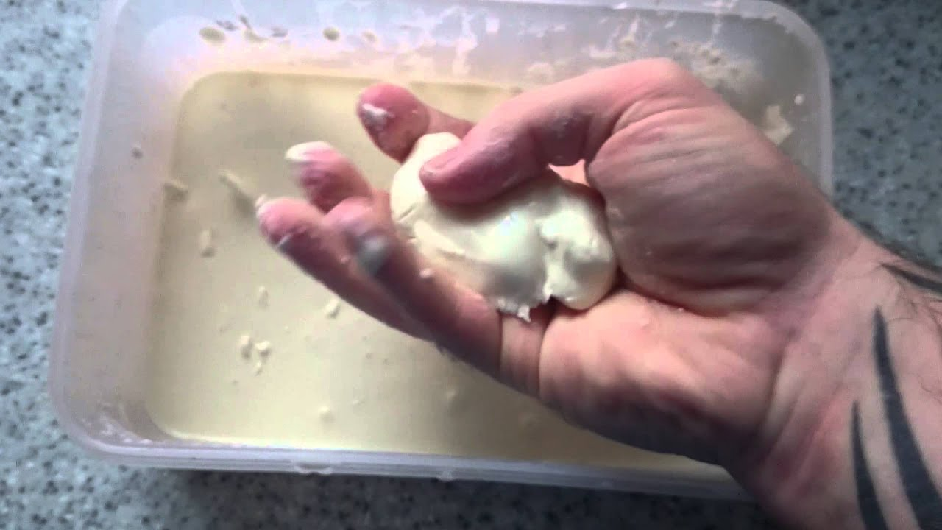
What I’m learning in Science today
Date: Wednesday 10th February 2021
L.Obj: *I can identify that some substances can fit into more than one state of matter.
You will need:
*corn flour
*water

Slide 2
Last week, we planned and carried out an investigation to find out which frozen liquid melted the quickest.
Which of these changes of state happened during the investigation?
liquid to
gas
liquid to
solid
solid to
liquid
MELTING
EVAPORATING
freezing

Slide 3
Today, you are going to learn that some substances can be more than one state of matter at the same time.
Time for the live lesson video.

Slide 4
Watch the video below and if possible, join in with the video using corn flour and water at home.
Complete the activities that are given to you as you are watching the video.
Record what you’ve learned in your Science books as you are going along, following the video.
Video lesson
https://classroom.thenational.academy/lessons/which-substances-do-not-fit-into-one-state-of-matter-c5hp4r?step=2&activity=video
End of video quiz
https://classroom.thenational.academy/lessons/which-substances-do-not-fit-into-one-state-of-matter-c5hp4r?step=4&activity=exit_quiz

