Slide 1
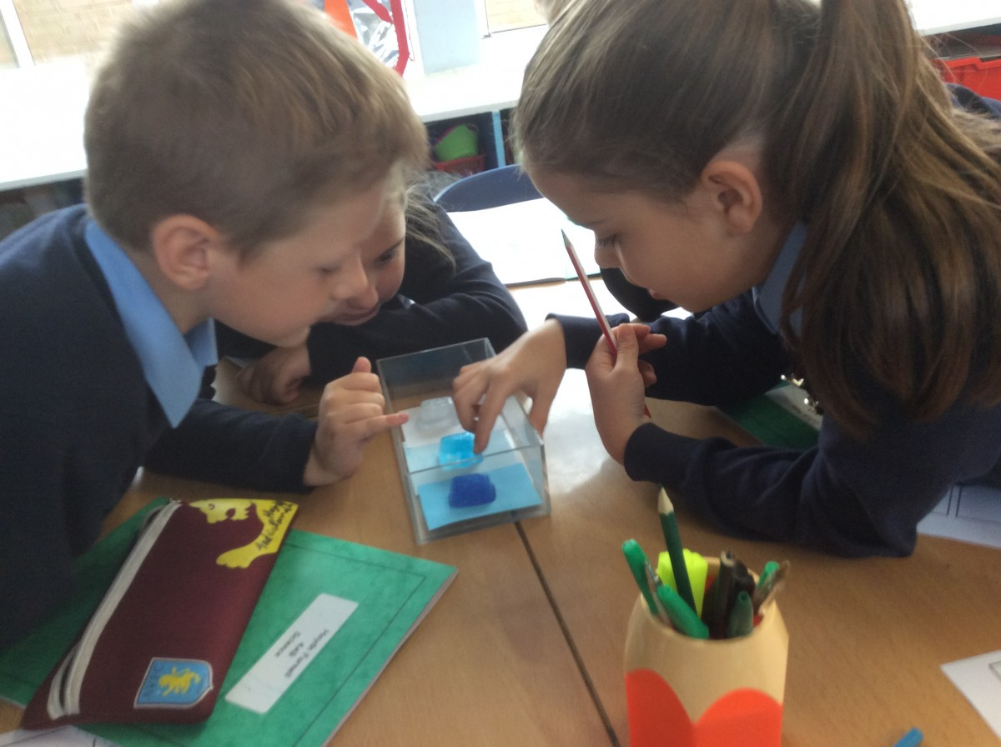
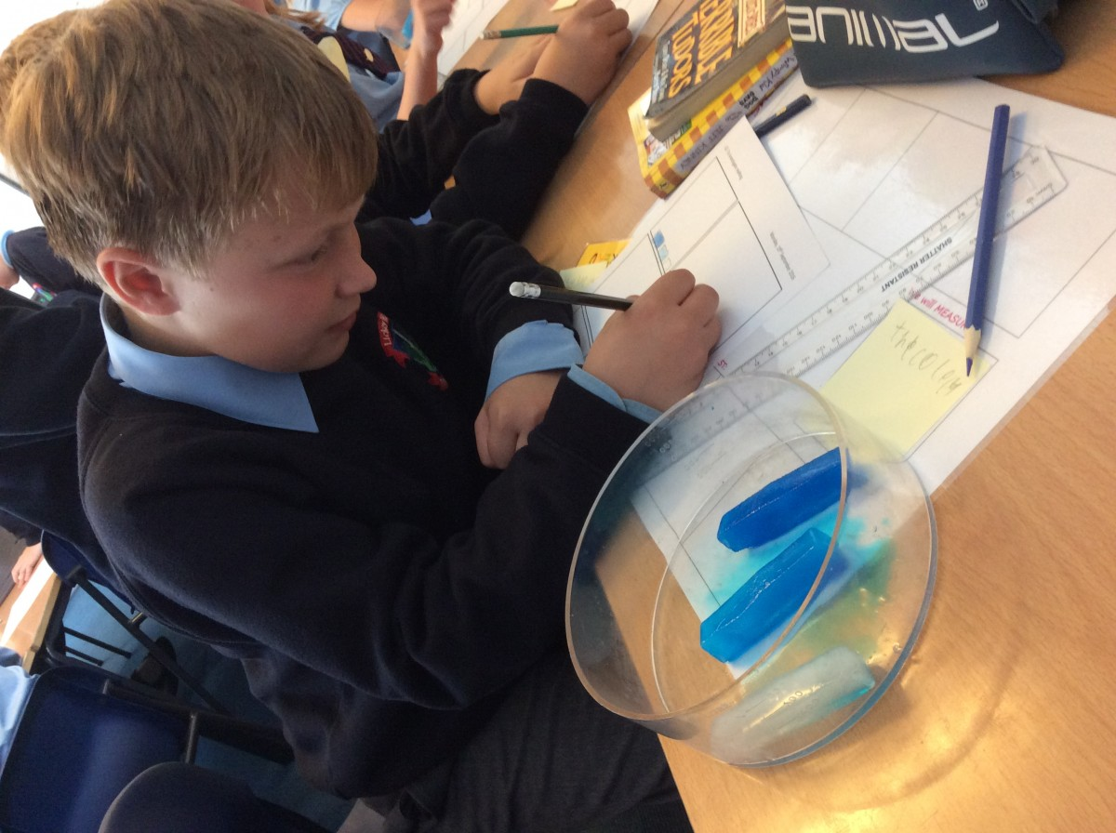
What I’m learning in Science today
Date: Tuesday 2nd February 2021
L.Obj: *I can plan, carry out and conclude an investigation, understanding the need for a fair test.
*I can investigate ‘melting’ of different liquids (as solids).
https://www.youtube.com/watch?v=zOUconVysFY
https://www.bbc.co.uk/bitesize/clips/zhtmhyc

Slide 2
Last week, we learned about how different liquids and solids can ‘melt’, ‘boil’ and ‘freeze’ at different temperatures.
What do these words mean?
freeze
melt
boil
Which of these changes of state happen when they take place?
liquid to
gas
liquid to
solid
solid to
liquid

Slide 3
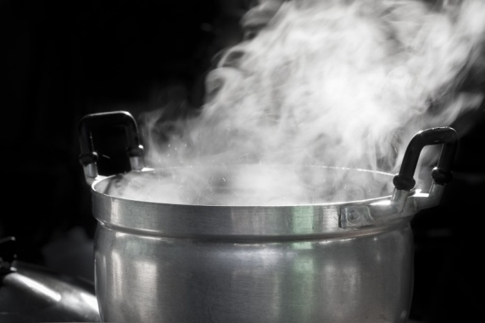
freeze
melt
boil
liquid to
solid
solid to
liquid
liquid to
gas

Slide 4
Today, I’d like you to plan and start an investigation about ‘melting’
Here’s the question that I’d like you to investigate over the next few days.
‘Which liquid melts the quickest?’

Slide 5
Science Investigation Plan
Tuesday 2nd February 2021
Investigating Melting
Question:
What I will do:
Resources:
Factors to keep the same:
Factor to change:
What I will measure:
Prediction:
Results:
Type of liquid (as a solid) | Length of time taken to full melt.
water (ice)
chocolate (solid)
(solid)
(solid)
Conclusion:

