Slide 1
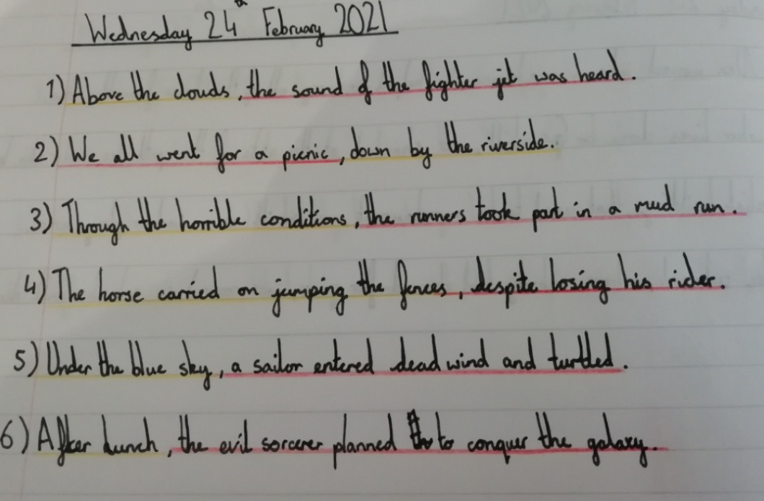
Amy used preposition phrases in her sentences today.

Slide 2
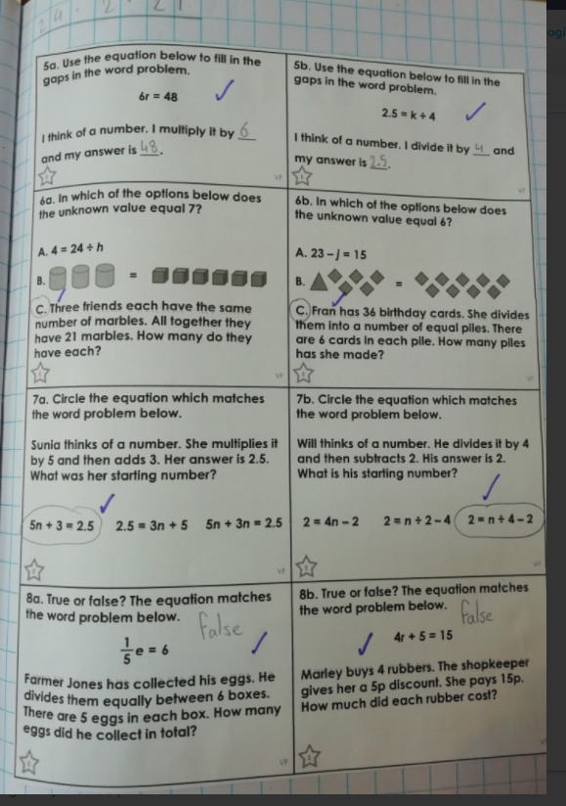
Amy has read the problems and equations correctly to match and complete them in maths.

Slide 3
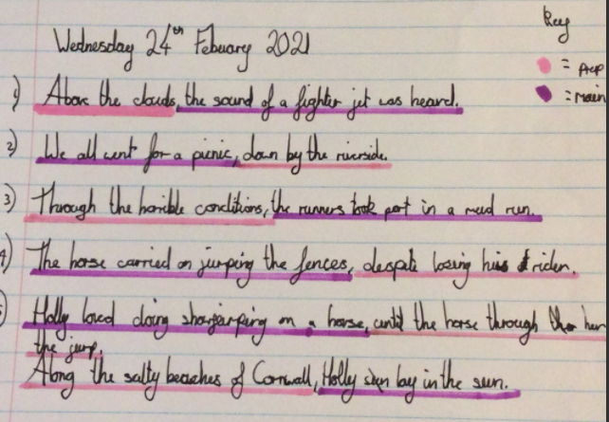
Holly H has been creating her sentences and finding her preposition phrases.

Slide 4
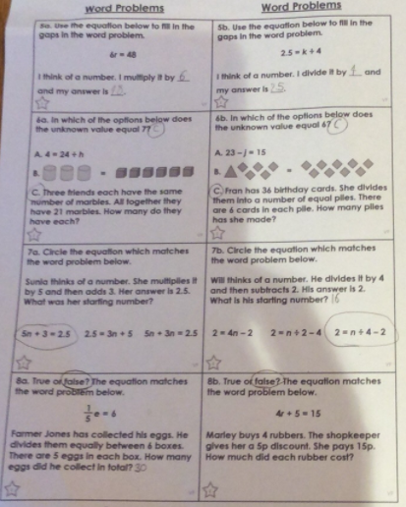
Holly H has been reading these problems carefully to match the algebra equations with them.

Slide 5
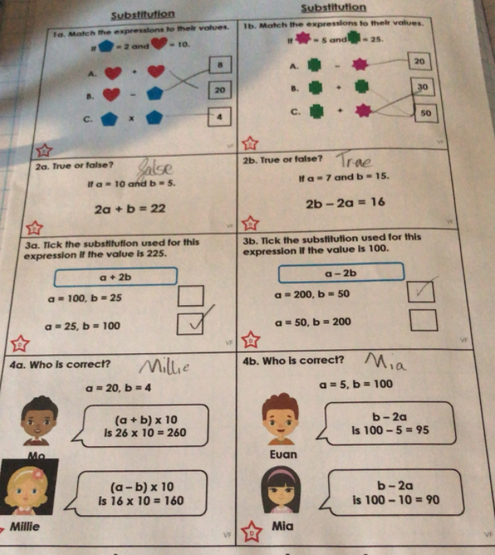
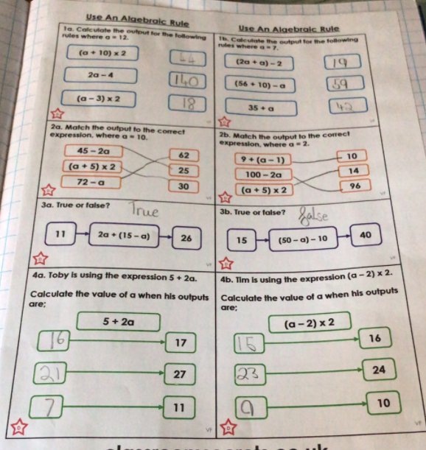
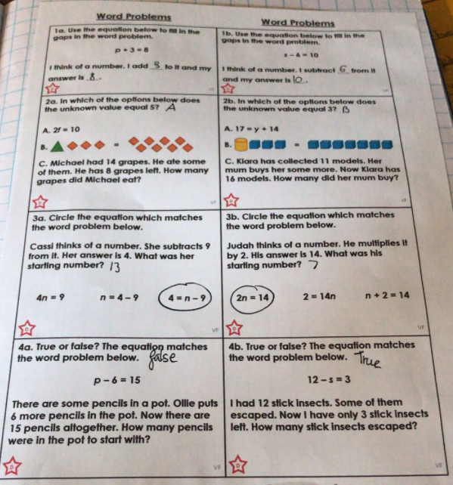
Rhys has been working hard this week in maths.

Slide 6
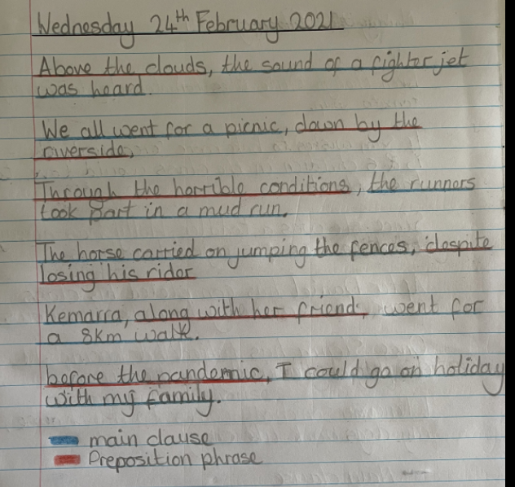
Nelly has been using preposition phrases in her sentences.

Slide 7
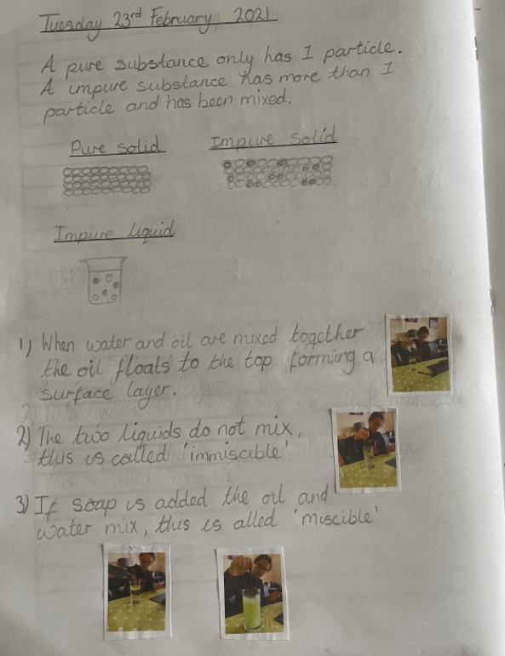
Nelly observed the video well in Science yesterday to experiment with pure, impure and mixtures in substances.

Slide 8
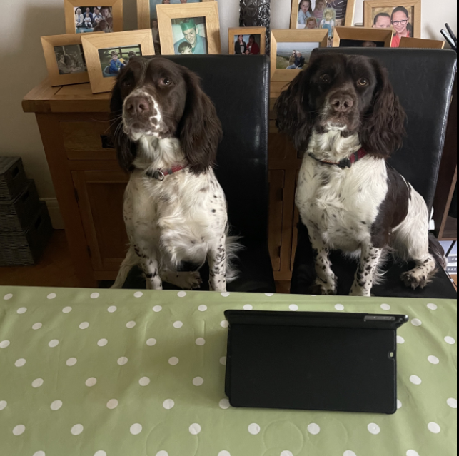
Penny and Belle are waiting to be allowed in to this morning’s Zoom meeting.

Slide 9
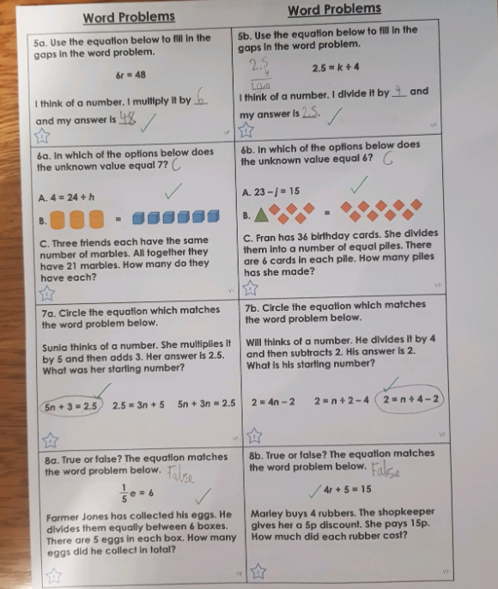
Cameron has matched the problems to the equations in maths today.

Slide 10
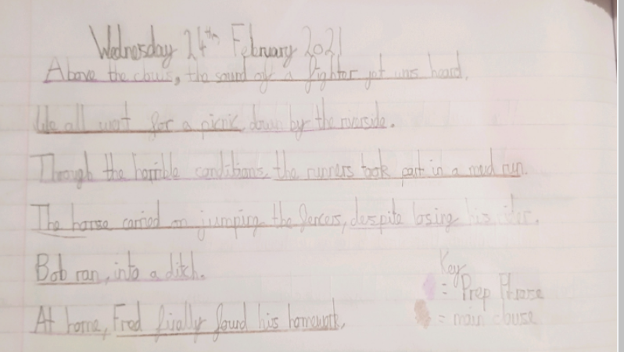
Cameron has used and recognised preposition phrases in his sentences today..

Slide 11
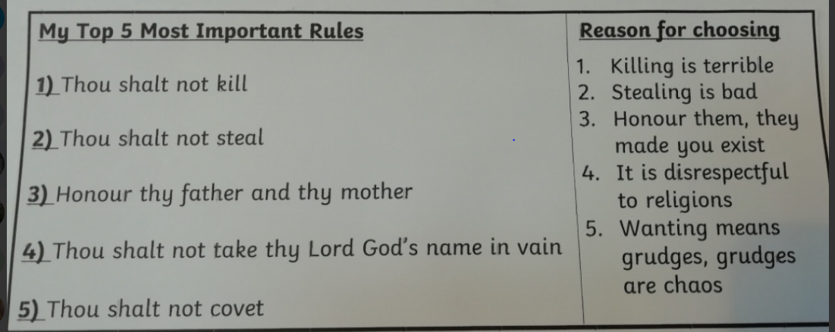
Amy has shared with us which she thinks are the most relevant of the Ten Commandments in today’s current life, giving her reasons why.

Slide 12
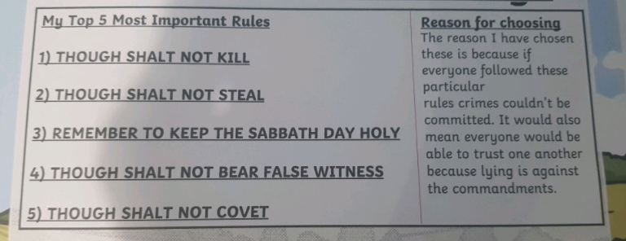
Cameron has shared with us which he thinks are the most relevant of the Ten Commandments in today’s current life, giving his reasons why.

Slide 13
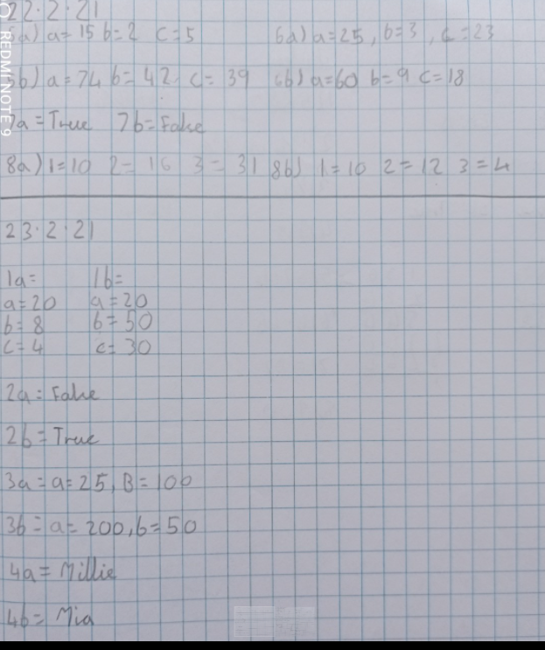
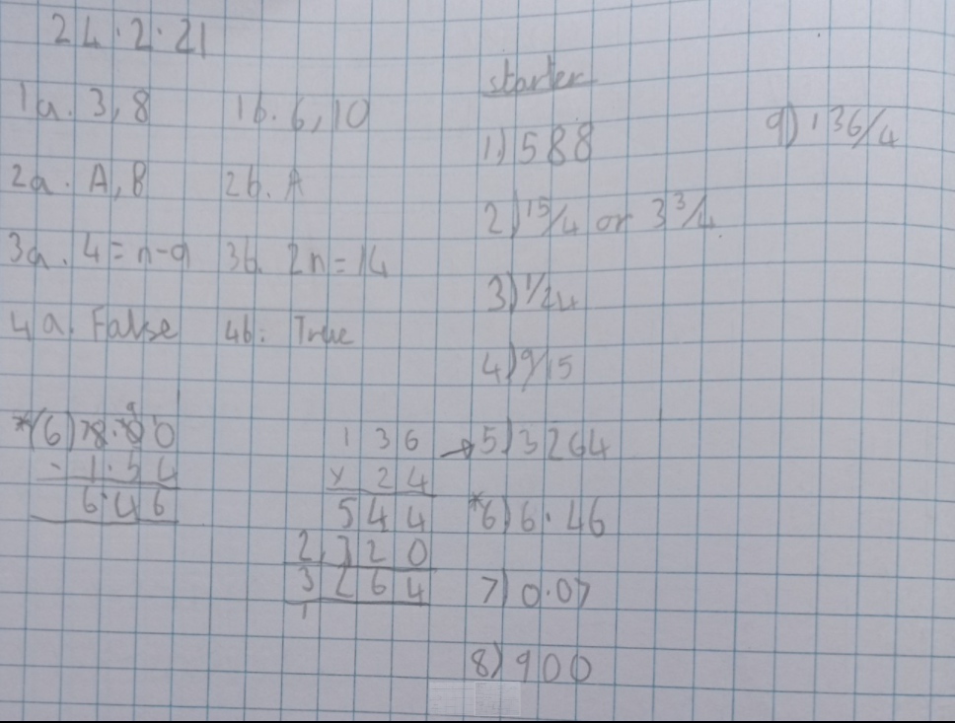
Lucy has been working hard on her algebra in maths recently.

Slide 14
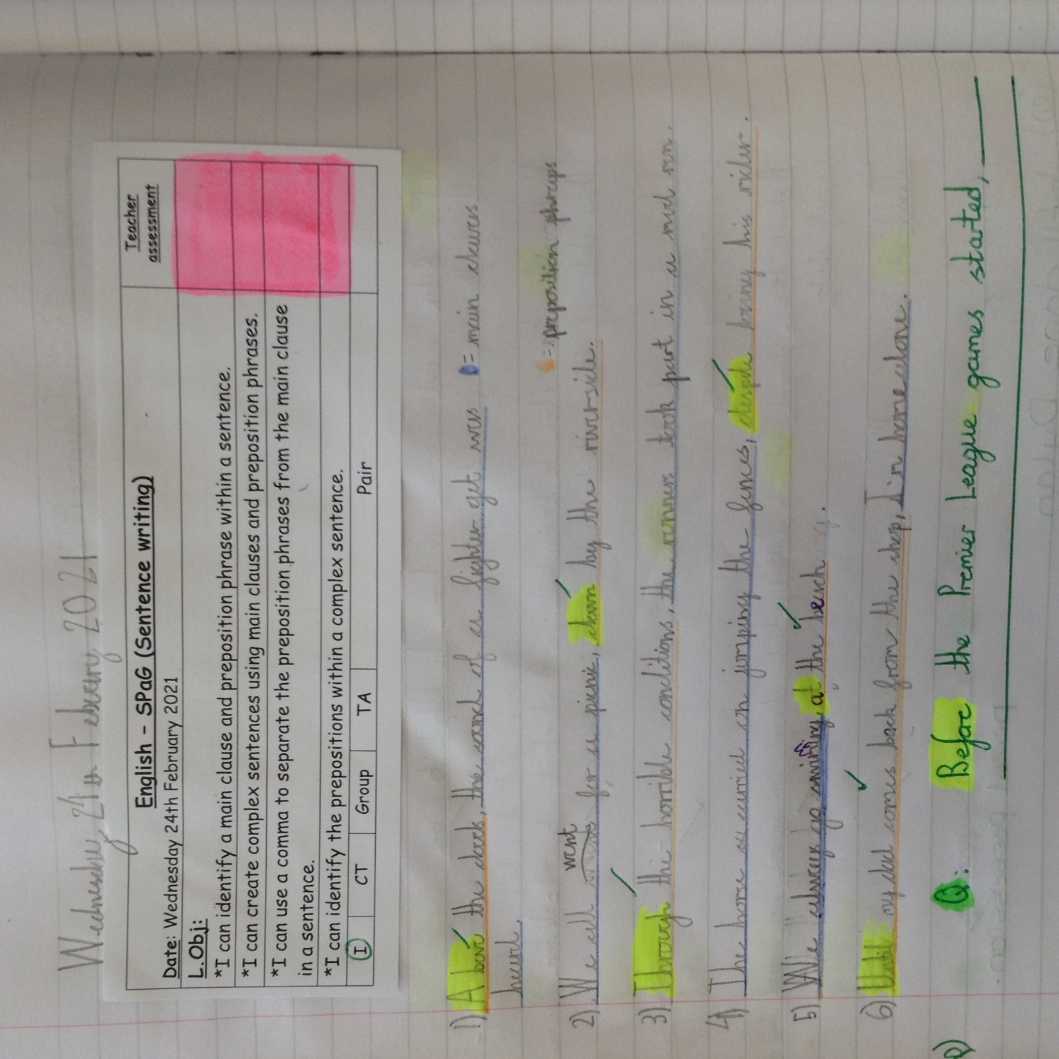
Dylan has identified and used preposition phrases today.

Slide 15
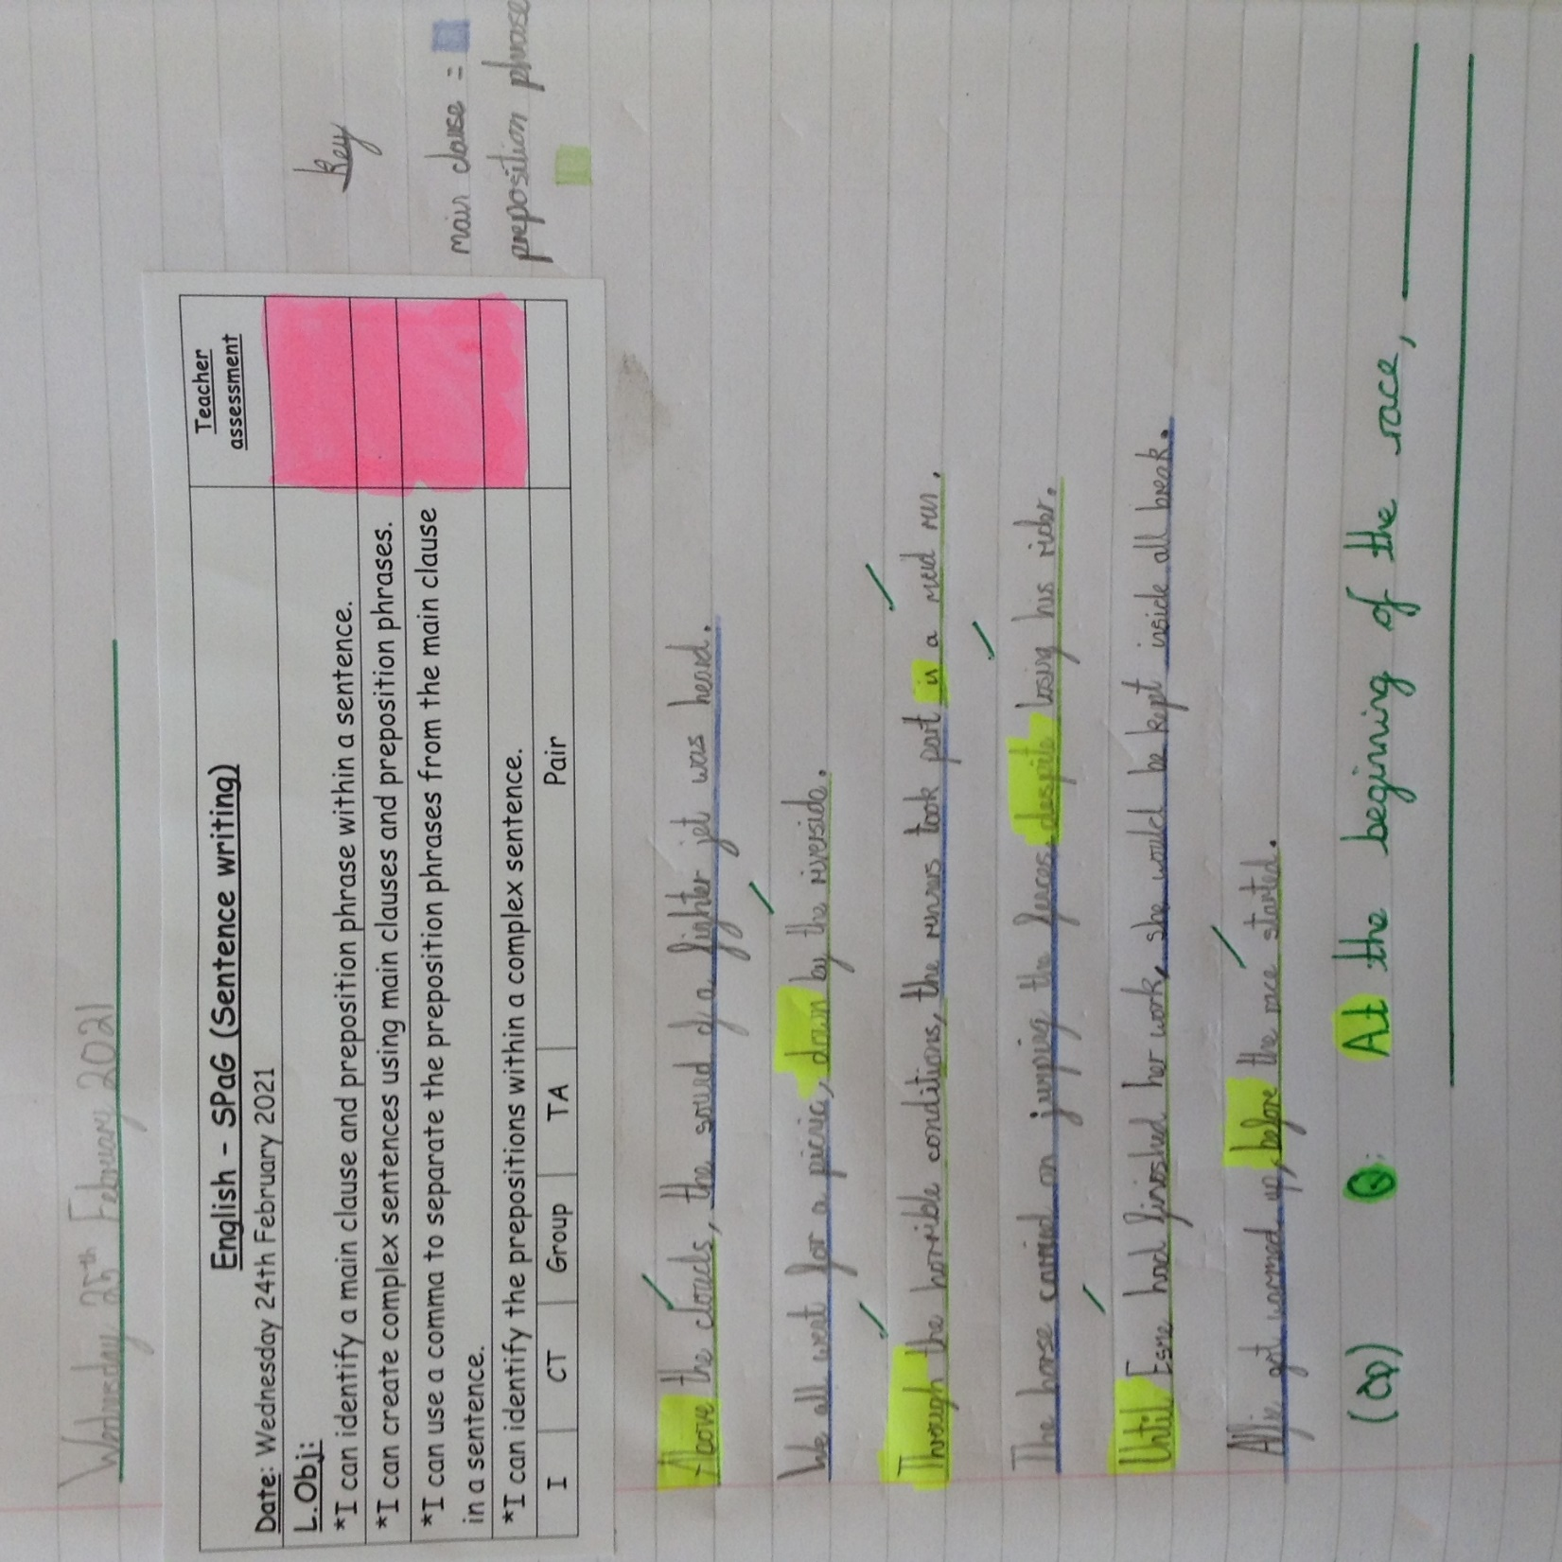
Cass has identified and used preposition phrases in his sentences today.

Slide 16
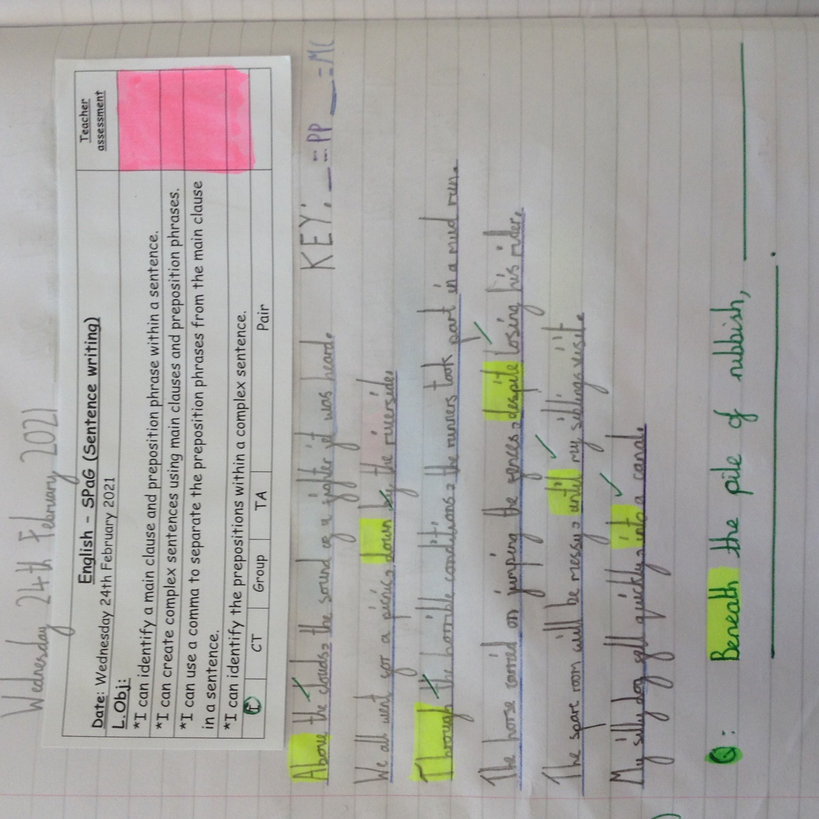
Ariana has used preposition phrases in her sentence today.

Slide 17
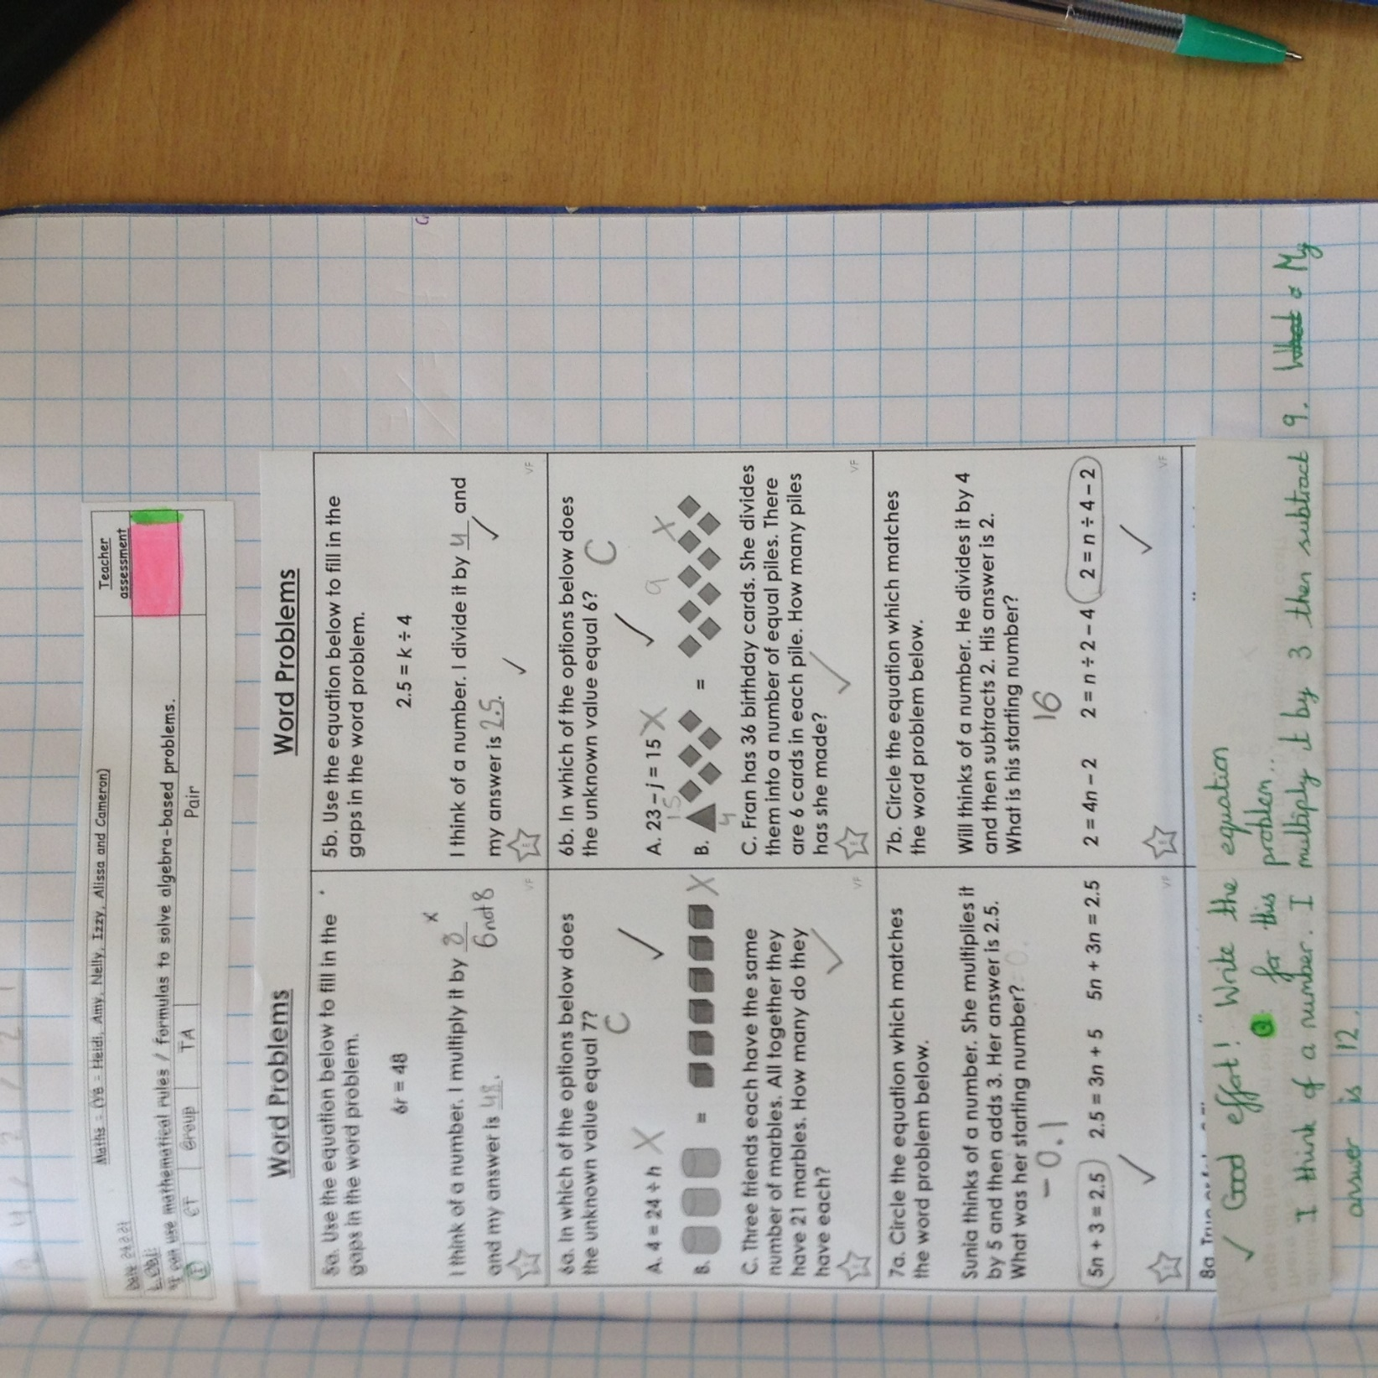
Heidi has been attempting to match the problem with the correct maths equation.

Slide 18
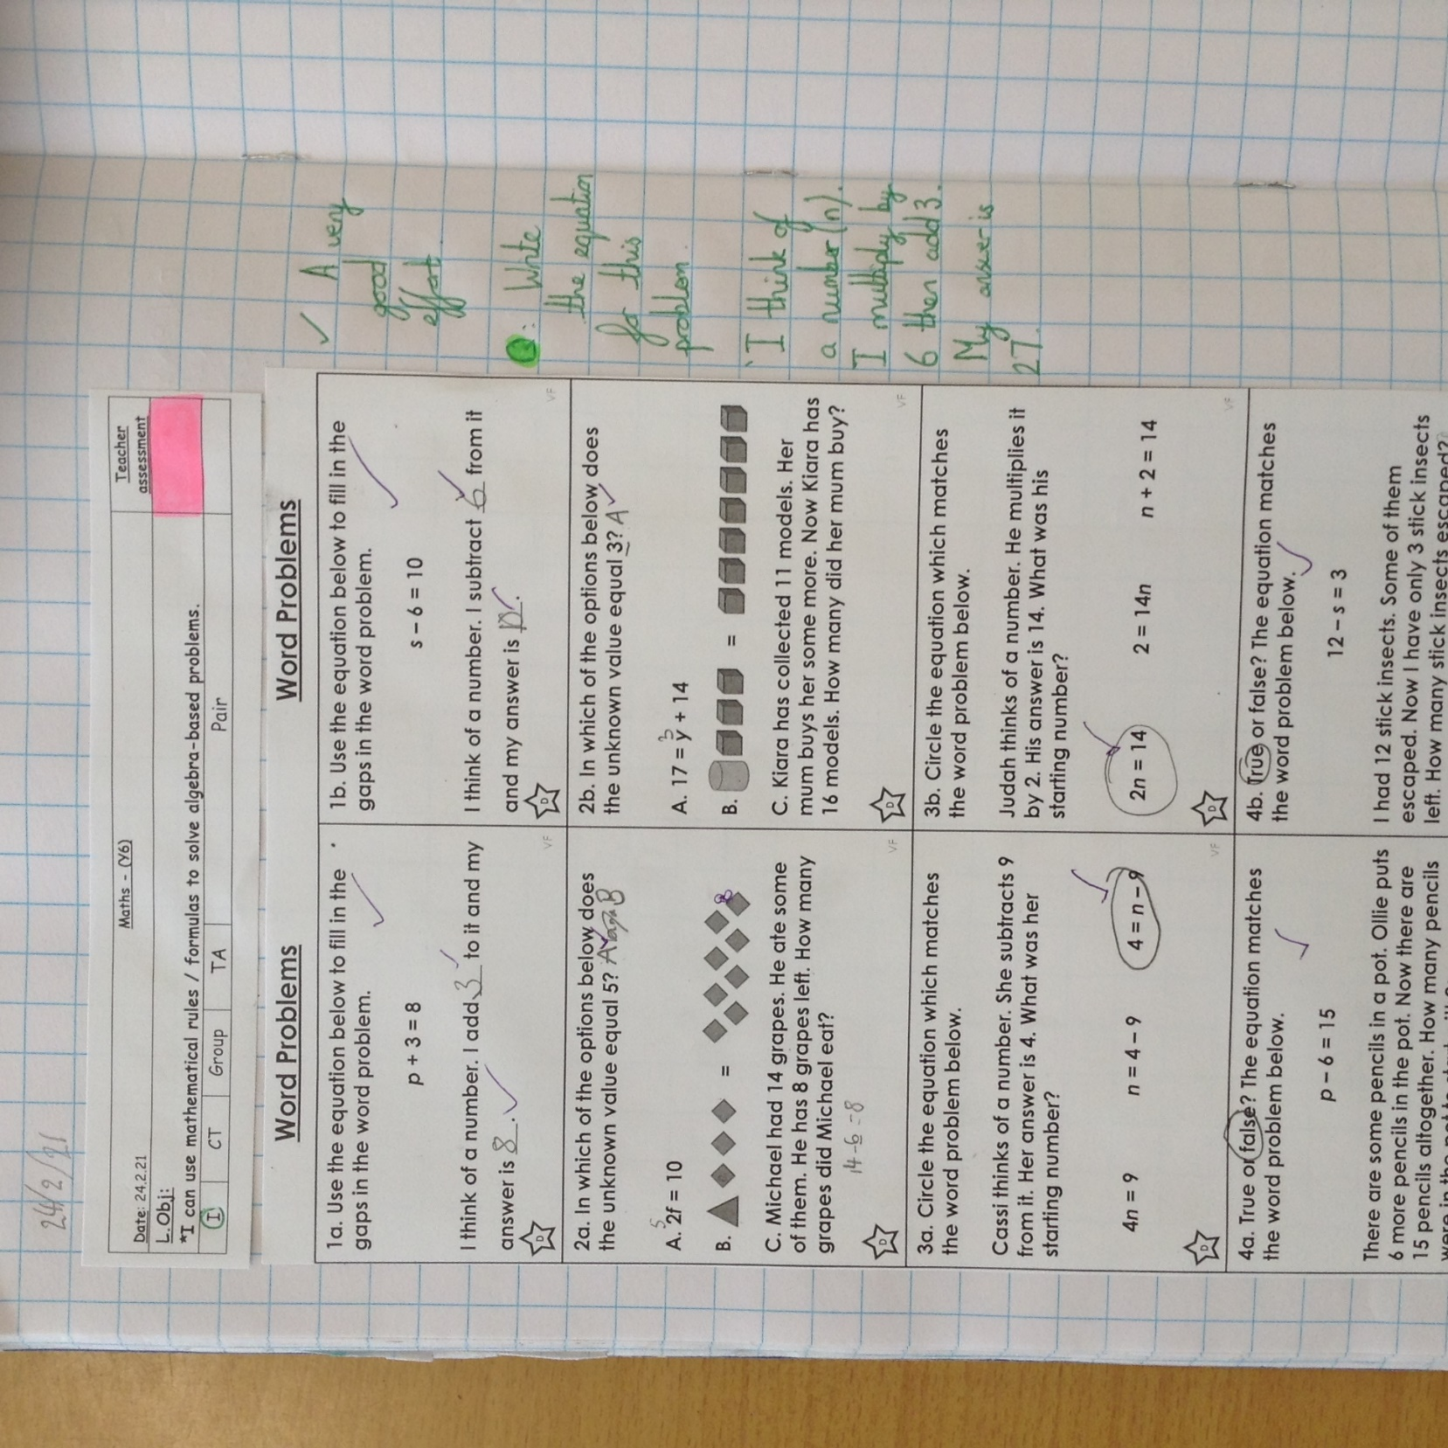
Zoe has identified the correct maths equation to match the problem given.

Slide 19
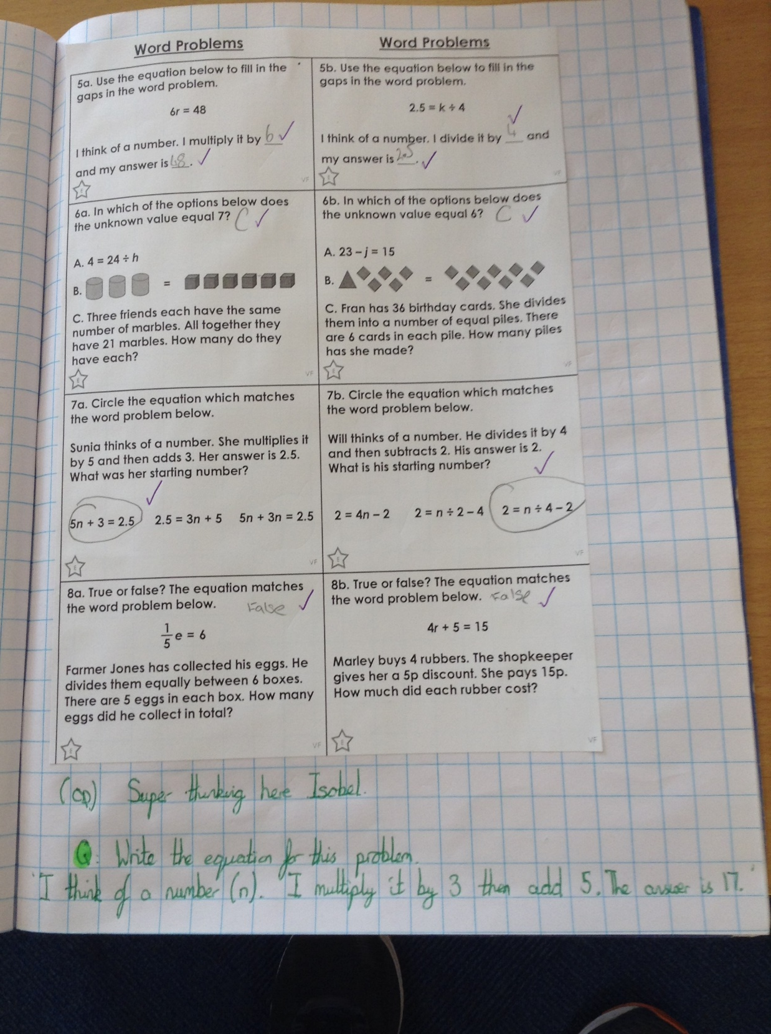
Isobel has identified the correct maths equation to match the problem.

Slide 20
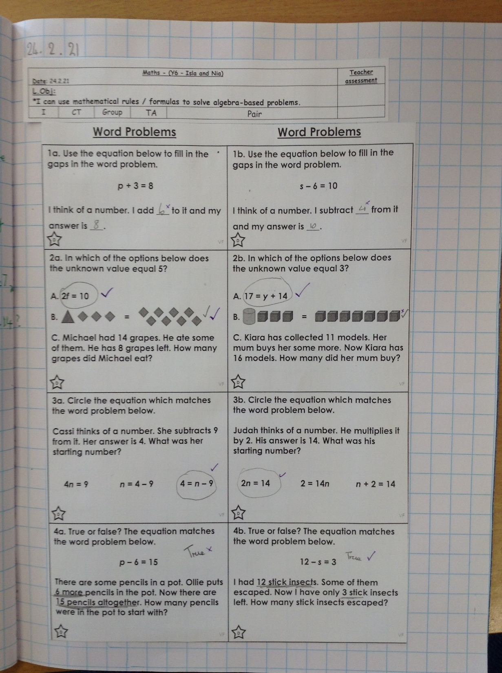
Isla has been thinking about maths equations which match a problem given.

Slide 21
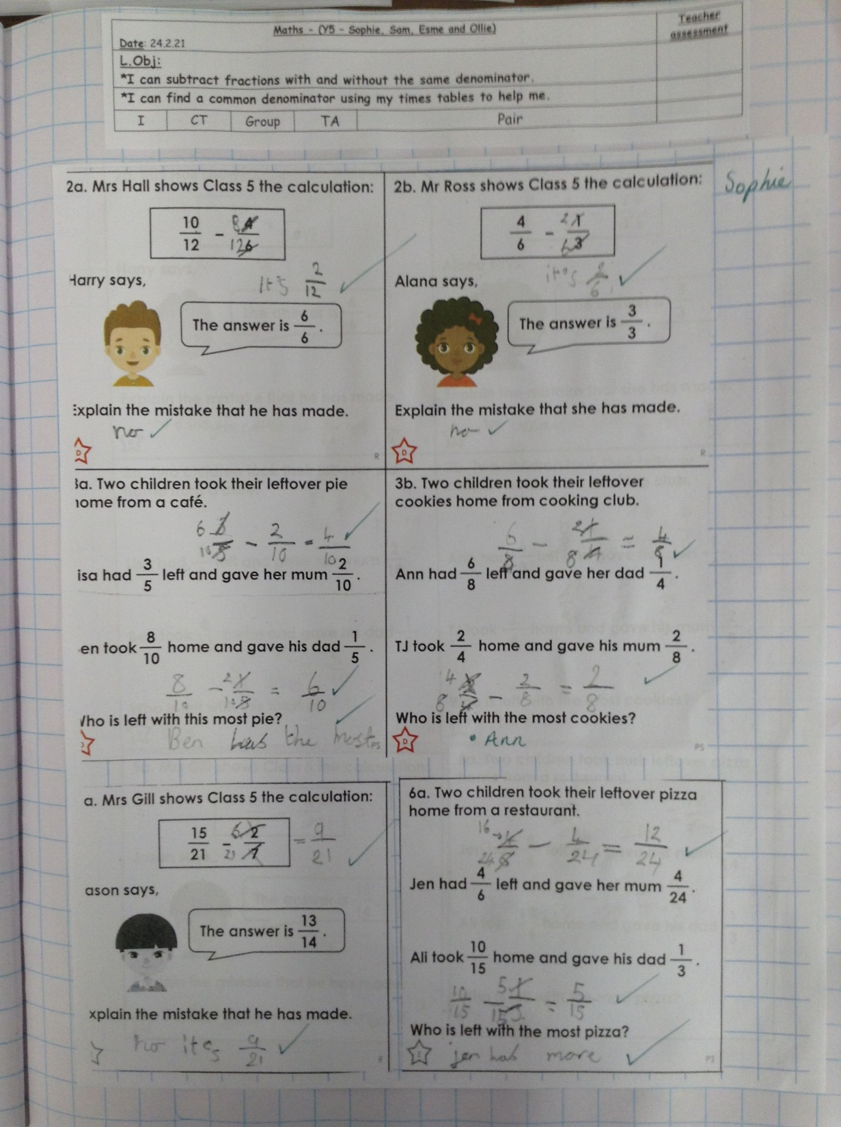
Sophie has been subtracting fractions by finding a common denominator.

Slide 22
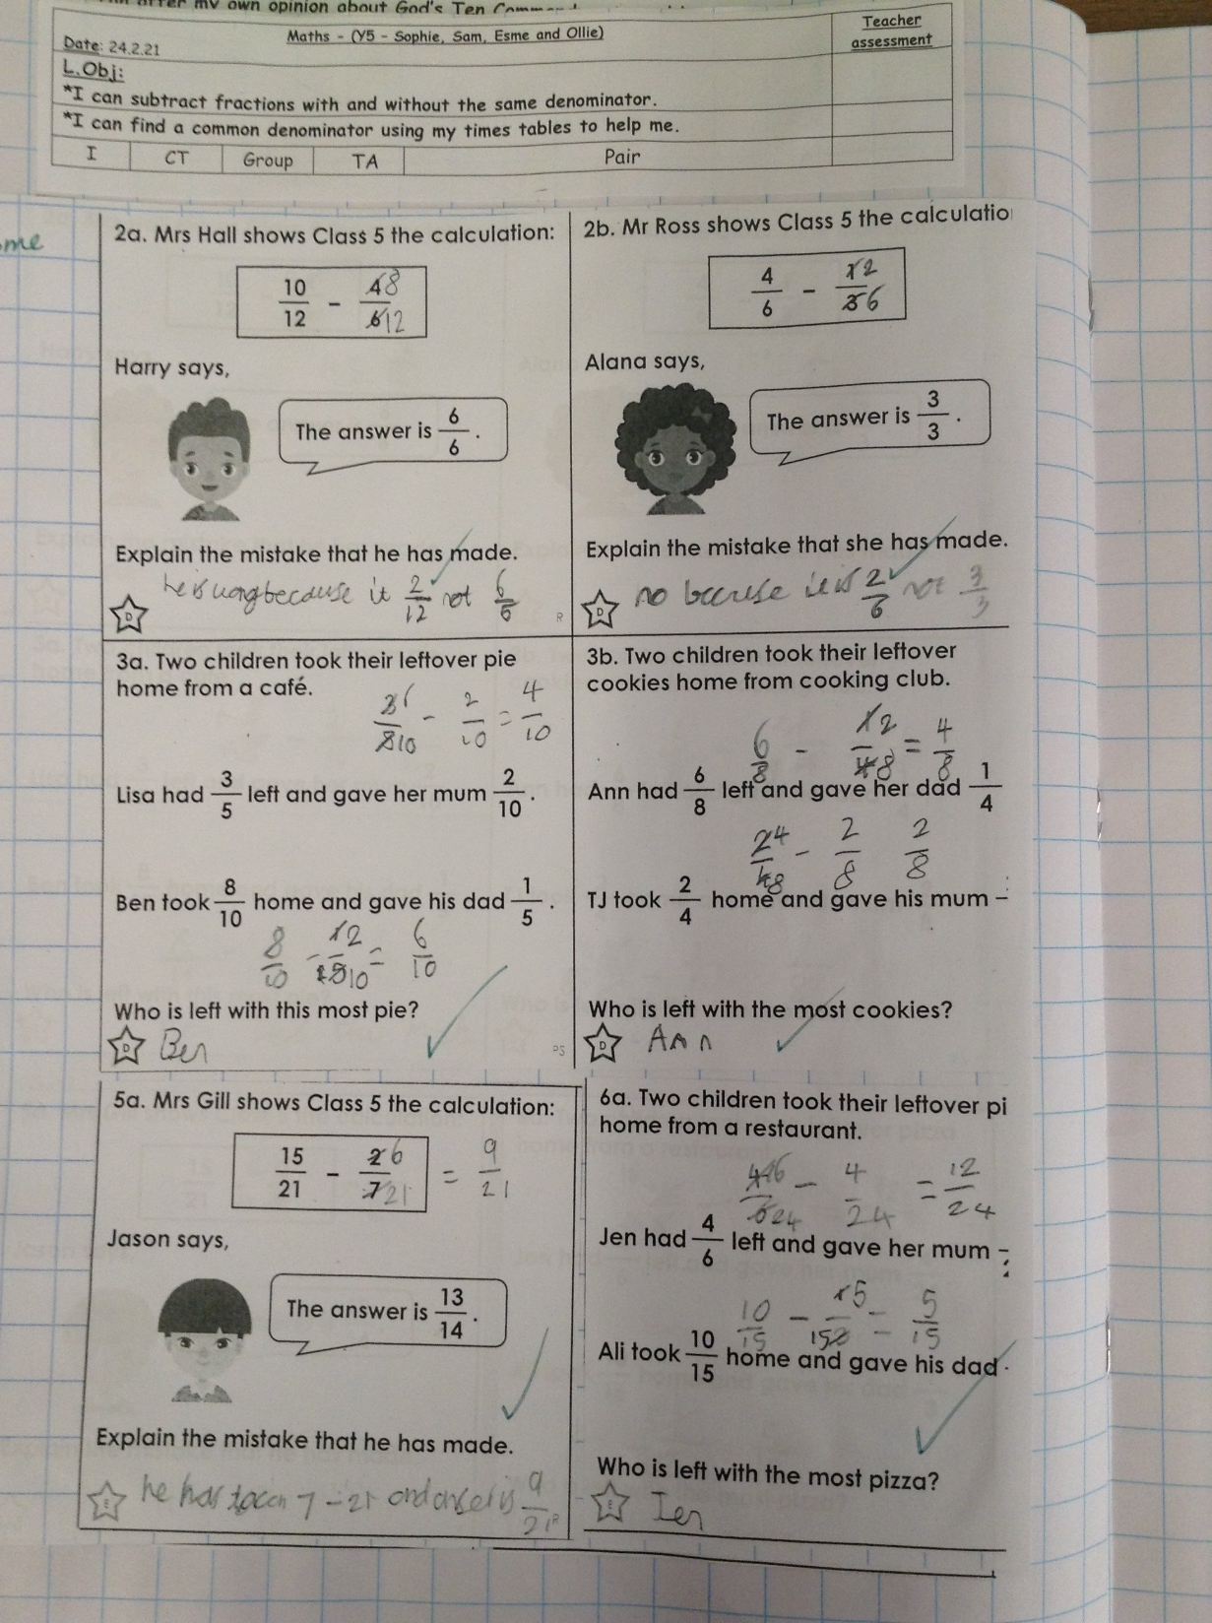
Esme has been subtracting fractions to solve problems, by finding a common denominator.

Slide 23
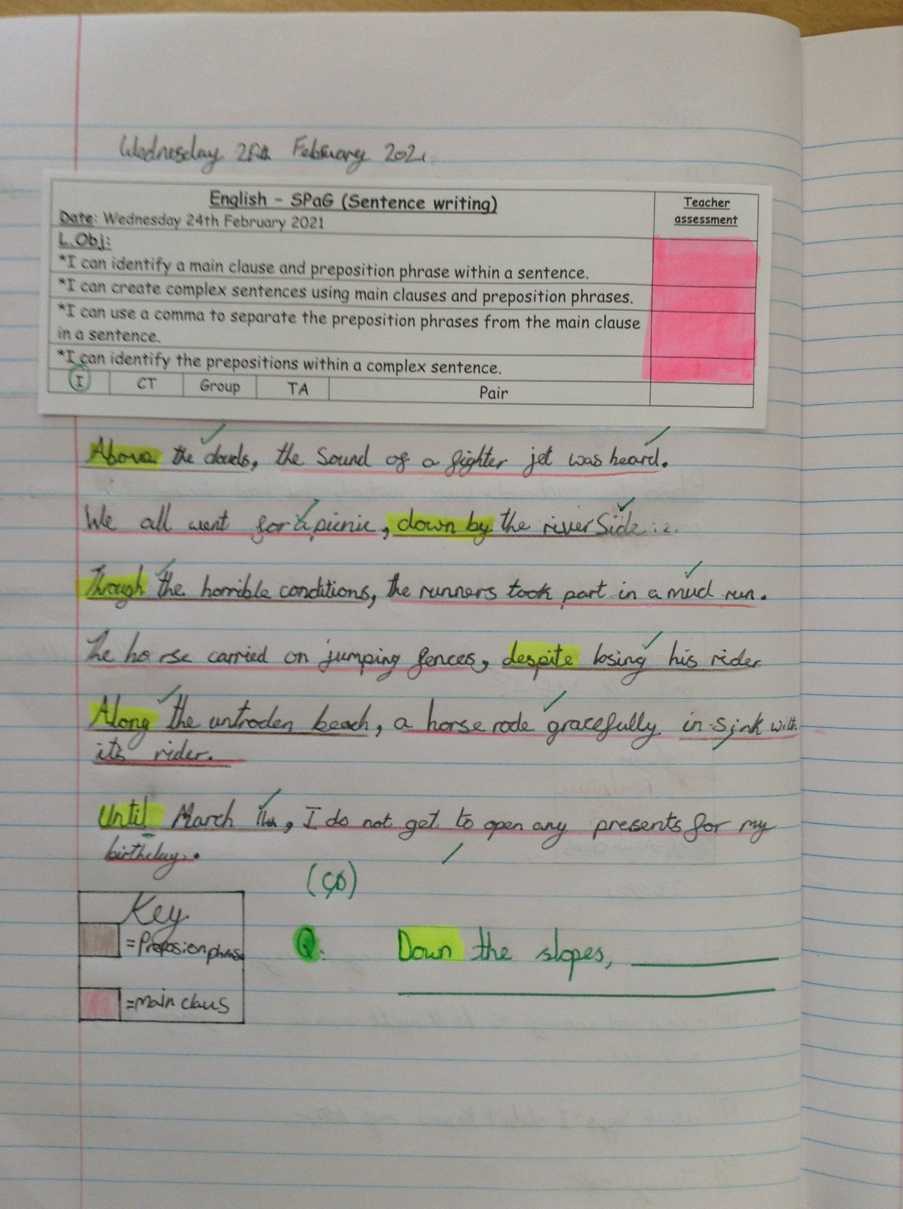
Zoe has created sentences with preposition phrases and identified the clauses within the sentences.

Slide 24
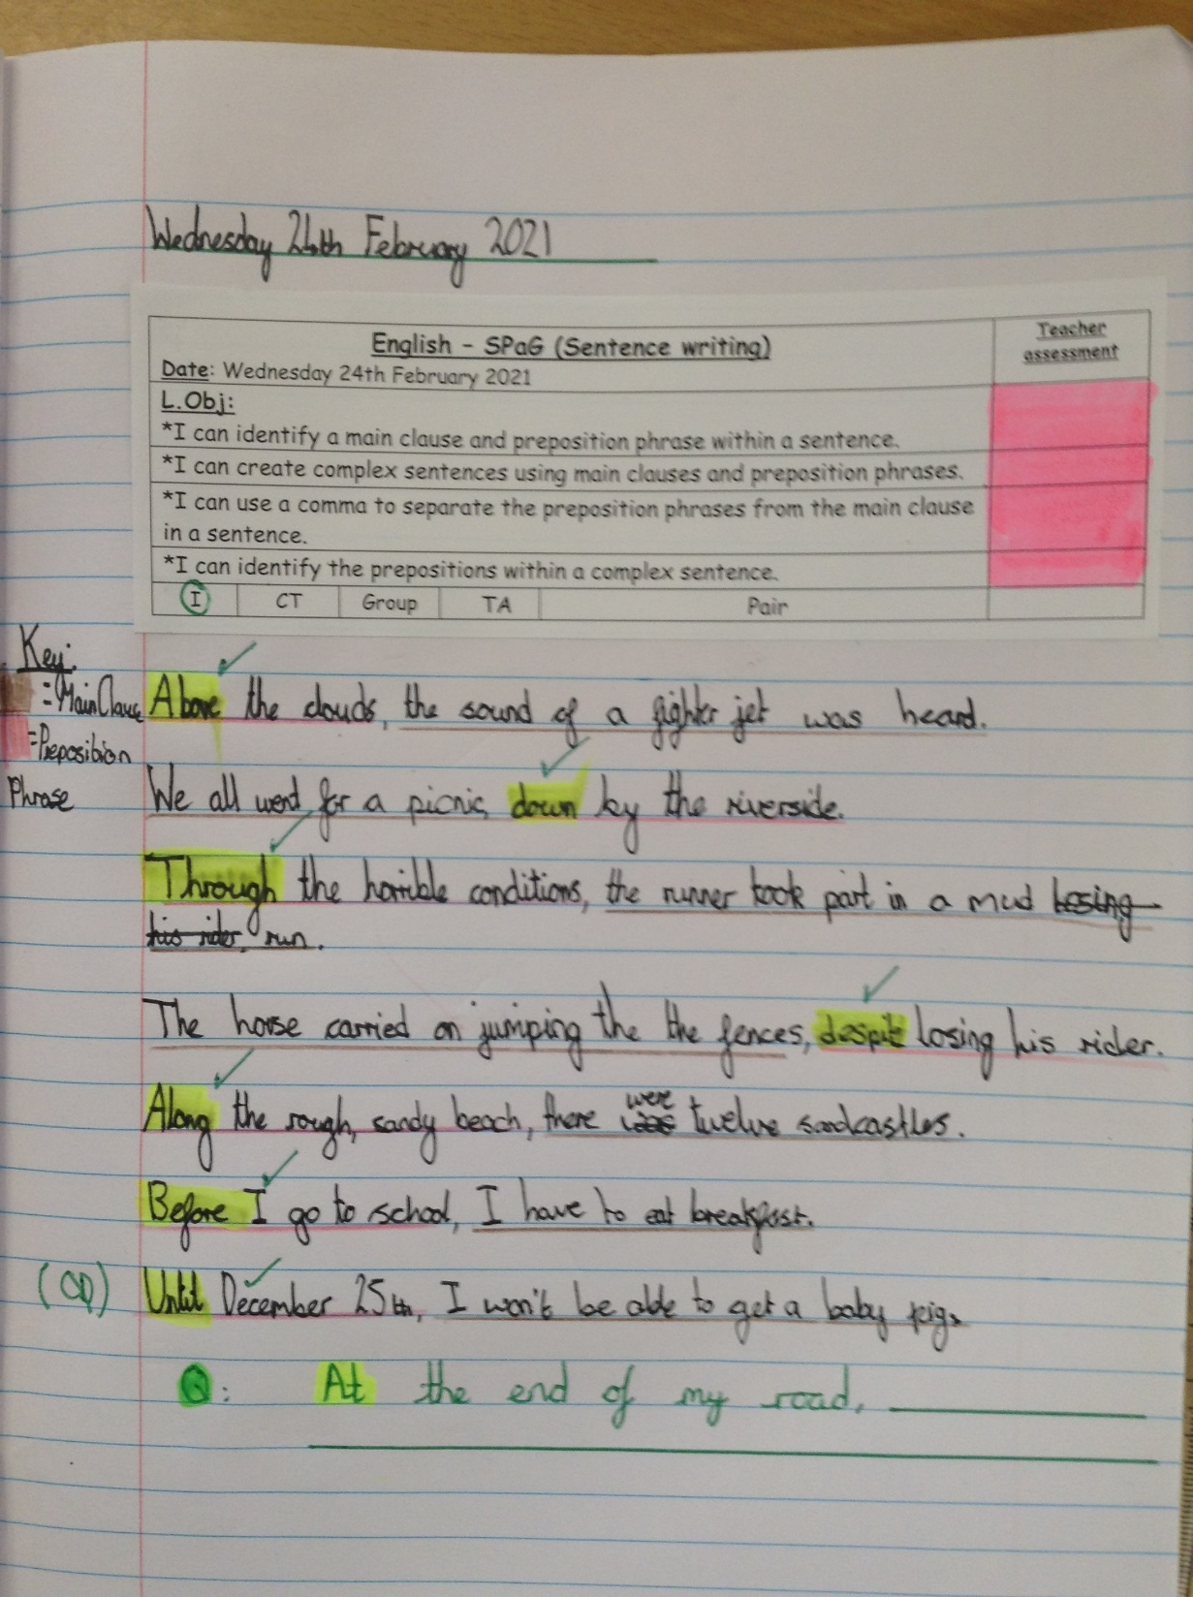
Isobel has been identifying the different main clauses and preposition phrases within the sentences and then created her own complex sentences.

Slide 25
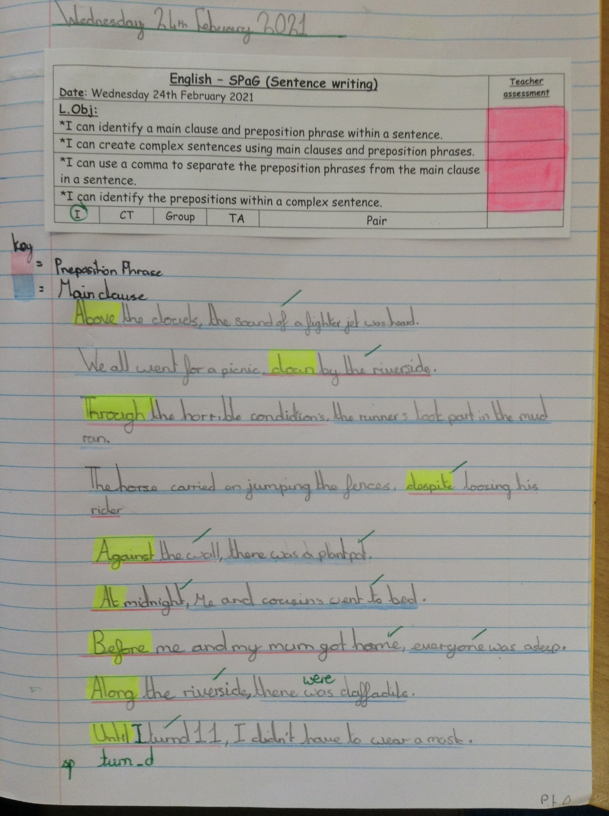
Isla has identified the preposition phrases and main clauses in each of these complex sentences.

Slide 26
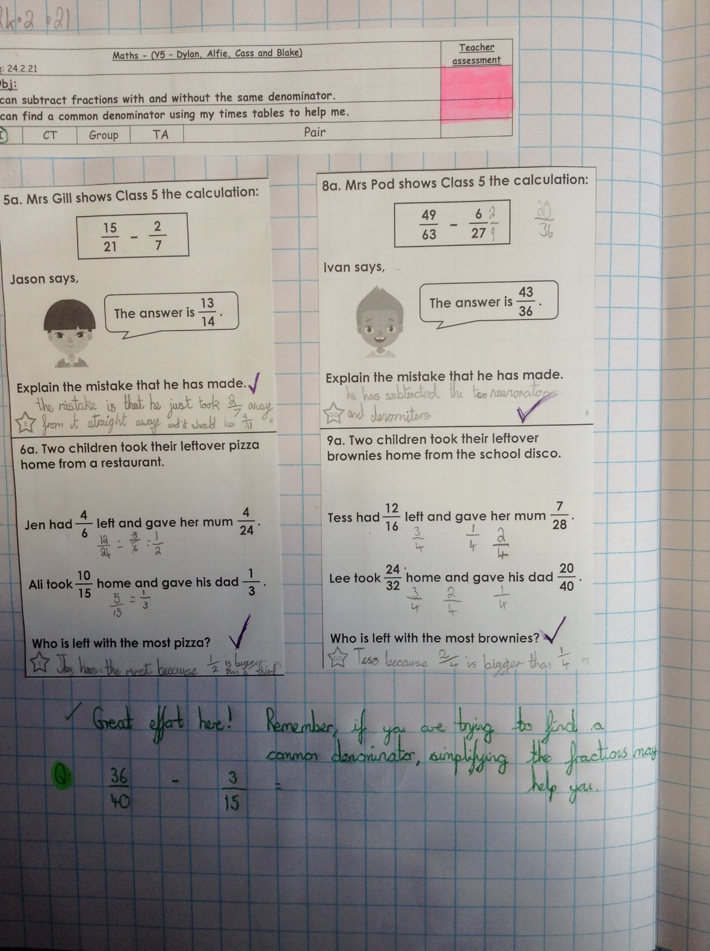
Cass has been subtracting fractions by finding common denominators.

Slide 27
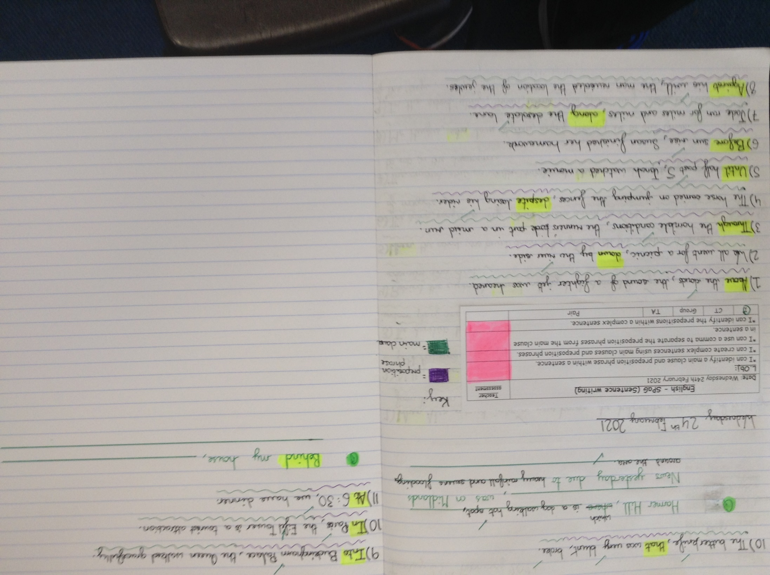
Heidi has identified the main clause and preposition phrase in each of these sentences and then created her own complex sentences.

Slide 28
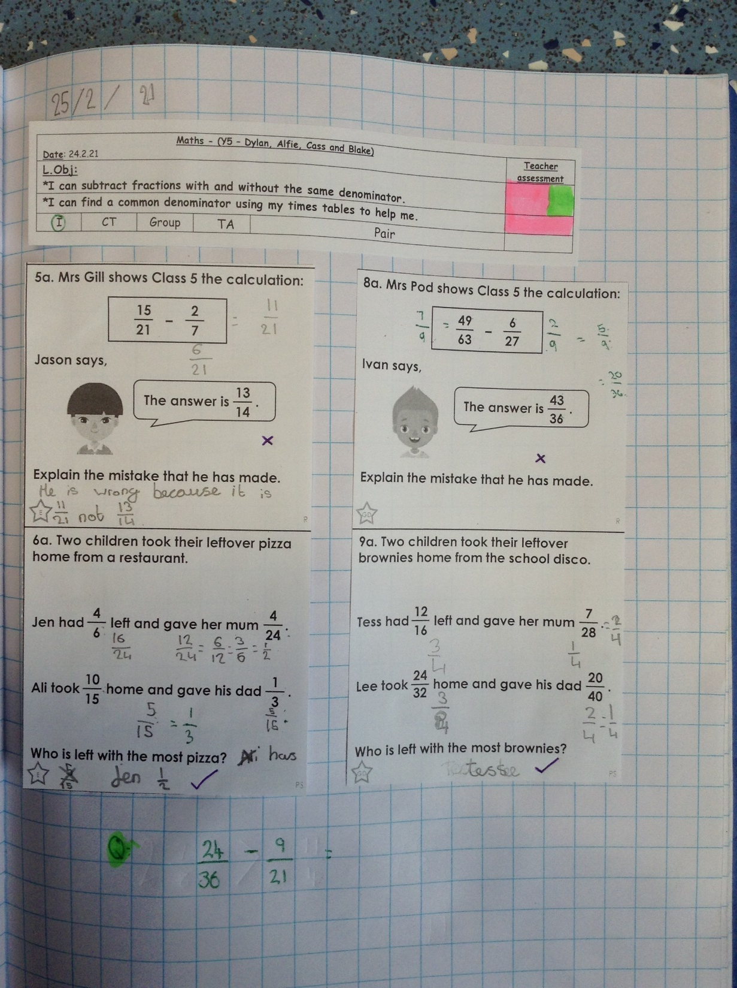
Alfie has been attempting to subtract his fractions by finding a common denominator.

Slide 29
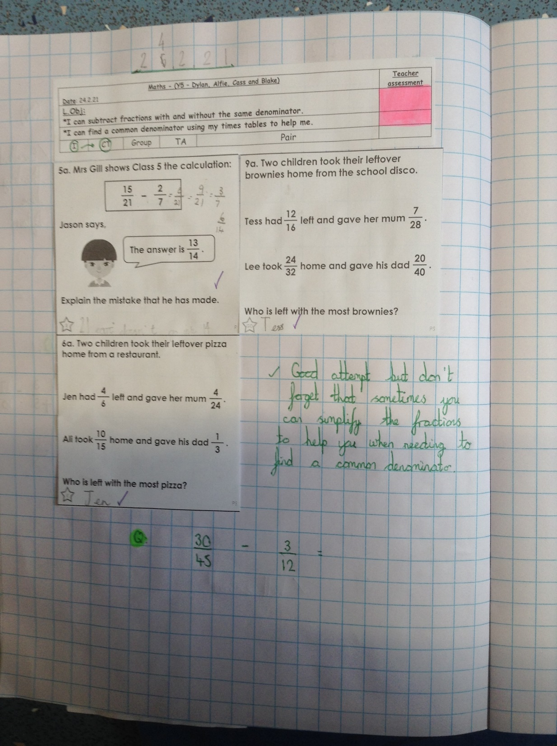
Dylan has been attempting to subtract his fractions today by finding a common denominator.

Slide 30
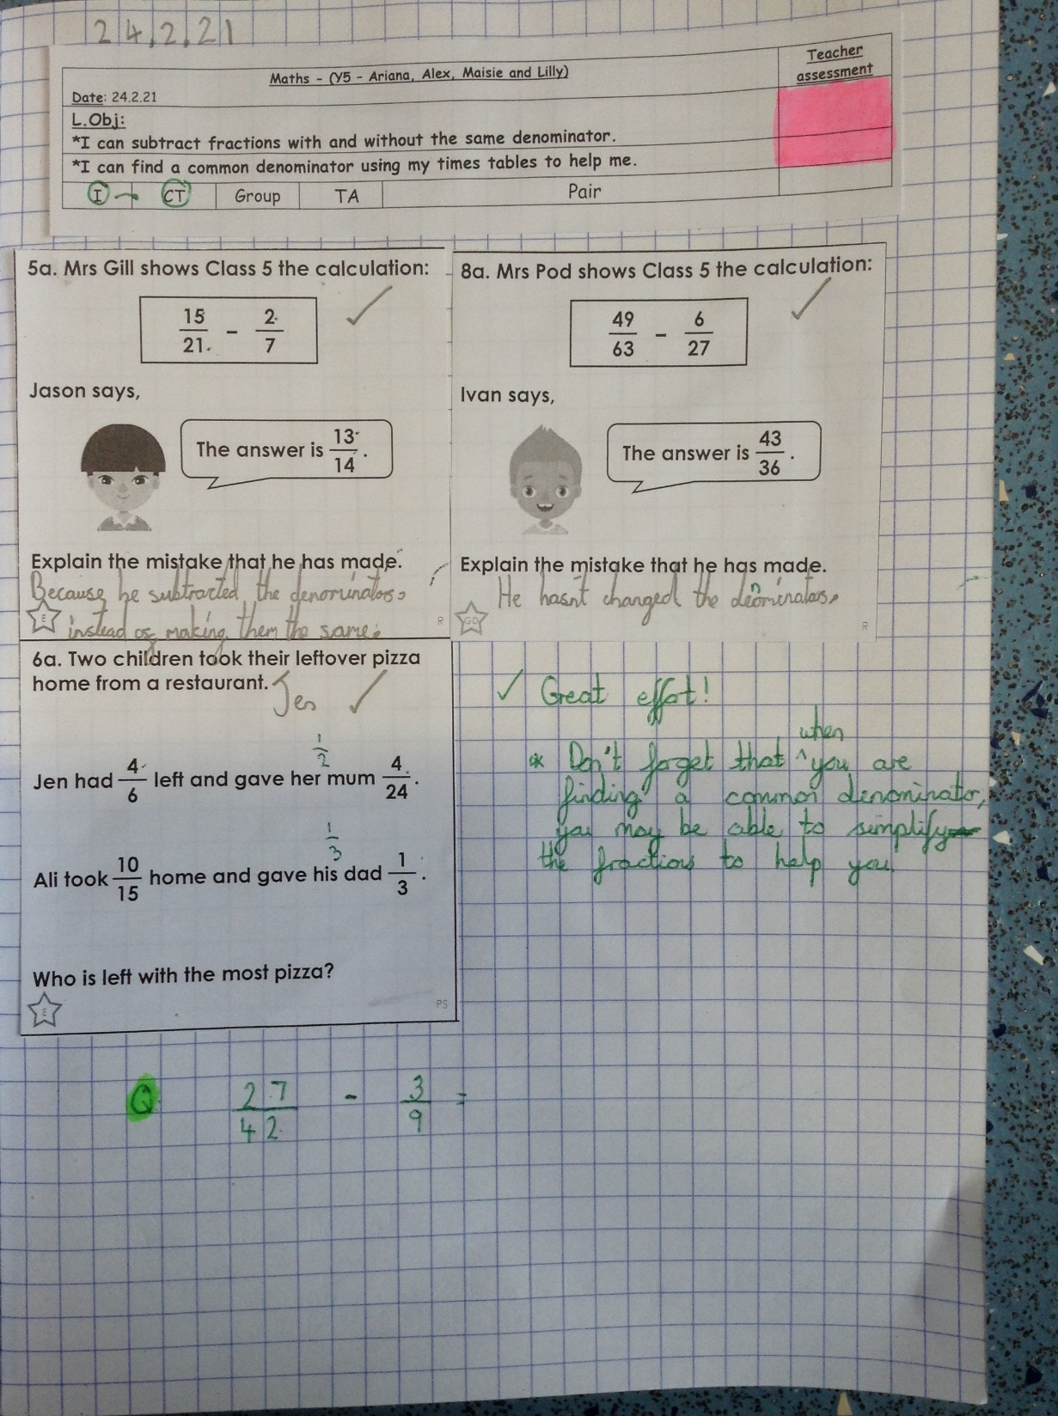
Ariana has been attempting to subtract her fractions today by finding a common denominator.

Slide 31
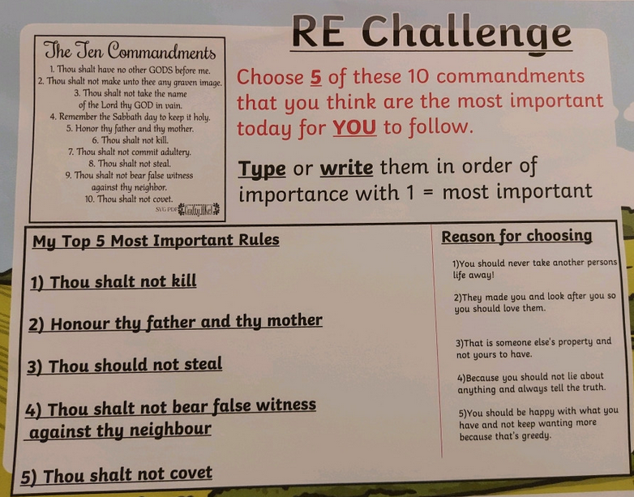
Ollie has thought really carefully about which of the Ten Commandments he thinks are the most important

Slide 32
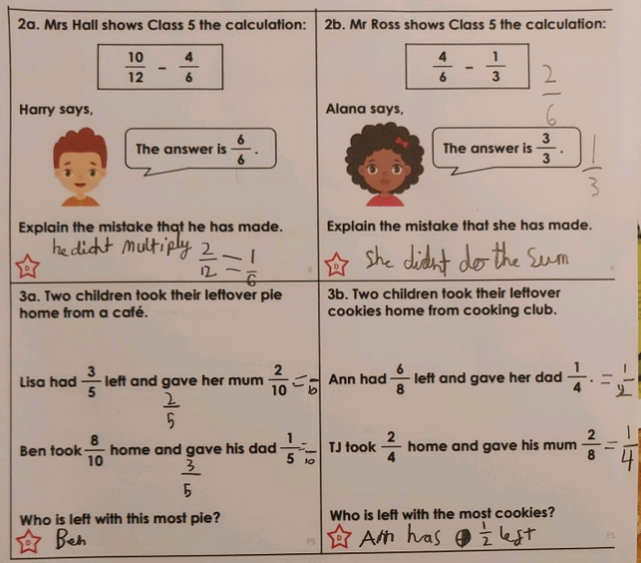
Ollie has been finding common denominators in maths to subtract his fractions.

Slide 33
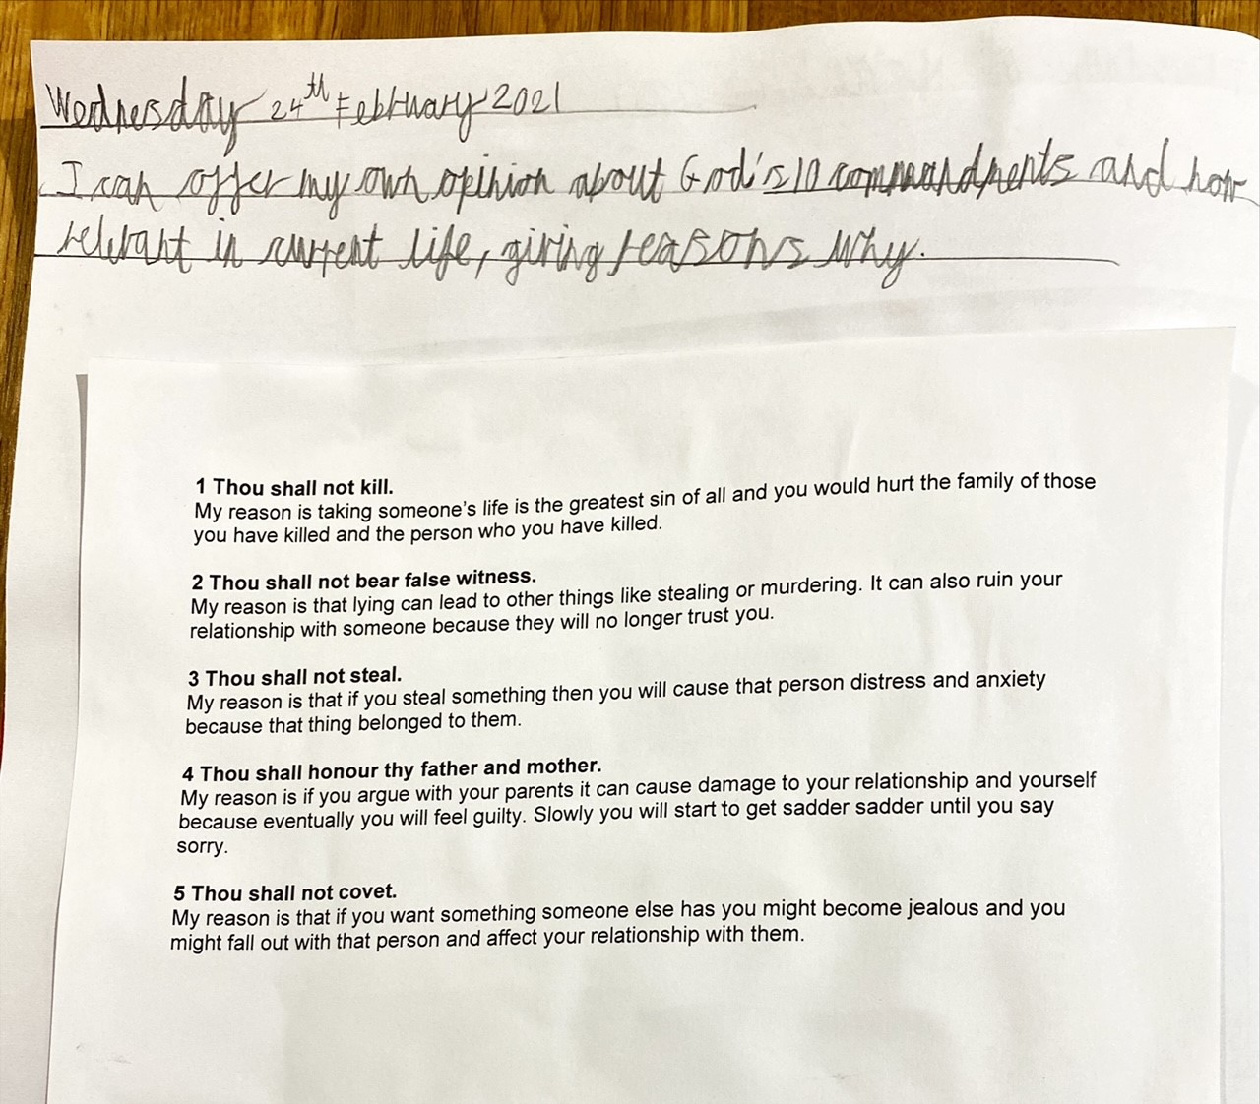
Sam has justified his reasons in RE

Slide 34
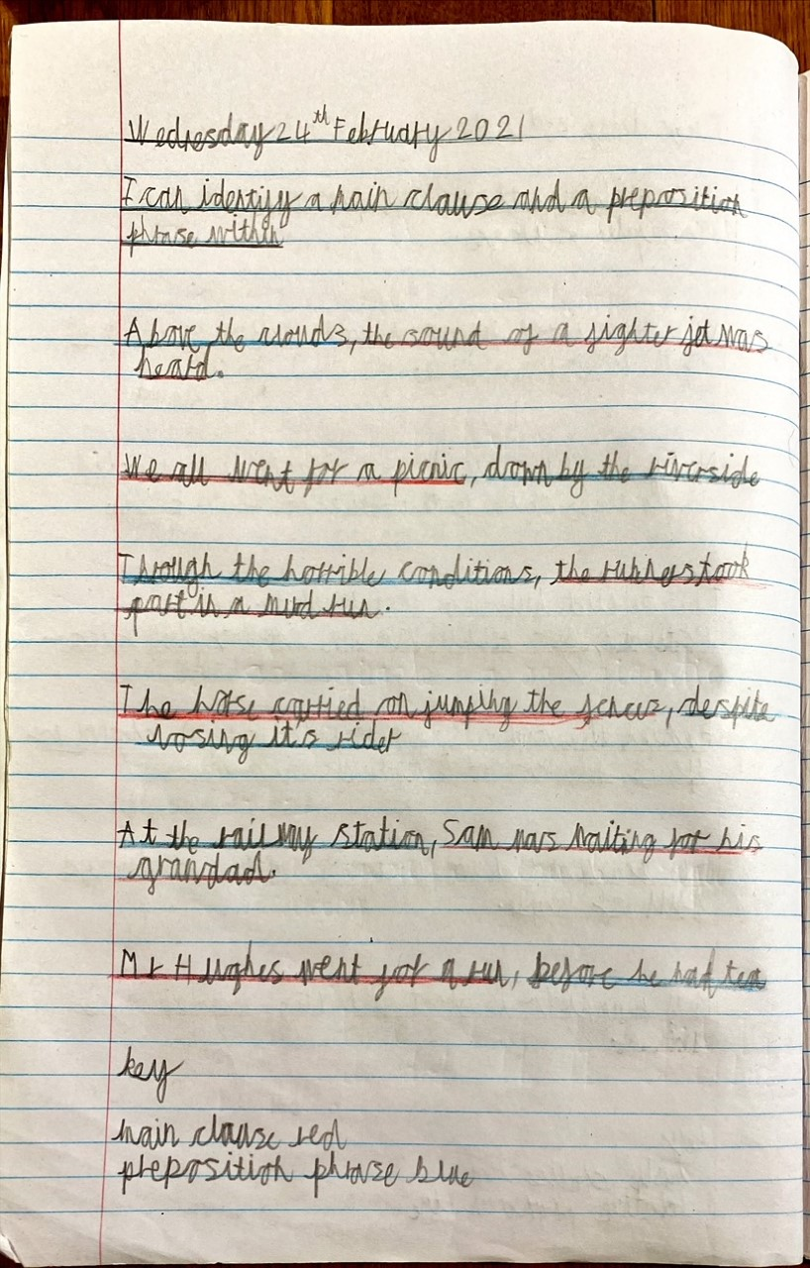
Sam has identified the preposition phrases in his sentences, and he has proved that he is a mind reader on his final sentence!

Slide 35
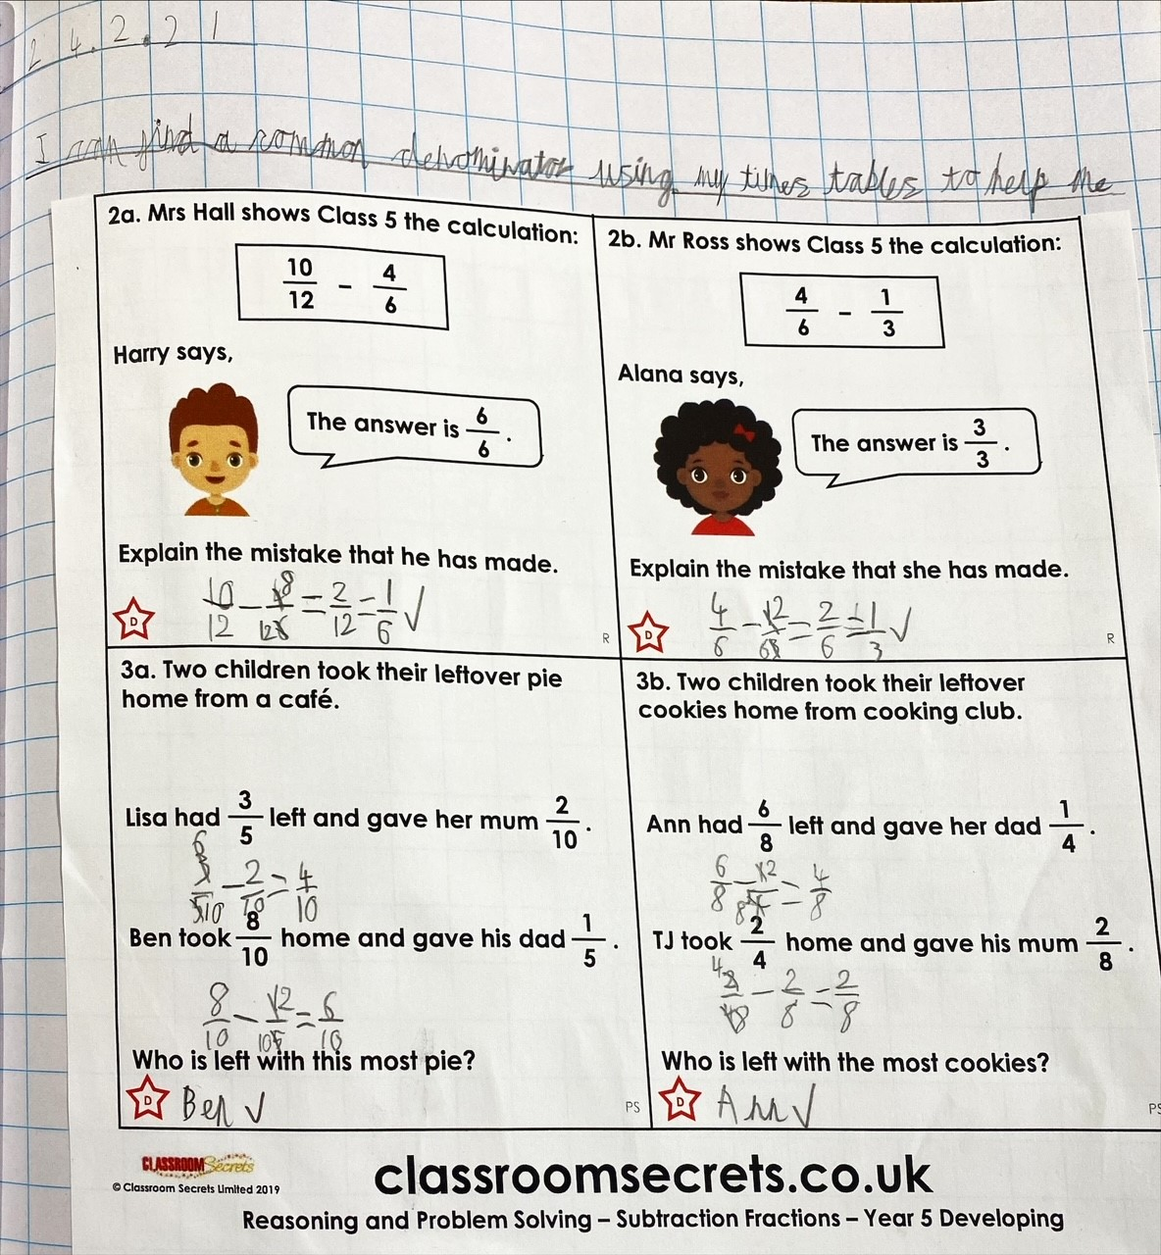
Sam is becoming more confident now at recognising common denominators to help him to subtract his fractions today.

Slide 36
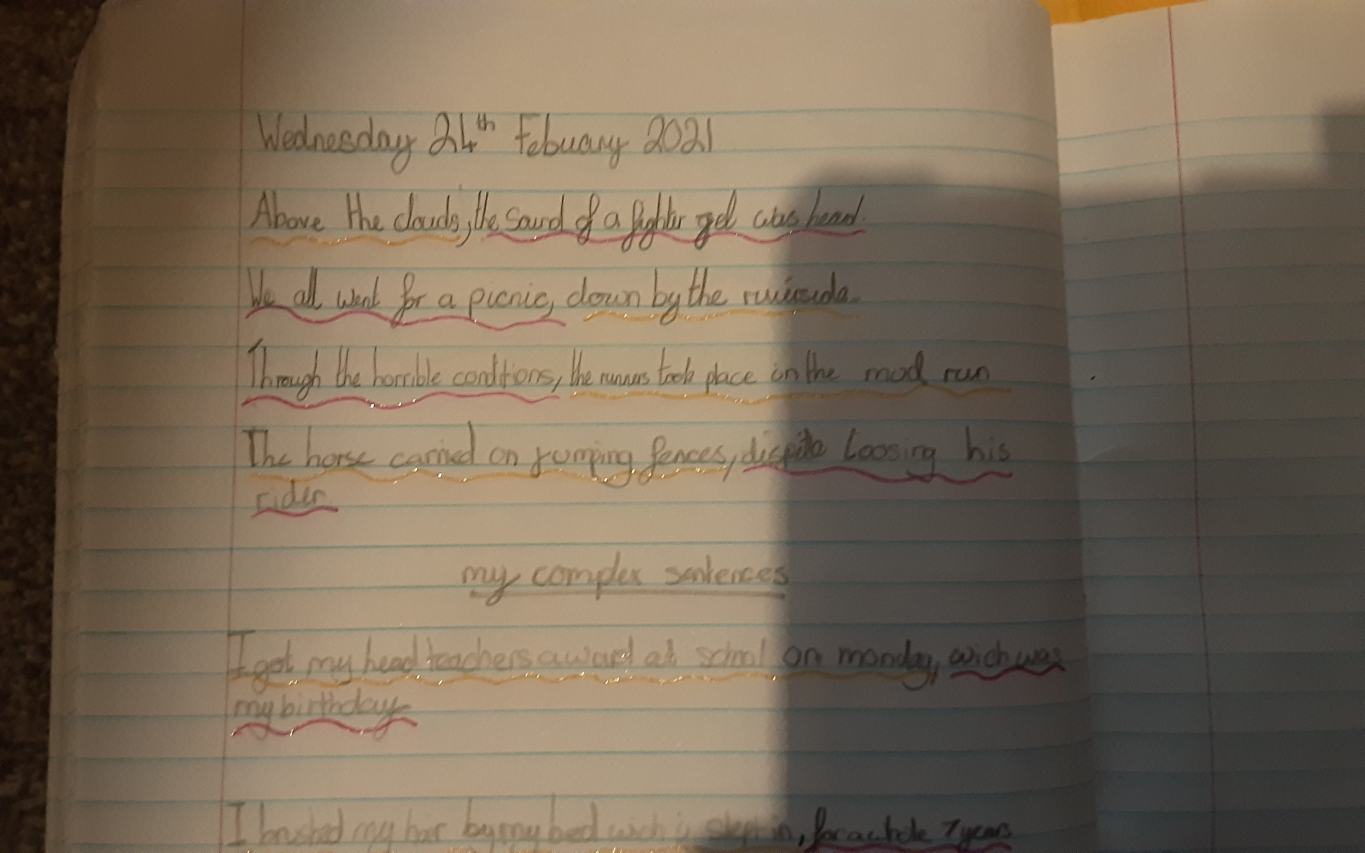
Lilly has been identifying the different clauses in the sentences.

Slide 37
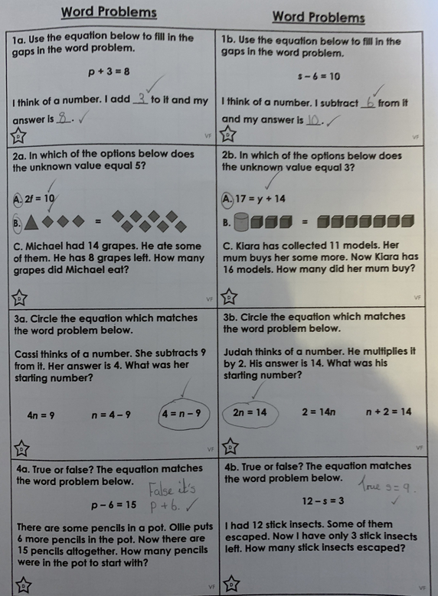
Sophie in Y6 has thought carefully about the equations that matched the problems.

Slide 38
Sophie in Y6 has been giving reasons for why she chose the Ten Commandments that she did.

Slide 39
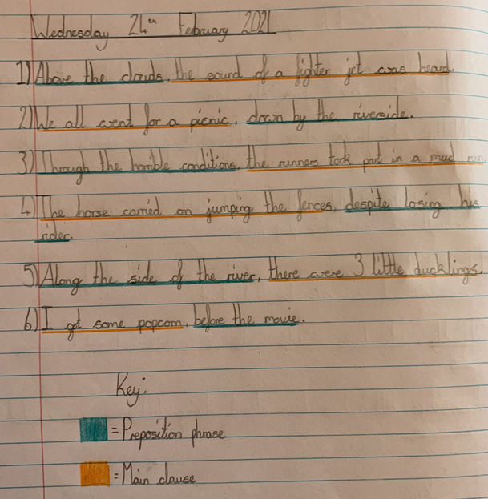
Sophie in Y6 has identified the preposition phrases in each of these sentences.

Slide 40
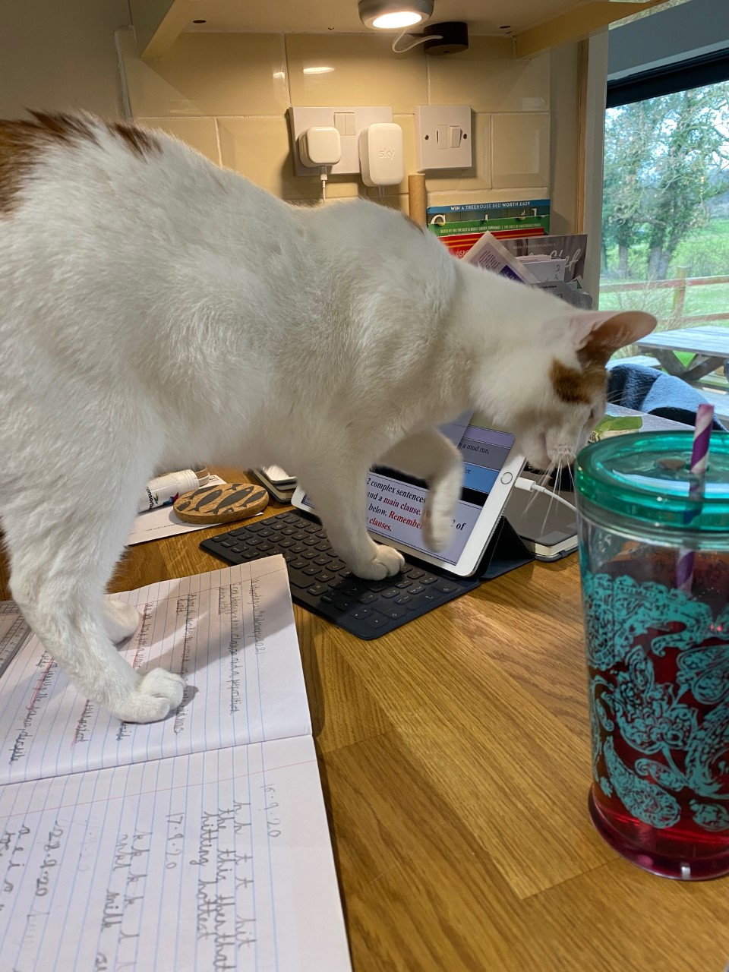
Juju the cat has been practising his typing skills, whilst checking on Sam’s presentation in his books.

