Slide 1
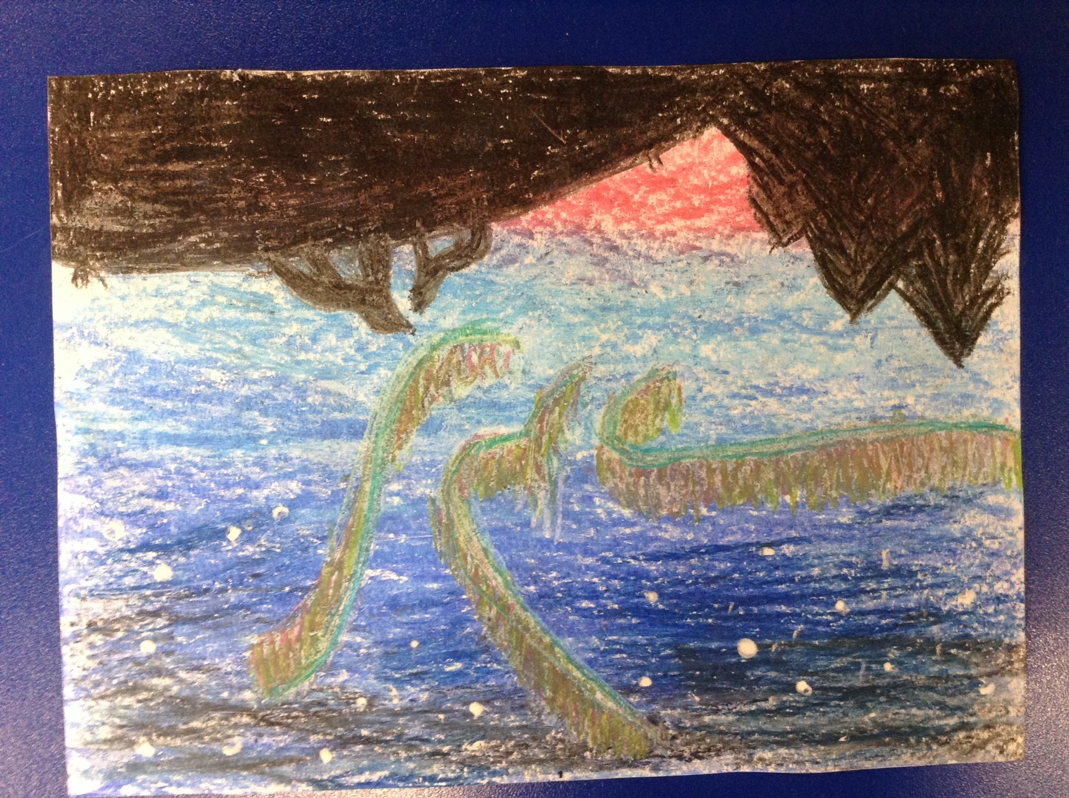
The Y5&6s have been created art work based on the Northern Nights in the Arctic.
Esme’s comprehension from today.

Slide 2
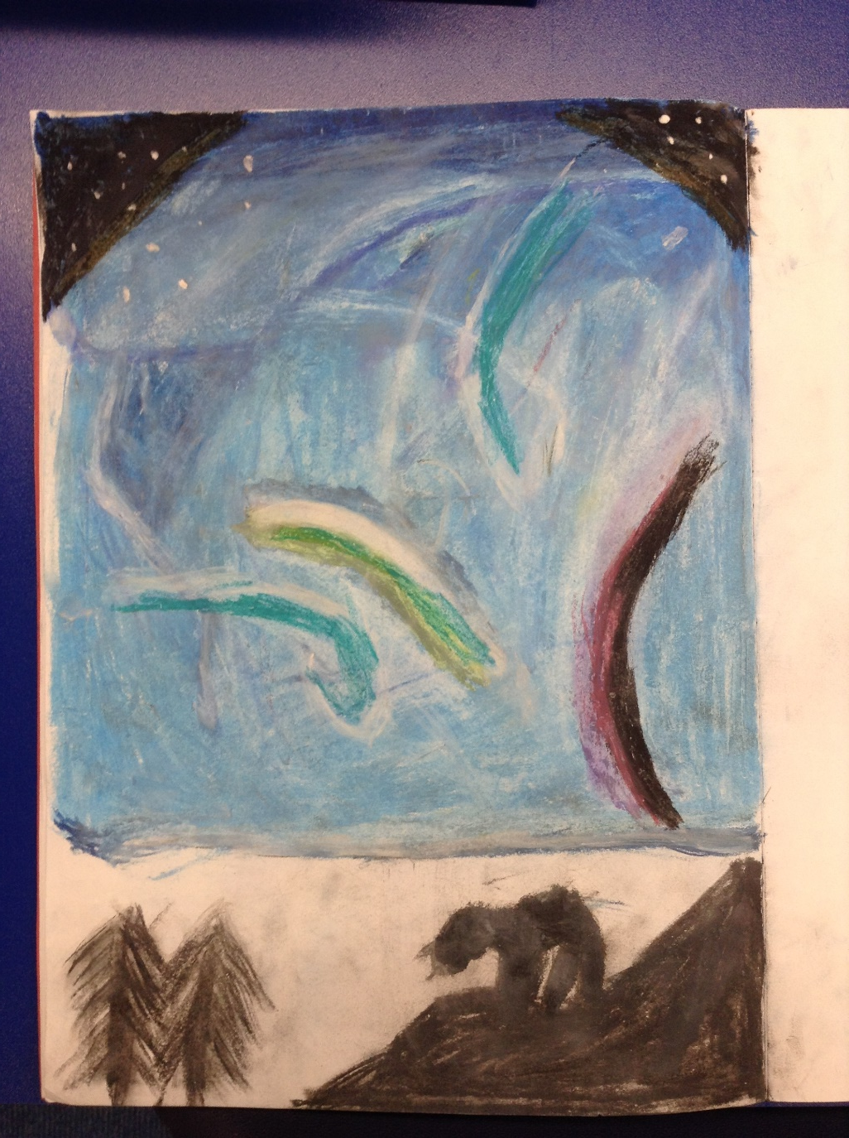
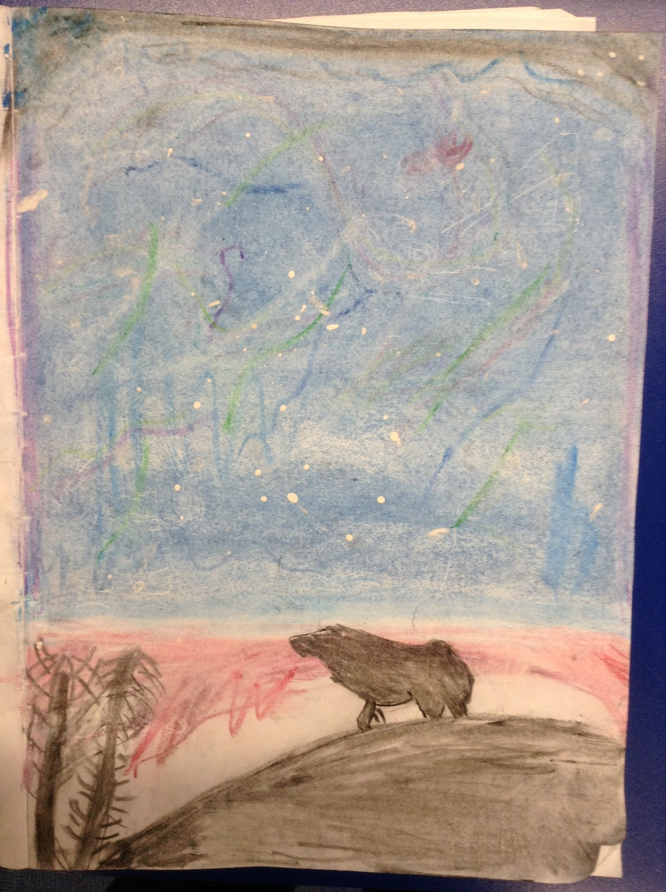
The Y5&6s have been created art work based on the Northern Nights in the Arctic.

Slide 3
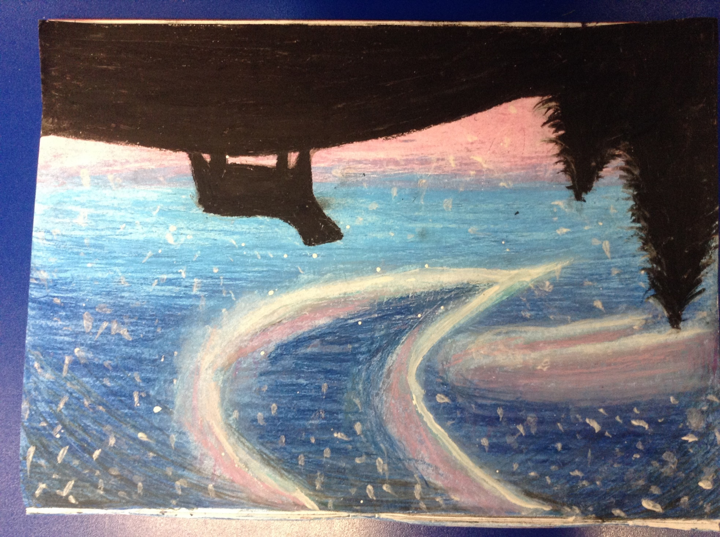
Rhys’ comprehension from today.
The Y5&6s have been created art work based on the Northern Nights in the Arctic.

Slide 4
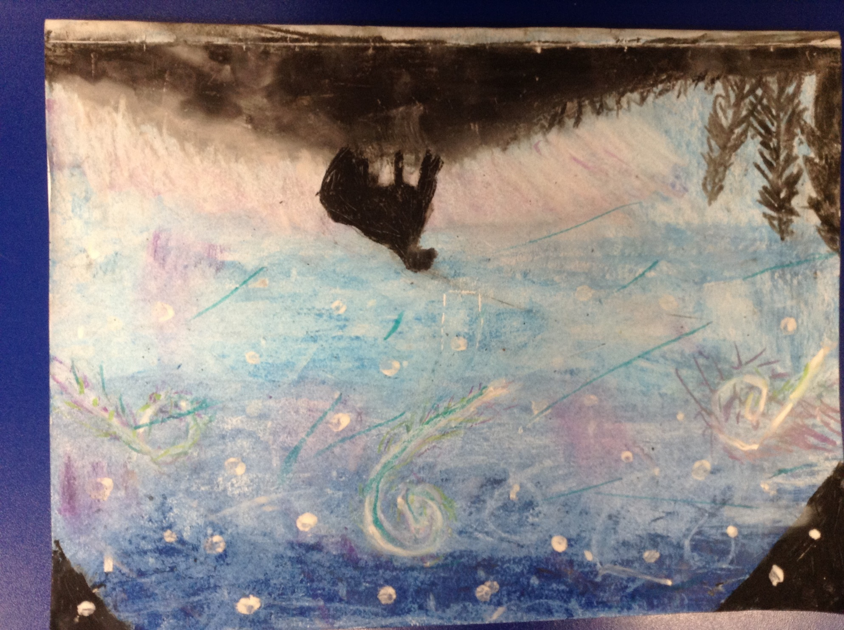
Nelly’s comprehension from today.
The Y5&6s have been created art work based on the Northern Nights in the Arctic.

Slide 5
Heidi’s final draft of her biography of Robert Falcon Scott.
Robert Falcon Scott
Introduction
Robert Falcon Scott was a famous explorer from the late 19th century into the early 1900. But how much do you actually know about him? Read on to discover more about this extraordinary man!
Early life
Scott was born on 6th June 1868 in Devonport, England, to father (John Edward, brewer and magistrate) and mother (Hannah Scott). From a young age, his family suffered from serious financial issues, and his father sadly lost the brewery. He was the third of six children, and attended Stubbington House School in Hampshire for several years, before leaving to join the Naval Cadets at the age of thirteen.
Working life / Expeditions
After serving for four years on various ships and completing his Navel Cadet instruction at age 15, Scott joined the West Indies Training Squadron as a torpedo officer on board the HMS Vernon in 1887. He met Sir Clements Markham - President of the Geographical Society - in 1899, learning that there was to be an expedition to the Antarctic on a Royal research ship called Discovery. Even better, the expedition was going to be led by Scott!
Accompanied by Ernest Shackleton and Edward Wilson, his team reached further south than anyone else had managed before. Due to bad weather and no surplus food, they had to turn back, returning as national heroes. Him and Shackleton fought over the exact details of the expedition, and decided to go separate ways. Whilst in England, he married Kathleen Bruce on 2nd September 1908, and had one child, Sir Peter Scott, who later became a famous painter and ornithologist (expert on birds), and also founded the WWF.
Planning another trip to the South, Scott gathered supplies and equipment for the long trek ahead. He left from Cardiff on a whaling ship called the Terra Nova with a team of 4 men: Edward Wilson, Lawrence Oates, Henry Bowers and Edgar Evans.
Scott, who received a telegram from rival explorer Roald Amundsen, stating that he was also heading to the pole, was in a hurry to get there first. When they eventually arrived, the team were disappointed to see that the Norwegian flag was already planted. They might have beaten Amundsen if they had chosen a quicker route, but they couldn’t go back in time. As a team, they deduced that the only place they could go now was home.
Death
Caught in a storm, they had to camp for days on end, eating all of the remaining food. Scott presumably died on the 29th March 1912 from hypothermia, starvation and frostbite, only 12.5 miles away from the next hut point. Their bodies were found by a search party of 11 men almost 6 months later.
Robert Falcon Scott has achieved so much in his lifetime; he will be remembered for generations to come.

Slide 6
Cameron’s completed biography of Ernest Shackleton
Ernest Shackleton™ Cameron
Ernest Shackleton was a successful explorer maybe the most well-known and famous of his time. How much do you know about this fantastic man himself? Who is Ernest Shackleton? Where did he come from? Read on to uncover the many secrets of this daring explorer.
Ernest was born in February 15, 1874 Ireland Kilkea. The soon to be explorer was born into a large family of twelve. Out of the ten children, (two boys’ eight girls) he was the oldest. Once his father –Henry Shackleton- completed his training to become a Physician, a type of doctor, the family moved into London in a desperate search for new areas of work. As a child he enjoyed reading, many fictional adventures but as he was a practical child he’d rather be in the escapades than simply read about them. Once in the new area of London at the age of ten Shackleton joined Fir prep collage. Three years later, Shackleton joined Dulwich College. His parents, Henrietta Letitia and Henry Shackleton, both encouraged him to be a doctor but it wasn’t appealing to him, he would rather be out free in the ocean then cramped in a clinic. Three years passed and finally at the age of 16 Ernest began training as a sailor with the merchant navy. Shackleton worked hard; at the age of 24 his hard work paid off and was awarded the grand title of Master Mariner. A master Mariner is allowed to travel in his/her boat anywhere anytime in the world.
Ernest Shackleton, who now owns a title of master mariner, joined Robert Falcon Scott’s British Antarctic expedition in 1901 however the attempt to discover the North Pole was a failure. Before beginning another expedition, Ernest married Emily Shackleton in 1904. The explorer was not content at home he wanted to venture, to explore, to achieve… to sail. Four years later Ernest led a new expedition (which went by the name of the Nimrod expedition). The adventure –which was made into many books-, was troublesome. Many challenges came their way Endurance (their ship) became lodged in ice, they were forced to sledge across the Antarctic and spirit was low. Food was scarce; the expedition was a race against time. They were finally forced to turn back. The Nimrod expedition was less than 805 km from their goal (the North Pole). Even though the expedition was a failure, they were still entered history as the 1st long distance sledge journey into Antarctica. The glory didn’t stop there after the expedition Edward VII knighted Ernest becoming Sir Ernest Shackleton. The zealous Sir Ernest Shackleton began a new escapade six years later. He put advertisements in many newspapers and attracted the attention of many eager explorers. The journey was in vain as they did not reach the North Pole and their leader became ill on the return journey. However the team (which included Robert Scott and Edward Wilson, managed to find the Ross ice shelf, the world’s largest body of floating ice.
After a life in the sea, Sir Ernest Shackleton returned home and had one child, Edward Shackleton. In a search for new work, Ernest attempted to become a member of parliament however was unsuccessful. He also dabbled in Hungarian mining, sold stamps and created a Tobacco Company, became a journalist and a secretary of a Geographical society. However at the start of his latest expedition the workaholic fell ill and died on his ship, Quest, in Feb 1922. At the request of his wife he was buried in South Georgia (where he died).
Sir Ernest Shackleton a workaholic, sailor and secretary. Even though he met his end over one hundred years ago his legacy as a sailor lives on. His adventures were made into books, legends, and history. He will be remembered as a sailor who died in an attempt to discover a land that man hadn’t stepped on.

Slide 7
Isobel’s final draft of her biography of Ernest Shackleton
Ernest Shackleton
Introduction
Ernest Shackleton is a well-known, famous explorer, and has achieved many great things. But, how much do you actually know? Read this text to find out more about this incredible man.
Early Life/Growing up
Sir Ernest Henry Shackleton was born in County Kildare, Ireland, on the 15th February 1874. His parents were Henry Shackleton and Henrietta Laetitia Sophia Gavan, his father was a doctor. Ernest had three siblings, Kathleen, Helen and Frank Shackleton. From an early childhood, Ernest was a big reader, passion later sparked on in future adventures. His family and him later moved to Dublin, and then moved to London, where he was raised, when Ernest was 10. The Shackleton family are of English origin and his mother was descended from the Fitzmaurice family. Ernest was schooled by a governess until the age of 11 and went to a school in Dulwich called Fir-Lodge Preparatory school. At the age of 13, Ernest attended a boy’s only collage in Dulwich. As he was so bored by his studies, he was quoted saying “I never learned much geography at school literature, too. After, he moved onto Trinity Collage, Dublin. He was so bored at school, that the teachers let him leave at the age of 16 to follow his passion to the sea. He was more close to his father because his helped him get his first job.
Life before exploring
After leaving school so early, his father got him a job at a shipping company, which he was in for four years. Ernest learnt his trade and travelled across the world on board the Hoghton Tower; later became a Merchant Navy Officer. In 1898, he was certified Master Mariner allowing him to command a British ship anywhere in the world. After achieving so much, he had become a first mate at the age of 18.
Expeditions
In 1901, Ernest joined Robert Falcon Scott (another famous explorer) in the British National Antarctic Expedition. They accomplished the first long-distance sledge journey into Antarctica. Mysteriously, Endurance, his ship, was stuck in ice before it even reached Antarctica! It then drifted for 10 months, before being crushed by ice. They were less than 500 miles (805 kilometres) from the South Pole; unfortunately, Shackleton became sick on the return trip over the ice shelf and was later sent back to England to recover. During this expedition in 1904 9th April he married Emily Dorman (Shackleton) and later had three children, Raymond- 1905, Cecily- 1906 and Edward, who was the youngest-19011. In 1914, he was determined to lead another expedition and planned to cross Antarctica. His father, Henry Shackleton, tried to enter to enter the army, but couldn’t because of his poor health, instead he became a farmer.
Shackleton’s death
In 1914, Shackleton made is third Antarctic trip on Endurance, Dr James Mcllory, medical officer, was on the third and fourth expeditions. On 5th January 1922, Shackleton died from a heart attack, at the age of 47 (1874-1922). He was buried on the island of South Georgia in the South Atlantic Ocean.

Slide 8
Isla’s final draft of her biography of Robert Falcon Scott
Robert Falcon Scott
Introduction!
Who is he? Robert was an explorer and scientists from the early 18 hundredths although do you really know a lot about him? If not read on.
Early life
Robert was born on the 6th June 1868 Plymouth. He lived with his dad John Edward Scott, Hannah Scott his mum and 5 siblings. He was the third child out of 6. Unfortunately they didn’t have a lot of money when his was younger. He went to Stubbigton House and then at the age of 13 he became a naval cadet and served on many royal navy ships from 1880 to 1890.
Expedition life
After leaving school, Robert started his naval career in 1881.Then in 1883 he became a mid-ship man. After serving four years on various different ships, he joined the West Indies training squadron as a torpedo officer on the HMS Vernon. In 1896 he attracted the notice of the royal geographical society, which appointed him to command the national Antarctica expedition from 1901 to 1904 being only 32 years old. After that he returned back to England as a national hero because he was the first person to go the furthest south. Robert got married in 1908 to Kathleen and had peter (his son).In Cardiff on the 15th of June 1910 on the terra nova Sailed to New Zealand.
Family life
Robert had a wife called Kathleen and had a son also two step children his son was peter Scott and step were waylan and baron .Kathleen was a British writer and unfortunately died on the 25 July 1947 London. Peter was born on the 14 September 1909, London his job was an ornithologist (a person who studies birds). He died on the29th august 1989 in Bristol.
His big expedition
Whilst being at home he planned this journey. In 1910, he set of his discovery ship on a once in a lifetime experience to the South Pole, with Ernest Shackleton. When they arrived, they also had a race to win. Could he be the first? Nervously he walked on the ice well it was more like snow. Can he survive? Robert thought it was a good idea to bring ponies and dogs but they were not able to survive, so they had to shoot them but he really did not want that to happen.so after that they were pulling the sledges to the south pole no that that they got closer to the south pole the weather was getting worse. Finally, after days of work, they got there but it was not worth it the Norwegians beat them. The Norwegians got there on December the 14 and Robert got there on the 17 Jan 1912. Provided for him was food and drink but that had already gone. Making his way back walking through a horrible blizzard. He decided to put up his tent to try and get warm but he left the tent and got frostbite and died. Robert who was 49 years old although if he walked another 12.5 miles he could of got to a supplies department. he was found by a search team 8months later.
To conclude this amazing person will be remember for generations.

Slide 9
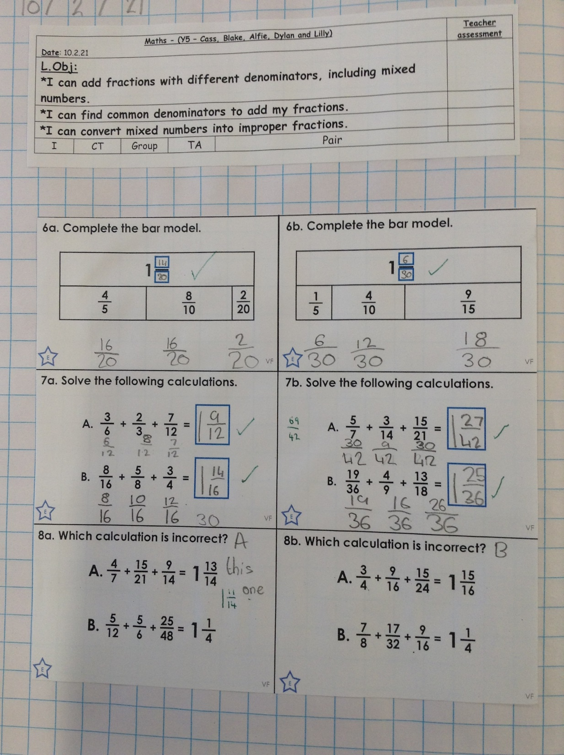
Alfie has worked really thoughtfully to add these fractions together.

Slide 10
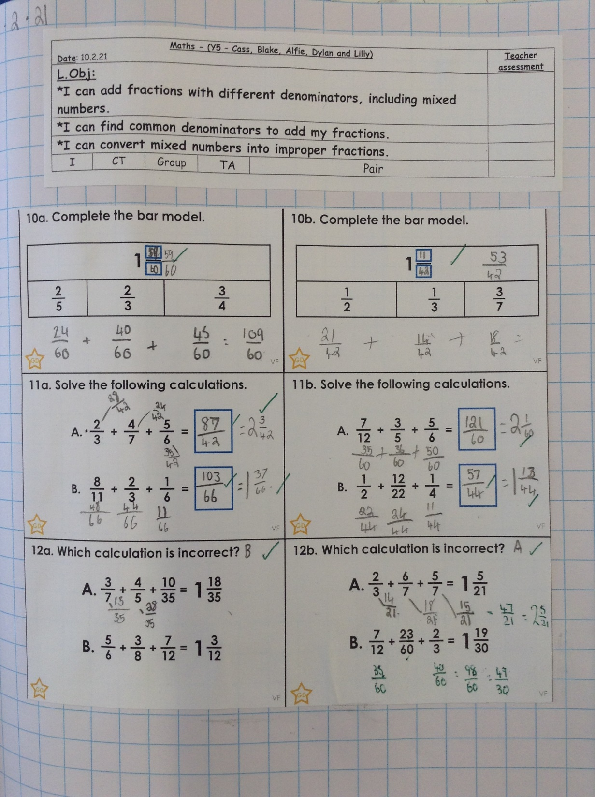
Cass has superbly added these fractions by finding common denominators.

Slide 11
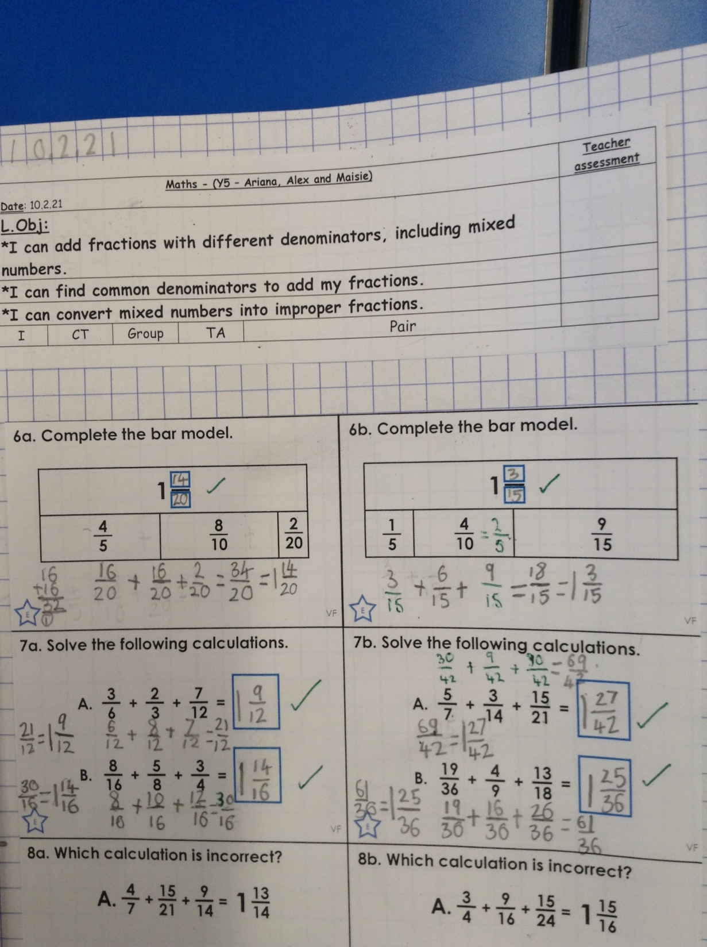
Ariana has superbly added these fractions by finding common denominators.

Slide 12
Sophie Collins has completed her biography of Ernest Shackleton.
Ernest Shackleton
Introduction
Ernest Shackleton was an Antarctic Explorer who attempted to reach the South Pole. Although he was unsuccessful, he had many stories about his expeditions and survival. Read on to find more about him.
Early life/ growing up
Ernest Shackleton was born on February 15th, 1874 in Kilkea, Ireland. He moved to Sydenham in suburban London when he was 10 years old. His father (Henry Shackleton) was a doctor. His mother (Henrietta Letitia Sophia Gavan) had ten children. Ernest was the second child and he had eight sisters and one brother. As a child Ernest loved to read. Ernest studied at Dulwich Collage. At 16 he served in the British Army during World War I, then went on to become a sailor and first mate at 18 years old and by the time he was 24 he was a certified Master Mariner.
Expeditions
Shackleton’s first expedition was in 1901 where he joined Robert Falcon Scott’s Antarctic expedition where they travelled by sledge over the Ross iceshelf. This was the first long distance sledge journey into Antarctic. Ernest then went on to do the Nimrod Expedition.
Family life/ life after exploring
Ernest married Emily Mary Dorman in 1904 and they had three children. Sadly, on the 5th of January 1922 Ernest Shackleton died of a heart attack at the age of 47 in Grytviken, South Georgia. During his life as well as his expeditions he loved to read and write and wrote two books.

Slide 13
Sam has completed his biography of Robert Falcon Scott
Robert Falcon Scott Biography
Introduction
Robert Falcon Scott was a famous explorer as well as a true hero; he is still remembered to this day even though he was not the first person to reach the Antarctic as we will see…
Early life.
He was born in Devonport Devon on 6th June 1869. He was the third of six children his brother was named Archie and his sisters names are unknown. His parents were named John Edward Scott and Hannah Scott. His father was a brewer and a magistrate. Following in family tradition he went to a local day school, where he stayed for 4 years. Afterwards, he went to Stubbington House School, before he became a navel cadet at 13 years old. He then went to various training ships, where he served for four years, then joined the West Indies training squadron, as a torpedo officer.
Working life.
Robert Falcon Scott was a British naval officer before he became an explorer. In 1912 he also married a woman named Kathleen Scott who was famous in her own right as a sculptor, and had one son named Peter who grew up to be a famous painter and ornithologist (an expert on birds). Robert Falcon Scott went on 2 famous expeditions in his time both to the Antarctic/South Pole. He was part of the discovery expedition in 1899 and reached further South than anyone else and returned as a hero with Ernest Shackleton.
On his next expedition he led the Terra Nova expedition in 1901-1904 he did complete the expedition and got to the South Pole! But sadly Roald Admundsen a Norwegian explorer had made it there first he had found a quicker route to get there first that only took 33 days and had dropped food on the way back for them to eat.
His death.
Robert Falcon Scott died on the Terra Nova expedition of exhaustion and hypothermia and the rest of the crew sadly perished as well. Their bodies were not found until 1912 when a search party was sent to look for them and when they found them in 19th October 1912 they planted a cross to show where this brave explorer was buried.
Conclusion.
Although his final expedition ended in tragedy, he is still remembered. We have remembered Robert Falcon Scott for almost 100 years and we will remember him for the next 100 years. Even though he wasn’t the first person to make it to the South Pole he was the second one, and the first Englishmen to make it there and he continues to inspire people from this day forth.

Slide 14
Rhys has completed his biography of Robert Falcon Scott
Robert Falcon Scott
Introduction
About 131 years ago, a man, named Robert Falcon Scott, set out on a journey. This travel made humans know what extreme nature feels like. Read on to know more about this famous explorer and what he did to get to the bottom of the Earth.
Early life
This great explorer was born on the 6th of June 1886 and was raised in Plymouth, Devon by John Edward and Hannah Scott. He was on of 6 children they had. Scott spent his early childhood in comfort, but after he had all ready established his naval career, his family had some unlucky financial problems. Robert spent most of his life in a local day care until he went to a privileged school called Stubbington House School.
Jobs before travel
Robert had one job before he set on his expedition and that was to be a sailor. Before his appointment to lead the expedition, Scott had followed the career of Naval officer in the navy. In 1899, he had a chance to encounter with Sir Clements Markham to study about the expedition to the south pole which he soon took the lead to become Captain.
Expedition and death
Captain Scott aged 42 travelled to the South Pole but sadly faced lots of problems like running out of food. Also the whole team including their ponies and dogs were exposed to hyperthermia and frostbite making the expedition extremely difficult. Out of seven members sadly only five made it their destination: Captain Scott, Bowers, Wilson, Oats and Evans. Devastation filled the air because after reaching the South Pole on January 17th the Norwegian flag was already flying high. They had to go back knowing that they lost the race to the bottom of the Earth. The extreme weather conditions cost them their lives and not one member made it back. Scott wrote 8 letters in his final days on the expedition. He wrote before he passed “I want you to secure a competence for my widow and boy.” meaning he wanted his family looked after by the state.

Slide 15
Cameron has thought really carefully about his final 10 questions in maths today.

Slide 16
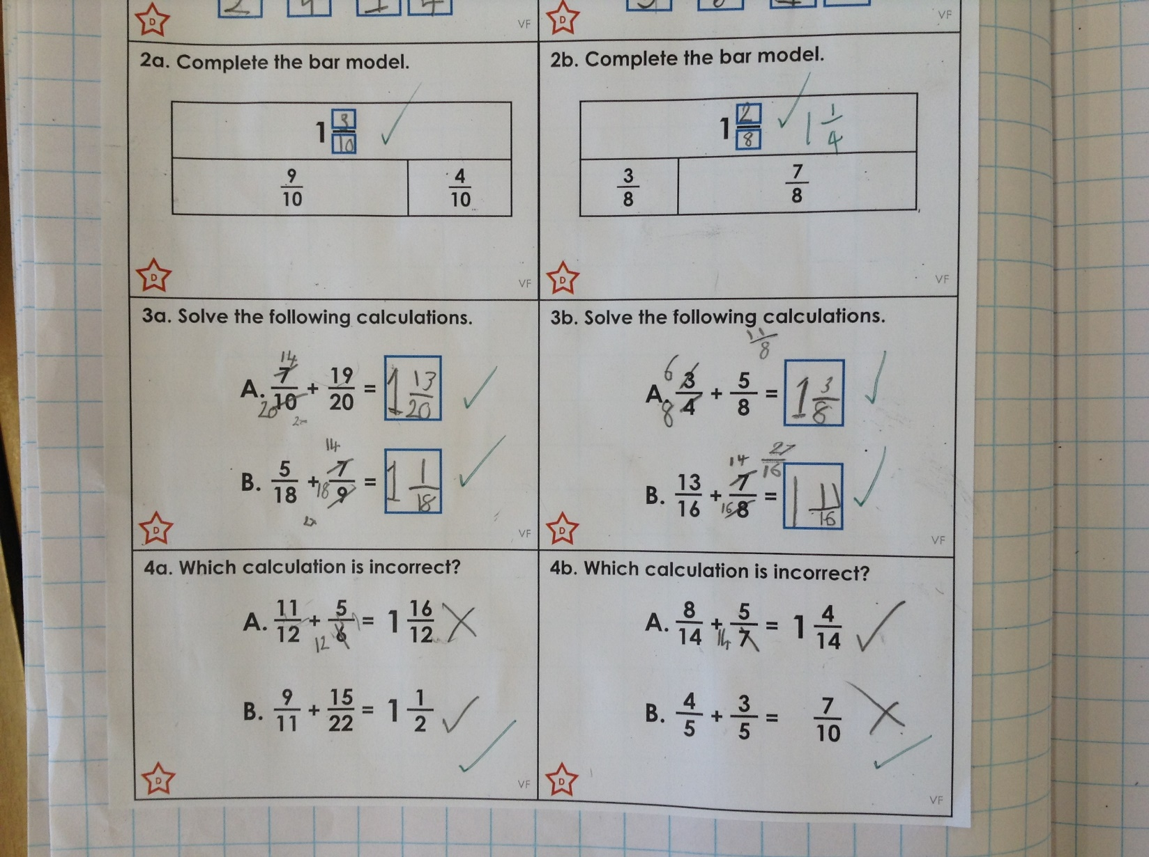
Sophie Carr has been adding fractions today to make mixed numbers.

Slide 17
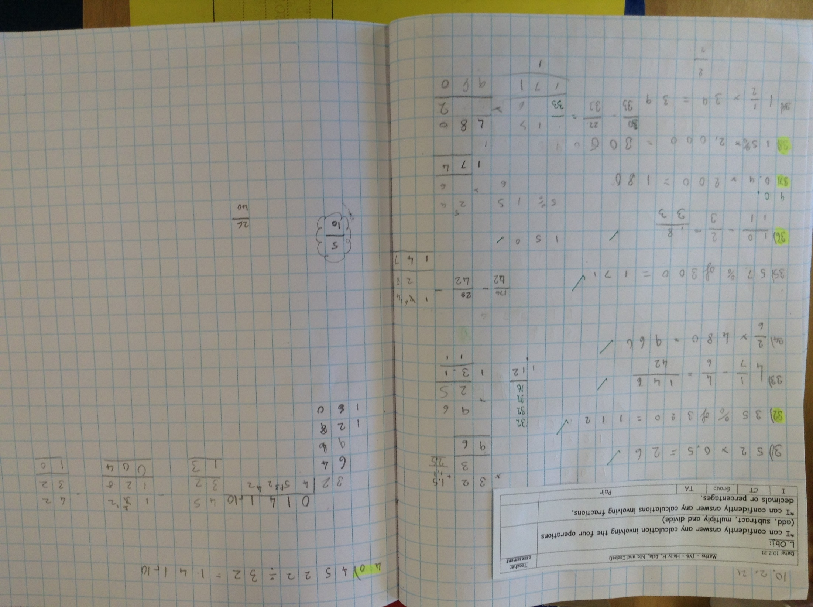
Isla has completed her final 10 maths questions

Slide 18
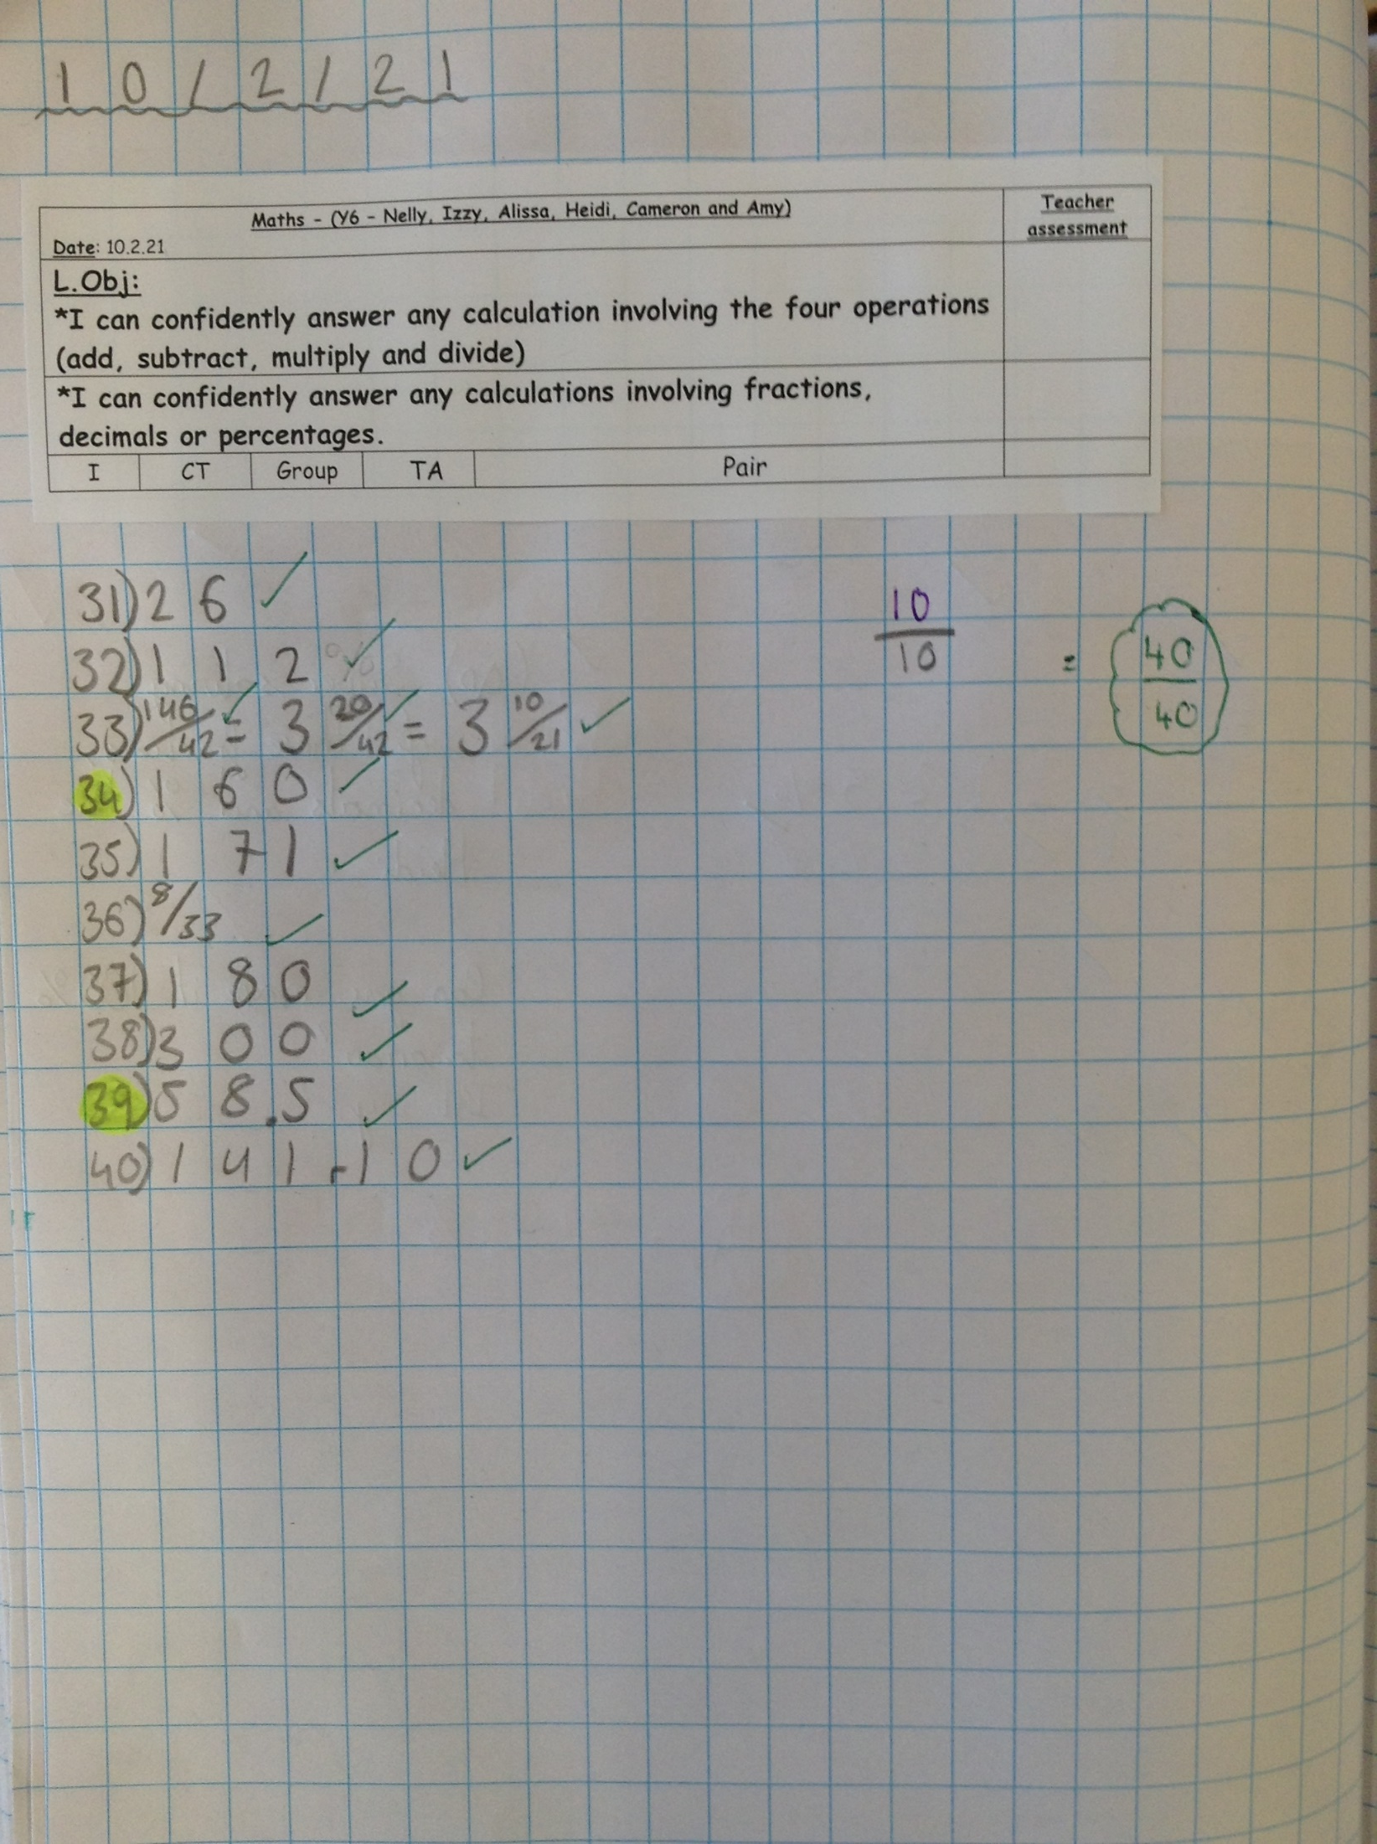
Heidi scored 100% altogether in her maths calculations.

Slide 19
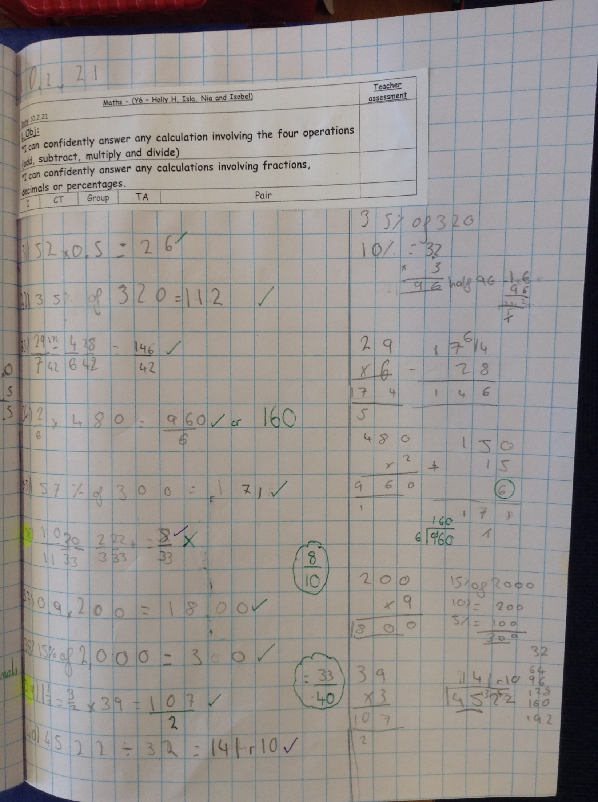
Isobel has completed her final maths calculations today.

Slide 20
Holly H has completed her final 10 questions really well in maths today.

Slide 21
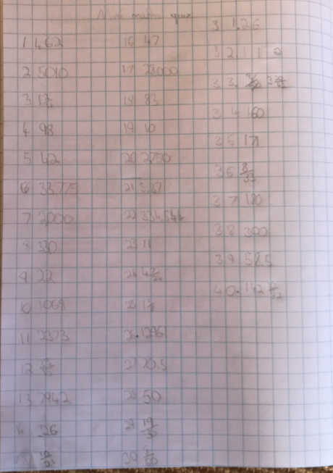
Rhys has been working really hard in his maths today to complete his final 10 questions.

Slide 22
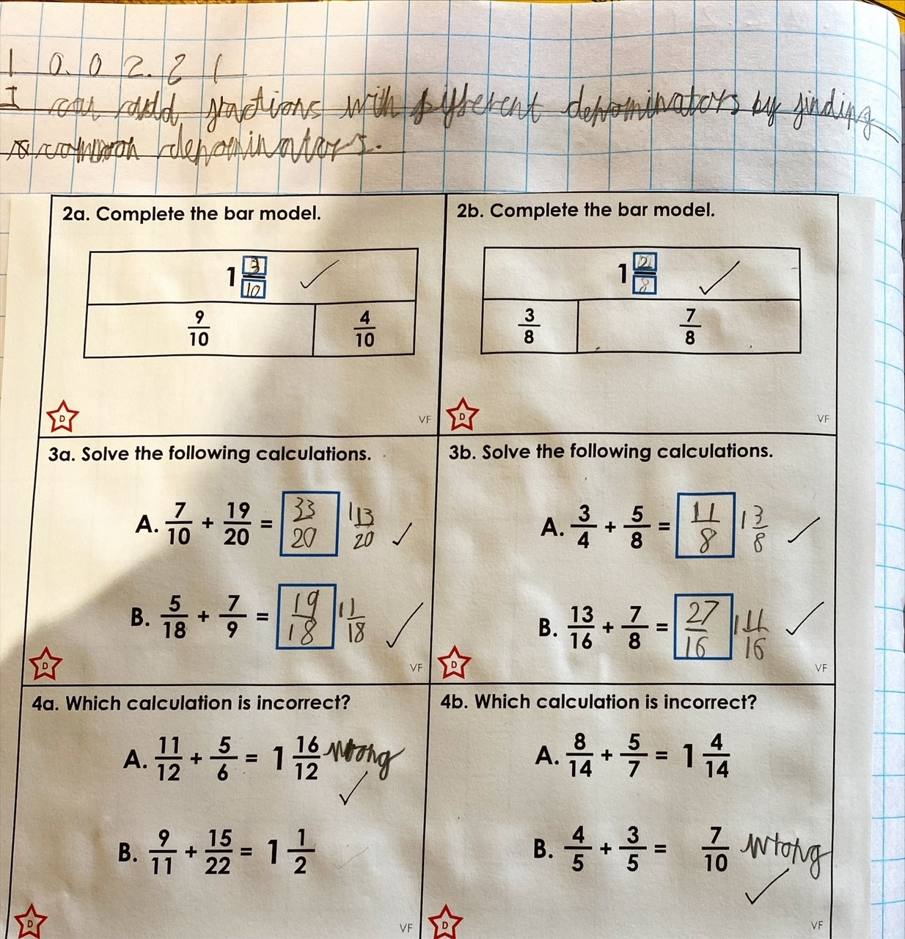
Sam has been adding fractions with different denominators that add up to make a mixed number.

Slide 23
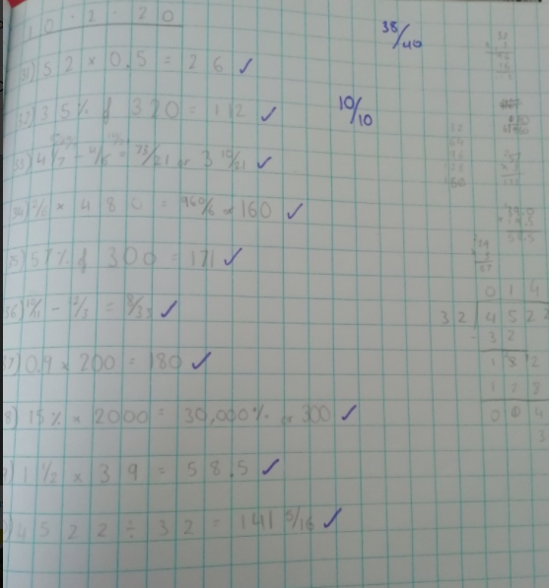
Amy scored 10 out of 10 on her final 10 maths calculations today.

Slide 24
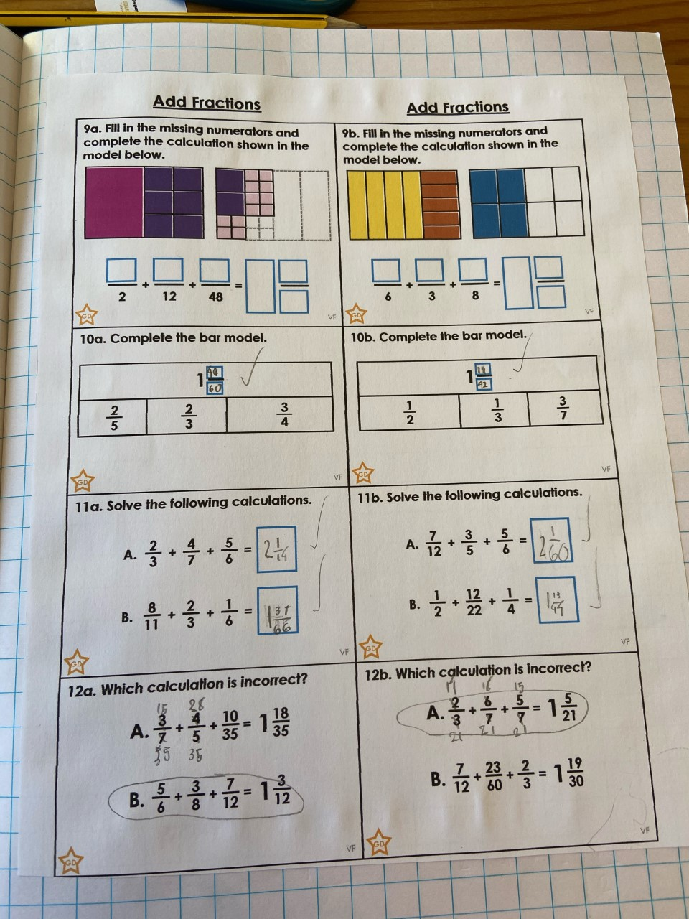
Dylan has worked really thoughtfully to add these fractions together.

Slide 25
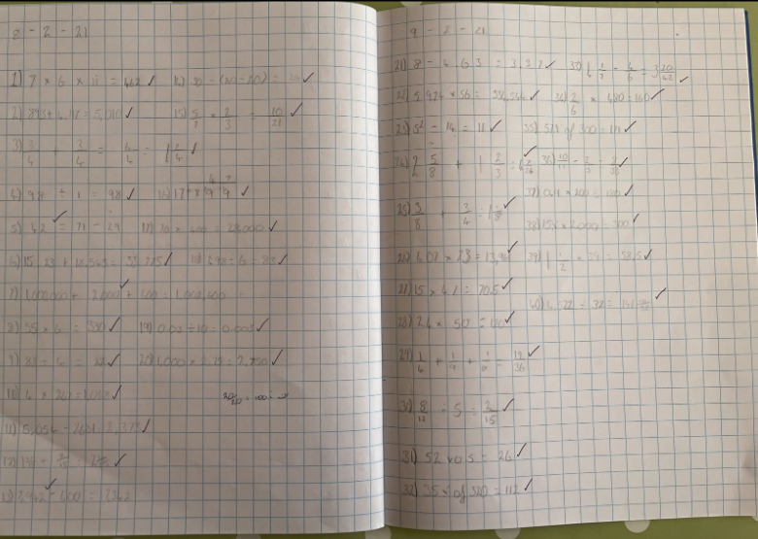
Nelly’s maths calculations – 100%

Slide 26
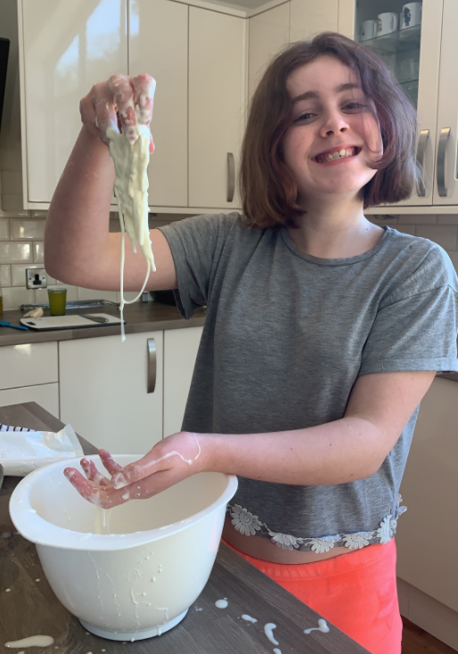
Holly has been mixing cornflour and water to identify that some substances can be more than one state of matter.

Slide 27
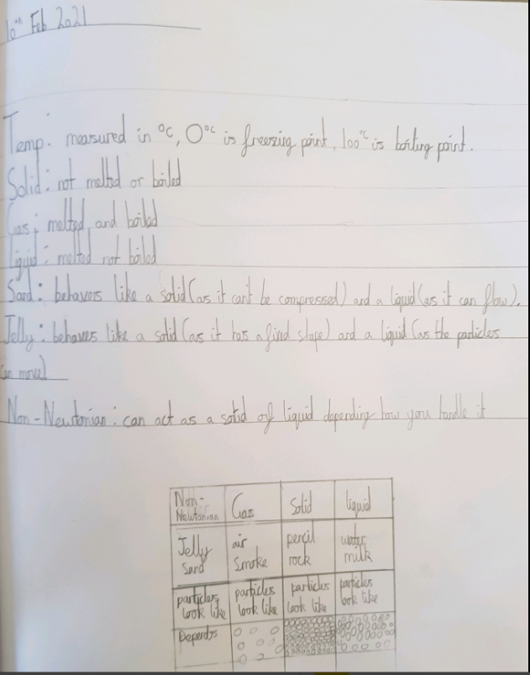
Cameron has followed the video really well on his Science today.

Slide 28
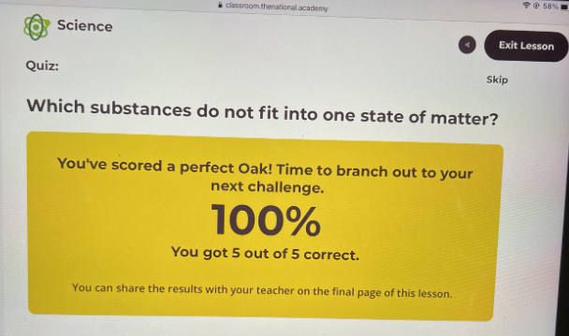
Nelly completed her Science quiz today.

Slide 29
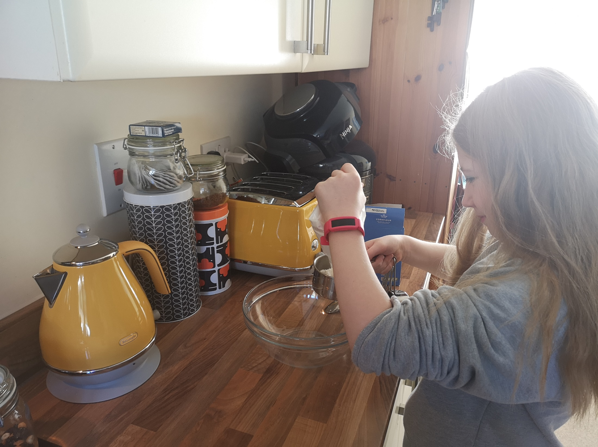
Lilly has enjoyed her Science today.

Slide 30
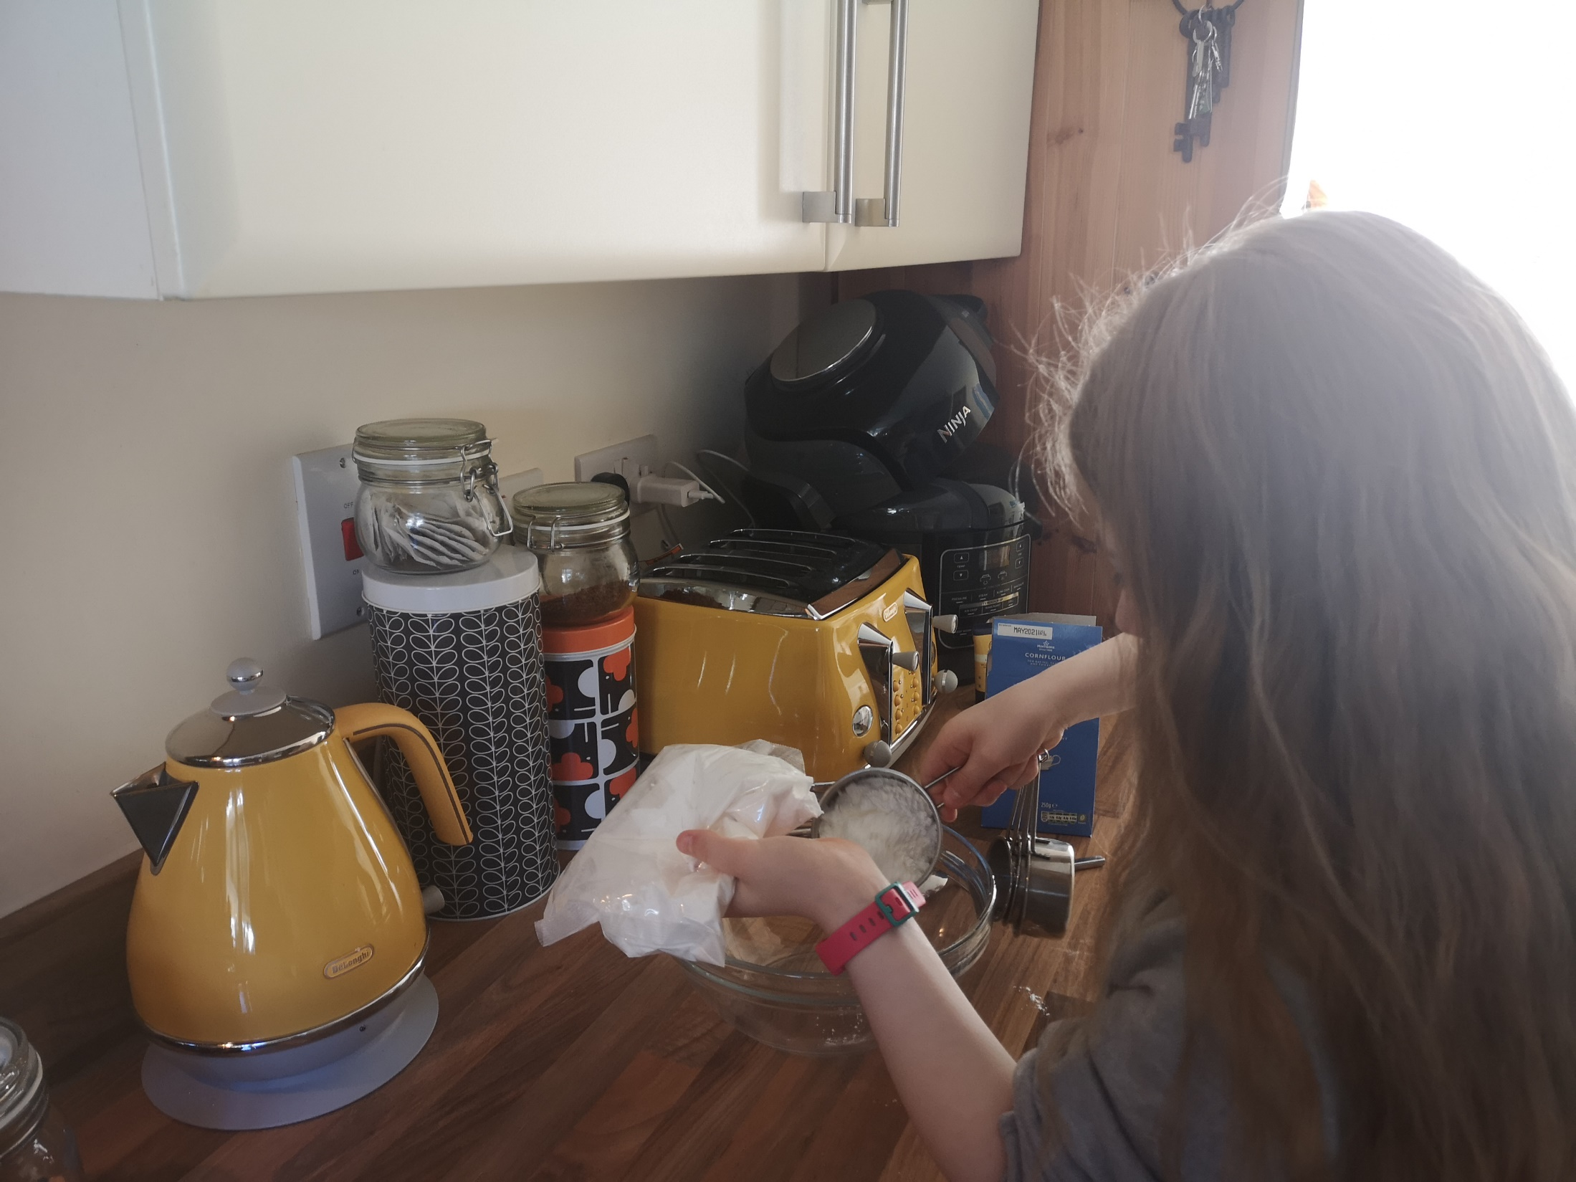
Lilly has enjoyed her Science today.
Cameron scored 100% on his maths calculations today.

Slide 31
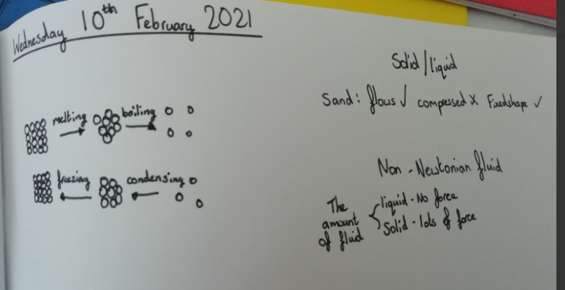
Amy learned about non-Newtonian fluids in Science today.

Slide 32
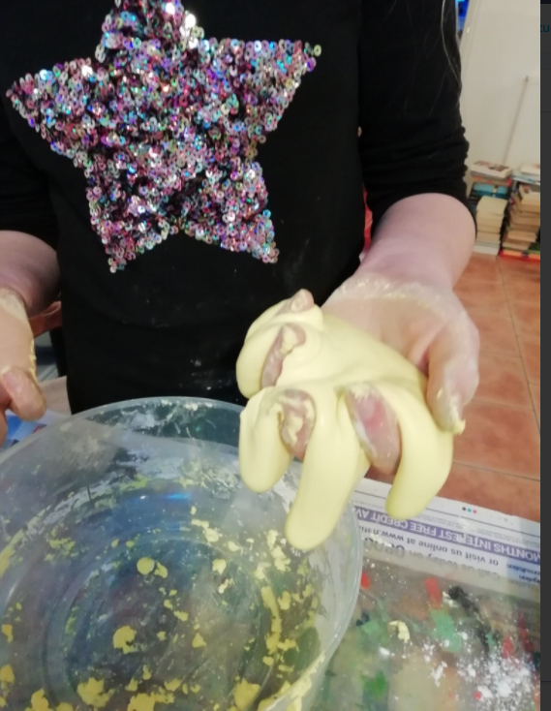
Amy mixed her corn flour and water together to see what would happen.

Slide 33
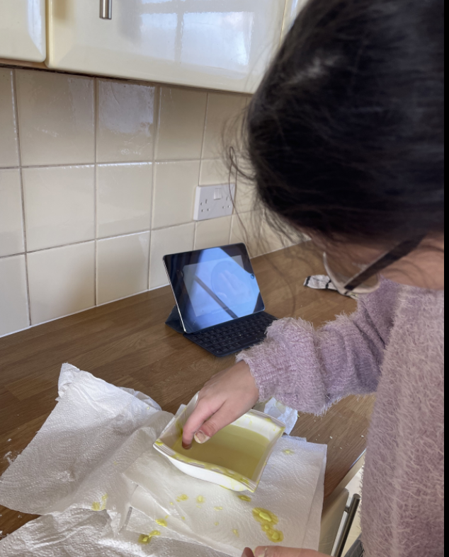
Nelly has been mixing her corn flour with water to see what would happen.

Slide 34
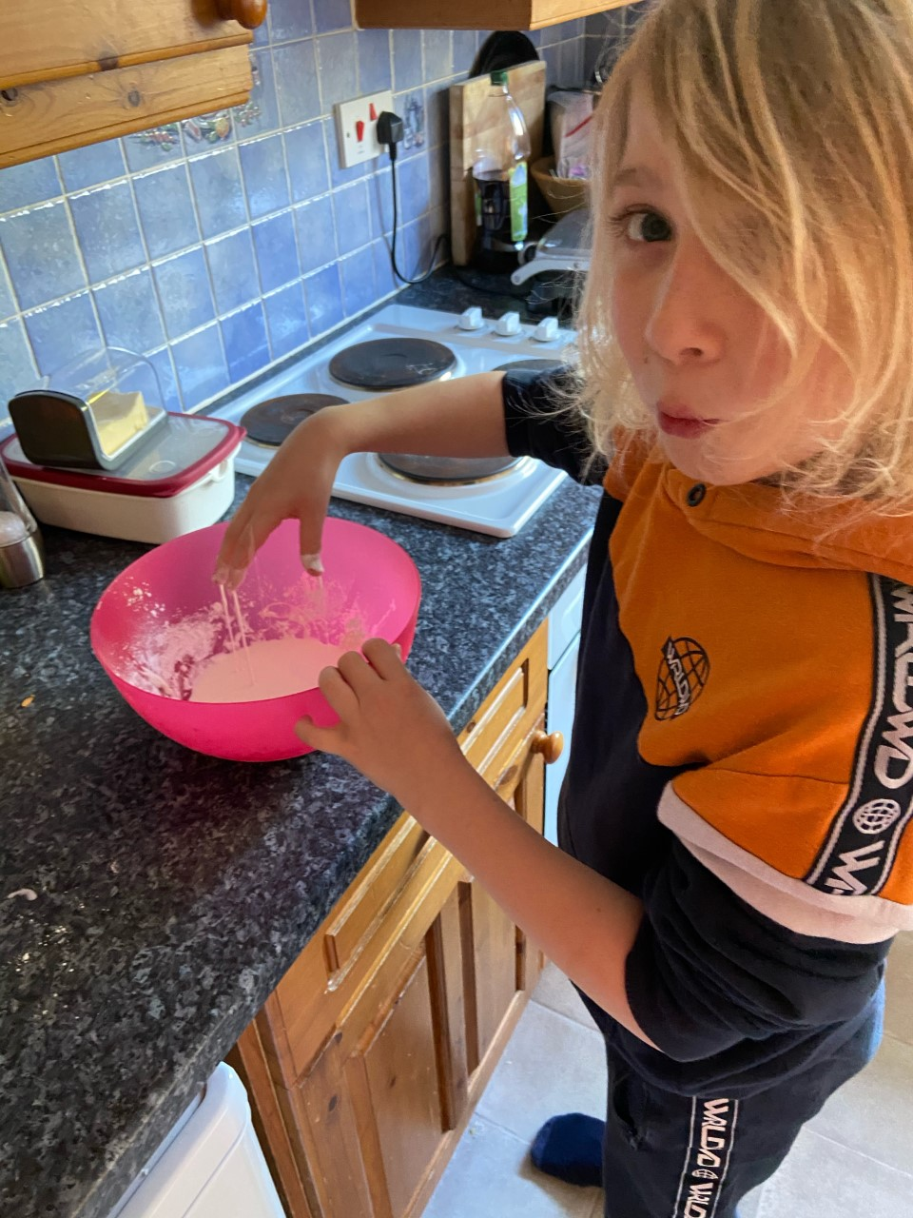
Dylan has been mixing his corn flour with water to see what would happen.
Sorry Dylan, this one isn’t edible like your delicious lemon drizzle cake!

Slide 35
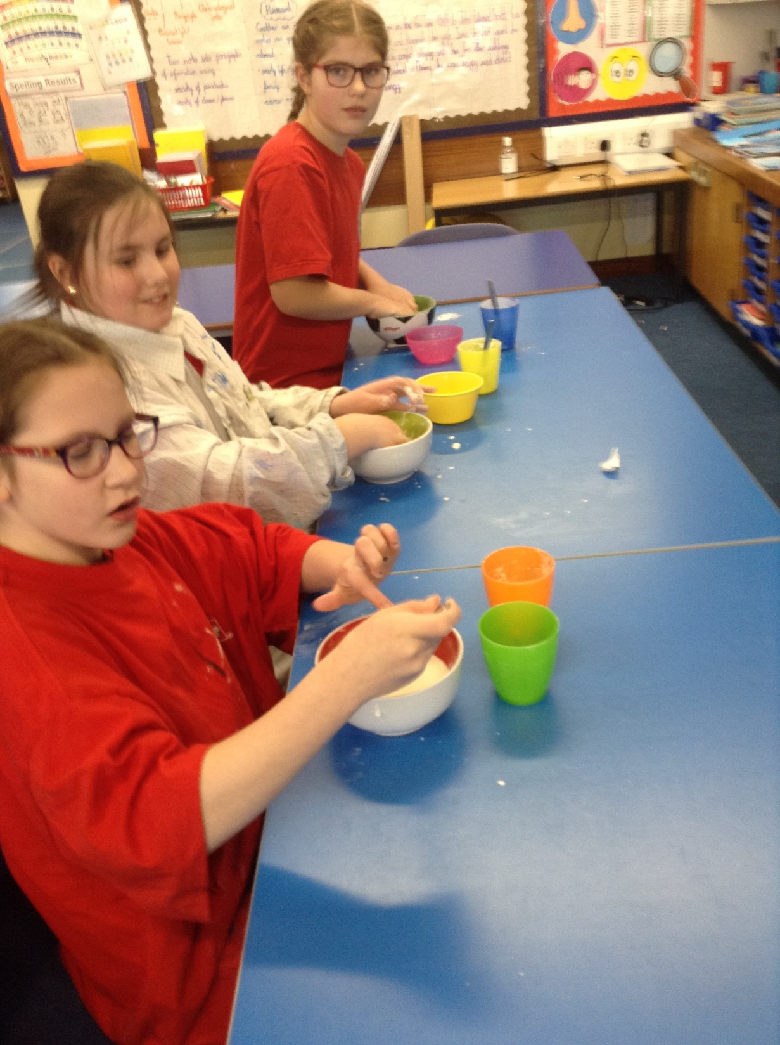
We have been mixing our corn flour with what to find out what would happen.

Slide 36
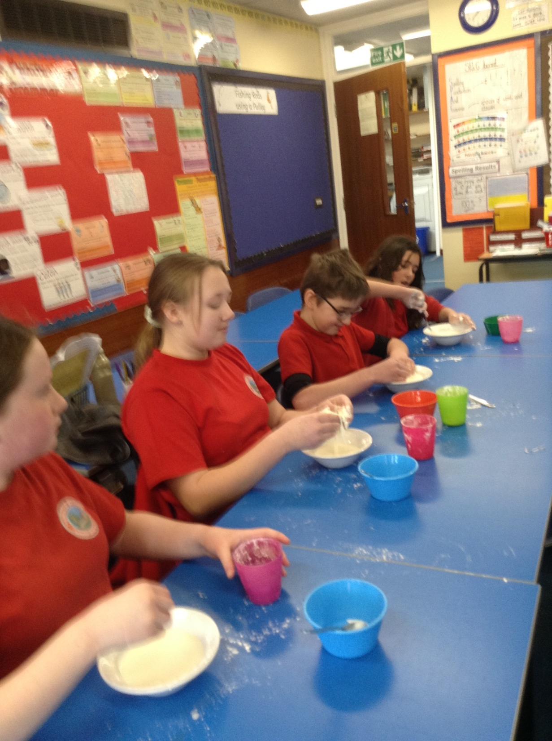
We have been mixing our corn flour with what to find out what would happen.

Slide 37
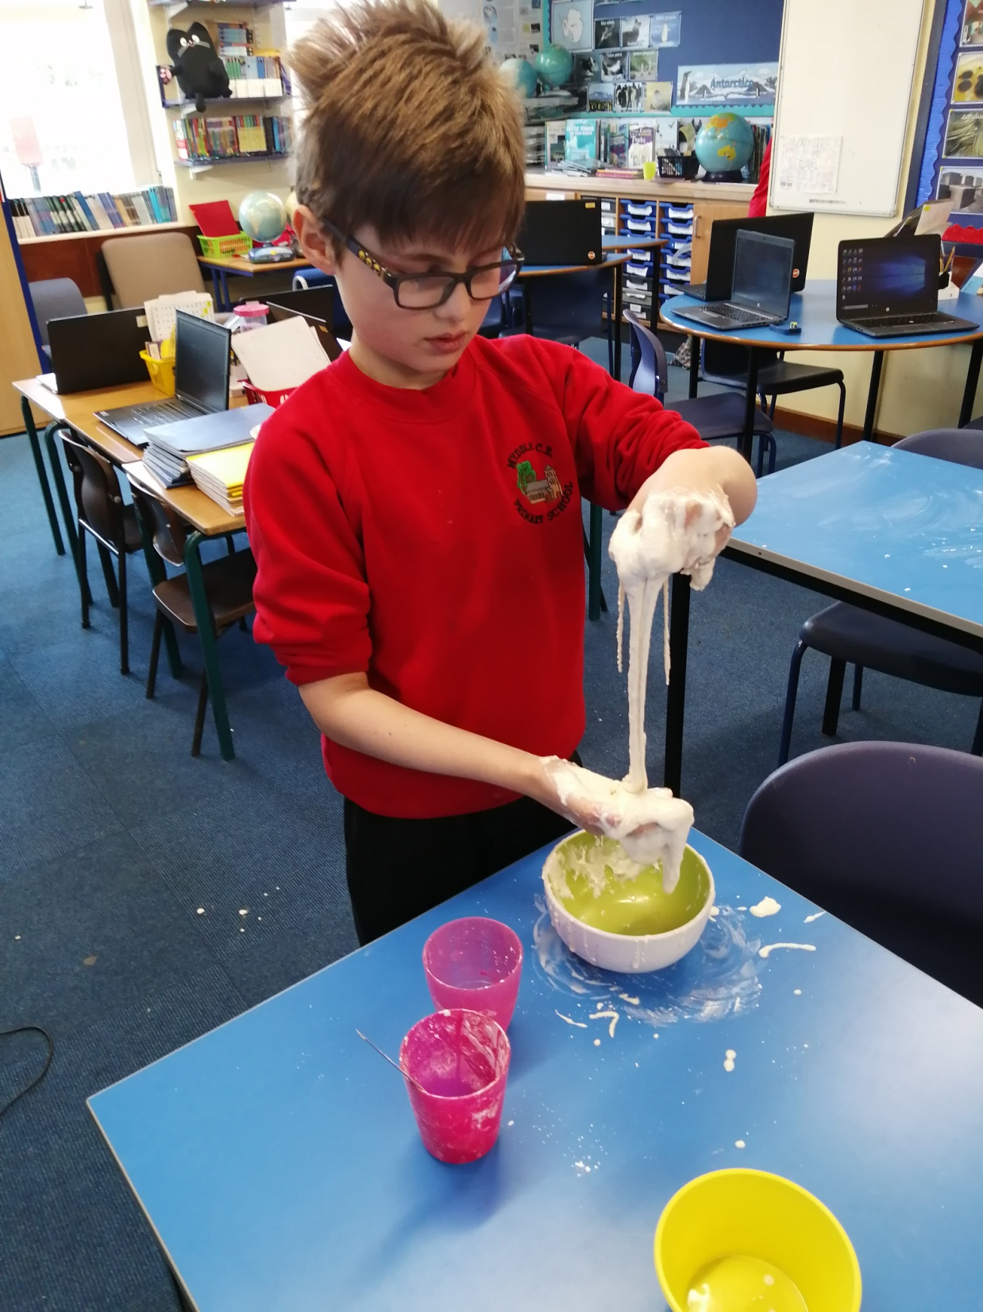
Cass enjoyed taking part in Science today, studying how some substances show more than one state of matter.

Slide 38
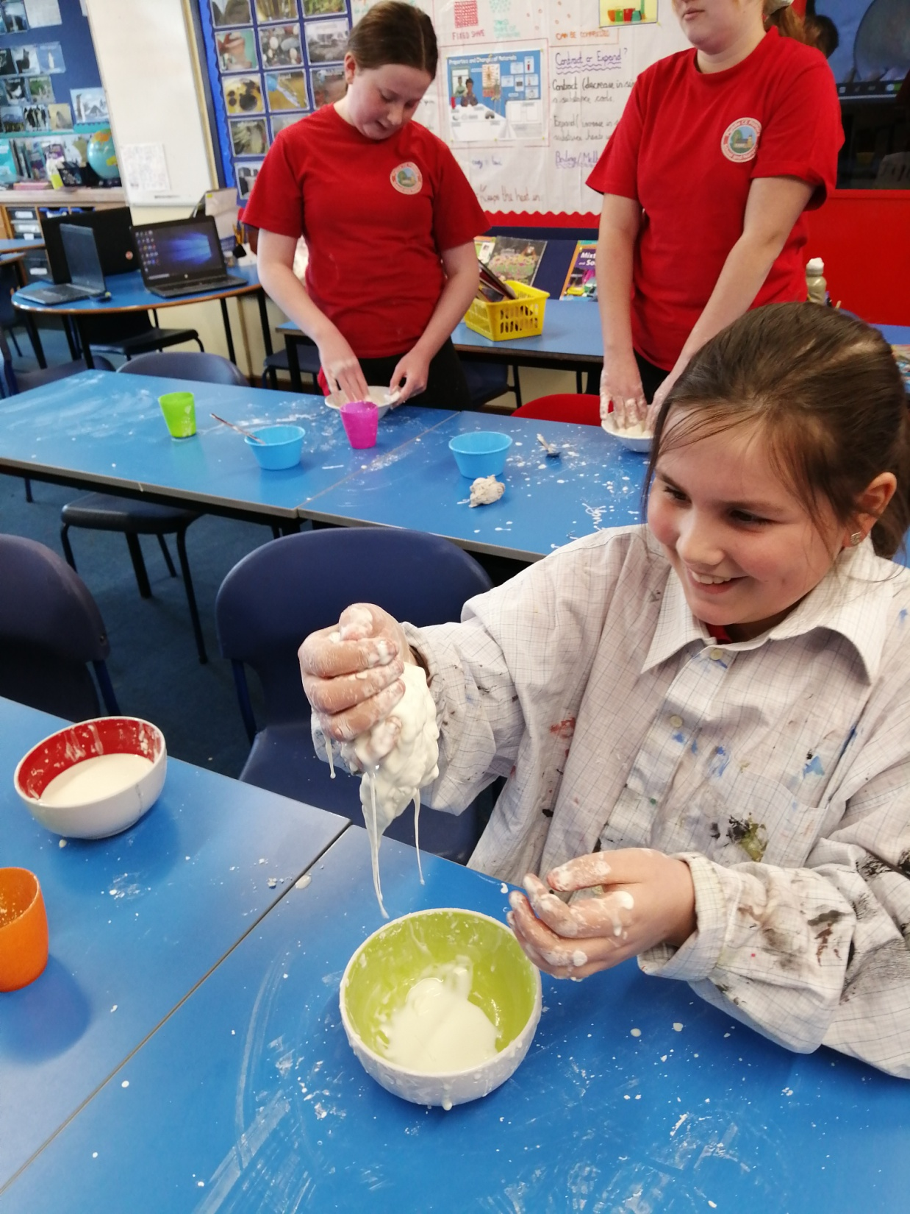
Heidi enjoyed taking part in Science today, studying how some substances show more than one state of matter.

Slide 39
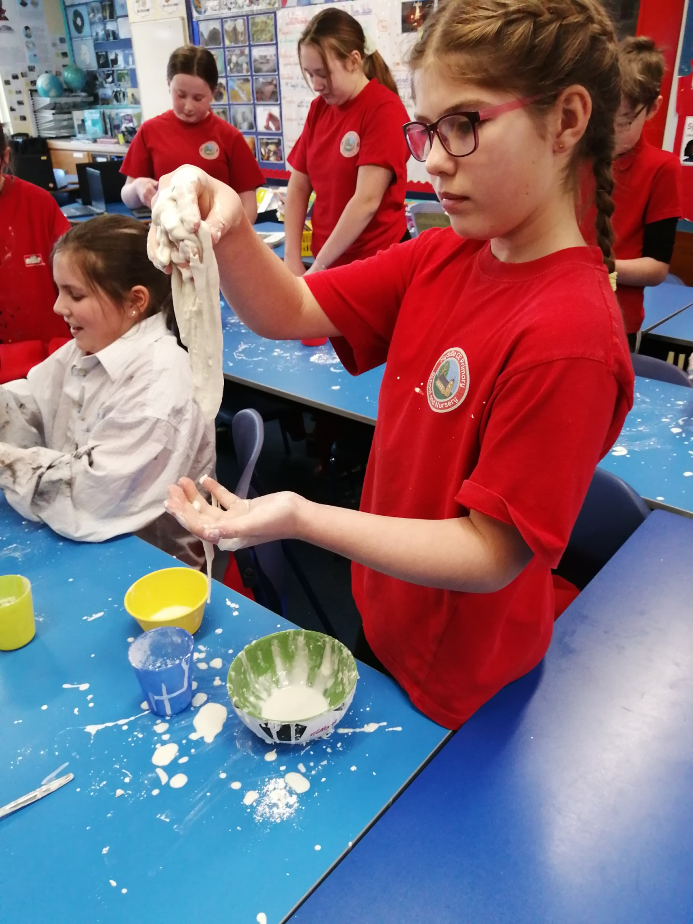
Sophie enjoyed taking part in Science today, studying how some substances show more than one state of matter.

Slide 40
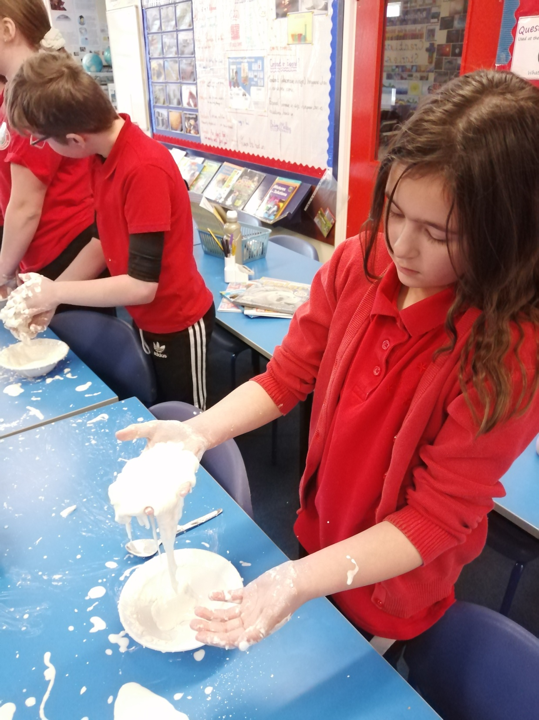
Esme enjoyed taking part in Science today, studying how some substances show more than one state of matter.

Slide 41
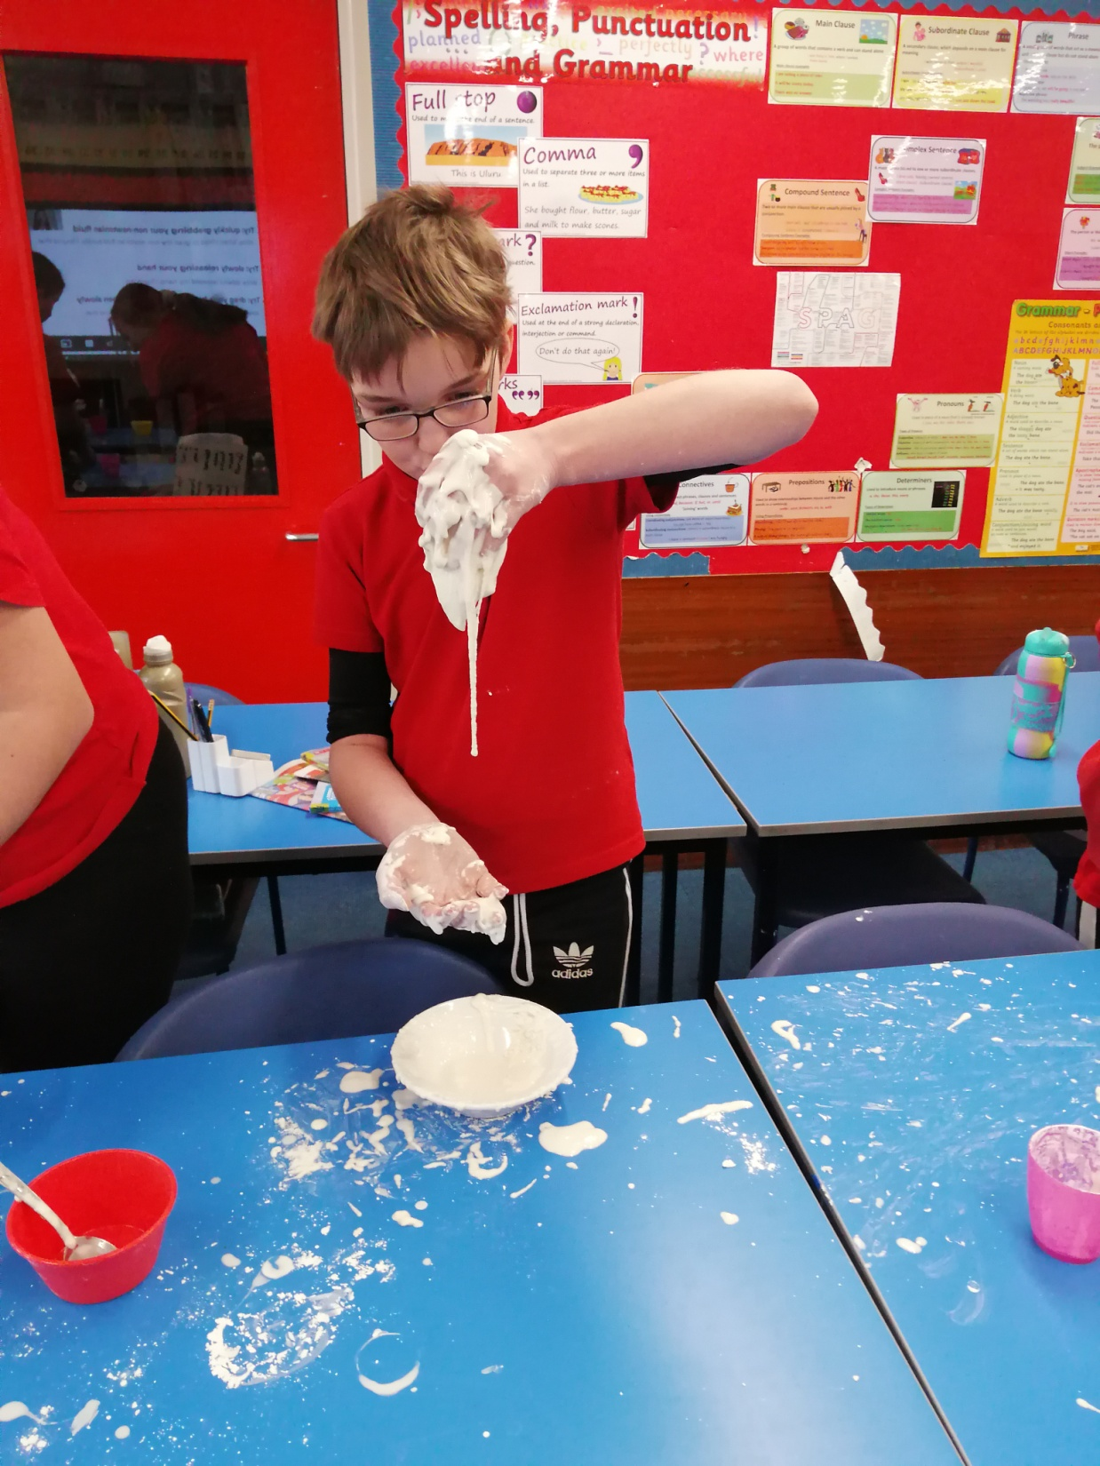
Alfie enjoyed taking part in Science today, studying how some substances show more than one state of matter.

Slide 42
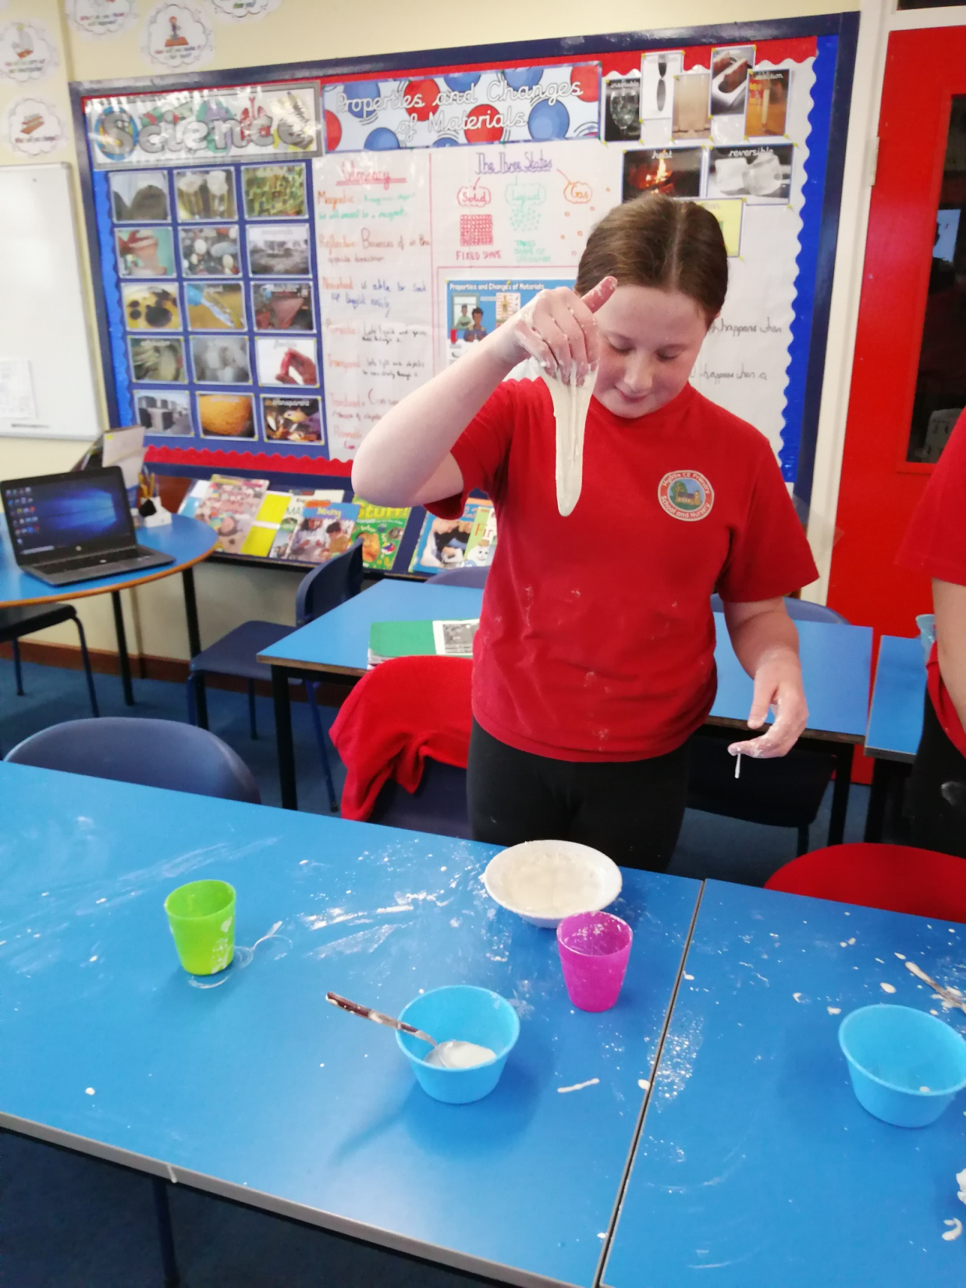
Holly enjoyed taking part in Science today, studying how some substances show more than one state of matter.

Slide 43
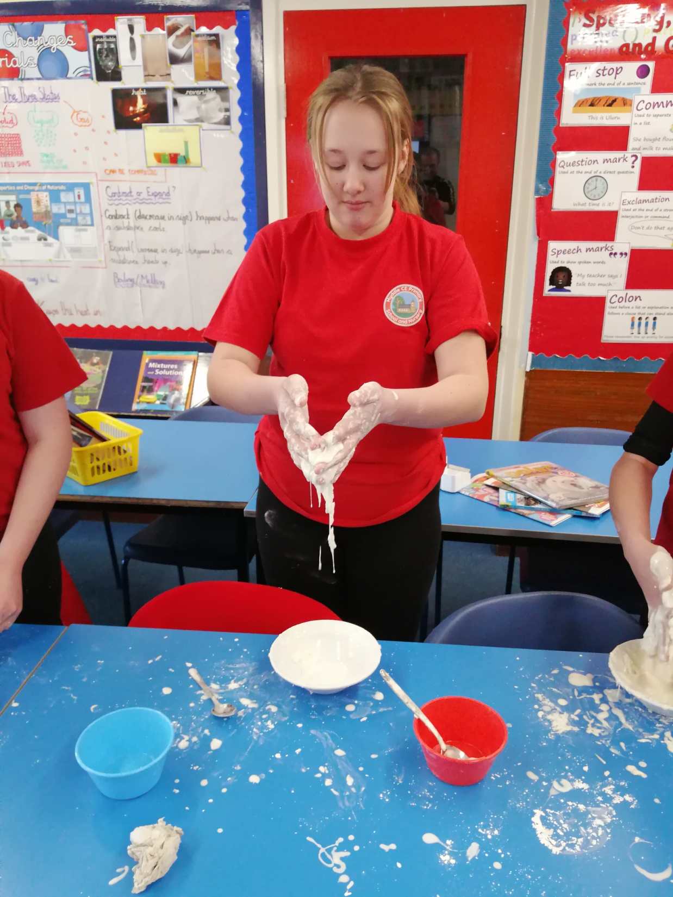
Isla enjoyed taking part in Science today, studying how some substances show more than one state of matter.

Slide 44
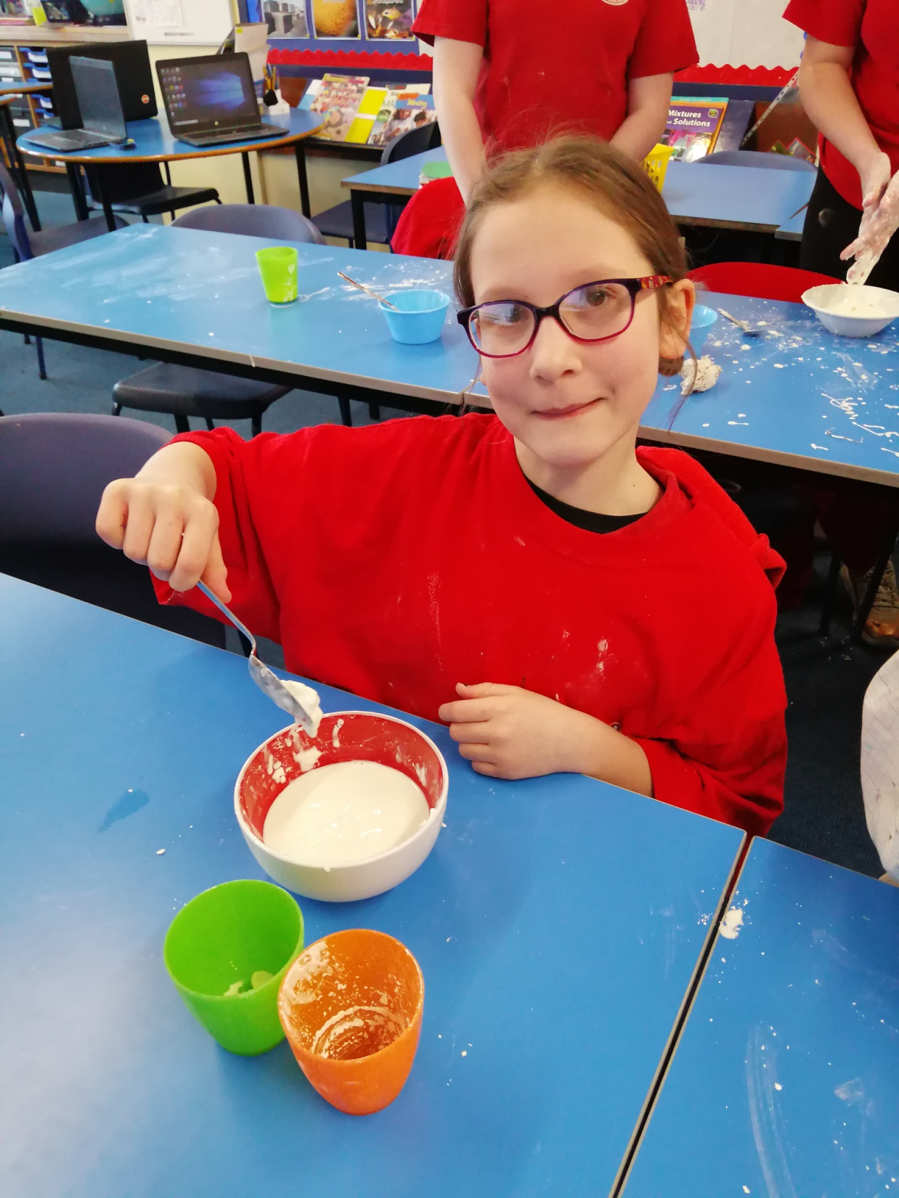
Ariana enjoyed taking part in Science today, studying how some substances show more than one state of matter.

Slide 45
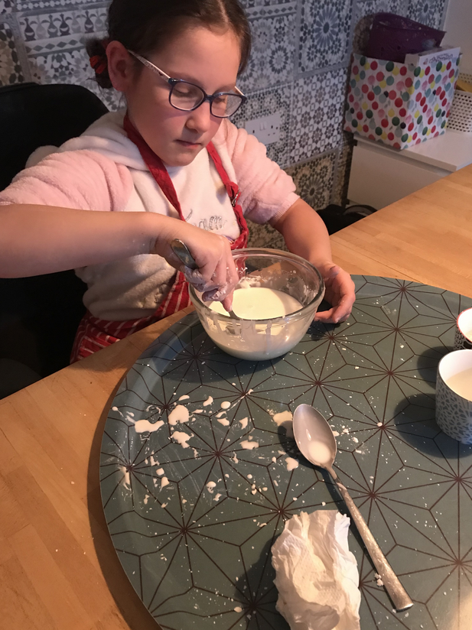
Then she went home to show her parents!

Slide 46
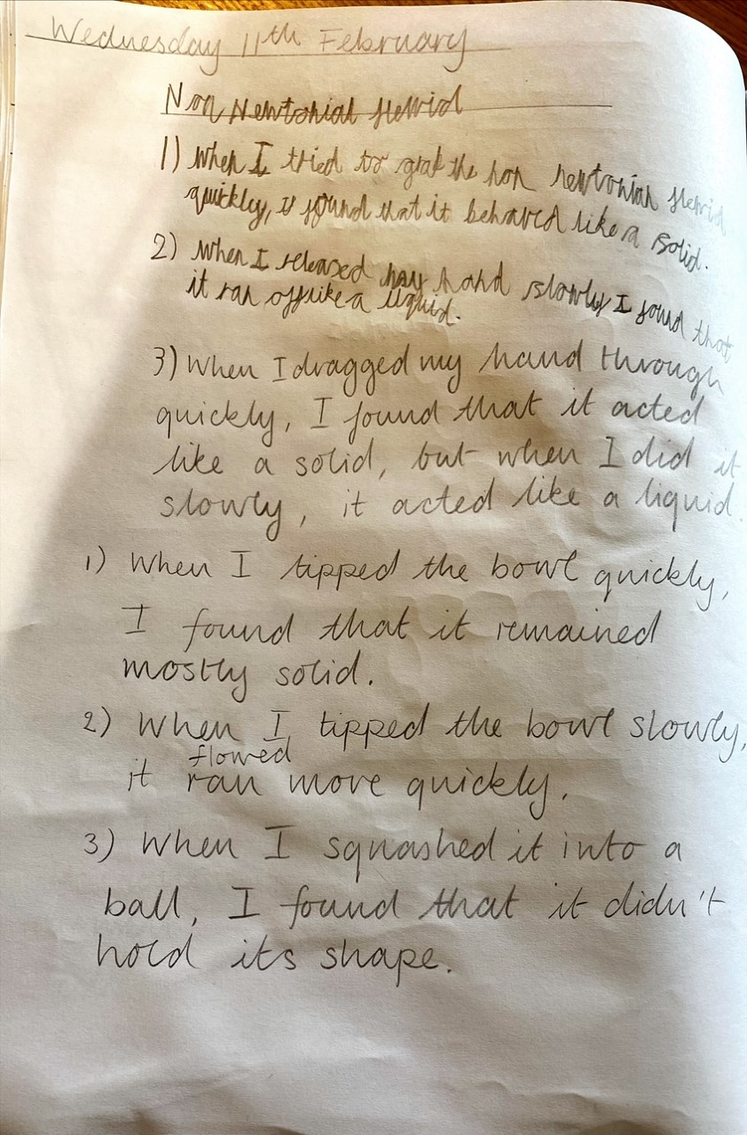
Sam has been mixing corn flour and water to see what happens.

Slide 47
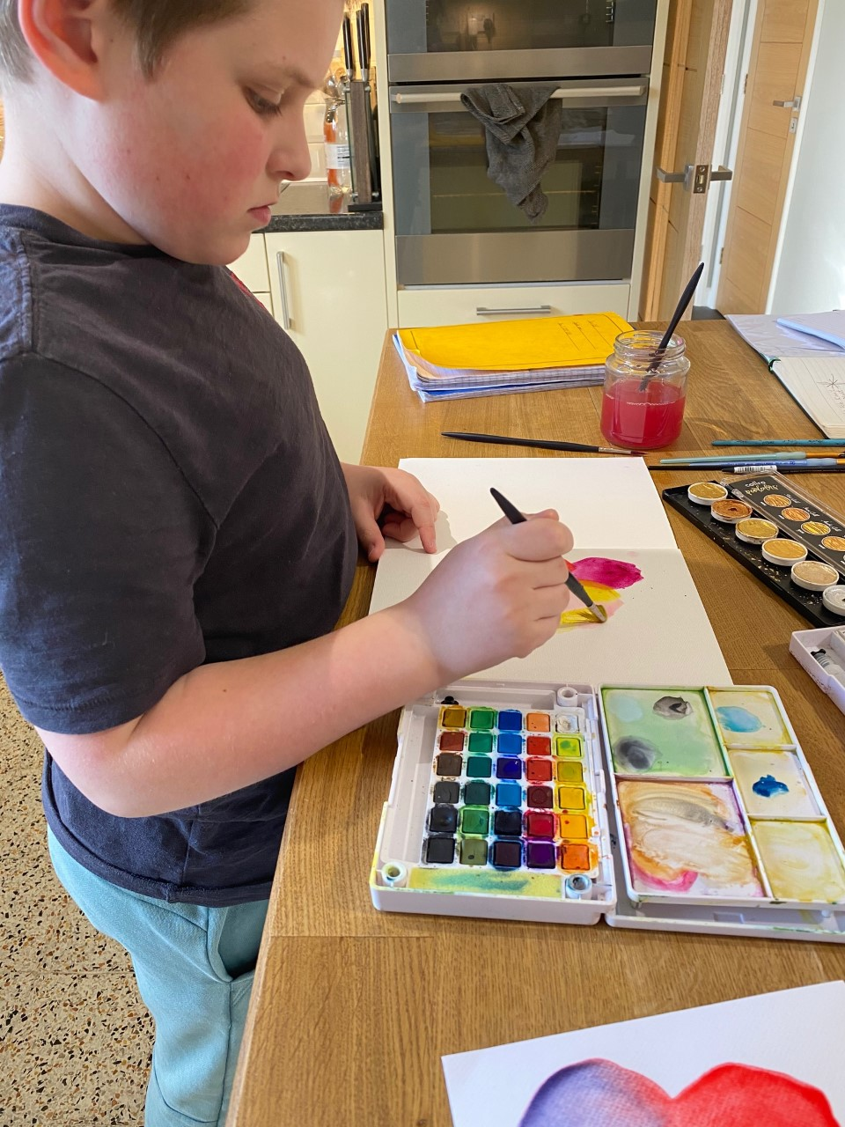
Sam has been arty today.

Slide 48
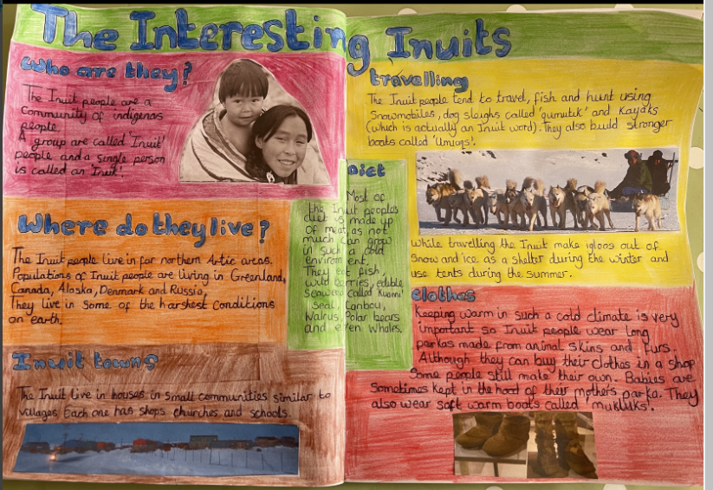
Nelly’s Interesting Inuits

Slide 49
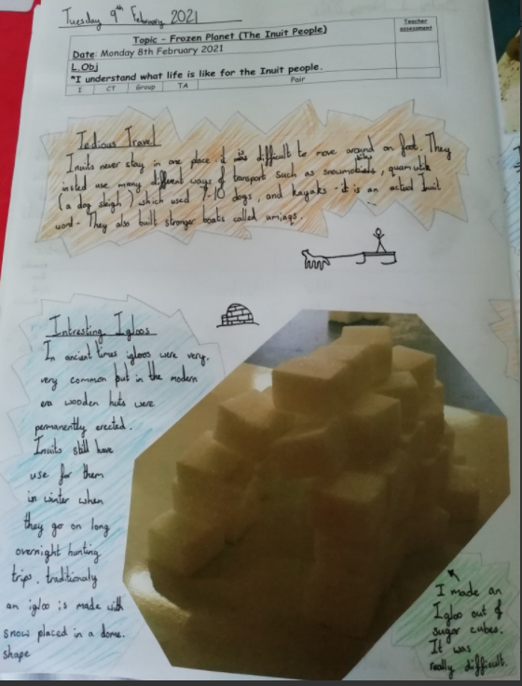
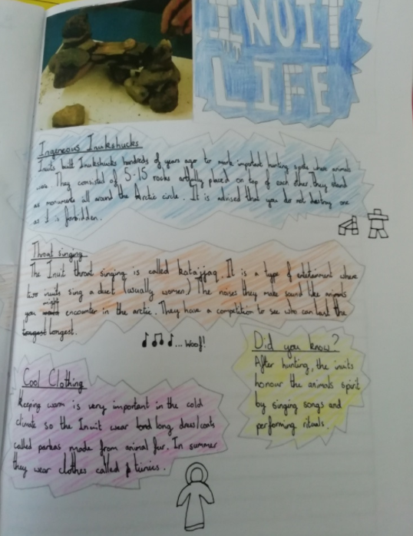
Amy’s completed double page spread about the Inuits people.

