Slide 1
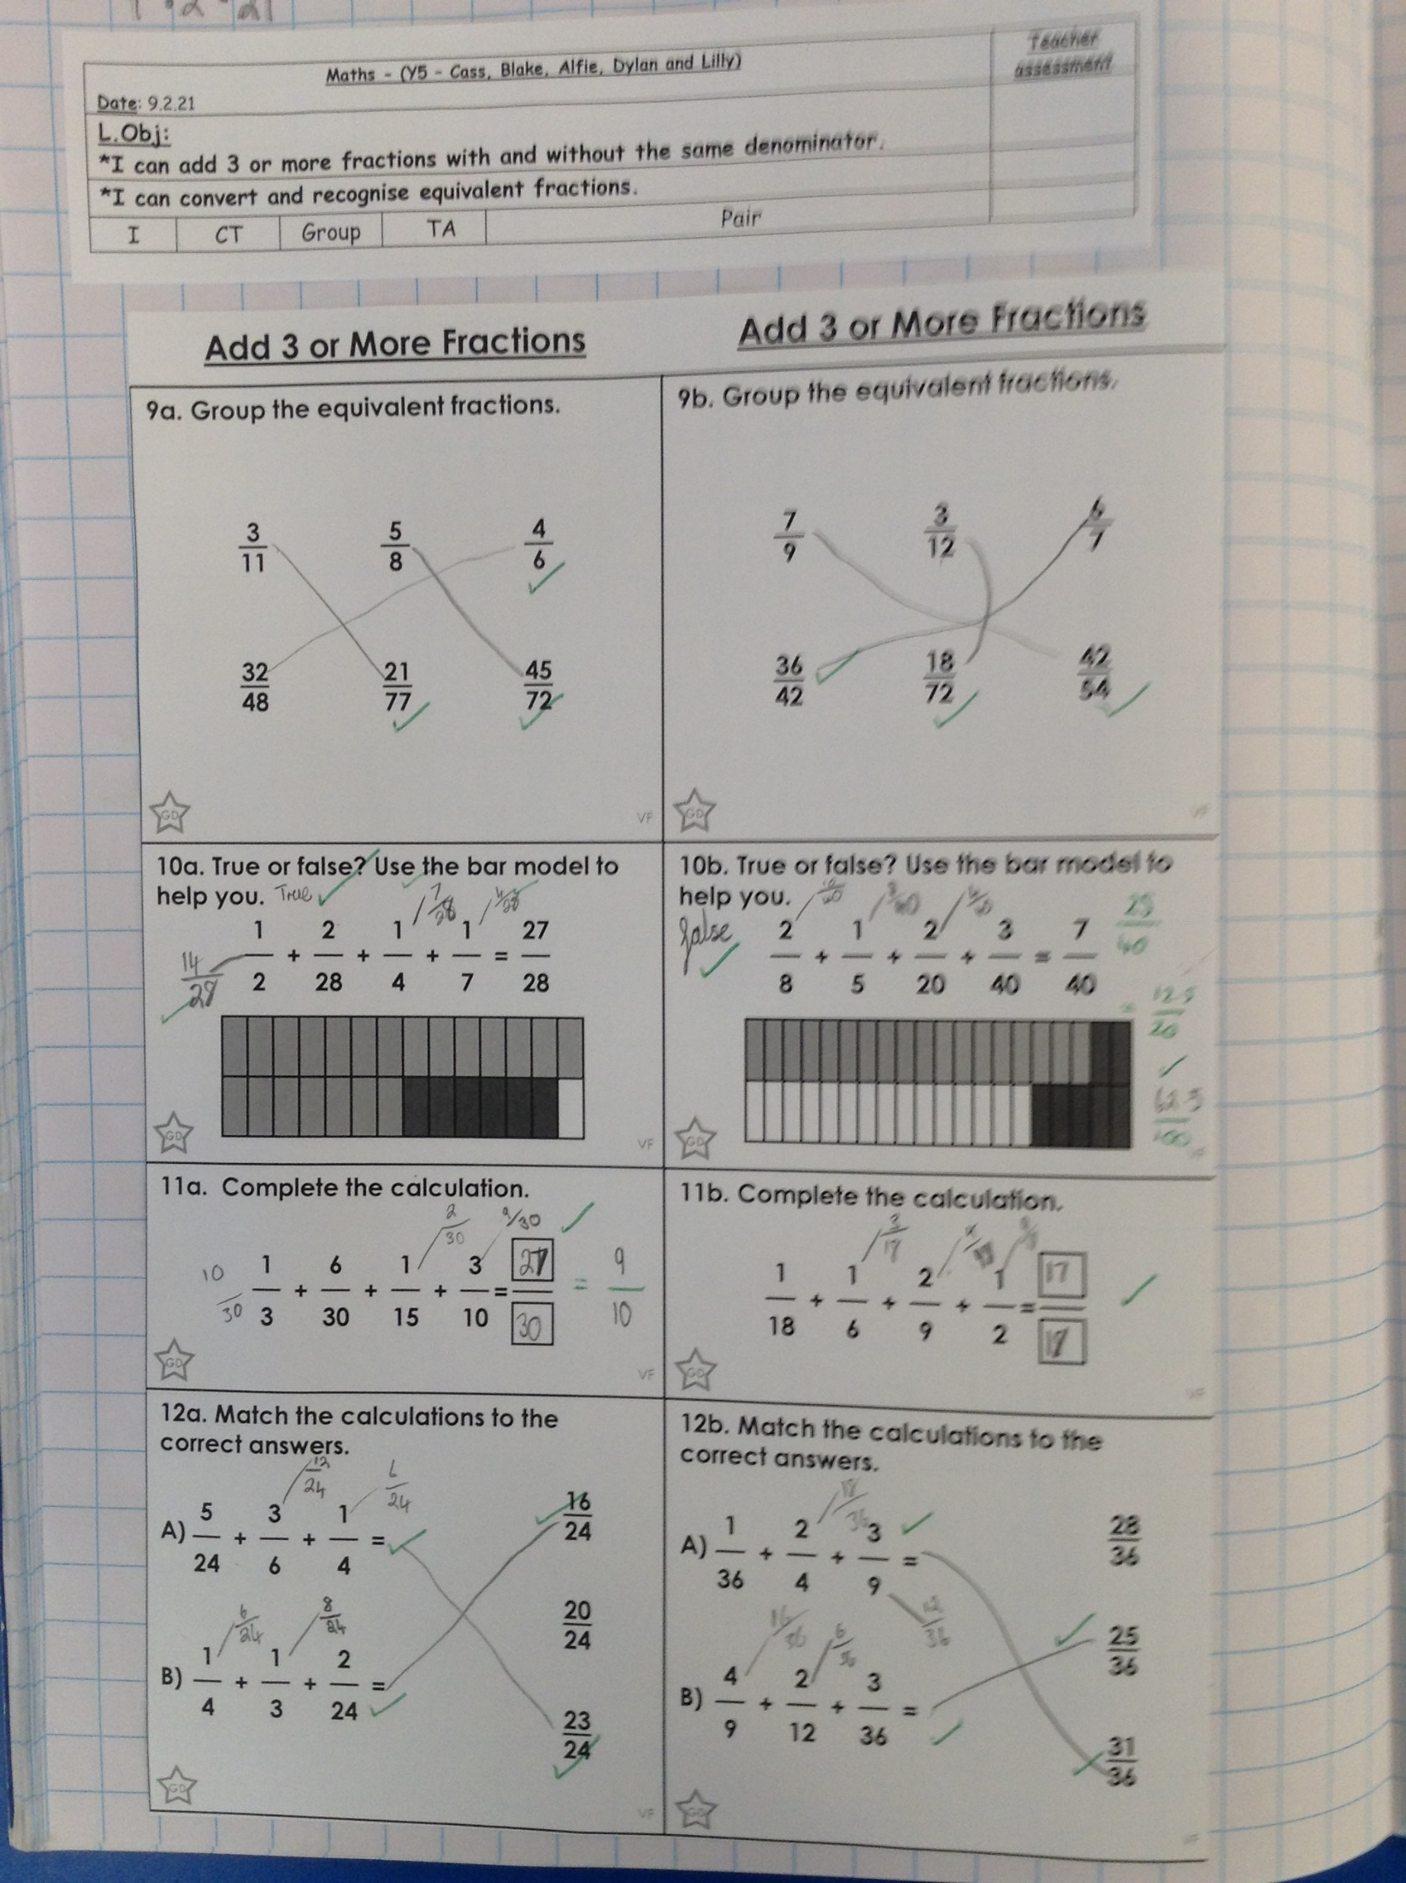
Cass has added three fractions together really well today by finding a common denominator.

Slide 2
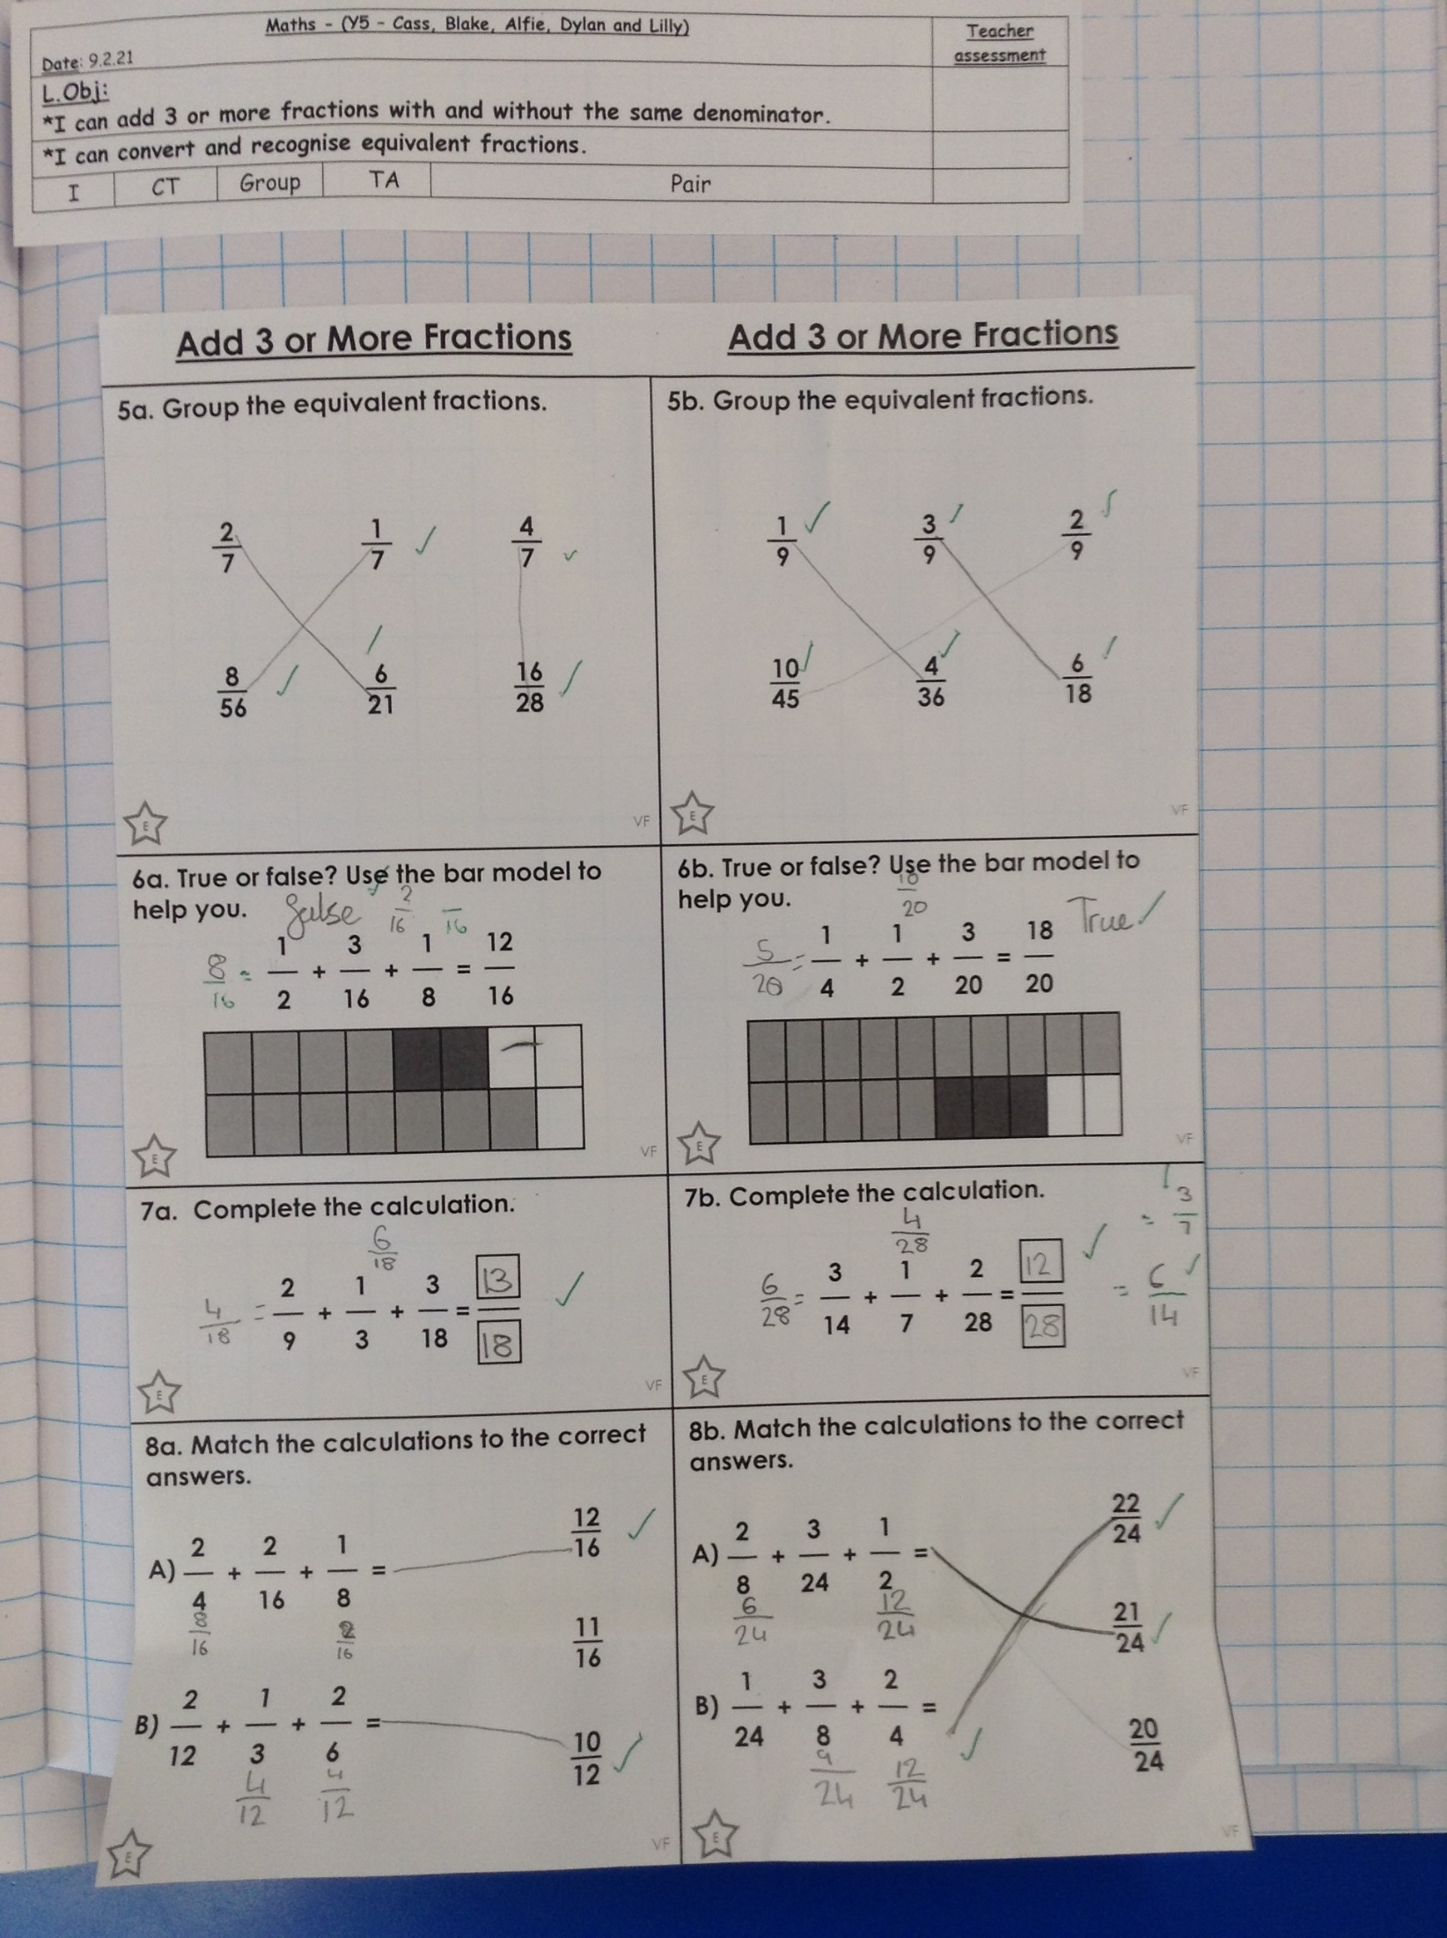
Holly H’s comprehension from today.
Alfie has added three fractions together really well today by finding a common denominator.

Slide 3
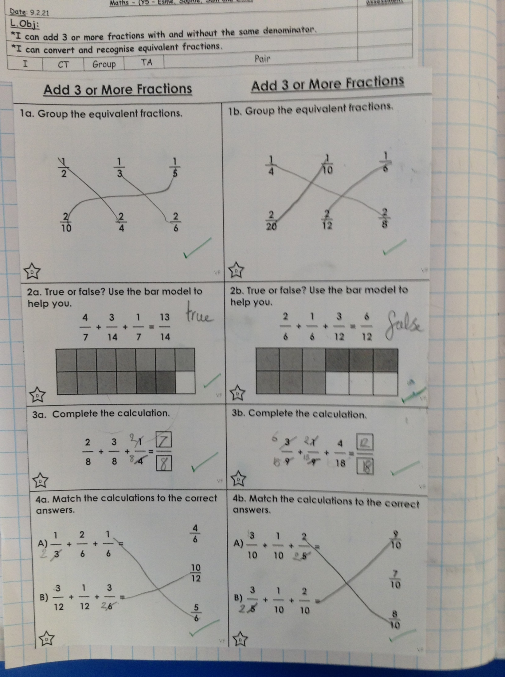
Zoe’s comprehension from today.
Sophie Carr has added three fractions together really well today by finding a common denominator.

Slide 4
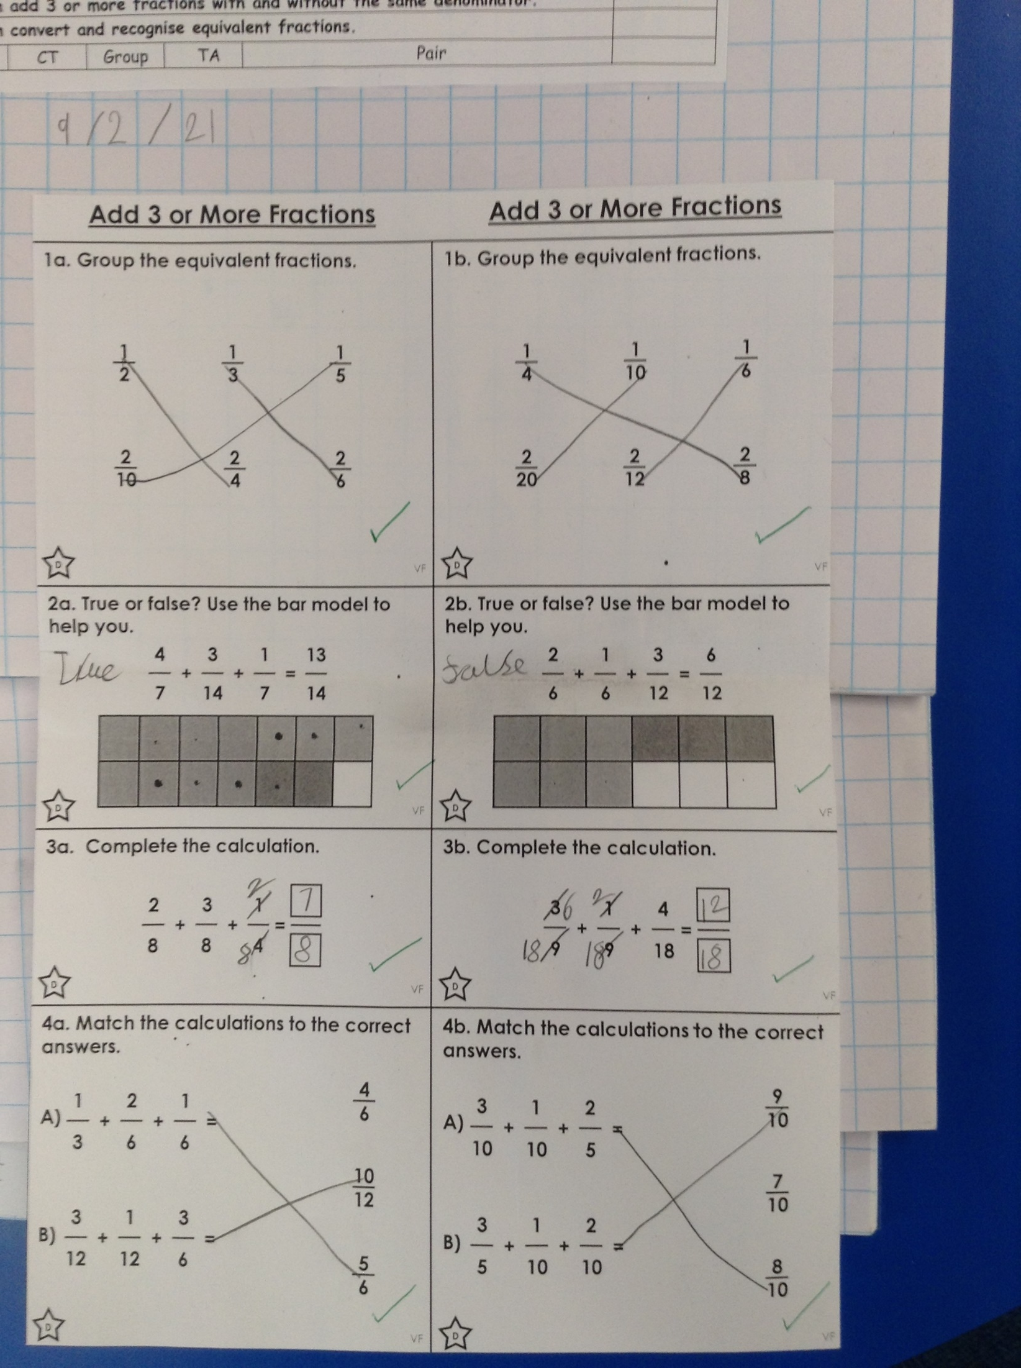
Cameron’s comprehension from today.
Esme has added three fractions together really well today by finding a common denominator.

Slide 5
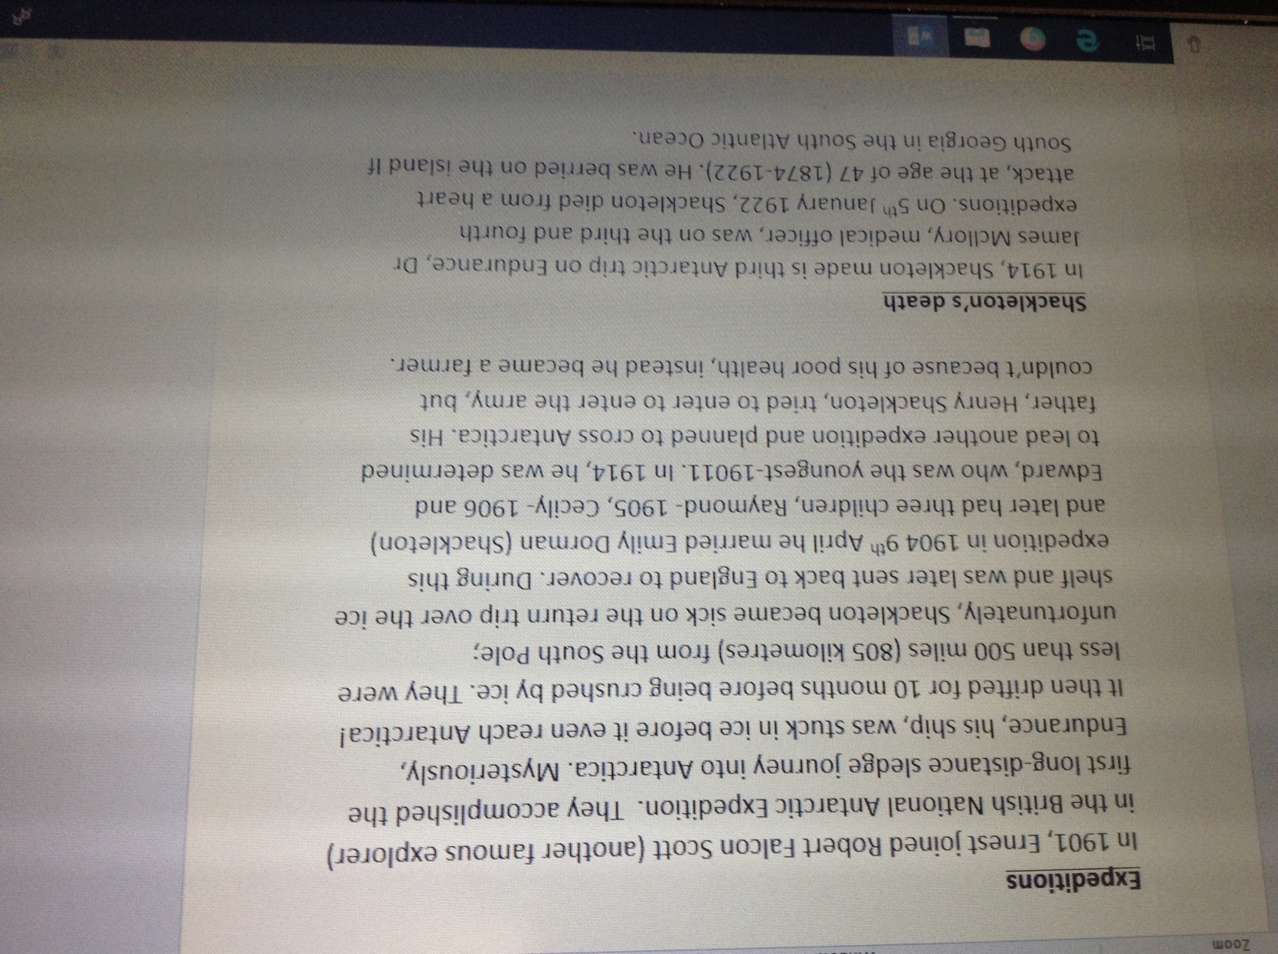
Isobel has continued the final part of her biography of Ernest Shackleton

Slide 6
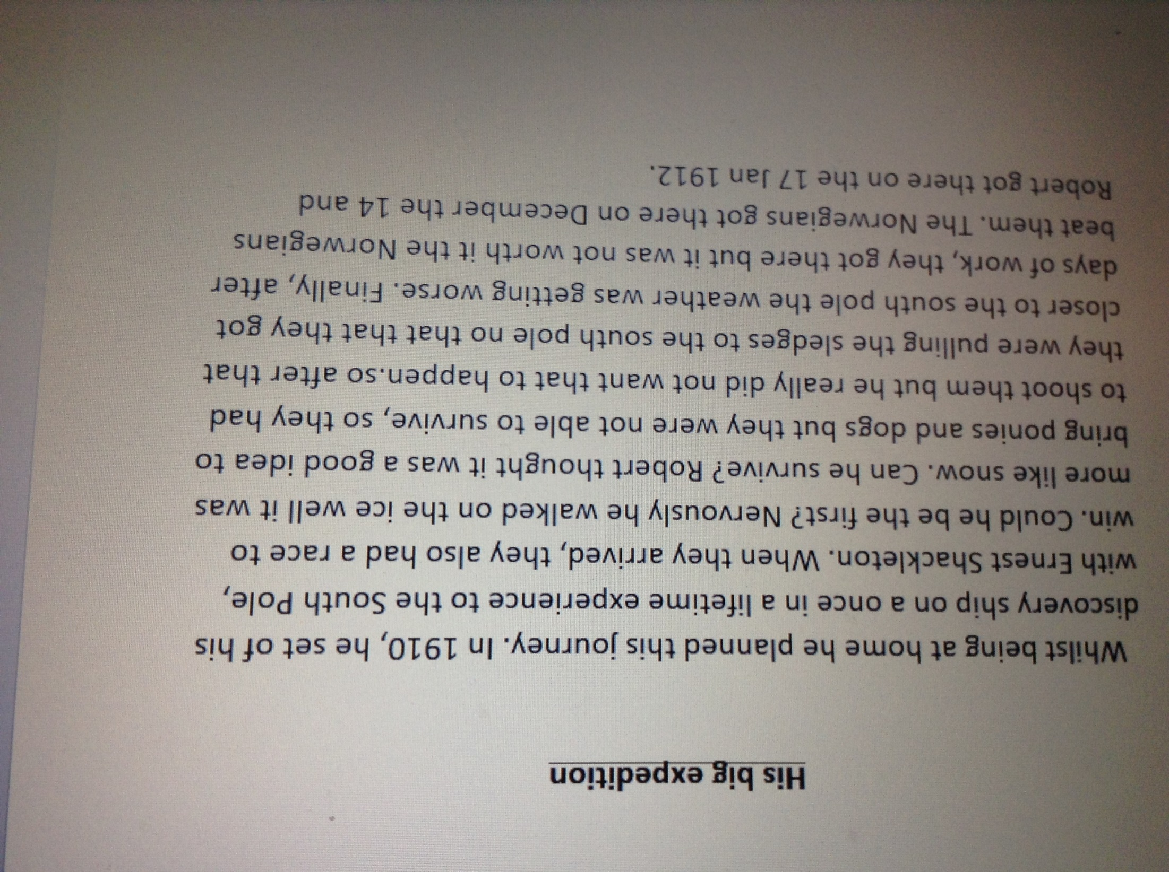
Isla has continued her biography from yesterday.

Slide 7
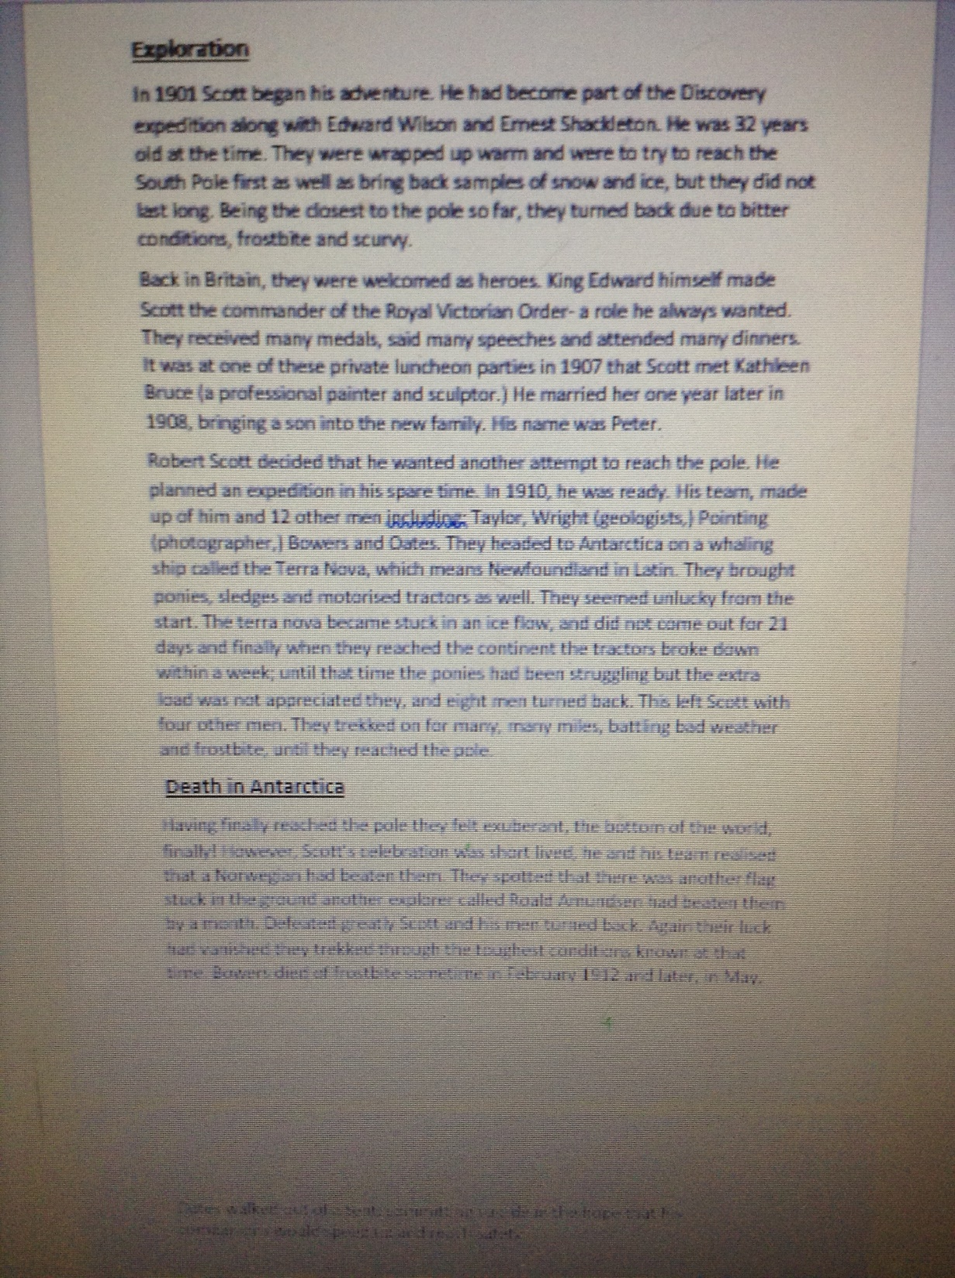
Amy has continued to write her biography about Robert Falcon Scott

Slide 8
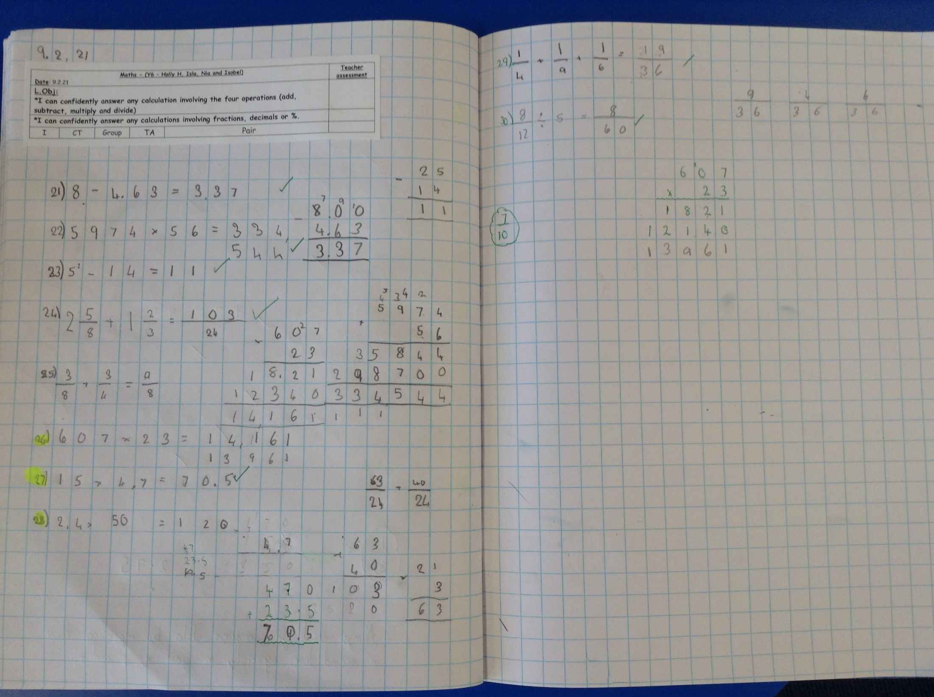
Isla scored 70% on her maths calculations today.

Slide 9
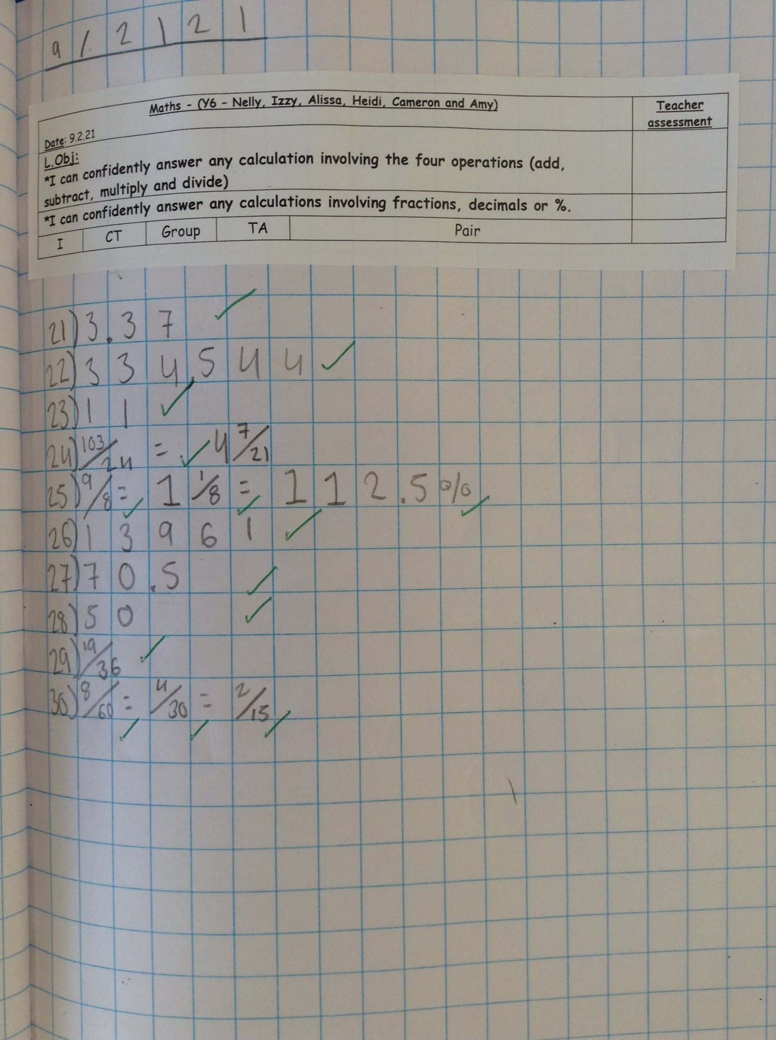
Heidi scored 100% on her maths calculations today.

Slide 10
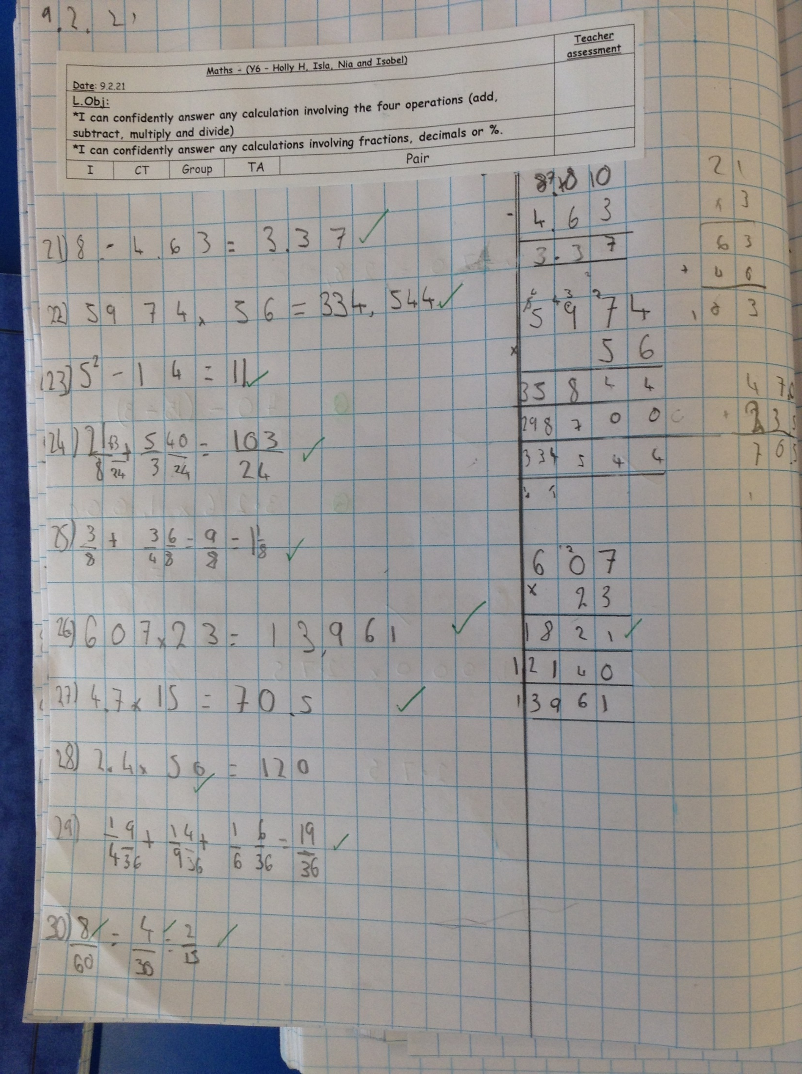
Isobel calculated her answers really well in maths today, using very effective jottings.

Slide 11
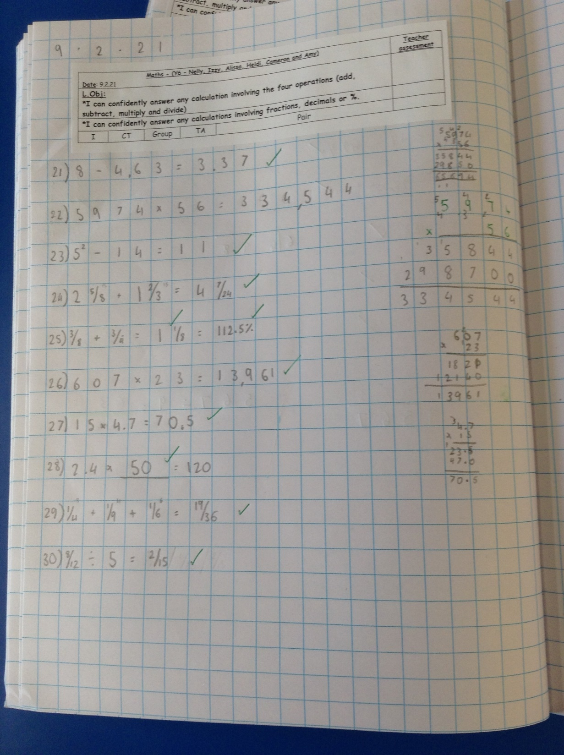
Amy thought really carefully to answer these maths calculations, including fractions, decimals and percentages, correctly.

Slide 12
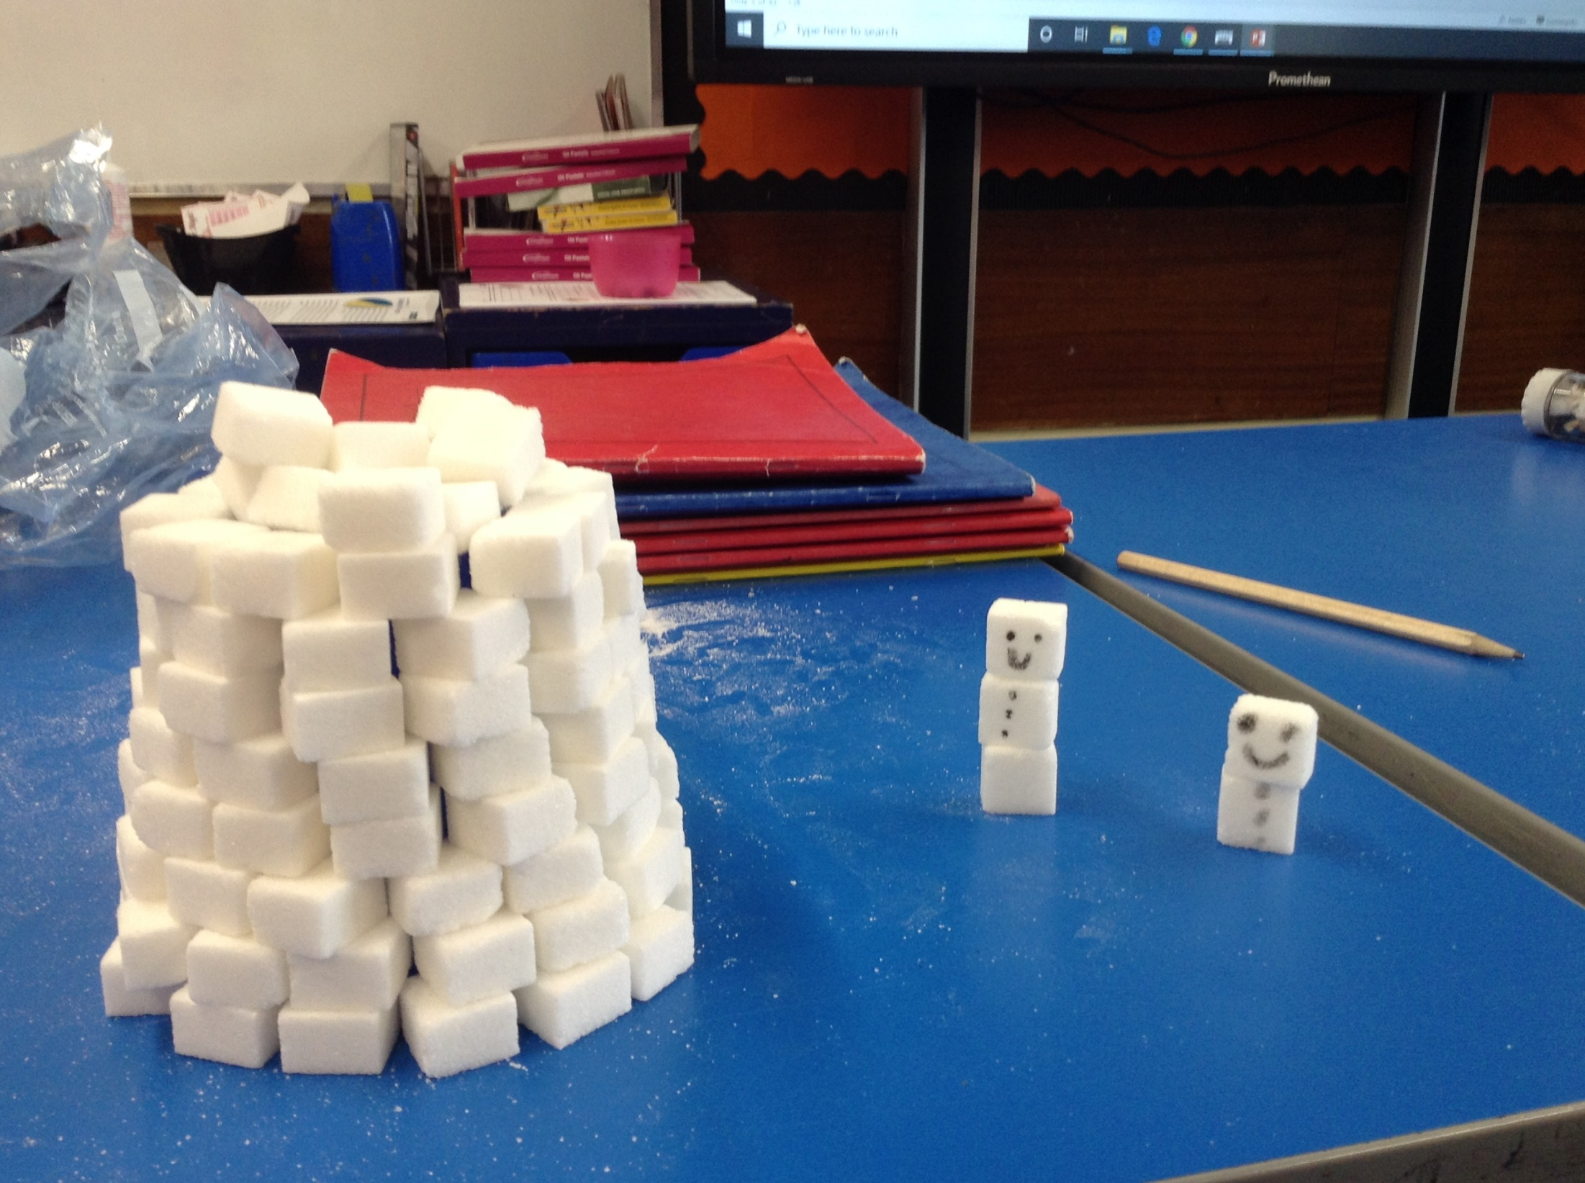
Esme has been in school today and created her igloo using sugar cubes. The Inuk snowmen look very happy about it!

Slide 13
Rhys has continued his biography today, thinking about how Robert Falcon Scott died on his expedition.

Slide 14
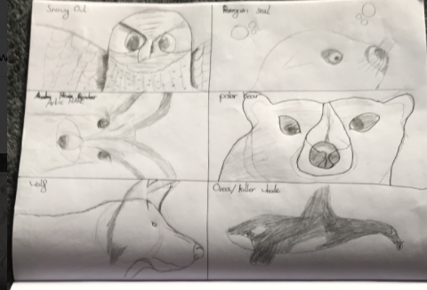
Here’s Rhys’ Arctic animal sketches

Slide 15
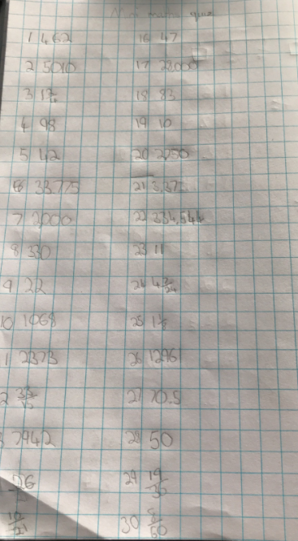
Rhys has completed questions 1-30 on his My Mini Maths calculations.

Slide 16
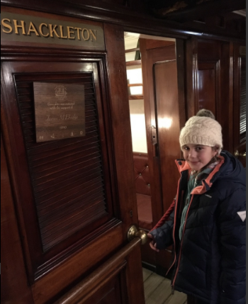
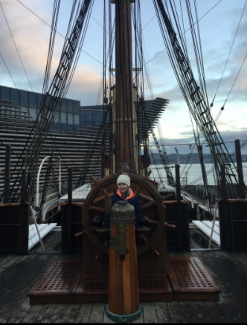
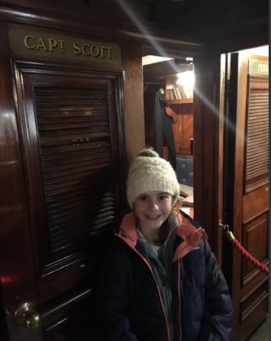
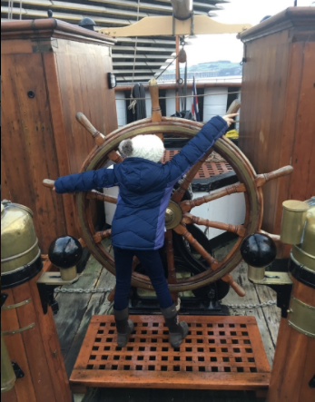
More photographs on board the famous Discovery ship.

Slide 17
Ollie has continued and completed his biography today.

Slide 18
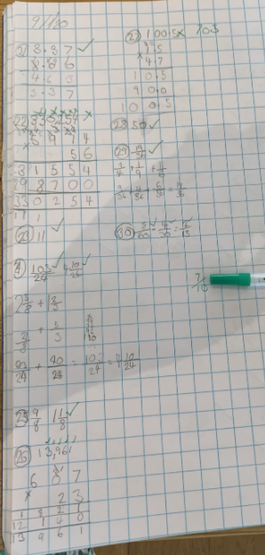
Zoe has continued her knowledge of calculations / fractions, decimals and percentages today.
27/30 so far!

Slide 19
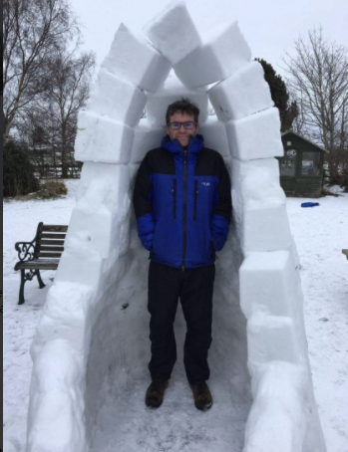
Zoe’s uncle and cousins have built their own igloo in Scotland

Slide 20
Dylan has completed his biography today.

Slide 21
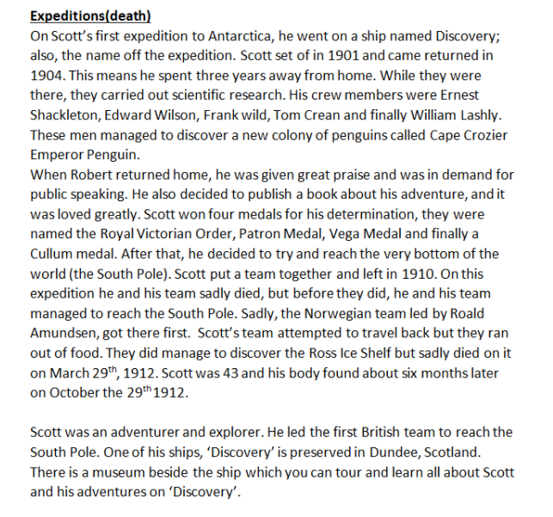
Zoe has completed the final part of her biography today.

Slide 22
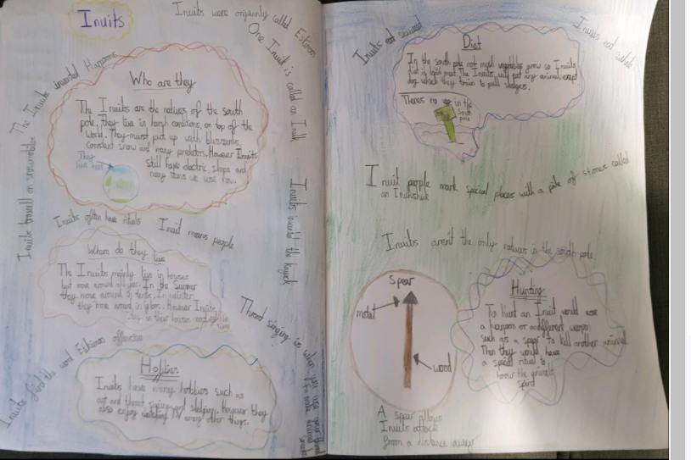
Cameron’s been creating his double page spread about The Inuits

Slide 23
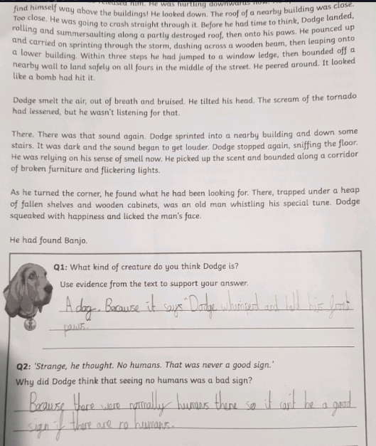
Cameron has been reading his story extract today.

Slide 24
Cameron has produced part of his double page spread about the Inuits.

Slide 25
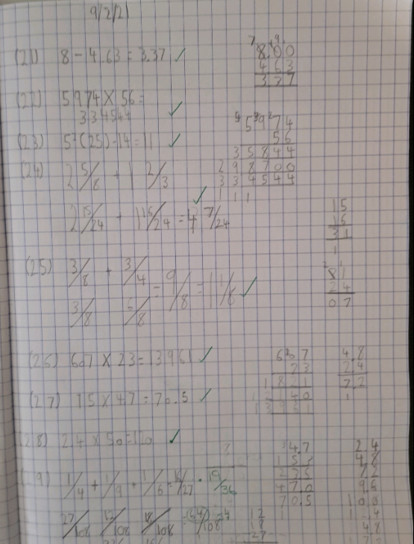
Cameron achieved 9/10 correct on his maths calculations today.

Slide 26
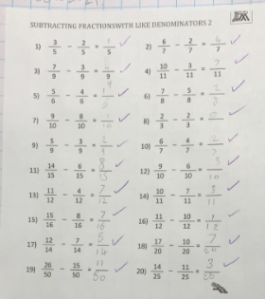
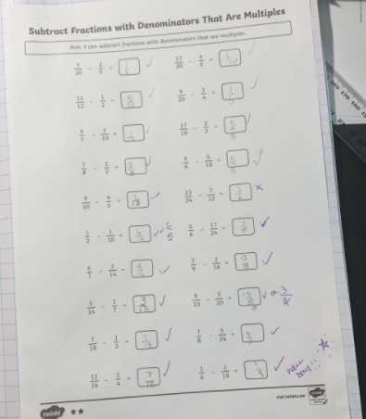
Alex’s fraction subtraction from yesterday

Slide 27
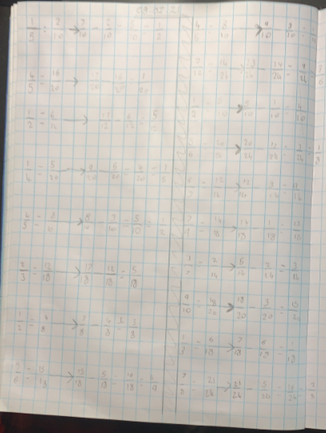
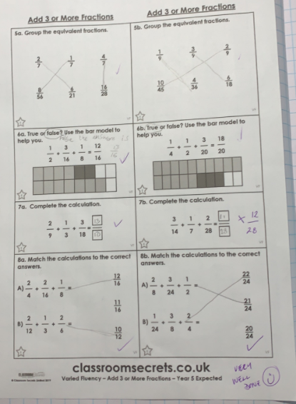
Alex has been adding 3 fractions together.

Slide 28
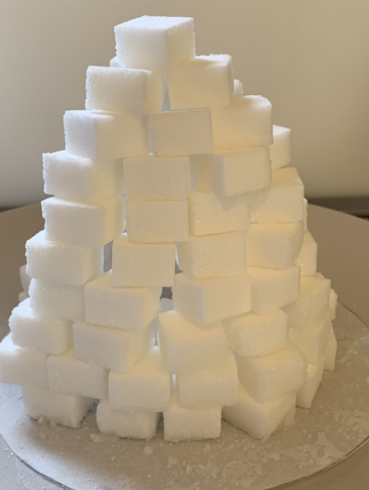
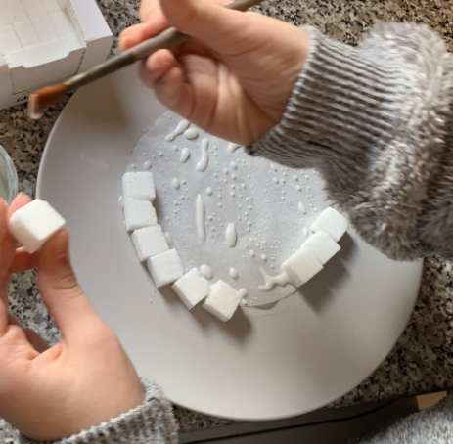
Sophie’s been creating her Inuit igloo.

Slide 29
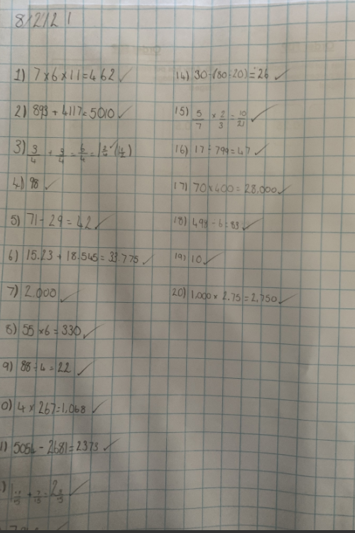
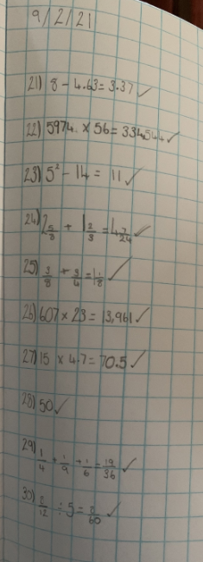
Sophie has been working hard on her calculations in maths.

Slide 30
Sophie has been completing her biography.

Slide 31
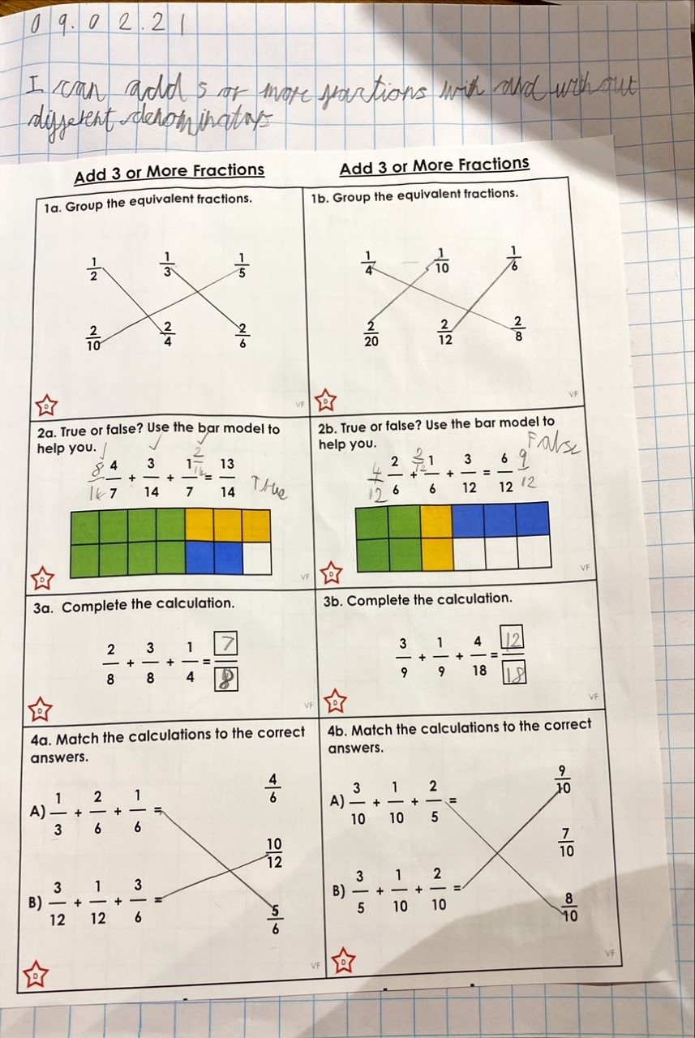
Sam added his three fractions together really well, showing a great understanding of finding a common denominator.

Slide 32
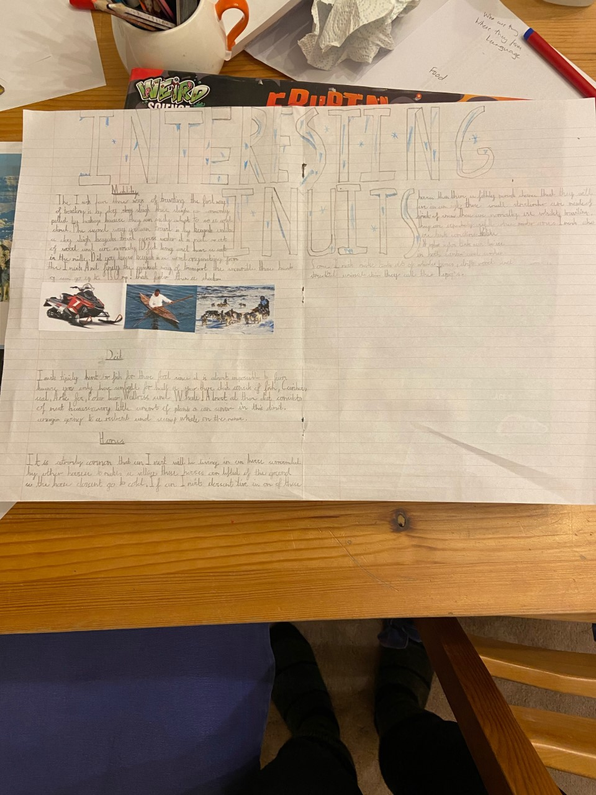
Dylan’s wonderful ‘double page spread’ about the Inuits.

Slide 33
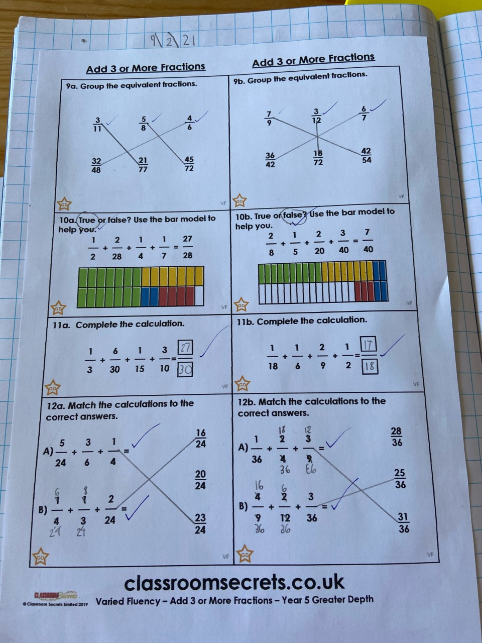
Dylan has been adding his three fractions really well by finding common denominators.

Slide 34
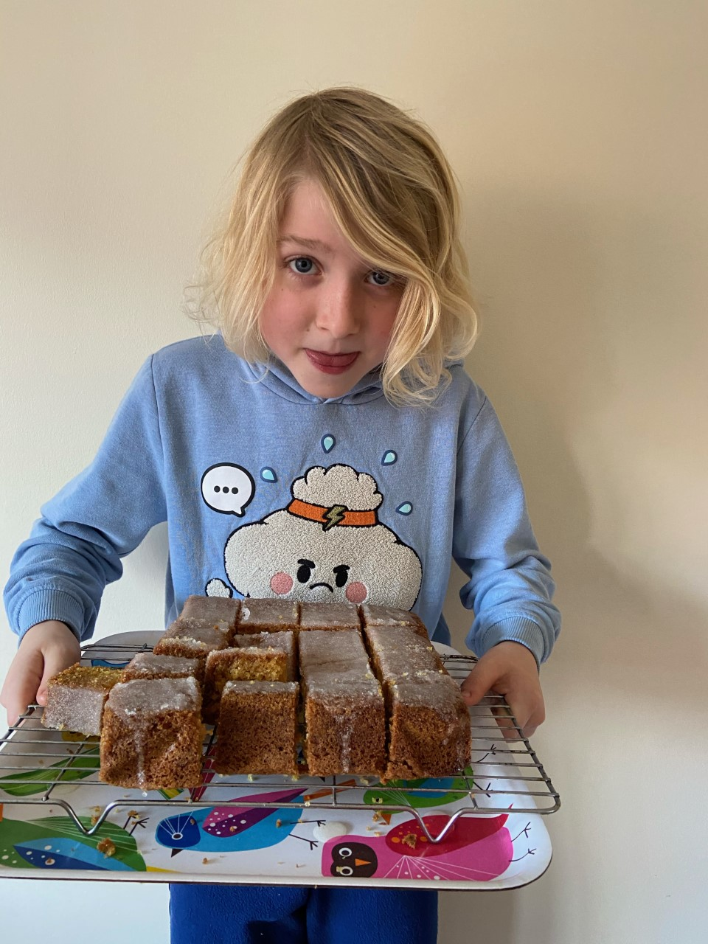
Who wants to be Dylan’s BEST friend after he made this lemon drizzle cake?

