Slide 1
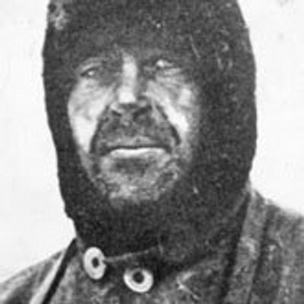
Early life / growing up
School / College / Qualifications gained
Life before exploring (jobs)
Born 6th June 1868 in Devonport, Devon, England
John Edward – father
Mother – Hannah Scott
third of 6 children
Suffered from serious financial misfortunes
Father was a brewer and magistrate
Grandpa and uncles served in army / navy
Went to Stubbington House School in Hampshire
Completed Naval cadet instruction on the Royal Navy’s training ship – Britannia
Became naval cadet at 13
Served for 4 years on various training ships
Joined the West Indies training squadron as a torpedo officer in 1887
Became midshipman in 1883
In 1899, met Sir Clements Markham, president of the Geographical Society in London – learned there was to be an expedition of the Antarctica on a Royal Naval research ship (RRS) called ‘Discovery
Expeditions
Leader of the expedition in 1899 and reached further south than anybody else
Returned as a hero (with Ernest Shackleton)
Different expedition from Cardiff called the Terra Nova expedition
Reached South Pole but not before Amundsen did 5 weeks earlier
Robert Falcon Scott
Life after exploring / Death
Family life
Presumably died on 29th March 1912 on the Terra Nova expedition along with his crew, Edward Wilson, Lawrence Oates, Henry Bowers and Edgar Evans.
12.5 miles away from the next hut point
Caught in a storm
Died presumably of frostbite, starvation and hyperthermia
Married Kathleen Scott on September 2nd 1908
One child, Peter
Peter became a famous painter and ornithologist (expert on birds)
Peter was part of UK team for the 1936 Summer Olympics in sailing (won bronze)
Founded the WWF (World Wildlife Fund)

Slide 2
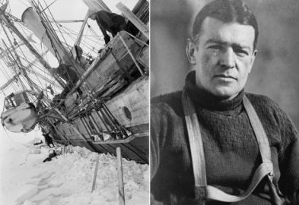
Early life / growing up
School / College / Qualifications gained
Life before exploring (jobs)
second oldest of ten children
family later moved to London when he was 10, where Ernest was raised
father Henry was a doctor and hoped Ernest would become a doctor too
Mother - Henrietta
born - February 15, 1874, in Kilkea, County Kildare, Ireland
as child, loved to read - inspired him to have own adventures.
18 - he had become first mate
24 - he was a certified master mariner
schooled by a governess until 11
age 13 – Dulwich college
left school and joined the merchant navy at 16 - became a sailor and sailed all over the world
Expeditions
1901 - joined Robert Falcon Scott’s British National Antarctic Expedition.
Scott, Shackleton, and Edward Wilson travelled by sledge over the Ross Ice Shelf, the world’s largest body of floating ice in Antarctica.
1st long-distance sledge journey into Antarctica. They were less than 500 miles (805 kilometers) from the South Pole.
Shackleton became sick on the return trip over the ice shelf. He was sent back to England to recover.
returned to Antarctica in 1908 as leader of the Nimrod expedition (came within 112 miles of the South Pole.
Shackleton led another expedition in 1914. Planned to cross Antarctica.
Endurance trapped in ice before it reached Antarctica - ship then drifted for 10 months before being crushed by the ice.
Ernest Shackleton
Life after exploring / Death
after Nimrod expedition, awarded a knighthood by Edward VII
made Commander of the Royal Victorian Order.
also dabbled in Hungarian mining, sold stamps and created a tobacco company.
gave lectures and wrote two books, The Heart of the Antarctic (1909) and South (1919)
died of heart attack on January 5, 1922, at Grytviken, South Georgia, at the beginning of another Antarctic expedition on ship ‘Quest
buried there.
Family life
He married Emily Mary Dorman in 1904
3 children – youngest Edward

Slide 3
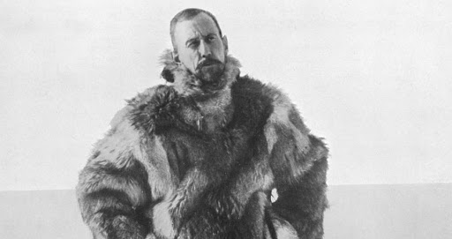
Early life / growing up
School / College / Qualifications gained
Life before exploring (jobs)
Expeditions
Roald Amundsen
Life after exploring / Death
Family life

Slide 4
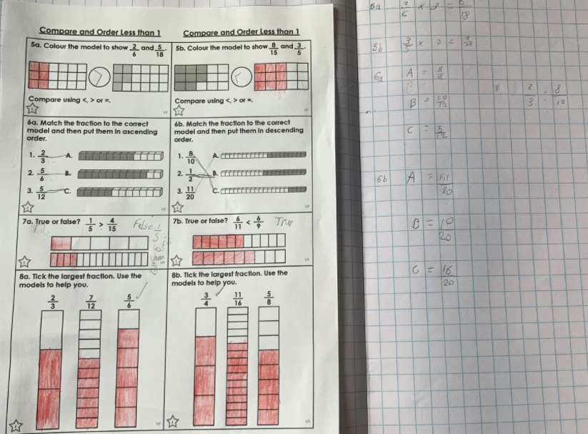
Alex has been comparing and ordering fractions by finding a common denominator to help him.

Slide 5
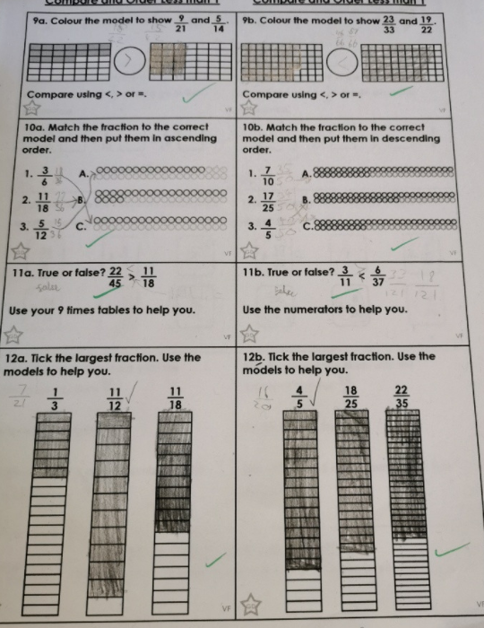
Blake has worked hard today in his fractions work in maths

Slide 6
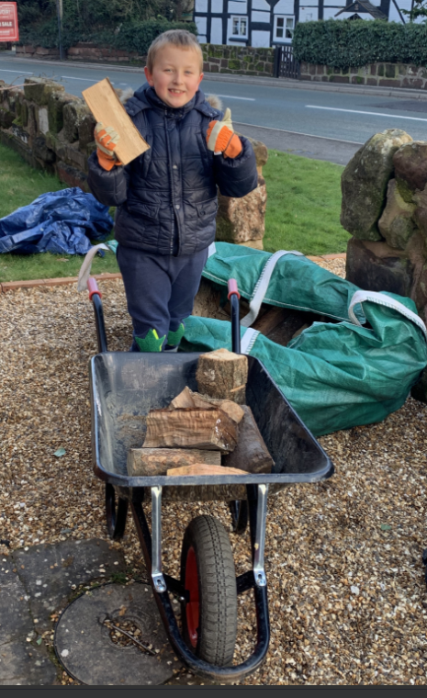
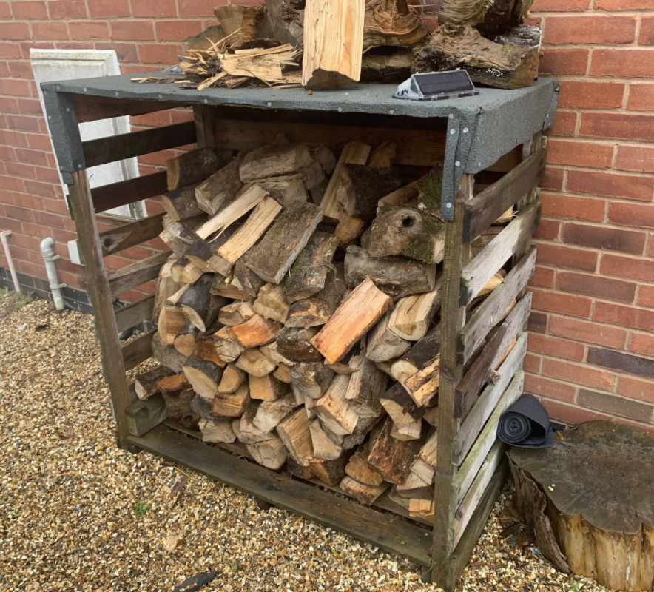
Alex has been busy helping to organise the log store.

Slide 7
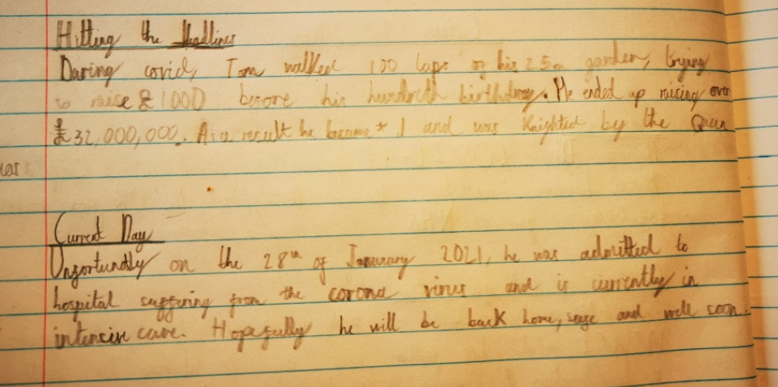
Here’s Blake’s completed ‘Captain Tom’ biography from yesterday.

Slide 8
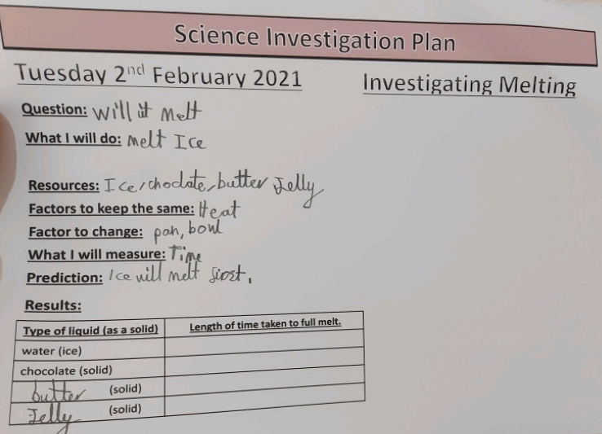
Ollie has planned his ‘melting’ Science investigation today.

Slide 9
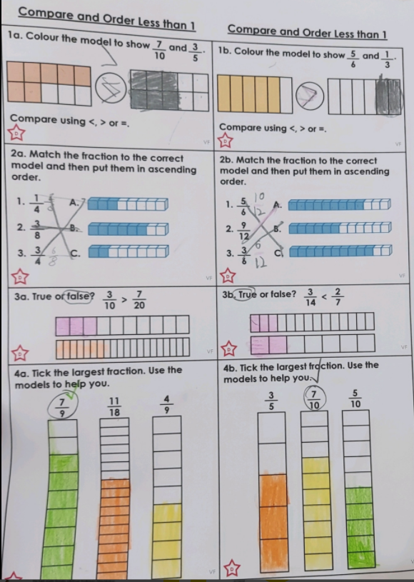
Ollie has worked hard today in his fractions work in maths

Slide 10
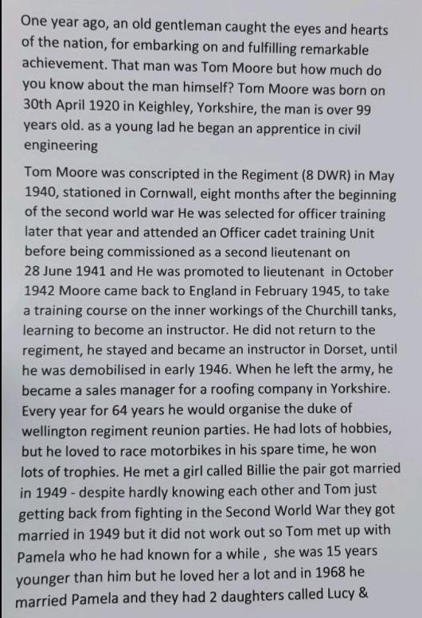
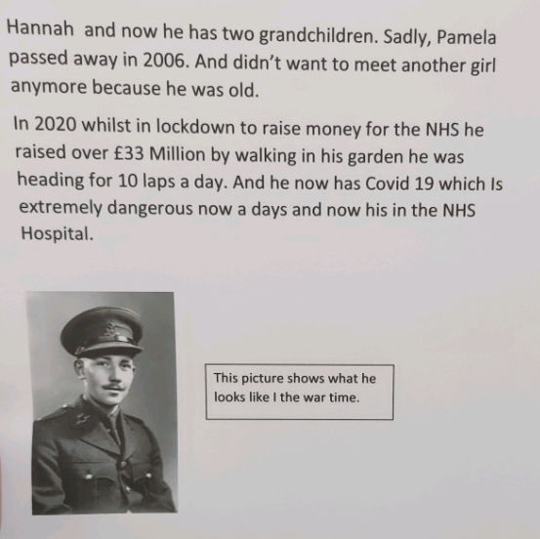
Ollie has completed his Captain Tom biography today.

Slide 11
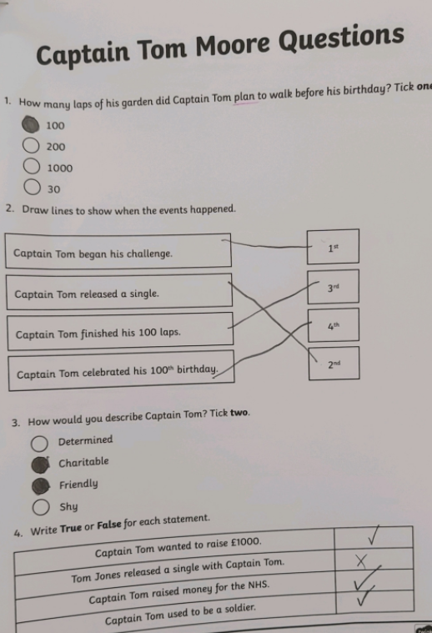
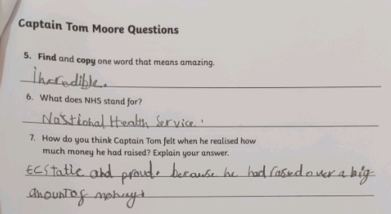
Ollie has been reading his text well about the life of Captain Tom

Slide 12
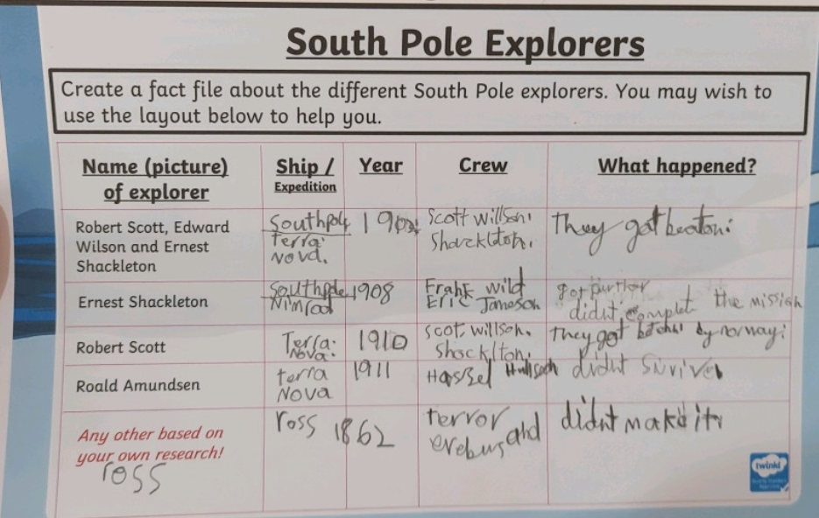
Ollie has been researching the expeditions of these polar explorers.

Slide 13
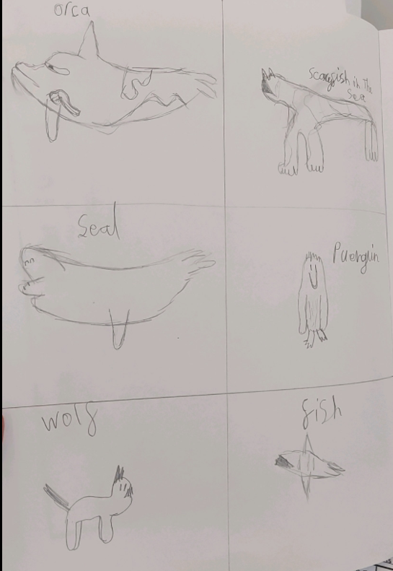
Ollie’s Arctic animals art work

Slide 14
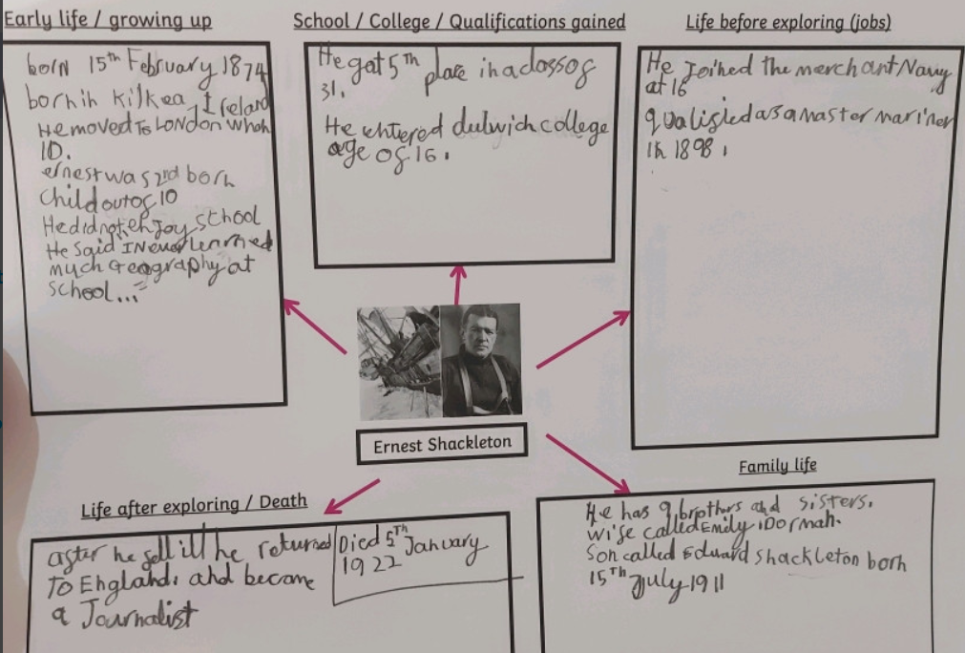
Ollie has gathered his research about Ernest Shackleton

Slide 15
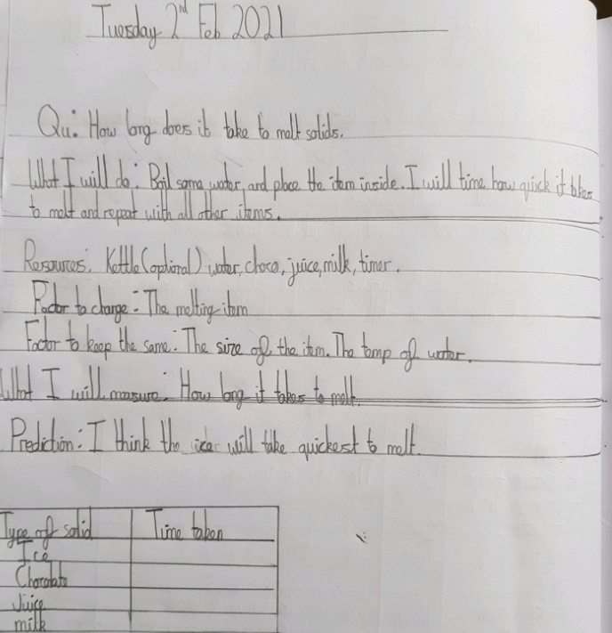
Cameron has planned and started his Science ‘melting’ investigation.

Slide 16
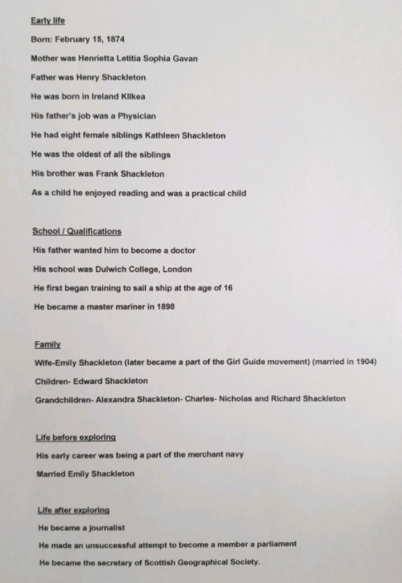
Cameron has gathered all of his research into the life of Ernest Shackleton

Slide 17
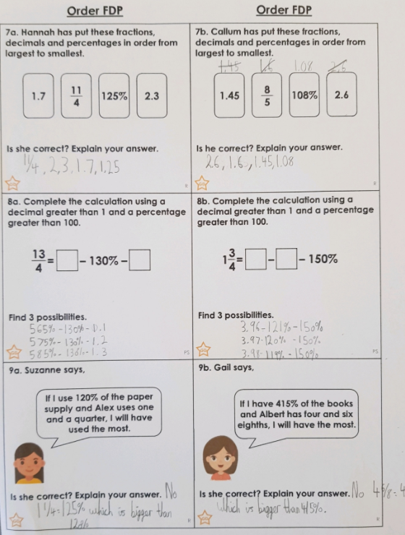
Cameron has ordered his decimals, fractions and percentages today.

Slide 18
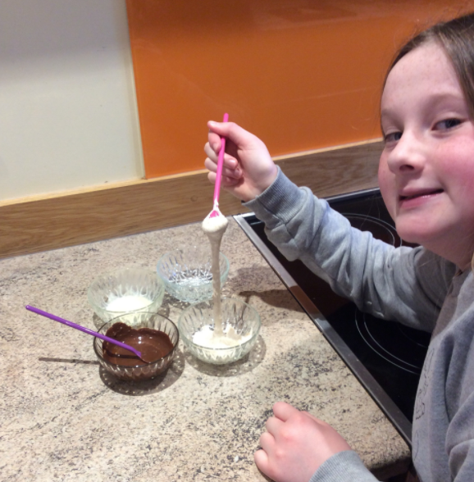
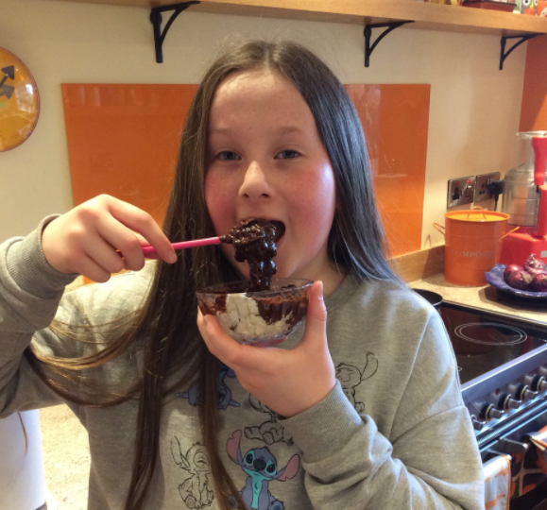
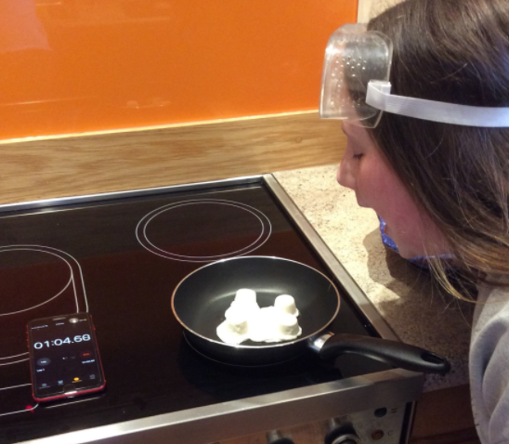
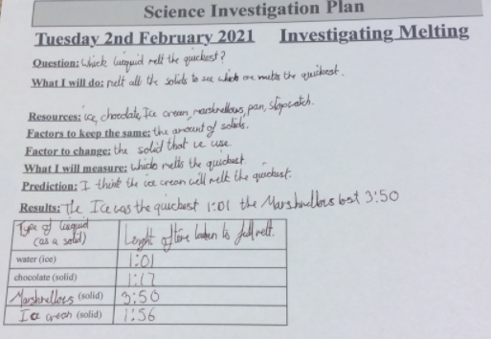
Holly has been investigating melting today in Science.

Slide 19
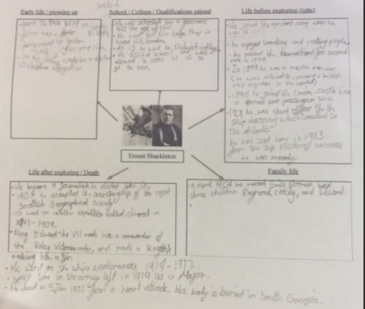
Holly H has gathered her research about Ernest Shackleton

Slide 20
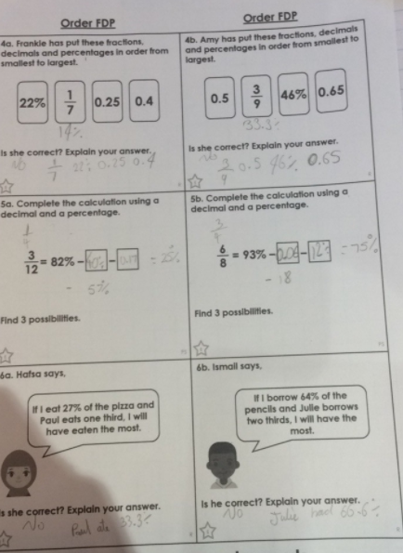
Holly H has been ordering decimals, fractions and % in maths today.

Slide 21
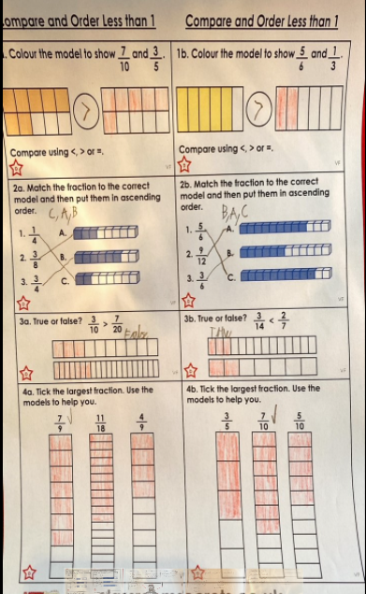
Sam has put these fractions in size order by using understanding of equivalent fractions to help him as well as the diagrams.

Slide 22
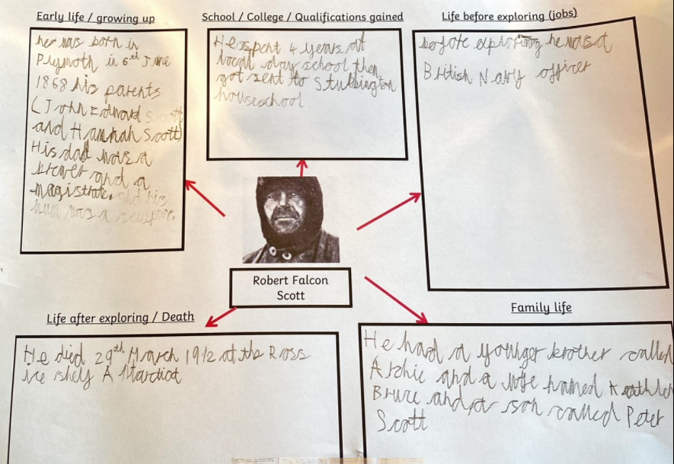
Sam has gathered his research about the explorer Scott.

Slide 23
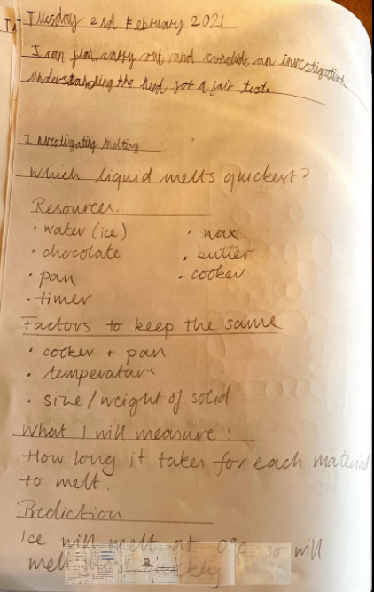
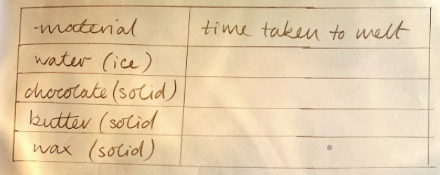
Sam has planned his Science investigation today and will be ready to start melting once they’ve been taken out of the freezer.

Slide 24
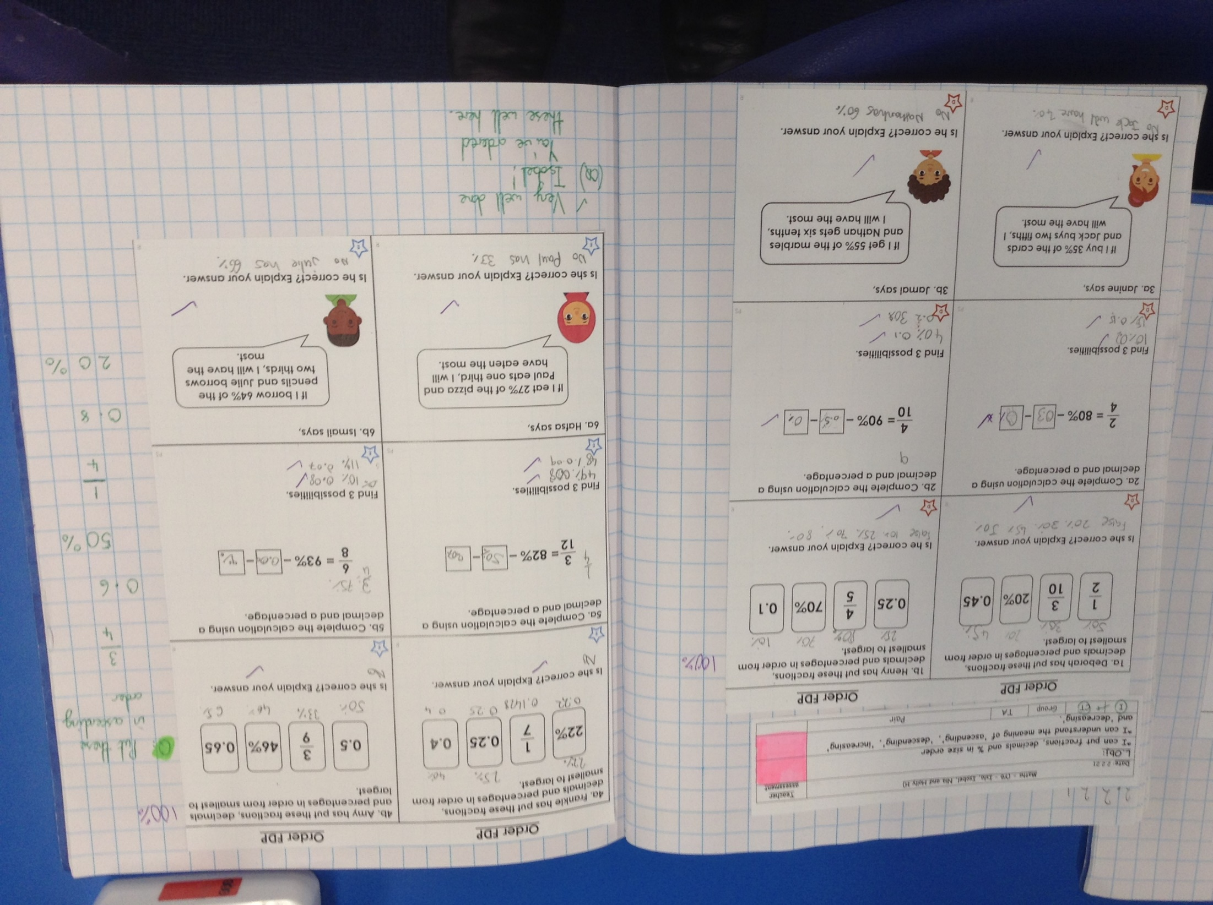
Isobel has been thinking hard to order these fractions, decimals and % in maths.

Slide 25
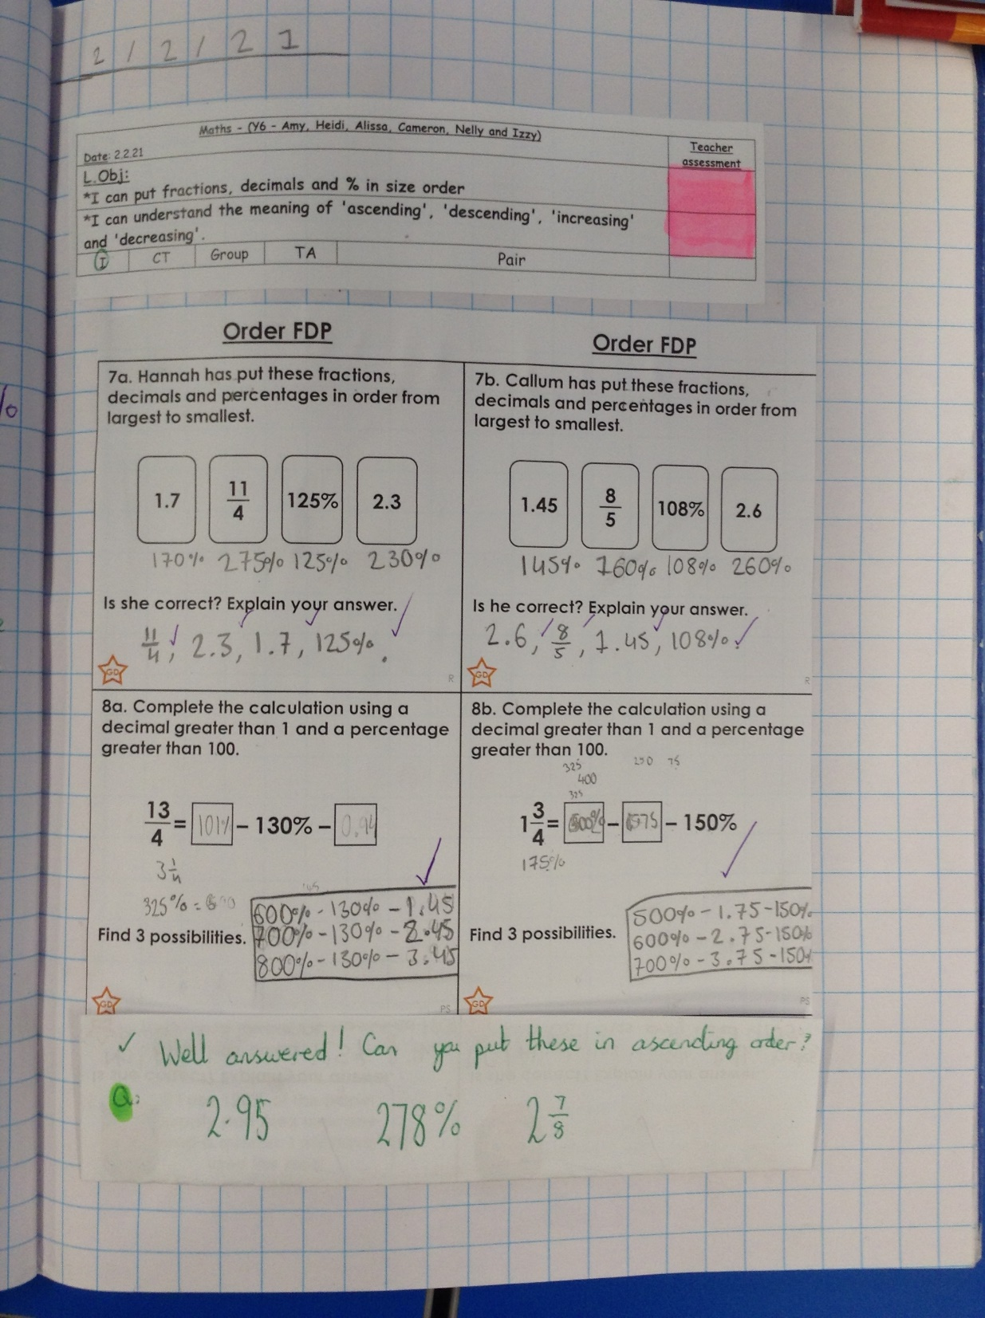
Heidi has ordered these fractions, decimals and % very well, including improper and mixed fractions.

Slide 26
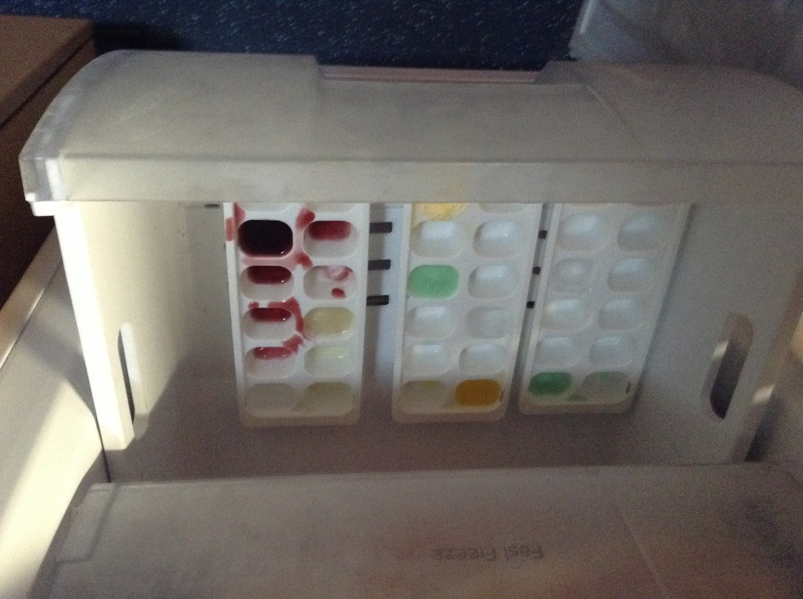
The children in the class have been investigating melting using butter, water, blackcurrant, washing up liquid and orange cordial.
Which do you think will melt the quickest?

Slide 27
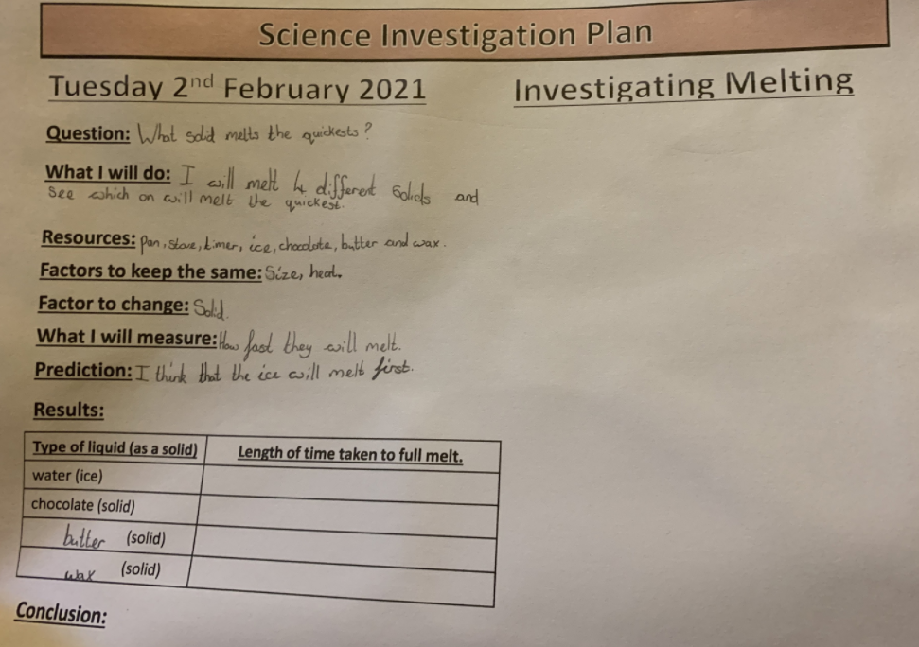
Sophie Collins has planned her ‘melting’ investigation and will soon be ready to gather her results.

Slide 28
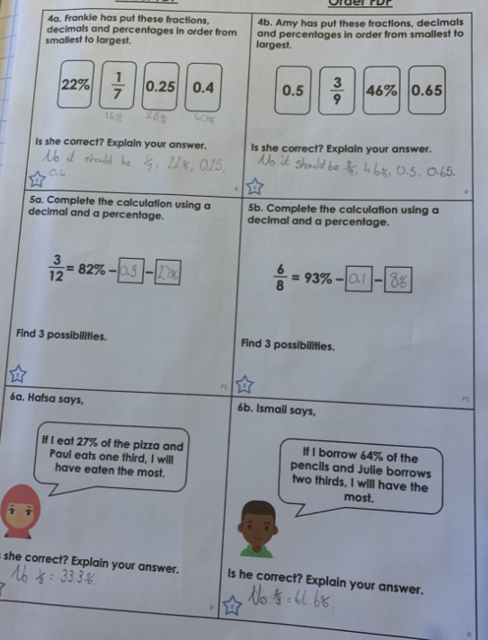
Sophie Collins has converted each of her decimals and fractions into % to help her to order them.

Slide 29
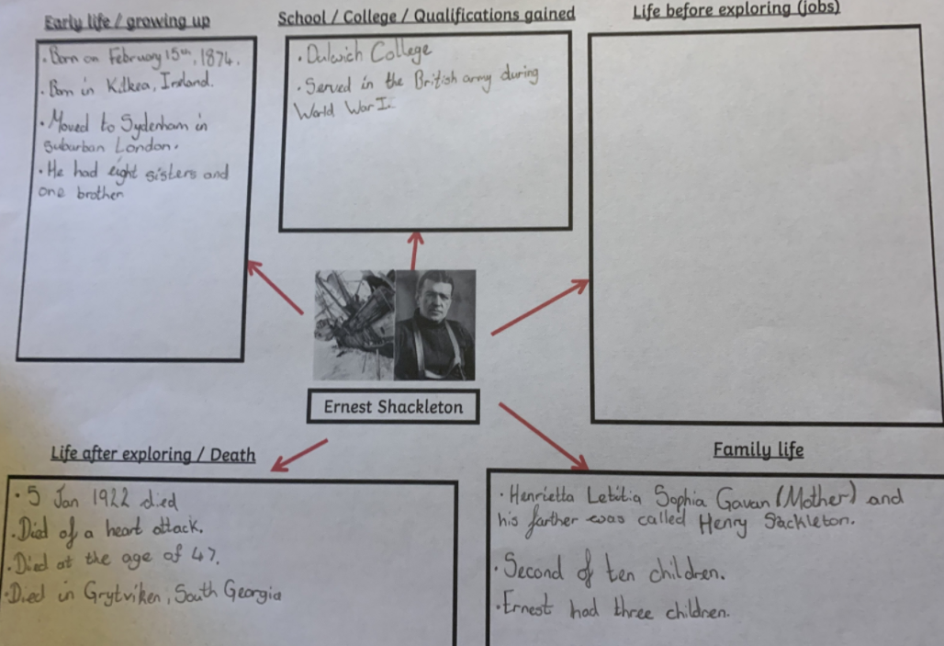
Sophie Collins has been gathering her research about Ernest Shackleton.

Slide 30
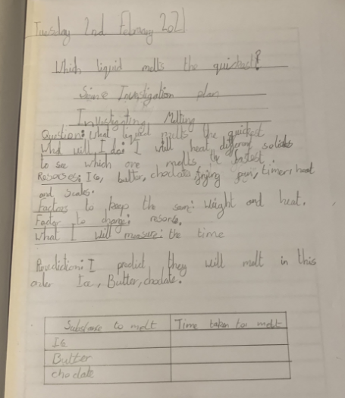
Great planning here of Alex’s Science investigation.
I agree with your prediction Alex.

Slide 31
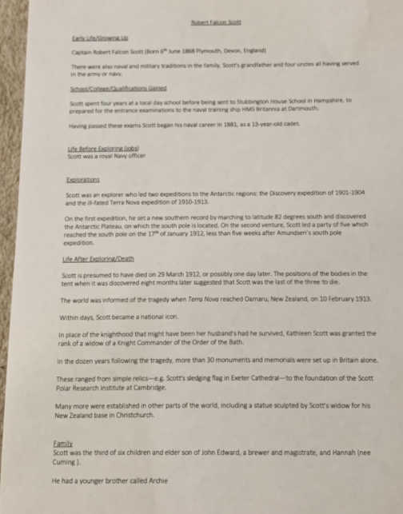
Alex has been researching really thoroughly to gather as much information as he could about Robert Falcon Scott.
You can use some of Alex’s notes to help you in your own research.

Slide 32
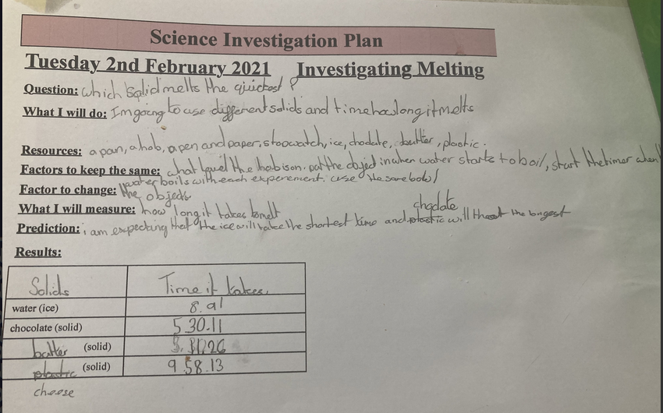
Isla has planned and carried out her ‘melting’ investigating today.

Slide 33
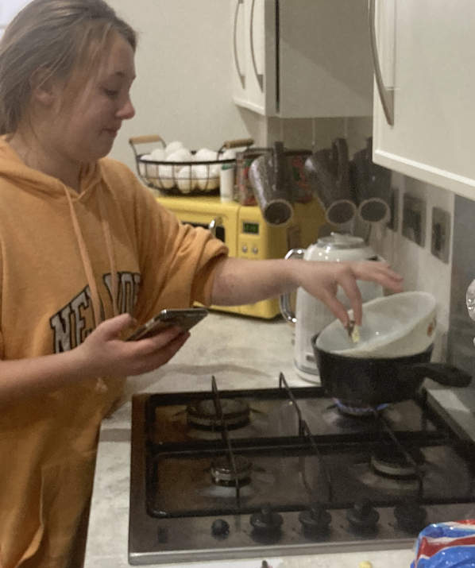
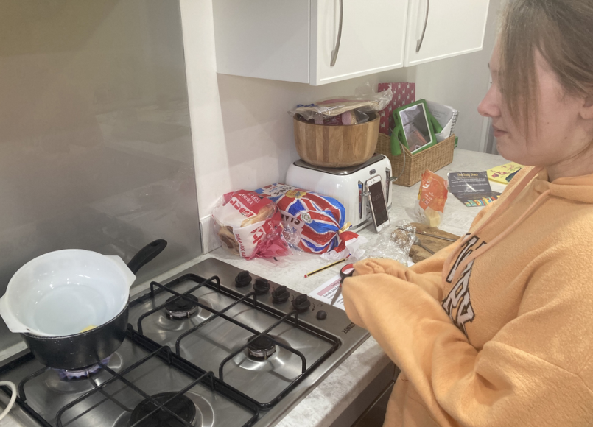
Isla being investigative in her kitchen

Slide 34
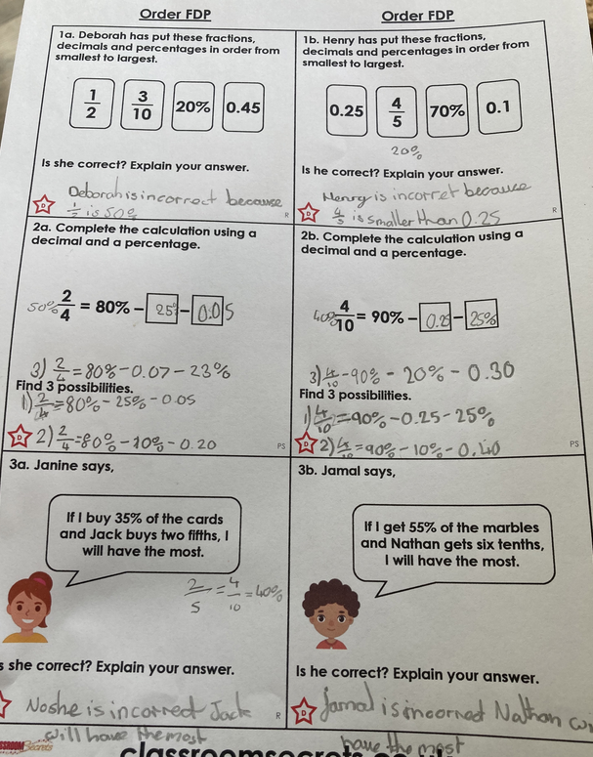
Isla turned her decimals and fractions into % to help her to order them or solve which was the largest.

Slide 35
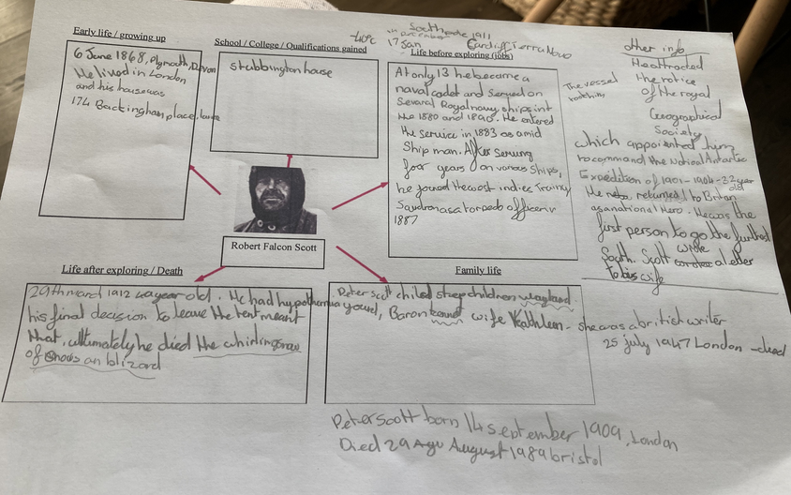
Isla has been gathering a lot of notes about Robert Falcon Scott as part of her research.

Slide 36
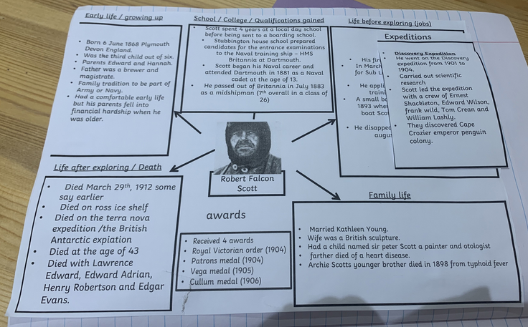
Zoe has been gathering a lot of notes about Robert Falcon Scott as part of her research.

Slide 37
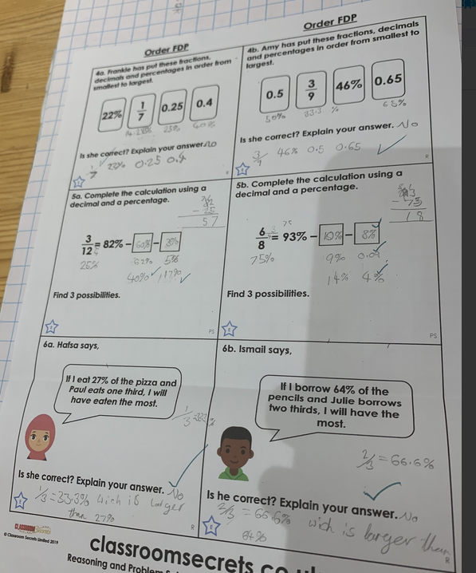
Zoe has converted her fractions and decimals into % very well here to help her on her maths today.

Slide 38
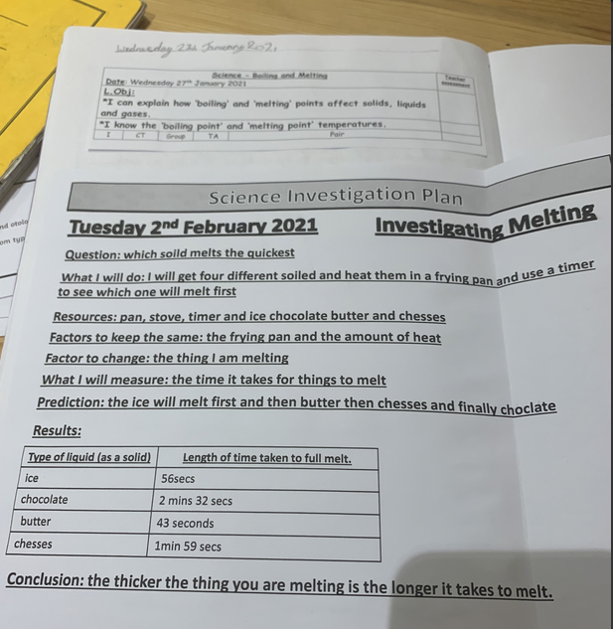
Zoe investigated whether ice, chocolate, butter or cheese melted first.
Look at her results.

Slide 39
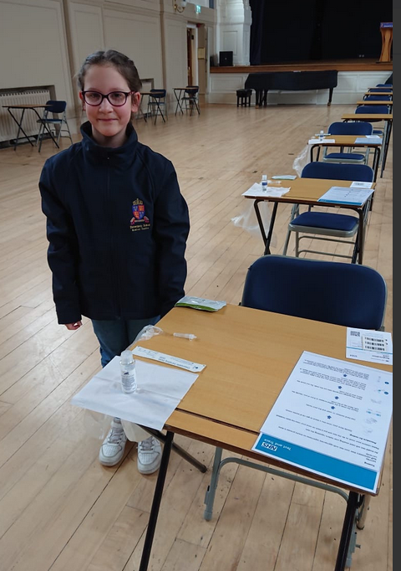
Ariana was setting up Covid-19 stations at Shrewsbury School today.

Slide 40
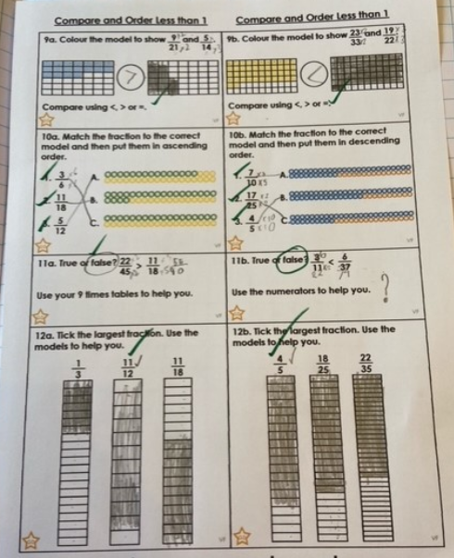
Dylan has been using equivalent fractions to help him to put these fractions in size order.

Slide 41
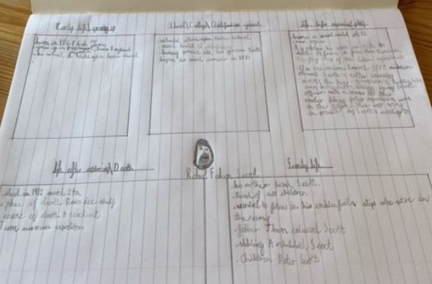
Dylan has been researching about the life of Robert Falcon Scott for his biography.

Slide 42
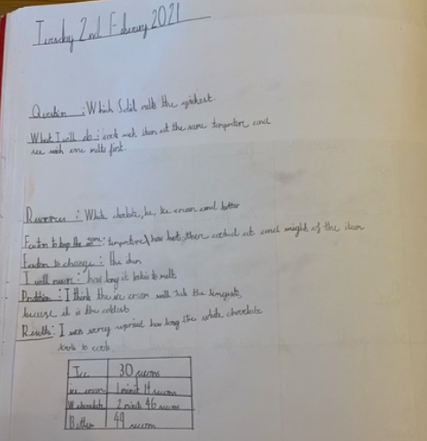
Dylan’s Science ‘melting’ investigation consisted of butter, chocolate, ice and ice cream.
Look at the results to see which melted first.

