Slide 1
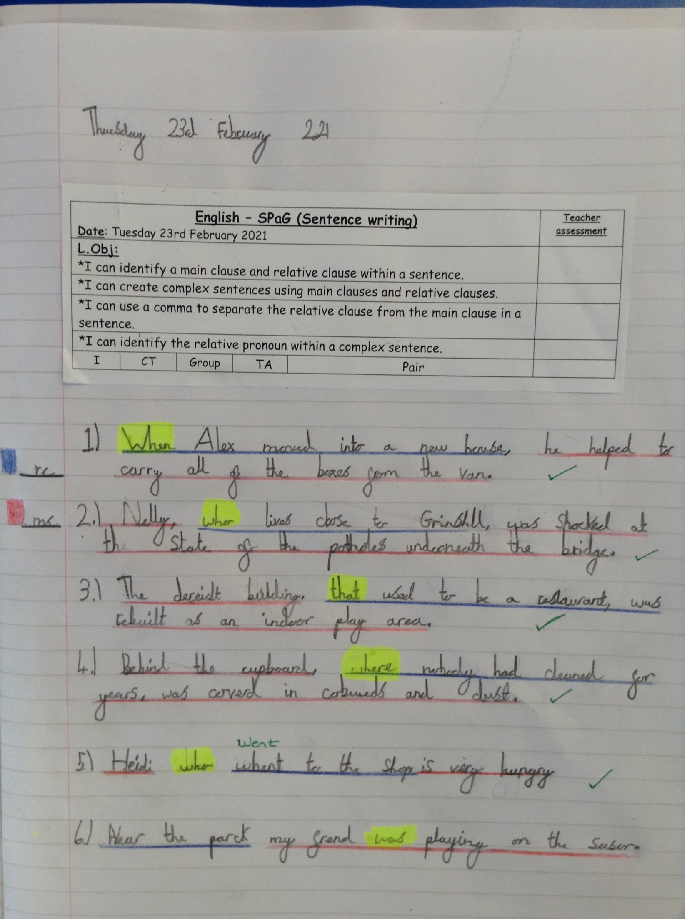
Sophie Carr has created her complex sentences today using relative clauses.

Slide 2
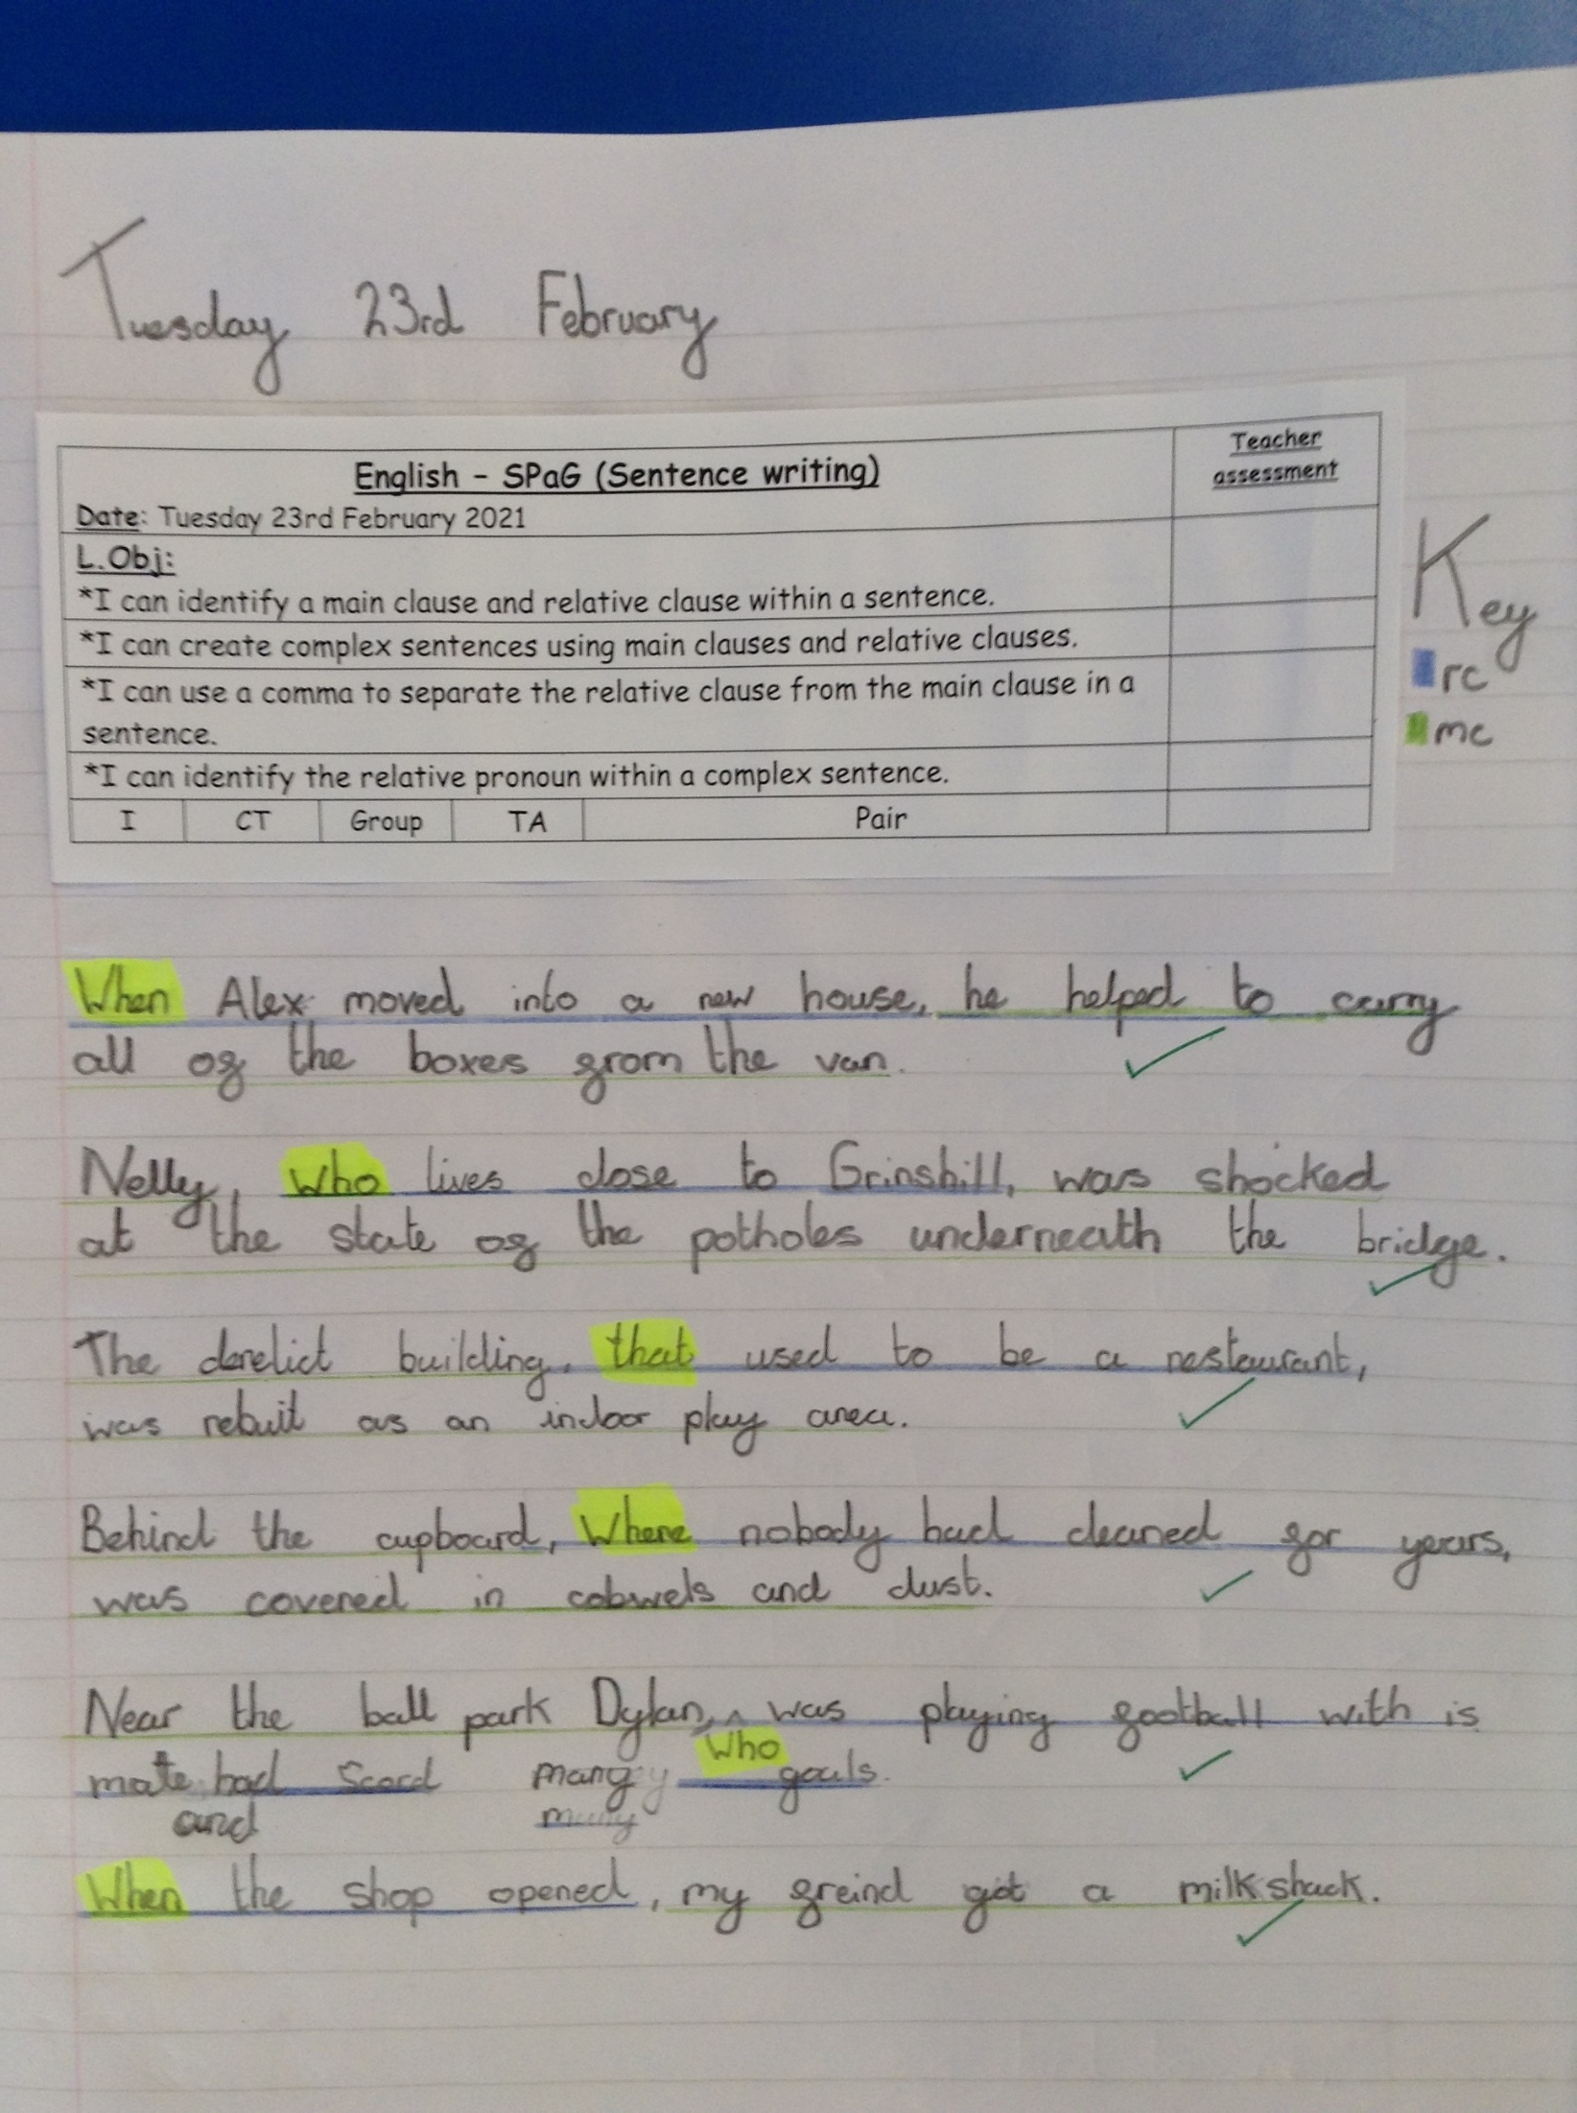
Alfie has created his complex sentences today using relative clauses.

Slide 3
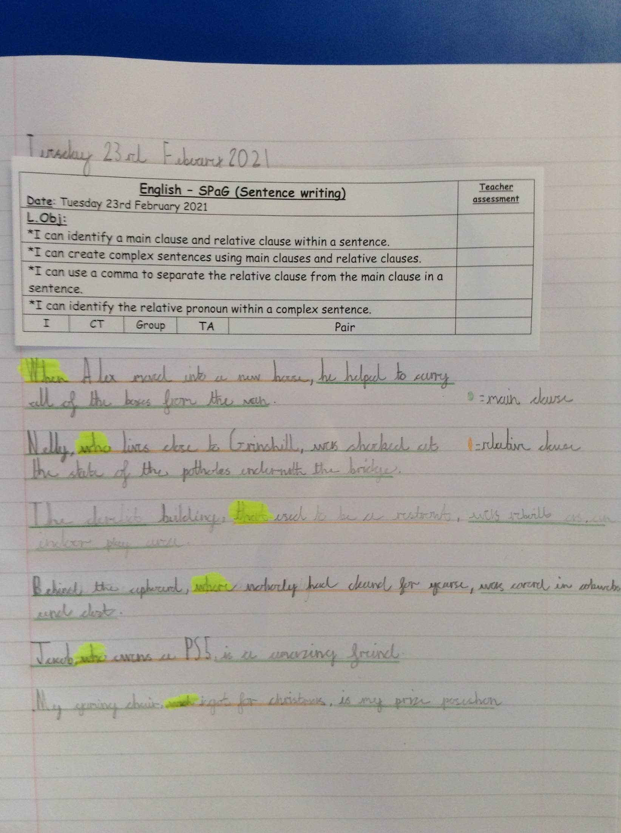
Dylan has created his complex sentences today using relative clauses.

Slide 4
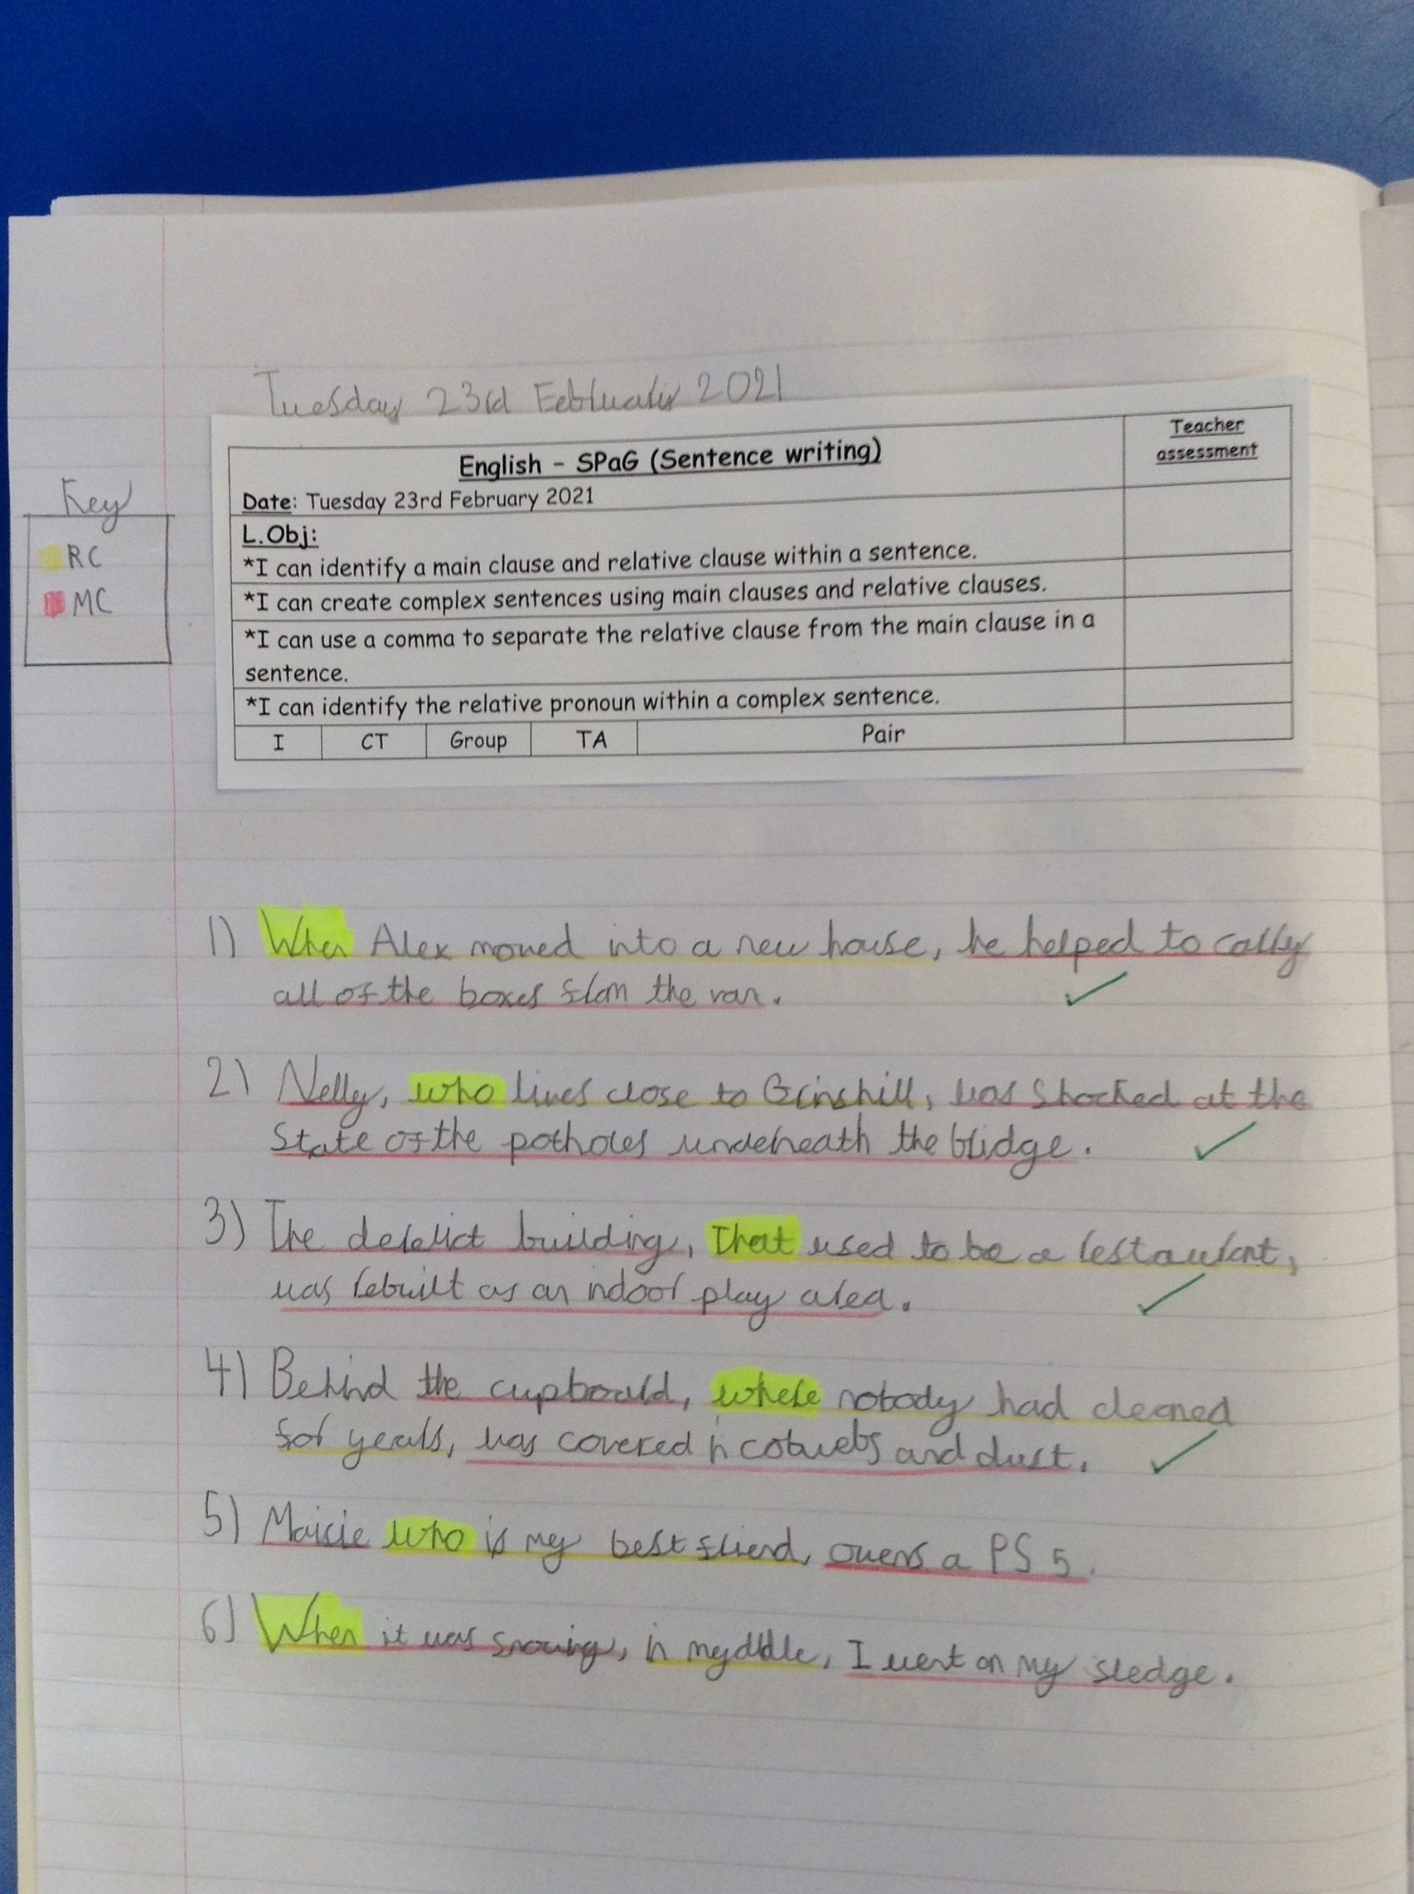
Esme has created her complex sentences today using relative clauses.

Slide 5
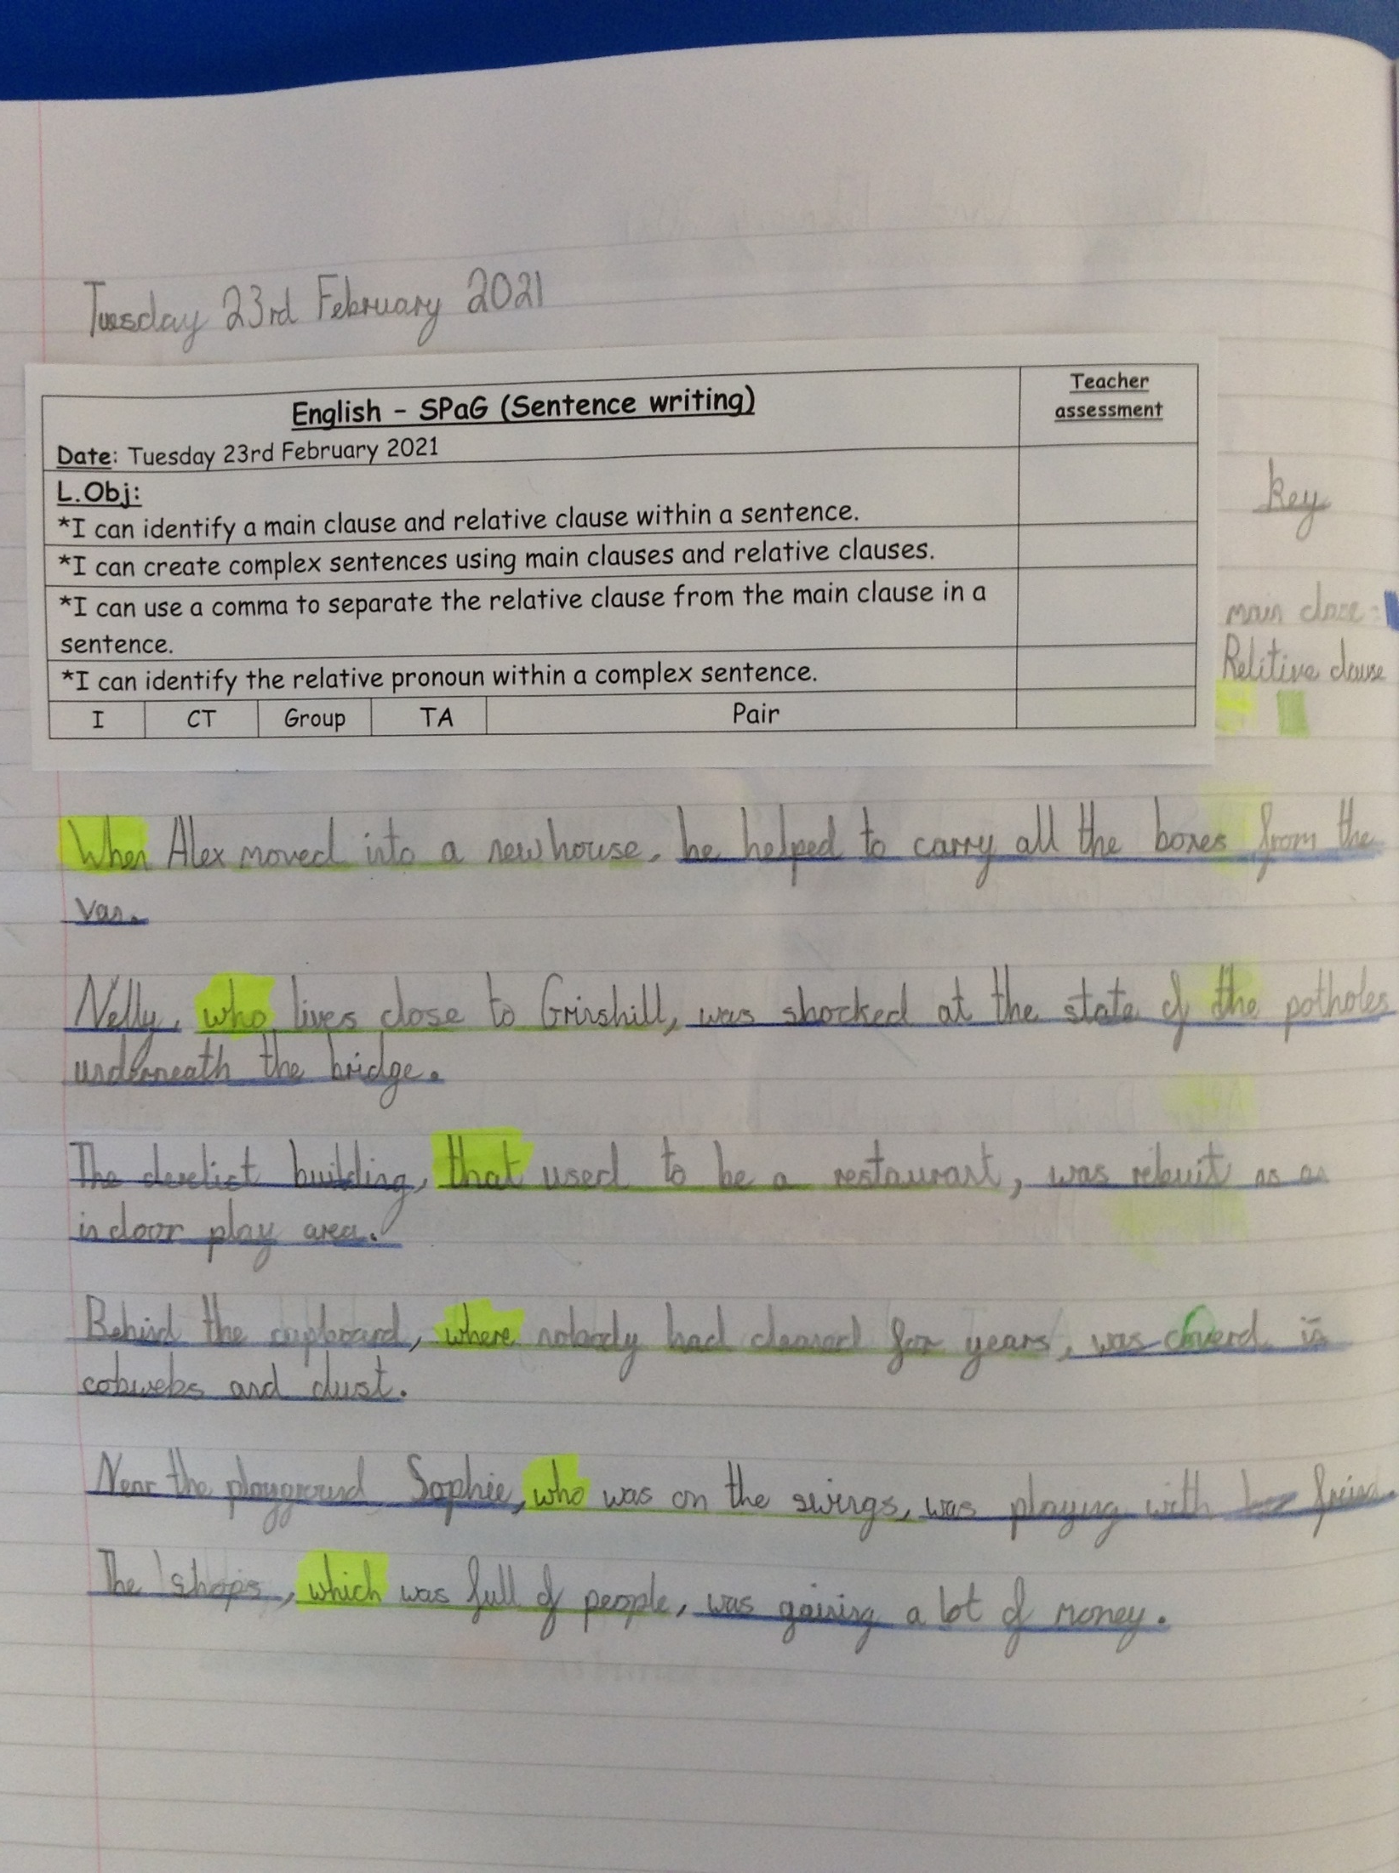
Cass has created his complex sentences today using relative clauses.

Slide 6
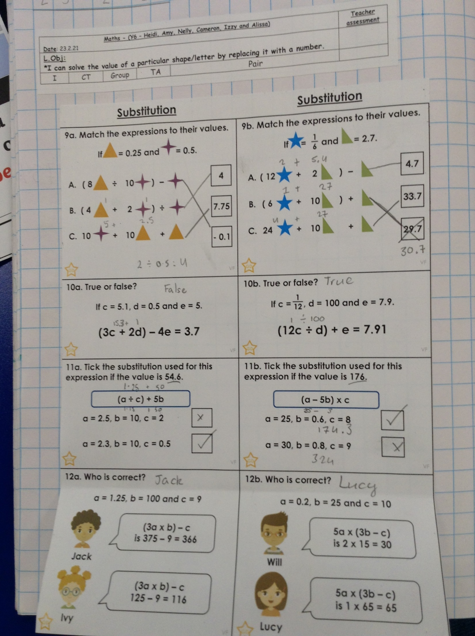
Heidi has been solving the algebra problems and calculations today.

Slide 7
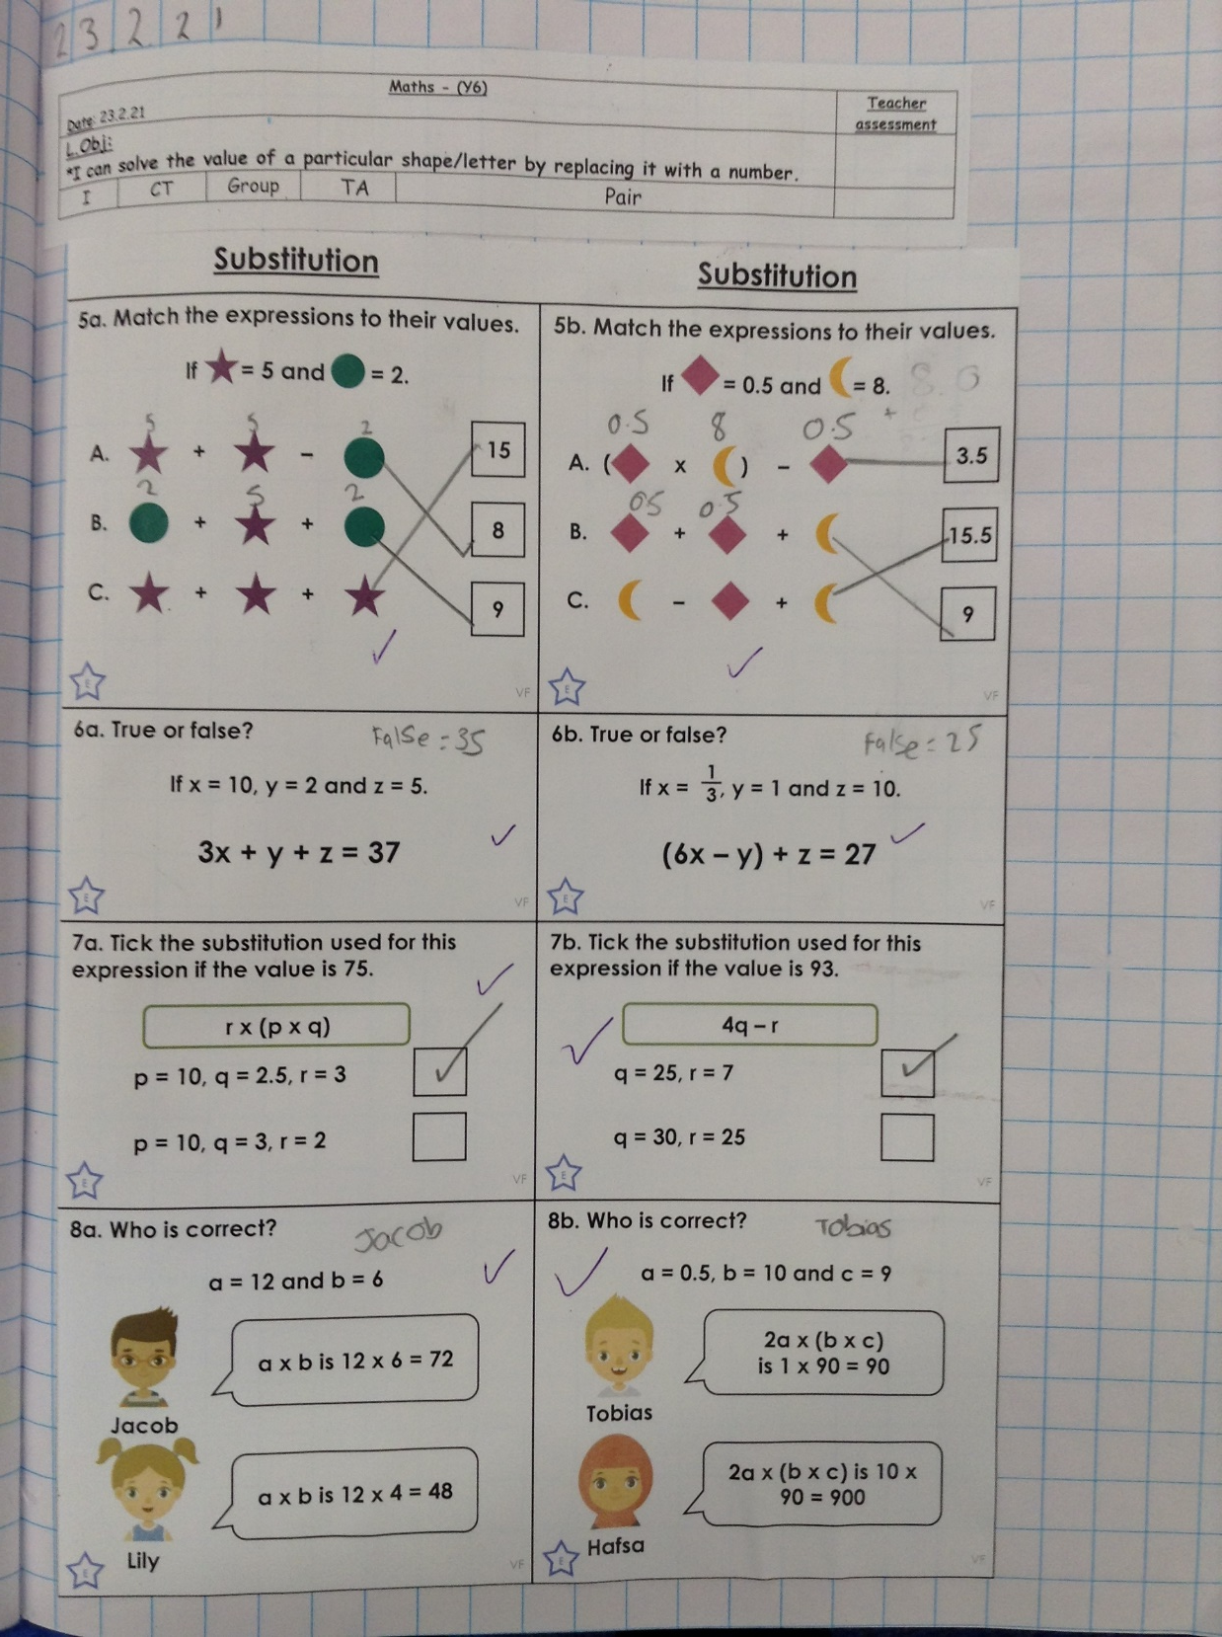
Isobel has been solving the algebra problems and calculations today.

Slide 8
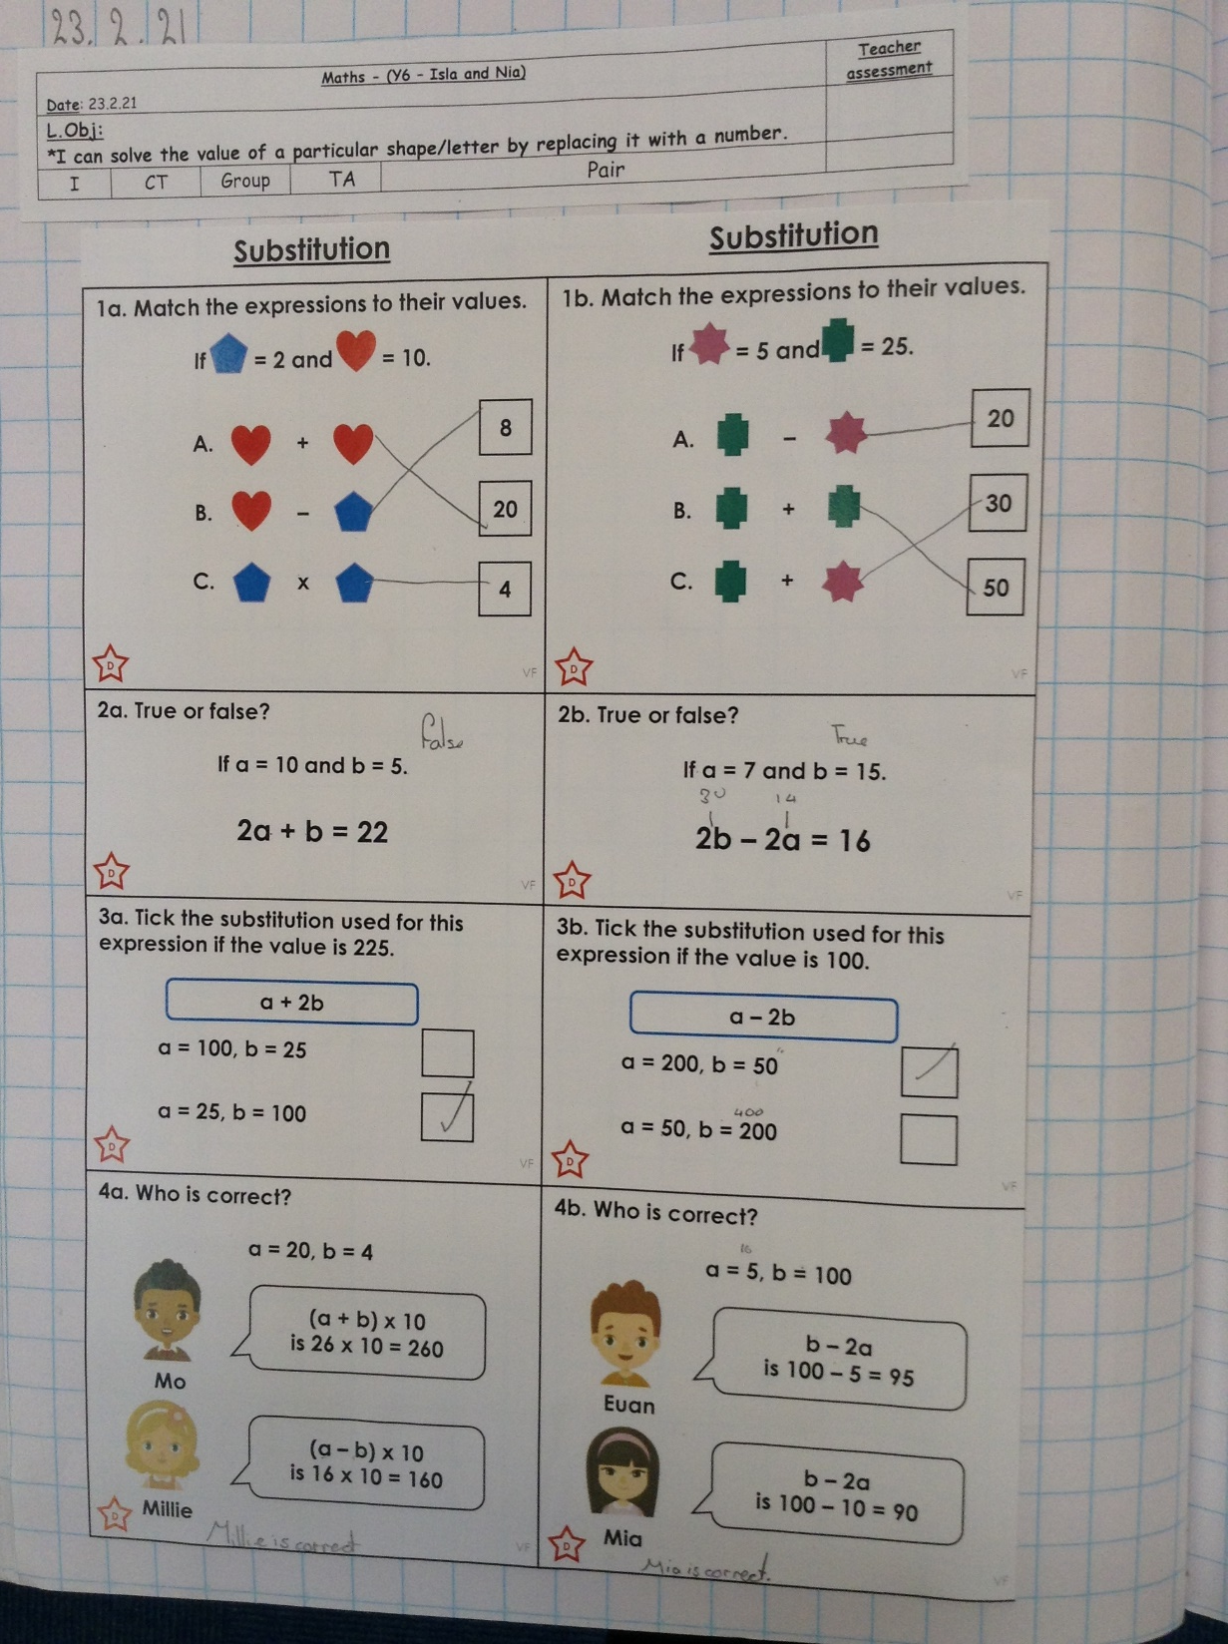
Isla has been solving the algebra problems and calculations today.

Slide 9
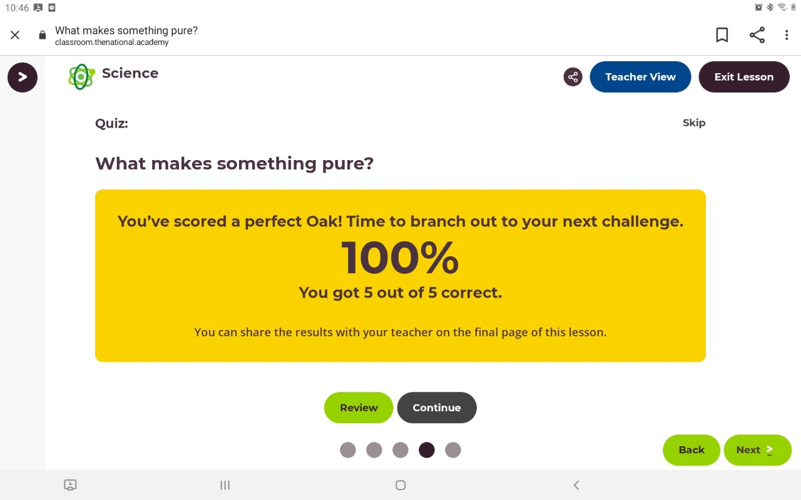
Lilly scored 100% in her Science quiz today.

Slide 10
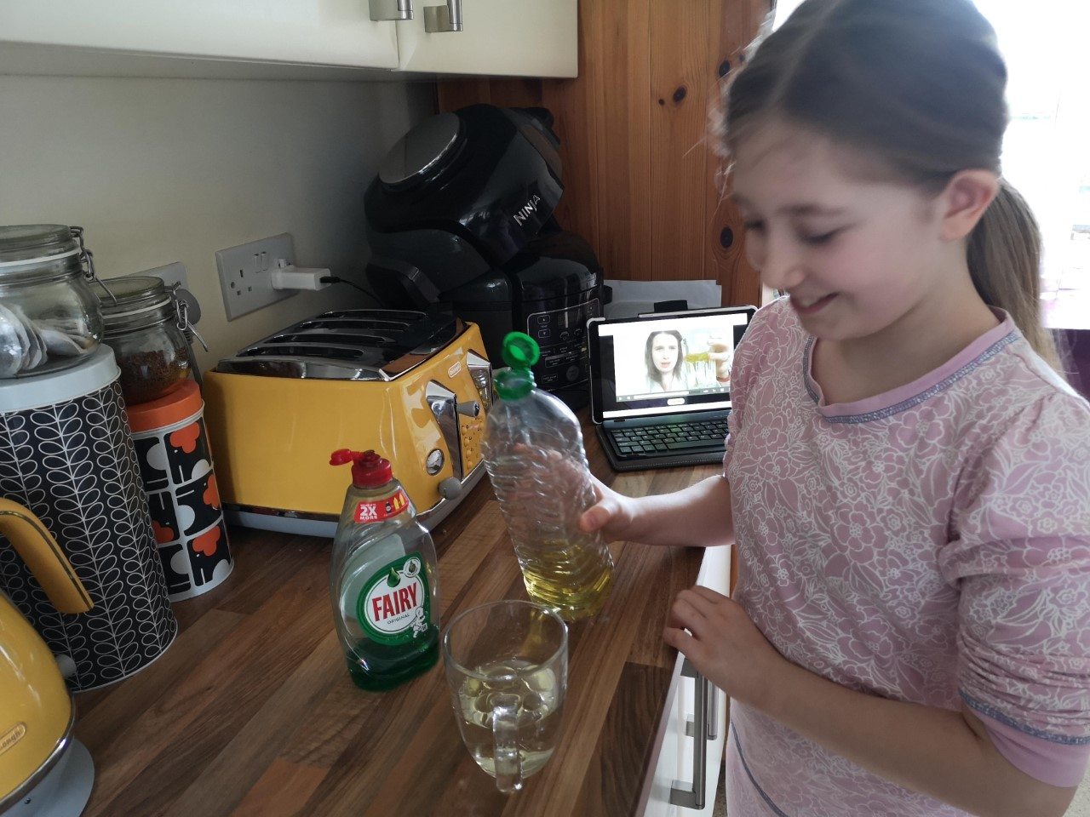
Lilly has been experimenting in Science today.

Slide 11
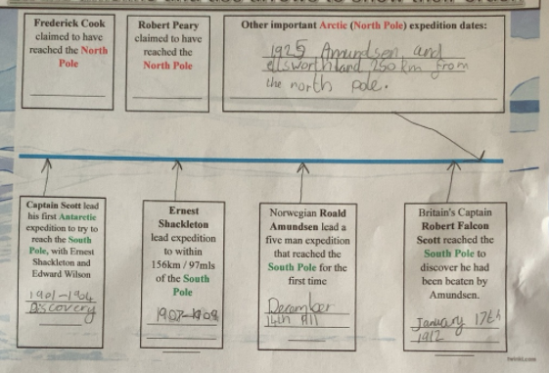
Alex researched yesterday the most famous polar exploration dates.

Slide 12
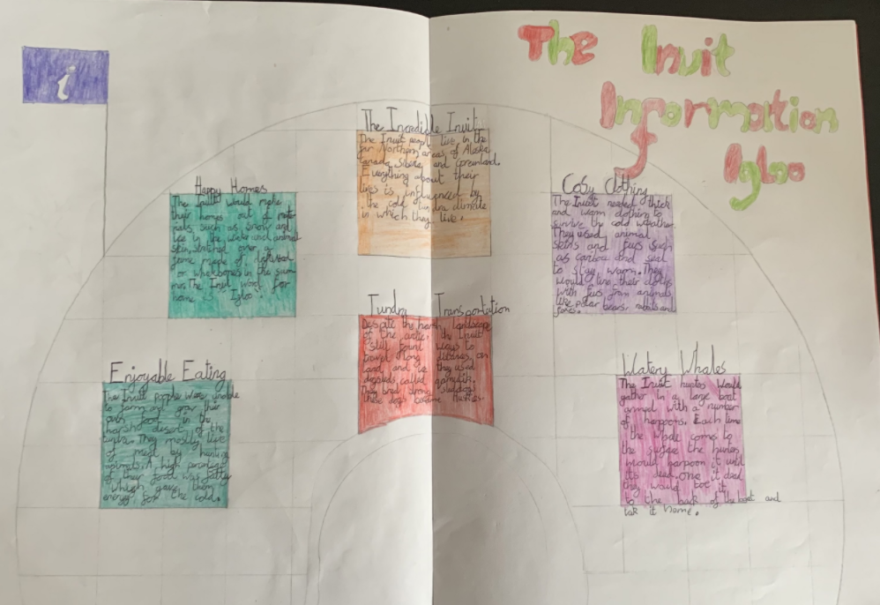
Alex’s Inuit double page spread

Slide 13
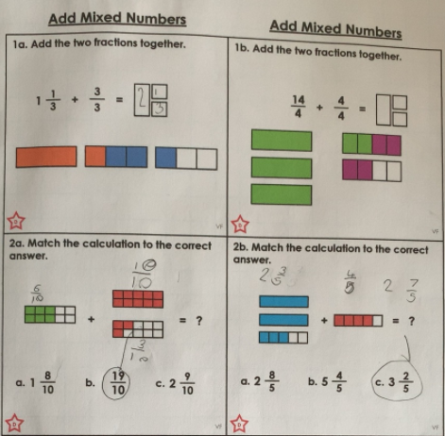
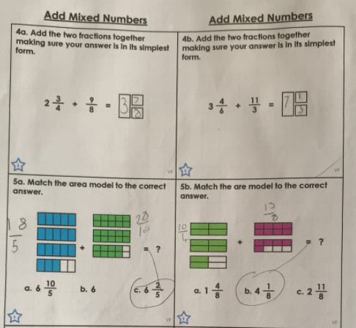
Here’s Alex’s fraction addition calculations from yesterday.

Slide 14
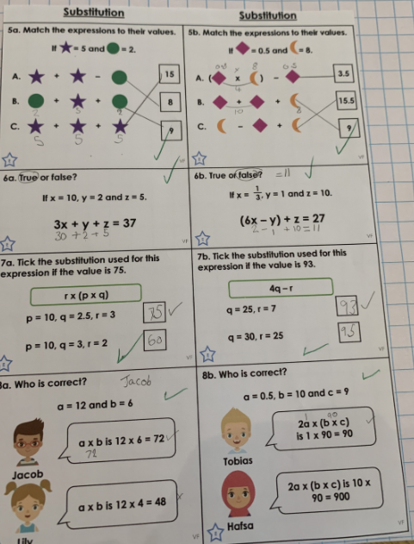
Zoe has whizzed through her algebra based calculations / problems today.

Slide 15
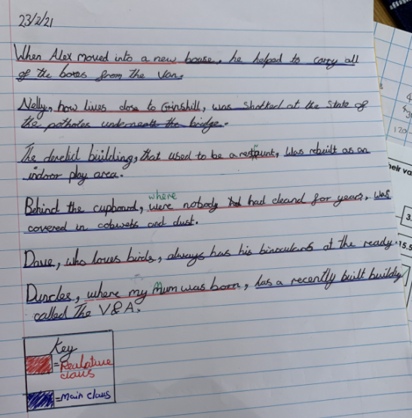
Zoe has been creating complex sentences using relative clauses today.

Slide 16
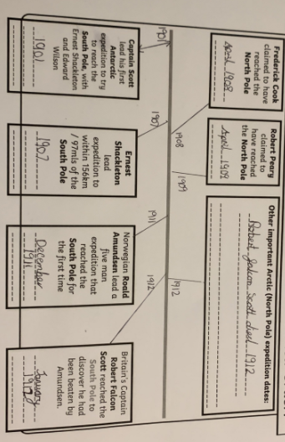
Zoe has researched these major polar exploration dates.

Slide 17
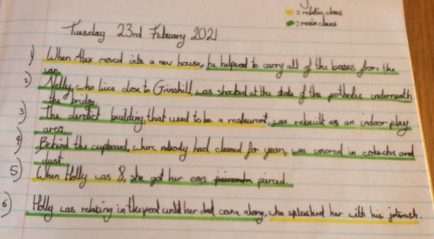
Holly H has identified the relative clauses and main clauses in her complex sentences today.

Slide 18
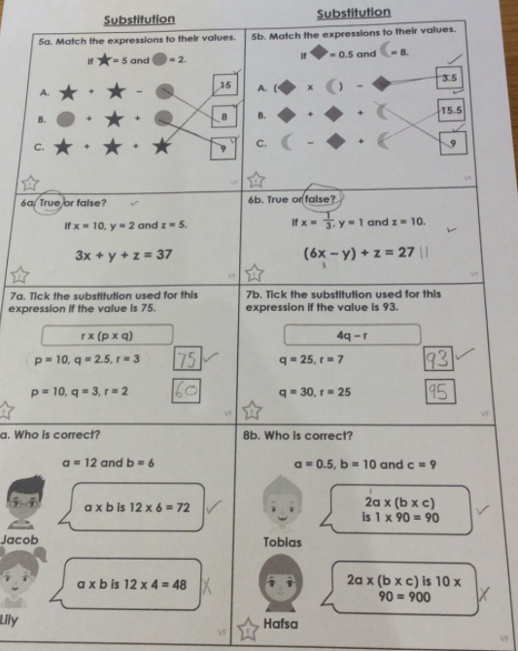
Holly H has completed her algebra based calculations / problems today in maths.

Slide 19
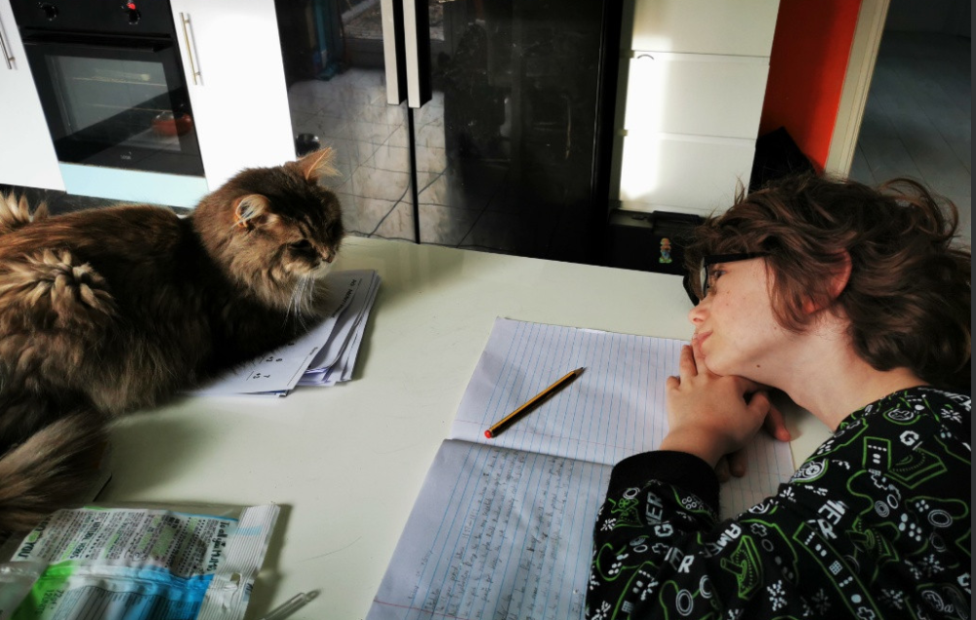
Mojo is disturbing Blake or he’s being a very good paperweight!

Slide 20
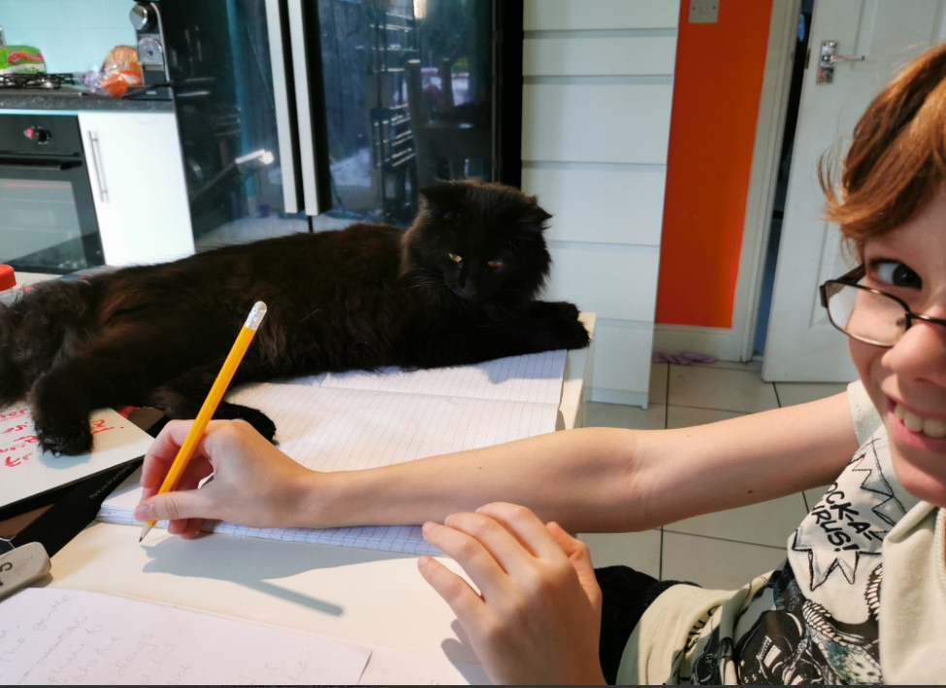
Voodoo is making sure that Blake is focusing on his handwriting.

Slide 21
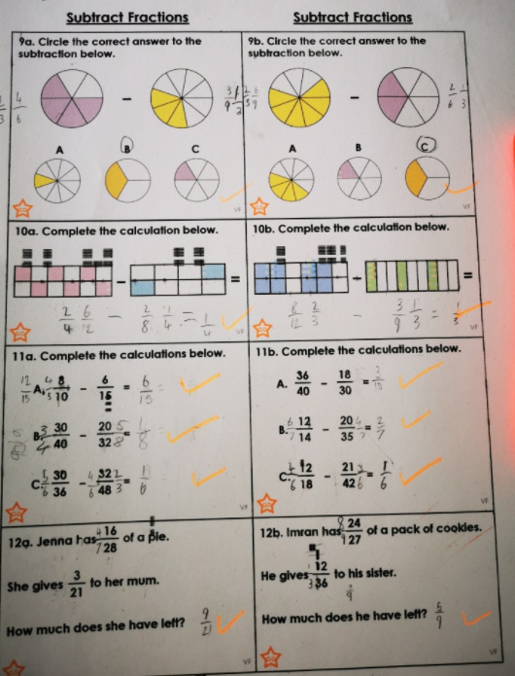
Blake has used his fractions knowledge to help him to subtract these fractions very well today.

Slide 22
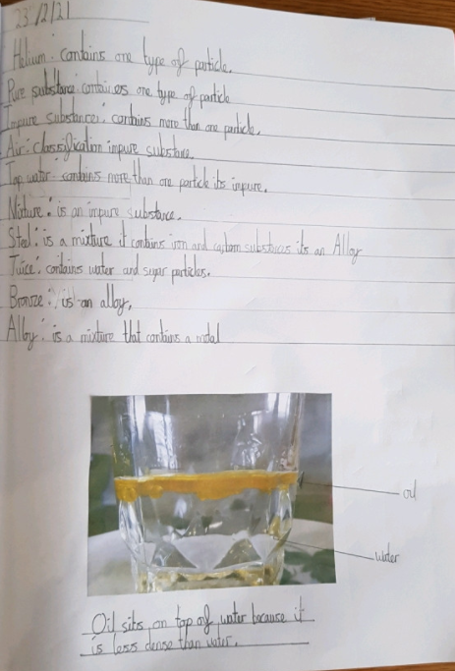
Cameron has produced excellent science today, showing what he has learned as he’s gone along with the video.

Slide 23
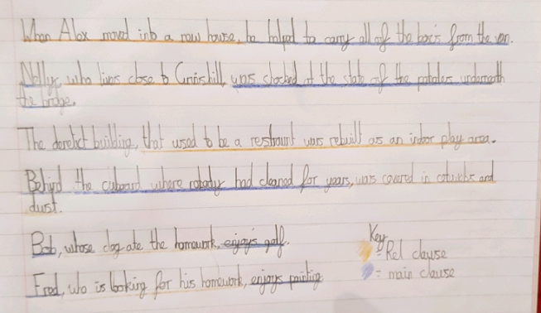
Cameron has identified the relative clauses and main clauses in his sentences today.

Slide 24
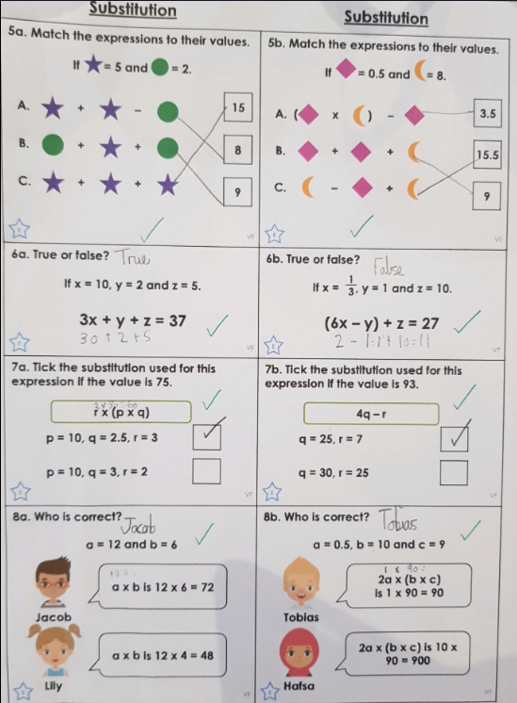
Cameron solved these algebra based calculations / problems very well in maths today.

Slide 25
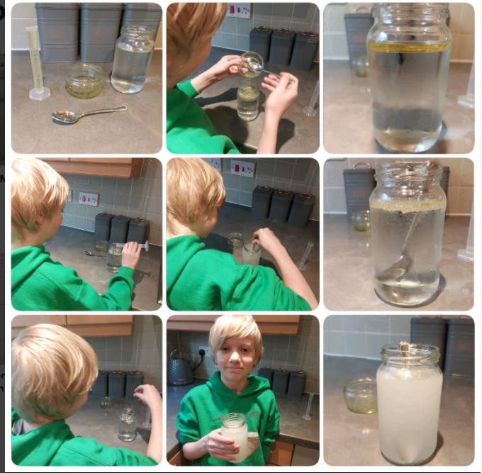
Ollie has been experimenting with mixtures today in science.

Slide 26
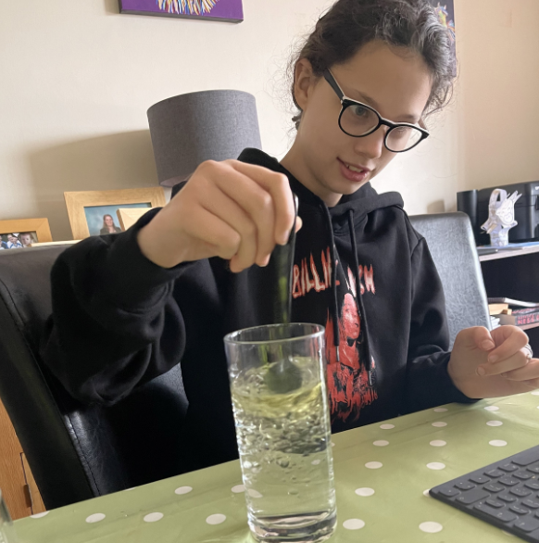
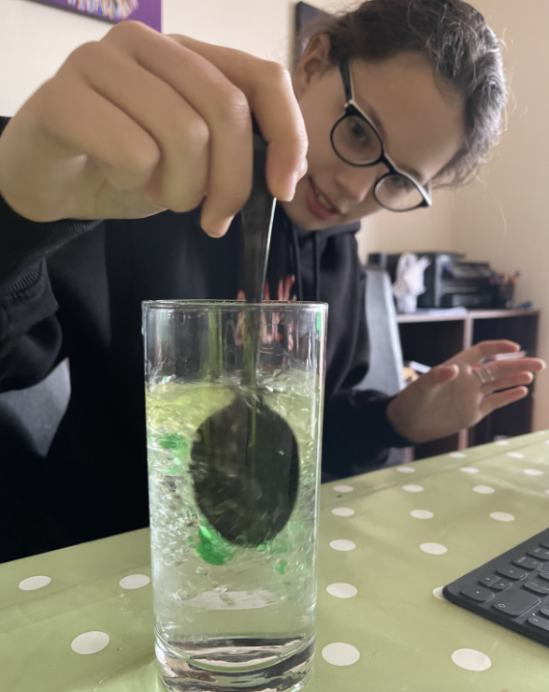
Nelly has followed the video well to experiment with mixtures in Science.

Slide 27
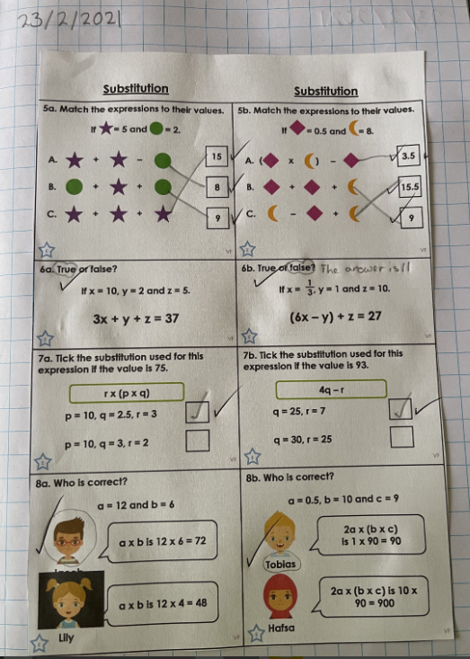
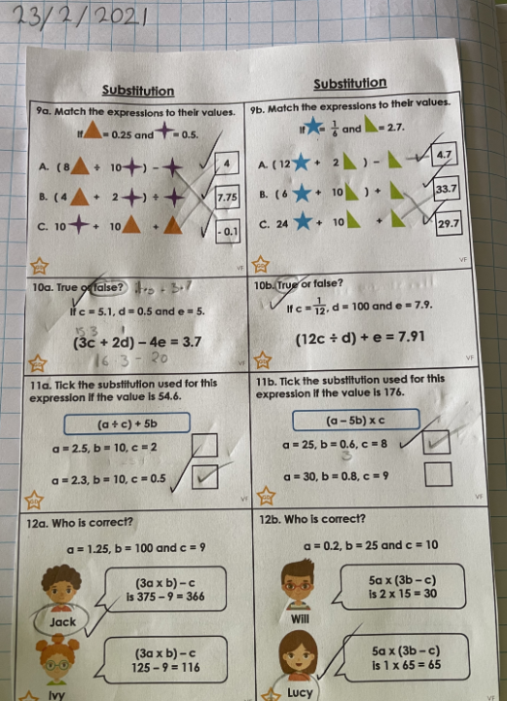
Nelly completed her algebra problems in maths and then wanted to challenge herself.

Slide 28
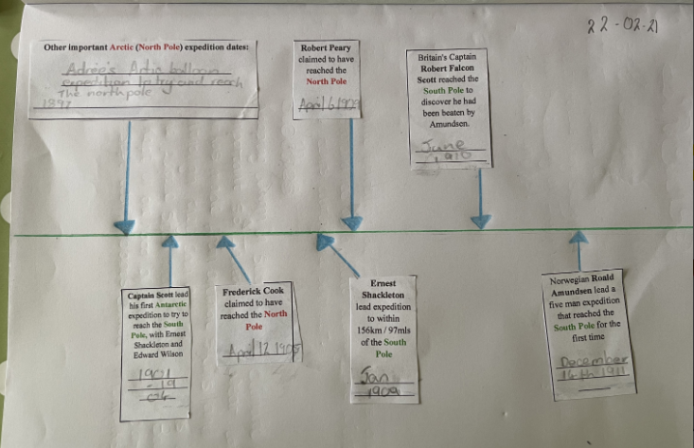
Nelly has been researching the most important dates of polar exploration.

Slide 29
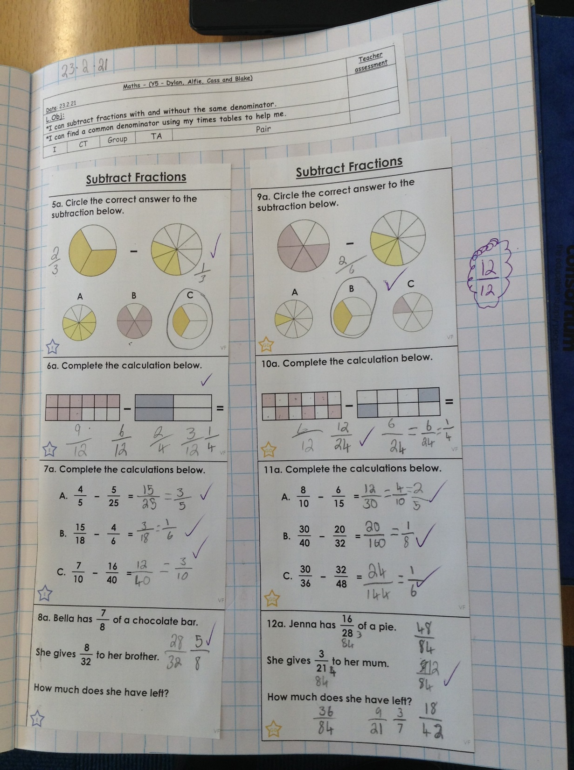
Cass achieved 100% in his fraction subtraction calculations today in maths.

Slide 30
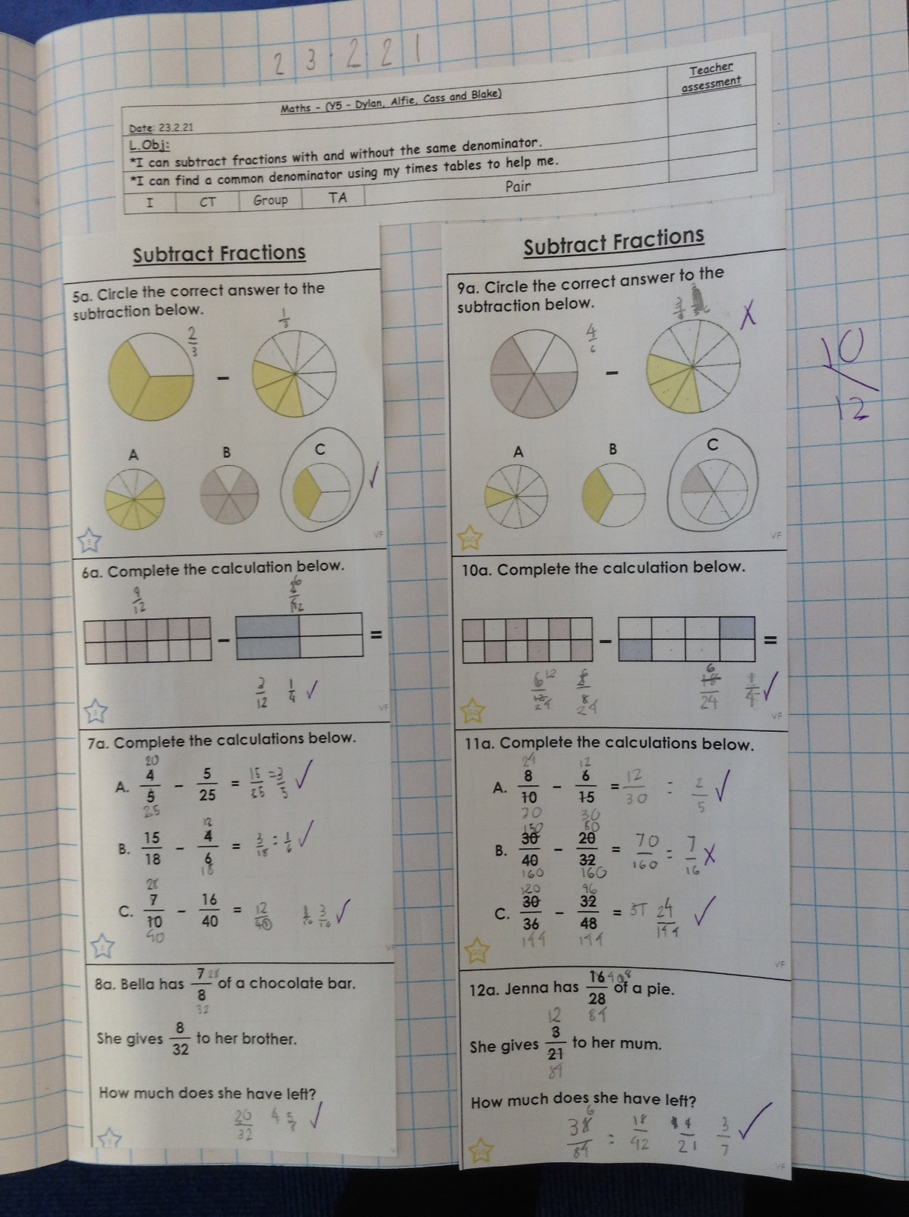
Dylan has been thinking carefully to subtract fractions in maths today.

Slide 31
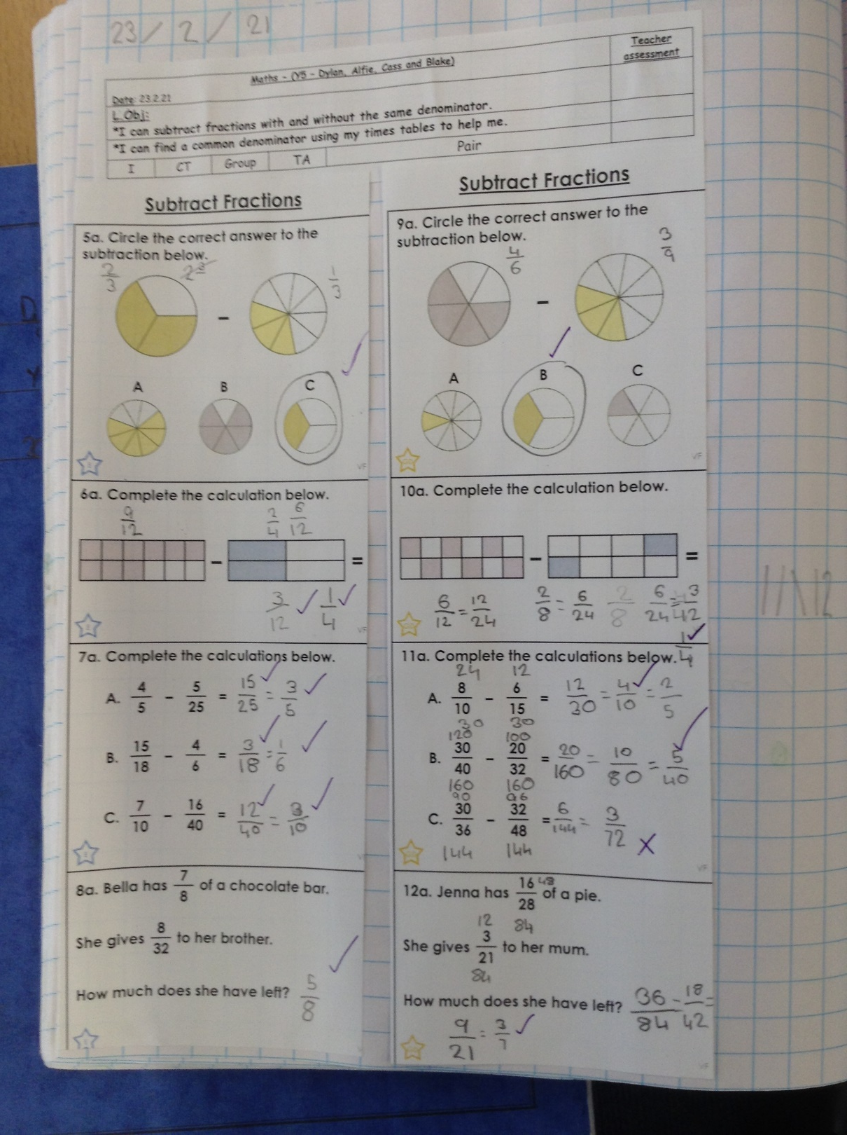
Alfie has shown excellent knowledge of fractions to complete these subtraction calculations today.

Slide 32
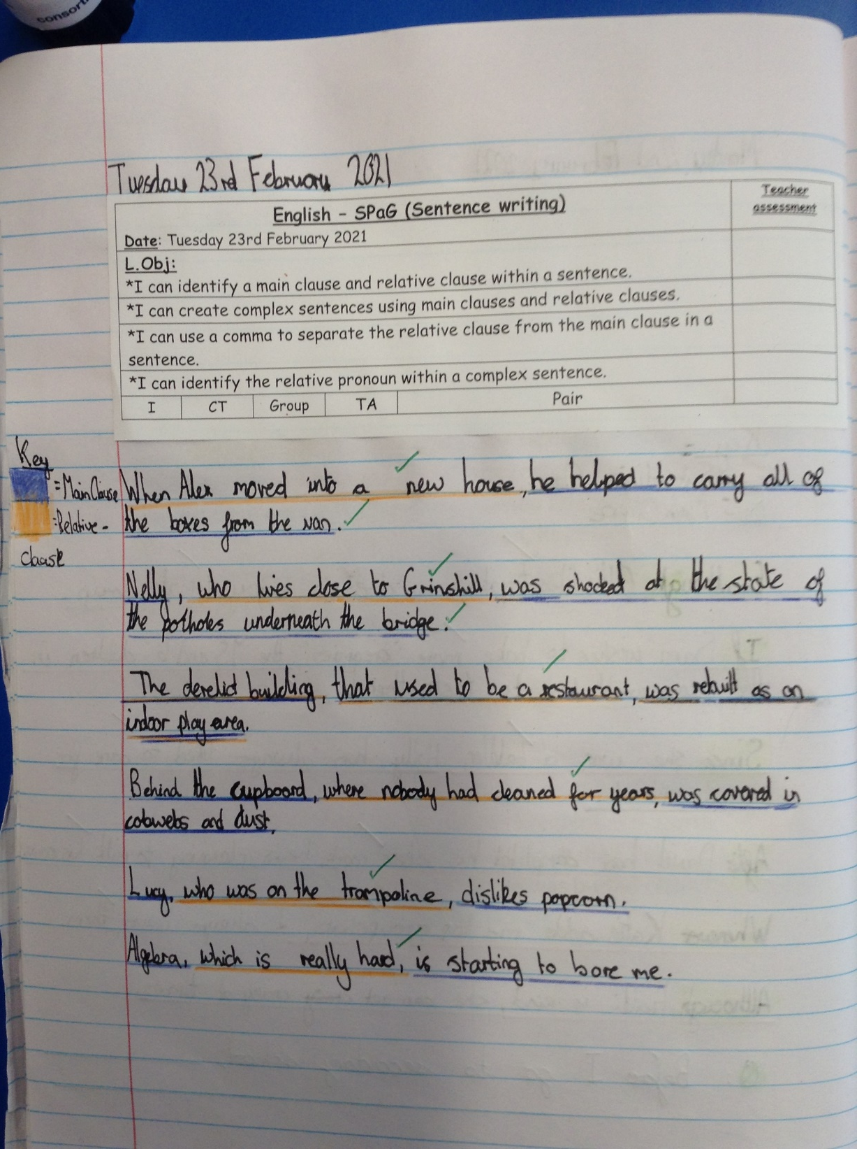
Isobel has created her complex sentences today using relative clauses.

Slide 33
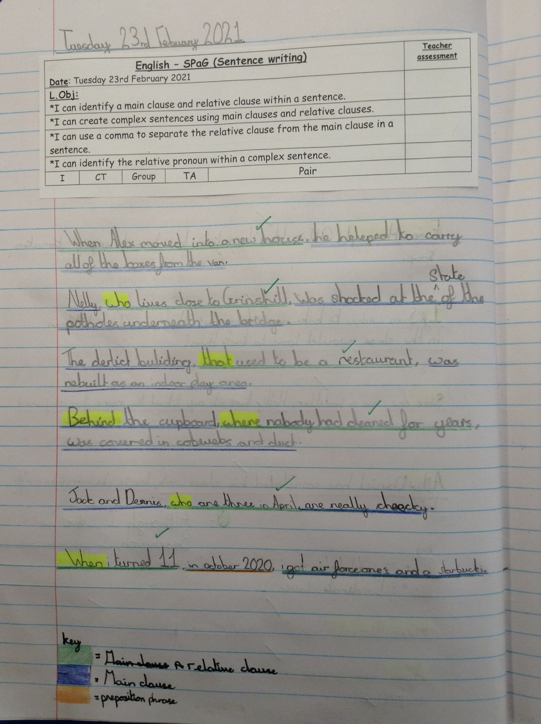
Isla has created her complex sentences today using relative clauses.

Slide 34
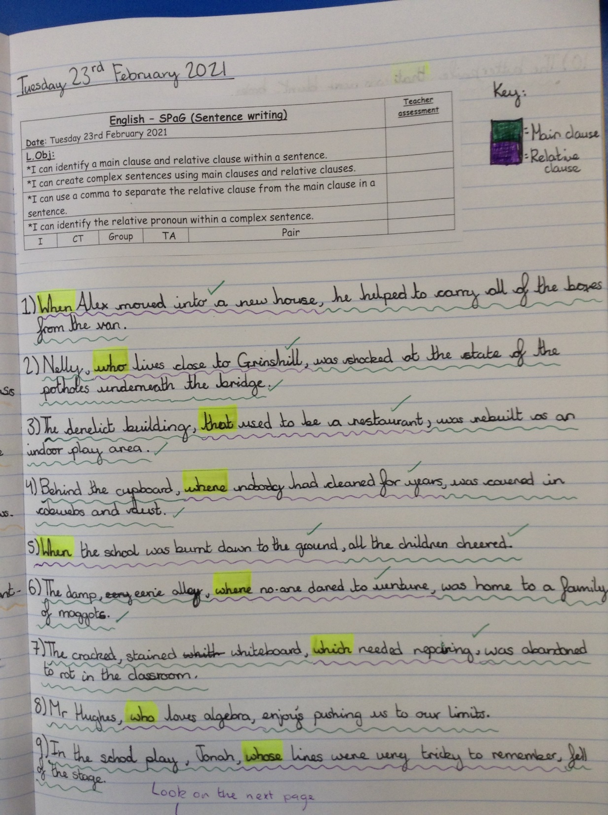
Heidi has created her complex sentences today using relative clauses.

Slide 35
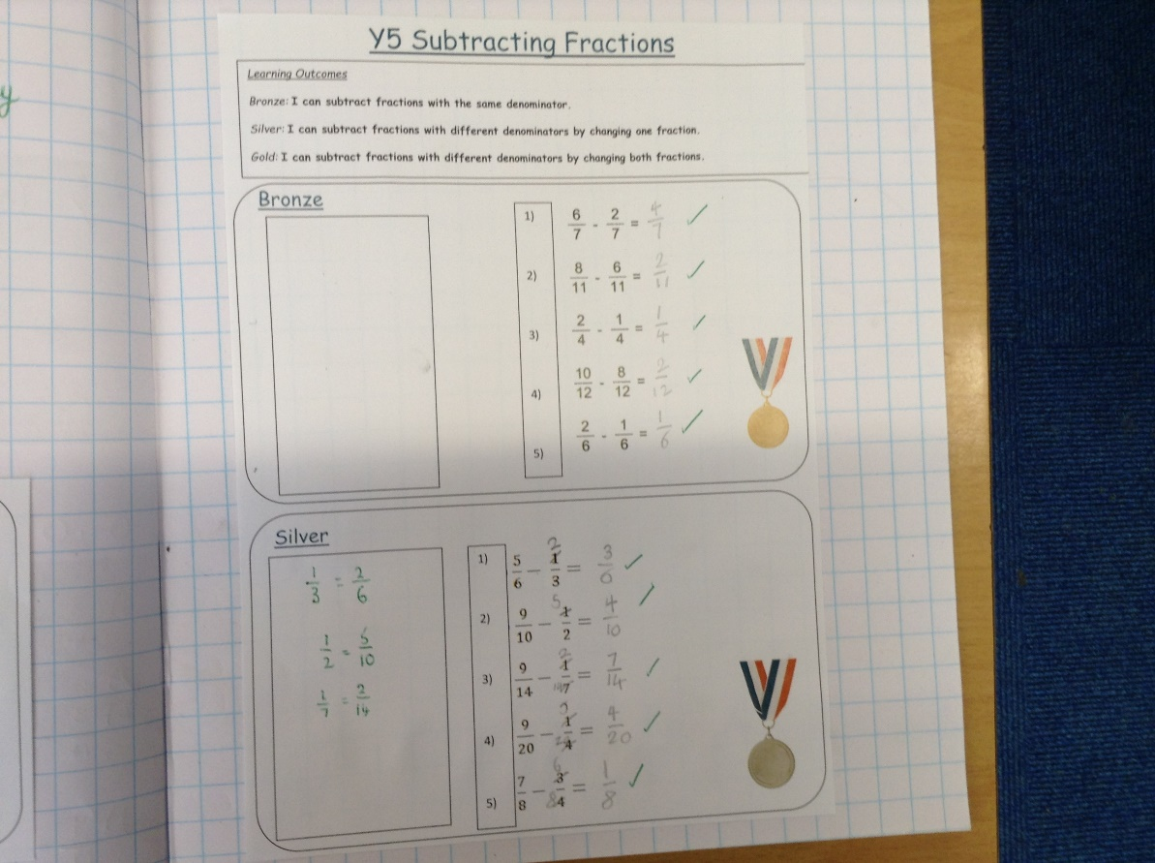
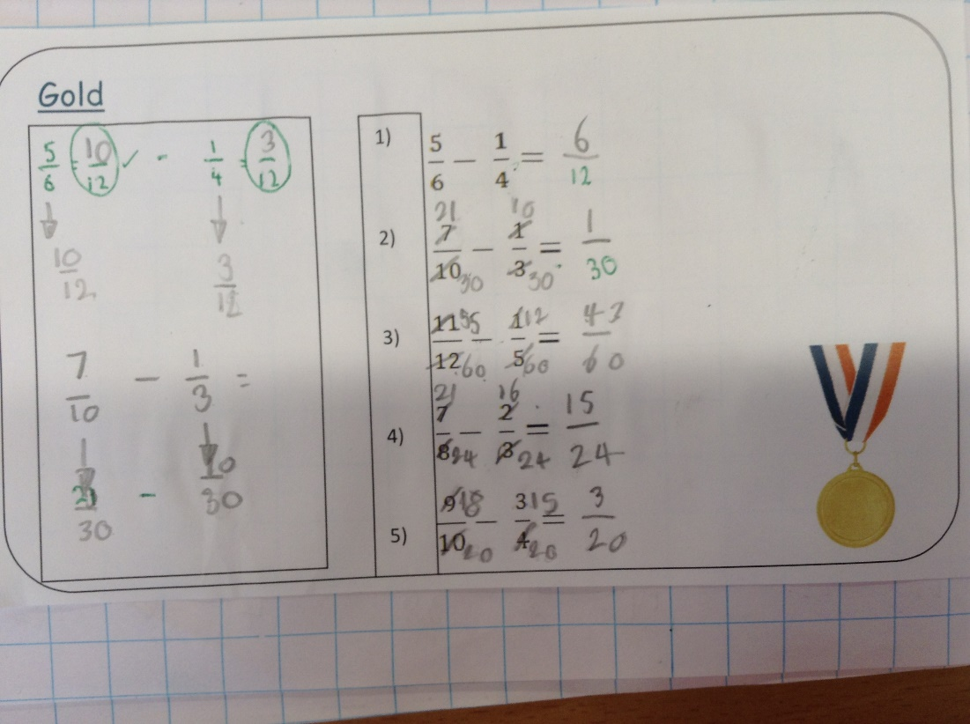
Esme has been trying to achieve gold in her fraction subtraction today.

Slide 36
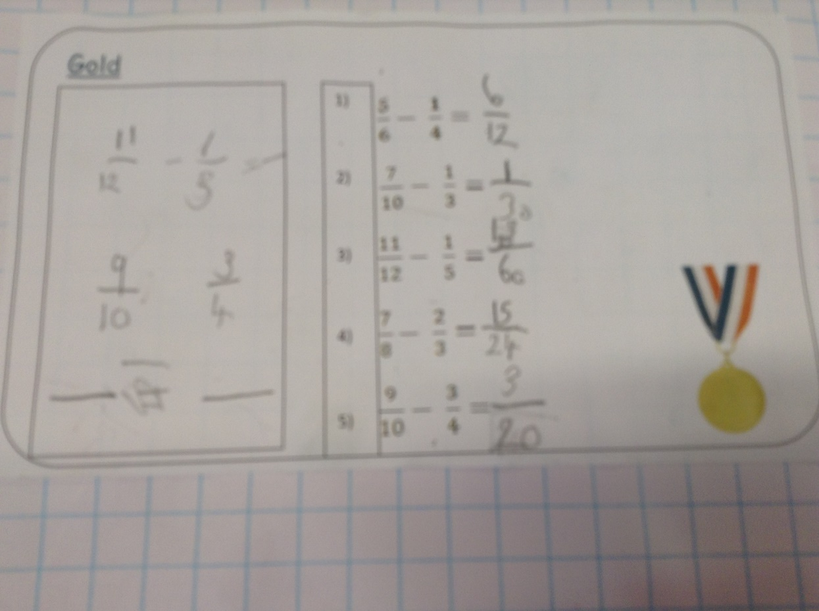
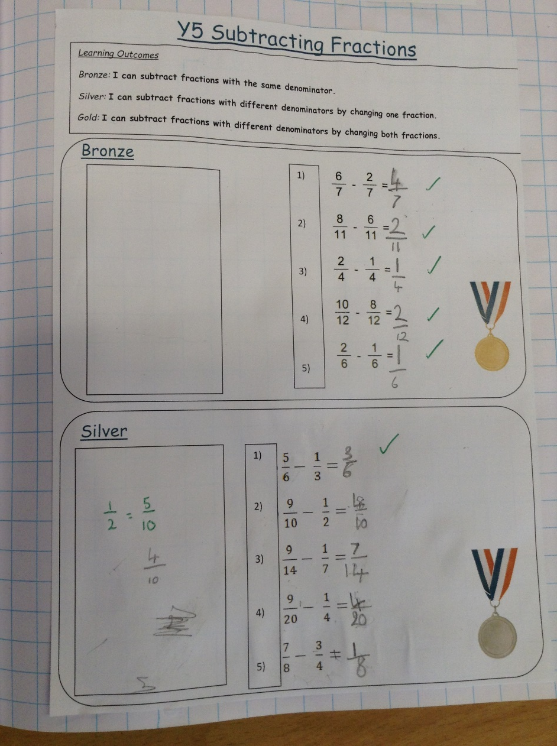
Sophie Carr has been trying to achieve gold in her fraction subtraction today.

Slide 37
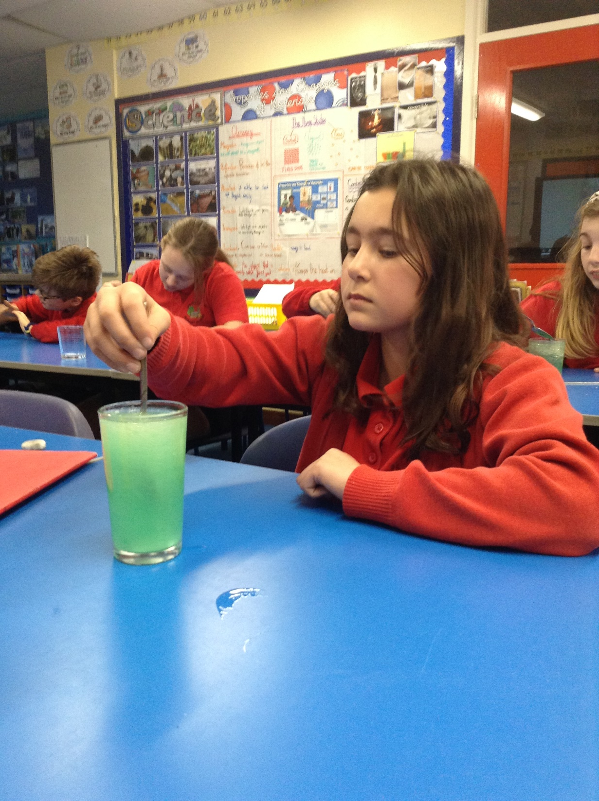
Esme has been studying pure and impure substances in Science. She’s identified that liquid mixtures can be miscible or immiscible.

Slide 38
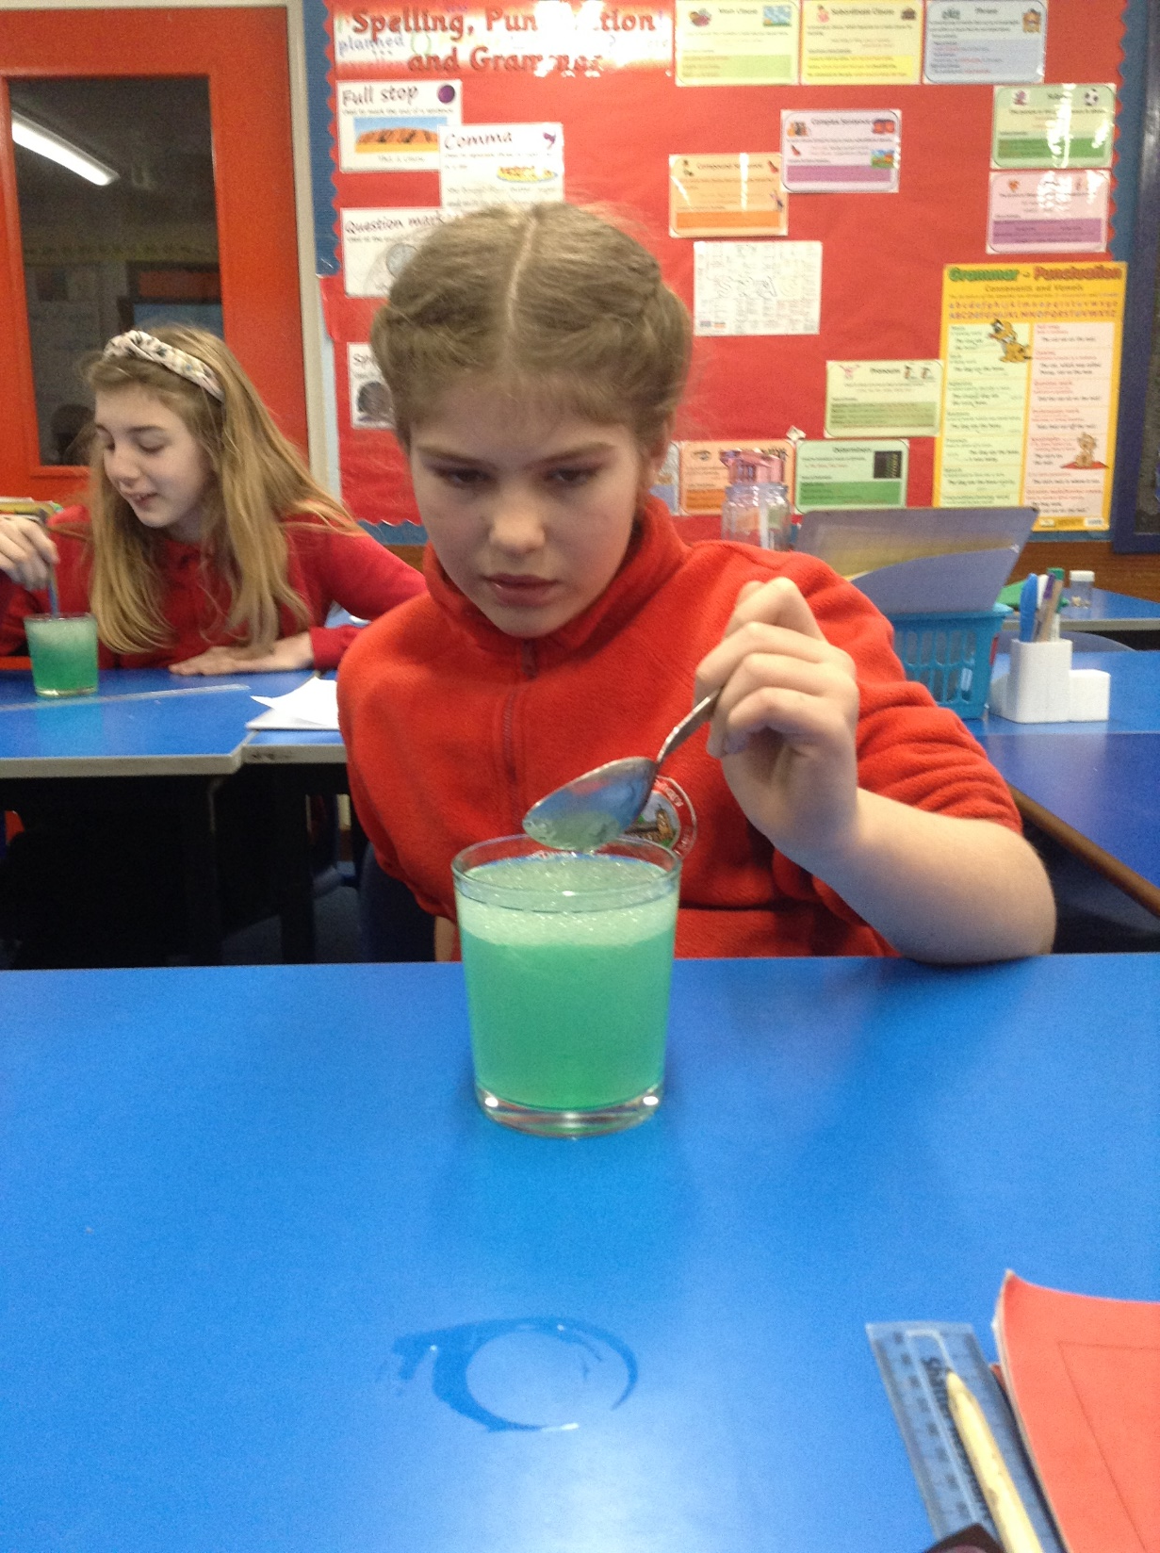
Sophie has been studying pure and impure substances in Science. He’s identified that liquid mixtures can be miscible or immiscible.

Slide 39
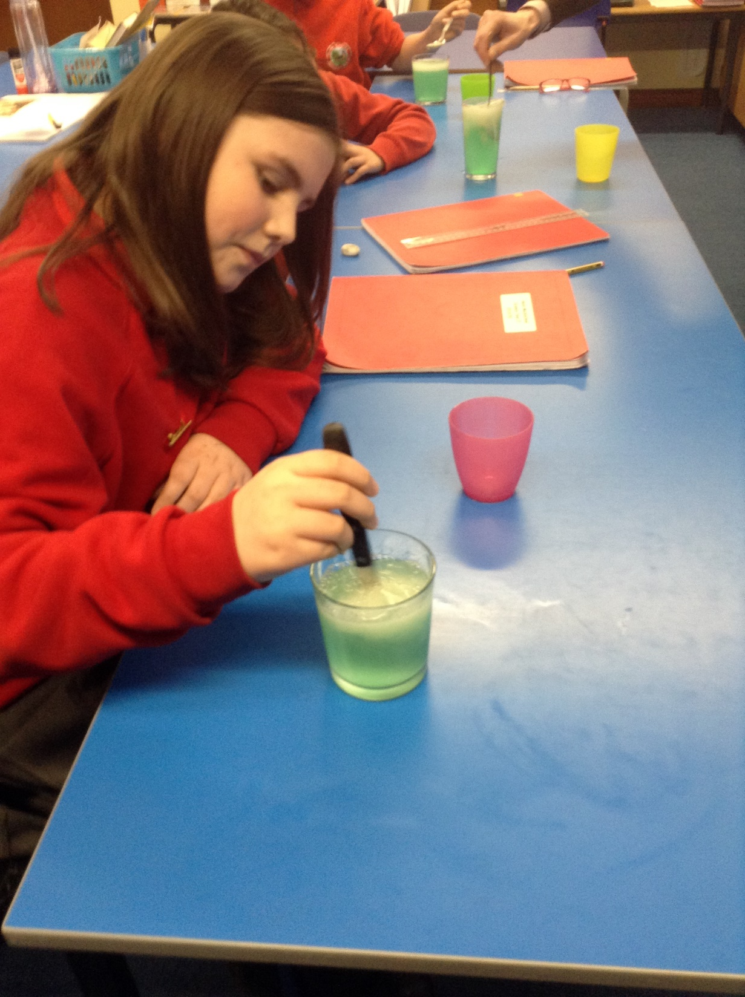
Heidi has been studying pure and impure substances in Science. She’s identified that liquid mixtures can be miscible or immiscible.

Slide 40
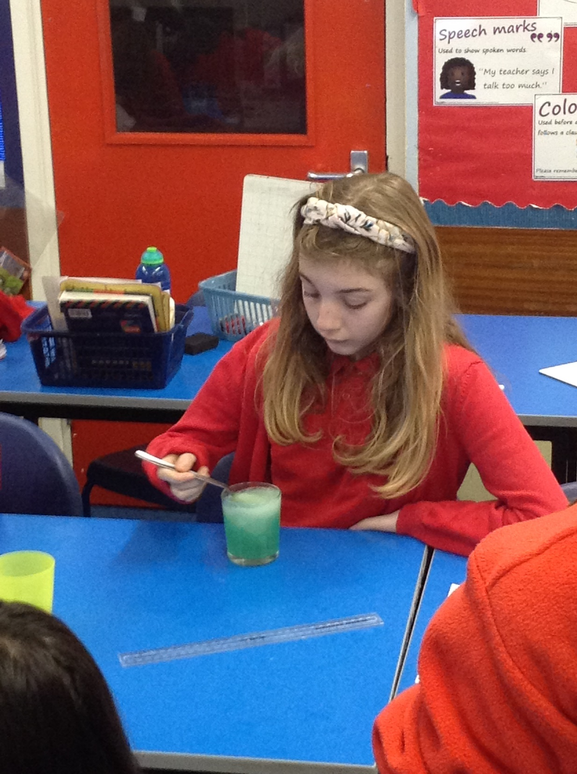
Isobel has been studying pure and impure substances in Science. She’s identified that liquid mixtures can be miscible or immiscible.

Slide 41
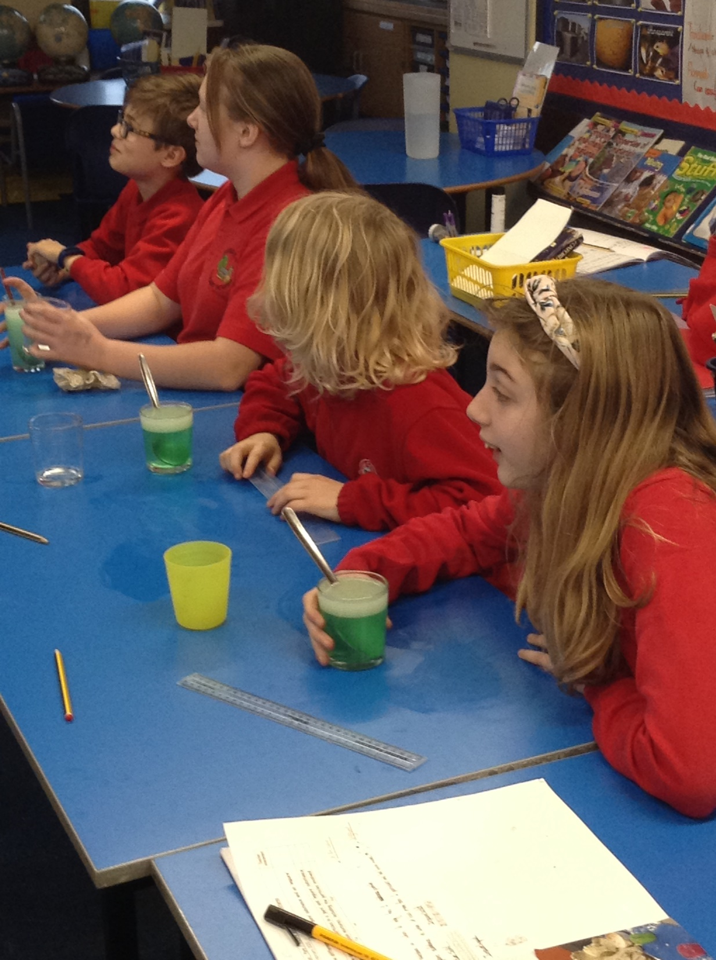
The class have been studying pure and impure substances in Science. We’ve identified that liquid mixtures can be miscible or immiscible.

Slide 42
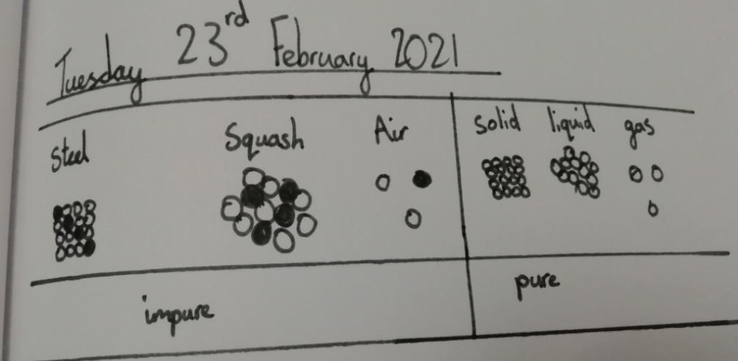
Amy has shown what the particles in pure and impure substances look like.

Slide 43
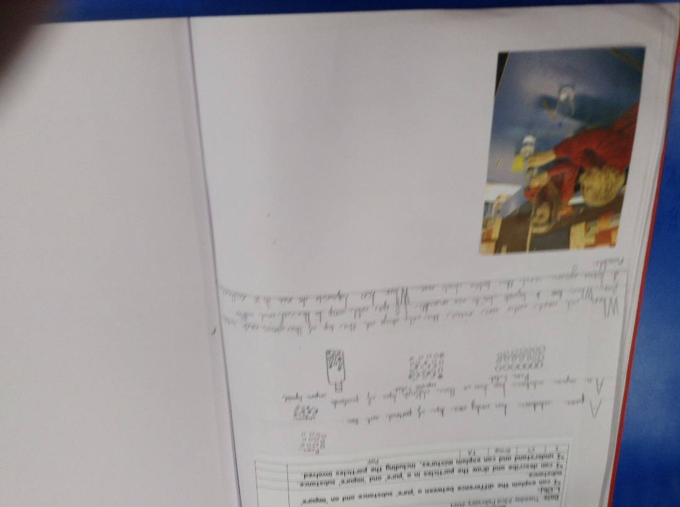
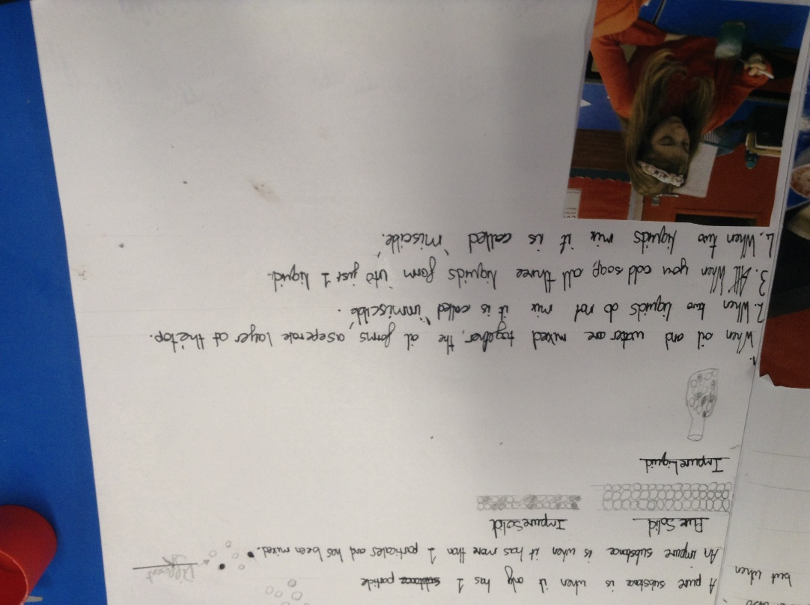
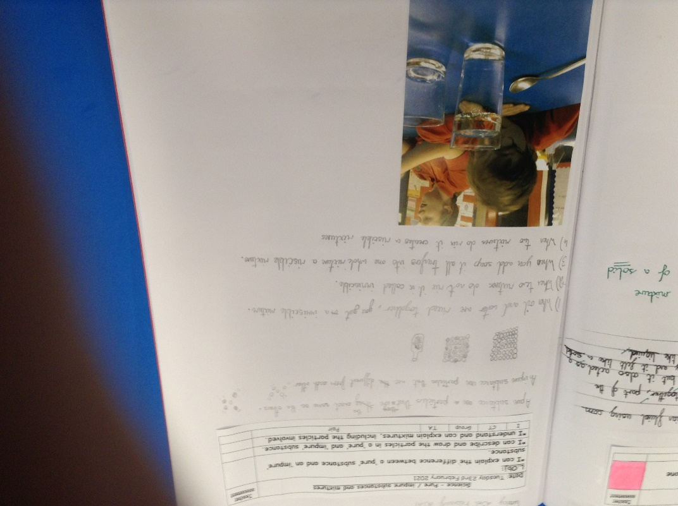

Slide 45
Amy has identified the relative clauses and main clauses in these complex sentences.

Slide 46
Amy has solved the calculations / problems correctly using her understanding of algebra.

Slide 47
Sophie Collins has recognised the difference between the main clause and the relative clause in her sentences.

Slide 48
Sophie Collins has shown good understanding of algebra to help her to solve the missing letters / answers in her maths calculations.

Slide 49
Sophie Collins has observed the science video well to learn about what the particles are like in pure, impure and mixtures of substances.

Slide 50
Ariana has been adding and subtracting fractions really well, including mixed numbers and improper fractions.

Slide 51
Ollie has been subtracting fractions really well, sometimes using a common denominator.

Slide 52
Sam has been identifying how the particles are different in pure, impure and mixtures of substances.

Slide 53
Sam has identified the different clauses in these sentences, including the relative clauses today.

Slide 54
Sam has reached the gold award today by subtracting these fractions with and without the same denominator.

Slide 55
Paddy fancied a walk today but clearly he must have had a fall out with Sophie.
They aren’t speaking to each other now!

