Slide 1
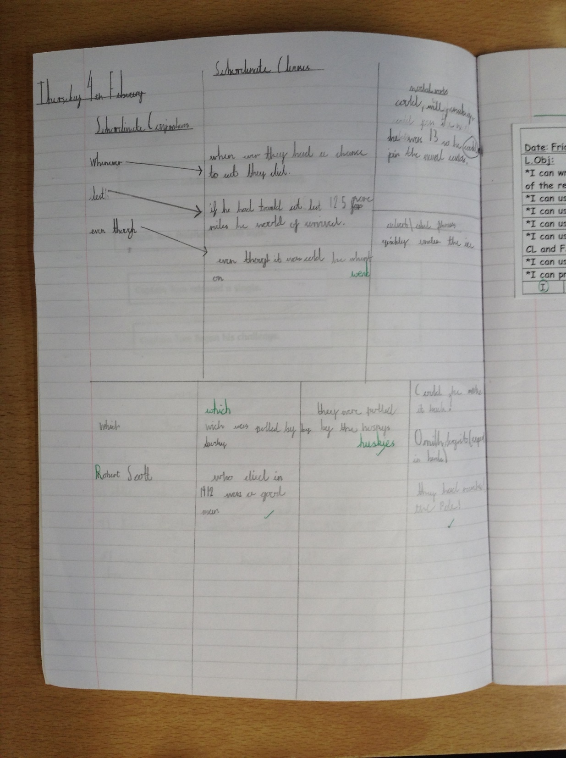
Here’s some of the Y5&6 class’ ‘Thinking side’ today in preparation for their biographies.

Slide 2
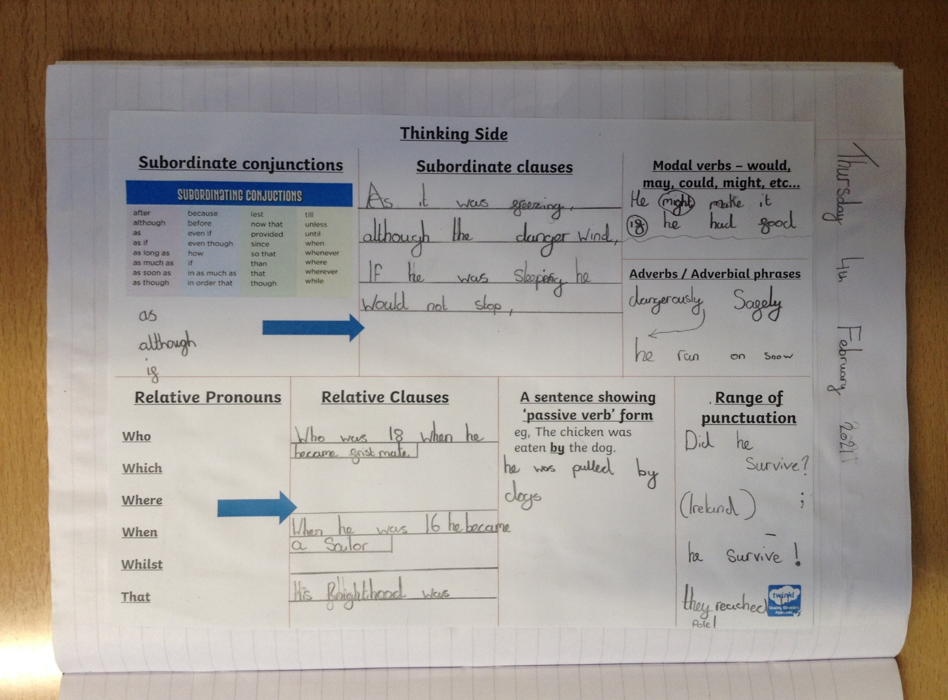
Here’s some of the Y5&6 class’ ‘Thinking side’ today in preparation for their biographies.

Slide 3
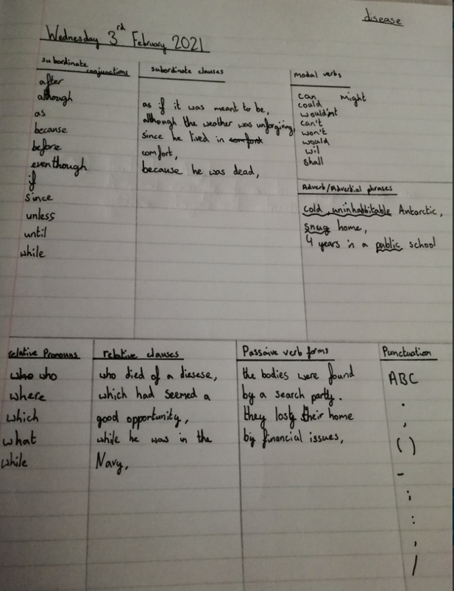
Amy planned some of her sentences really well this morning in preparation for her biography.

Slide 4
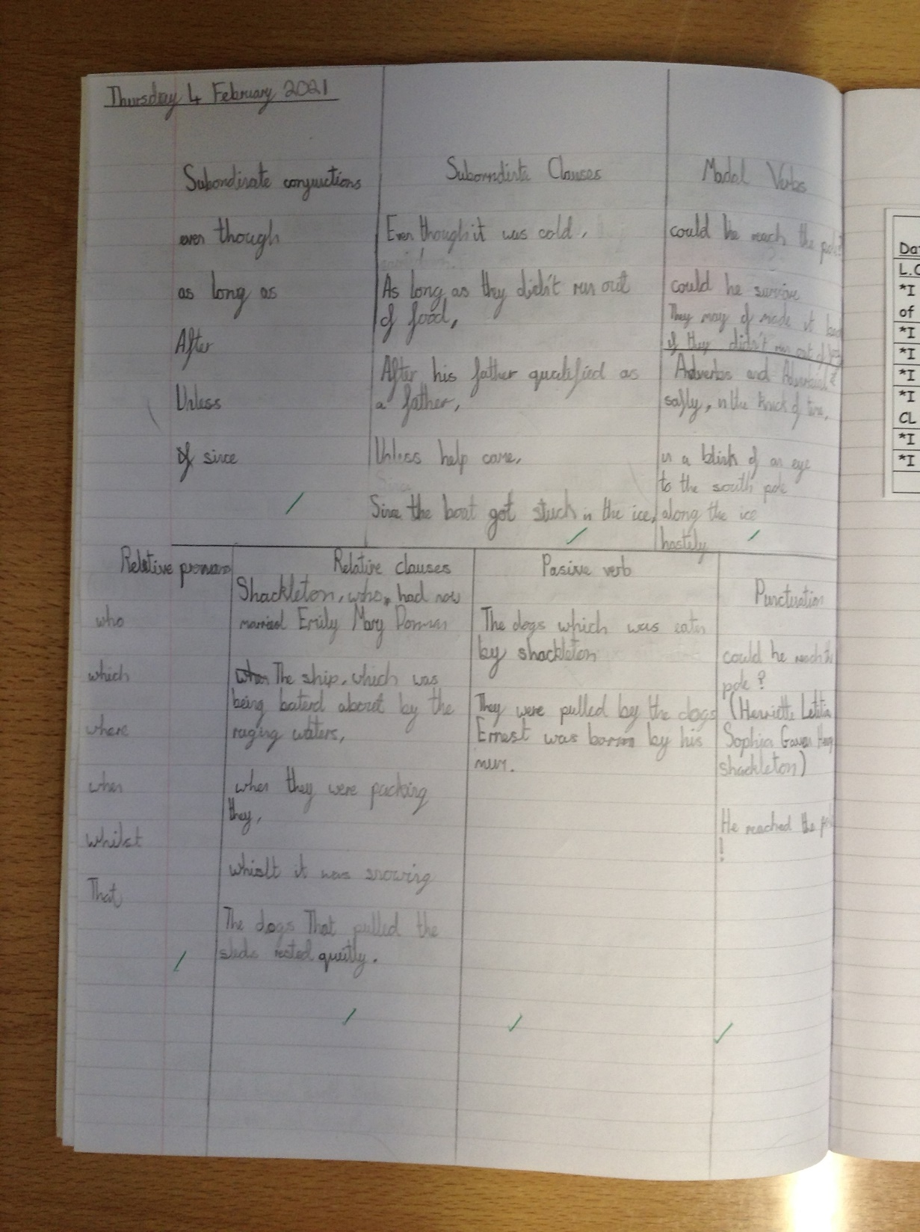
Here’s some of the Y5&6 class’ ‘Thinking side’ today in preparation for their biographies.

Slide 5
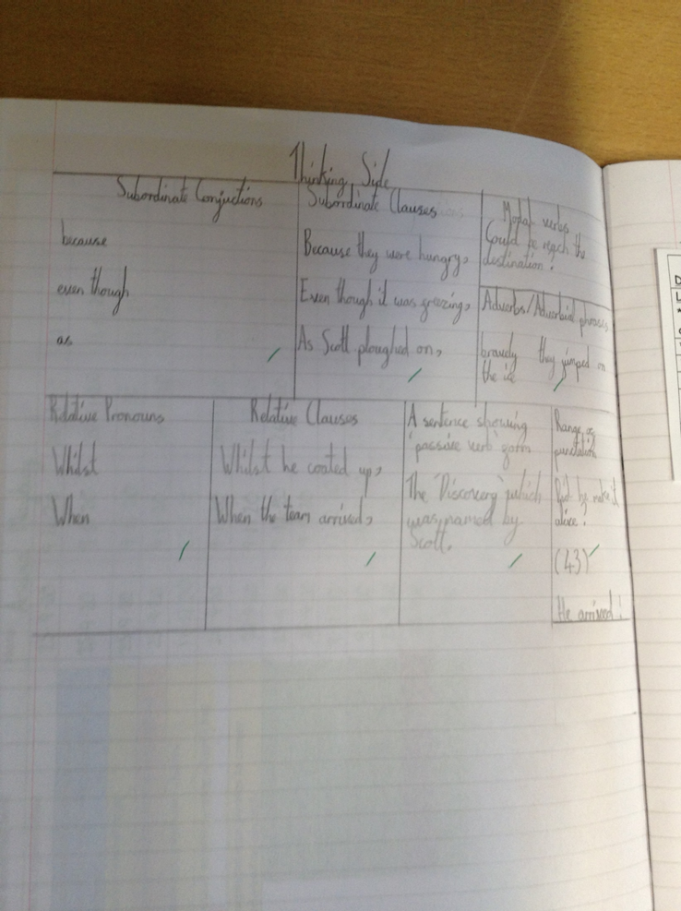
Here’s some of the Y5&6 class’ ‘Thinking side’ today in preparation for their biographies.

Slide 6
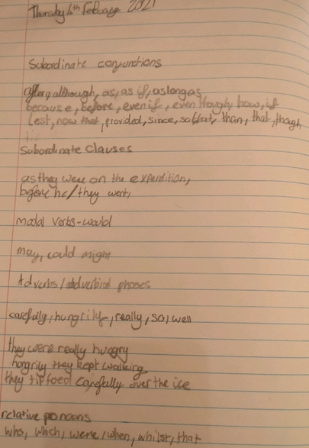
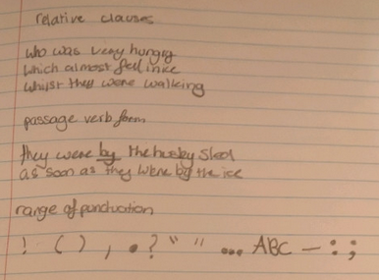
Lilly has been planning some of the sentences that she is going to use in her biography.

Slide 7
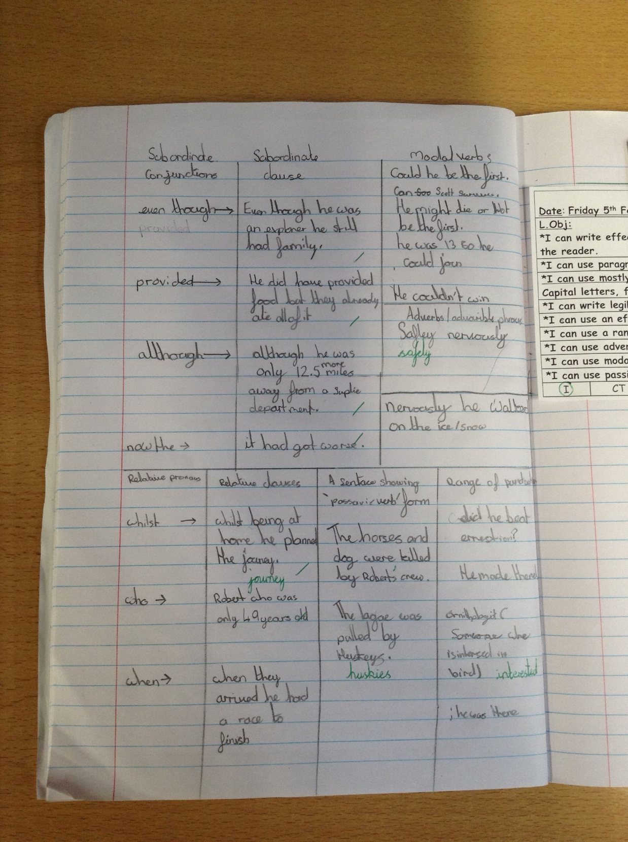
Here’s some of the Y5&6 class’ ‘Thinking side’ today in preparation for their biographies.

Slide 8
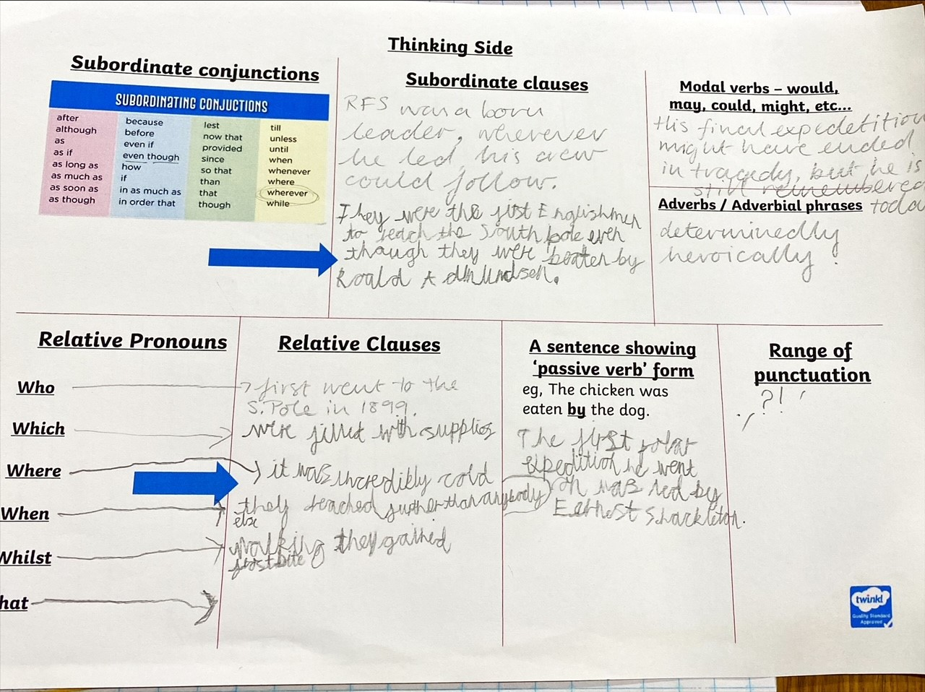
Sam has been planning the sentences that he is going to use in his biography.

Slide 9
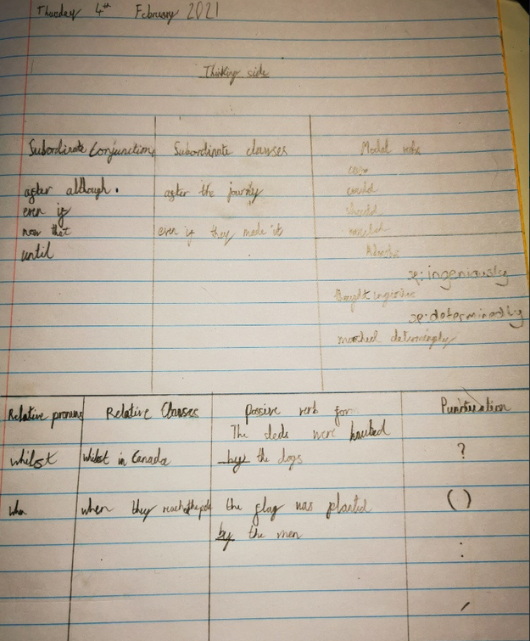
Blake has been using his ‘Thinking side’ really well to help him to plan some of the sentences he will use in his biography.

Slide 10
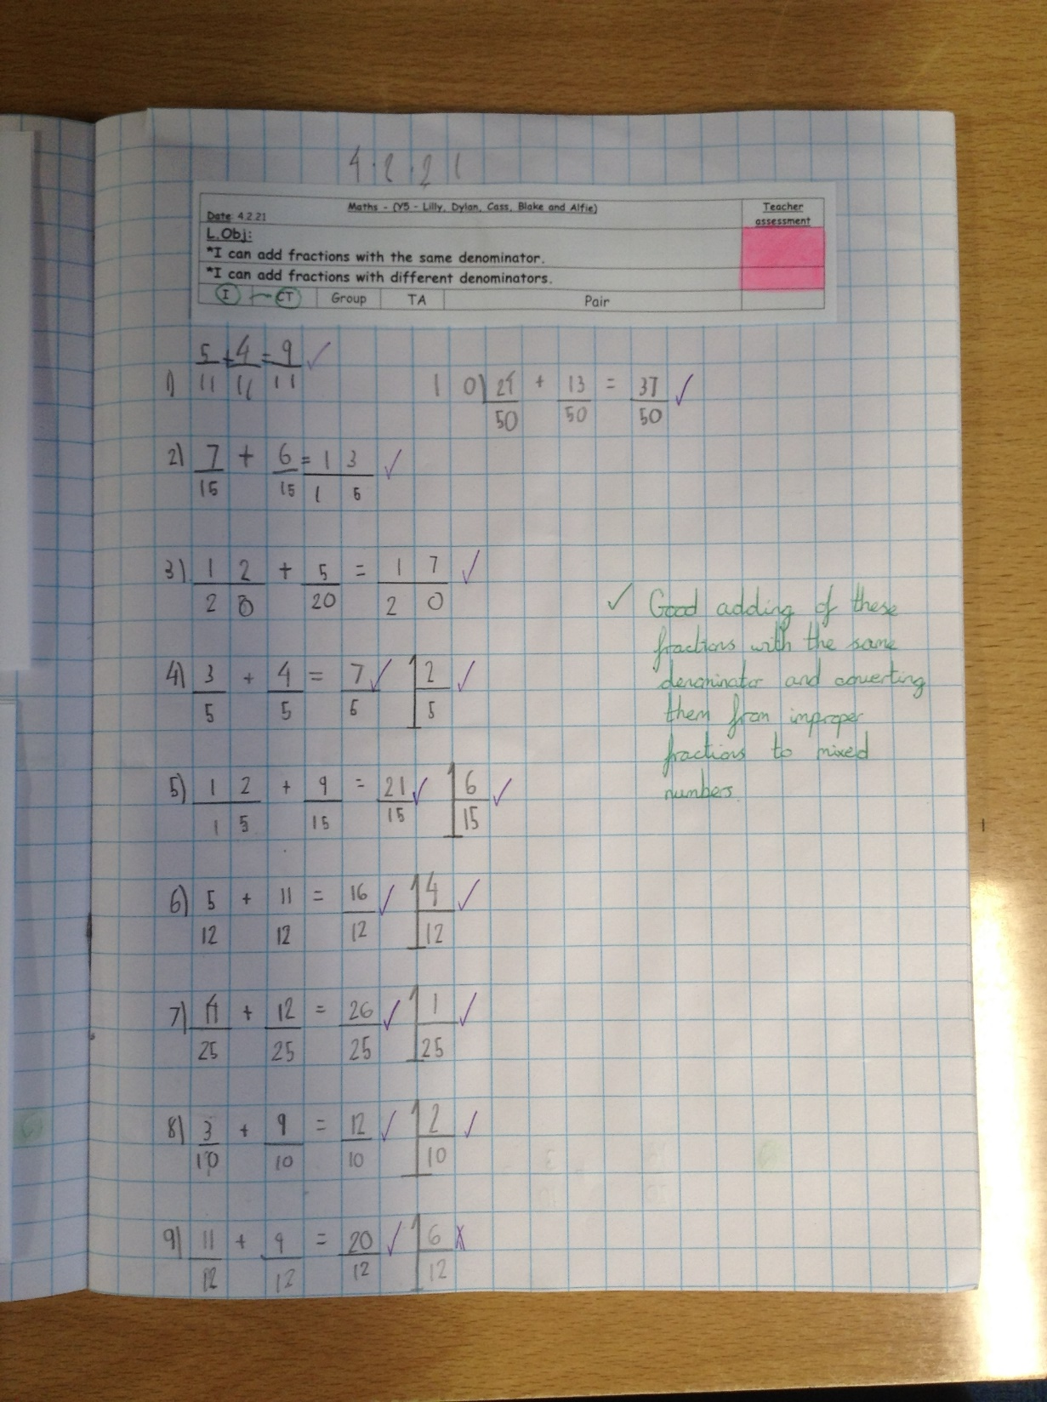
Alfie has added his fractions with the same denominators well and then converted them from improper fractions to mixed numbers.

Slide 11
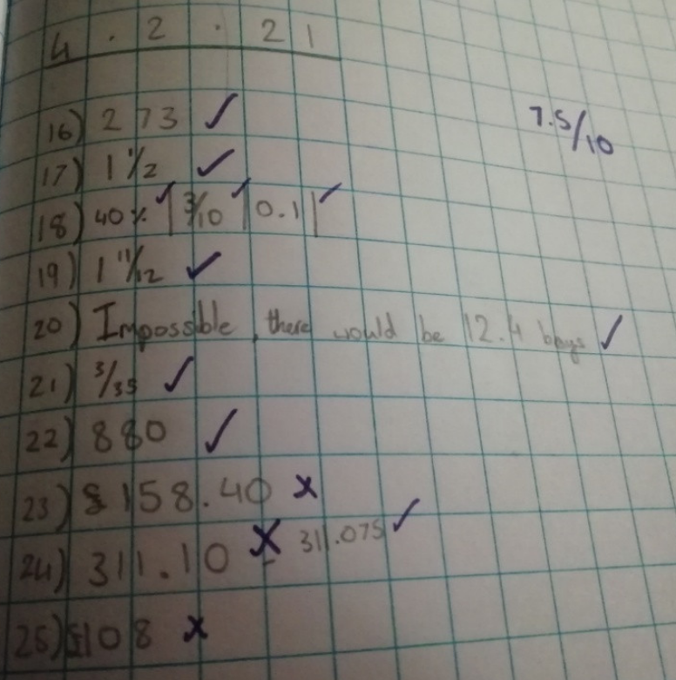
Amy had to concentrate hard on some tricky fraction, decimals and % problems and calculations today in maths.

Slide 12
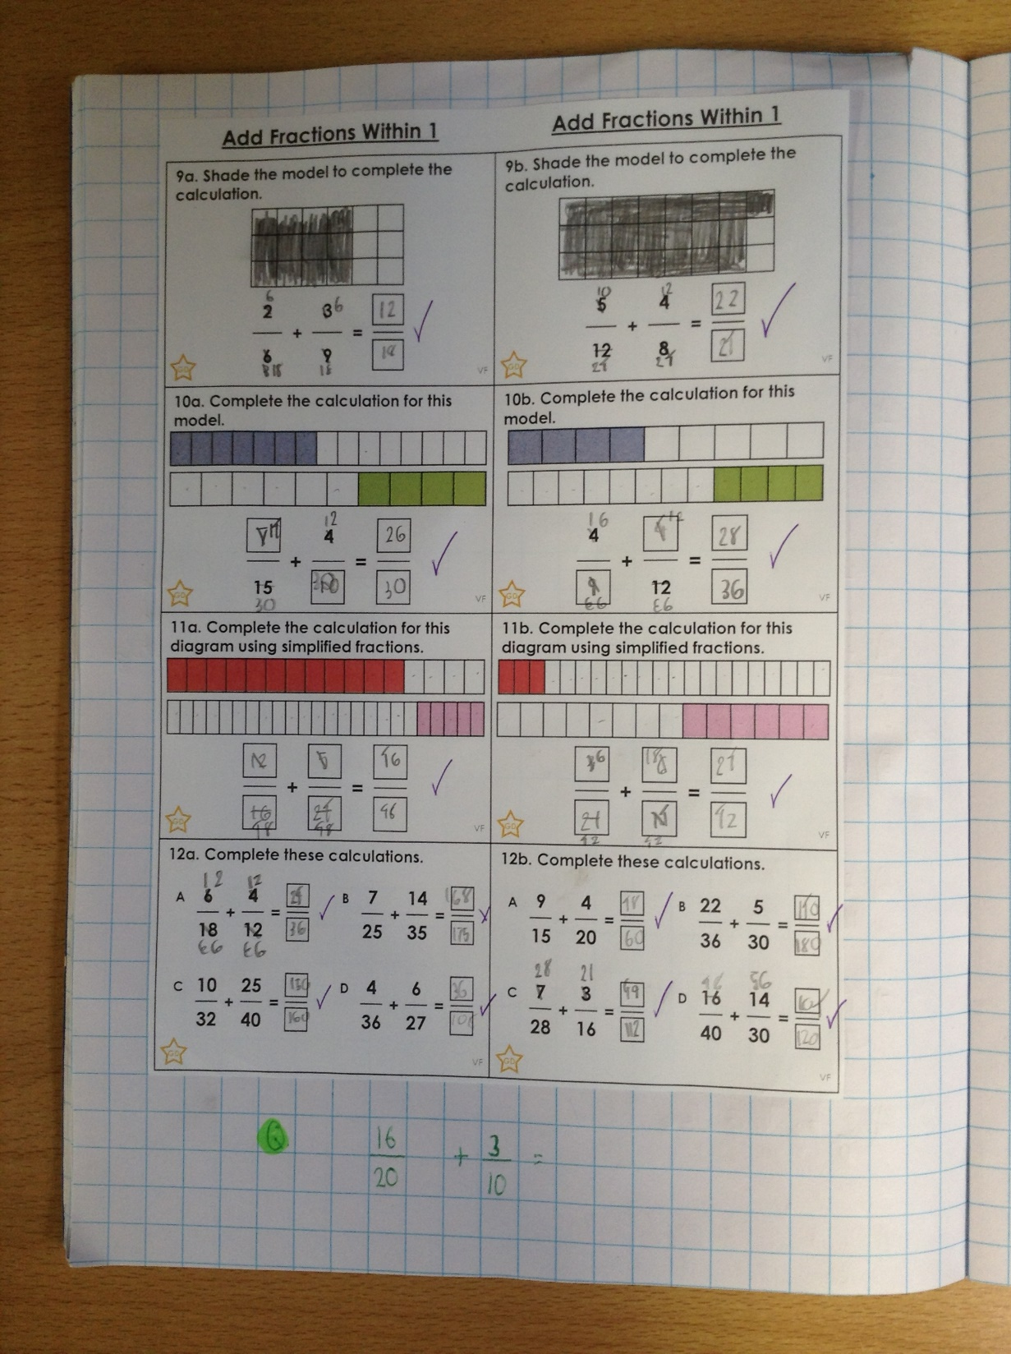
Alfie has then added fractions with different denominators by finding a common denominator.

Slide 13
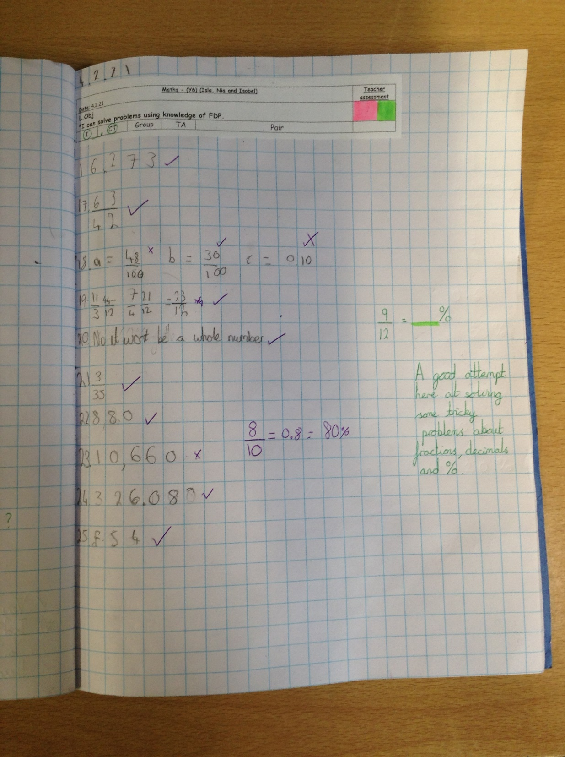
Isobel has been solving problems and calculations based on fractions, decimals and percentages.

Slide 14
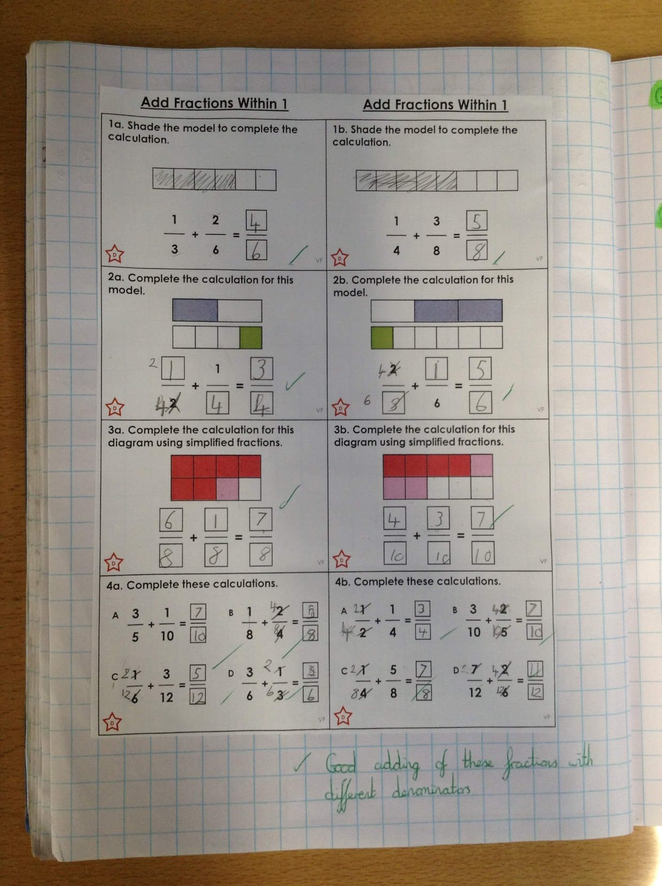
Sophie has added fractions with different denominators by finding a common denominator.

Slide 15
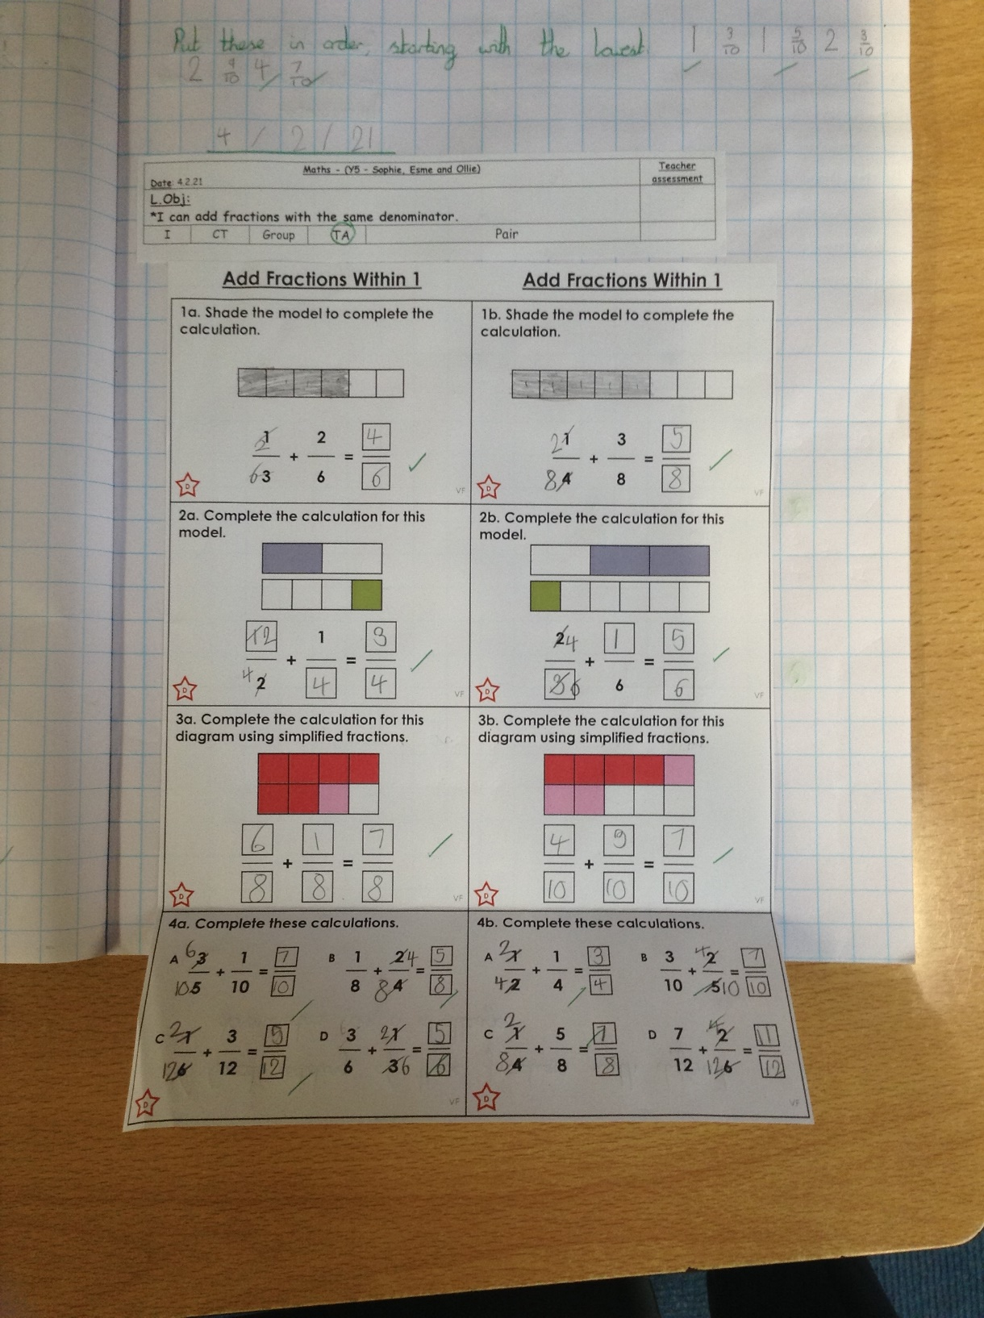
Esme has been adding fractions with different denominators by finding a common denominator.

Slide 16
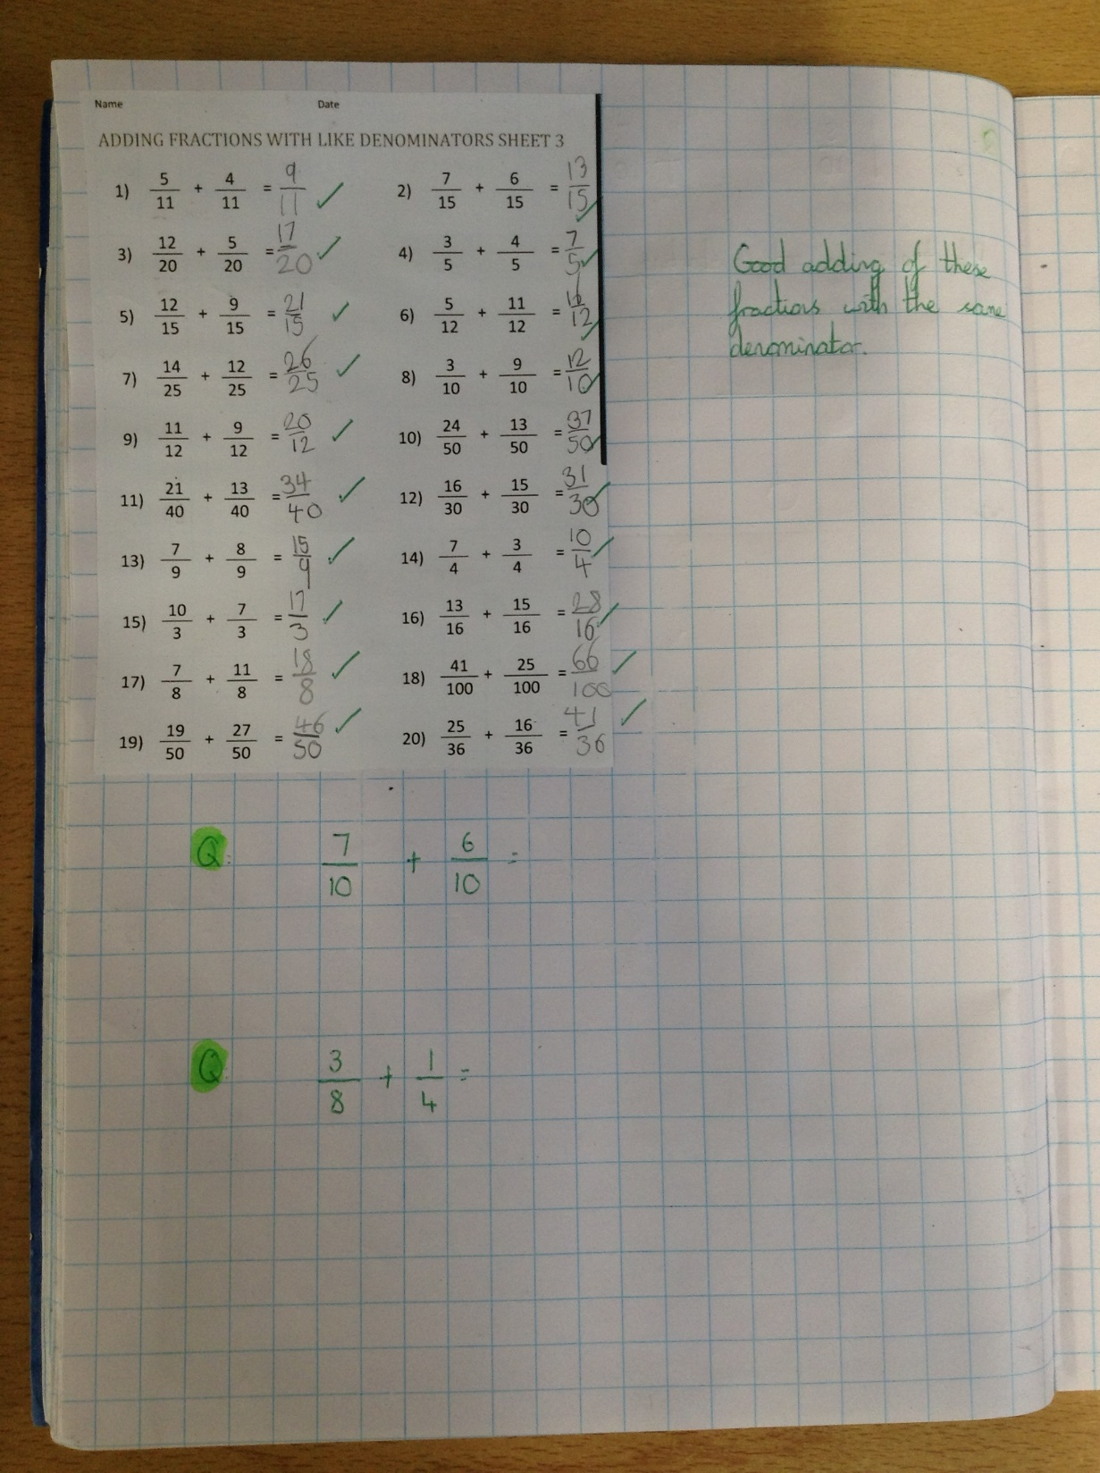
Sophie has whizzed through her fraction adding today with the same denominator.

Slide 17
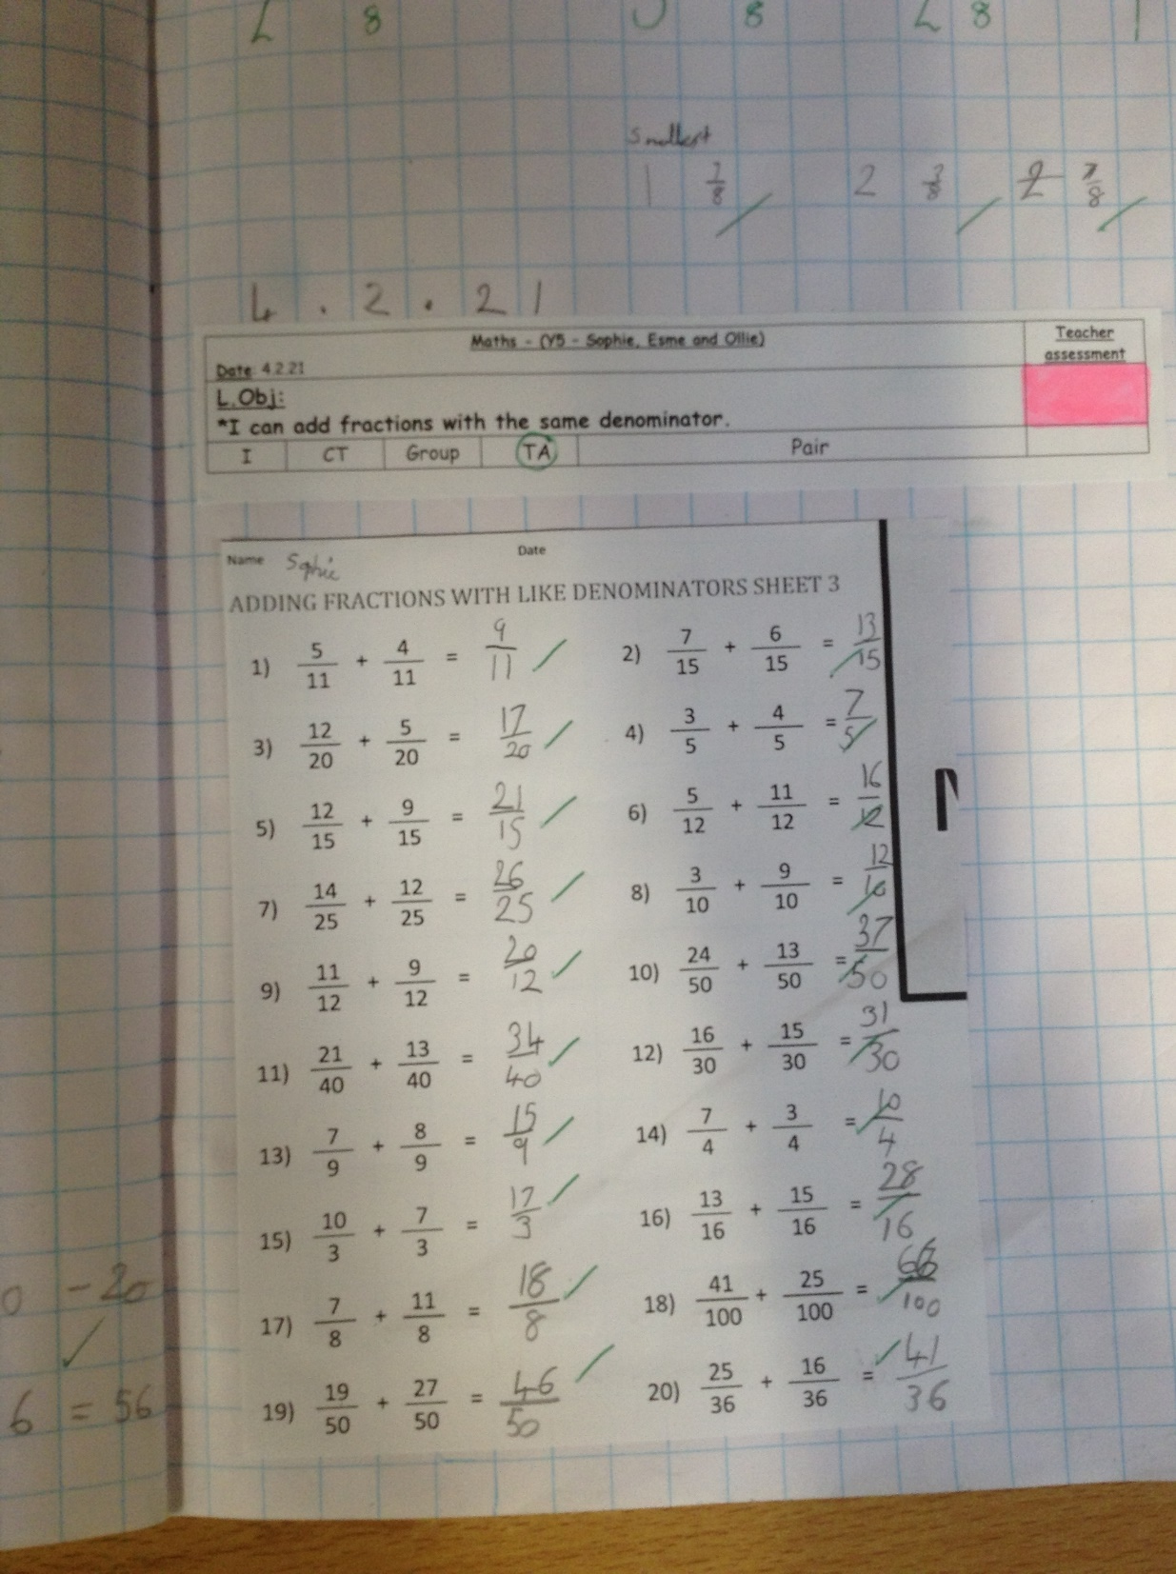
Esme has whizzed through her fraction adding today with the same denominator.

Slide 18
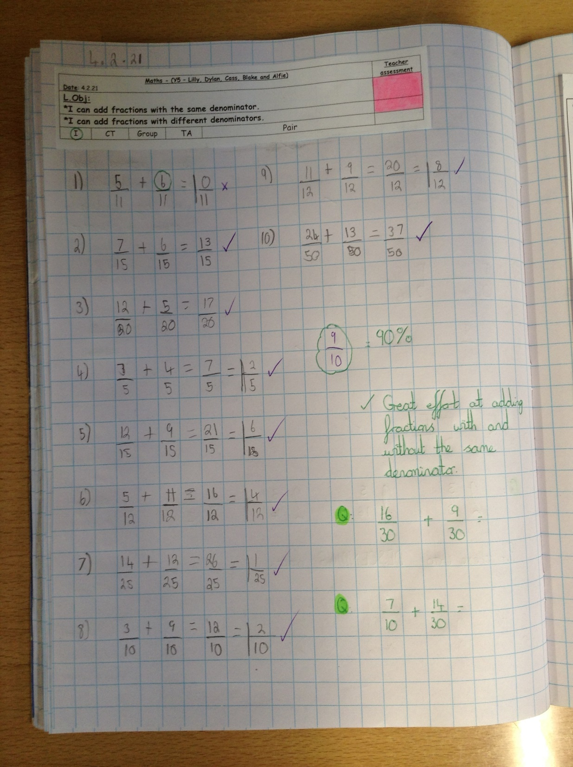
Cass has added these fractions with the same denominator very well in maths today.

Slide 19
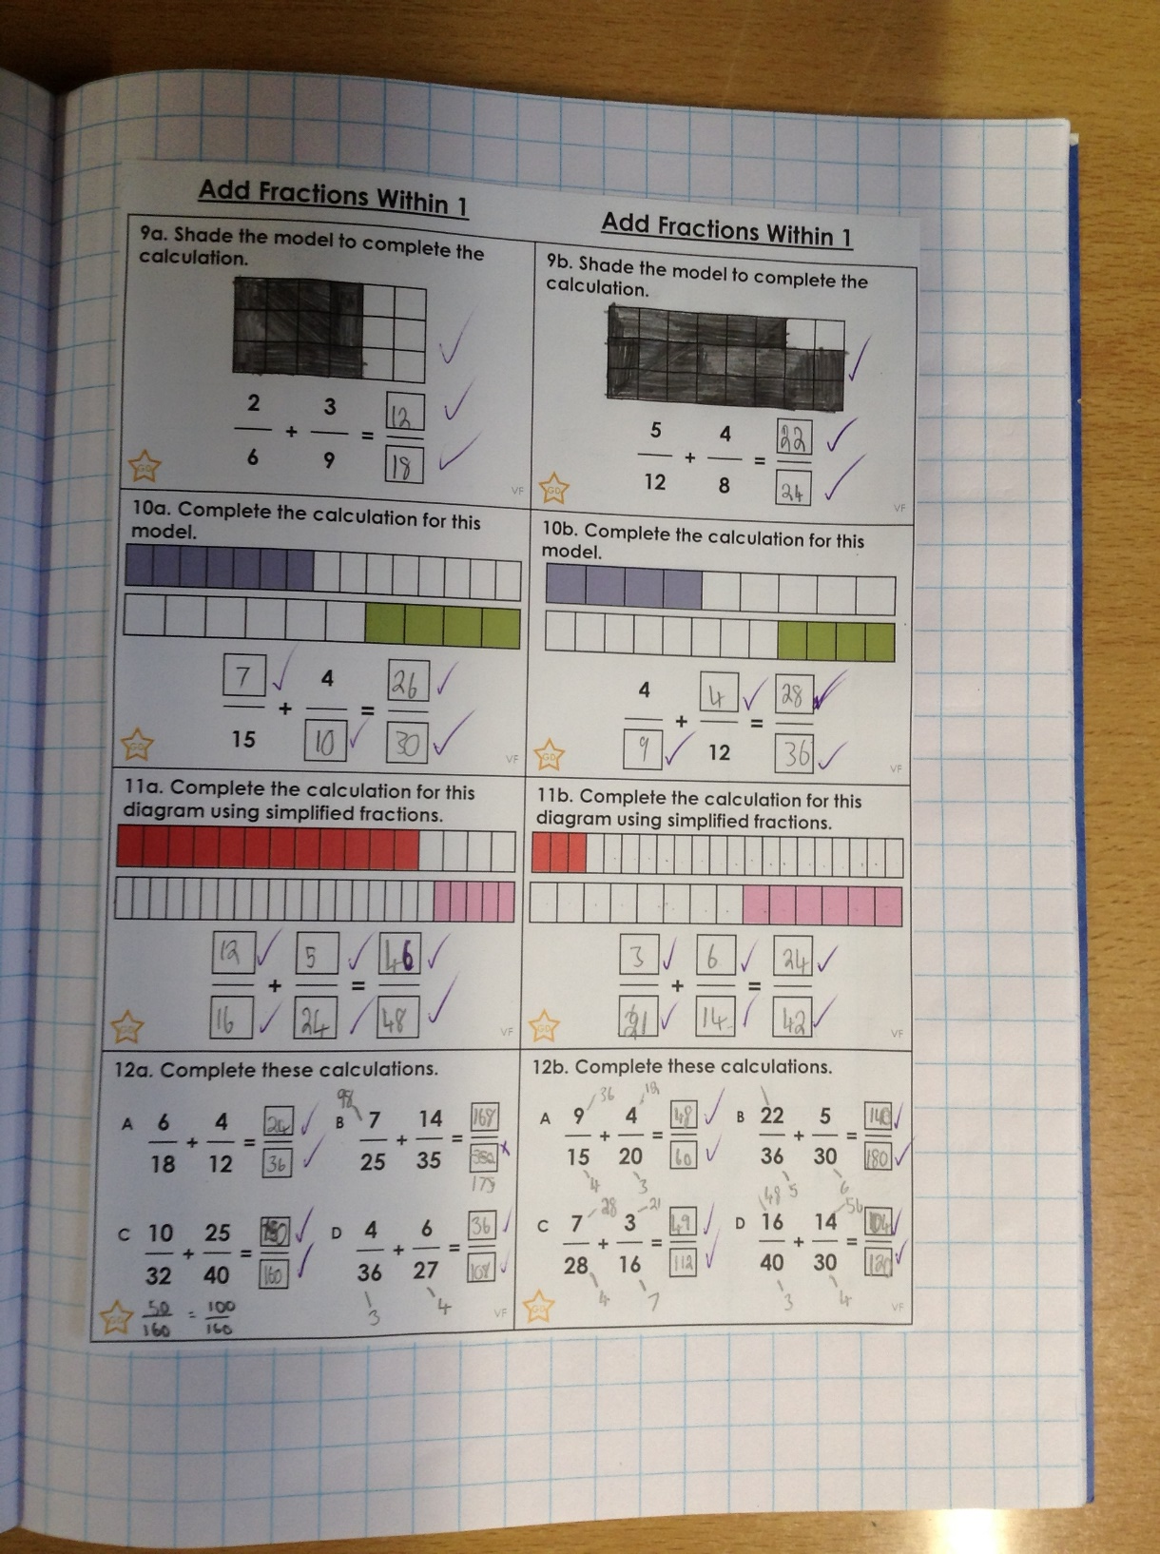
Cass has then added fractions with different denominators by finding a common denominator.

Slide 20
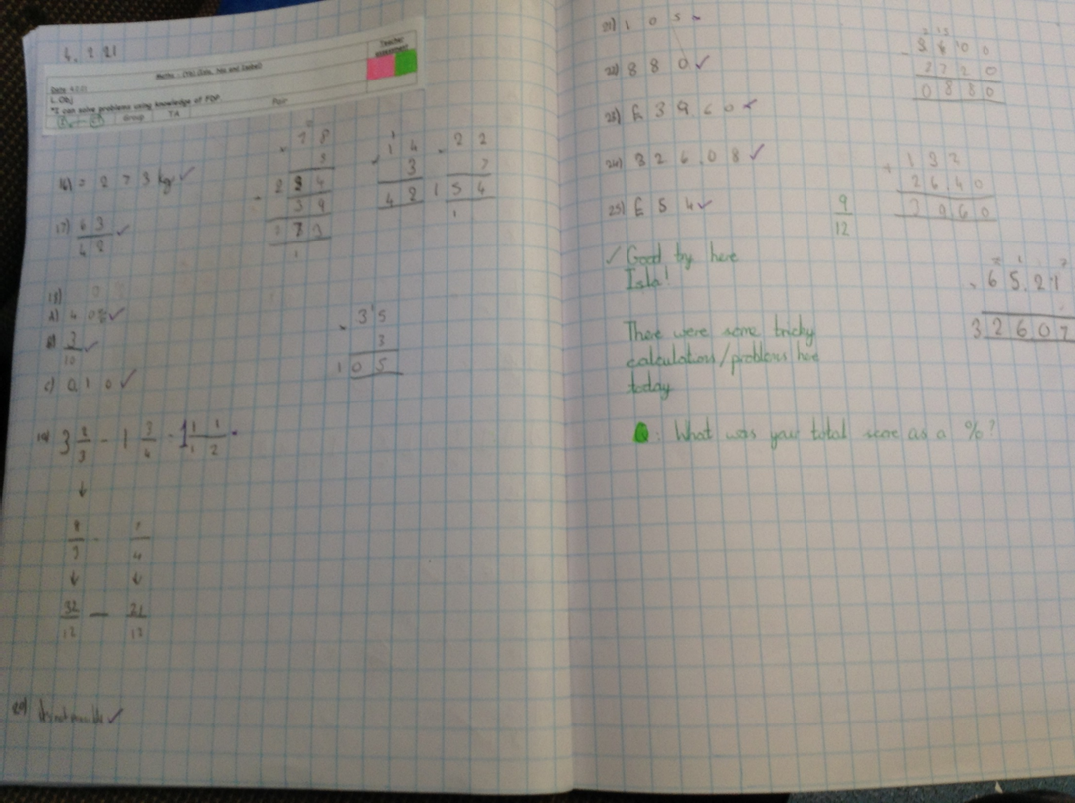
Isla has been solving problems and calculations based on fractions, decimals and percentages.

Slide 21
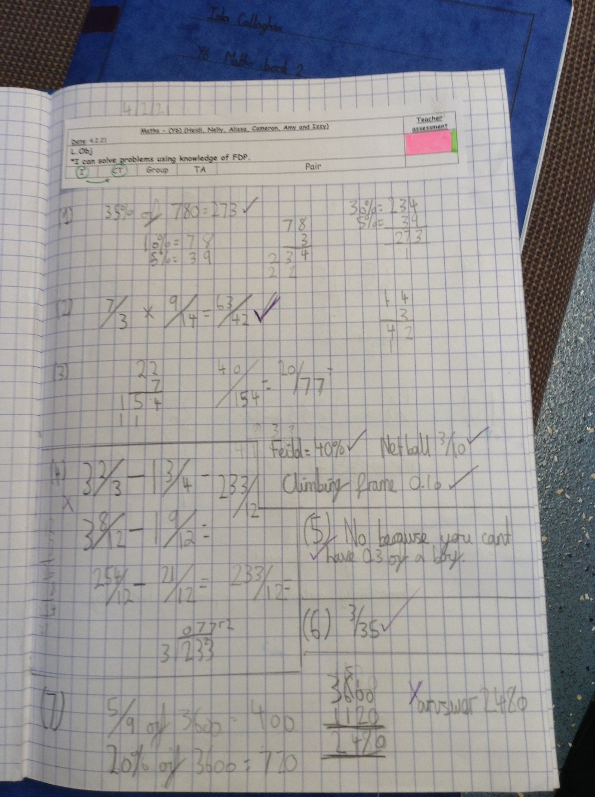
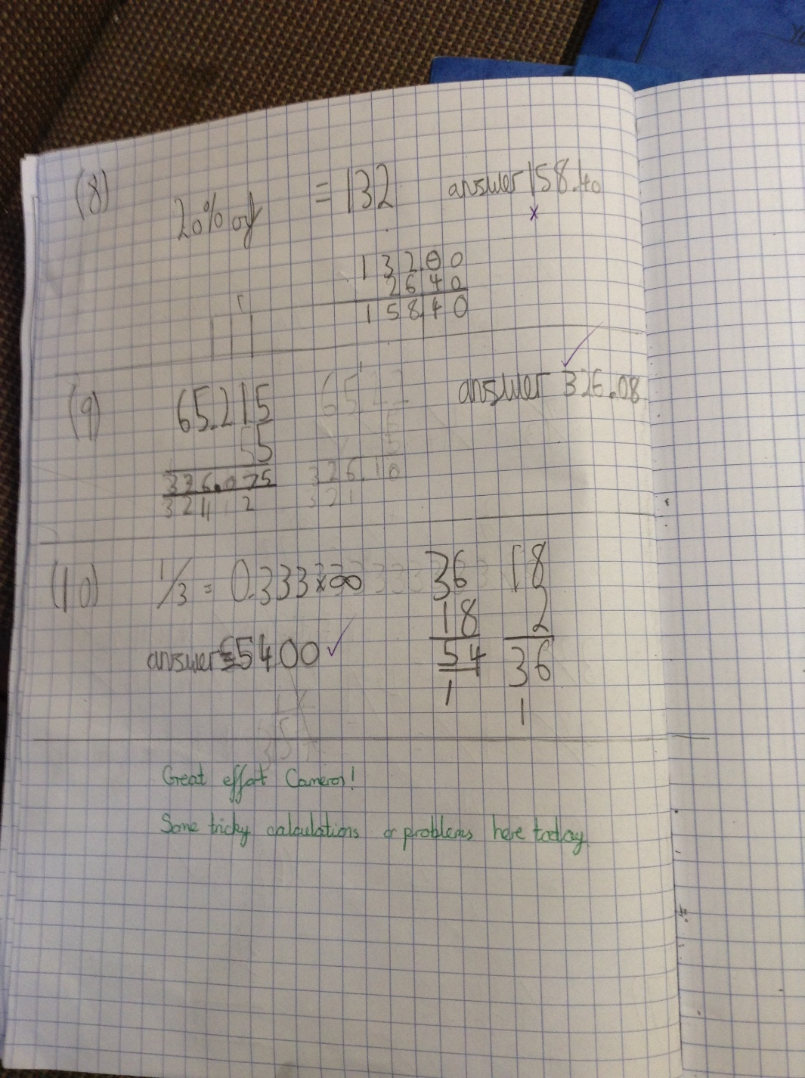
Cameron has been solving problems and calculations based on fractions, decimals and percentages.

Slide 22
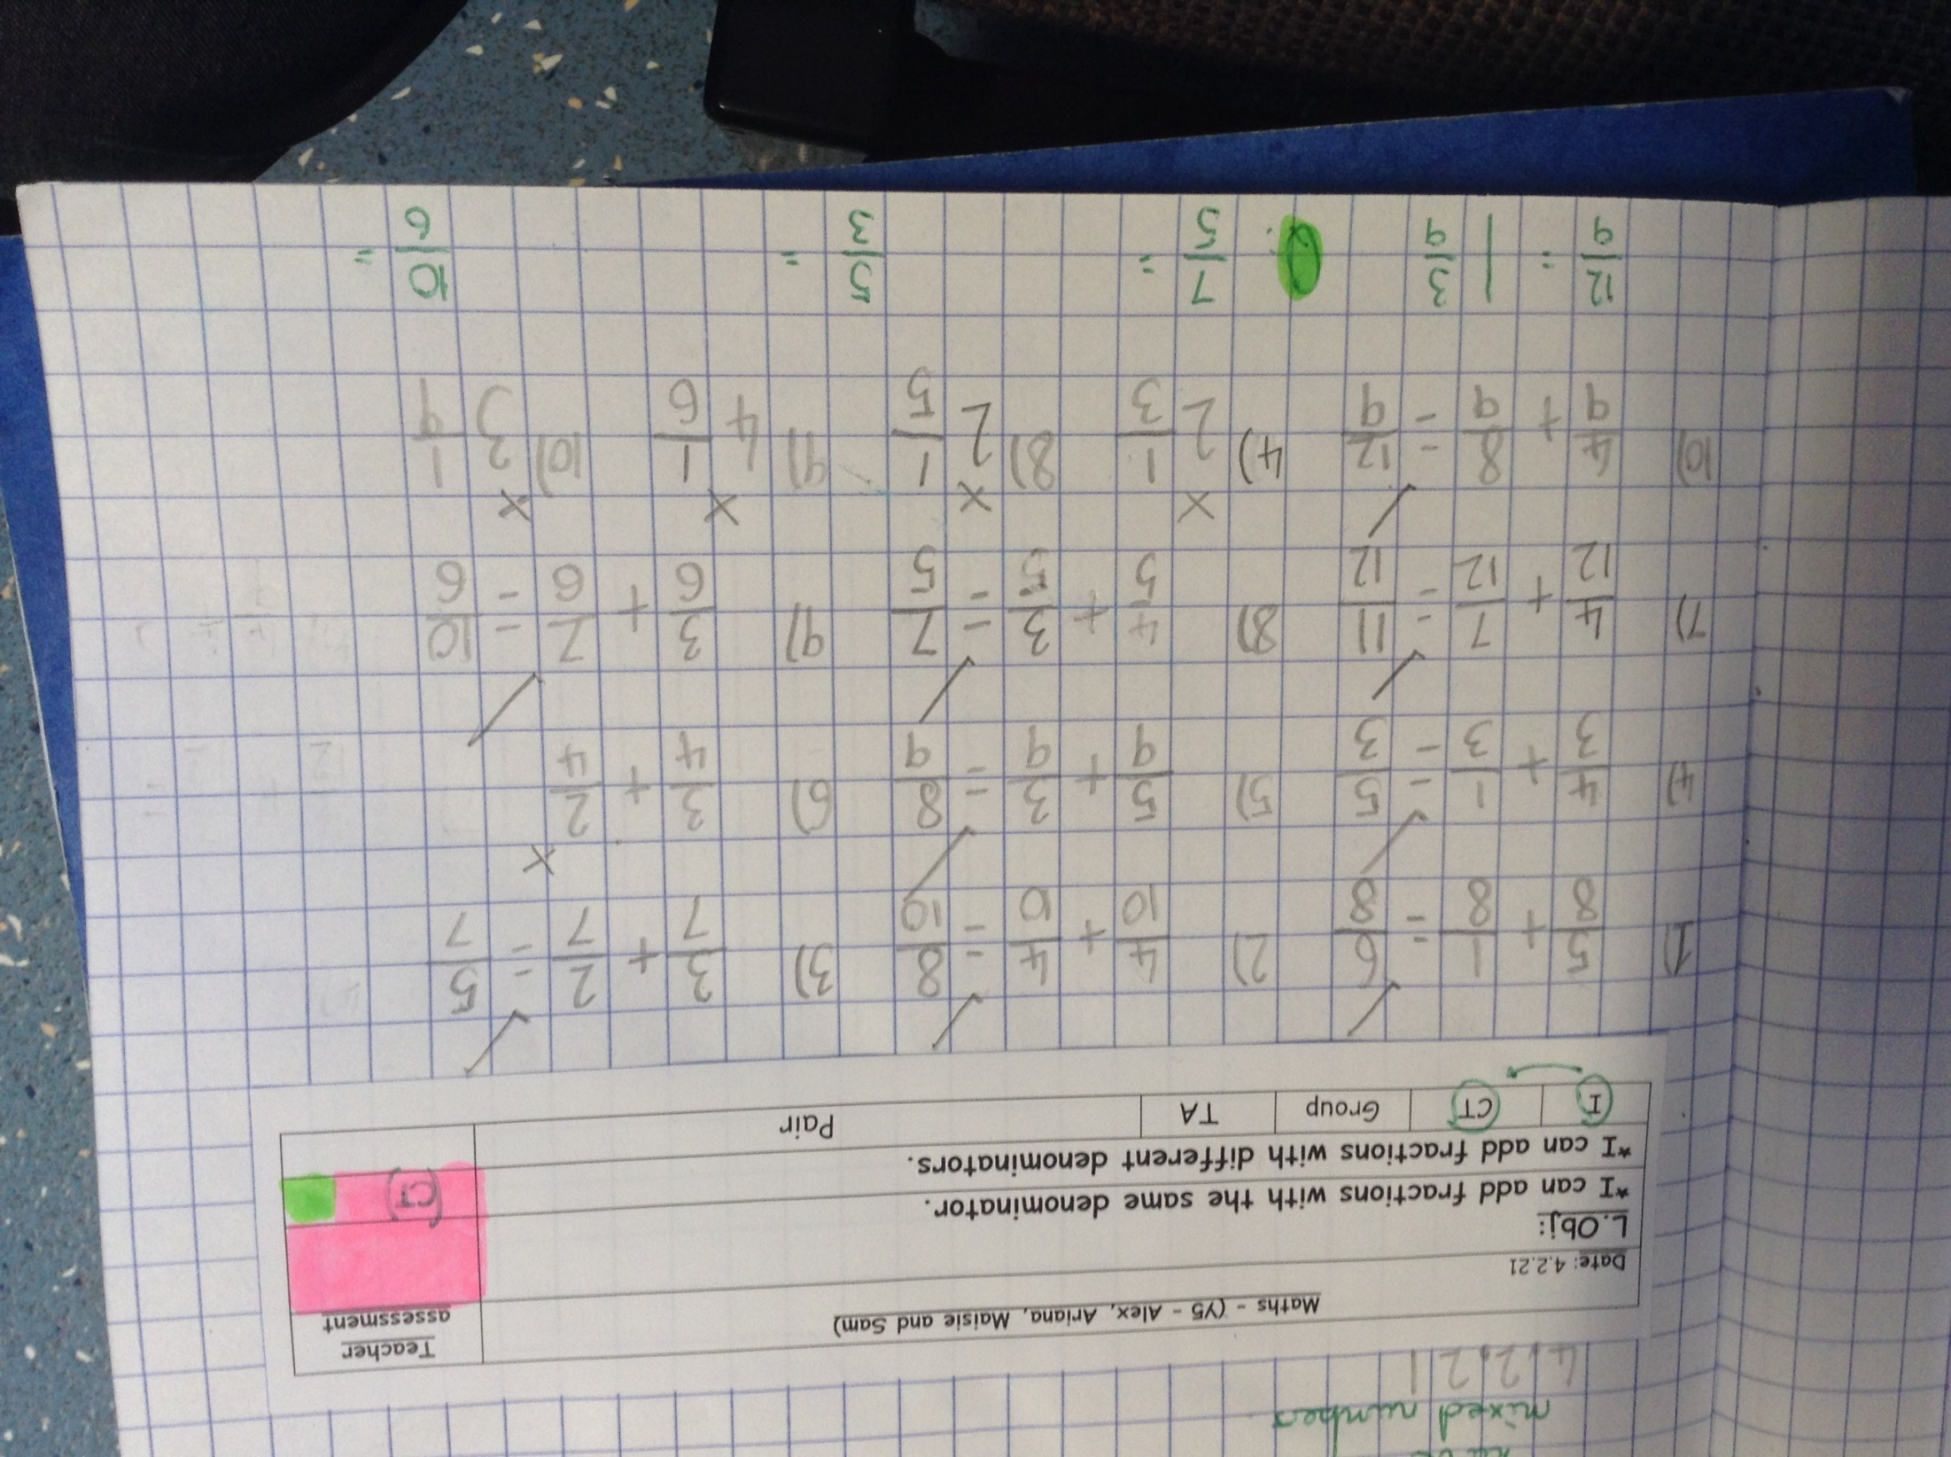
Ariana has been adding fractions today.

Slide 23
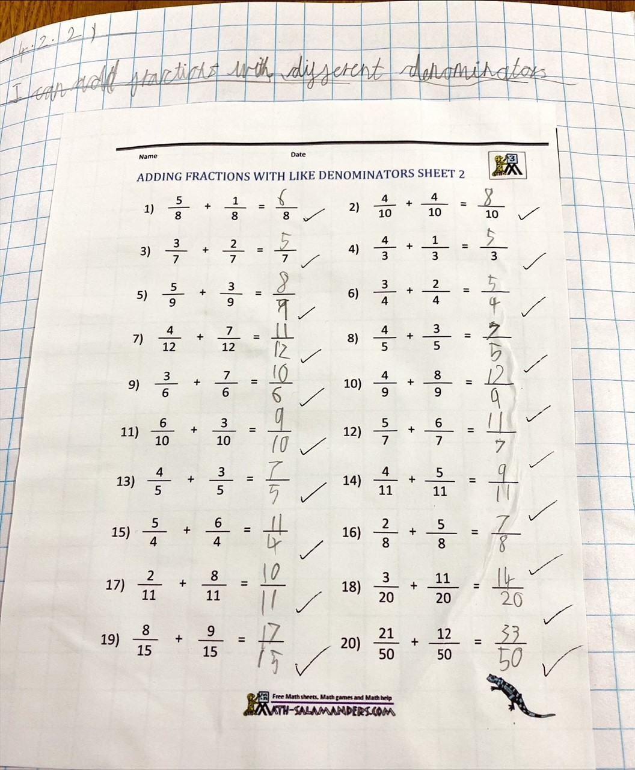
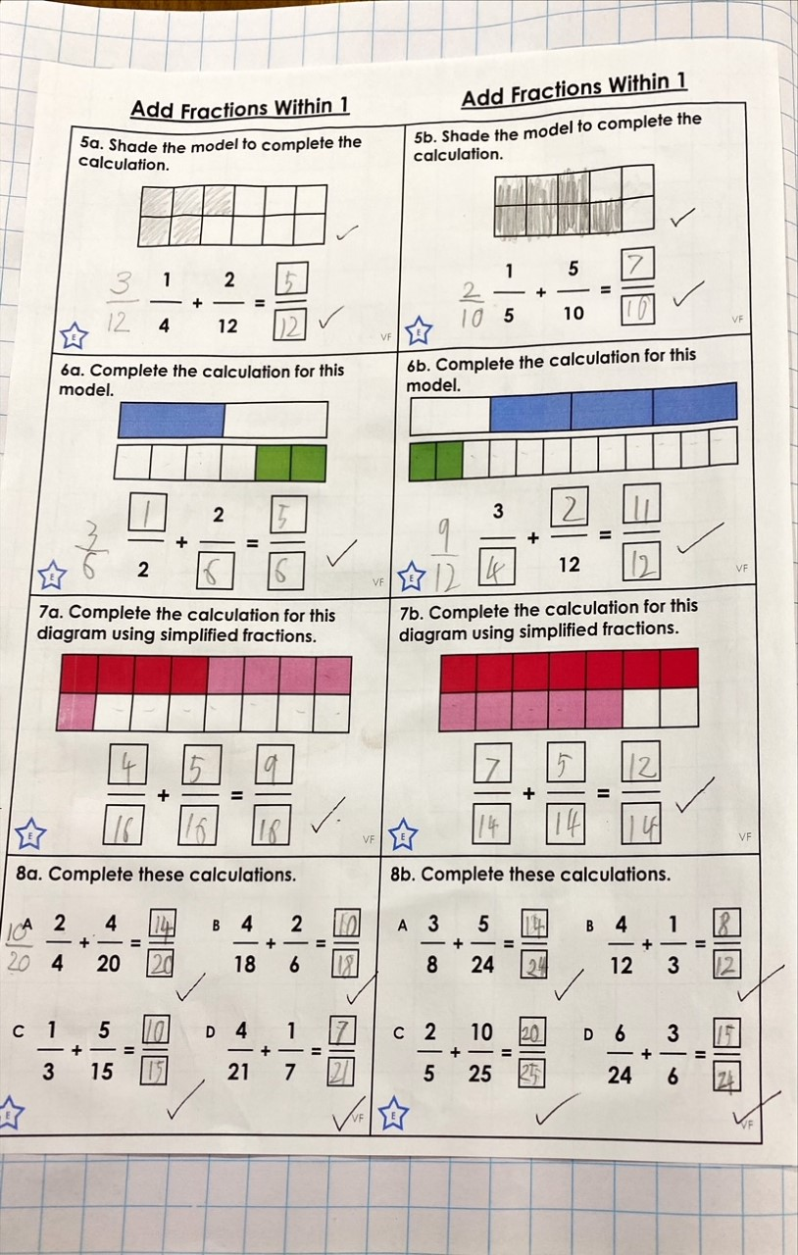
Sam has been adding fractions today.

Slide 24
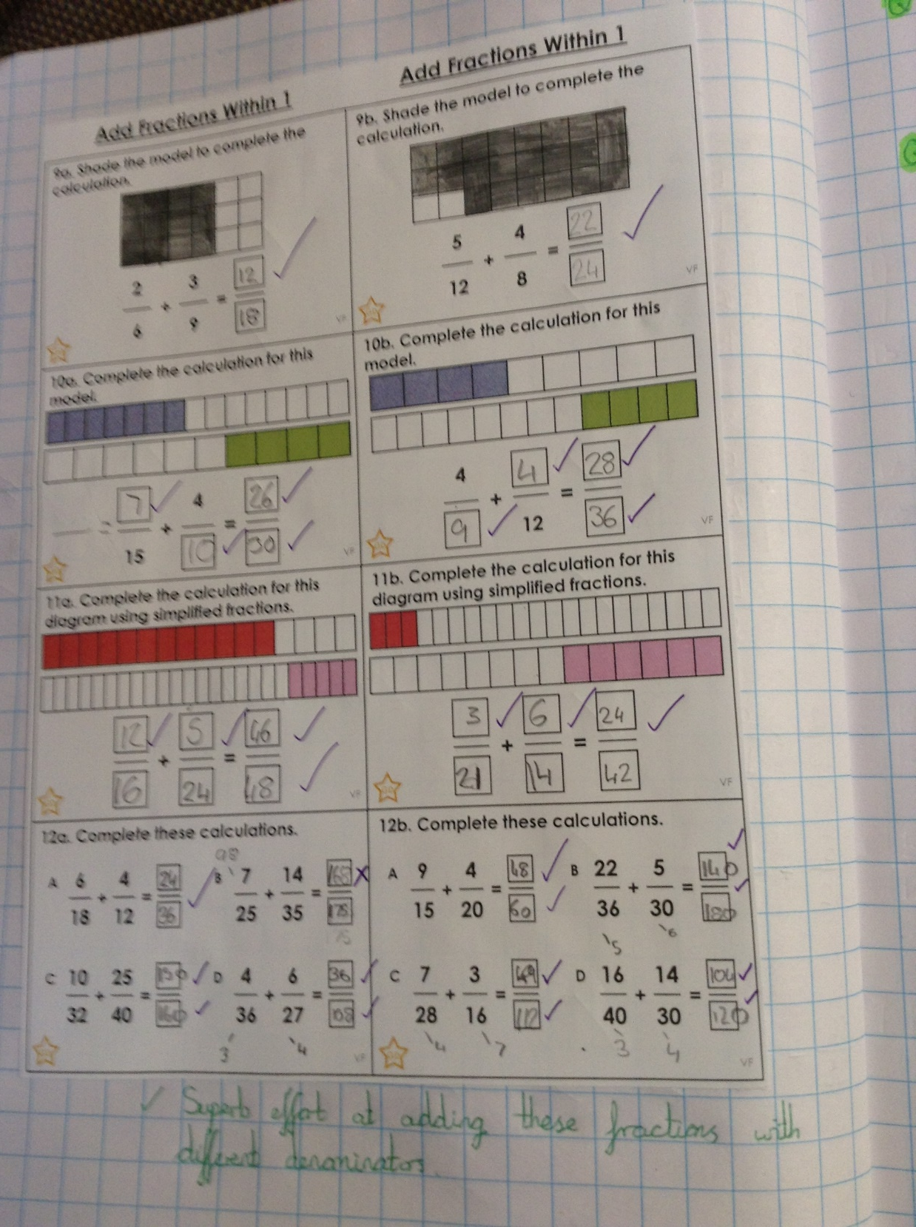
Dylan has then added fractions with different denominators by finding a common denominator.

Slide 25
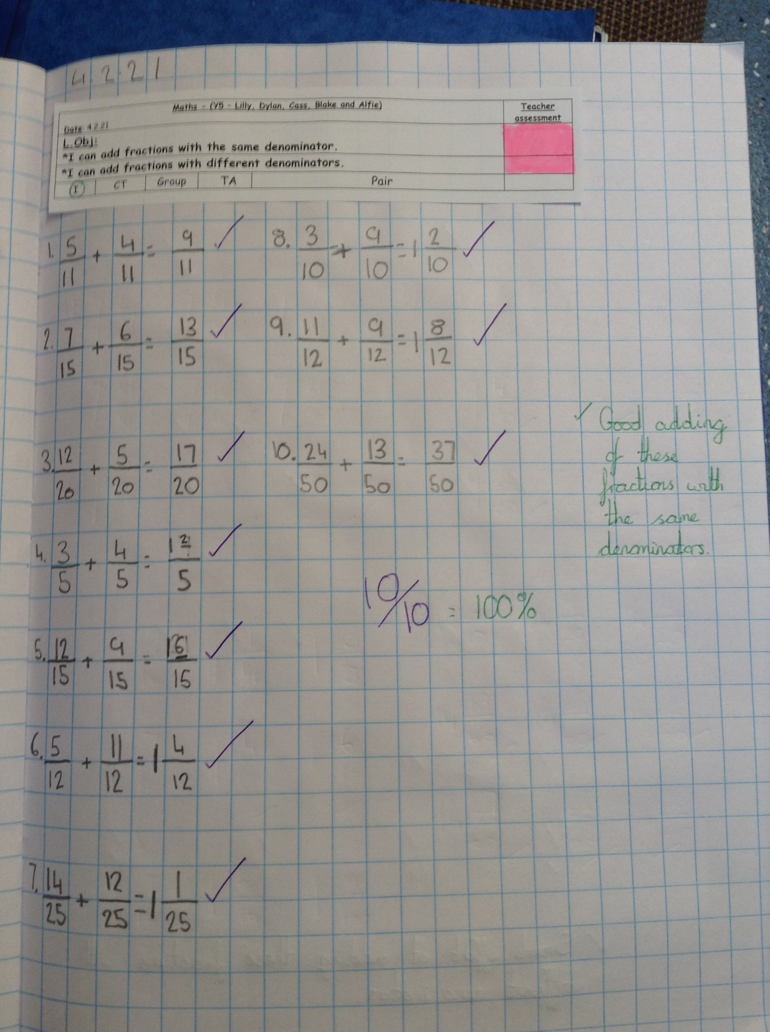
Dylan has added these fractions with the same denominator very well in maths today.

Slide 26
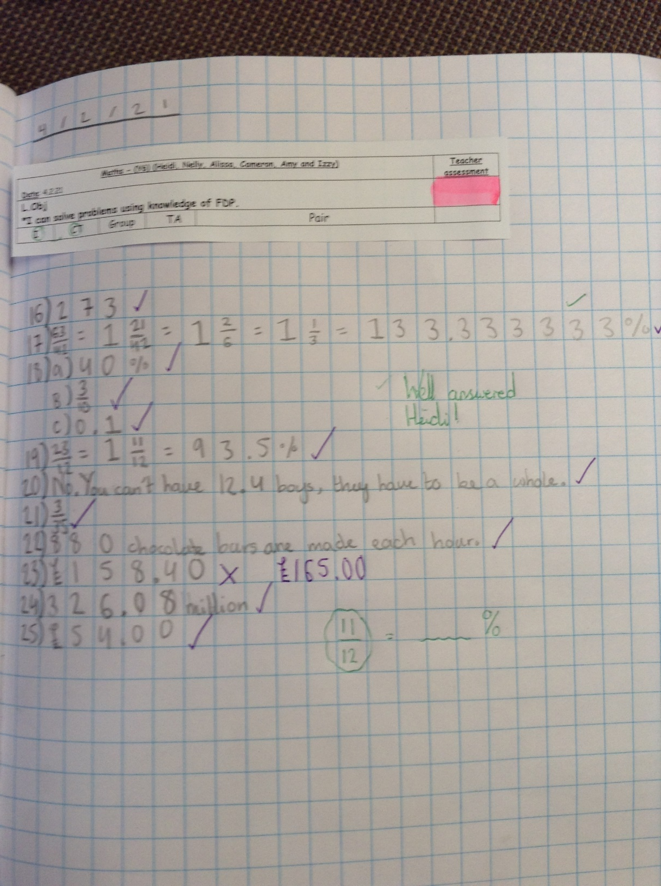
Heidi has been solving problems and calculations based on fractions, decimals and percentages.

Slide 27
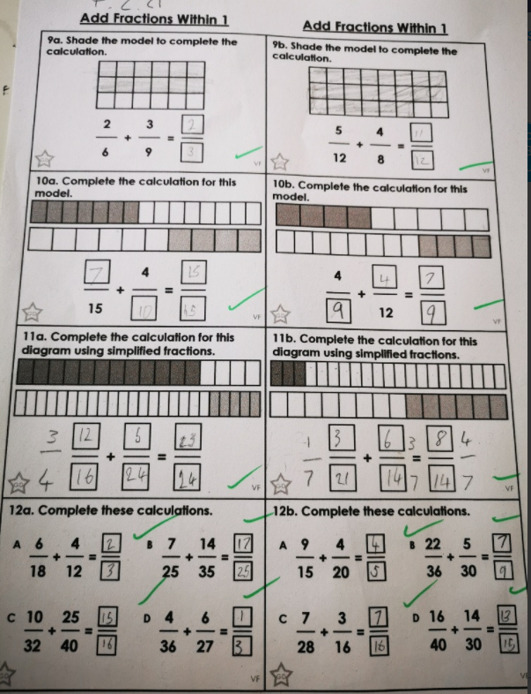
Blake has been adding fractions with different denominators very successfully.

Slide 28
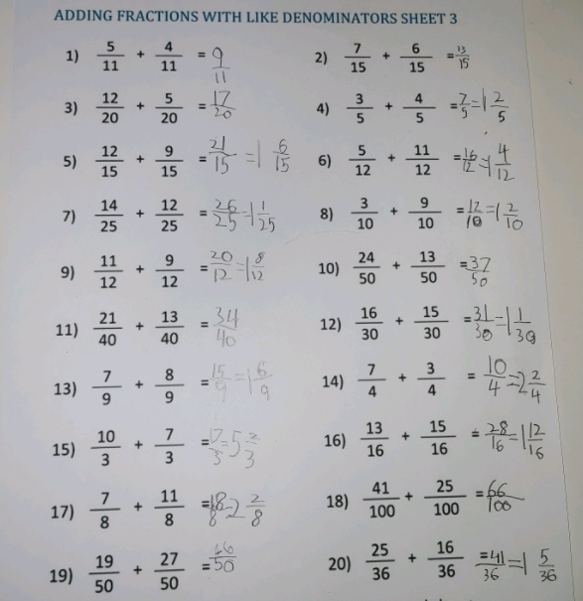
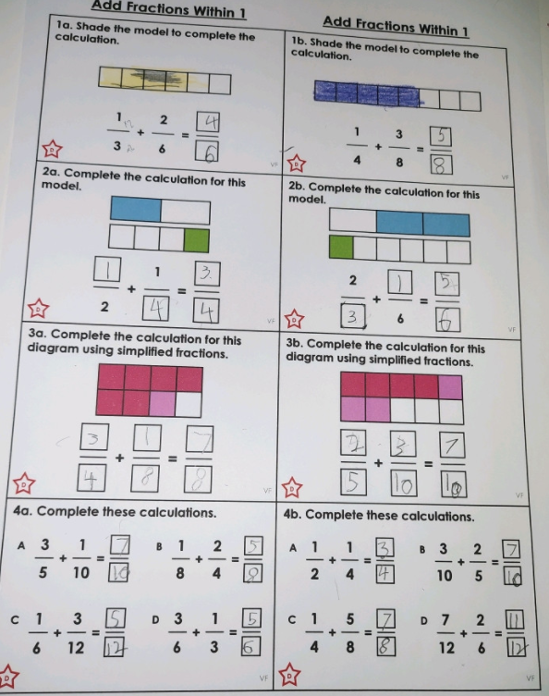
Ollie has added fractions with and without the same denominator.

Slide 29
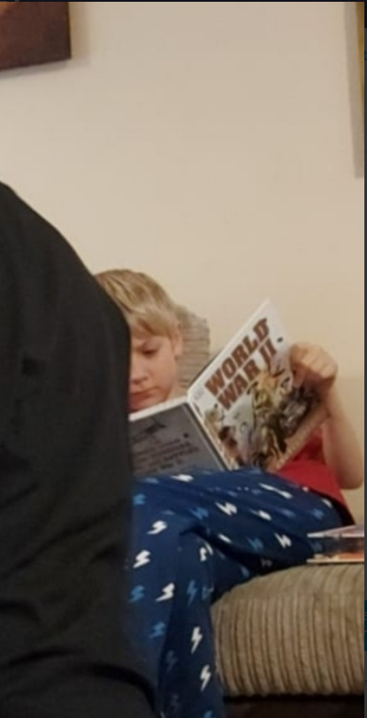
Ollie loves learning about the events of World War 2.

Slide 30
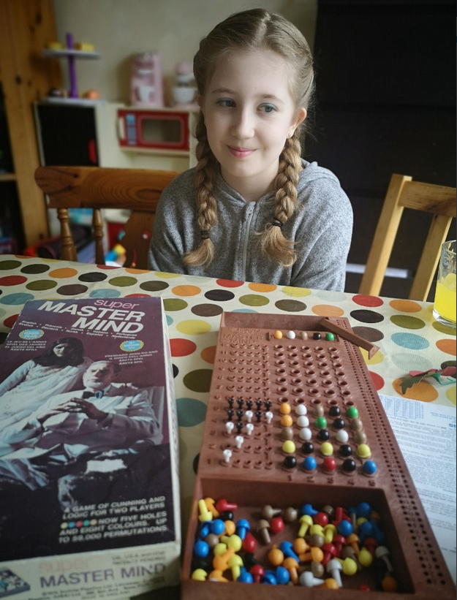
Lilly has played a few games of Master Mind today.
I wonder what she’s thinking in this photograph? Any suggestions?
“_____________
_____________
_____________”

Slide 31
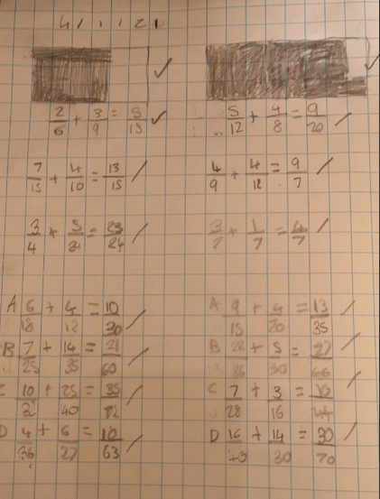
Lilly has been adding fractions today, with and without the same denominator.

