Slide 1
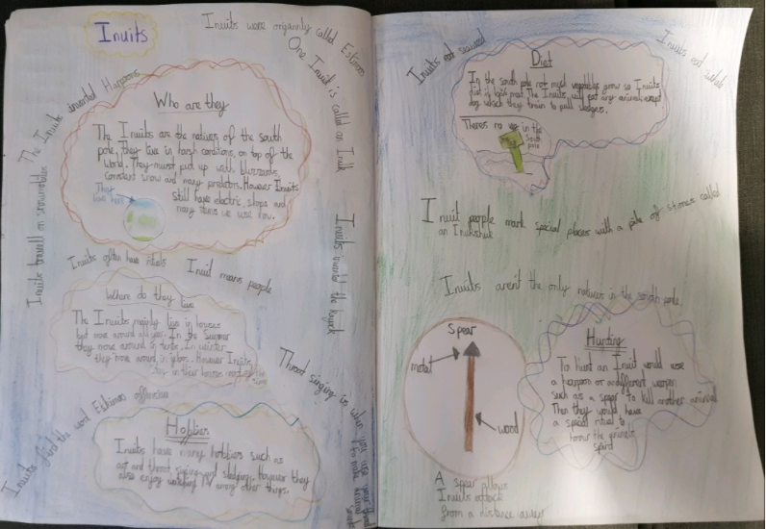
Cameron’s double page spread

Slide 2
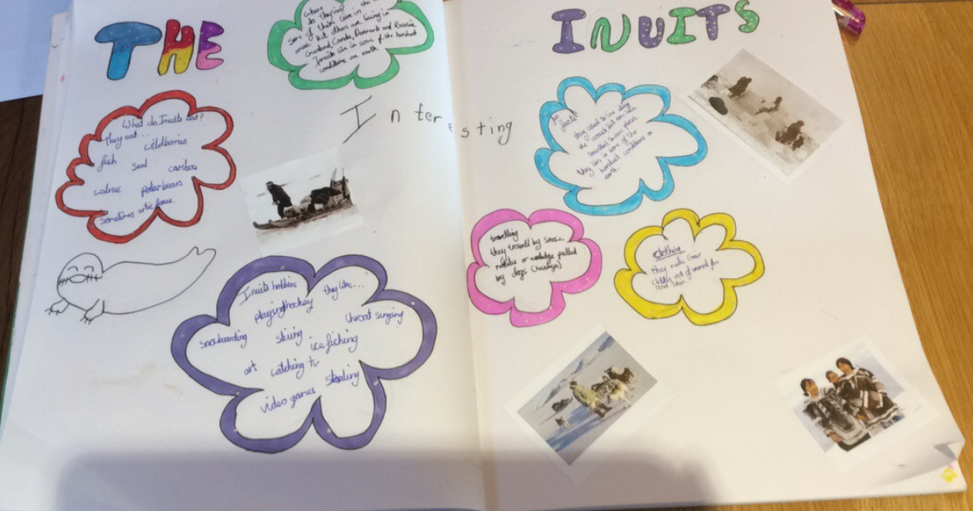
Holly H’s double page spread

Slide 3
Jacob’s biography of Ernest Shackleton
Ernest Shackleton
Ernest Shackleton was an Anglo-Irish best known polar explorer who was associated with four expeditions exploring the Antarctica.
Shackleton, was born 15^{th Feb} 1874 in Kilkea, County Kildare, Ireland. His mother was called Henrietta and his father Henry, who was a doctor, hoped Ernest would become one too. When Ernest was 10 years old he moved to London with his family and was raised with his 9 other siblings Ernest being the second oldest. As a child Ernest loved to read, it inspired him to have his own adventures. He was home schooled until the age of 11. He then went to Firlodge preparatory school. In 1887 he went to Dulwich College where he later dropped out in 1890 and joined the merchant Navy at the young age of 16. The options available were a Royal Navy Cadetship at Britannia, which Shackleton could not afford; the mercantile marine cadetships Worcester and Conway; or an apprenticeship “before the mast” on a sailing vessel. The 3rd option was chosen. His father was able to secure him a berth with the North Western shipping company aboard the square-rigged sailing ship Houghton Tower.
He spent 4 years at sea, where he learnt his trade, visiting the four corners of the earth and forming acquaintances with a variety of people from many walks of life, learning to be at home with all kinds of men. In August 1894, he passed his examination for second mate and accepted a post as third officer on a tramp steamer of the Welsh Shire Line. Two years later, he had obtained his first mate's ticket, and in 1898, he was certified as a master mariner, qualifying him to command a British ship anywhere in the world.
Ernest Shackleton went on his first Antarctic expedition in 1901, along with Robert Scott and trekked closer to the pole than anyone before him. However, he became very sick and had to go back home early.
In 1904 he married Emily Mary Dorman at Christ Church, Westminster. They had 3 children Raymond, Cecily and Edward. He was a womanizer and Unfortunately was not a good husband or father.
In 1908, he went on his second Antarctic expedition, this time as leader, on the ship Nimrod. The team left behind several crates of brandy and whiskey which were found in Antarctica in 2010.
After the Nimrod expedition, Shackleton was regarded as a hero and was awarded a medal by the Royal Geographical Society. He was also knighted, becoming Sir Ernest Shackleton.
During this time, he made money from lecturing about his travels. He also dabbled in Hungarian mining, selling stamps and he created a tobacco company.
Before his next expedition, Shackleton placed a newspaper ad asking for men to join him. The advertisement promised dangerous conditions, low wages and cold temperatures.
On his 3rd expedition in 1914, Shackleton’s ship, Endurance, was trapped in the ice for almost a year. The team escaped by sailing across 1,300 km of ocean in a small boat to the tiny uninhabited South Georgia island. Amazingly, all of Shackleton’s crew survived the journey.
Shackleton’s final expedition in 1921 to the Antarctica aboard the Quest was an attempt to map 2000 miles of coastline. By this time he was in poor health, though he was disguising it well from those around him. Sadly Ernest Shackleton died from a heart attack in 1922 while on this expedition, and he was buried on the remote Atlantic island of South Georgia.
Although Ernest was unsuccessful in his expeditions his remarkable tales and survival skills are what make him famous today.

Slide 4
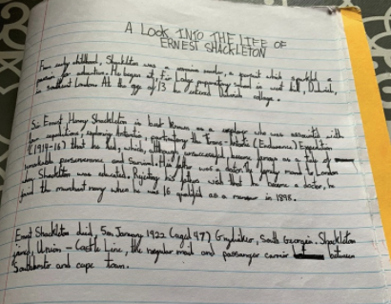
Maisie has been completing her biography of Ernest Shackleton.

Slide 5
Lilly has completed her biography of Ernest Shackleton.
Introduction
Ernest Shackleton is famous because more than a centaury ago he was on a Antarctic expedition called Imperial Trans- Antarctic Expedition. On that journey his sights were incredible different species, the fury polar bears and even widdle waddle penguins! Read on to find out more about this mans amazing expedition.
Life At A Young Age
When Ernest Shackleton was born on the 15th February 1874 he grew up in, Kilkia Ireland as a kid he was a passionate reader. He was schooled by a Governess until the age of 11 , the age when he had started Fir Lodge Preparatory school in west hill Dulwich in southeast London at the age of 13 he entered Dulwich College.
His life
On 9 April 1904 he married Emily Dorman with whom he had three children: Raymond Cecily and Edward, him self an explorer and later a politician in 1905 Shackleton became a shareholders in a speculative company and aimed to make a fortune transporting Russian troops home from the far east.
His expedition
Shackleton was chosen to go on the Antarctic expedition led by British naval officer Robert Falcon Scott on the ship 'Discovery'. With Scott and one other, Shackleton trekked towards the South Pole in extremely difficult conditions, getting closer to the Pole than anyone had come before. Shackleton became seriously ill and had to return home but had gained

Slide 6
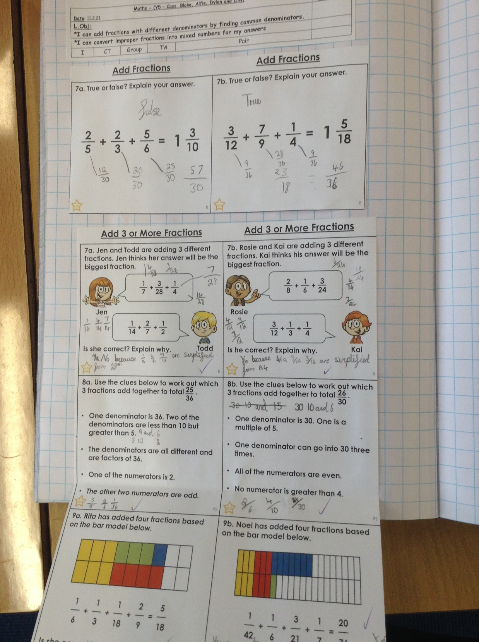
Cass added these fractions with different denominators today to solve these problems.

Slide 7
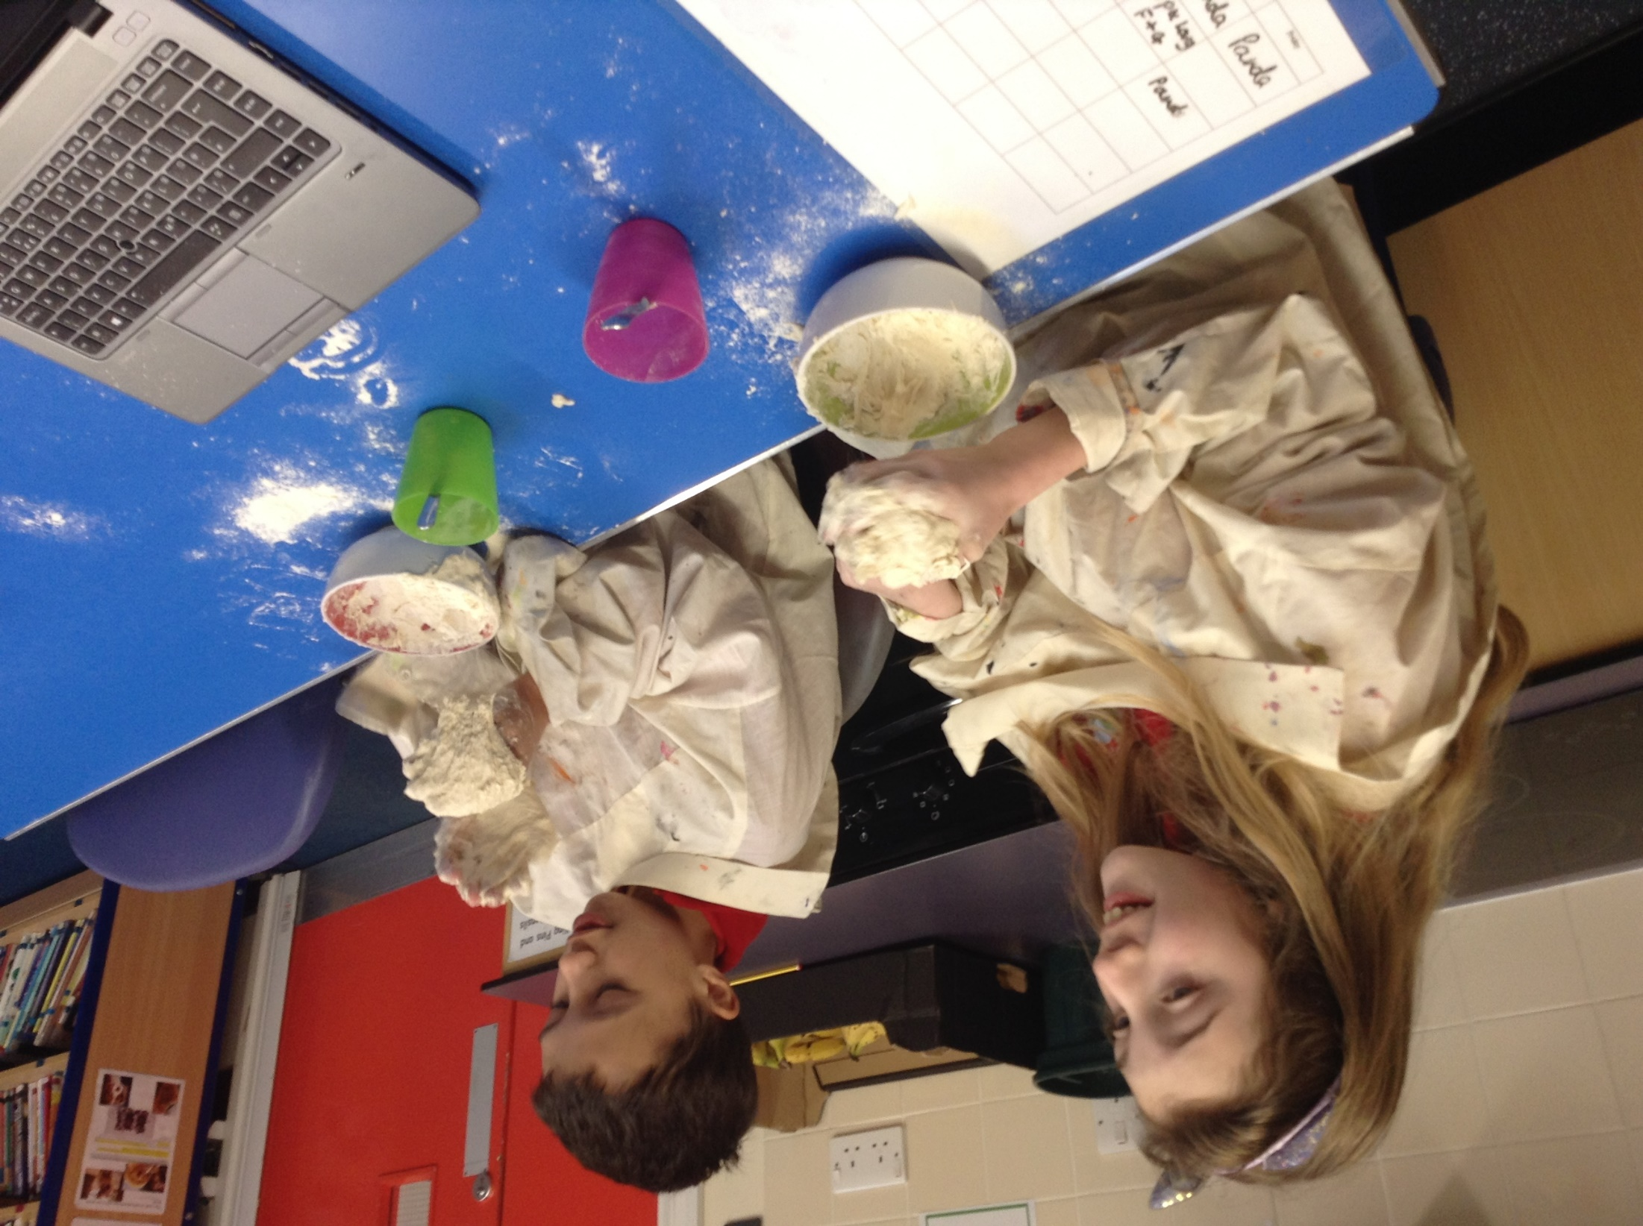
Cameron and Isobel enjoyed taking part in Science today, studying how some substances show more than one state of matter.

Slide 8
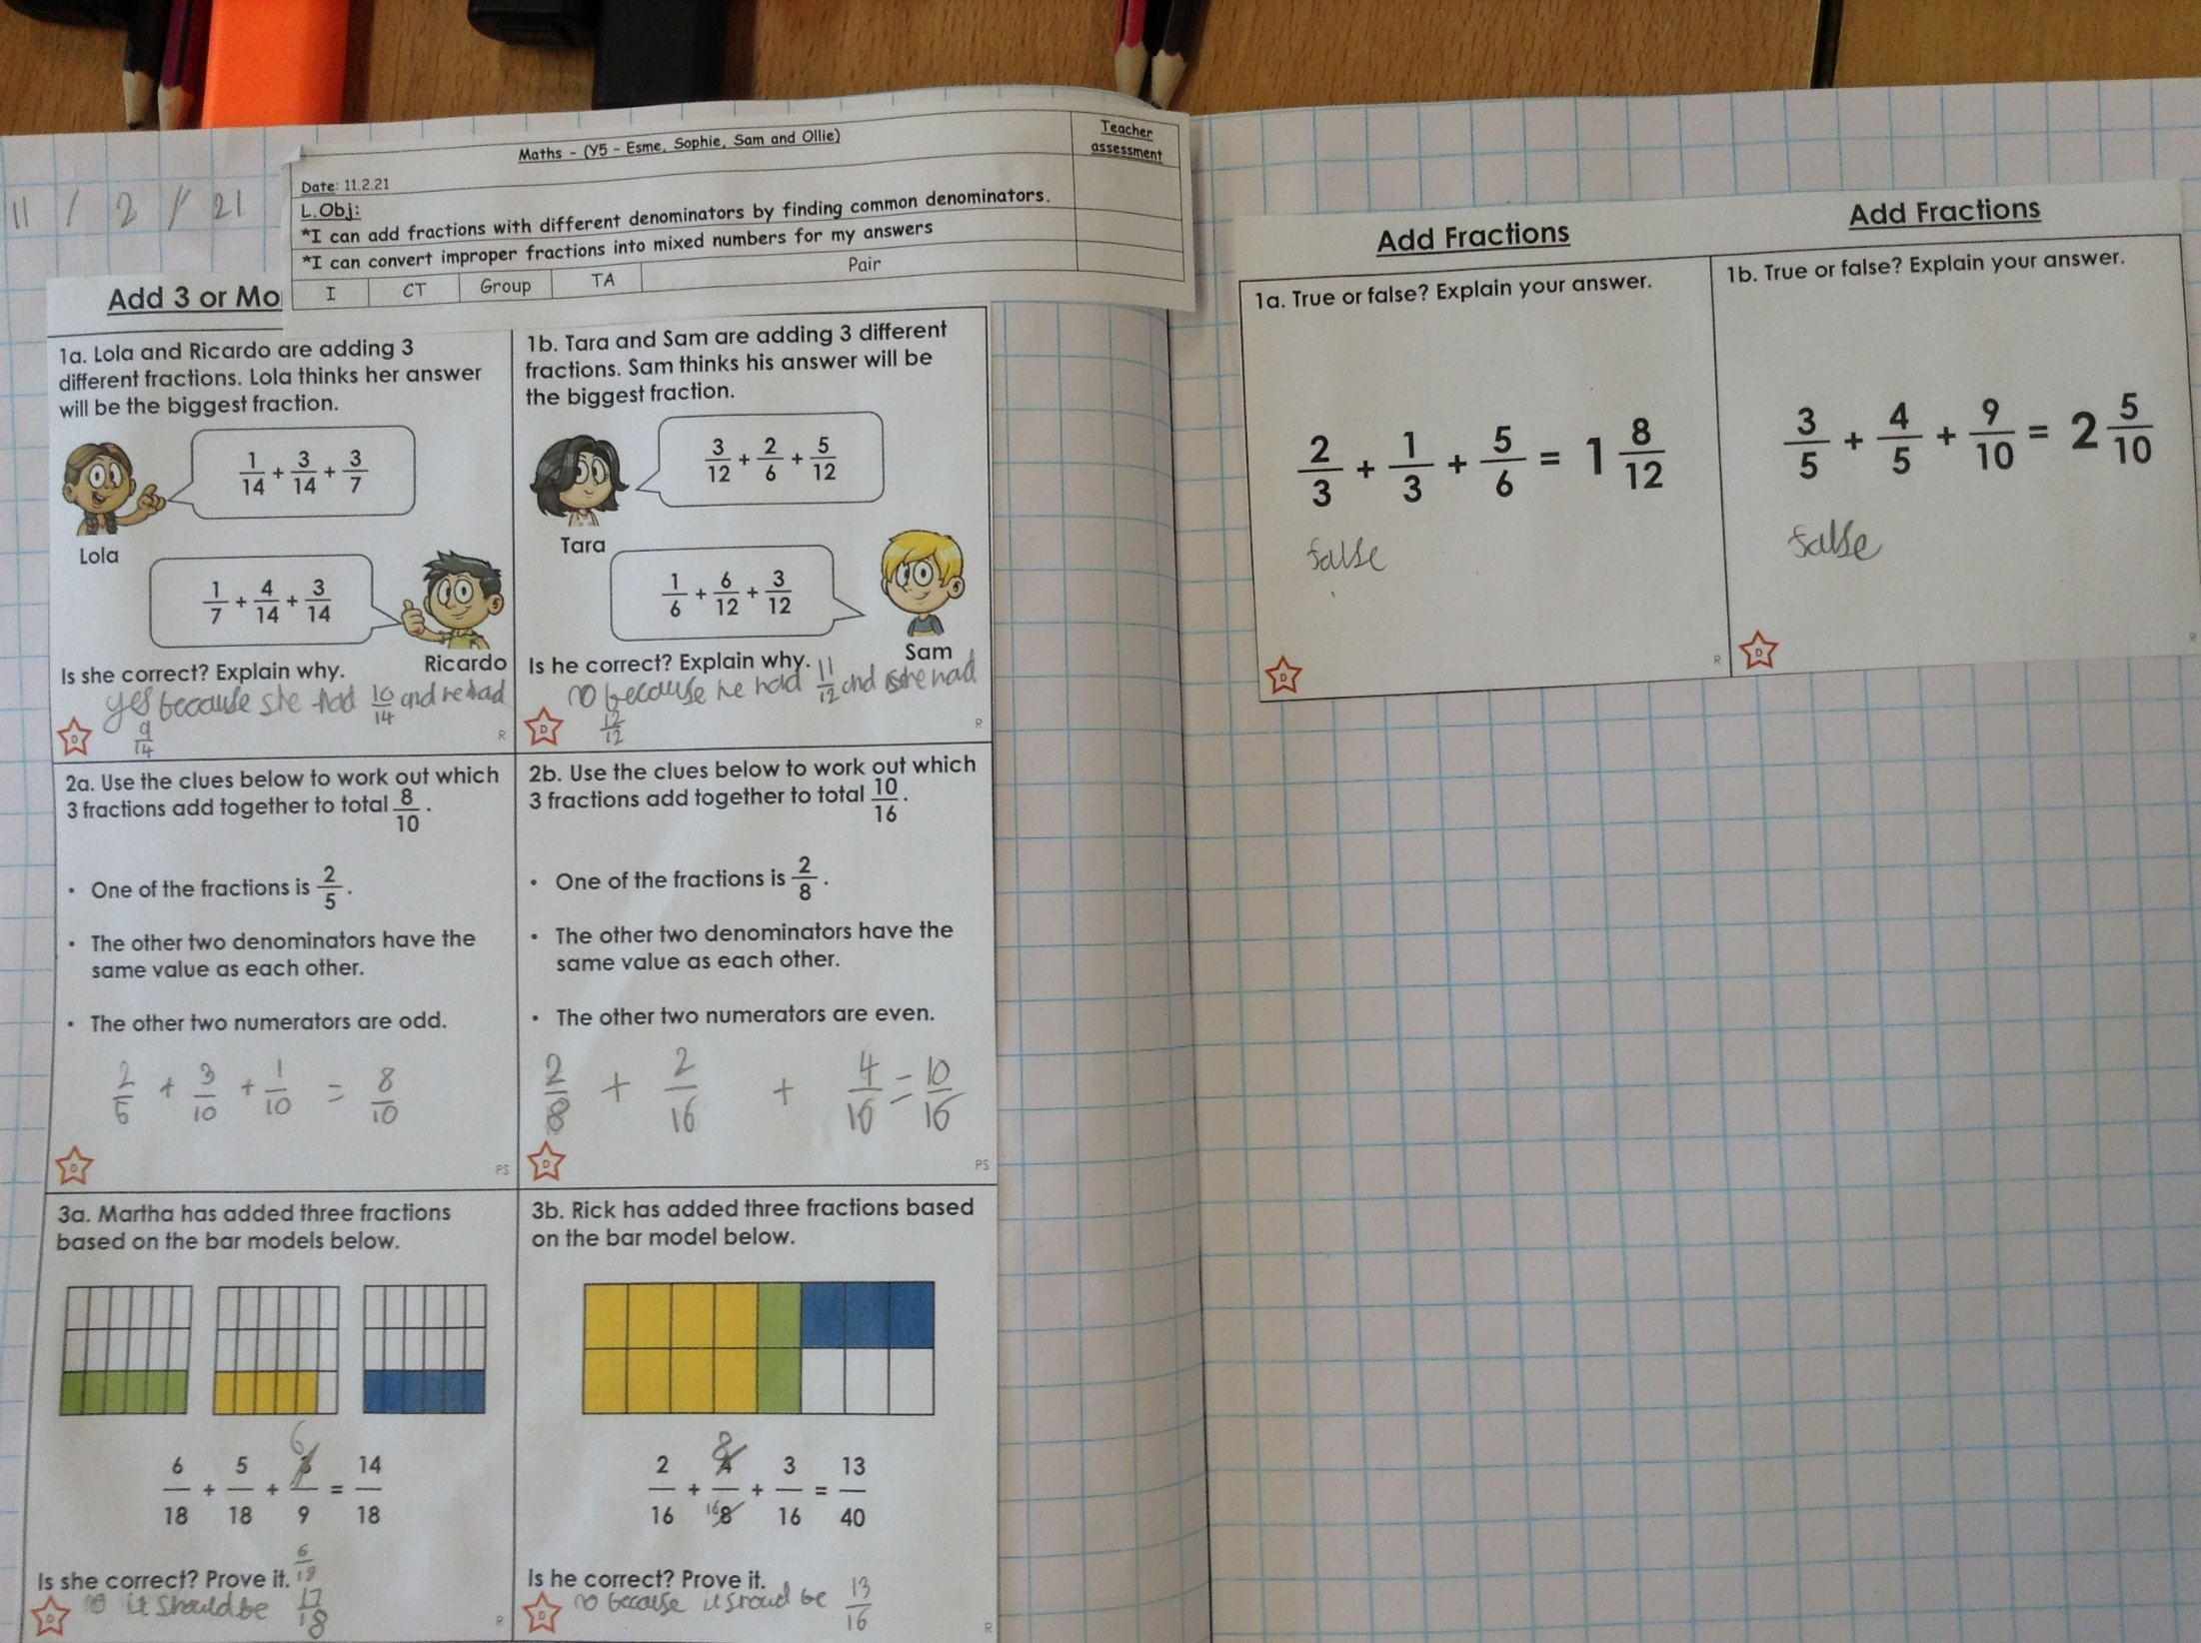
Sophie added fractions with different denominators to equal mixed numbers.

Slide 9
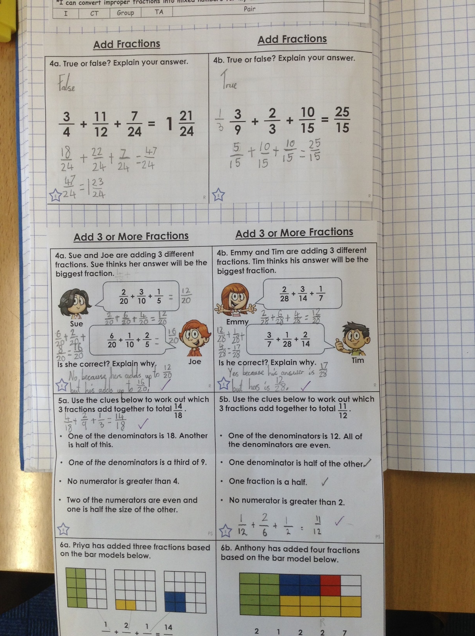
Ariana added fractions with different denominators very well to solve these problems today.

Slide 10
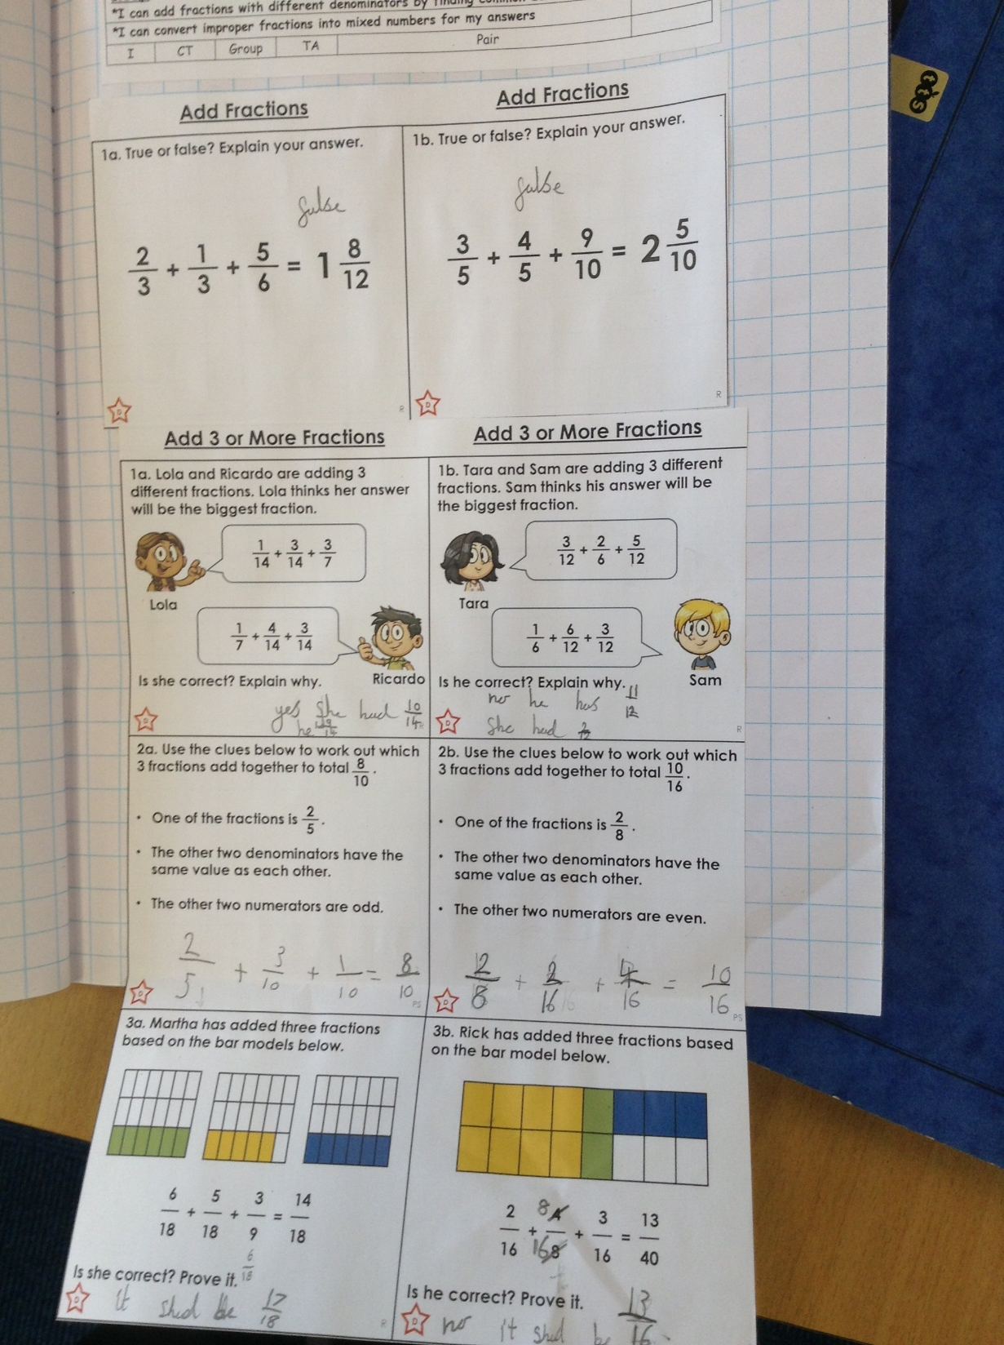
Esme added these fractions with different denominators well today to solve these maths problems.

Slide 11
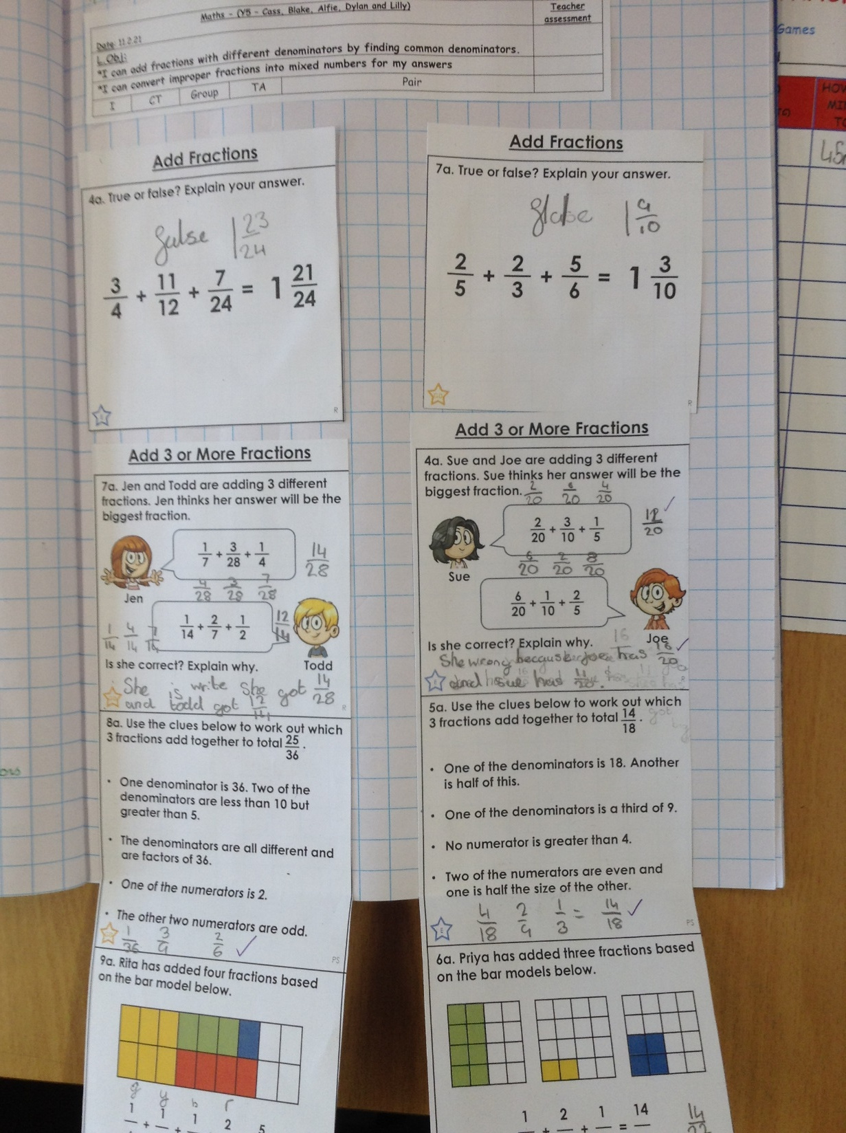
Alfie added these fractions with different denominators very well today to solve these problems in maths.

Slide 12
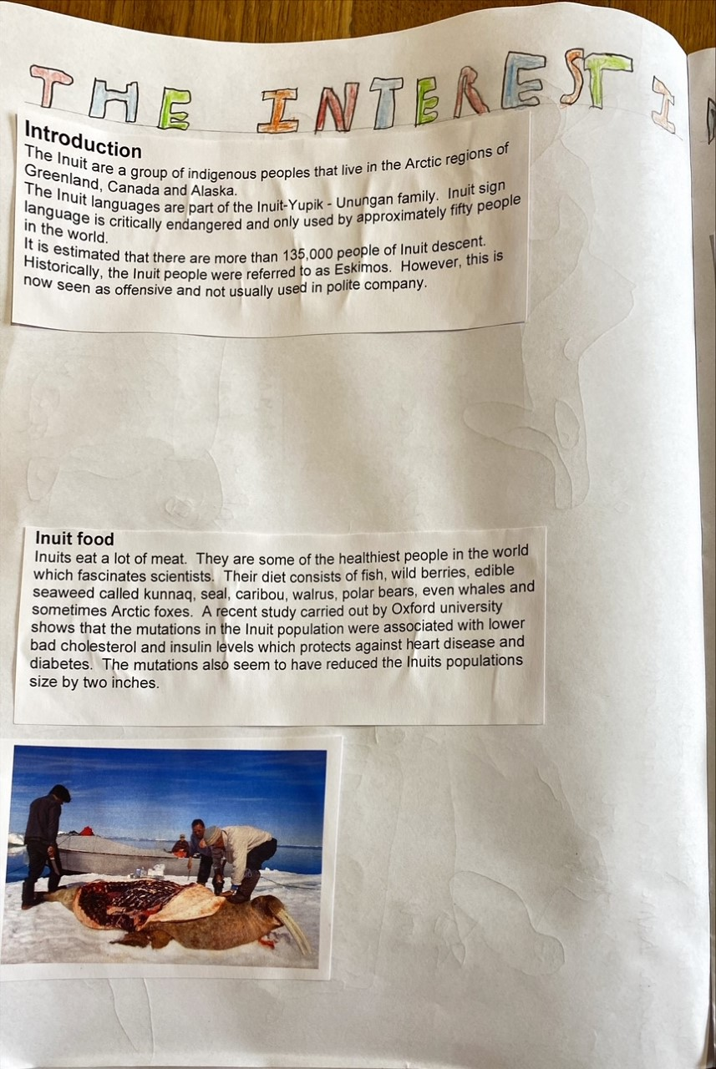
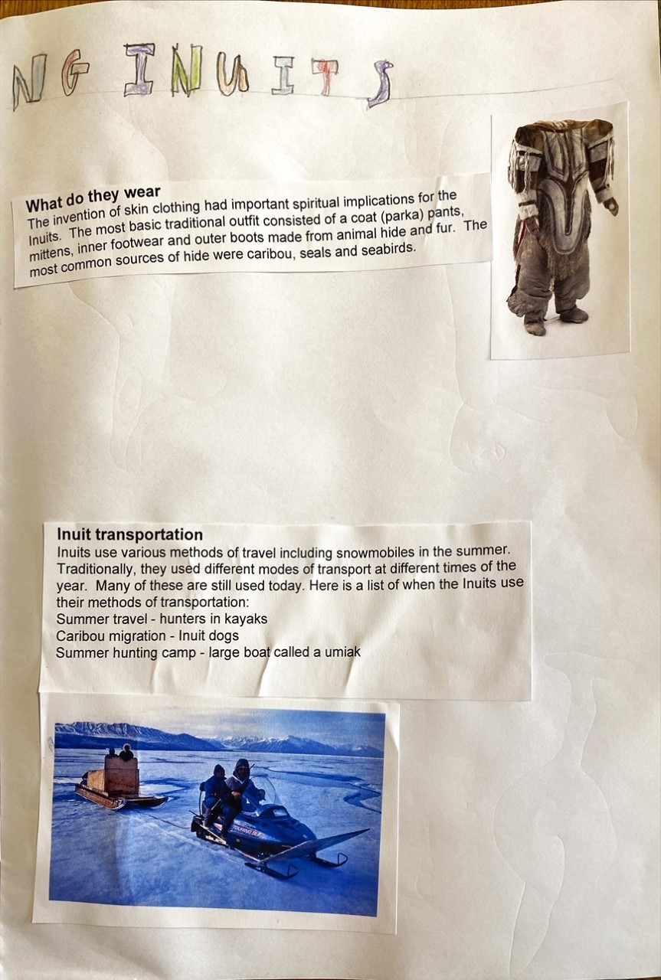
Sam has been focused on his learning about the Inuit people today.

Slide 13
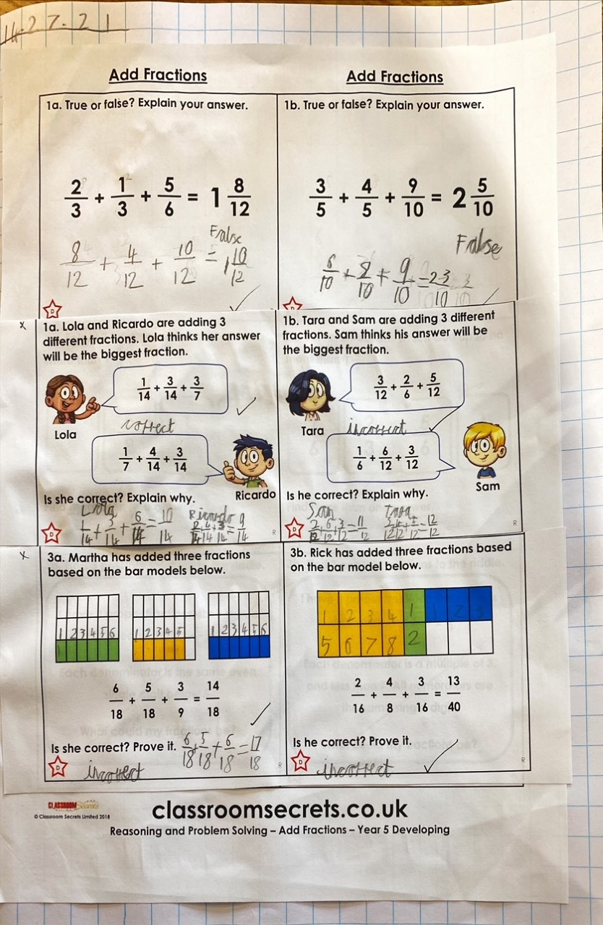
Sam has been focused on his maths today – adding three fractions with different denominators.

Slide 14
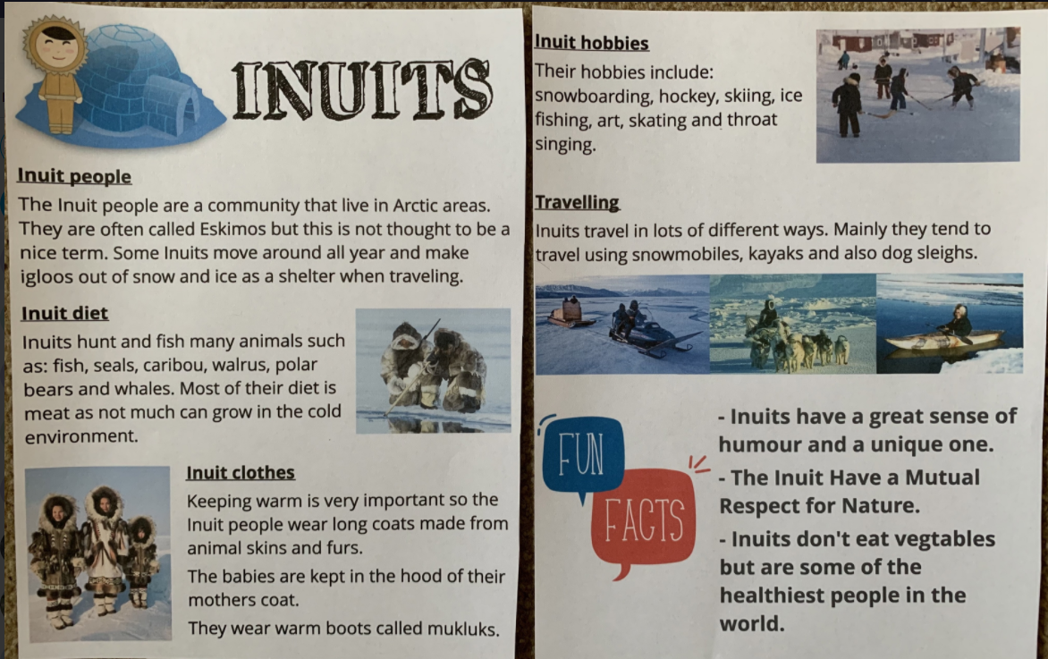
Sophie Collins’ fantastic ‘Inuit’ double page spread

Slide 15
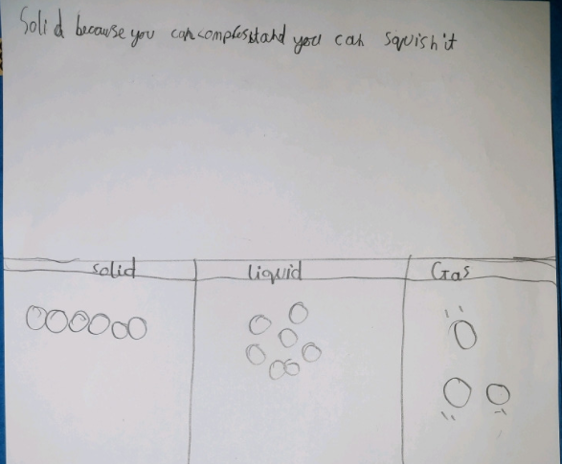
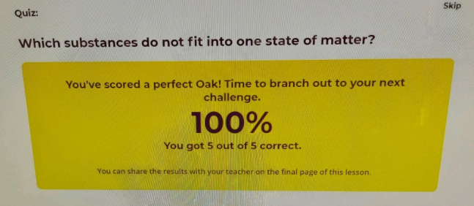
Ollie has been learning more about solids, liquids and gases today in Science.

Slide 16
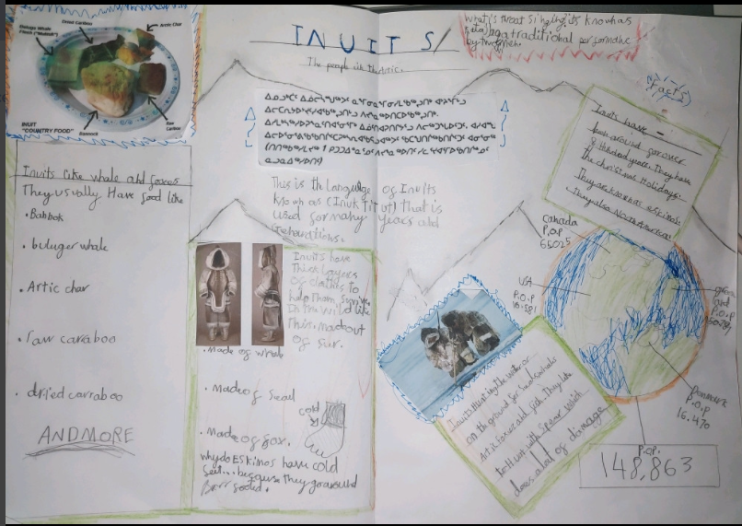
Ollie has been learning a lot about the Inuit people.

Slide 17
Amy has been revising the areas of her calculation skills which she needed to practise a little bit more.

Slide 18
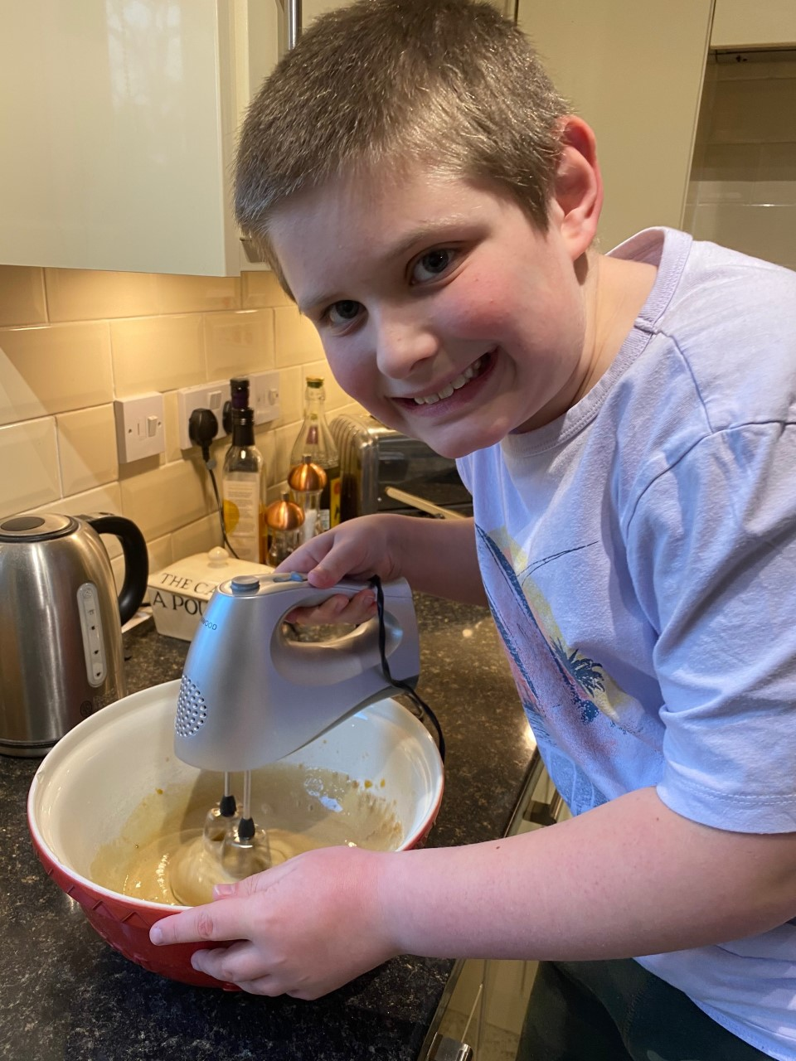
What do you think Sam is making in the kitchen today?
Any guesses?

Slide 19
Amy has completed her biography about
Robert Falcon Scott.
Robert Falcon Scott
Robert Falcon Scott is a well-renowned explorer and scientist. His claim to fame was his Antarctic expedition. Do you know how he ended up there, at the bottom of the Earth? You may think you know all there is to know about him and his life, but do you? Read this text to find out about this amazing man.
Early Life
Robert Scott was born on the 6th of June 1868 to John Edward Scott (a brewer and magistrate,) and Hannah his wife. Since he had spent his first twelve years of life in comfort, playing with his five other siblings and going to a day school in Stoke Damerel, Devon, he was happy. At eight years old, Robert attended Stubbington House School in Hampshire where he prepared himself to complete the entrance exam to be in the Navy- it was a family tradition. Age thirteen, Scott became a cadet.
Life before the expeditions
As a descendant of many sailors, Robert Scott thrived on his boat- HMS Brittania and quickly flew up through the ranks. Just two years since he’d joined, Scott became a mid-shipman (someone who had been in the Navy 2-3 years.) There he was helping the boat and its crew a lot. In March 1888, Scott was promoted to a sub-lieutenant and then in 1889 became a lieutenant. After this, Robert took up a two year torpedo training course on the HMS Vernon.
While this was happening, his family in Devon were suffering greatly as they invested in a deal that didn’t work. This led to them being involved in many financial issues leaving them penniless and reliant on Scott and his two older brothers. Because they had no money, they could do nothing to stop the dreaded heart disease from claiming Robert’s father and brother.
As if it was meant to be, Scott one day stumbled upon Sir Clements Markham, at the time the head of the Royal Geographical Society. They immediately became friends. Clements was planning a scientific expedition to the Antarctic and Scott was eager to be involved…

Slide 20
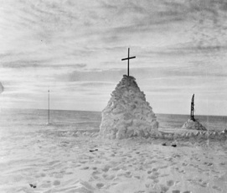
Amy has completed her biography
about Robert Falcon Scott.
Exploration
In 1901 Scott began his voyage. He had become part of the Discovery expedition along with Edward Wilson and Ernest Shackleton. He was 32 years old at the time. They were wrapped up warm and were to try to reach the South Pole first as well as bring back samples of snow and ice, but they did not last long. Being the closest to the pole so far at 82°17′S, they turned back due to bitter conditions, hypothermia, frostbite and scurvy.
Back in Britain, they were welcomed as heroes. King Edward II himself made Scott the commander of the Royal Victorian Order- a role he always wanted. They received many medals, said many speeches and attended many dinners. It was at one of these private luncheon parties in 1907 that Scott met Kathleen Bruce (a professional painter and sculptor.) He married her one year later in 1908, bringing a son into the new family. His name was Peter (later to become Sir Peter.)
Robert Scott decided that he wanted another attempt to reach the pole. He planned an expedition in his spare time. In 1910, he was ready. His team made up of him and 12 other men including: Taylor, Wright (geologists,) Pointing (photographer,) Bowers, Wilson, Evans and Oates. They headed to Antarctica on a whaling ship called the Terra Nova, which means Newfoundland in Latin. They brought ponies, sledges and motorised tractors as well. They seemed unlucky from the start. The terra nova became stuck in an ice flow and did not come out for 21 days. Finally, when they reached the continent, the tractors broke down within a week; until that time the ponies had been struggling but the extra load was not appreciated they, and eight men turned back. This left Scott with four other men. They trekked on for many, many miles, battling bad weather and frostbite, until they reached the pole.
Death in Antarctica
Having finally reached the pole they felt exuberant, the bottom of the world, finally! However, Scott’s celebration was short lived, he and his team realised that a Norwegian had beaten them. They spotted that there was another flag stuck in the ground. Another explorer called Roald Amundsen had beaten them by a month. Defeated greatly Scott and his men turned back. Again their luck had vanished they trekked through the toughest conditions known at that time. Bowers died of frostbite sometime in mid-February 1912 and later, on the 17th of March, Oates walked out of a tent, committing suicide in the hope that his colleagues would speed up and reach safety. On the 29th of March Scott died. Oates gave them 12 extra days to live. He and his two remaining companions froze in their tent after nine days sheltering from the most violent storm ever recorded. Robert was 43. He and his accomplices were found on the Ross ice shelf by a search party sent from Cape Evans. They were only 12.5 miles from their largest depot station.
Scott will be ever remembered for his bravery.

