Slide 1
Recognise 2D and 3D shapes

Slide 2
Which one of these is the odd one out?

Slide 3
What are these shapes?

Slide 4
Which shape is the hexagon?
How can you remember what a hexagon is?
A hexagon has six sides. Both hexagon and six have the letter X in, this might help you.

Slide 5
Complete question 1

Slide 6
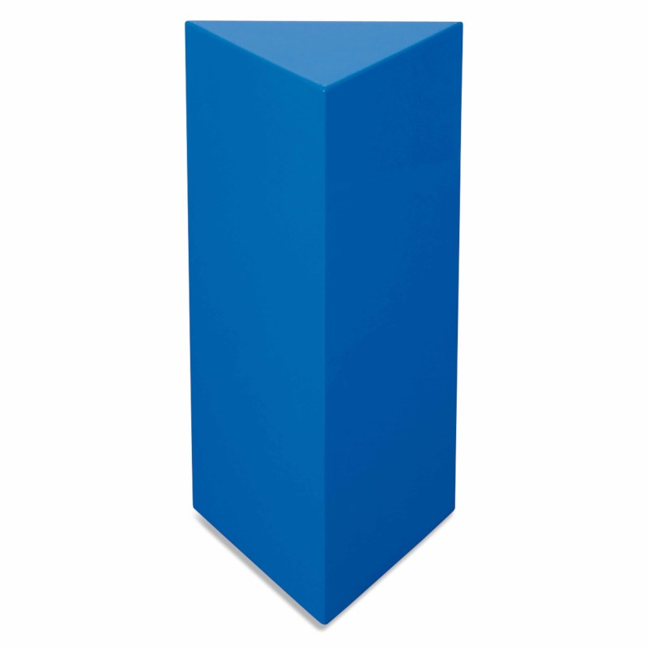
What are these shapes?

Slide 7
Which of these shapes are cylinders?

Slide 8
What shapes can you see?

Slide 9
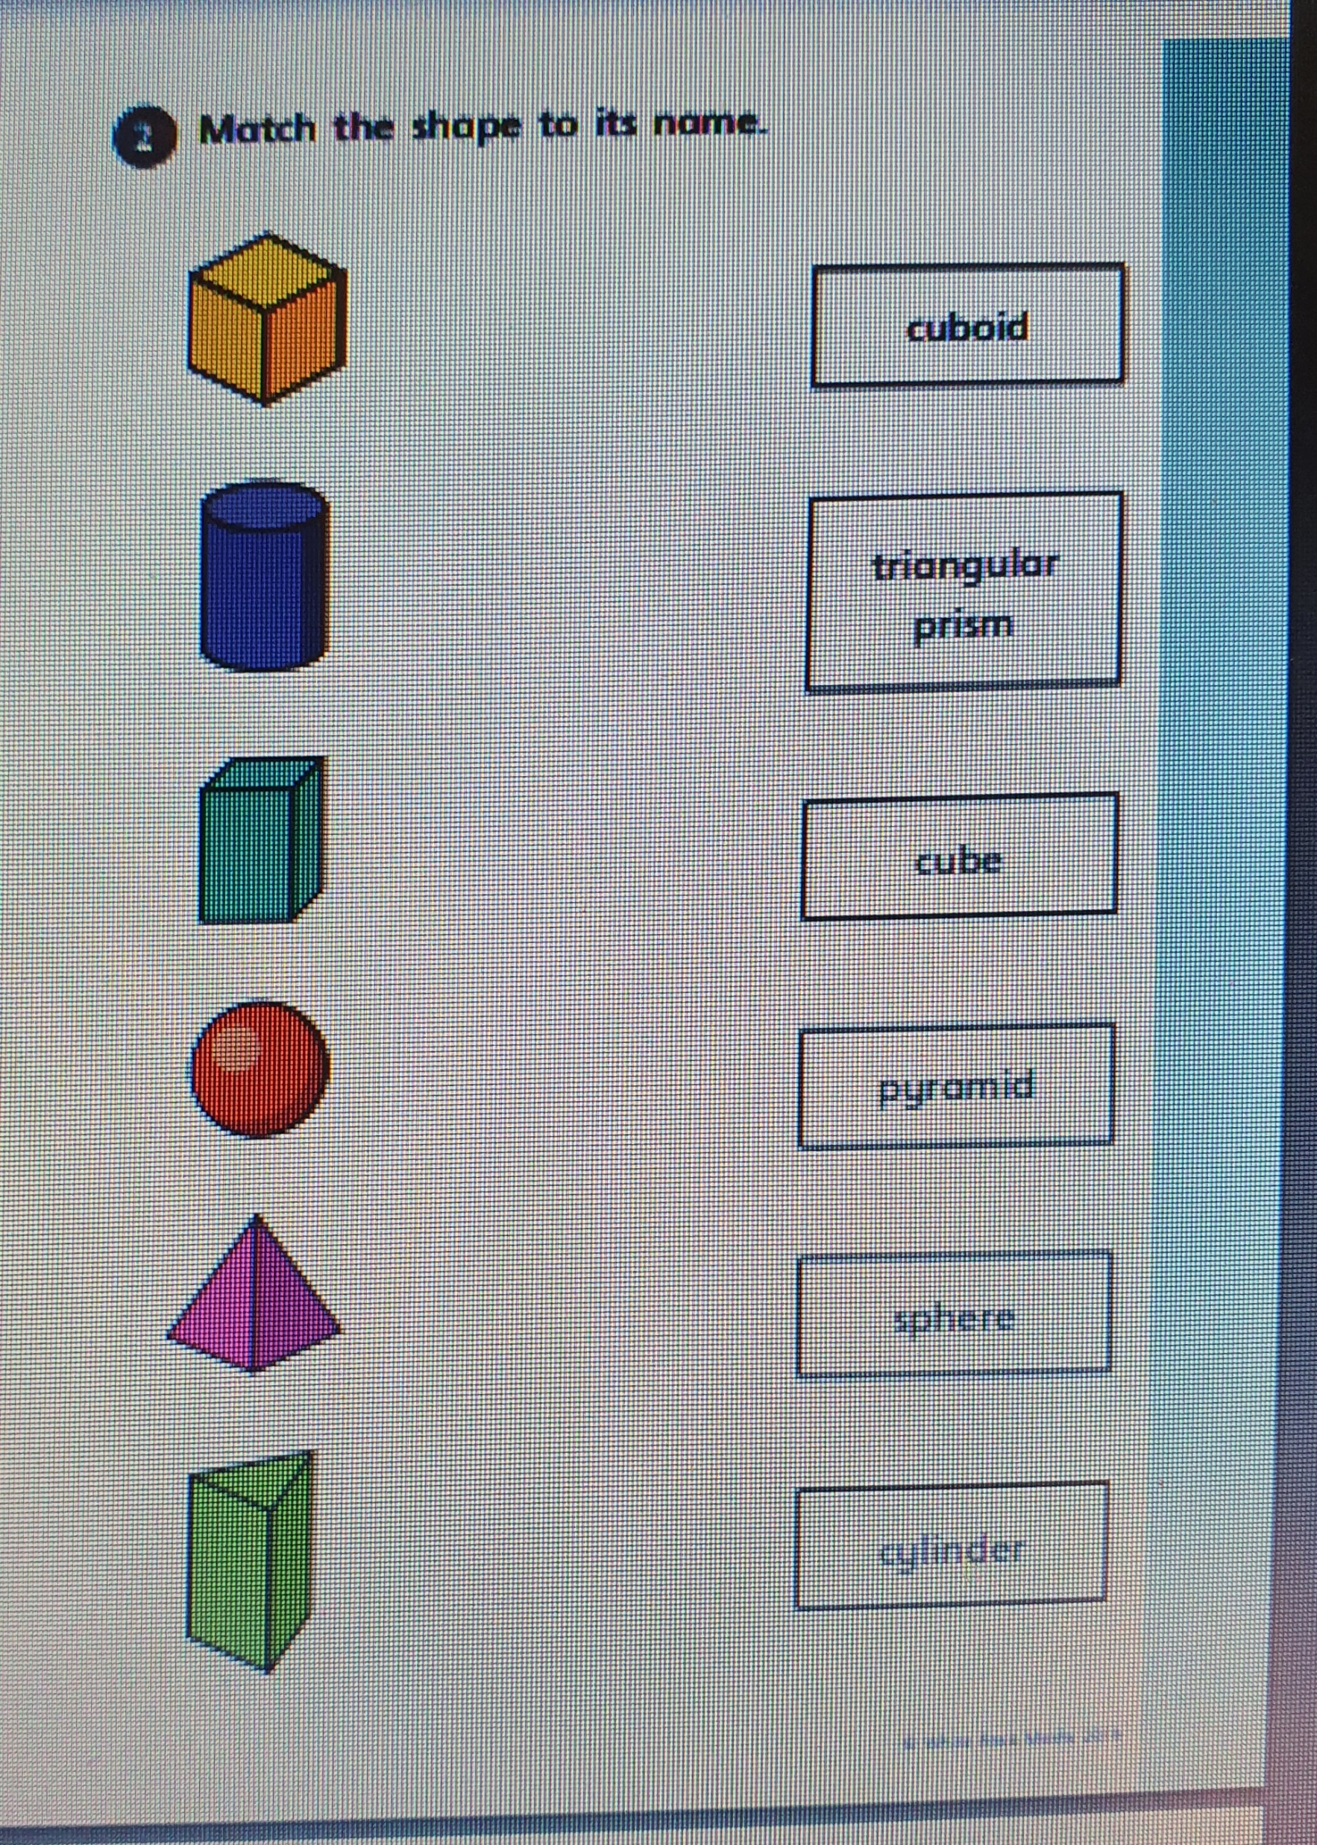
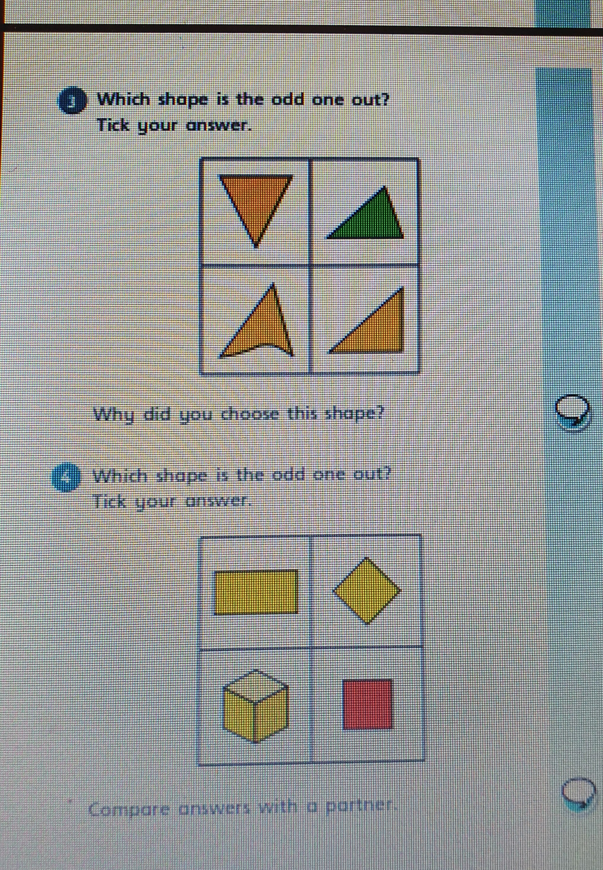
Complete questions 2, 3, 4

Slide 10
Shape Tally Chart
Shape | Tally | Total
Triangles
Squares
Pentagons
Hexagons

Slide 11
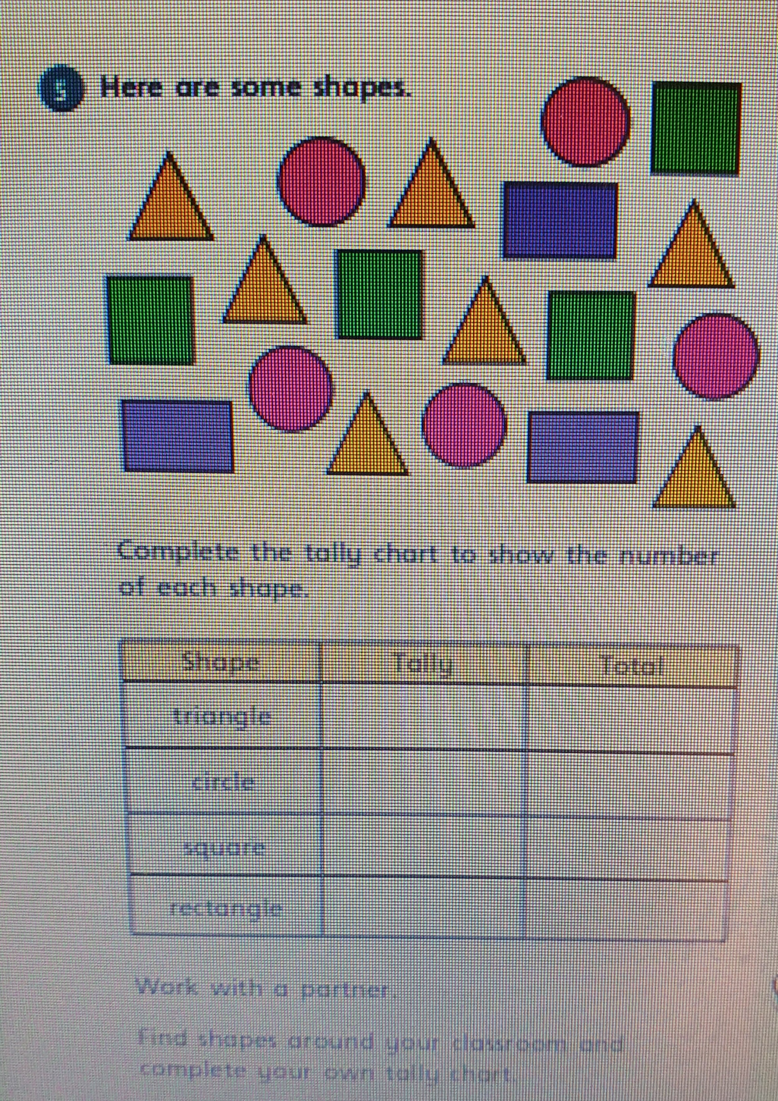
Have a go at question 5

Slide 12
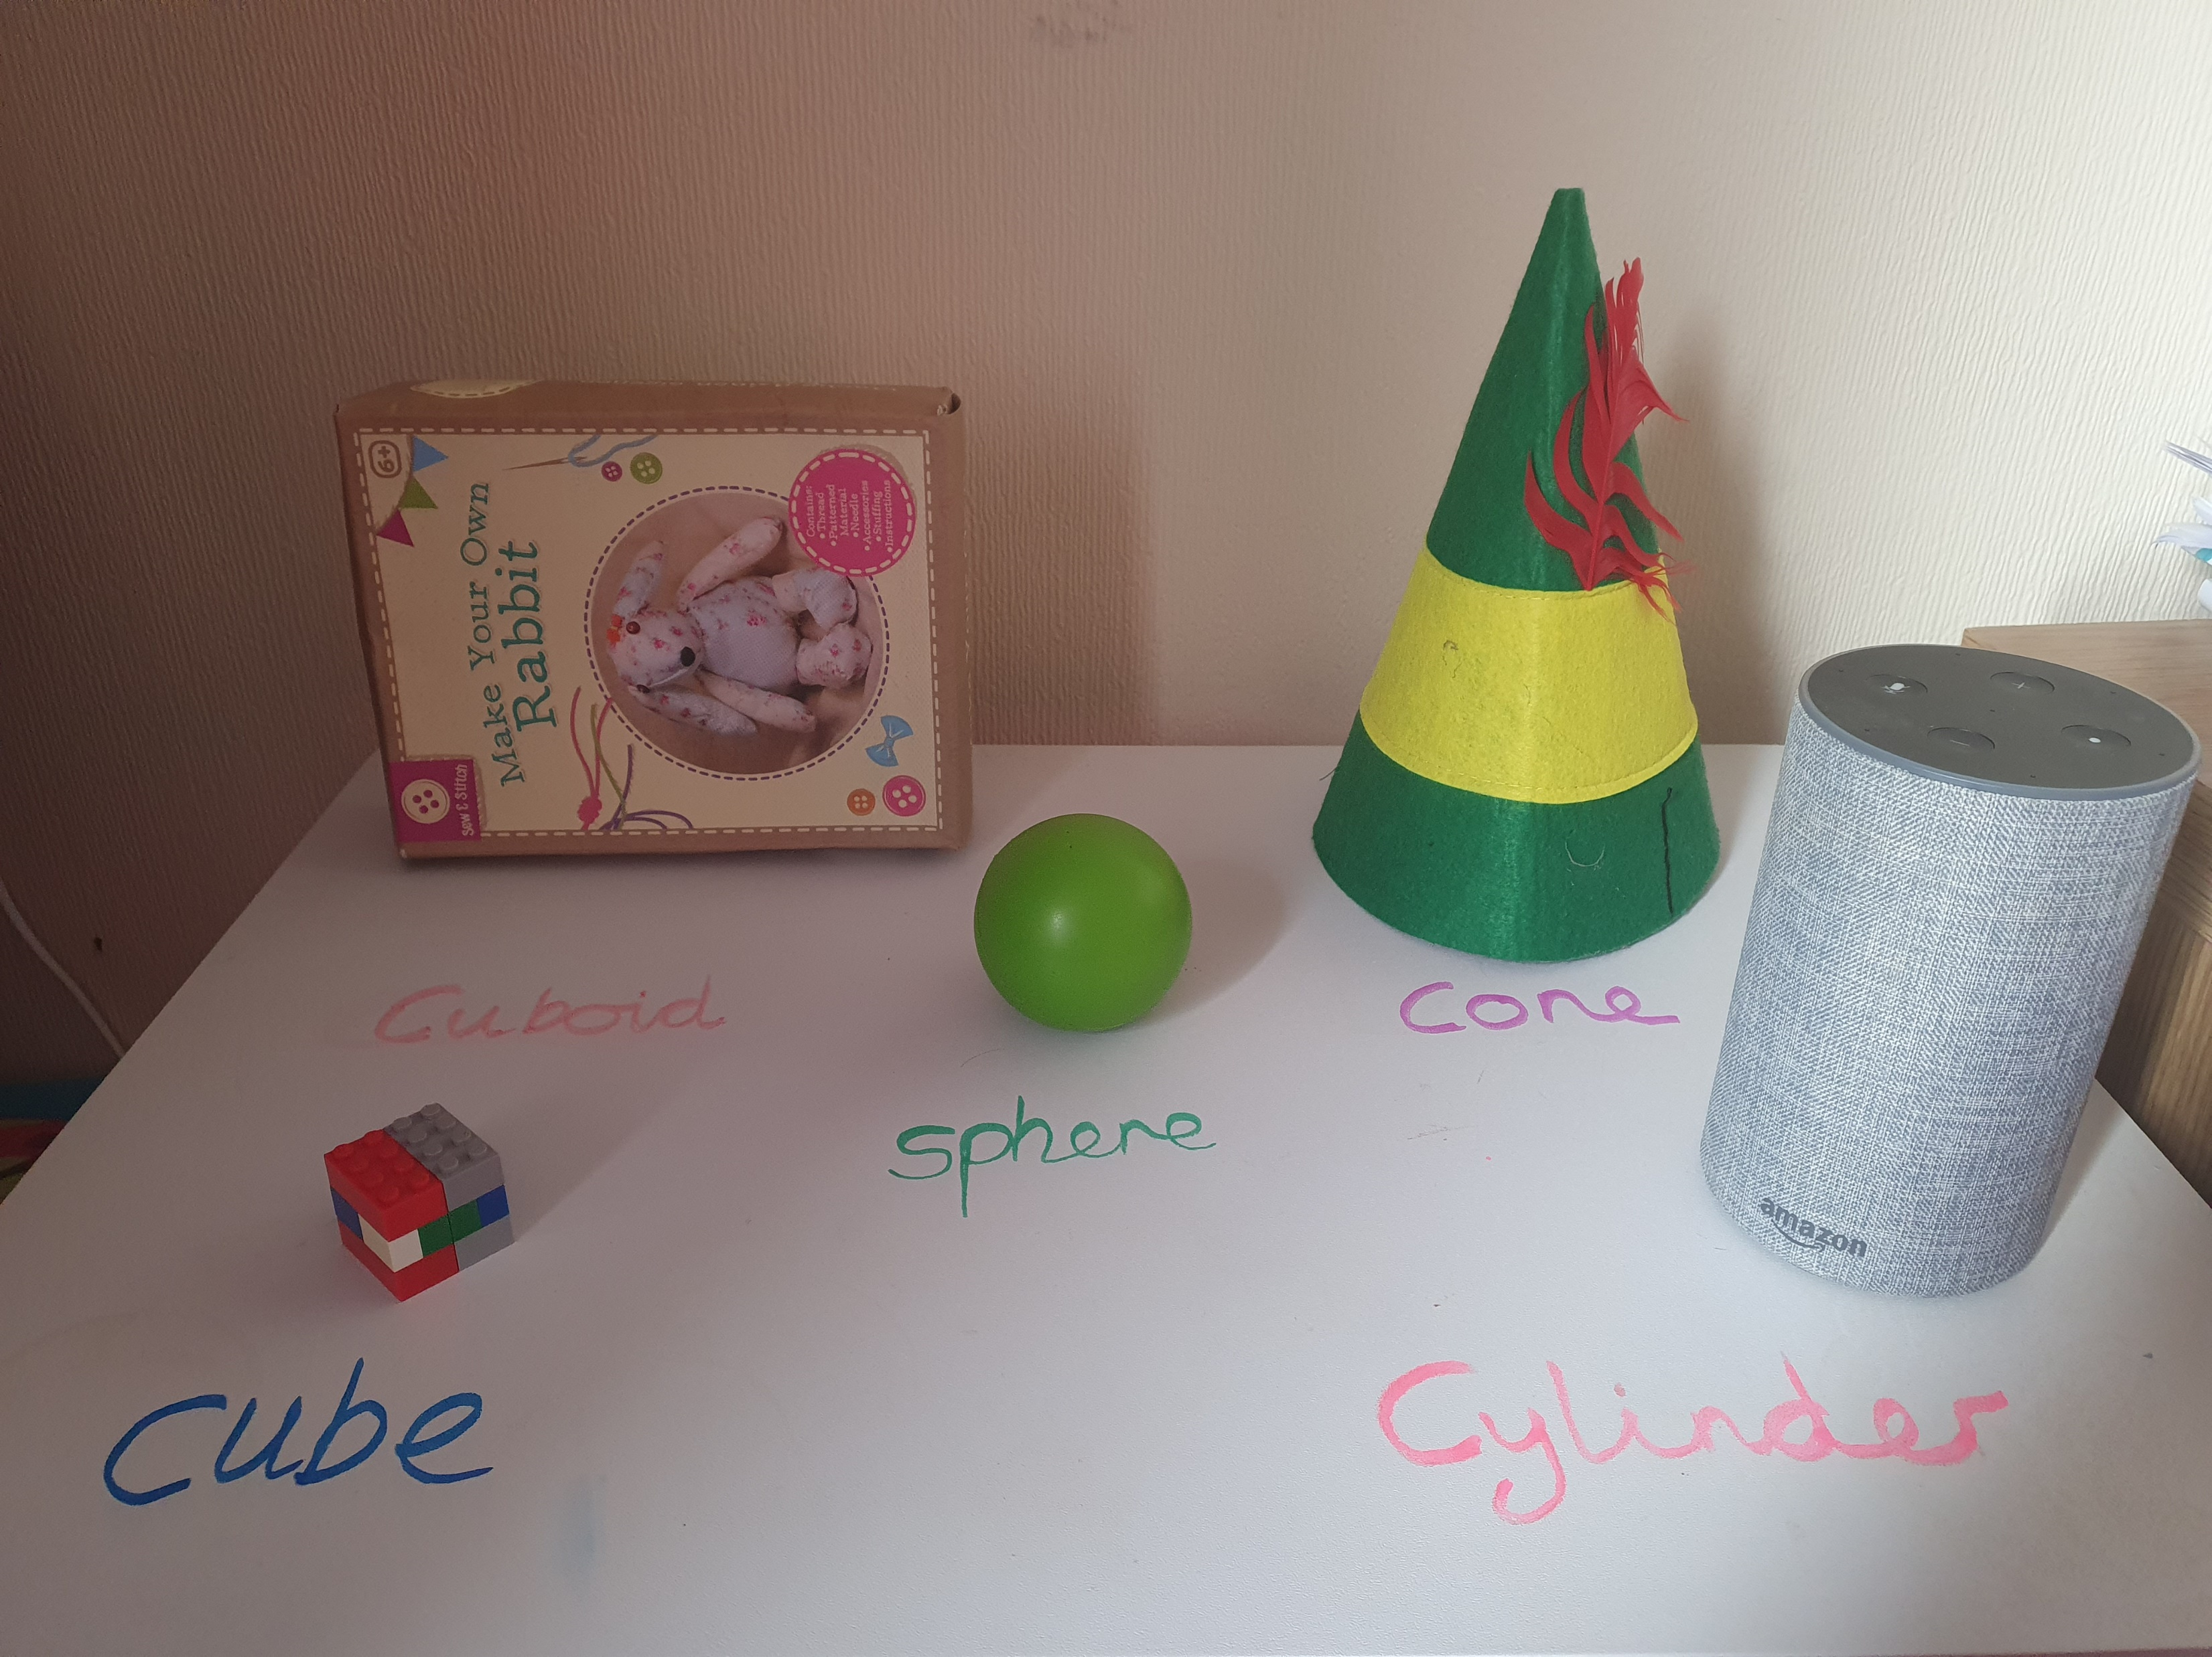
Shape hunt.

