Slide 1
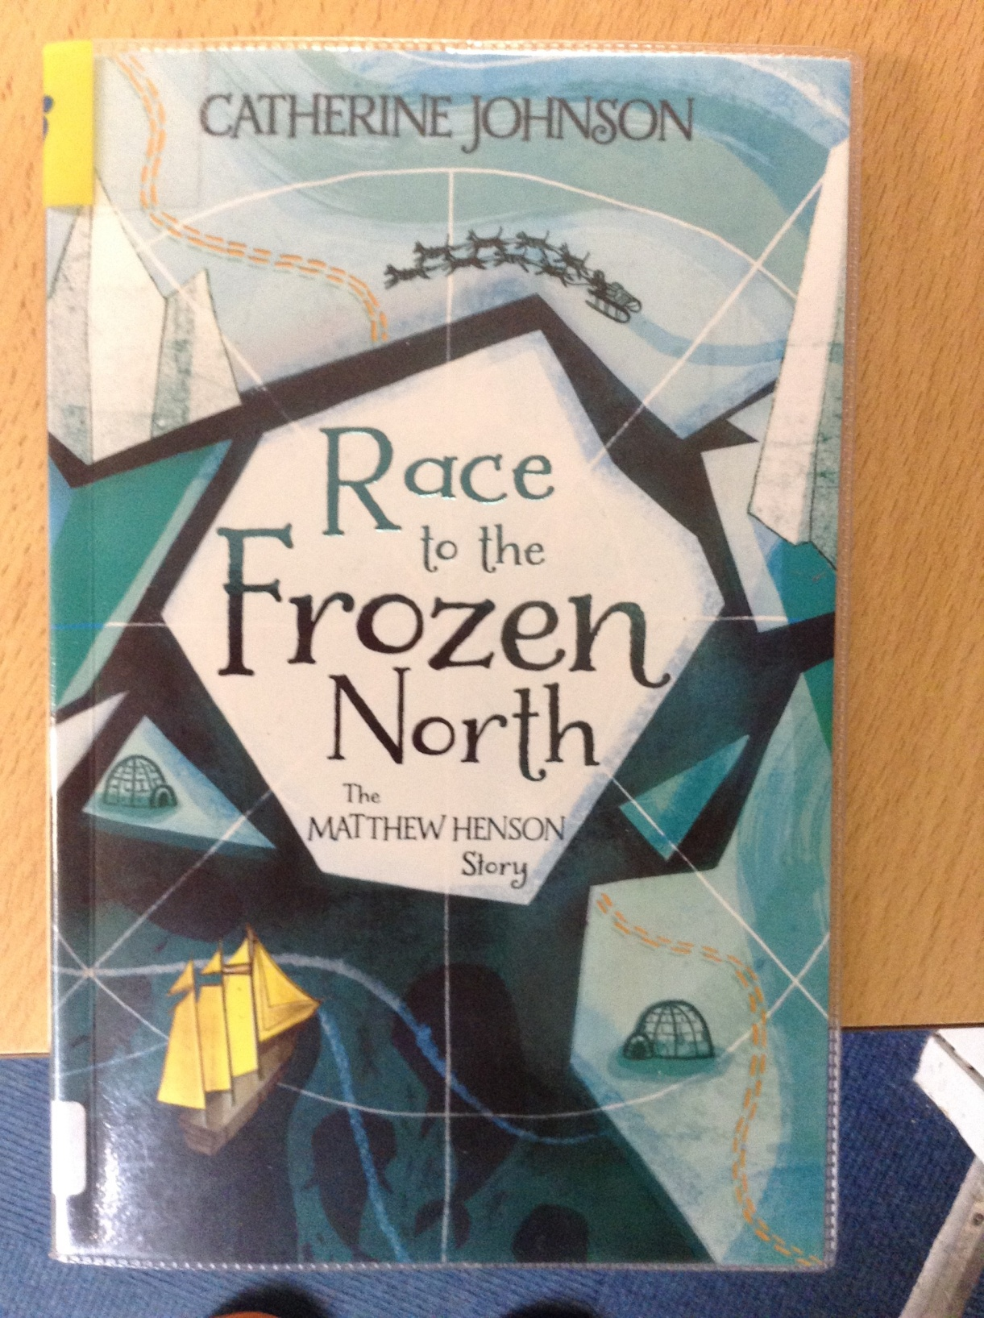
GUIDED READING
Y6
Chapter 1
Pages 5-11

Slide 2
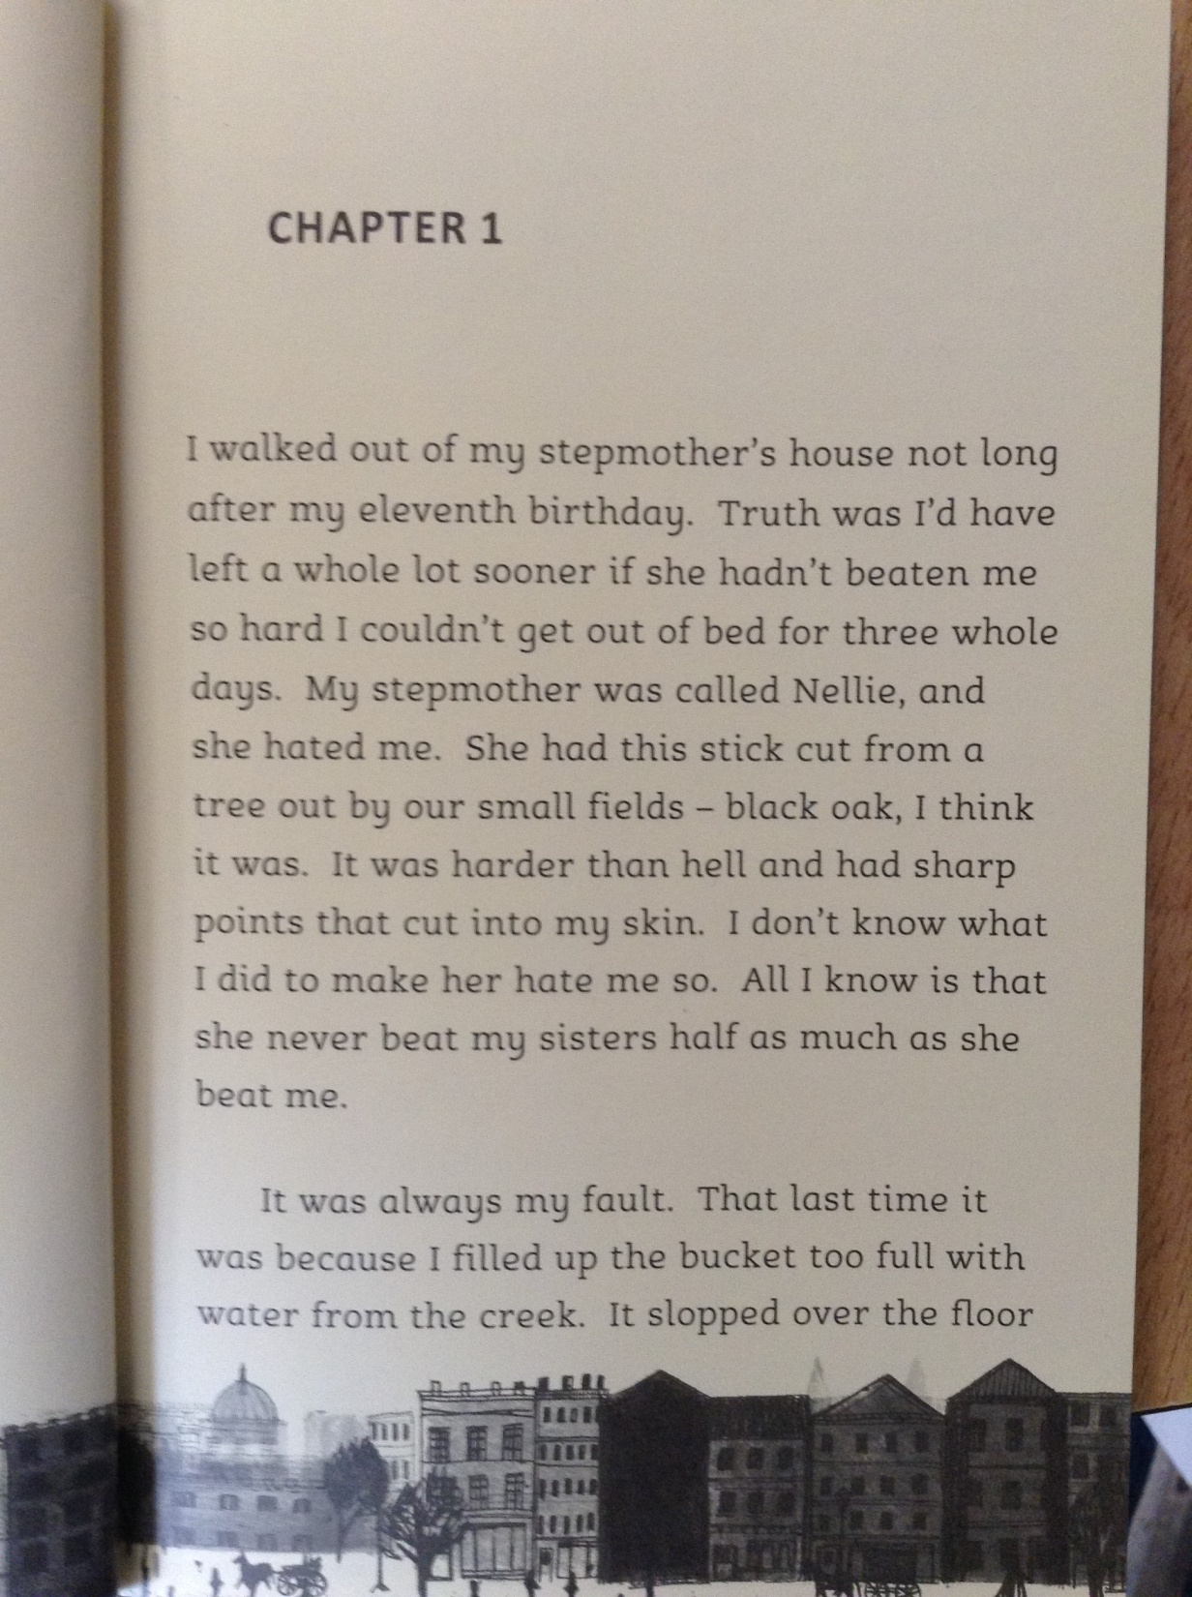

Slide 3
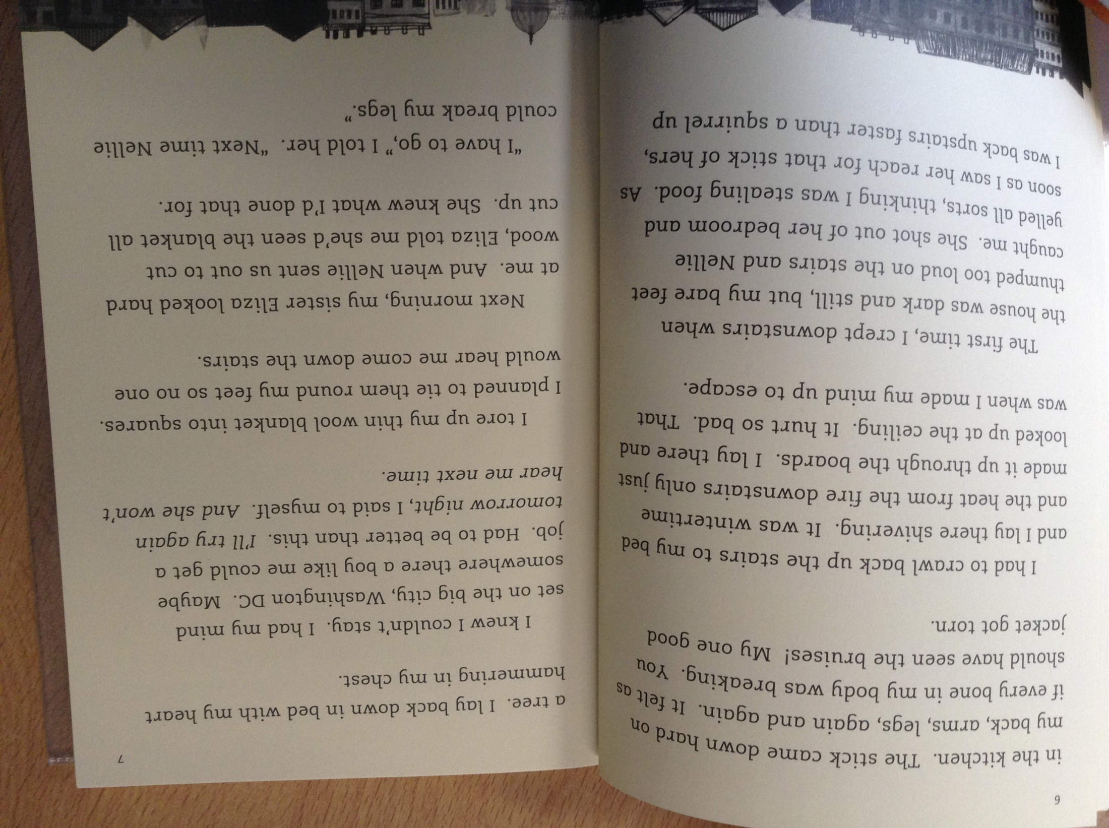

Slide 4
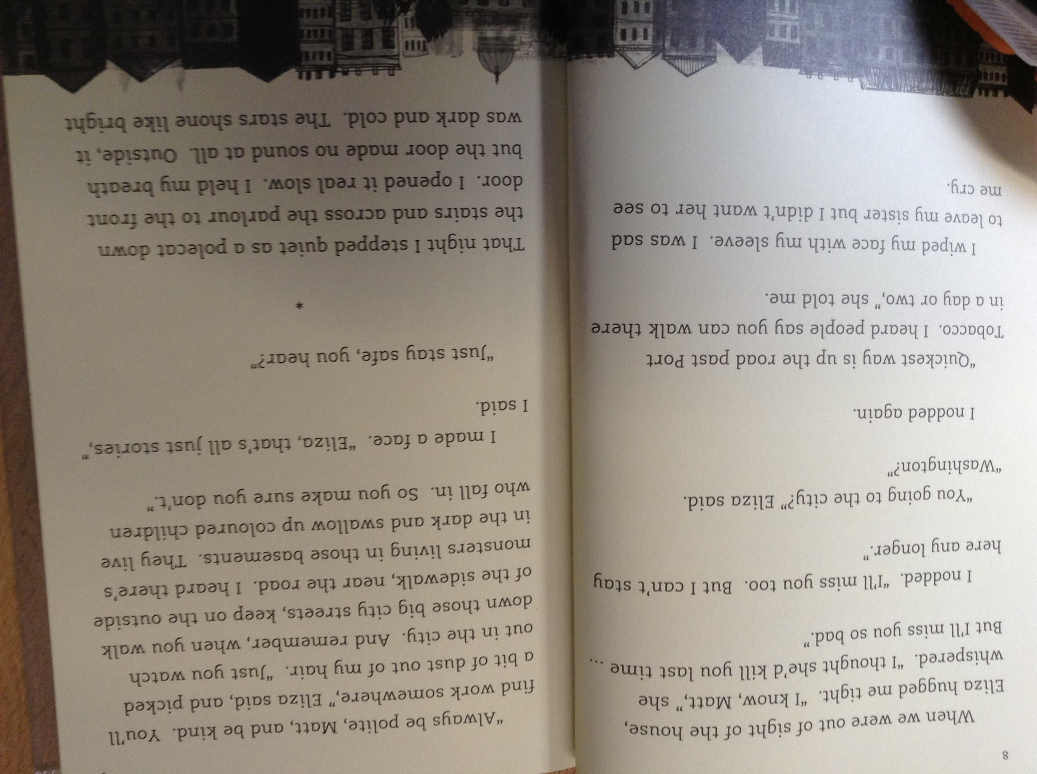

Slide 5
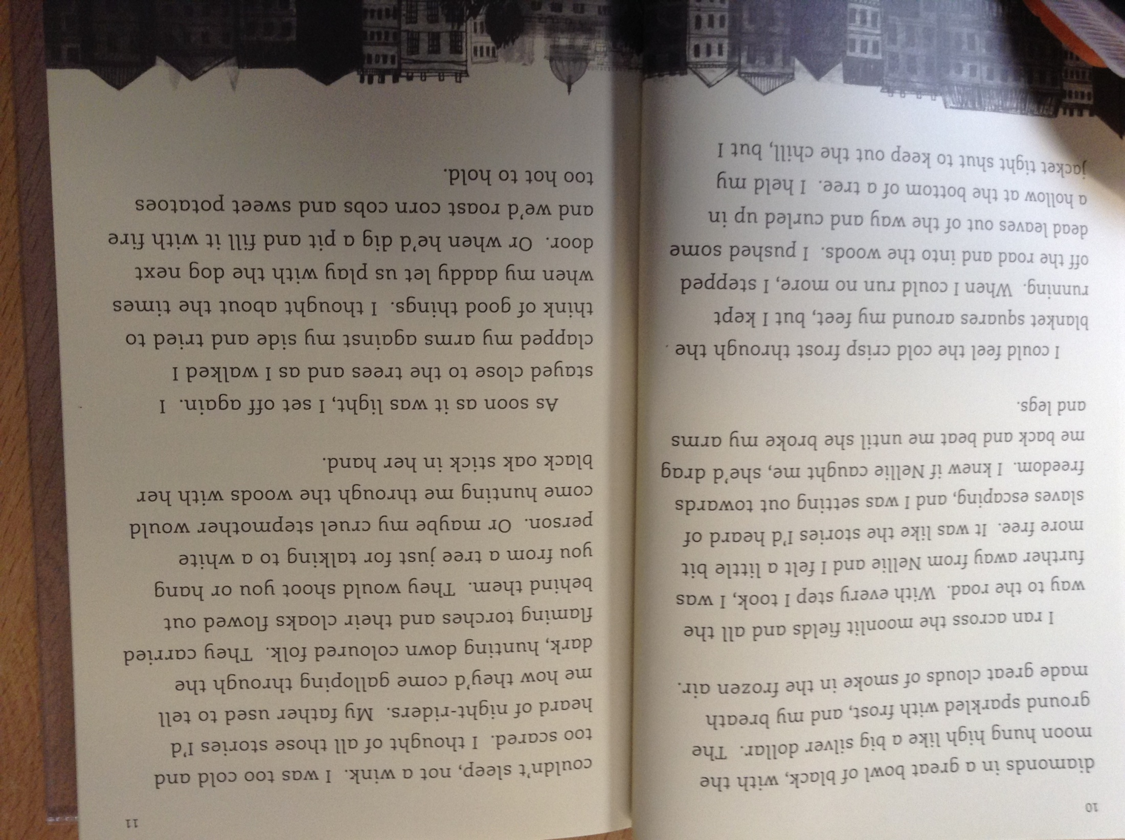

Slide 6
The story has been narrated by Matthew Henson.
*Please note – the word ‘coloured’ has been used on 2 occasions to describe characters in the story. This word is offensive and shouldn’t be used in modern society.
Matthew was mistreated by his stepmother Nellie. Find two examples of sentences which prove this on pages 5-7.
‘Faster than a squirrel up a tree’. Why has this simile been used on pages 6 and 7?
Read page 8. How did Matthew feel about leaving his sister behind? Find evidence in the text to support your answer.
Read page 10. When Matthew finally escaped, where did he spend the night?

