Slide 1
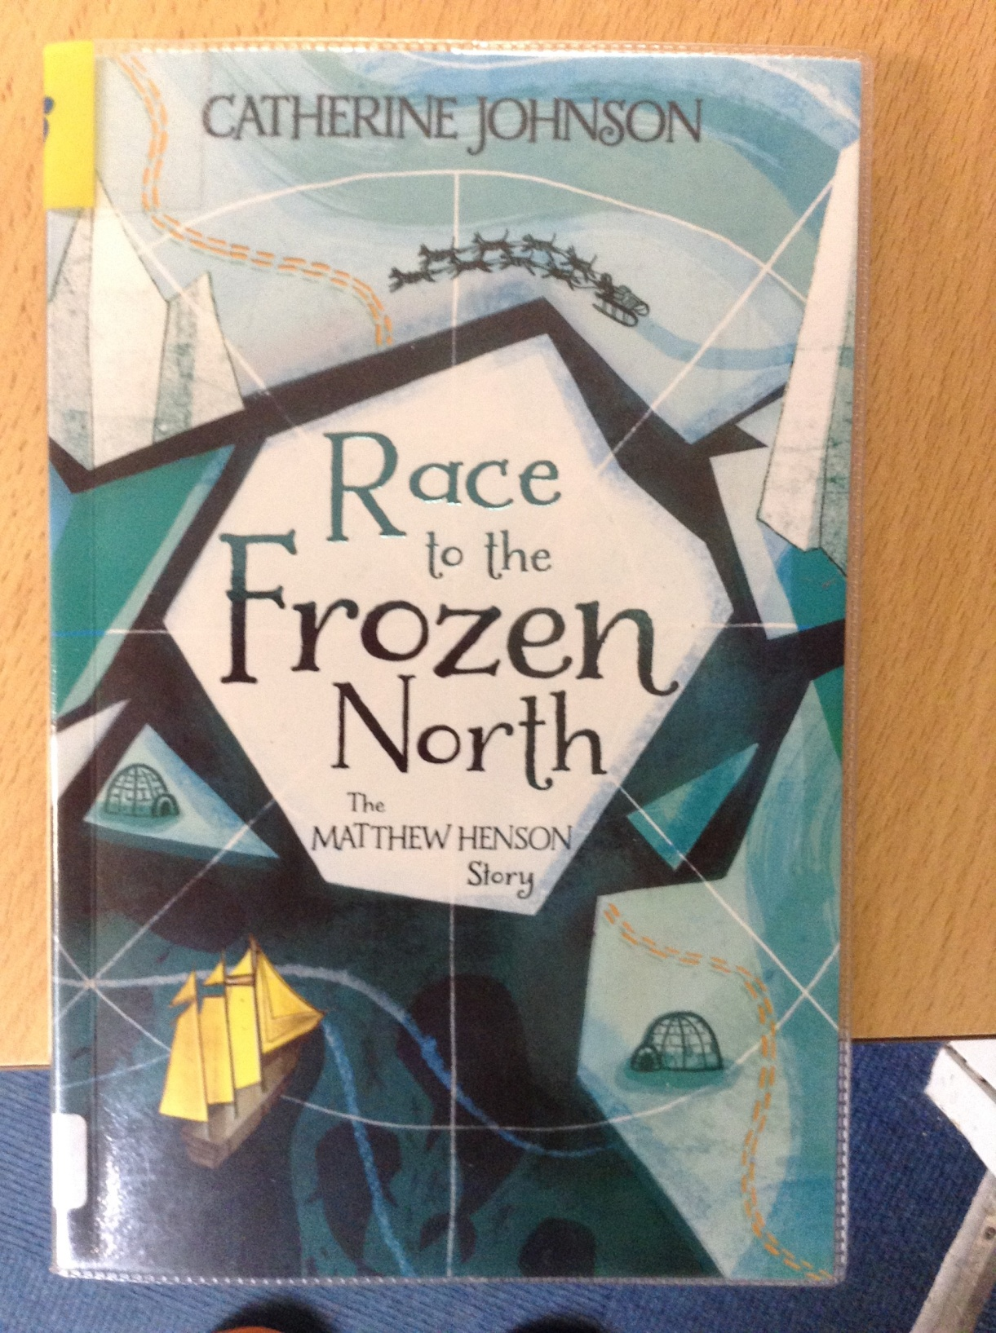
GUIDED READING
Y6
Chapter 3
Pages 27-32

Slide 2
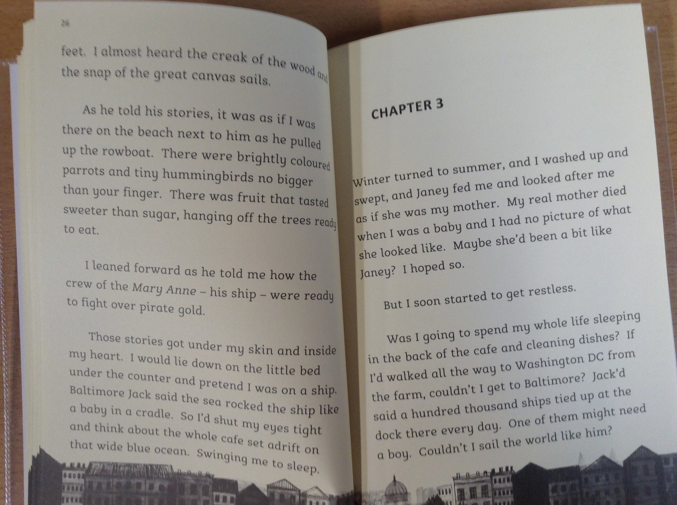

Slide 3
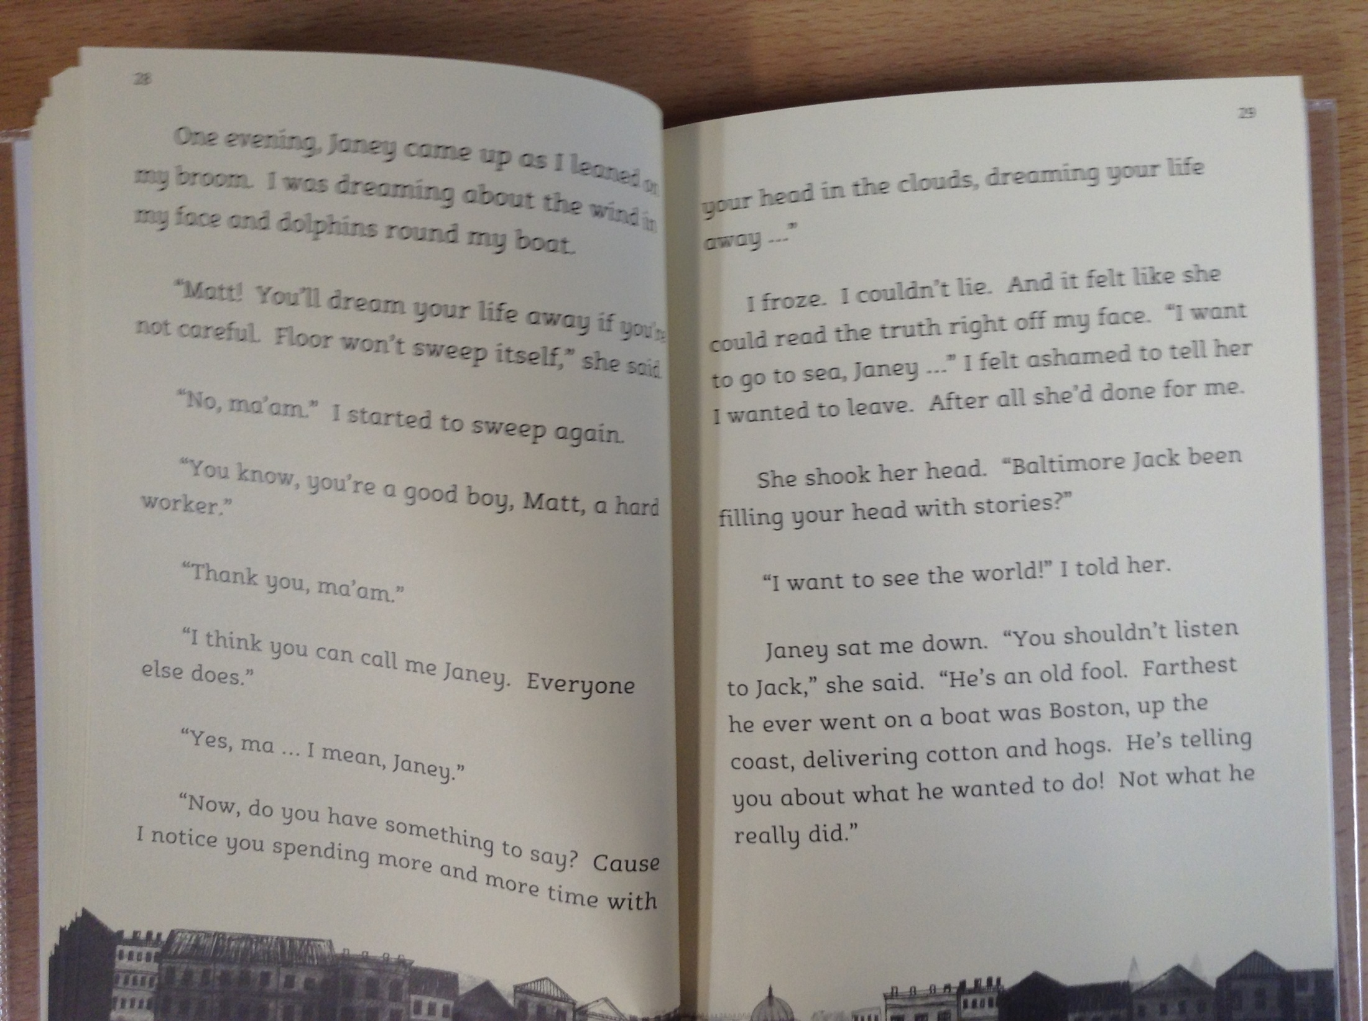

Slide 4
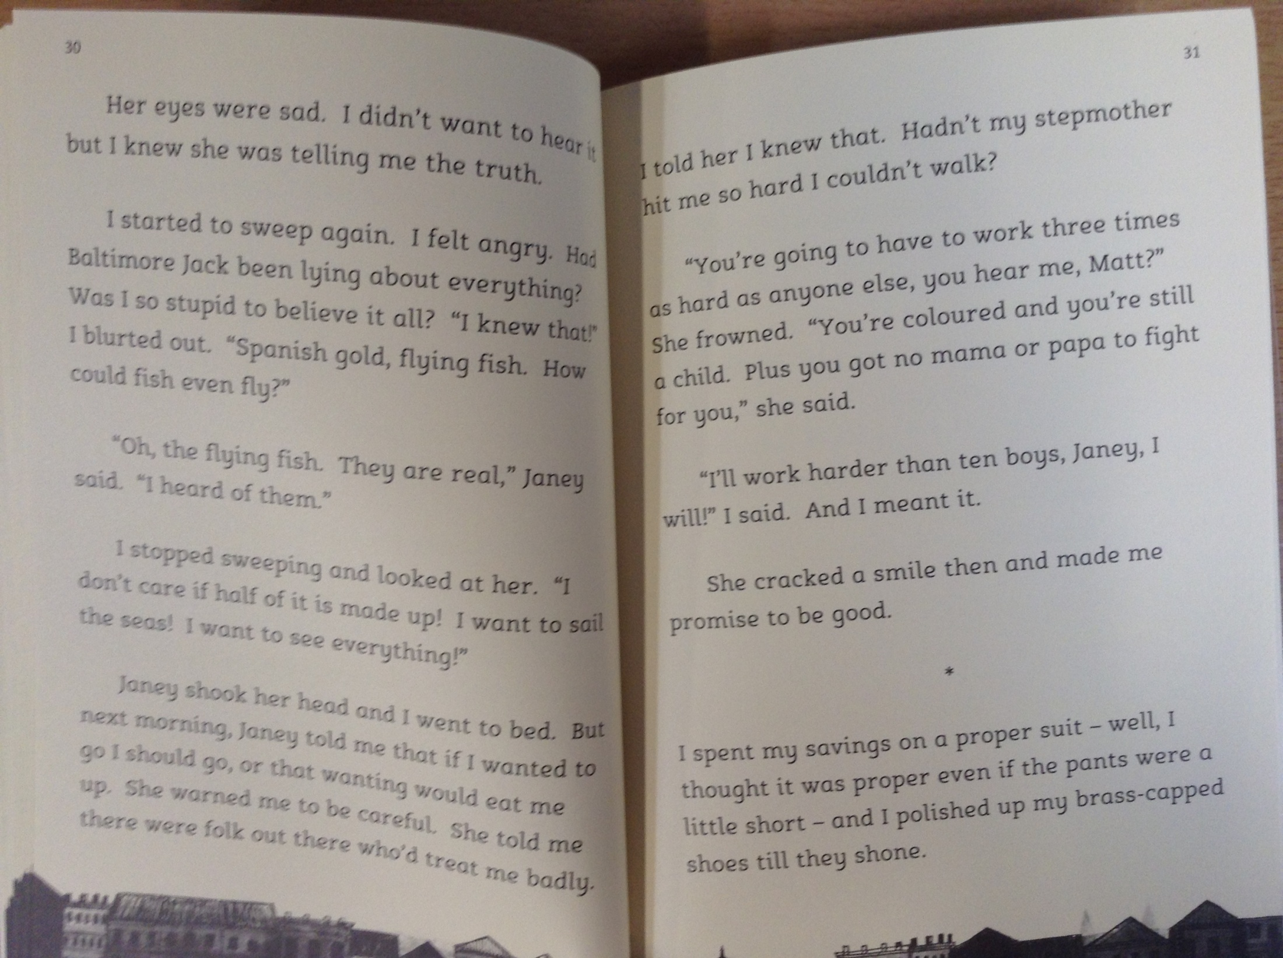

Slide 5
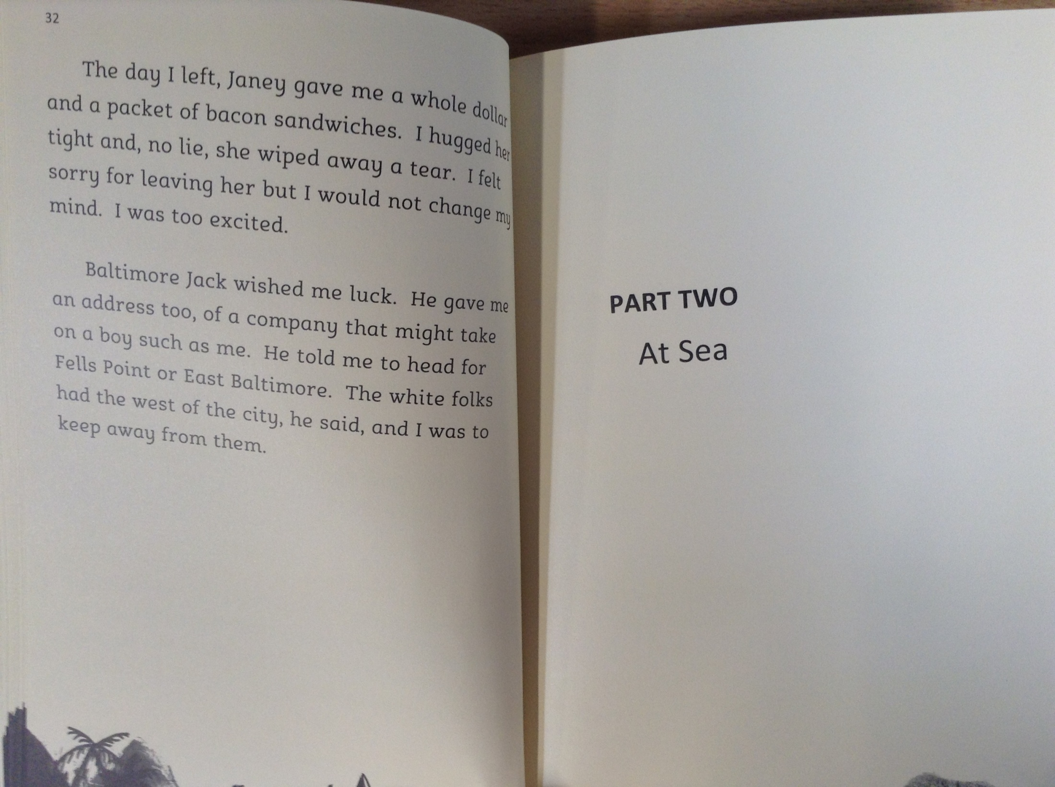

Slide 6
The story has been narrated by Matthew Henson.
*Please note – the word ‘coloured’ has been used to describe characters in the story. This word is offensive and shouldn’t be used in modern society.
13) Read page 27. Where did Matthew have ambitions of travelling to?
14) What advice did Janey give to Matthew before he left?
15) Read page 32. How did Janey feel about Matthew leaving? Find evidence in the text to support your thinking.
16) Read page 32. ‘The white folks had the west of the city, and I was to keep away from them.’ What does this tell you what society was like during this time?

