Slide 1
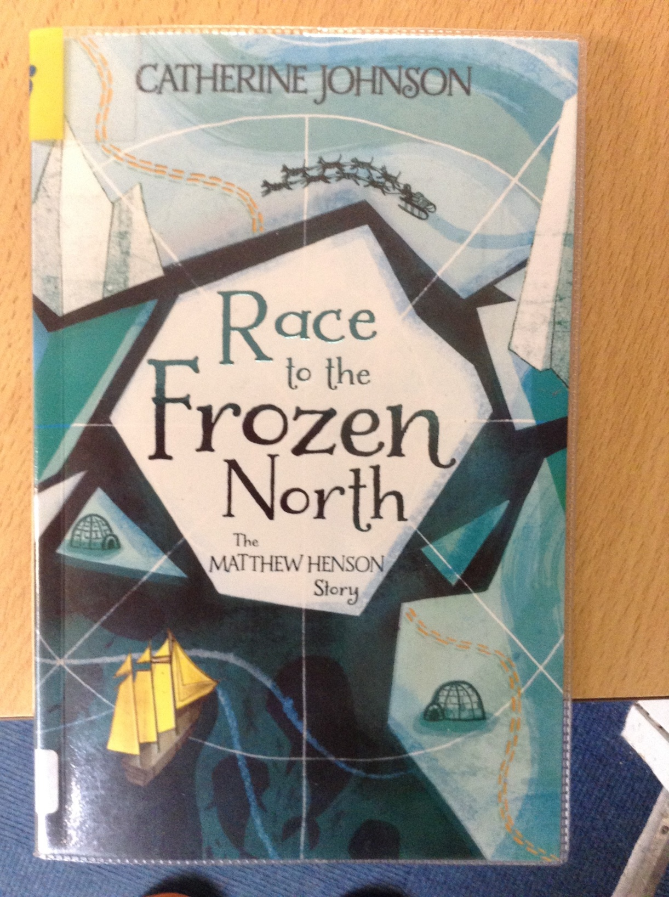
GUIDED READING
Y6
Chapter 2
Pages 18-26

Slide 2
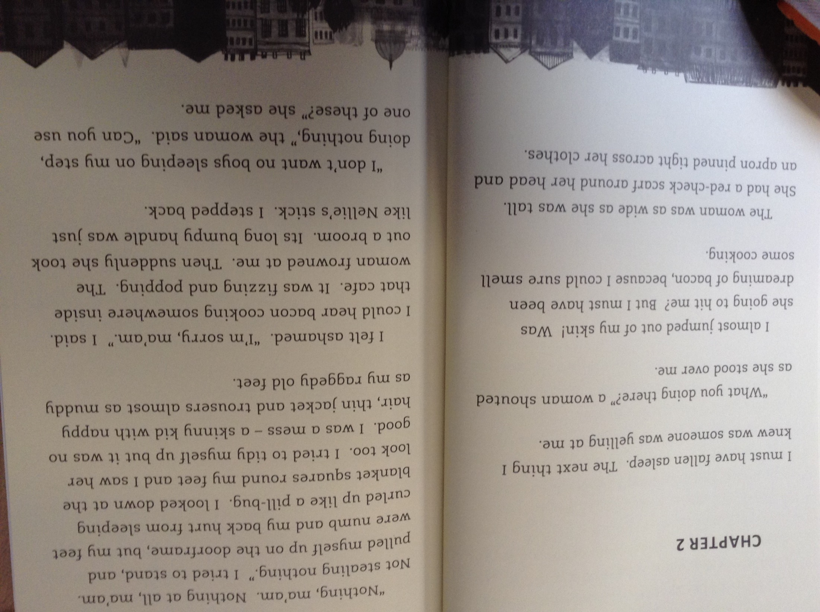

Slide 3
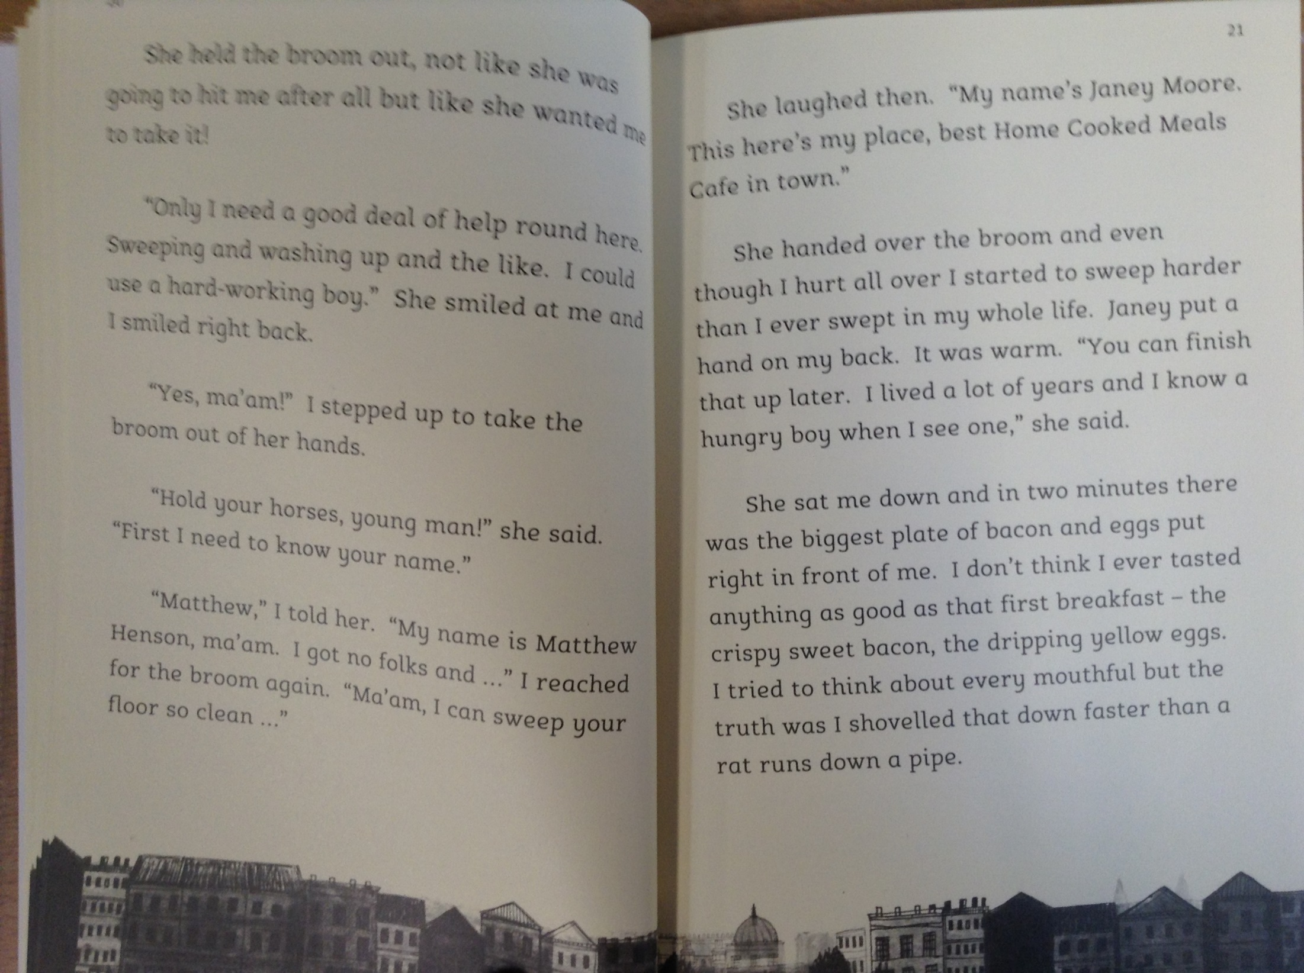

Slide 4
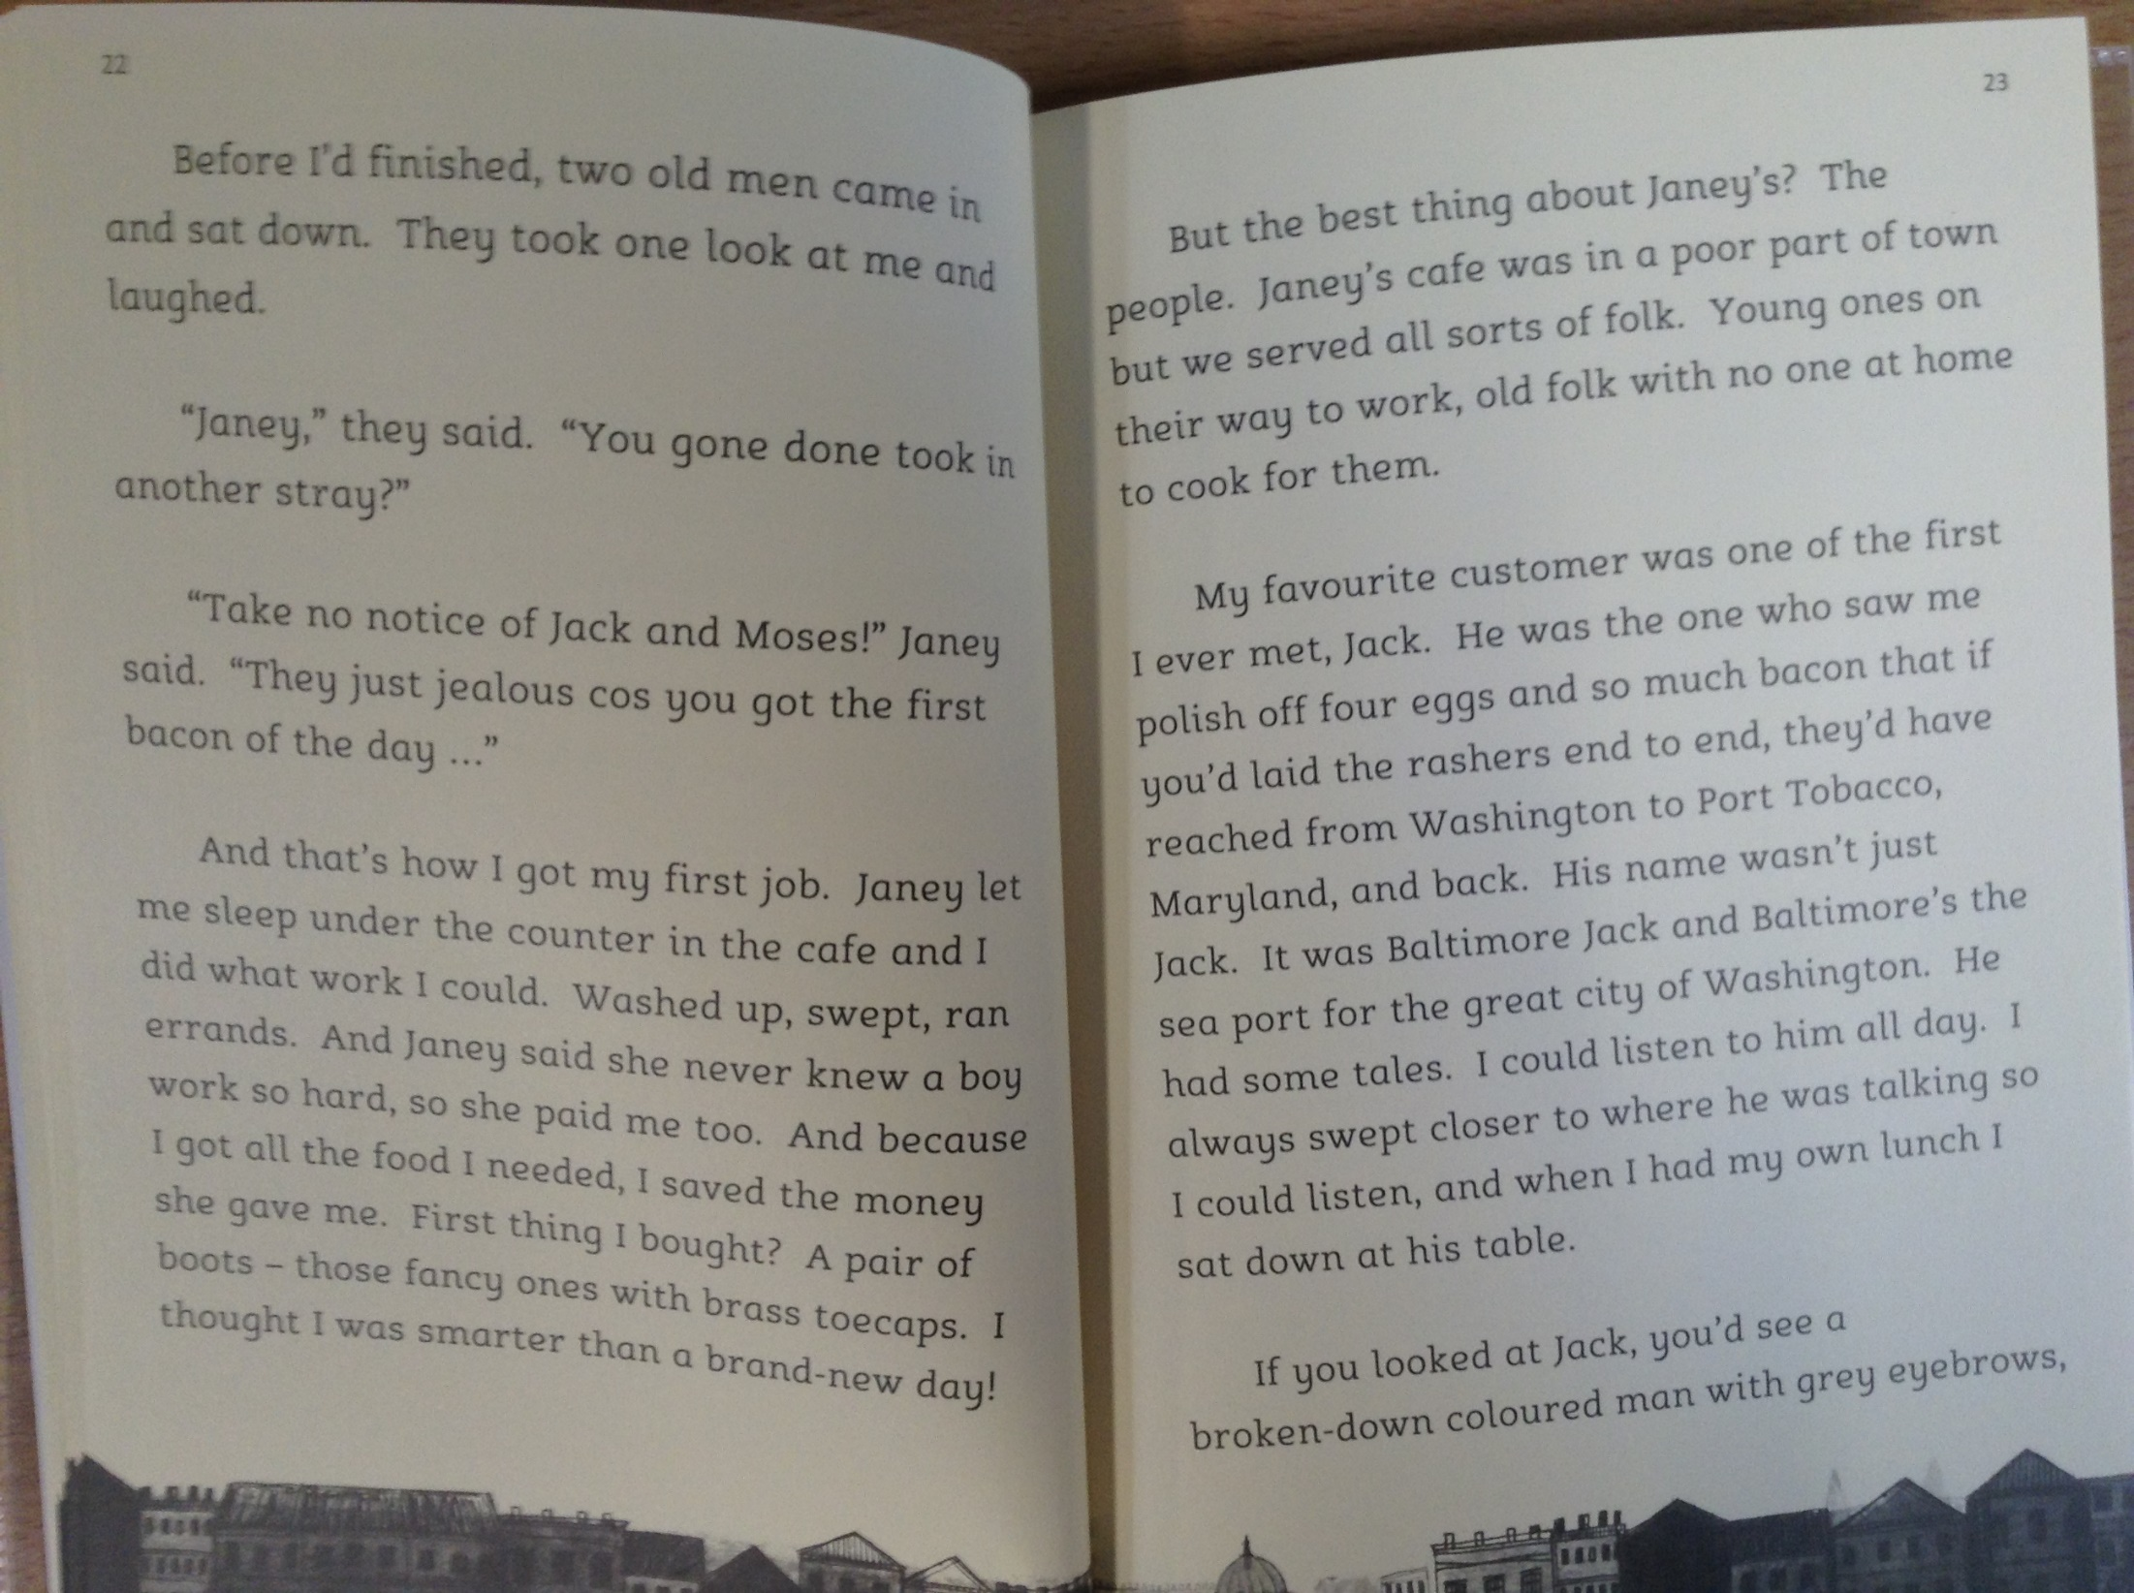

Slide 5
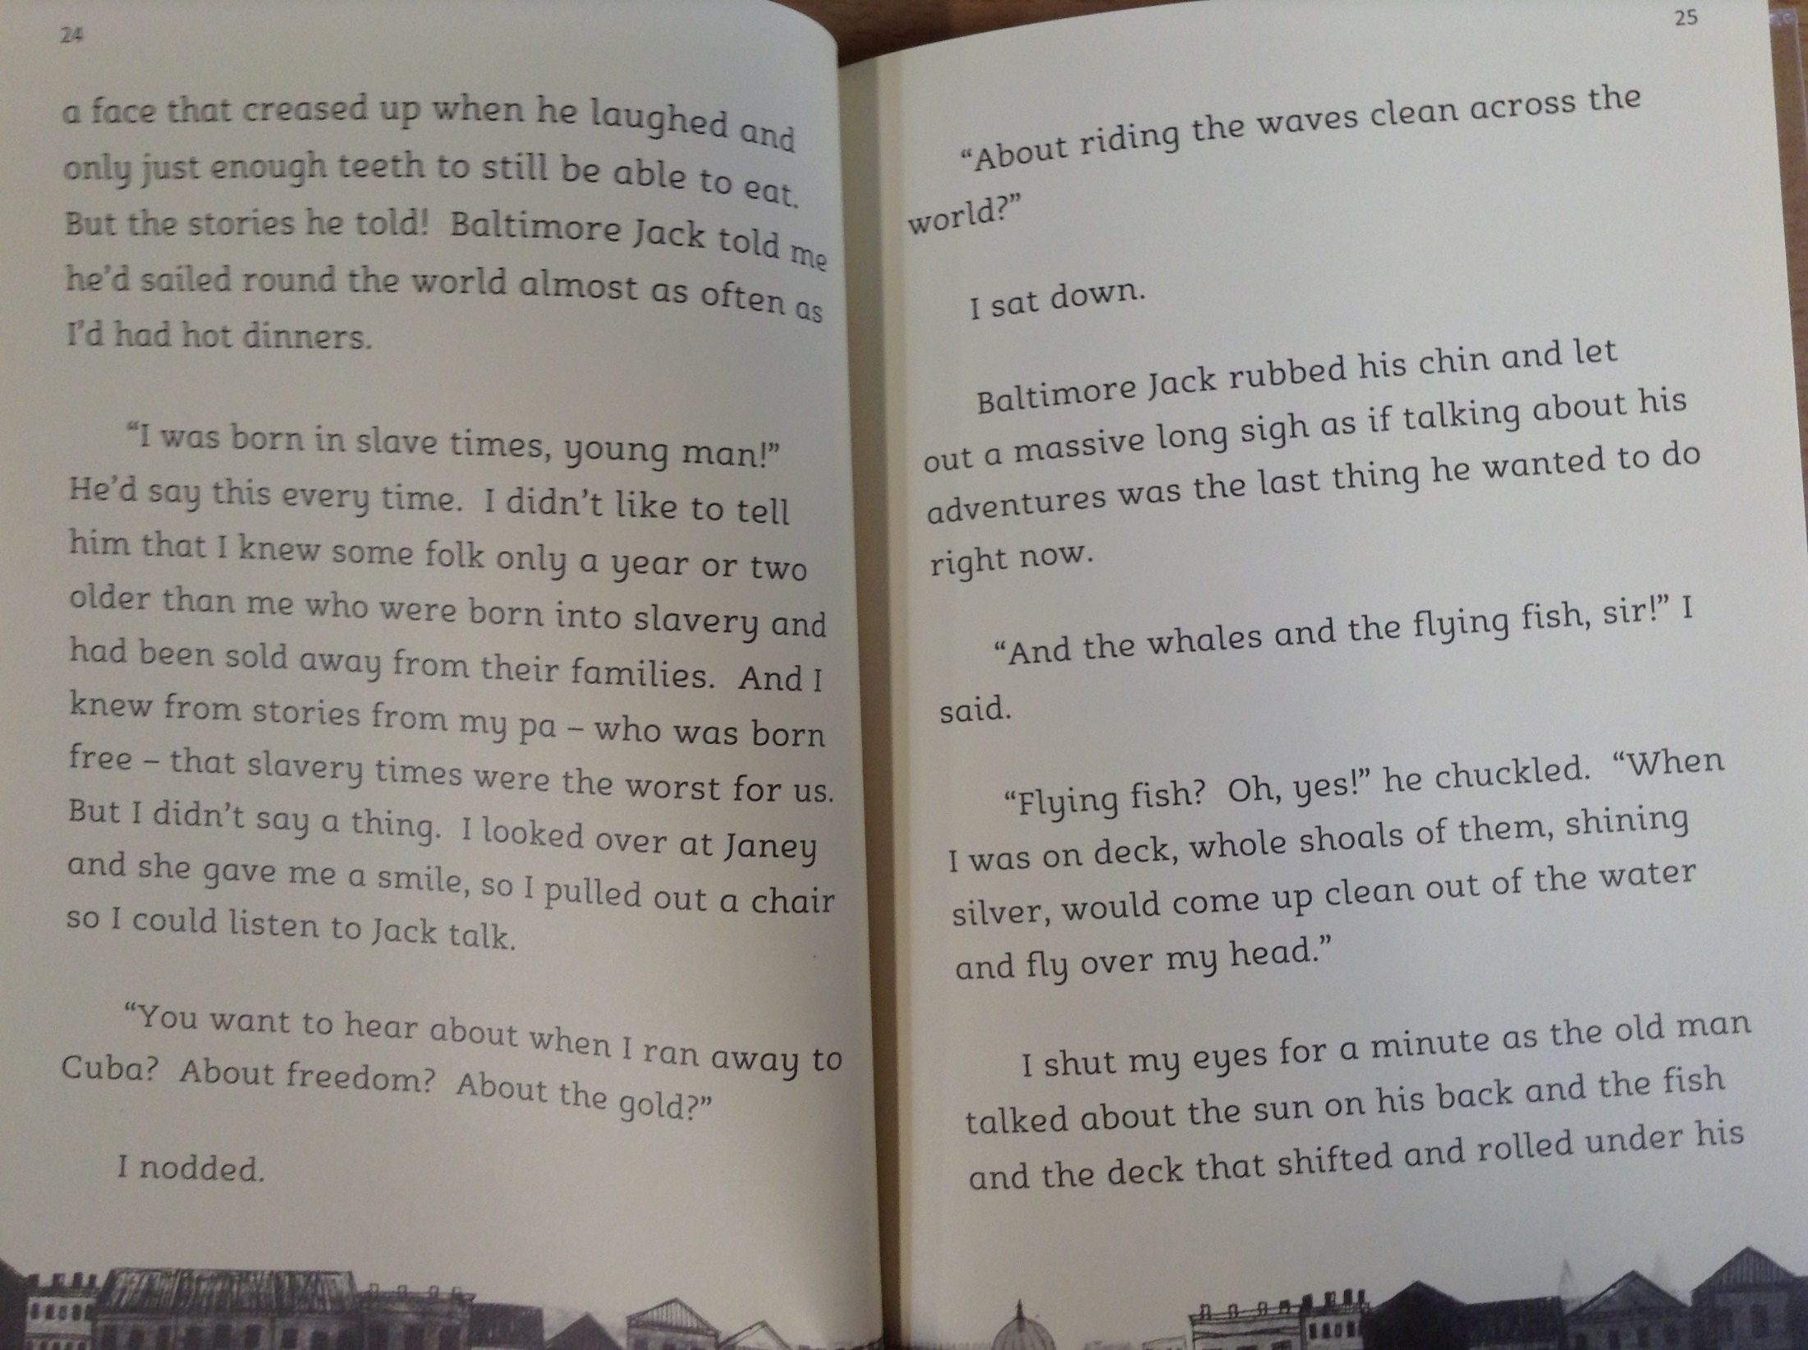

Slide 6
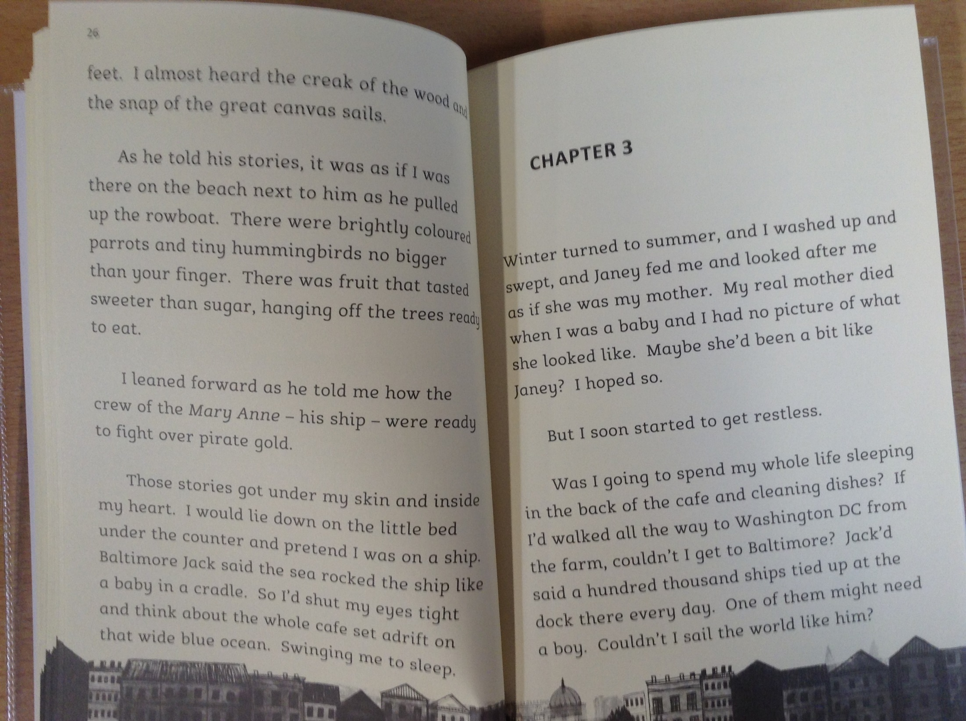

Slide 7
The story has been narrated by Matthew Henson.
*Please note – the word ‘coloured’ has been used to describe characters in the story. This word is offensive and shouldn’t be used in modern society.
9) How did Janey want Matthew to help her?
10) Read page 22. Do you think that Janey was impressed with Matthew’s work? How do you know?
11) Why do you think Matthew enjoyed listening to Jack’s stories so much?
12) How do you think the stories that Jack told may have shaped Matthew’s future?

