Slide 1
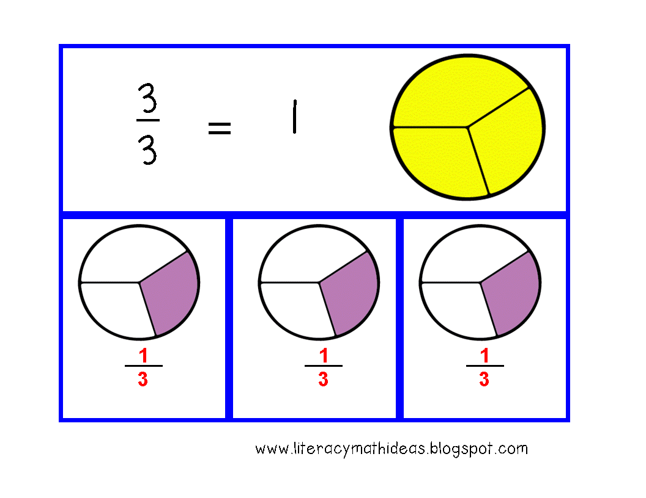
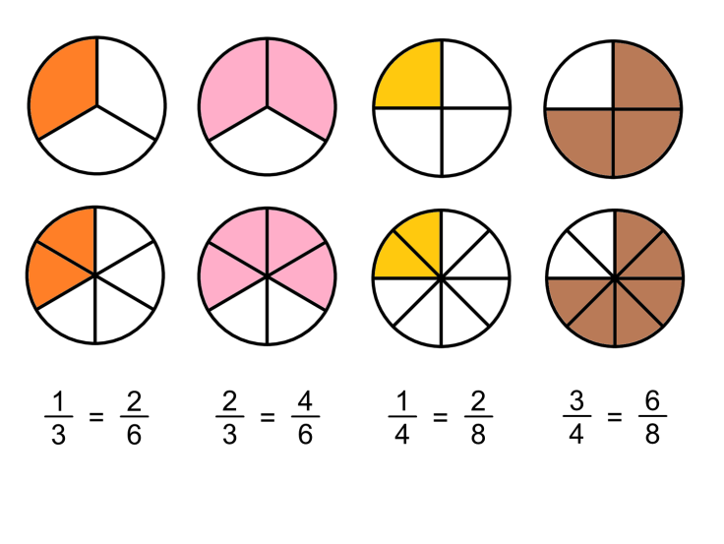
What I’m learning in Maths today
Maths – Y5 Date: 24.2.21
L.Obj: *I can subtract fractions with and without the same denominator.
*I can find a common denominator using my times tables to help me.

Slide 2
Maths Starter - What’s my missing number
I’m thinking of a number.
I add 5.
Then I multiply it by 4.
The answer is 60.
What is my number?
Top tip:
Start with the answer, work backwards and do the inverse….
So, start on 60, divide it by 4, then subtract 5.
I’m thinking of a number.
I subtract 8.
Then I divide it by 8.
The answer is 2.
What is my number?
Top tip:
Start with the answer, work backwards and do the inverse….
So, start on 2, multiply it by 8, then add 8.
I’m thinking of a number.
I double it.
Then I subtract 19.
Next I divide it by 3.
My answer is 5.
What is my number?
Top tip:
Start with the answer, work backwards and do the inverse….
So, start on 5, multiply it by 3, add 19, then halve it.

Slide 3
Maths Starter - What’s my missing number
I’m thinking of a number.
I add 5.
Then I multiply it by 4.
The answer is 60.
What is my number?
10
I’m thinking of a number.
I subtract 8.
Then I divide it by 8.
The answer is 2.
What is my number?
24
I’m thinking of a number.
I double it.
Then I subtract 19.
Next I divide it by 3.
My answer is 5.
What is my number?
34

Slide 4
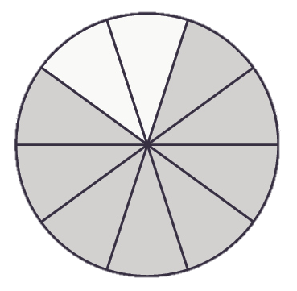
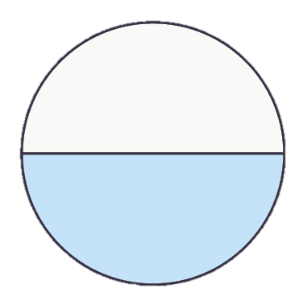
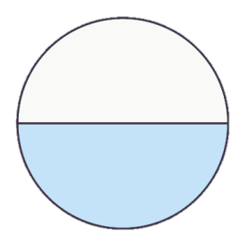
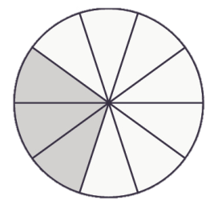
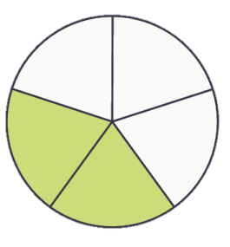
Varied Fluency 1
Circle the correct answer to the subtraction below.
–
A
B
C
© Classroom Secrets Limited 2019

Slide 5
Varied Fluency 1
Circle the correct answer to the subtraction below.
–
A
B
C
© Classroom Secrets Limited 2019

Slide 6
Varied Fluency 2
Complete the calculation below.
–
=
© Classroom Secrets Limited 2019

Slide 7
Varied Fluency 2
Complete the calculation below.
, or
–
=
9
18
3
6
1
2
© Classroom Secrets Limited 2019

Slide 8
Varied Fluency 3
Complete the calculations below.
A. | 3 | – | 16 | =
 | 4 |  | 32
B. | 42 | – | 5 | =
 | 56 |  | 8
C. | 4 | – | 12 | =
 | 5 |  | 60
© Classroom Secrets Limited 2019

Slide 9
Varied Fluency 3
Complete the calculations below.
A. | 3 | – | 16 | =
 | 4 |  | 32
8 | or | 1
32 |  | 4
B. | 42 | – | 5 | =
 | 56 |  | 8
7 | or | 1
56 |  | 8
C. | 4 | – | 12 | =
 | 5 |  | 60
36 | or | 3
60 |  | 5
© Classroom Secrets Limited 2019

Slide 10
Varied Fluency 4
Sarah has of a chocolate bar.
She gives to her brother.
How much does she have left?
5
7
18
63
© Classroom Secrets Limited 2019

Slide 11
Varied Fluency 4
Sarah has of a chocolate bar.
She gives to her brother.
How much does she have left?
5
7
18
63
27 | or | 3
63 |  | 7
© Classroom Secrets Limited 2019

