Slide 1
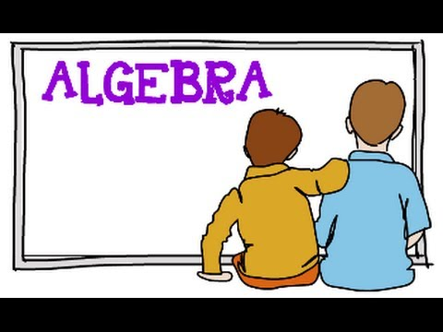
What I’m learning in Maths today
Maths – Y6 (Algebra) Date: 23.2.21
L.Obj: *I can solve the value of a particular shape / letter by replacing it with a number.
Using it

Slide 2
1) 972 ÷ 27 =
2) 17% of 80 =
3) 1/4 x 7 =
4) 1/4 ÷ 7 =
5) 3/9 + 2/3 =
6) 156 x 43 =
7) 15 – 3.45 =
8) 5 ÷ 100 =

Slide 3
972 ÷ 27 = 36
17% of 80 = 13.6
1/4 x 7 = 7/4 = 1 ¾
1/4 ÷ 7 = 1/28
3/9 + 2/3 = 9/9 or 1 whole
156 x 43 = 6,708
15 – 3.45 = 11.55
5 ÷ 100 = 0.05

Slide 4
Introduction
If = 10 and = 5
Calculate:
+ + +
© Classroom Secrets Limited 2019

Slide 5
Introduction
If = 10 and = 5
Calculate:
+ + +
10 + 10 + 10 + 5 = 35
© Classroom Secrets Limited 2019

Slide 6
Varied Fluency 1
Match the expressions to their values.
If = 10 and = 0.25.
A. | ( | x | ) | +
B. |  | + |  | +
C. |  | – |  | +
19.75
2.75
30
© Classroom Secrets Limited 2019

Slide 7
Varied Fluency 1
Match the expressions to their values.
If = 10 and = 0.25.
A. | ( | x | ) | +
B. |  | + |  | +
C. |  | – |  | +
19.75
2.75
30
© Classroom Secrets Limited 2019

Slide 8
Varied Fluency 2
True or false?
If a = , b = 10 and c = 7.
(8a + c) x b = 84
1
4
© Classroom Secrets Limited 2019

Slide 9
Varied Fluency 2
True or false?
If a = , b = 10 and c = 7.
(8a + c) x b = 84
False; 9 x 10 = 90
1
4
© Classroom Secrets Limited 2019

Slide 10
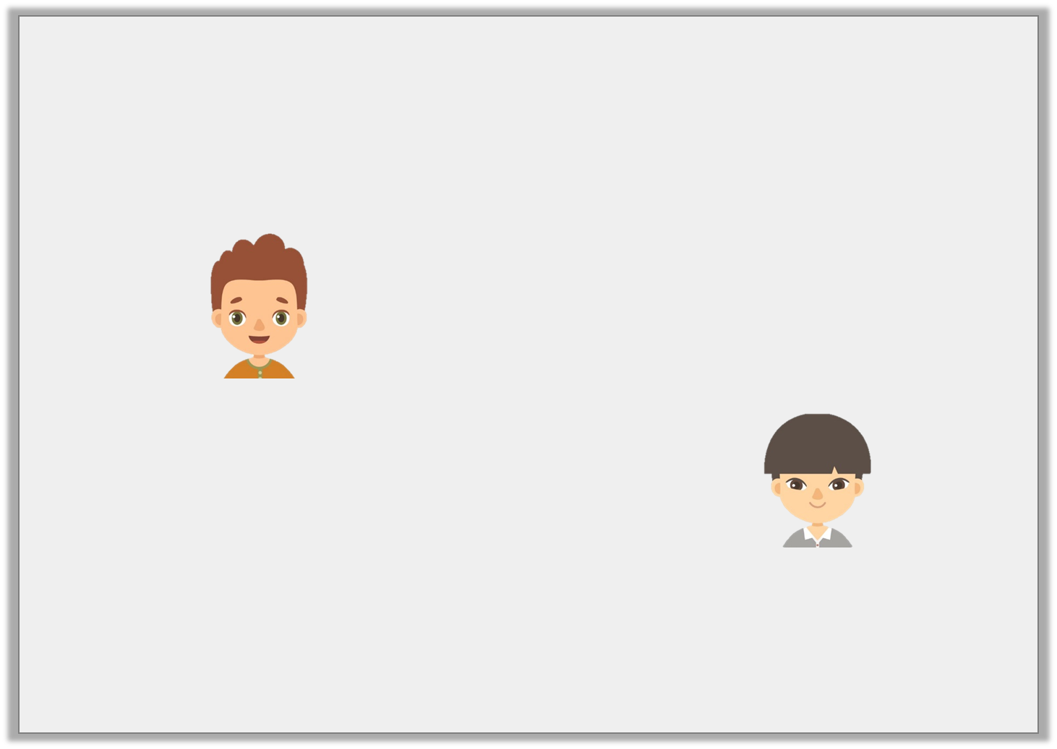
Varied Fluency 4
. Who is correct?
a = 10, b = 25 and c = 2
2b – a is
25 – 10 = 15
Sam
2b – a is
50 – 10 = 40
Jay
© Classroom Secrets Limited 2019

Slide 11
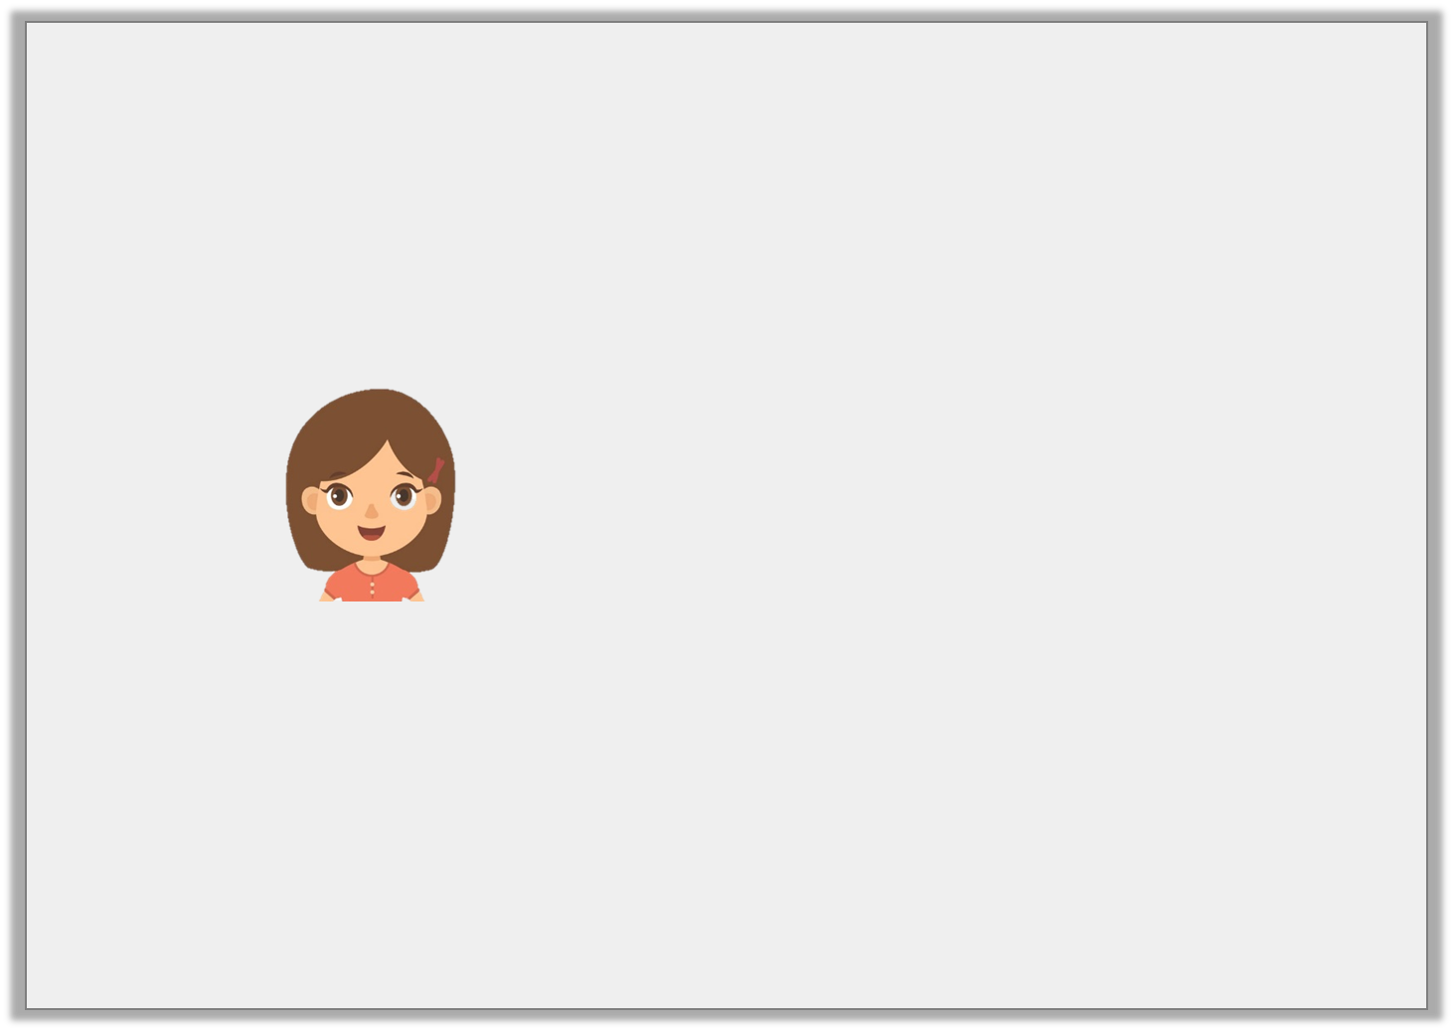
Reasoning 1
a = 5b ÷ 2
c = a + 5.5
Sophie says:
Is she correct?
Explain your answer.
If b = 8 then c = 25.
© Classroom Secrets Limited 2019

Slide 12
Problem Solving 1
Ryan is calculating the perimeter of a rectangle.
He is using the equation P = 2a + 2b.
When a = 12.5cm, he calculates that P = 45cm.
What is the value of b?
a
b
Not to scale
© Classroom Secrets Limited 2019

Slide 13
Problem Solving 1
Ryan is calculating the perimeter of a rectangle.
He is using the equation P = 2a + 2b.
When a = 12.5cm, he calculates that P = 45cm.
What is the value of b?
10cm
a
b
Not to scale
© Classroom Secrets Limited 2019

