Slide 1
History
Vikings and Anglo-Saxons
Year One
History | LKS2 | Vikings and Anglo-Saxons | Laws and Justice | Lesson 5

Slide 3
Aim
I can explain how the legal system worked in Anglo-Saxon and Viking Britain.
Success Criteria
I can demonstrate understanding of crime and punishment in Anglo-Saxon and Viking Britain.
I can compare and contrast the Anglo-Saxon and Viking justice systems with the modern British justice system.

Slide 4
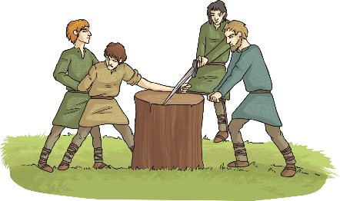
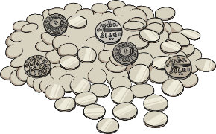
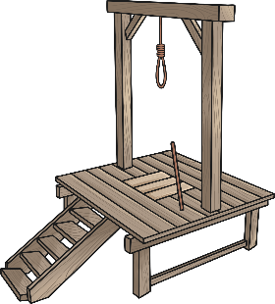
Fair or Foul?
Read the different scenarios and the proposed punishments. Which do you think are fair punishments? Which do you think are foul (unfair)?
Baldwine steals a pig from the market.
Punishment: one of his hands are cut off.
Is this fair? Why/why not?
Elfgar kills his neighbour, Wigmund, when they get into a fight.
Punishment: Elfgar has to pay Wigmund’s family 100 shillings.
Is this fair? Why/why not?
Mildburg is accused of doing magic and being a witch.
Punishment: Mildburg is hung by the neck until he dies.
Is this fair? Why/why not?
Alwin, a slave, tried to run away from his master.
Punishment: he is whipped and his little finger is cut off.
Is this fair? Why/why not?

Slide 5
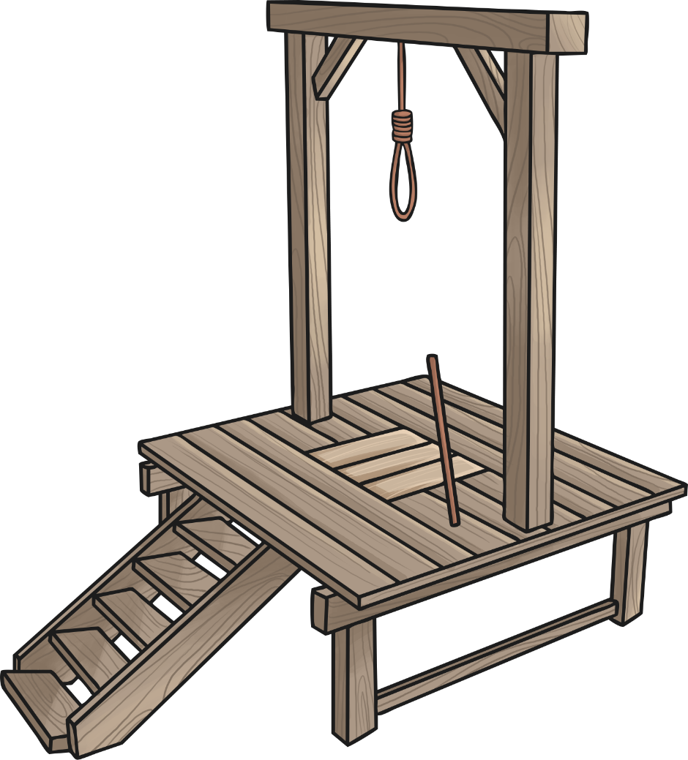
Anglo-Saxon Justice System
Many laws we have in Britain today are not that different from the laws of Anglo-Saxon Britain. However, the punishments were considerably different.
There were no prisons to send criminals to, so punishments were designed to be a huge deterrent to those thinking of breaking the law and they were often pretty brutal!
The different Anglo-Saxon kings and kingdoms had their own laws and punishments.

Slide 6
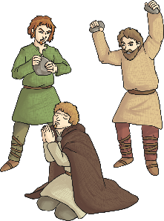
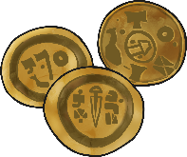
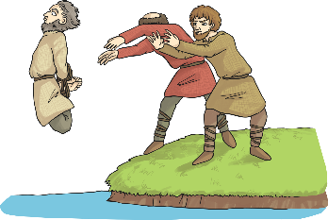
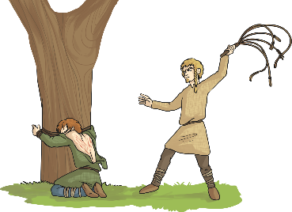
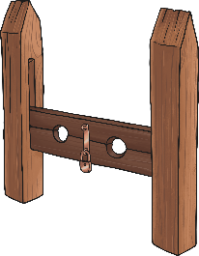
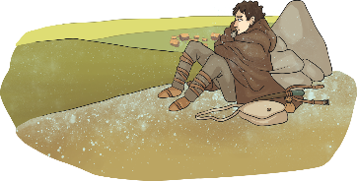
Types of Punishments
Here are some typical Anglo-Saxon punishments…
Paying a fine (if a person could not afford their fine, they could be put into slavery)
Stoning
Hanging
Mutilation (bits of the body cut off)
Drowning
Whipping
Branding (burned with a hot iron rod)
Exile (being sent away)
Stocks
Most punishments were carried out in public to make an example of the guilty person and to deter others from committing the same crime.

Slide 7
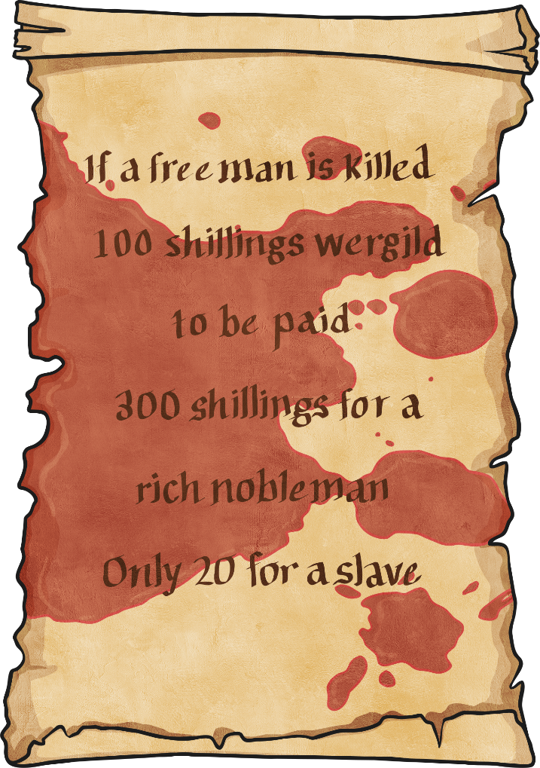
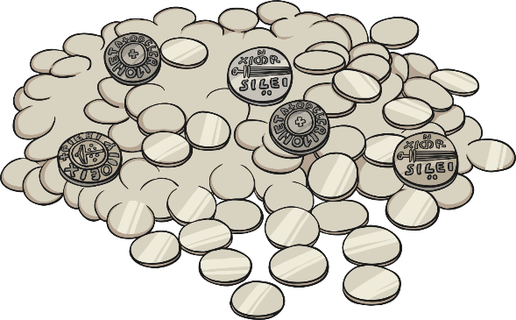
Wergild
Wergild was a payment system used in Anglo-Saxon times to settle disputes between the criminal and the victim or the victim’s family.
Wergild would be paid if someone was killed and the amount depended on how important the victim was.

Slide 8
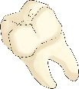
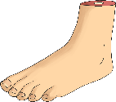
Body Parts
Different parts of the body even had a wergild value. So if you lost a finger in a fight, your attacker would have to pay you compensation.
Look at the chart showing how much different body parts were worth in the wergild system. Use the chart to help you work out how much compensation you would get for the missing body parts on your Missing Body Parts Card.
Body Part | Wergild Value
Broken tooth | 1 shilling
Broken nose | 10 shilling
Lost Finger | 6 shillings
Lost thumb | 20 shillings
Lost foot | 50 shillings

Slide 9
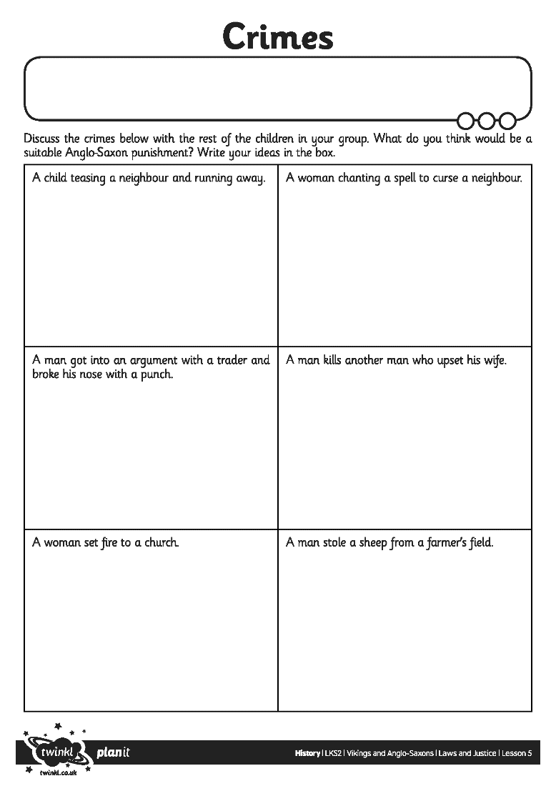
Crimes and Punishments
Discuss the scenarios you have been given with the other children in your group. Based on what you have learnt in the lesson so far, can you decide on a likely Anglo-Saxon punishment and a likely modern day punishment. Make sure you are able to explain your choices and be ready to feed your ideas back to the rest of the class.

Slide 10
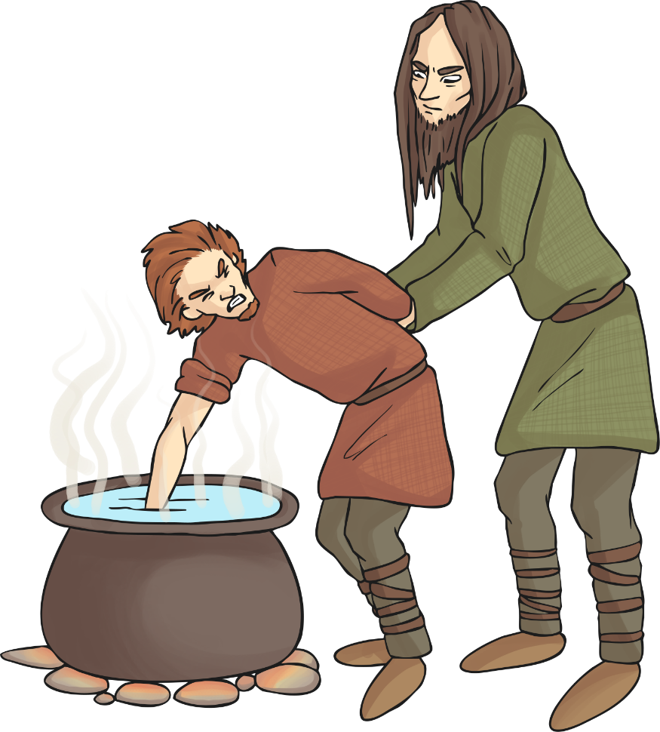
Anglo-Saxon Courts
In Anglo-Saxon Britain, people accused of crimes had to go to court and be tried for their crimes, just like the courts in Britain today.
A jury would decide if the defendant (person accused of the crime) was innocent or guilty and decide on a suitable punishment.
The defendant could choose oath-keepers who would swear they were innocent (a bit like witnesses today).
If the defendant insisted they were innocent and/or a decision could not be reached, sometimes there would be a trial by ordeal through which the Anglo-Saxons believed god would decide if the person was guilty or not. The defendant could choose which ordeal to go through.

Slide 11
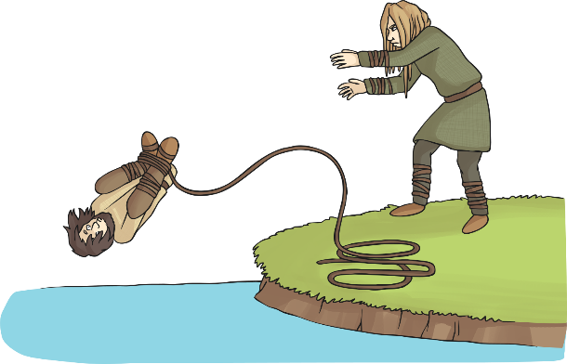
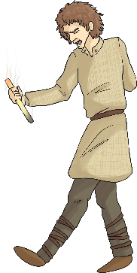
Ordeals
There were three main ordeals in Anglo-Saxon Britain. Who will volunteer to choose to take an ordeal?
Cold Water Ordeal
The person would have their hands and feet tied with rope, be given a drink of holy water and then thrown into an icy cold lake. If they sank to the bottom, they were innocent. If they floated, they were guilty.
Hot Water Ordeal
The person would have to plunge their hand into a pot of boiling hot water and retrieve a stone from the bottom. The hand would be bandaged for three days and then checked. If it was healing without infection, the person was deemed innocent, but if it was infected they were guilty.
Iron Bar Ordeal
The person had to carry a glowing hot iron bar for nine feet. They would then have their hand bandaged for three days. Like the hot water ordeal, if it was healing without infection the person was deemed innocent but if it was infected, they were guilty.

Slide 12
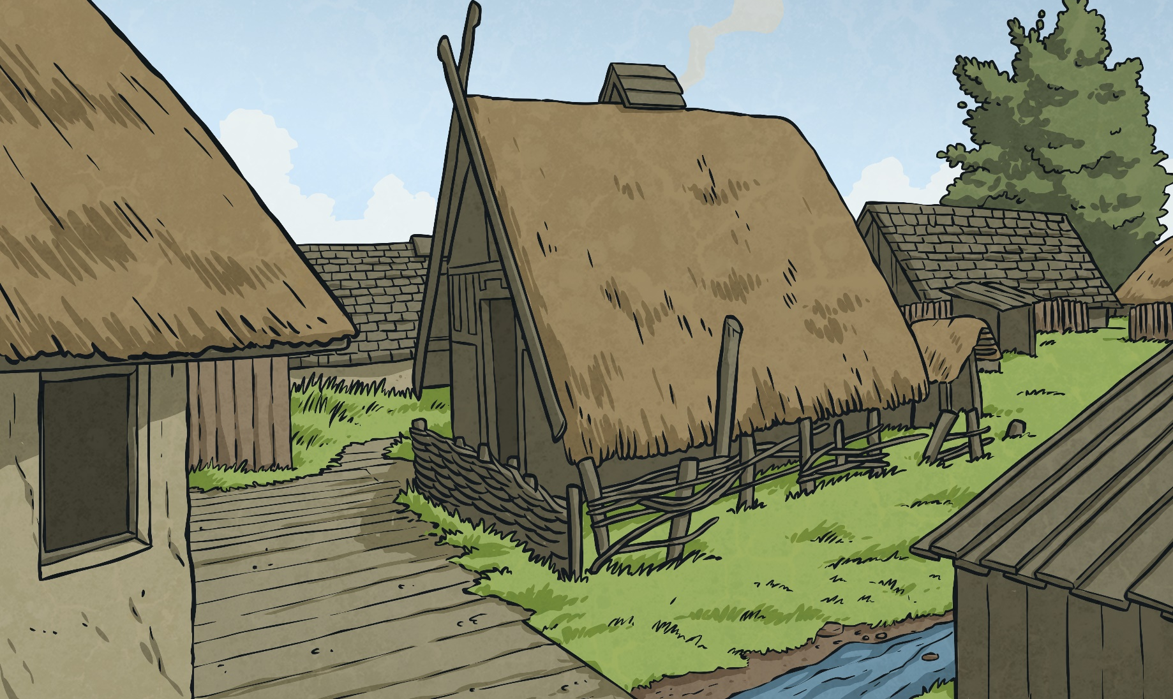
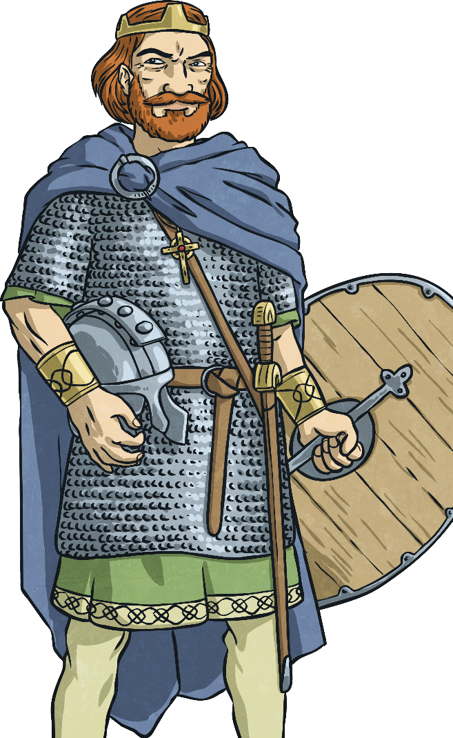
Viking Justice System
Just like their Anglo-Saxon neighbours, the Vikings in Britain also had their own laws and punishments. The Vikings may have had a reputation for being ruthless raiders, but their justice system was fairly civilised.
Each Viking community had its own laws. These were not written down, but were passed from person to person and from parents to children by word of mouth. In each community their was a law speaker. This person would remember all the laws of that community. The disputes and punishments for breaking the laws were decided by a Thing.

Slide 13
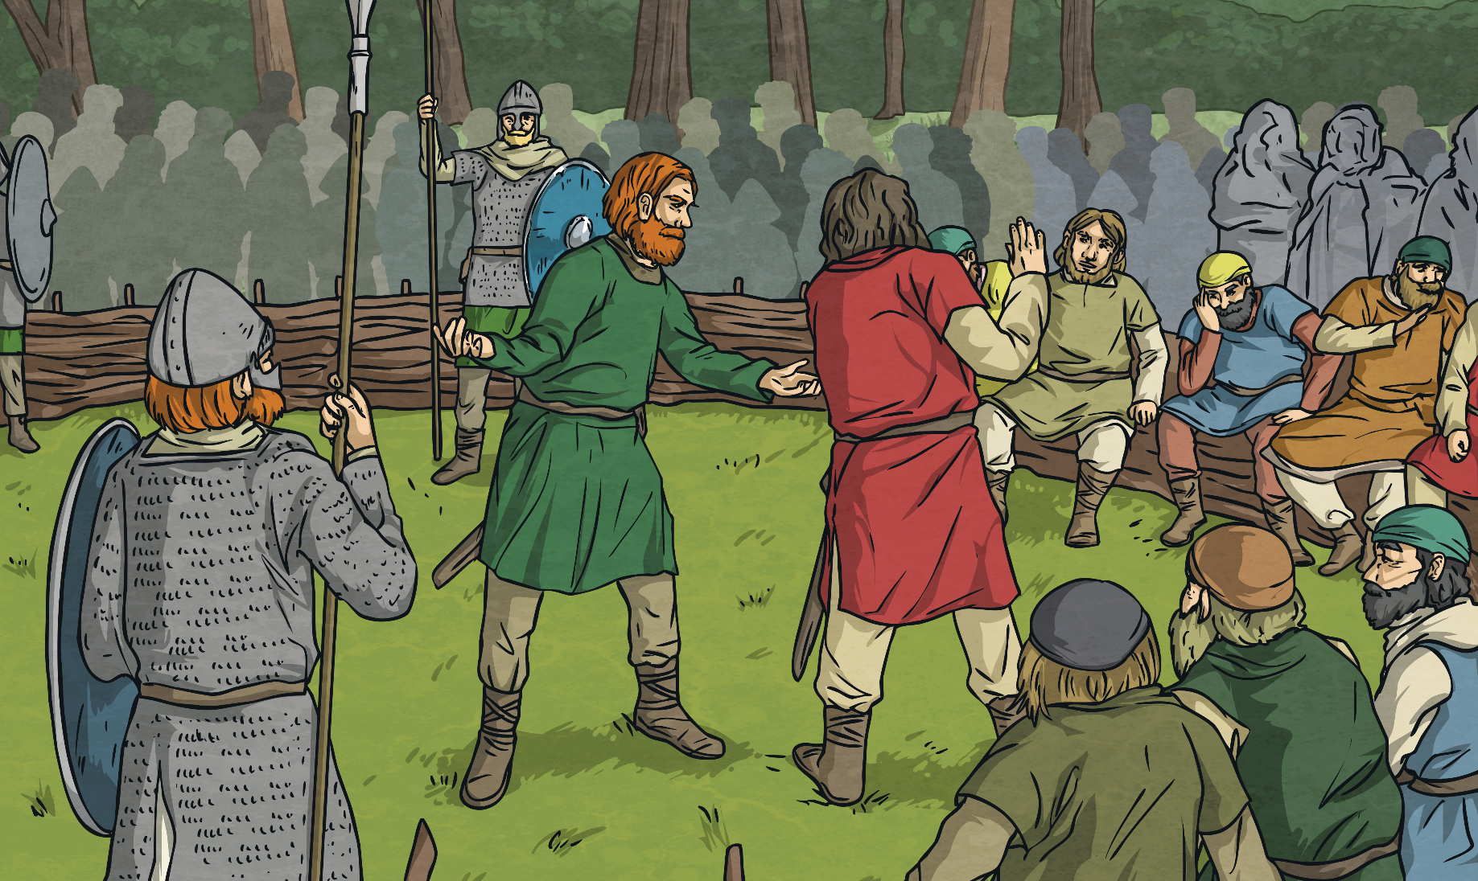
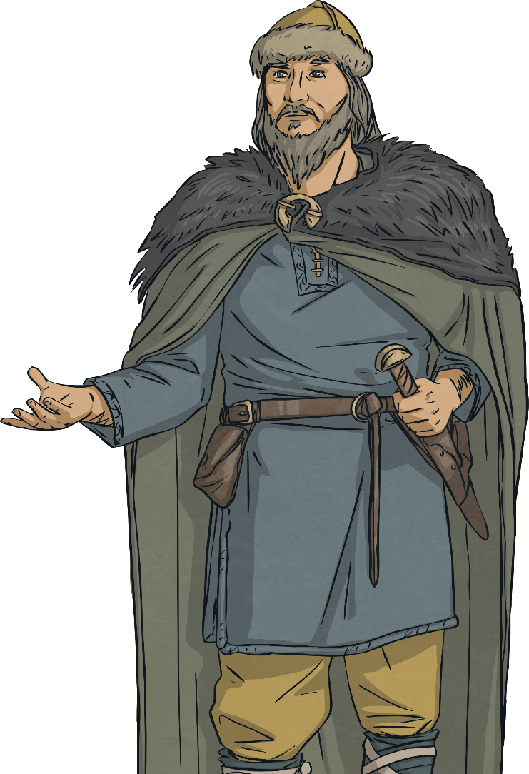
Viking Justice System
The Thing was a group made up of all the free men and women (people who weren’t slaves) of the community. They would meet to solve disputes and punish people who broke the laws. The law speaker would be at each Thing along with the leader of the community, the chieftain.
Things were held in open places and sometimes could last days. Everyone was allowed to say what they thought at the Thing, but chieftain and the law speaking would usually settle the disputes based on what the laws said.

Slide 14
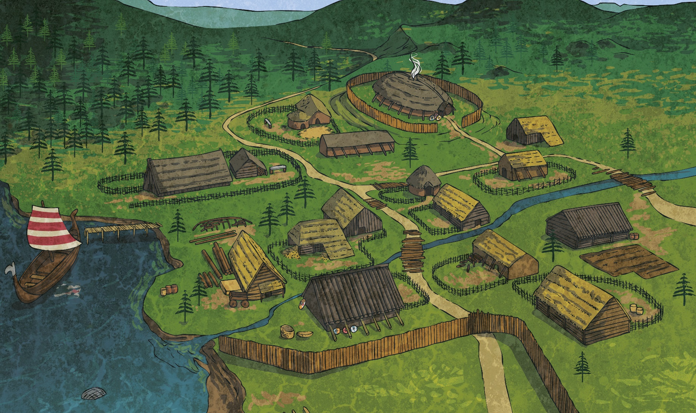
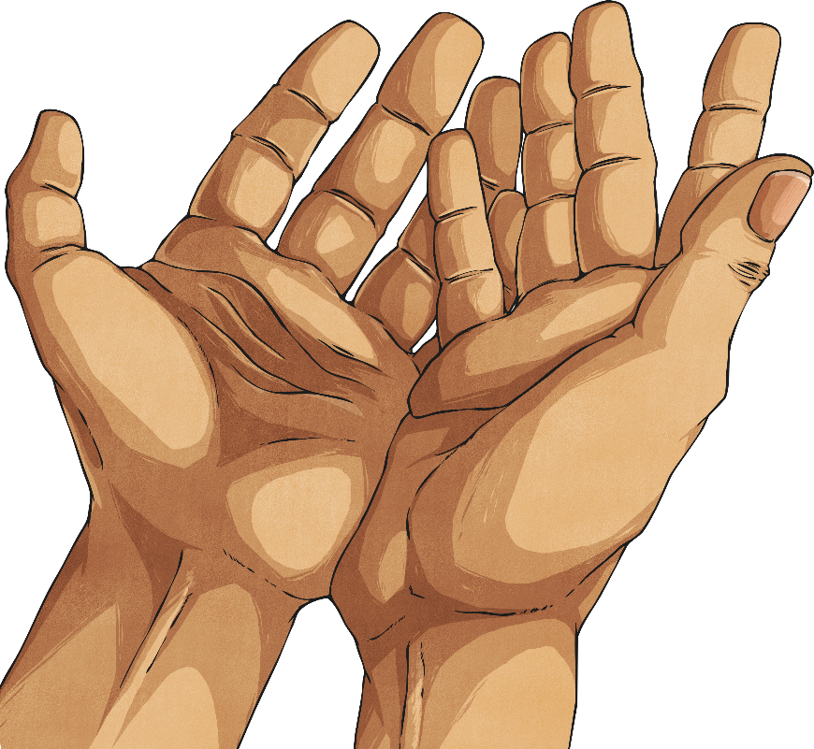
Viking Justice System
Anyone who was tried at the Thing and found guilty could face one of these punishments:
● A fine
● Being semi-outlawed (outlawed for a short time)
● Being fully outlawed (outlawed forever).

Slide 15
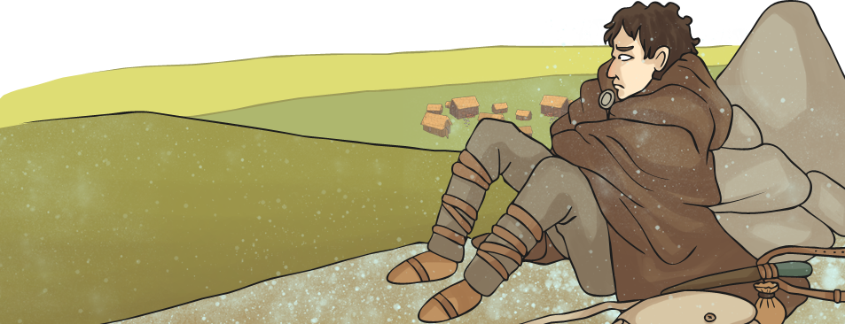
Viking Justice System
Being outlawed may sound like an easy punishment compared to the Anglo-Saxon punishments but if you were outlawed, all of your property was taken off you and you could no longer live in the community. No one was allowed to help you to find food, shelter or water. Worse than the loneliness, being outlawed also meant that anyone could kill you without a reason!

Slide 16
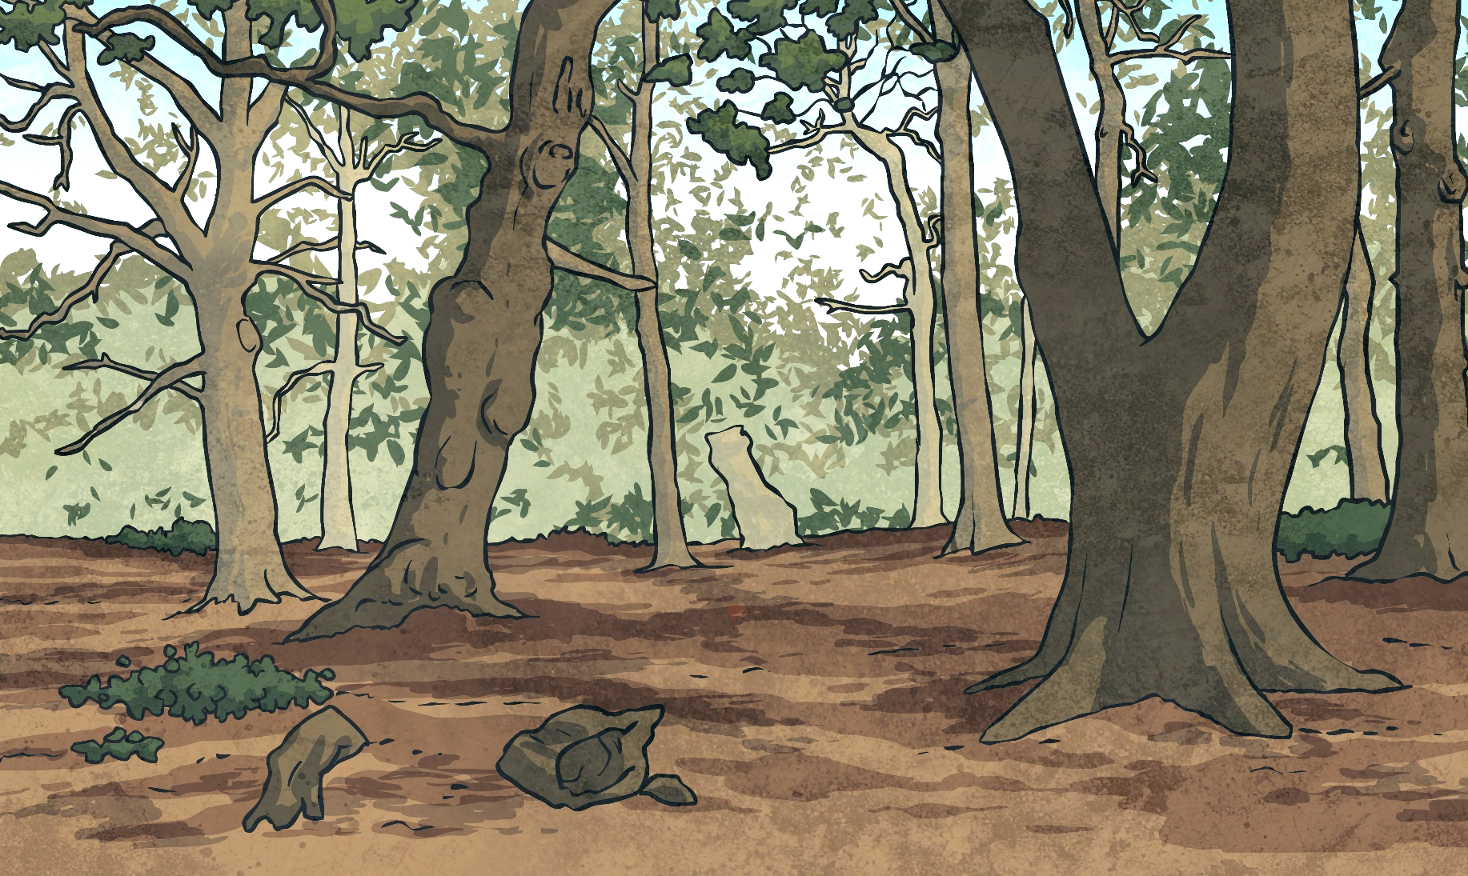
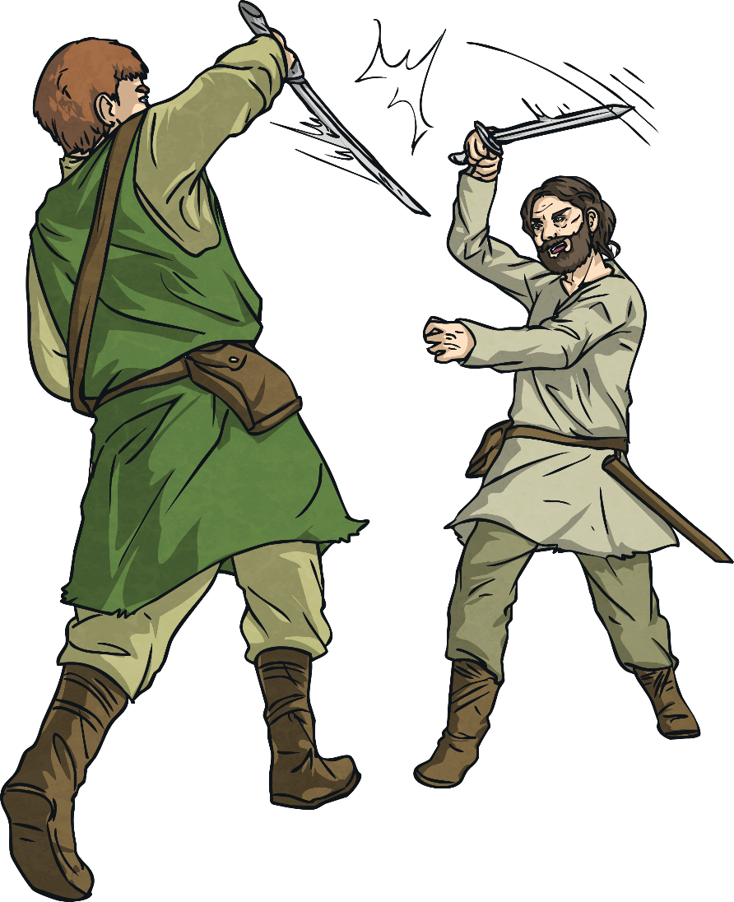
Viking Justice System
Vikings did not have to take their disputes to a Thing to be settled. They could also settle them with a fight or duel to the death.
This literally meant the people who were having the dispute or argument could agree to fight until one of them was killed by the other!

Slide 17
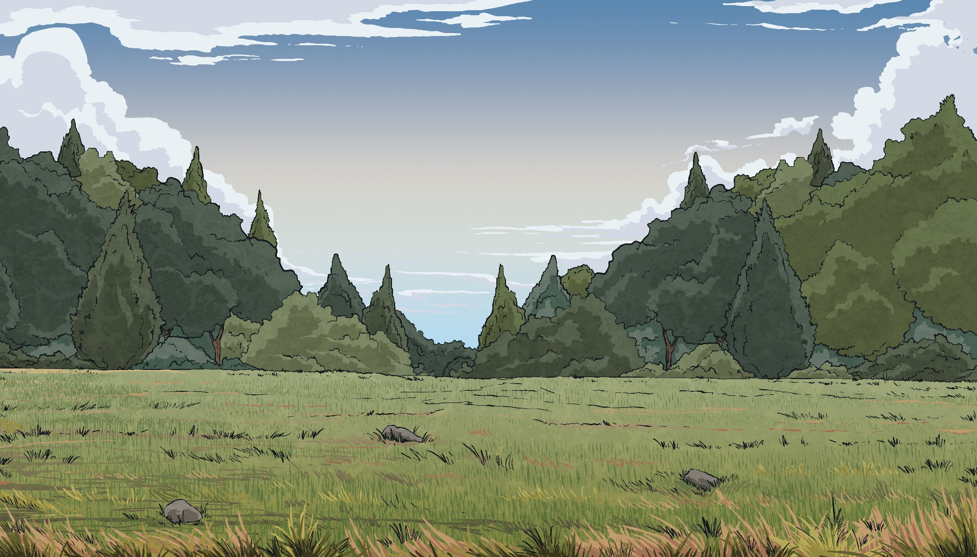
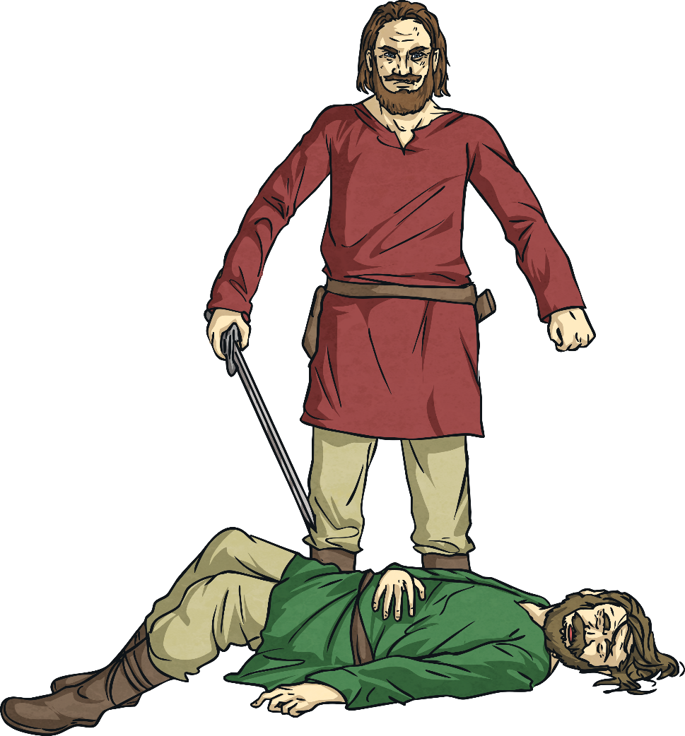
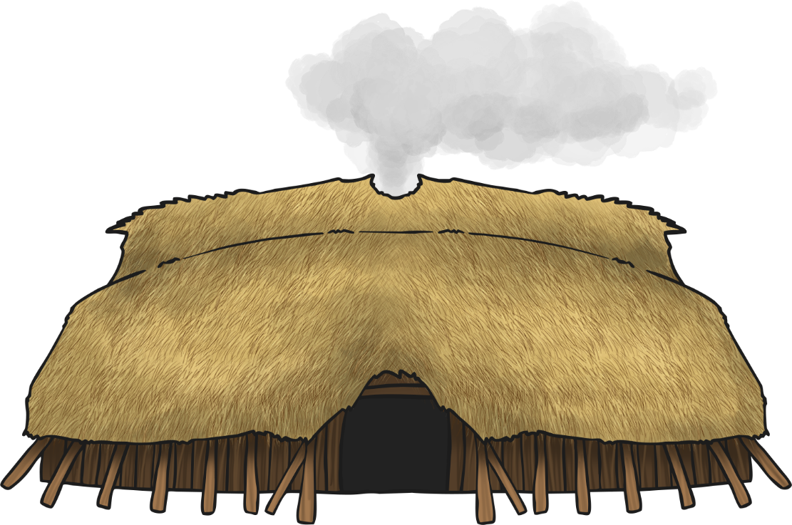
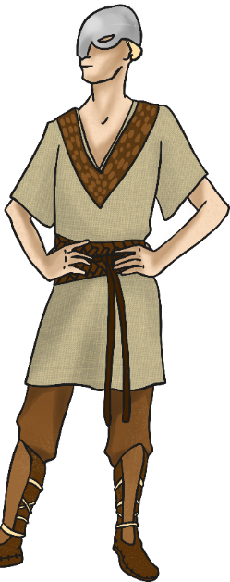
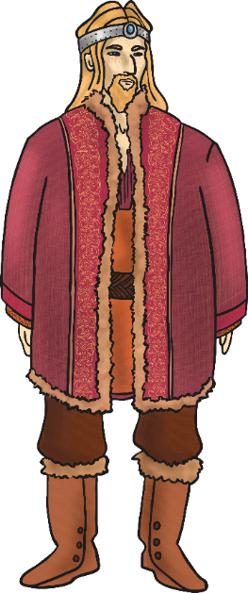
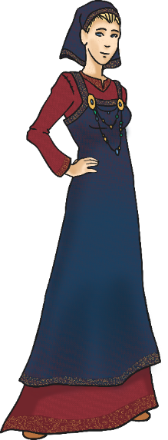
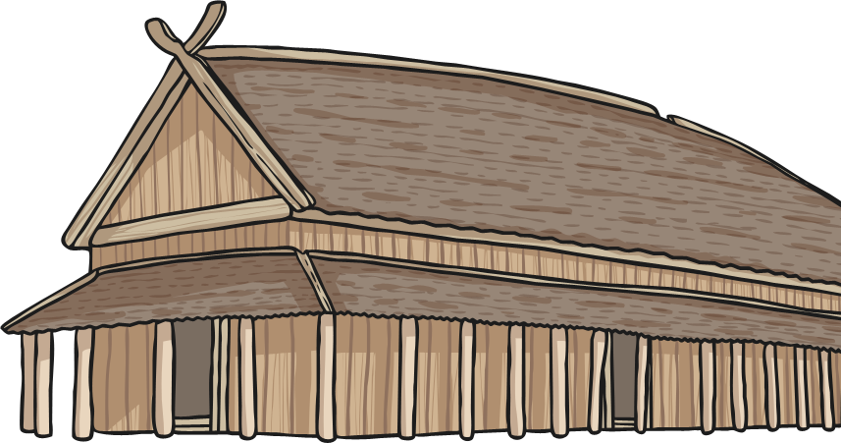
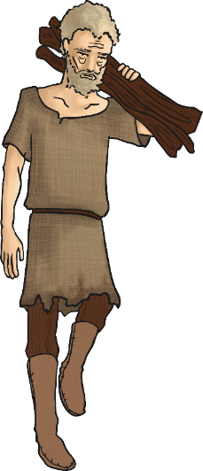
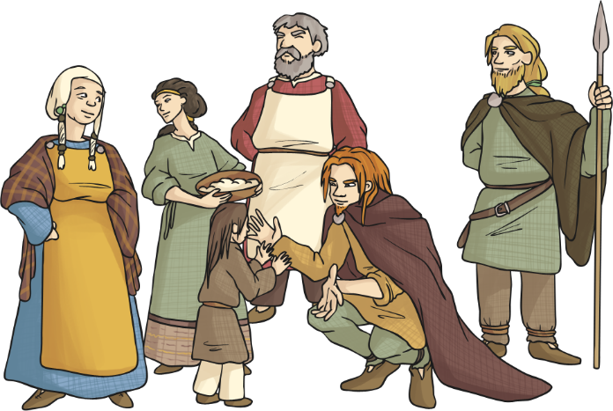
Viking Justice System
As a Viking, you could also take revenge on someone who had killed a member of your family - as long as you were open and honest about it.
This meant you would need to kill them in a public place and give them chance to react. You might have to pay your victims family a fine, but you would not face any other consequences.

Slide 18
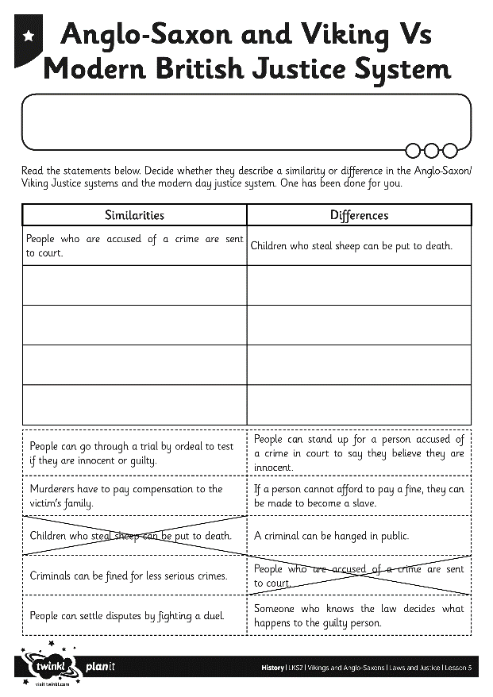
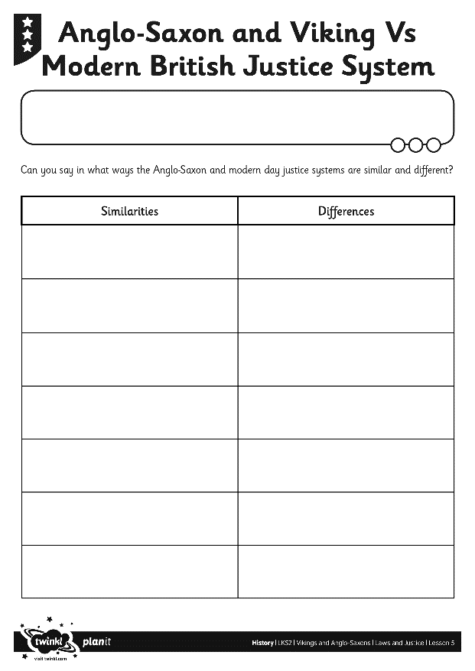
Anglo-Saxons and Vikings Vs Modern Britain Justice Systems
How does the Anglo-Saxon justice system compare to the system we have in Britain today?
Which aspects are similar and which are different?
Complete the chart to show the similarities and differences.

Slide 19
Aim
I can explain how the legal system worked in Anglo-Saxon and Viking Britain.
Success Criteria
I can demonstrate understanding of crime and punishment in Anglo-Saxon and Viking Britain.
I can compare and contrast the Anglo-Saxon and Viking justice systems with the modern British justice system.

