Slide 1
Draw 2D shapes

Slide 2
Is it a square?
1
3
2
4

Slide 3
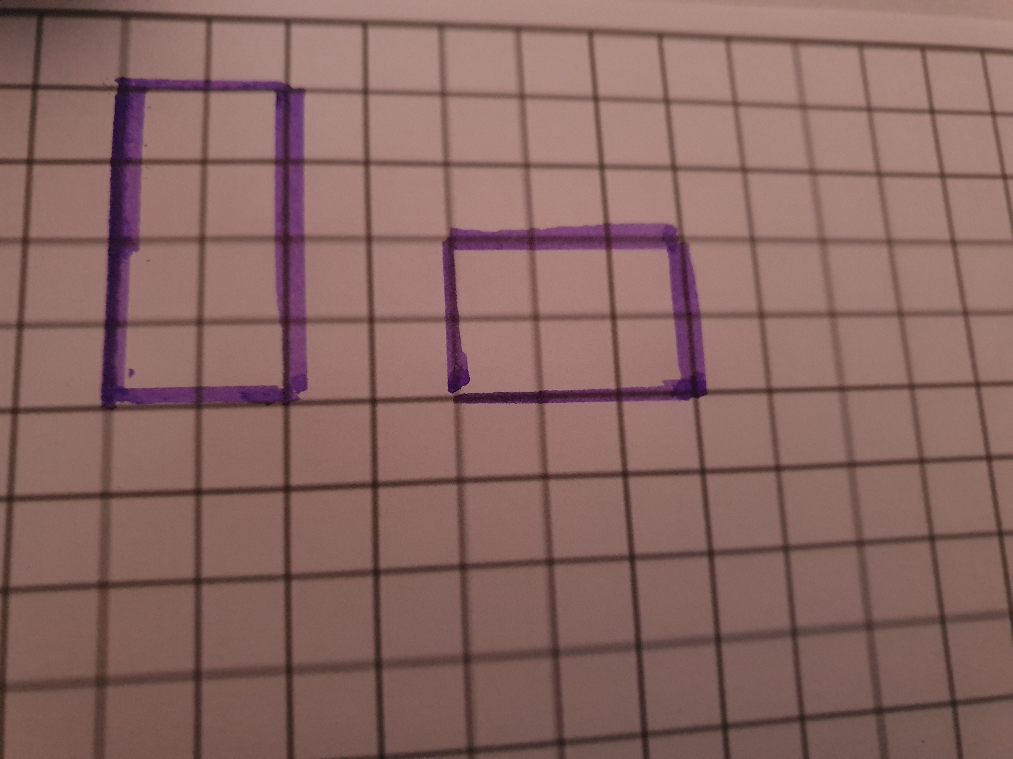
Are these two shapes the same?

Slide 4
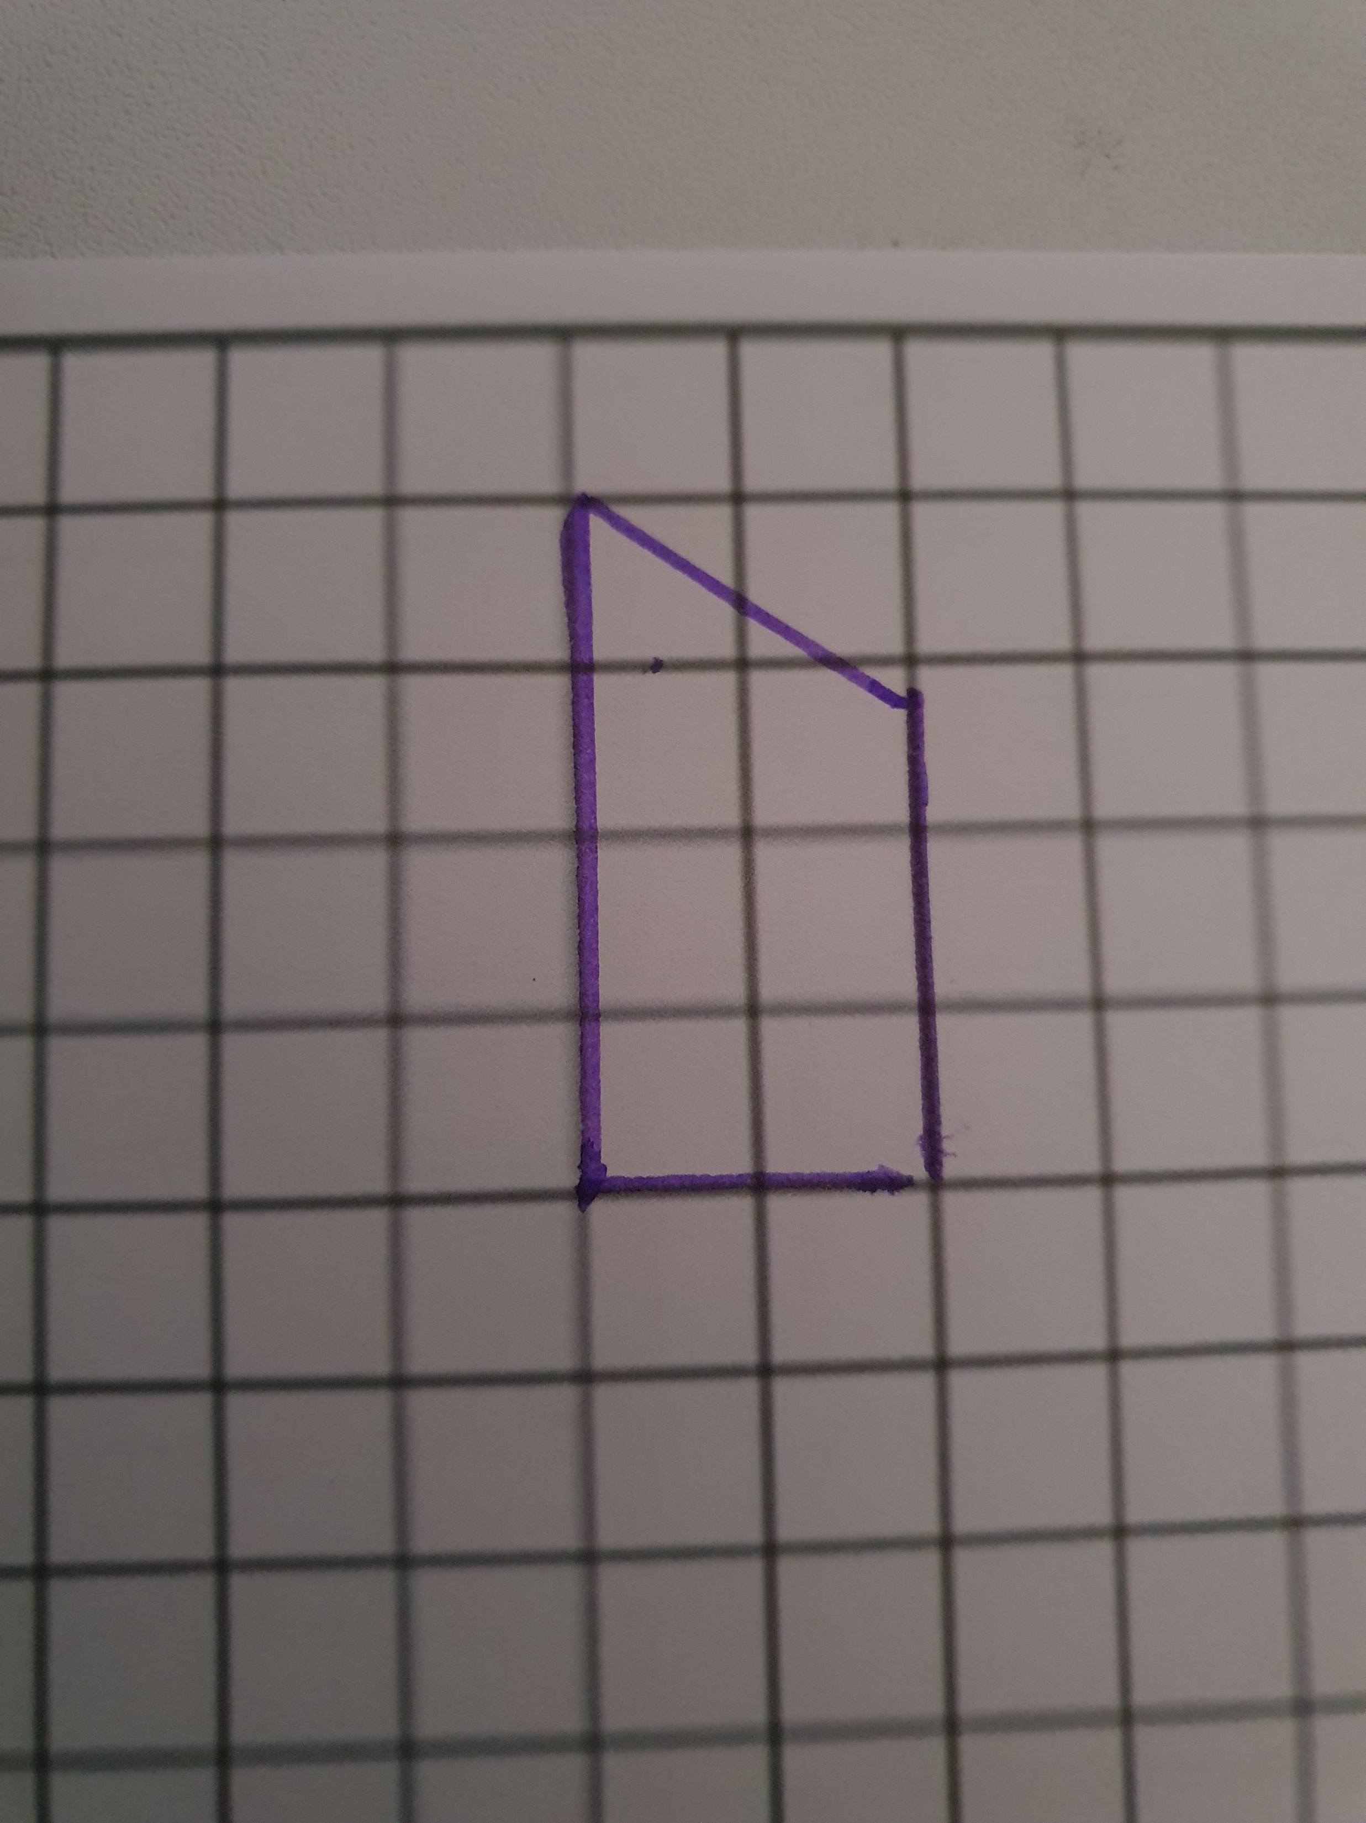
Is this a rectangle?

Slide 5
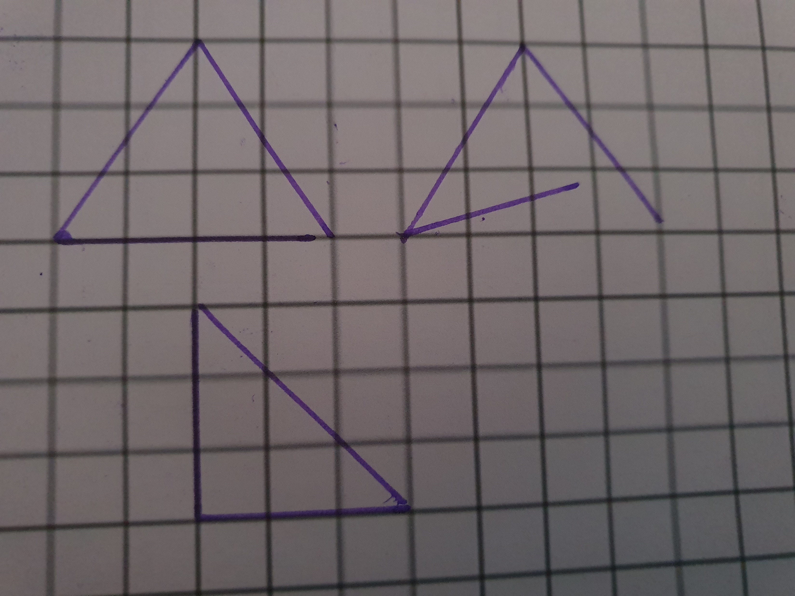
Triangles

Slide 6
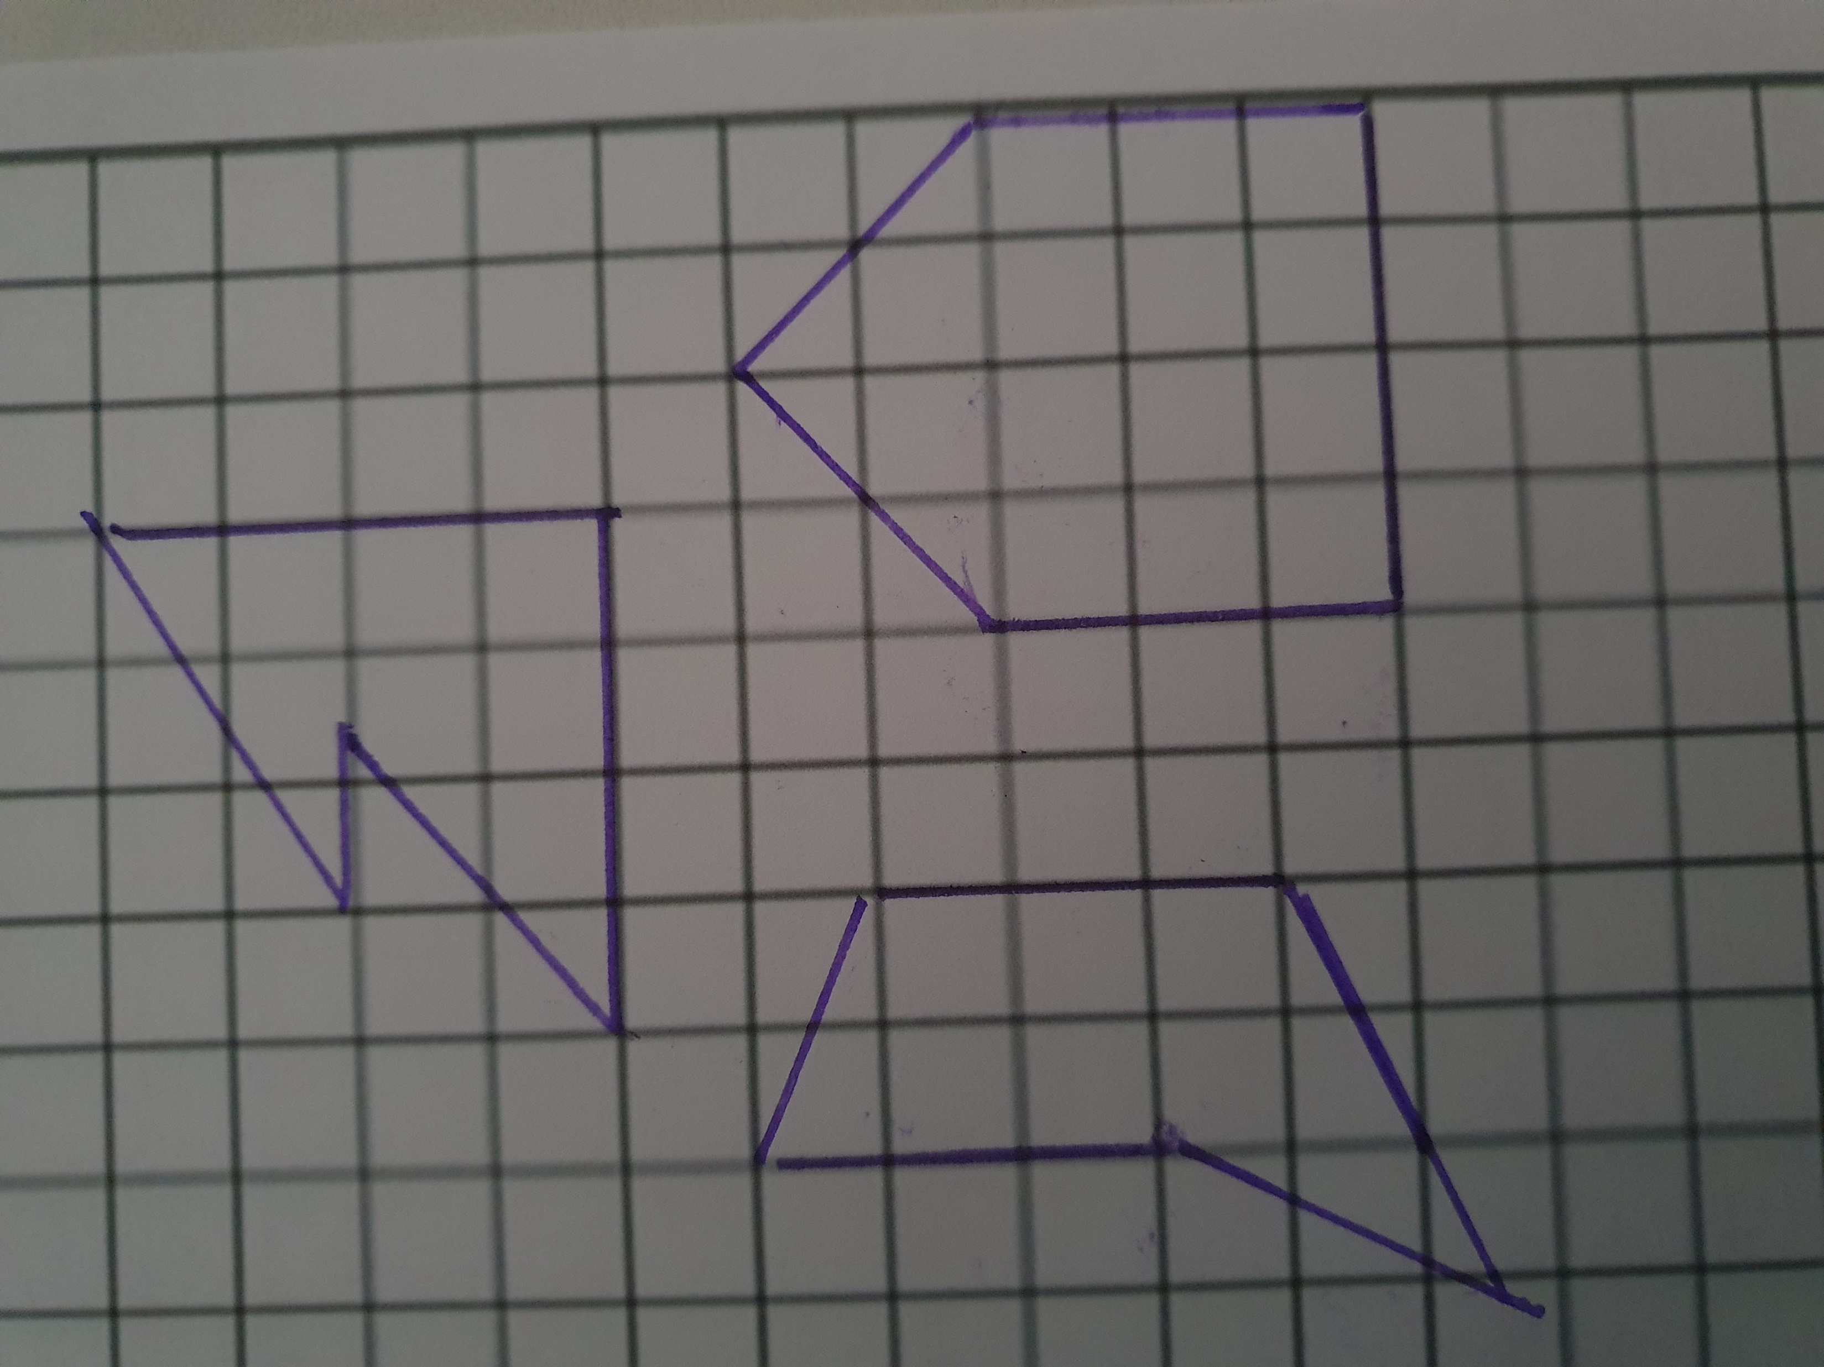
Pentagon

Slide 7
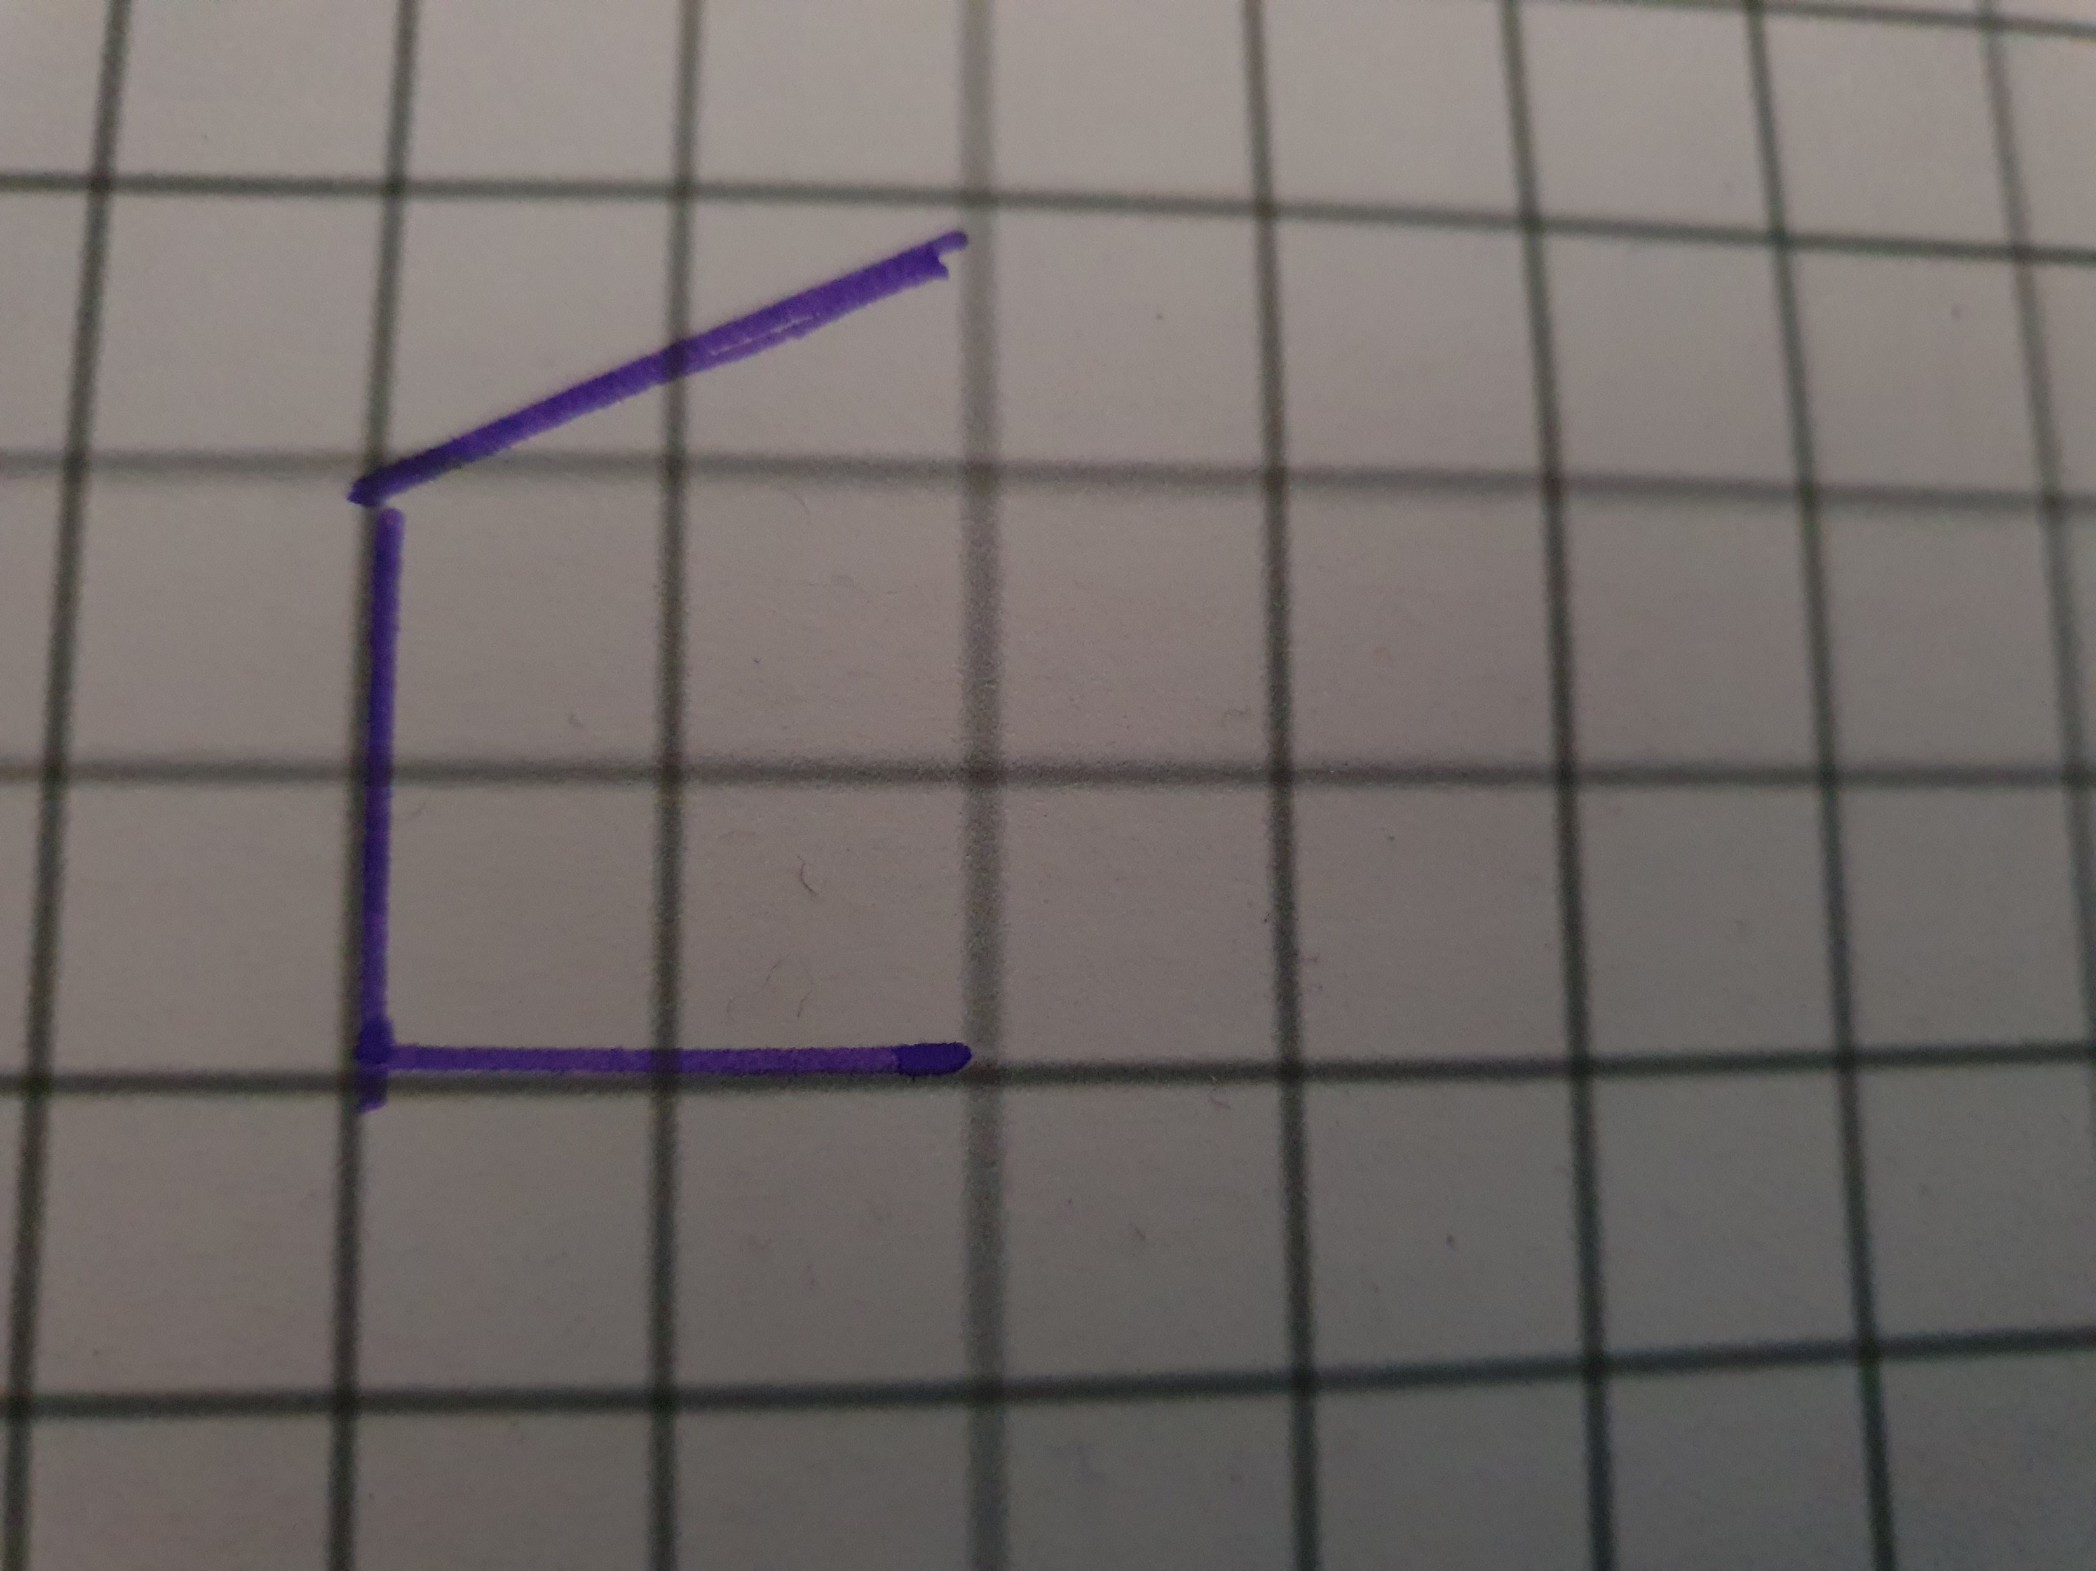
What shape will I draw?
Triangle
Square
Rectangle
Pentagon

Slide 8
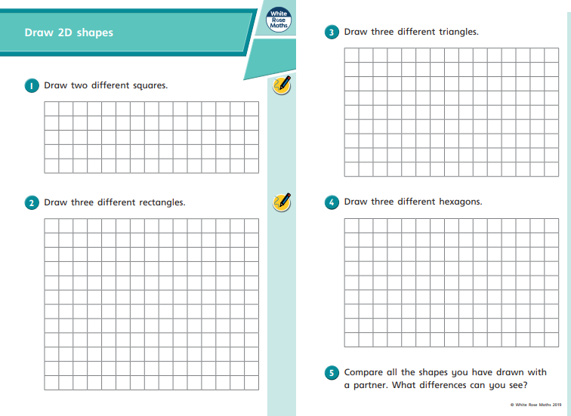
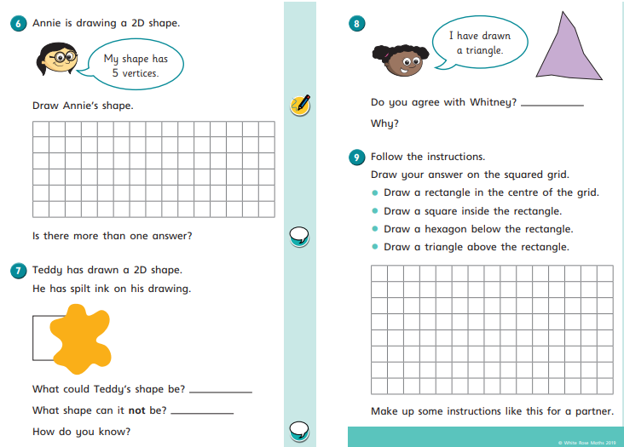
Worksheet

