Slide 1
Count sides on 2D shapes

Slide 2
Which one of these is the odd one out?

Slide 3
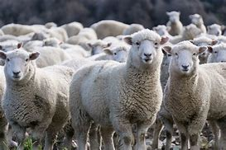
Counting sides
Annie has some sheep. She thinks she can keep them in with two straight lines!
What do you think?

Slide 4
Annie needs to draw a 2D shape to keep the sheep in.
Can she make a 2D shape with two straight lines?
How many lines will she need to make a 2D shape for her sheep?

Slide 5
Annie realises that you need at least 3 straight lines to make a 2D shape.
This shape has 3 vertices.
This shape has 3 sides.

Slide 6
Are all shapes with 3 sides triangles?

Slide 7
How many sides?

Slide 8
Pentagon Rectangle Square Triangle Hexagon
What shapes have I used to make my shape picture?

Slide 9
Your turn, can you answer the questions on the worksheet.
After that, can you make your own 2D shape picture?

