Slide 1
What I’m learning in Maths today
Maths – Y6 (Algebra) Date: 22.2.21
L.Obj: *I can solve algebraic calculations and problems using inputs and outputs.
*I can solve the missing input by working backwards from the output and using the opposite operations.
Using
it

Slide 2
Year 6
1) 20 – 4 x 2 =
2) 2/5 ÷ 2 =
3) 11/5 – 1/4 =
4) 2,331 ÷ 37 =
5) 3/4 + 7/8 =
6) 3/4 ÷ 2 =

Slide 3
Year 6
1) 12
2) 2/10 or 1/5
3) 19/20
4) 63
5) 13/8 or 1 5/8
6) 3/8

Slide 4
Algebra is the part of mathematics where the numbers have been replaced, often with letters. It is up to you to calculate what numbers each of the letters represent.

Slide 5
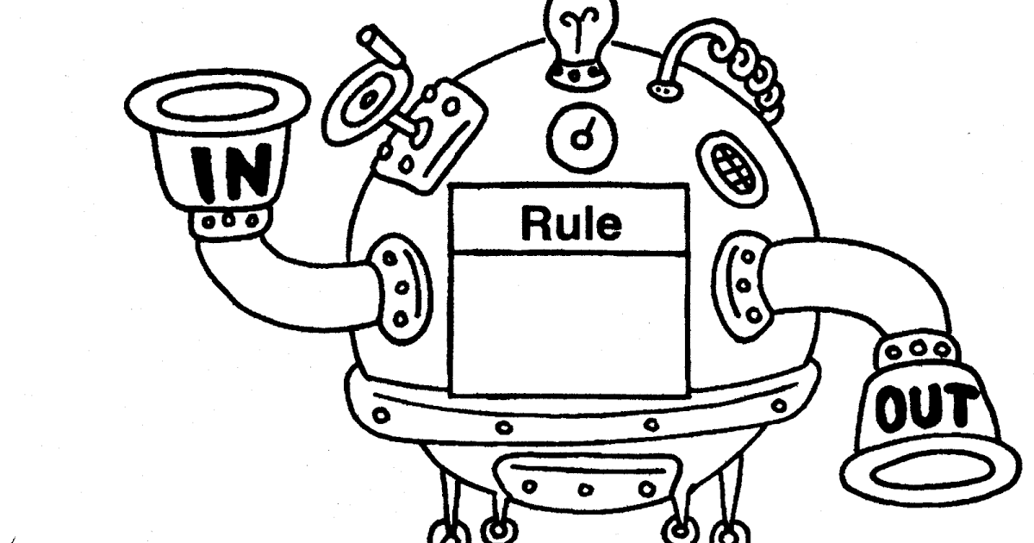
Here is an expression that has come from a function machine: Output = 𝟒𝒂+𝟑, which means 4 lots of a, then add 3.
•What is the output if the input, a, is 7?
•What is the output if the input is 2.5?
•What is the input if the output is 63?
4a + 3

Slide 6
Here is an expression that has come from a function machine: Output = 𝟒𝒂+𝟑
•31
•13
•15
4a + 3

Slide 7
Introduction
What would the algebraic rules look like for the following functions?
Let’s say that the number going in (INPUT) is ‘a’ and the answer coming out (OUTPUT) is ‘b’.
a
x
5
+
20
b
© Classroom Secrets Limited 2019

Slide 8
5a + 20 = b
(5 lots of a, then + 20 = b)
a
x
5
+
20
b
© Classroom Secrets Limited 2019

Slide 9
Varied Fluency 1
Calculate the output for the following rules where a = 10..
a² + 25
(2a + 5) ÷ 5
(a ÷ 2) x 10
Top tip:
The part in brackets should be completed first.
If there are no brackets, ‘x’ and ‘÷’ take priority over ‘+’ and ‘-’.
© Classroom Secrets Limited 2019

Slide 10
Varied Fluency 1
Calculate the output for the following rules where a = 10..
a² + 25
125
(2a + 5) ÷ 5
5
(a ÷ 2) x 10
50
© Classroom Secrets Limited 2019

Slide 11
Varied Fluency 2
Match the output to the correct expression, where a = 3.
10a – a
35
(3a – 2) x 5
23
10a – 7
27
© Classroom Secrets Limited 2019

Slide 12
Jack is using the expression (2a + 2) ÷ 2.
Calculate the value of a when his outputs are:
(2a + 2) ÷ 2
8
12
26
Top tip:
Start with the answer (OUTPUT), work backwards and do the opposite (inverse).
Start with 8, then x 2, then – 2 then ÷2.
Start with 12, then x 2, then – 2 then ÷2.
Start with 26, then x 2, then – 2 then ÷2.
© Classroom Secrets Limited 2019

Slide 13
Varied Fluency 4
Jack is using the expression (2a + 2) ÷ 2.
Calculate the value of a when his outputs are:
(2a + 2) ÷ 2
7
8
11
12
25
26
© Classroom Secrets Limited 2019

