Slide 1
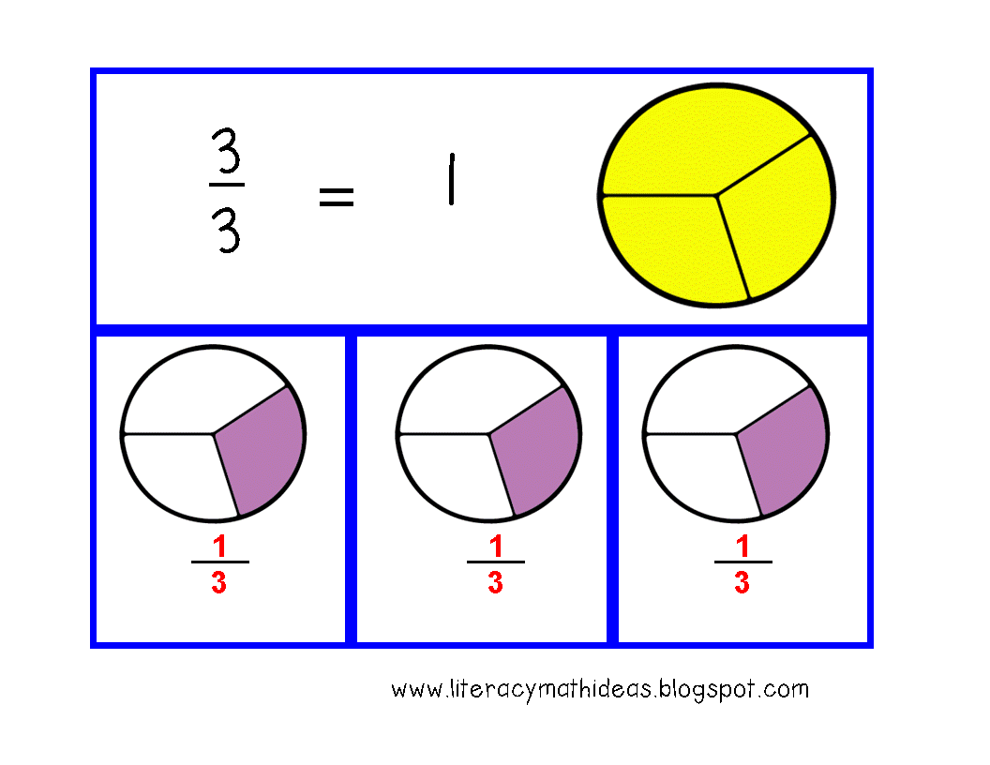
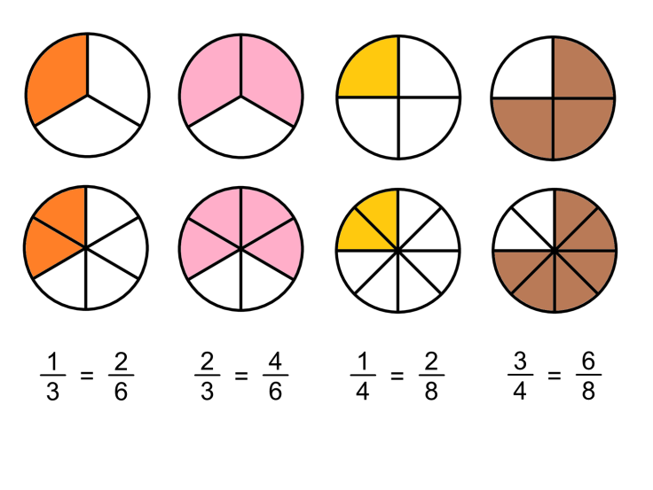
What I’m learning in Maths today
Maths – Y5 (adding fractions) Date: 22.2.21
L.Obj: *I can add mixed numbers and fractions.
*I can convert mixed numbers into improper fractions and find a common denominator.
(Sophie, Ollie and Esme) *I can add fractions with different denominators.

Slide 2
Balancing Equations – Fill in the missing number
4 x ___ = 5 x 8
Extra challenge!
4³ = ½ of ____
31.5 x 2 = 7 x ___
8.1 x __ = 90²
___ x 10 = 240 - 50
42 ÷ 6 = ½ of ___
7 x 4 = 50 - ___
360 ÷ 10 = 9 x ___
____ + 50 = 8²

Slide 3
Balancing Equations – Fill in the missing number
4 x 10 = 5 x 8
Extra challenge!
4³ = ½ of 128
31.5 x 2 = 7 x 9
8.1 x 1,000 = 90²
19 x 10 = 240 - 50
42 ÷ 6 = ½ of 14
7 x 4 = 50 - 22
360 ÷ 10 = 9 x 4
14 + 50 = 8²

Slide 4
Can you turn the mixed number into an improper fraction with the same denominator?
Then, look at the symbols in between each fraction. Are they correct? Yes or No?
a. | 3 | 2 | > | 17
 |  | 5 |  | 5
b. |  | 12 | > | 4 | 1
 |  | 8
 |  |  |  |  | 8
c. | 2 | 6 |  | < | 5 | 1 |  | > | 4 | 4
 |  | 10 |  |  |  | 4 |  |  |  | 5
© Classroom Secrets Limited 2019

Slide 5
a. | 3 | 2 | > | 17
 |  | 5 |  | 5
a. | 3 | 2 | = | 17
 |  | 5 |  | 5
✗
b. |  | 12 | > | 4 | 1
 |  | 8
 |  |  |  |  | 8
b. |  | 12 | < | 4 | 1
 |  | 8
 |  |  |  |  | 8
✗
c. | 2 | 6 |  | < | 5 | 1 |  | > | 4 | 4
 |  | 10 |  |  |  | 4 |  |  |  | 5
✓
© Classroom Secrets Limited 2019

Slide 6
Add the two fractions together making sure your answer is in its simplest form.
Convert them into improper fractions with the same denominator to help you.
3 | 5 | + | 13 | =
 | 6 |  | 3
© Classroom Secrets Limited 2019

Slide 7
3 | 5 | + | 13 | = | 8 |  | 1
 | 6 |  | 3
 |  |  |  |  |  |  | 6
© Classroom Secrets Limited 2019

Slide 8
Varied Fluency 2
Can you add together these two fractions? Which of the totals is correct?
+ |  | = ?
a. | 8 | 2 | b. | 6 | 3 | c. | 7 | 1
 |  | 12 |  |  | 4 |  |  | 4
© Classroom Secrets Limited 2019

Slide 9
4 3/12 + 2 3/6 so 51/12 + 15/6 so 51/12 + 30/12 = 81/12
81/12 can be simplified to 27/4 because 3 is a common factor!
+ |  | = ?
a. | 8 | 2 | b. | 6 | 3 | c. | 7 | 1
 |  | 12 |  |  | 4 |  |  | 4
27/4
© Classroom Secrets Limited 2019

Slide 10
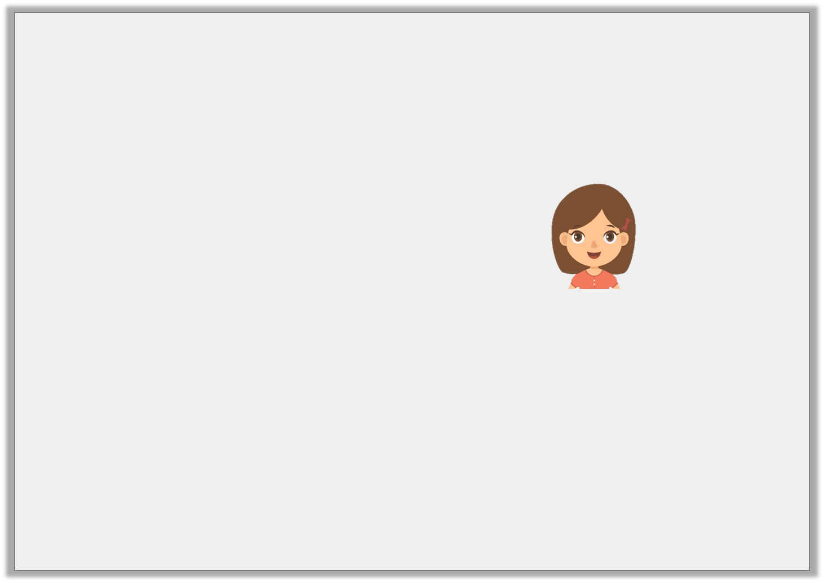
Reasoning 2
Esme has completed the following calculation.
Is she correct?
Explain how you know.
8 | 5 | + | 12 | = | 12 | 1
 | 6 |  | 3 |  |  | 2
© Classroom Secrets Limited 2019

Slide 11
Is she correct?
Explain how you know.
She is incorrect because the correct answer is
is equivalent to 4 which added to makes .
53/6 + 24/6 = 77/6 = 12 5/6
8 | 5 | + | 12 | = | 12 | 1
 | 6 |  | 3 |  |  | 2
12 | 5
 | 6
 | 12
 | 3
8 | 5
 | 6
12 | 5
 | 6
© Classroom Secrets Limited 2019

Slide 12
What’s my missing number
I’m thinking of a number.
I add 4.
Then I multiply it by 3.
The answer is 27.
What is my number?
TOP TIP:
Work backwards, starting from the answer and do the opposite (inverse)
So, start on 27, divide it by 3, then subtract 4.
I’m thinking of a number.
I subtract 50.
Then I divide it by 5.
The answer is 2.
What is my number?
TOP TIP:
Work backwards, starting from the answer and do the opposite (inverse)
So, start on 2, multiply it by 5, then add 50.
I’m thinking of a number.
I multiply it by 9.
Then I subtract 14.
Next I divide it by 8.
My answer is 5.
What is my number?
TOP TIP:
Work backwards, starting from the answer and do the opposite (inverse)
So, start on 5, multiply it by 8, then add 14 and finally divide it by 9.

Slide 13
What’s my missing number
I’m thinking of a number.
I add 4.
Then I multiply it by 3.
The answer is 27.
What is my number?
5
I’m thinking of a number.
I subtract 50.
Then I divide it by 5.
The answer is 2.
What is my number?
60
I’m thinking of a number.
I multiply it by 9.
Then I subtract 14.
Next I divide it by 8.
My answer is 5.
What is my number?
6

