Slide 1
What are the different parts of the human body?
Science.

Slide 2
What are the parts of the human body? - BBC Bitesize

Slide 3
How many parts of your body can you name?
Elbows
Head
Feet
Arms
Fingers
Shoulders
Legs
Eyes
Fingers
Knees
Mouth
Ears
Wrists
Nose
Ankles
Back
Tummy
Chest
Toes
Hands

Slide 4
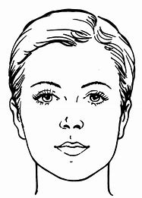
My face

Slide 5
Eye lashes
Nose
Chin
Hair
Eyes
Ears
Mouth
Neck

Slide 6
Our eye enable us to see things clearly. The pupil (black dot in the middle) lets light into the eye that helps you to see. The coloured part is called the iris.
Our eyes have eye lids and eye lashes, these help to protect your eyes from dust and debris.
Your nose helps you to breath effectively. Your nose filters the air as you inhale.
You also use your nose for your sense of smell.
Your outer ear collects sounds and funnels them down into your inner ear where they are processed, this helps us to be able to hear.
You mouth has multiple purposes. You use it for speaking, your lips change shape as you make different sounds.
You also use your mouth for eating and drinking, tiny taste buds on your tongue enable you to be able to taste your food helping you decide if you like it.

Slide 7
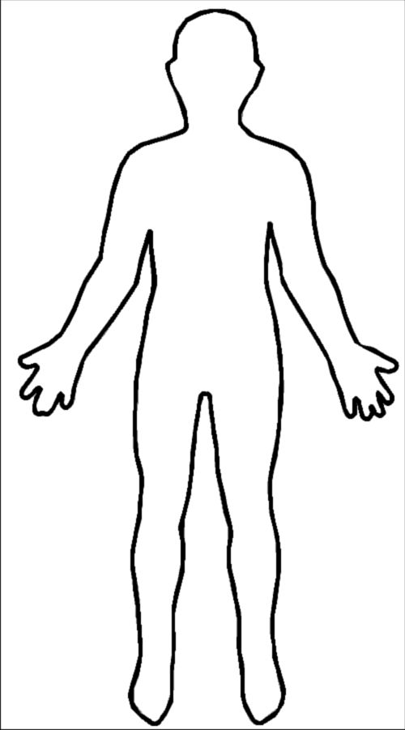
What about the rest of our body?
Skeleton
Arms
Elbows
Wrists
Fingers
Legs
Feet
Toes
Knees
Hips

Slide 8
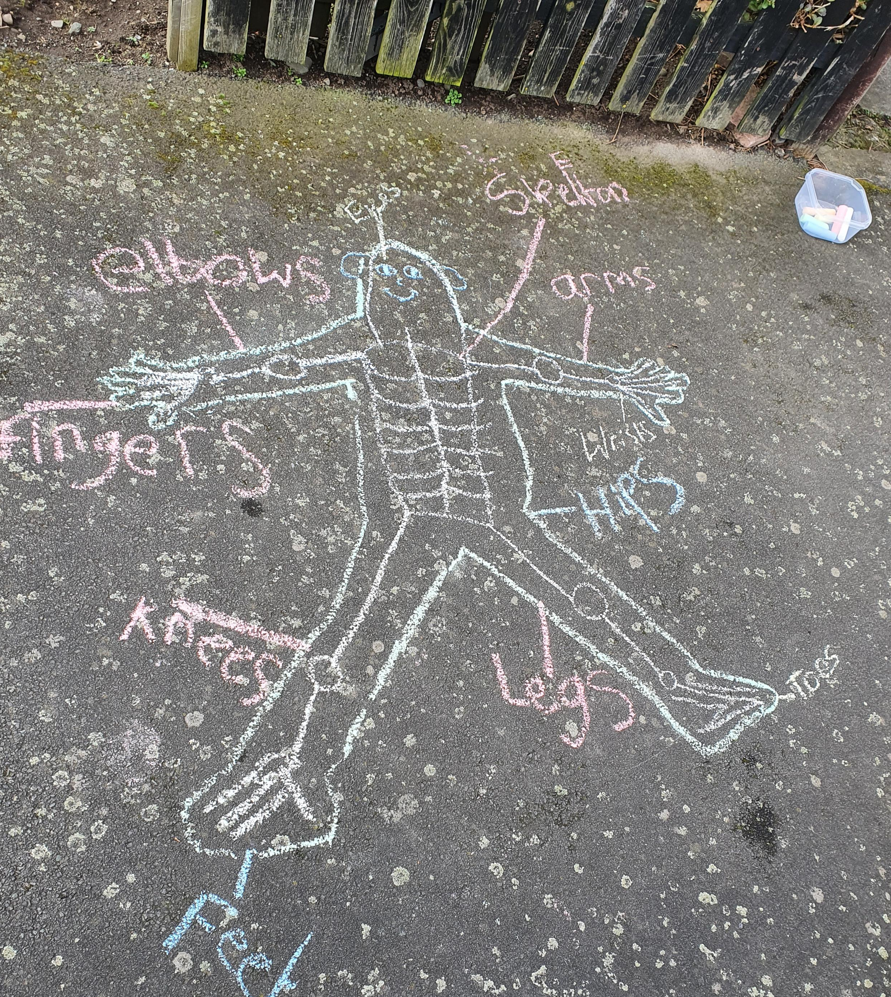
My girls created their own labelled body picture using chalk outside.
I look forward to seeing your labelled pictures.

Slide 9
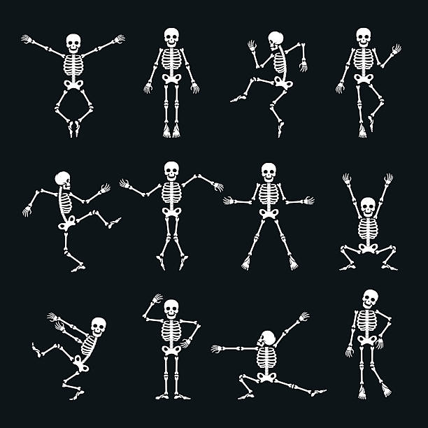
What is a skeleton?
An adult skeleton has 206 bones. It is used to support the organs in your body such as your heart and lungs.
Our skeleton supports our body and holds it up.

Slide 10
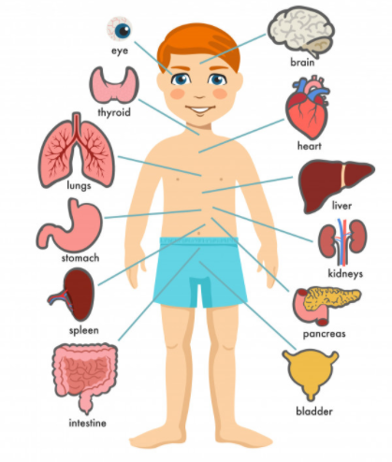
Brain- This controls the whole body.
What is an organ?
Kidneys- These clear the bloody, remove waste and make urine.
Heart- Your heart is part of your circulatory system. It works in conjunction with bloody vessels to transport blood around your body.
Intestine- This is a long organ that helps to break down food so the body can use it for energy. Your intestines are nearly 6.5m long- that’s nearly the same length as a double decker bus!

Slide 11
Question 1
An adult skeleton has 206 bones? True/False
Question 4
What does your brain do?
Question 2
The black dot in the centre of our eyes is called the iris
True/False
Quiz
Question 5
Your nose helps to filter air when you breath?
True/false
Question 3
How long are your intestines?

Slide 12
Question 1
An adult skeleton has 206 bones?
True
Question 4
What does your brain do?
Controls the body.
Question 2
The black dot in the centre of our eyes is called the iris
False-it’s called the Pupil
Quiz
Question 5
Your nose helps to filter air when you breath?
True, your nose has tiny hairs inside that help to clean the air as you breath.
Question 3
How long are your intestines?
6.5m long, nearly the same length as a double decker bus.

