Slide 1
GUIDED READING
Y5
Chapters
1 and 2
Pages 1-7

Slide 2
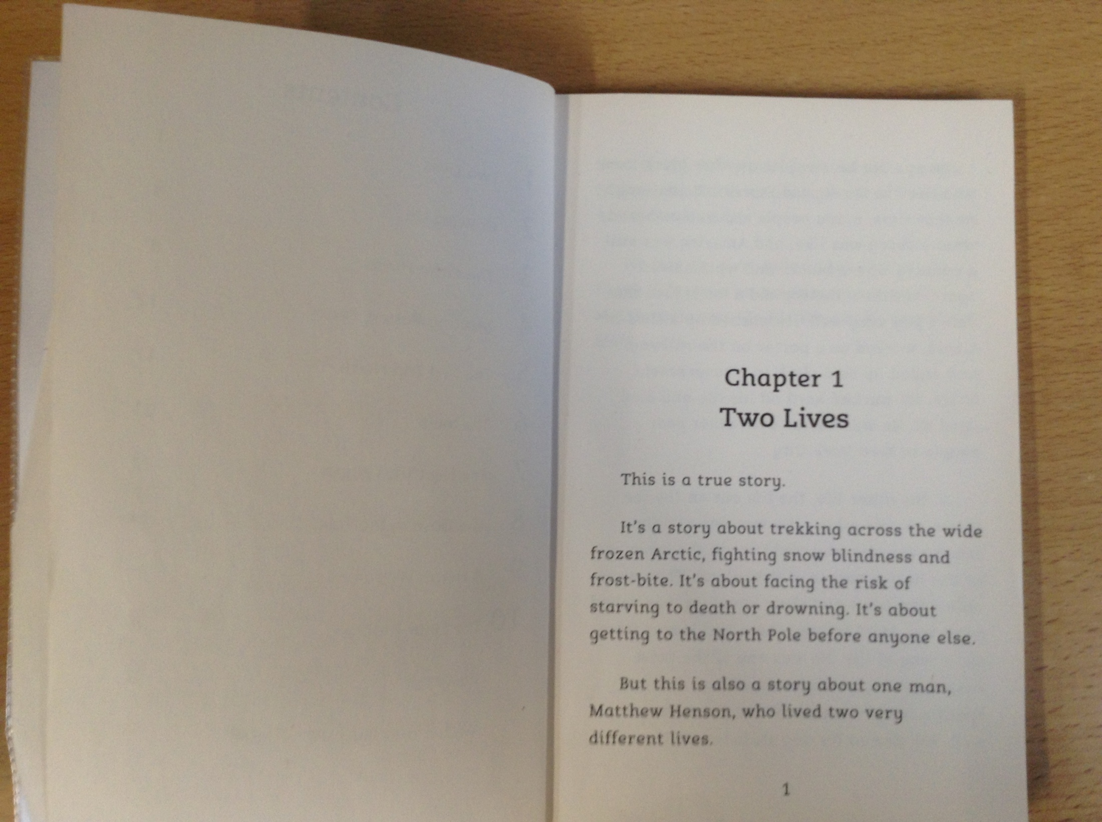

Slide 3
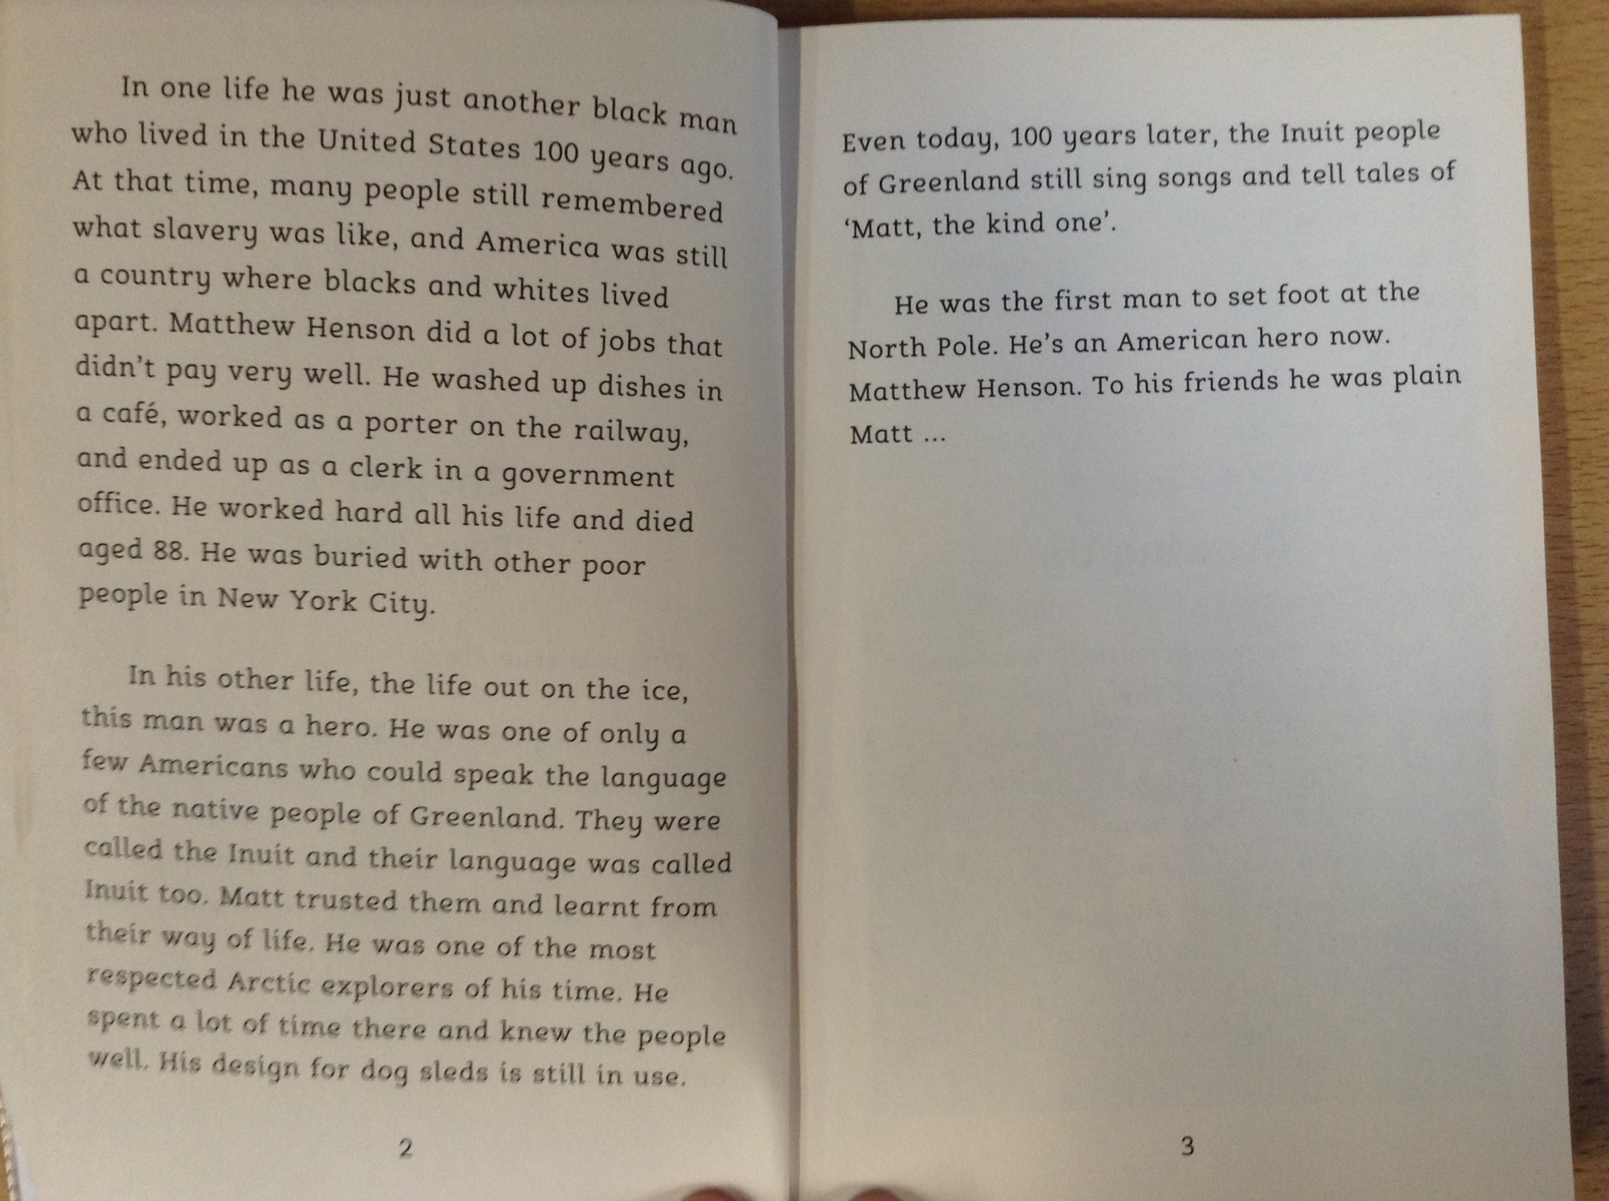

Slide 4
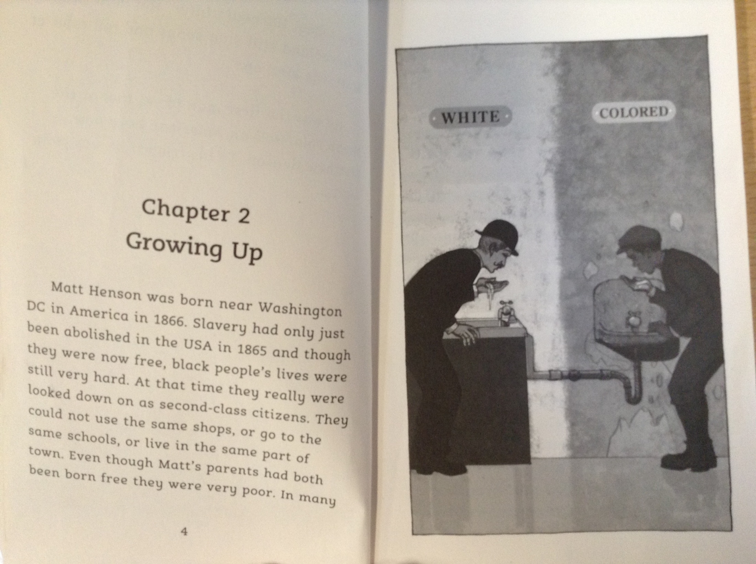

Slide 5
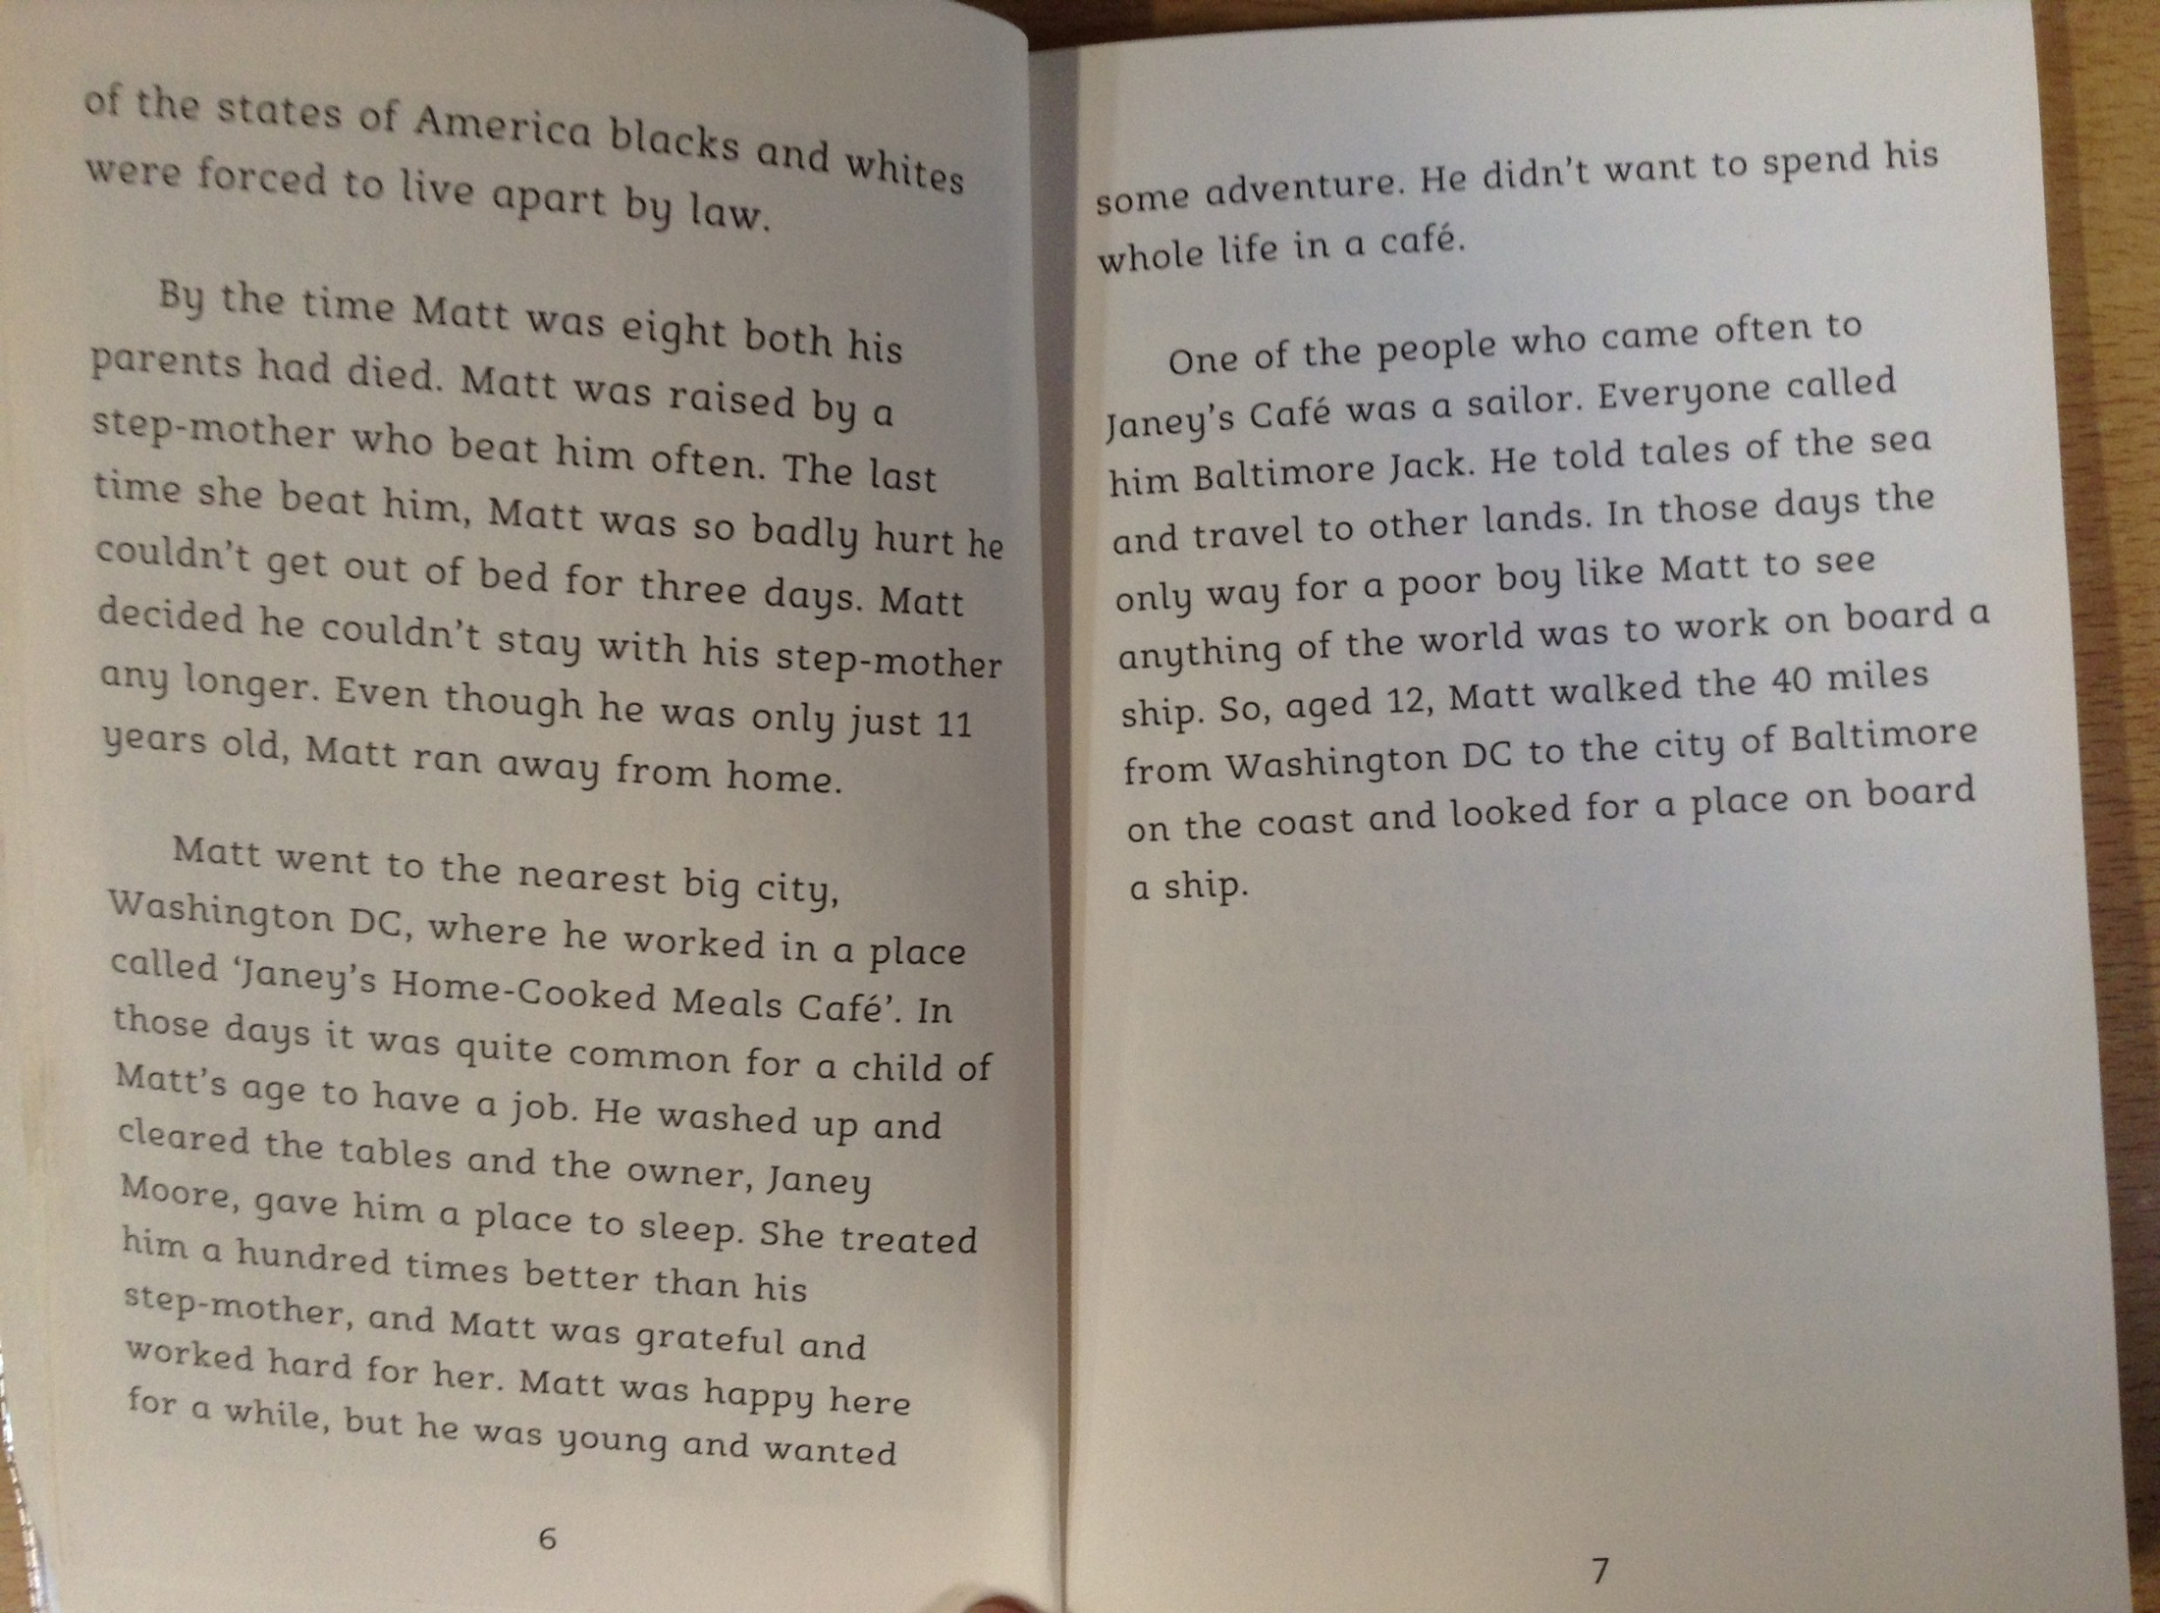

Slide 6
*Please note – the word ‘coloured’ has been used to describe characters in the story. This word is offensive and shouldn’t be used in modern society.
When Matthew Henson was growing up, why was it difficult for black people in the USA during this time?
How was Matthew treated by his stepmother? What did this force him to do at the age of 11?
Who was Janey and how did she help Matthew?
How did Baltimore Jack help to inspire Matthew?

