Slide 1
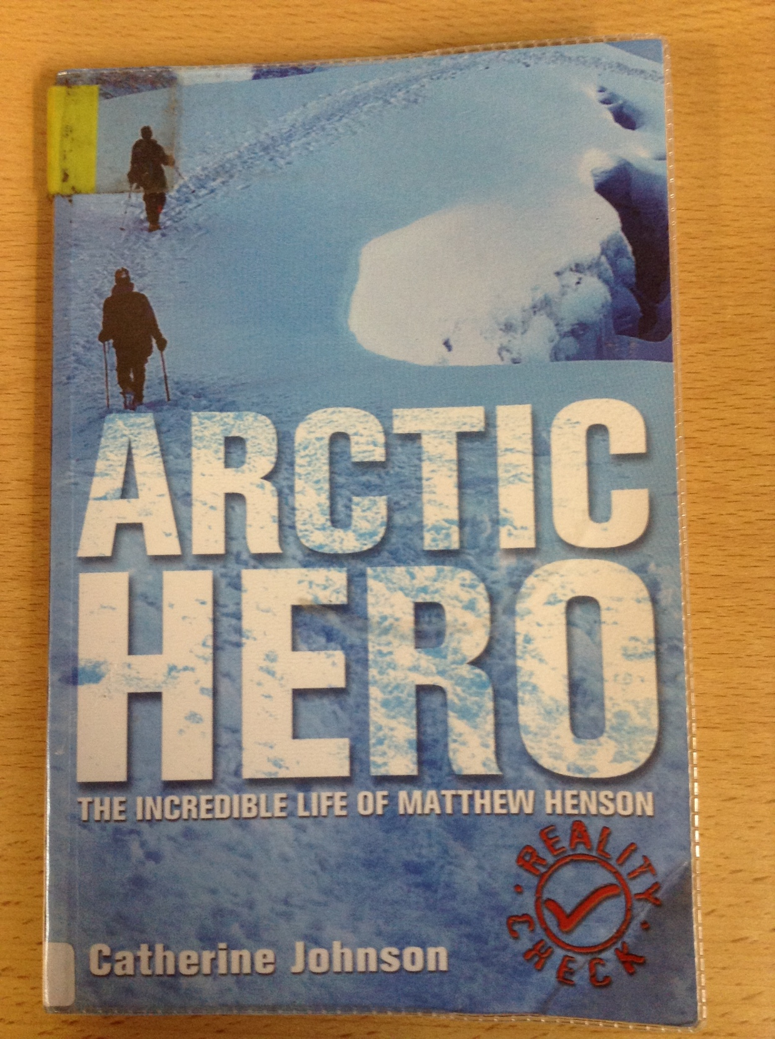
GUIDED READING
Y5
Chapter 3
Pages 8-11

Slide 2
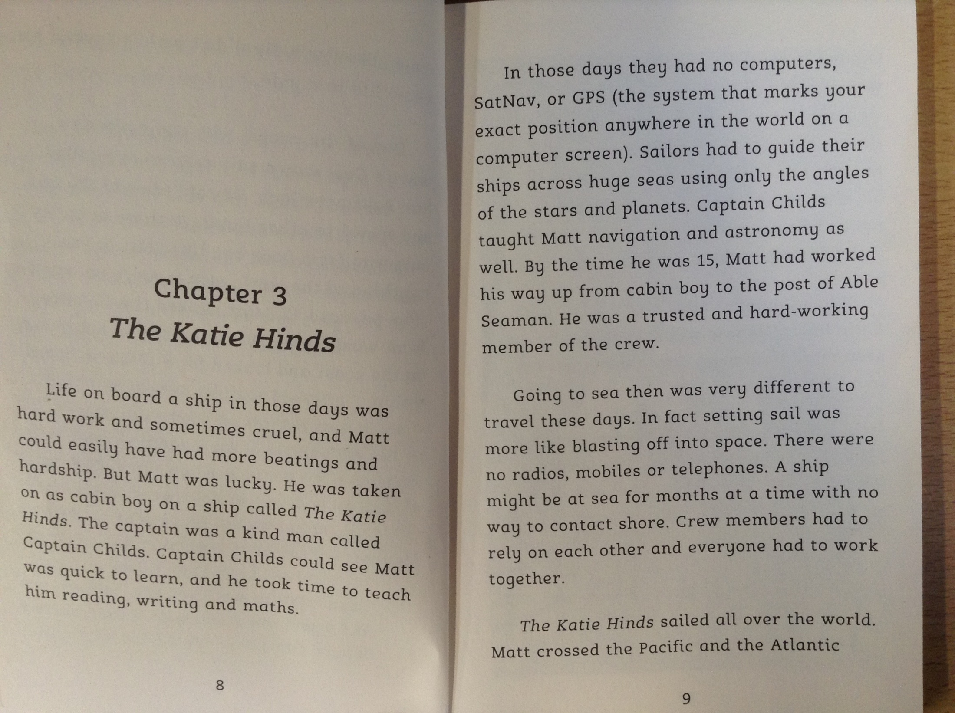

Slide 3
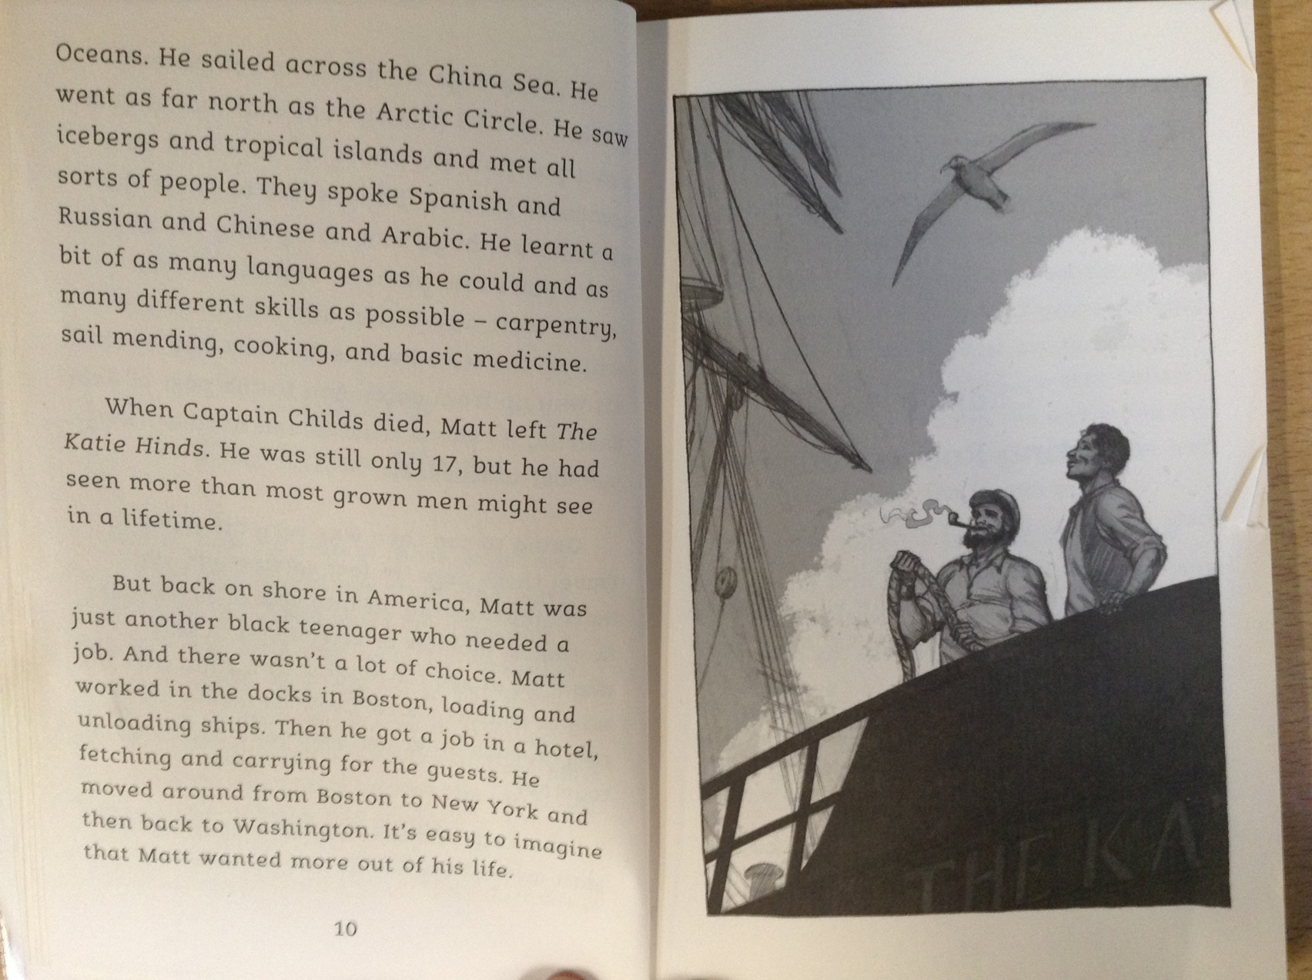

Slide 4
6) What was the name of the first shape that Matthew went on board?
7) Read page 9. What is the purpose of the part in brackets?
8) Who trained Matthew to develop his skills on board a ship and to learn navigation?
9) What was difficult about life on board a ship during those days?
10) What did Matthew love about travelling?
11) When Matthew arrived back on shore, name two other jobs that he had.

