Slide 1
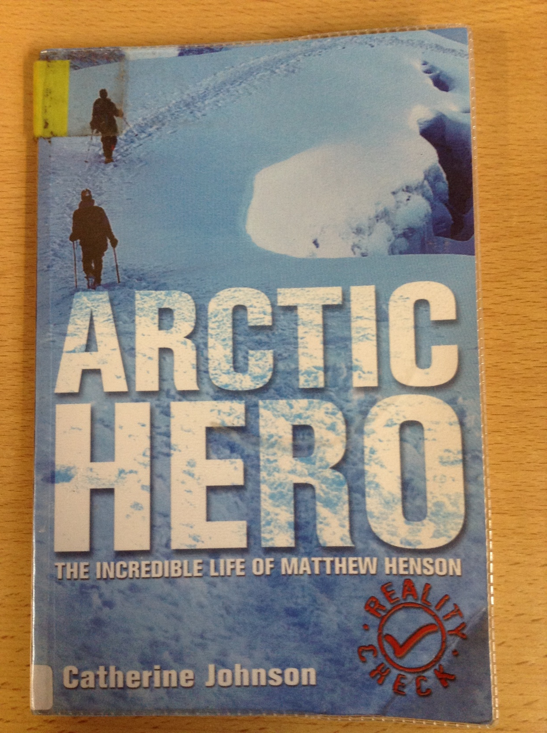
GUIDED READING
Y5
Chapter 5
Pages 17-20

Slide 2
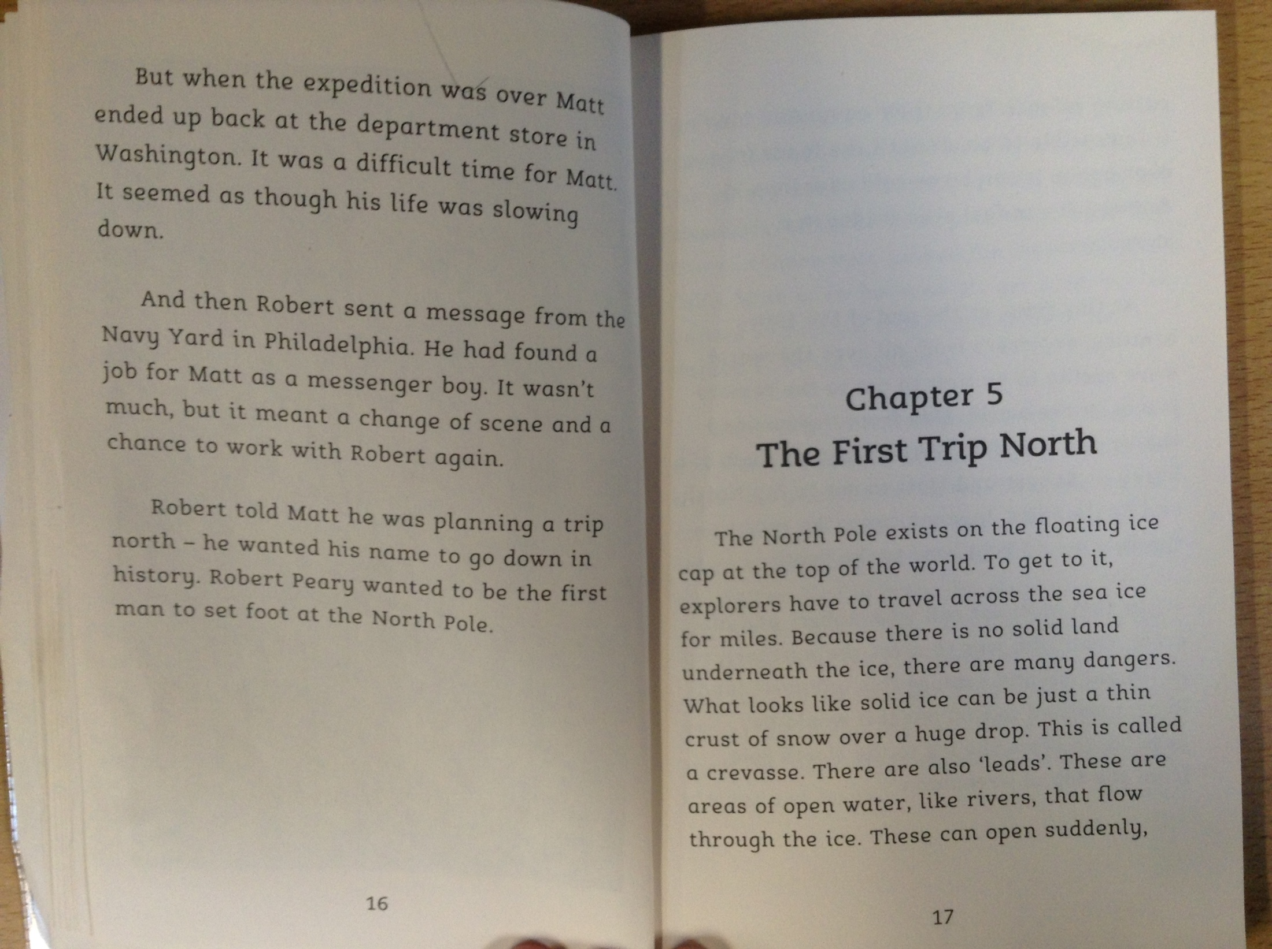

Slide 3
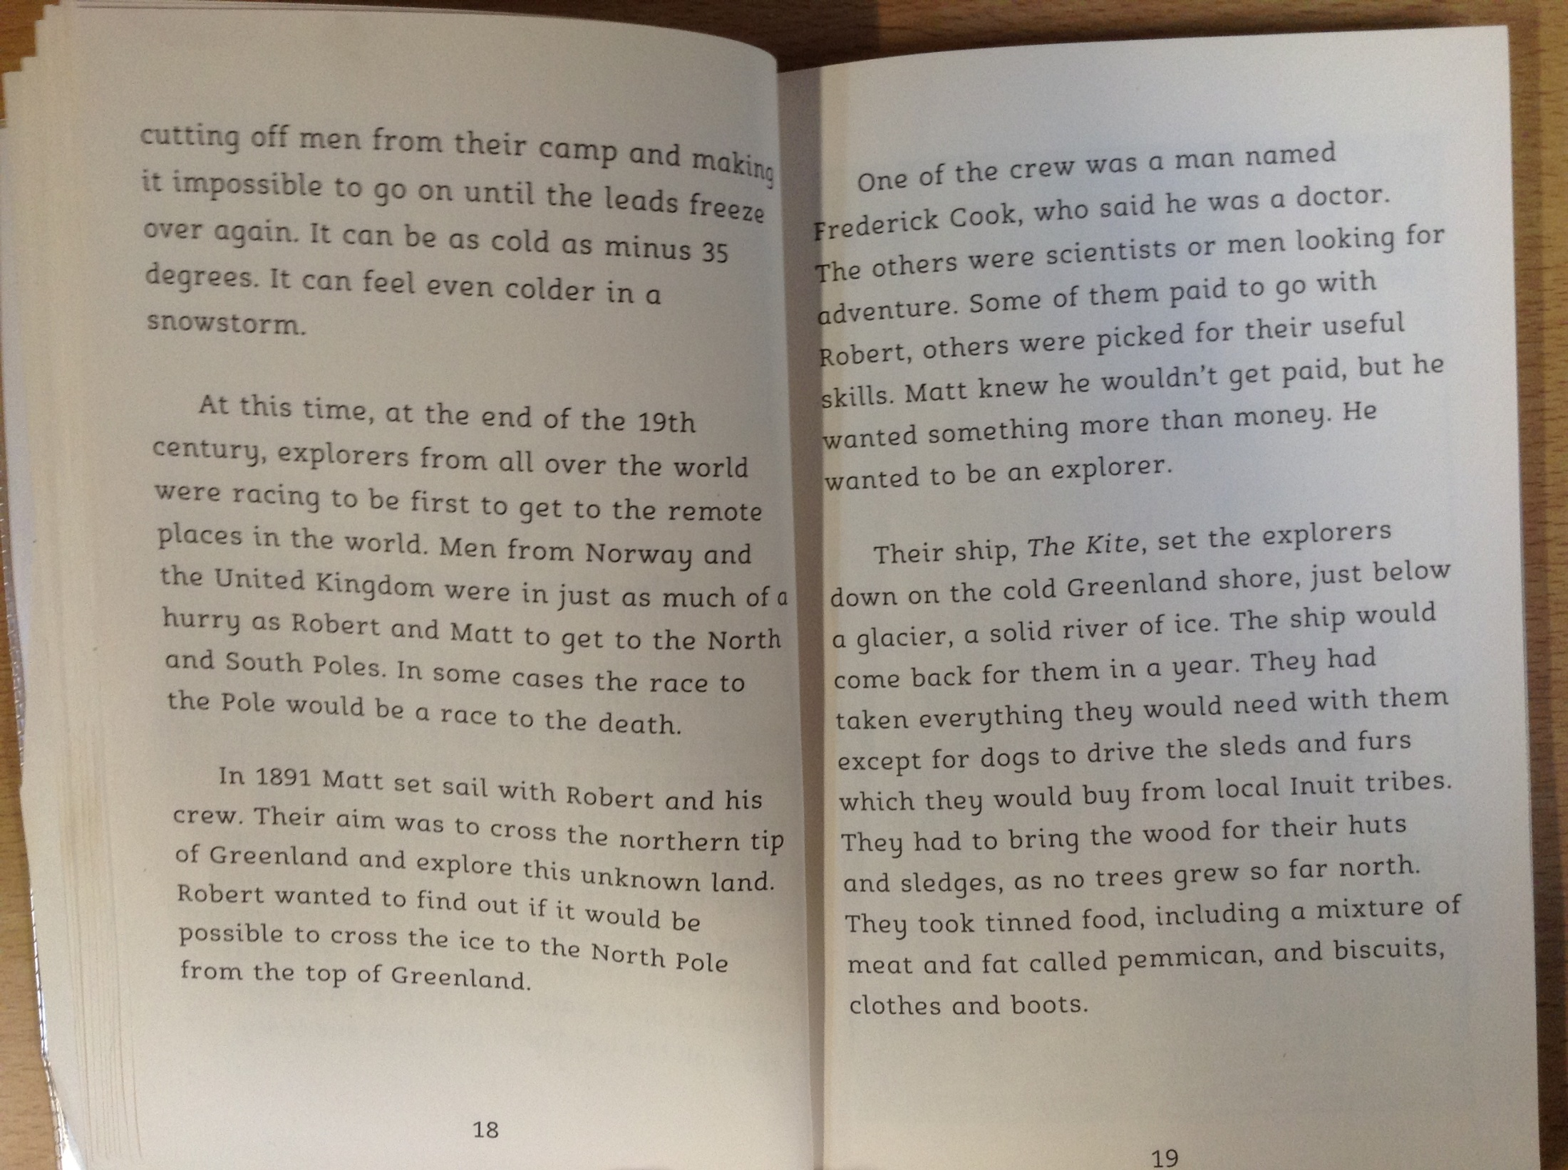

Slide 4
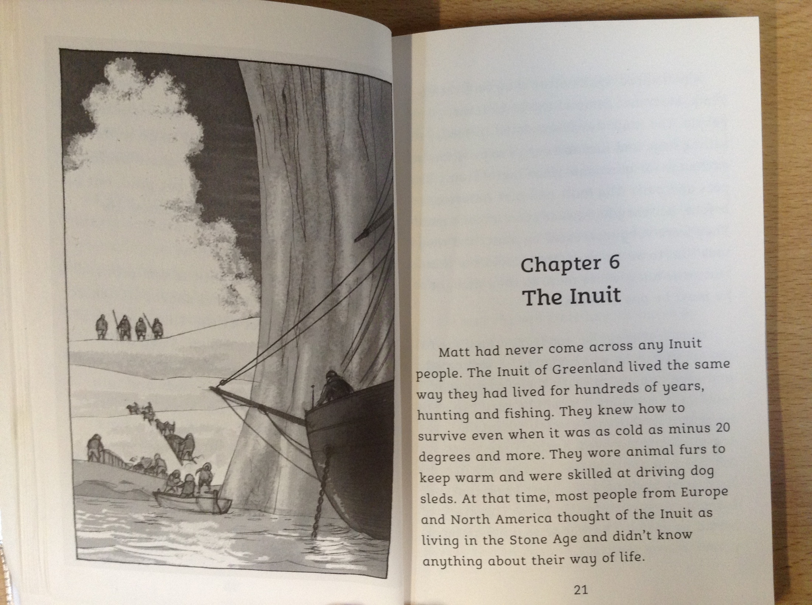

Slide 5
18) Read page 17. What is a thin crust of ice over a huge drop called?
What achievement did Robert want to gain?
What was the name of the ship that Matthew travelled on with Robert and his crew?
Why did they not need to take dogs with them from the USA?
How long were they planning to be on foot for before the ship returned for them?
Name three items that they took with them to help support them on their expedition.

