Slide 1
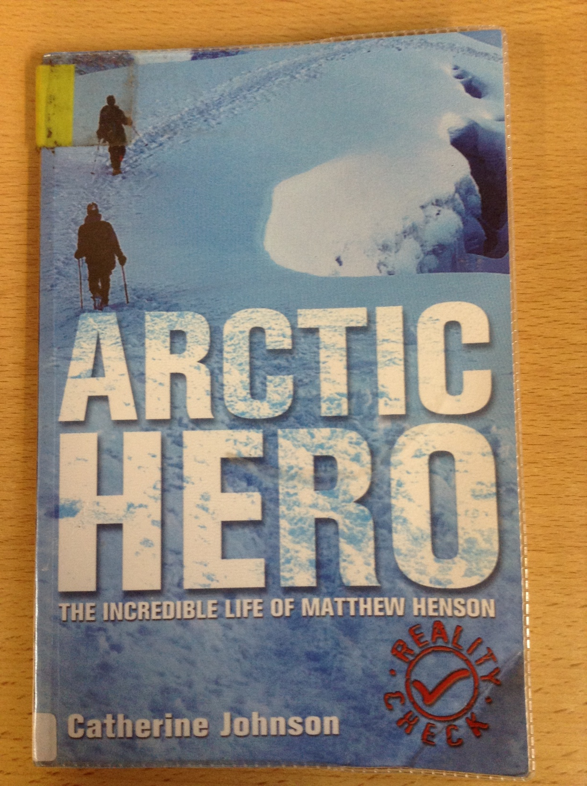
GUIDED READING
Y5
Chapter 4
Pages 12-16

Slide 2
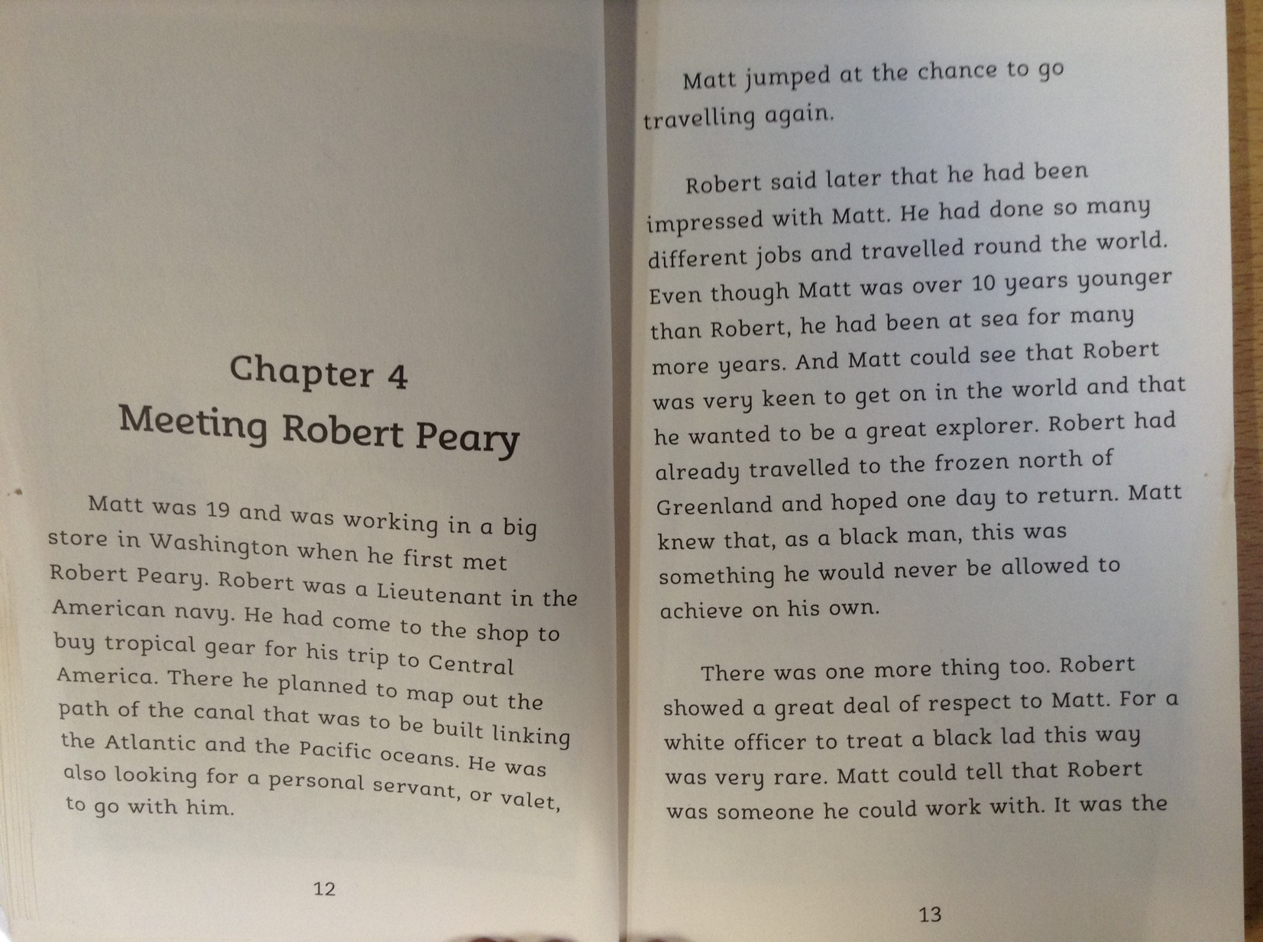

Slide 3
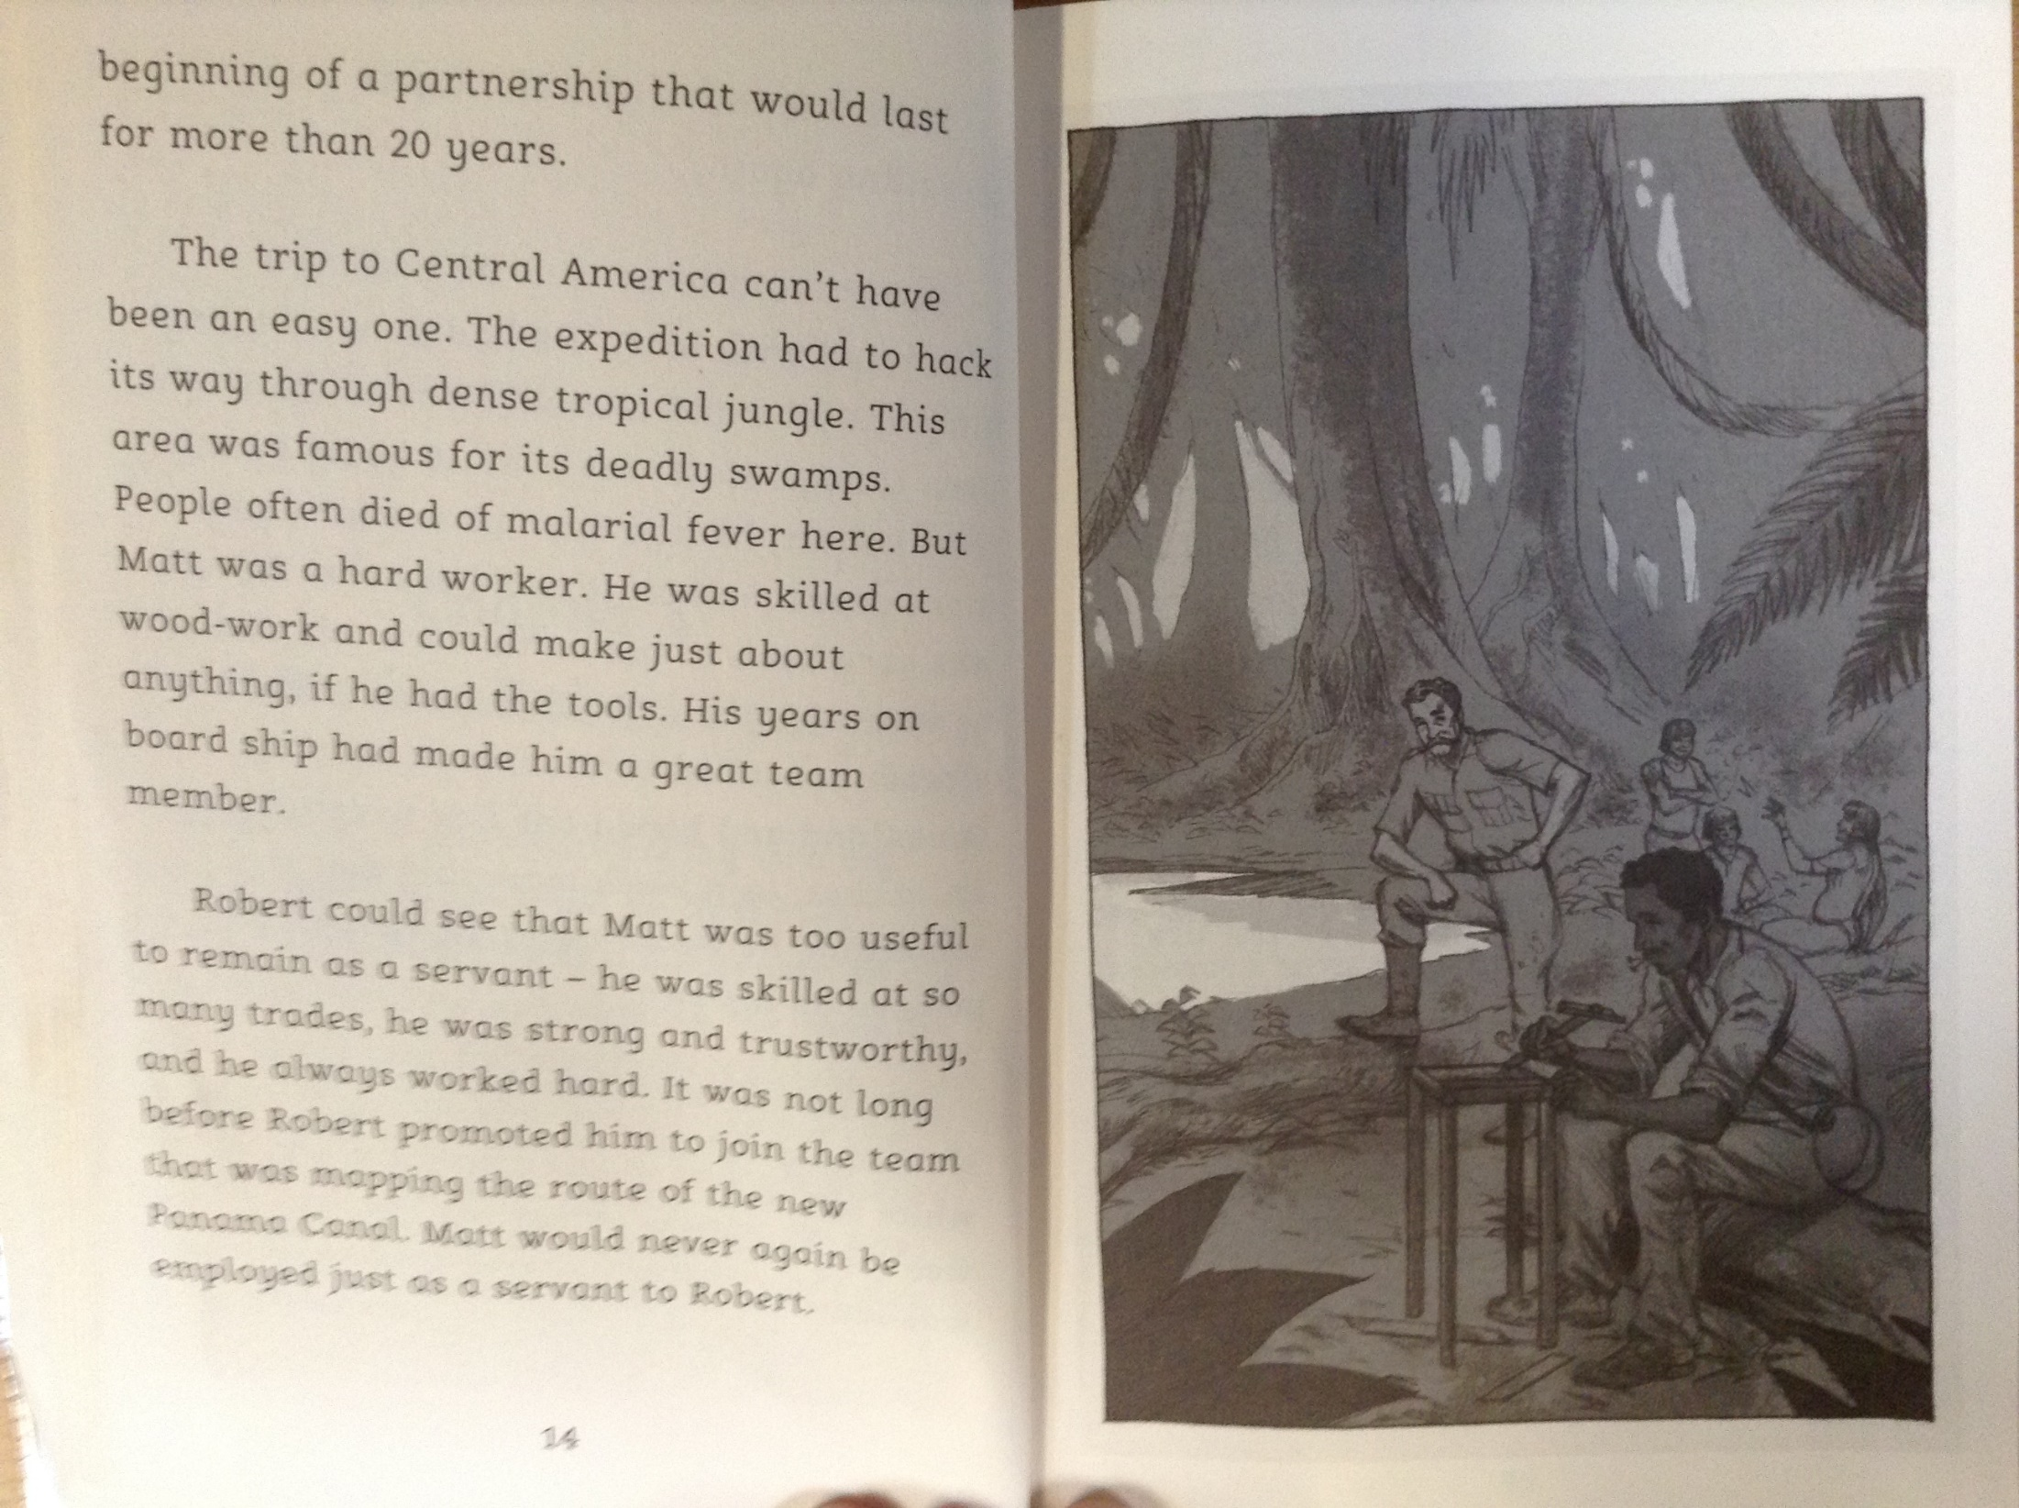

Slide 4
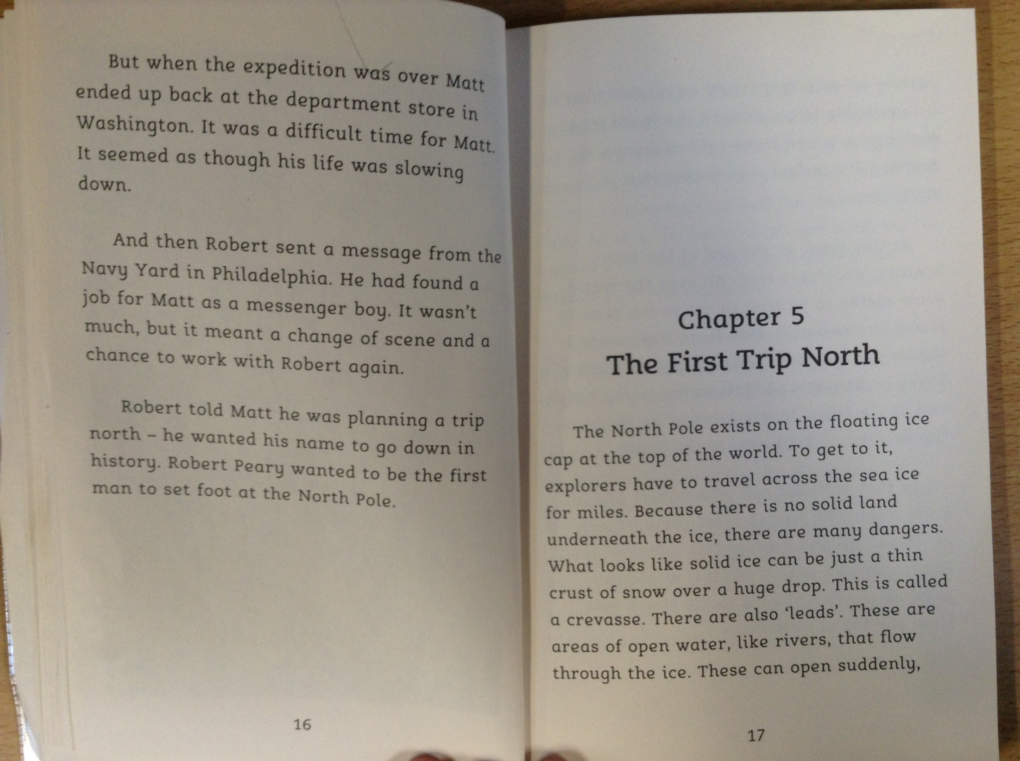

Slide 5
Why was Matthew so impressed with Robert Peary and why was Robert so impressed with Matthew?
Which part of the world did they travel to first?
What particular skills did Matthew have that Robert was particularly impressed with?
Read the final paragraph on page 14. Which two adjectives have been used to describe Matthew?
When Robert was planning a journey to the North Pole, why do you think he wanted Matthew to accompany him?

