Slide 2
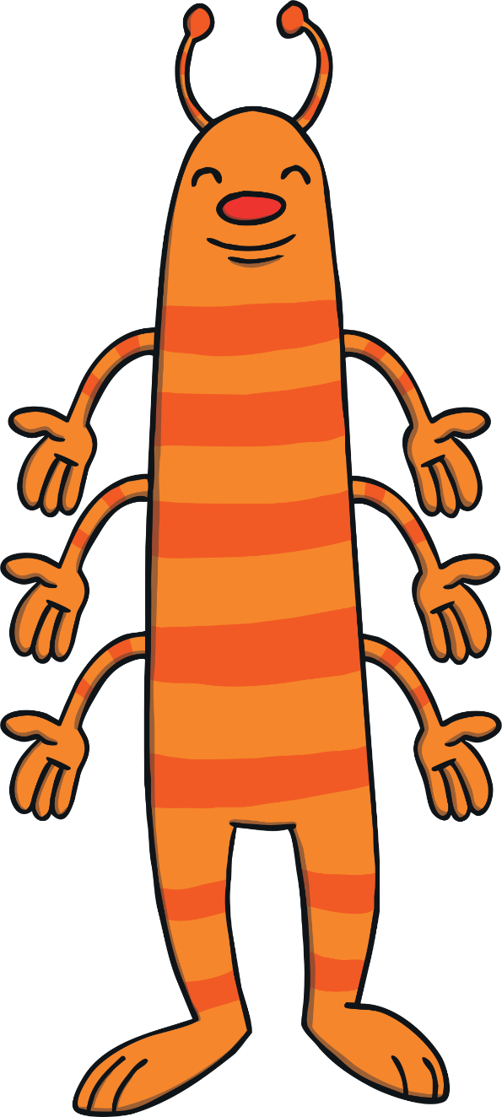
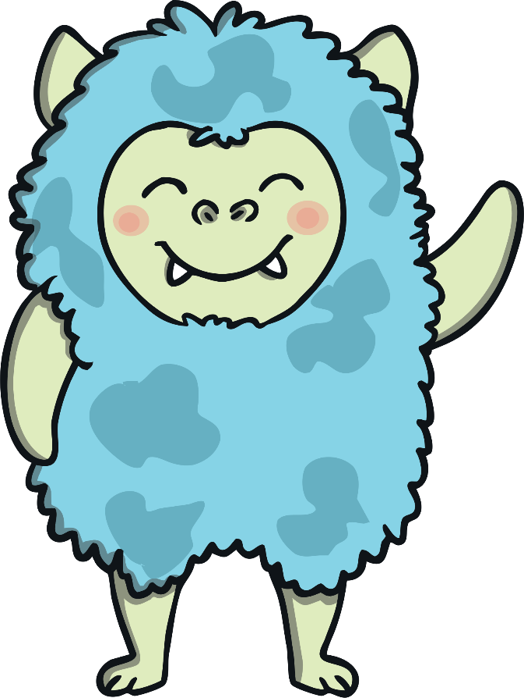
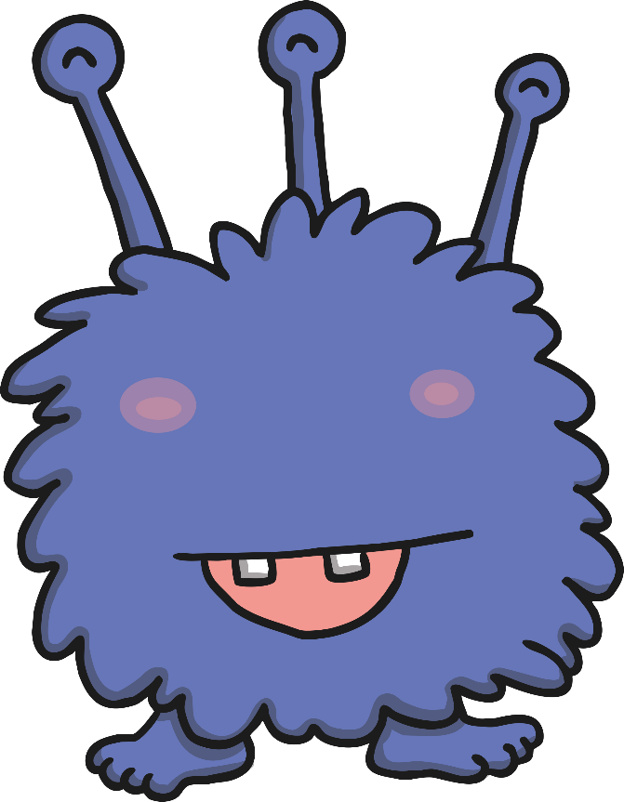
Can you help the aliens to make a collection of things that are all based on their favourite number? You will need to count them very carefully.
My favourite number is the number 6.
My favourite number is the number 7.
My favourite number is the number 8.

Slide 3
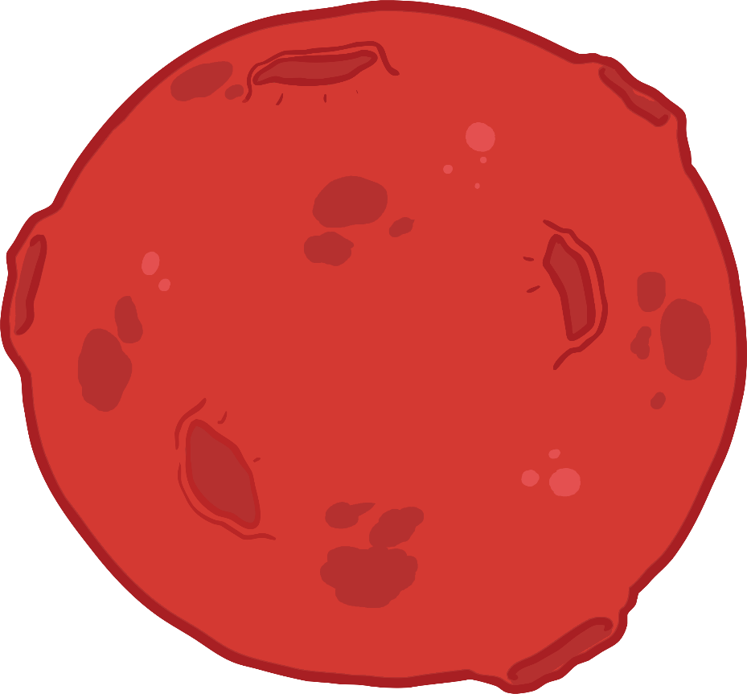
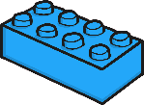
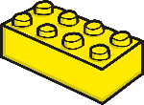
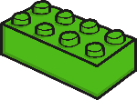
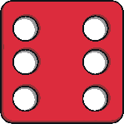
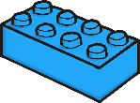
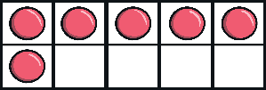
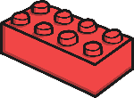
Look carefully at the pictures below.
Which pictures would this alien like? Why?
Click the pictures to place them on Planet 6.
6
Count the things in each picture. Which pictures show the number 6?

Slide 4
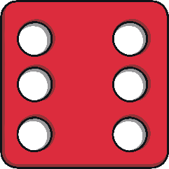
All of these things show the number 6 – perfect for my collection! Why do you think 6 is my favourite number?
6

Slide 5
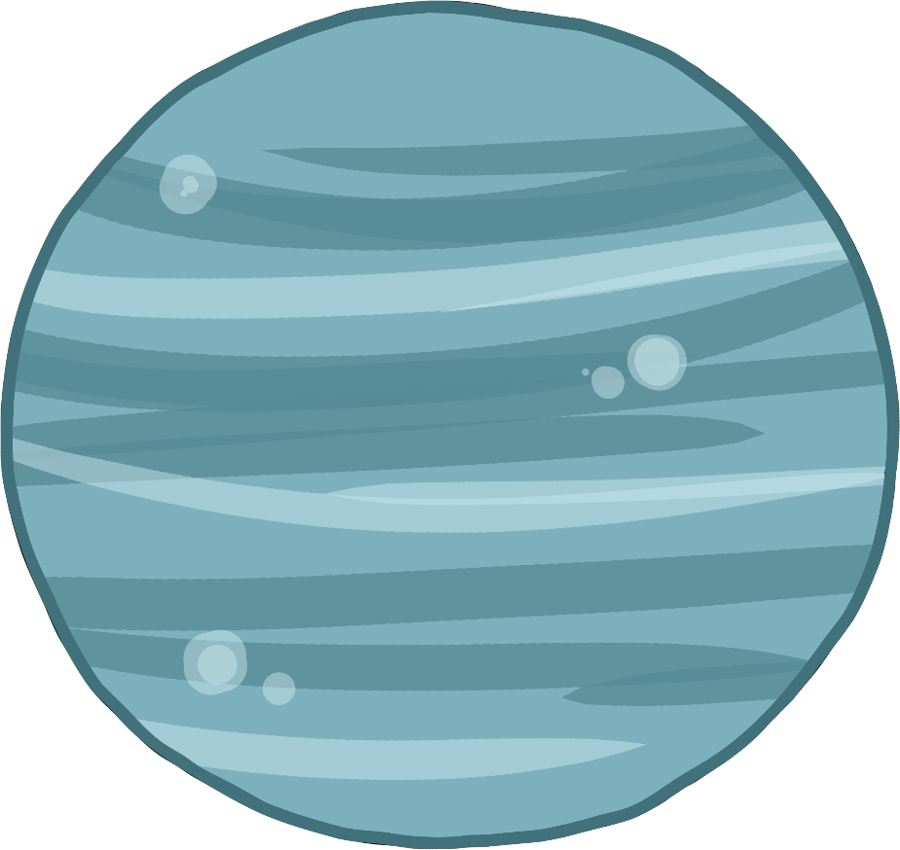
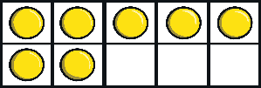
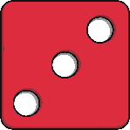
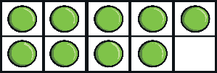
Look carefully at the pictures below.
Which pictures would this alien like? Why?
Click the pictures to place them on Planet 7.
Count the things in each picture. Which ones show the number 7?
7

Slide 6
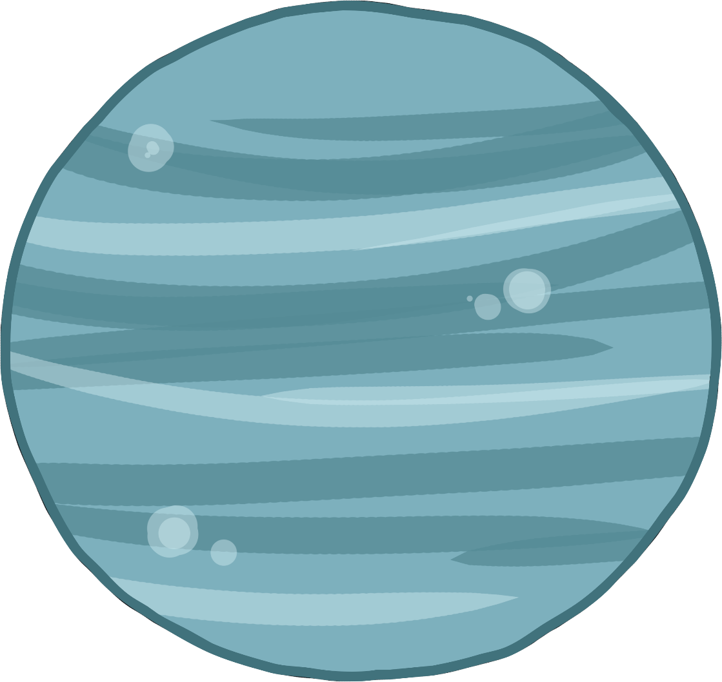
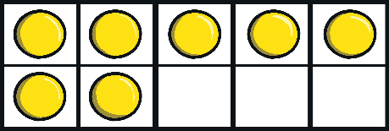
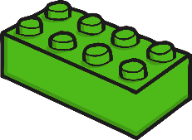
All of these things show the number 7!
Can you show me 7 fingers? Can you find a different way to show me 7 fingers?
7

Slide 7
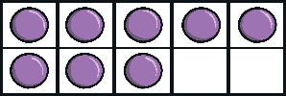
Look carefully at the pictures below.
Which pictures would this alien like? Why?
Click the pictures to place them on Planet 7.
Look carefully at the pictures below.
Which pictures would this alien like? Why?
Click the pictures to place them on Planet 8.
8
Count the things in each picture. Which pictures show the number 8?

Slide 8
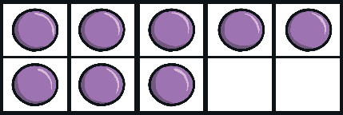
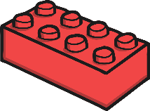
All of these things show the number 8. Can you give yourself 8 big claps for doing such brilliant counting?
8

Slide 9
Thank you for helping the aliens fill their planets with things for their favourite numbers. Did you notice something about the aliens?
Alien 6 has 6 arms.
Alien 7 has 7 eyes.
Alien 8 has 8 spots.
Can you count them to check?

