Slide 1
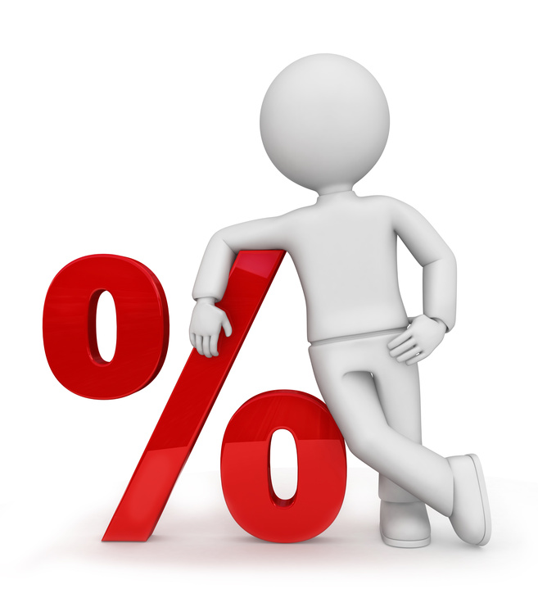
What I’m learning in Maths today
Maths – Y6 (Missing %) Date: 27.1.21
L.Obj: *I can calculate % of amounts by using equivalent fractions and %.
*I can solve the missing number in a % calculation.

Slide 2
Y6s
1) 10 x 11 x 2 = _____
2) 683 + 917 = ______
5/12 + 10/12 = ______
4) 66 x 1 = ______
5) 75 x 38 = ______
6.1 + 3.317 = _____
100,000 + _____ + 60 = 106,060
9 x 48 = ______

Slide 3
1) 10 x 11 x 2 = 220
2) 683 + 917 = 1,600
5/12 + 10/12 = 17/12 or 1 5/12
4) 66 x 1 = 66
5) 75 x 38 = 2,850
6.1 + 3.317 = 9.417
100,000 + 6,000 + 60 = 106,060
9 x 48 = 432

Slide 4
Introduction
Match the fractions, decimals and percentages.
0.25
3
4
75%
0.75
1
4
10%
0.1
1
10
25%
© Classroom Secrets Limited 2019

Slide 5
Introduction
Match the fractions, decimals and percentages.
0.25
3
4
75%
0.75
1
4
10%
0.1
1
10
25%
© Classroom Secrets Limited 2019

Slide 6
Varied Fluency 3
True or false?
If | 16% = 48 | then | 4% = 4
© Classroom Secrets Limited 2019

Slide 7
Varied Fluency 3
True or false?
False; 4% = 12
If | 16% = 48 | then | 4% = 4
© Classroom Secrets Limited 2019

Slide 8
Varied Fluency 5
A gardener grows peonies and sunflowers in his garden.
There are 150 flowers in his garden altogether, and 52% of those are peonies.
How many sunflowers does he have?
© Classroom Secrets Limited 2019

Slide 9
Varied Fluency 5
A gardener grows peonies and sunflowers in his garden.
There are 150 flowers in his garden altogether, and 52% of those are peonies.
How many sunflowers does he have? 72
© Classroom Secrets Limited 2019

Slide 10
350,000 people visited the Natural History Museum last week.
15% of people visited on Monday.
40% of people visited on Saturday.
How many people visited the Natural History Museum the rest of the week?

Slide 11
If 7 is 10% of a number, what is the number?
Use the bar model
to help you.
7

Slide 12
Complete: Use a bar model to help you if you need.
10% of ____ = 15
___% of 150 = 45
30% of ___ = 90
15
150
15 | 30 | 45
 |  | 90

Slide 13
Varied Fluency 4
Find the missing values.
15 | % | of | 30 | =
30 | % | of |  | = | 6
60 | % | of | 30 | =
75 | % | of |  | = | 15
© Classroom Secrets Limited 2019

Slide 14
Varied Fluency 4
Find the missing values.
15 | % | of | 30 | = | 4.5
30 | % | of | 20 | = | 6
60 | % | of | 30 | = | 18
75 | % | of | 20 | = | 15
© Classroom Secrets Limited 2019

Slide 15
Problem solving 2
In a survey of 250 people, 90% of people reported exercising regularly each week.
Of those people: 80% ran; 12% went to the gym; and 8% played team sports.
How many people play team sports?
90% of 250
?
© Classroom Secrets Limited 2019

Slide 16
Problem solving 2
In a survey of 250 people, 90% of people reported exercising regularly each week.
Of those people: 80% ran; 12% went to the gym; and 8% played team sports.
How many people play team sports?
90% of 250 is 225, and 8% of 225 is 18.
90% of 250
18
© Classroom Secrets Limited 2019

Slide 17
Balancing Equations – Fill in the missing number
4/9 of 54 = 3 x __
Extra challenge!
10³ = ½ of ____
9.5 x 4 = 50 - ___
4.5 x __ = 50 x 90
___ ÷ 10 = 0.4 + 0.35
121 ÷ 11 = Double __
30% of 45 = 20 - ___
1% of 1,000 = ¼ of ___
____ + 80 = 5³

