Slide 1
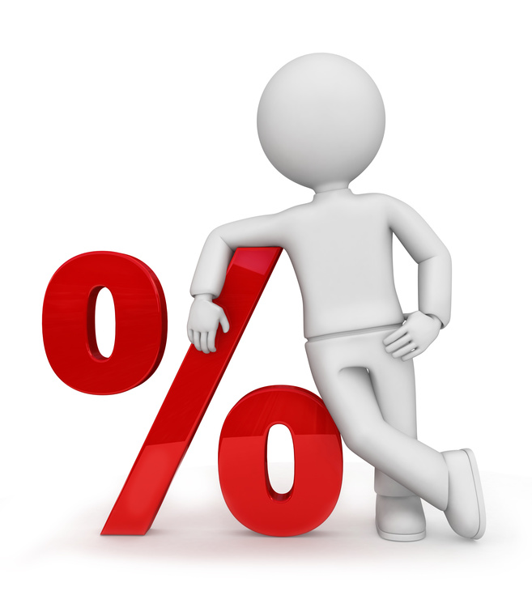
What I’m learning in Maths today
Maths – Y6 (Calculate % of amounts) Date: 25.1.21
L.Obj: *I can calculate % of amounts using different strategies depending on the question.

Slide 2
Y6s
3 x 7 x 10 =
413 + 1,285 =
3) 8/9 – 3/9 =
4) 27 x 0 =
5) _________ = 325 - 61
6) 4.95 - 3.7 =
________ = 400,000 + 70 = 5,400,070
6 x 17 =
72 ÷ 3 =

Slide 3
Y6s
3 x 7 x 10 = 210
413 + 1,285 = 1,698
3) 8/9 – 3/9 = 5/9
4) 27 x 0 = 0
5) 264 = 325 - 61
6) 4.95 - 3.7 = 1.25
5,000,000 = 400,000 + 70 = 5,400,070
6 x 17 = 102
72 ÷ 3 = 24

Slide 4
Today, you are going to be looking at a selection of old Y6 SATs questions where the children have to calculate % of amounts. Can you solve them correctly?

Slide 5
1) 45% of 460 =
Possible method if unsure
10% of 460 =
10% of 460 =
10% of 460 =
10% of 460 =
5% of 460 =
So 45% of 460 =

Slide 6
2) 7% of 500 =
Possible method if unsure
10% of 500 =
So 5% of 500 =
1% of 500 =
1% of 500 =
So 7% of 500 =

Slide 7
3) 15% × 1,000 =
Possible method if unsure
10% of 1,000 =
5% of 1,000 =
So 15% of 1,000 =

Slide 8
A cat sleeps for 12 hours each day. So, 50% of its life is spent asleep.
Write the missing percentage below.
A koala sleeps for 18 hours each day. So, _____% of its life is spent asleep.
Hint – How many hours are there in a day!

Slide 9
5) 20% of 1,200 =
Possible method if unsure
10% of 1,200 =
10% of 1,200 =
So 20% of 1,200 =

Slide 10
6) 99% of 200 =
Possible method if unsure
100% of 200 =
1% of 200 =
So 99% of 200 =

Slide 11
7) 28% of 650 =
Possible method if unsure
10% of 650 =
10% of 650 =
5% of 650 =
1% of 650 =
1% of 650 =
1% of 650 =
So 28% of 650 =

Slide 12
8) Jack has £400 He spends 35% of his money on a new bike.
How much does Jack spend on his new bike?
Possible method if unsure
35% of £400 (Find 10%, 10%, 10% and 5%)

Slide 13
ANSWERS
1) 207
2) 35
3) 150
4) 75% because 18/24 hours = ¾ which is 75%
5) 240
6) 198
7) 182
8) 140

