Slide 1
What I’m learning in Maths today
Maths – Y6 (Increase and Decrease %) Date: 28.1.21
L.Obj: *I can increase and decrease amounts by specific %.

Slide 2
Y6s
1) 56 ÷ 8 = _____
2) 4 x 83 = _____
5,120 – 215 = _____
4) 2/6 + 1 5/6 = _____
5) ____ - 100 = 1,272
30 + 8² = ______
7/9 x 6/9 = _____

Slide 3
Y6s
1) 56 ÷ 8 = 7
2) 4 x 83 = 332
5,120 – 215 = 4,905
4) 2/6 + 1 5/6 = 13/6 or 2 1/6
5) 1,372 - 100 = 1,272
30 + 8² = 94
7/9 x 6/9 = 42/81 or 14/27

Slide 4
Introduction
Match the answers to the correct question.
210 |  | 75% of 160
120 |  | 10% of 37
80 |  | 40% of 200
3.7 |  | 60% of 350
© Classroom Secrets Limited 2018

Slide 5
Introduction
Match the answers to the correct question.
210 |  | 75% of 160
120 |  | 10% of 37
80 |  | 40% of 200
3.7 |  | 60% of 350
© Classroom Secrets Limited 2018

Slide 6
Varied Fluency 1
Increase the following numbers by 35%.
A) 300
B) 60
C) 50
© Classroom Secrets Limited 2018

Slide 7
Varied Fluency 1
Increase the following numbers by 35%.
A) 300 35% of 300 = 105; 300 + 105 = 405
B) 60 35% of 60 = 21; 60 + 21 = 81
C) 50 35% of 50 = 17.5; 50 + 17.5 = 67.5
© Classroom Secrets Limited 2018

Slide 8
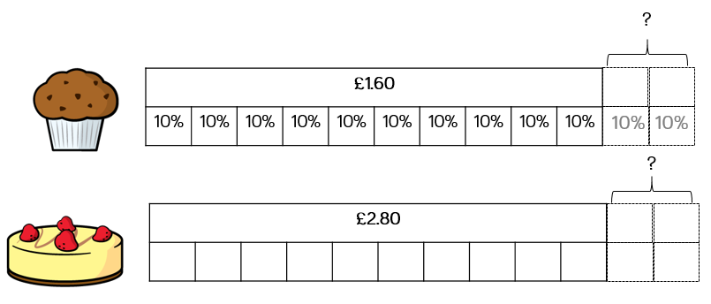
Janet is increasing the prices in her café by 20%
Calculate the percentage increase for the following items:

Slide 9
The price of houses has decreased by 10% in the last year.
Complete the table.
House | Original cost | 10% decrease | New cost
A | £235,650
B | £145,950

Slide 10
Football tickets cost £46.80 after a 20%
decrease.
Cindy says,
The original tickets cost £56.10
Can you explain her mistake?

Slide 11
James says,
Decreasing a number by 13% is the same as
finding 87% of that number.
Do you agree? Why?

Slide 12
Varied Fluency 2
Jaxon is reducing the prices of items in his shop by 20%.
Calculate the new prices.
£10.50 | £15 | £12
© Classroom Secrets Limited 2018

Slide 13
Varied Fluency 2
Jaxon is reducing the prices of items in his shop by 20%.
Calculate the new prices.
Yo-yo: 80% of £10.50 = £8.40
House: 80% of £15 = £12.00
Windmill: 80% of £12 = £9.60
£10.50 | £15 | £12
© Classroom Secrets Limited 2018

Slide 14
Varied Fluency 4
True or false?
A 5% decrease in price from £30 means there is £1 off.
© Classroom Secrets Limited 2018

Slide 15
Varied Fluency 4
True or false?
False. There is £1.50 off.
A 5% decrease in price from £30 means there is £1 off.
© Classroom Secrets Limited 2018

Slide 16
Reasoning 2
Two children were asked to explain their method for calculating a 40% increase:
I find 10% and times it by 4.
I then add this to my original number.
Mia
I divide my number by five and double it. Then I add it to the original number
Harry
© Classroom Secrets Limited 2018

Slide 17
Reasoning 2
Two children were asked to explain their method for calculating a 40% increase:
Both methods are correct, but Mia’s method has fewer steps so may be quicker. Children may have different answers depending on their preferred method.
I find 10% and times it by 4.
I then add this to my original number.
Mia
I divide my number by five and double it. Then I add it to the original number
Harry
© Classroom Secrets Limited 2018

Slide 18
Problem Solving 1
Theo is buying some trainers.​
​
There is 5% off for today only. ​
​
Theo calculates that 5% of the cost of the trainers is £6.50.​
​
What is the original price of the trainers?
© Classroom Secrets Limited 2018

Slide 19
Problem Solving 1
Theo is buying some trainers.​
​
There is 5% off for today only. ​
​
Theo calculates that 5% of the cost of the trainers is £6.50.​
​
What is the original price of the trainers?
£130
© Classroom Secrets Limited 2018

Slide 20
Balancing Equations – Fill in the missing number
5/7 of 42 = 3 x __
Extra challenge!
8³ = ½ of ____
7.1 x 4 = 40 - ___
4.2 x __ = 60 x 70
___ ÷ 10 = 0.7 + 0.15
132 ÷ 11 = Double __
60% of 45 = 30 - ___
1% of 700 = ¼ of ___
____ + 60 = 4³

