Slide 1
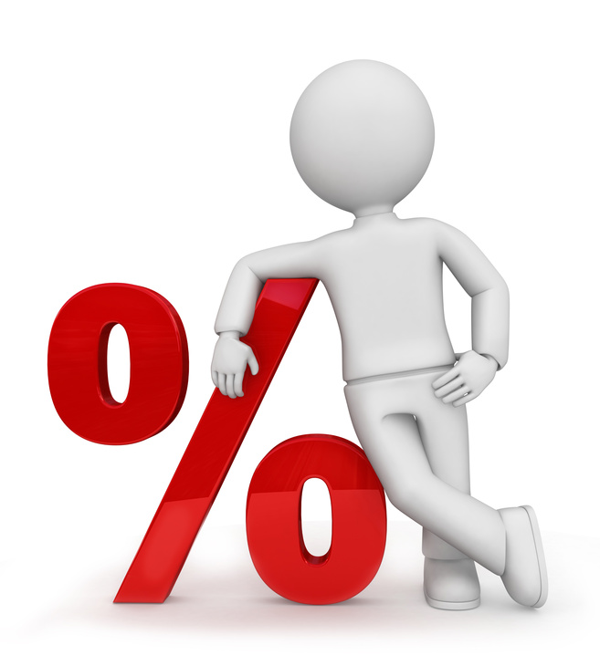
What I’m learning in Maths today
Maths – Y6 Date: 18.1.21
L.Obj: *I understand the meaning of percentage (%)
*I can convert fractions into % and vice versa.

Slide 2
Y6s
6 x 2 x 10 =
726 + 5,645 =
3) 6/9 – 4/9 =
4) 47 x 0 =
5) _________ = 545 - 34
6) 3.05 + 1.7 =
________ = 200,000 + 90 = 4,200,090
5 x 19 =
93 ÷ 3 =

Slide 3
Y6s
6 x 2 x 10 = 120
726 + 5,645 = 6,371
3) 6/9 – 4/9 = 2/9
4) 47 x 0 = 0
5) 511 = 545 - 34
6) 3.05 + 1.7 = 4.75
4,000,000 = 200,000 + 90 = 4,200,090
5 x 19 = 95
93 ÷ 3 = 31

Slide 4
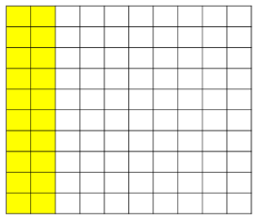
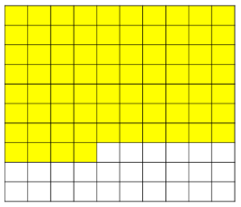
What fraction of the 100 square is shaded?
Can you write this as a percentage?

Slide 5
What numbers have been covered by the splats?
12/100 = %.
35/100 = %
12/50 = %.
44/200 = %

Slide 6
Complete the table
Fraction | Fraction in hundredths | Percentage (%)
7/10 | __/100
7/__ | 35/100
7/__ | __/100 | 28%

Slide 7
In a Maths test, Tom answered 62% of
the questions correctly.
Lily answered 3/5 of the questions
correctly.
Who answered more questions correctly?
Explain your answer.

Slide 8
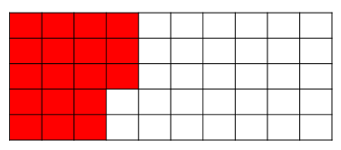
Mark thinks that 18/100 of this grid has been
shaded.
Nisha thinks that 36% of the grid has been shaded.
Who do you agree with? Explain your reasoning.

Slide 9
Introduction
Choose a percentage to match the fraction
3
20
25% |  | 20% |  | 15%
© Classroom Secrets Limited 2018

Slide 10
Introduction
Choose a percentage to match the fraction
3
20
25% |  | 20% |  | 15%
© Classroom Secrets Limited 2018

Slide 11
Varied Fluency 1
Match the fractions to the correct percentages.
 |  |  |  | 76%
 |  |  |  | 60%
 |  |  |  | 45%
 |  |  |  | 82%
6
10
82
100
41
50
76
100
9
20
60
100
19
25
45
100
© Classroom Secrets Limited 2018

Slide 12
Varied Fluency 1
Match the fractions to the correct percentages.
 | = |  | = | 60%
 | = |  | = | 82%
 | = |  | = | 45%
 | = |  | = | 76%
6
10
60
100
41
50
82
100
9
20
45
100
19
25
76
100
© Classroom Secrets Limited 2018

Slide 13
Varied Fluency 2
Shade the squares to show and write as a percentage.
7
25
© Classroom Secrets Limited 2018

Slide 14
Varied Fluency 2
Shade the squares to show and write as a percentage.
28 squares shaded = 28%
7
25
© Classroom Secrets Limited 2018

Slide 15
Varied Fluency 3
Which numbers are the same value?
2
25
54
100
9
10
8
100
90%
27
50
54%
90
100
8%
© Classroom Secrets Limited 2018

Slide 16
Varied Fluency 3
Which numbers are the same value?
= =
= =
= =
2
25
8
100
8%
9
10
90
100
90%
27
50
54
100
54%
© Classroom Secrets Limited 2018

Slide 17
Varied Fluency 4
True or false?
is equivalent to 85%
21
25
© Classroom Secrets Limited 2018

Slide 18
Varied Fluency 4
True or false?
is equivalent to 85%
False. is equal to 84%
21
25
21
25
© Classroom Secrets Limited 2018

Slide 19
Reasoning 1
George says,
Is he correct? Convince me.
40% is the same
as .
8
20
© Classroom Secrets Limited 2018

Slide 20
Reasoning 1
George says,
Is he correct? Convince me.
George is correct because = 40%
40% is the same
as .
8
20
8
20
© Classroom Secrets Limited 2018

Slide 21
Problem Solving 1
Competitors in an archery competition need more than 60% to get to the final. What percent did each child score?
Who gets to the final?
Name | Score
Maddie
Laila
Declan
Morris
1
10
36
50
20
25
19
100
© Classroom Secrets Limited 2018

Slide 22
Problem Solving 1
Competitors in an archery competition need more than 60% to get to the final. What percent did each child score?
Who gets to the final?
Maddie 10%, Laila 72%, Declan 80%, Morris 19%
so Laila and Declan get through to the next round.
Name | Score
Maddie
Laila
Declan
Morris
1
10
36
50
20
25
19
100
© Classroom Secrets Limited 2018

Slide 23
Problem Solving 2
Convert the fractions to percentages and sort them into the correct columns.
Less than 50% | Equal to 50% | More than 50%
12
20
9
25
18
50
45
50
41
100
8
10
© Classroom Secrets Limited 2018

Slide 24
Problem Solving 2
Convert the fractions to percentages and sort them into the correct columns.
Less than 50% | Equal to 50% | More than 50%
= 36% |  | = 60%
= 36% |  | = 80%
= 41% |  | = 90%
9
25
12
20
18
50
8
10
41
100
45
50
© Classroom Secrets Limited 2018

Slide 25
Balancing Equations – Fill in the missing number
3/7 of 21 = Double ___
____ x 9 = Half of 144
6.3 x 100 = 7 x ____
0.75 = ¼ x ____
72 - 24 = ___ x 8
6/10 of 40 = ¼ of ____

