Slide 1
Mental maths warm up Y6s
6 x 4 x 10 =
992 + 1,347 =
3/5 + 4/5 =
768 x ___ = 0
= 45 - 14
8.2 + 1.95 =
300,000 + ____ + 70 = 390,070
7 x 19 =

Slide 2
Y6s ANSWERS
6 x 4 x 10 = 240
992+1,347= 2,339
3/5 + 4/5 = 7/5 or 1 2/5
768 x 0 = 0
= 45 - 14
8.2 + 1.95 = 10.15
300,000 + 90,000 + 70 = 390,070
7 x 19 = 133
31

Slide 3
What I’m learning in Maths today
Maths – Y6 (Decimals) Date: 7.1.20
L.Obj: *I can recognise the value of digits up to 3 decimal places and use this knowledge accurately.

Slide 4
Complete the sentences.
There are ____ ones,
____ tenths, ____
hundredths and
____ thousandths.
The number in digits is _______________

Slide 5
3.456
Make this number.

Slide 6
Write down the value of the 3 in the following numbers.
M H Th T Th Th H T U . Tths Hths Thths
0.53
362.44
739.8
0.013
3,420.98

Slide 7
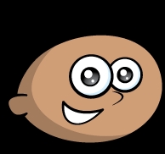
Qasim says;
“The more decimal places a number has, the smaller the number is.”
Do you agree?
Explain why.

Slide 8
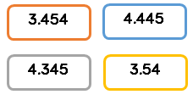
Four children are thinking of four different numbers.
Yvonne: “My number has four hundredths.”
Alex: “My number has the same amount of ones, tenths and hundredths.”
Louise: “My number has more tenths and hundredths than ones.”
Emily: “My number has 2 decimal places.”
Match each number to the correct child.

Slide 9
If you finished with time to spare,
here’s an extension to finish.

Slide 10
Balancing Equations – Fill in the missing number
20 + 30 = 5 x ____
____ x 4 = Double 12
Half of 64 = 8 x ____
3 x 12 = 4 x ____
28 + 6 + 8 = ___ x 7
___ x 9 = ½ of 72

